Slide 1


Projeto Big Data

Slide 2


Introduction
Machine Learning using Spark
Big Data Environment

Slide 3

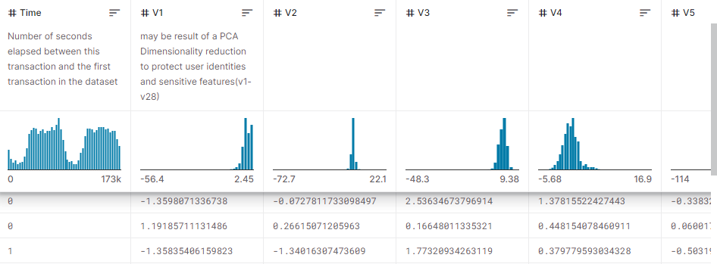
Dataset
creditcard.csv

Slide 4
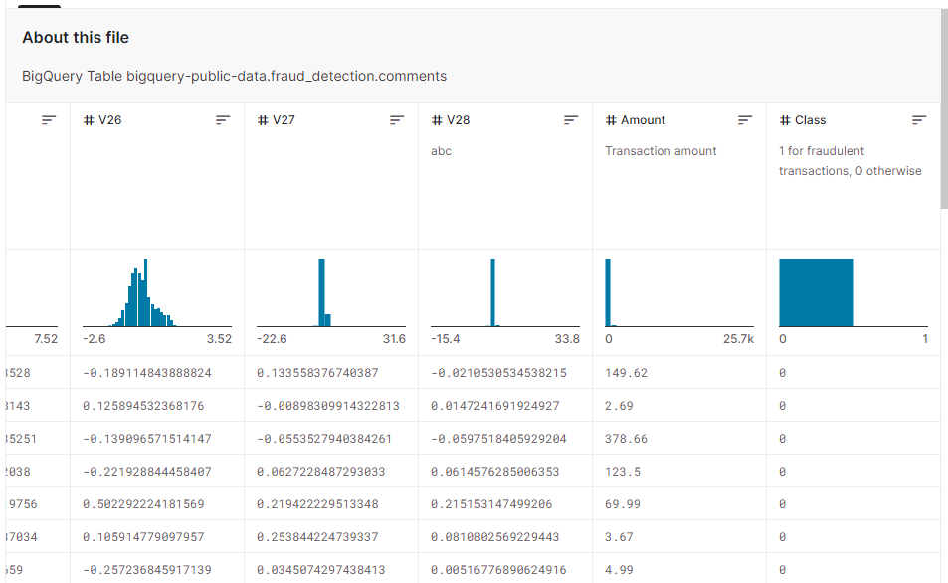
Dataset
284807
31
Dimension: 284807 entities
31 characteristics

Slide 5
Objectives
Detect Fraudulent transactions using machine leaning models.

Slide 6
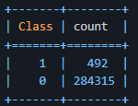
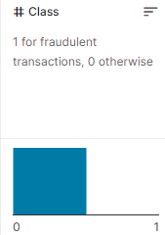
Problems with the dataset
Encrypted Data therefore we can’t fully understand it.
Absurd disparity on the Class characteristic.

Slide 7
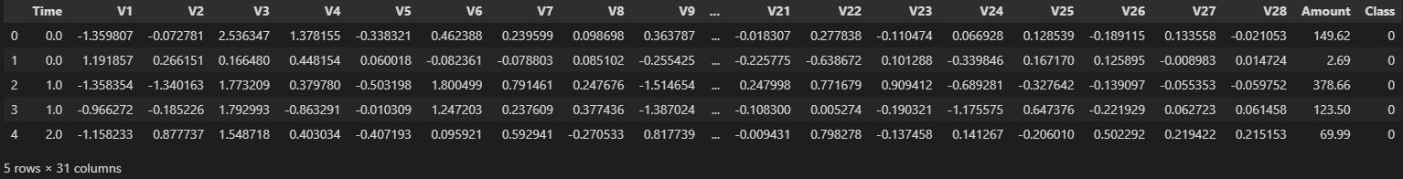
Visualizing the Data

Slide 8
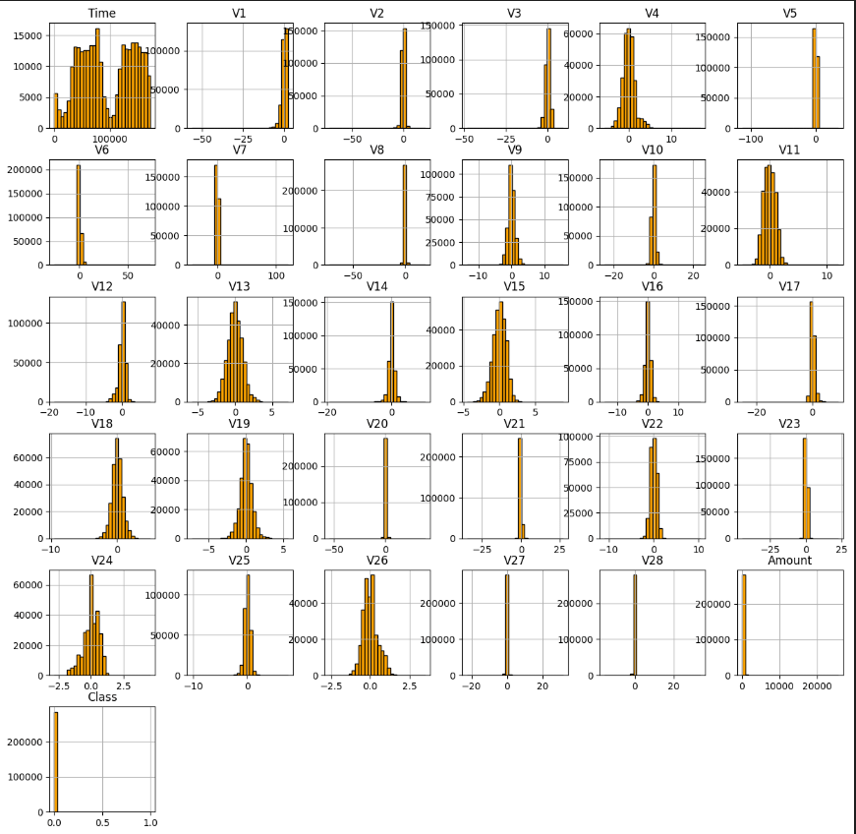
Visualizing the Data

Slide 9
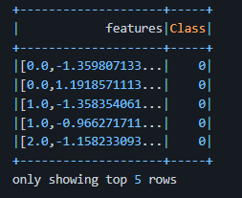
Pre-Processing the Data
Checking on NULL values
Vectorizing characteristics

Slide 10

Machine Learning Models

Slide 11
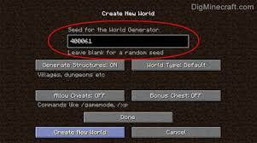

Train/Test Split

Slide 12
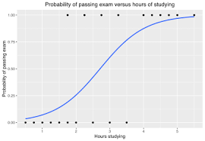
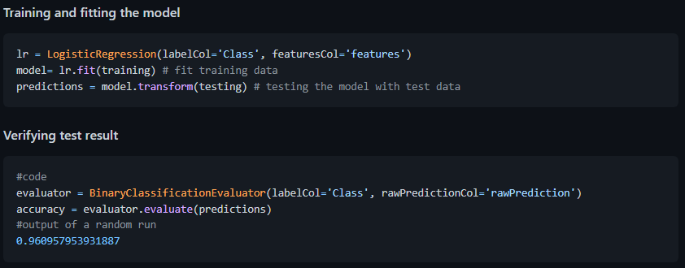
Model: Logistic Regression

Slide 13

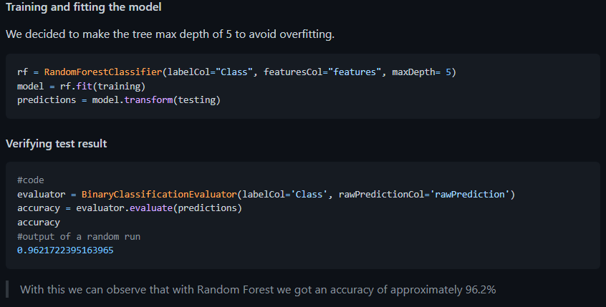
Model: Random Forest

