Slide 1
非阻塞编程/06
主讲：聂晓文
Email：niexiaowen@uestc.edu.cn
电子科技大学 计算机学院

Slide 2
本章内容
why non-blocking?
非阻塞技术
非阻塞echo客户端/非阻塞读写
非阻塞connect
非阻塞accept

Slide 3
1. Why non-blocking?
Case1：考虑一个对http服务器的攻击
http服务器采用epoll编写
Attacker建连
Attacker请求网页
服务器向客户端返回web网页，如果返回的内容包含一个jpg，文件大于发送buffer
Attacker修改TCP/IP协议栈，对服务器的响应数据不予Ack
Case2：多线程？
线程不能被阻塞，它是宝贵的计算资源
结论：从安全性考虑，服务器一定要采用非阻塞方式

Slide 4
2. 非阻塞技术
设置非阻塞
fcntl
Ioctl
采用IO复用技术通知事件

Slide 5
TCP阻塞与非阻塞对比
 | 阻塞 | 非阻塞
读 | 当收到的数据超过low_water_mark时，读返回；否则读操作阻塞 | 如果接收buffer没有数据，读操作返回-1，errno置为EAGAIN
写 | 如果发送buffer空间不够，没有办法将数据拷贝到发送buffer，写操作阻塞 | 如果发送buffer没有空间，写操作返回EAGAIN；如果发送buffer只有一部分空间，写操作会写一个寸头进发送buffer
accept | 有客户端与服务器成功建连，返回；否则阻塞。 | 如果没有客户端成功建连，返回EAGAIN
connect | 只有在收到服务器的SYN+ACK后，客户端才从阻塞态退出 | 客户端在启动3路握手之后，返回EINPROCESS

Slide 6
3. 非阻塞echo客户端
非阻塞事件
stdin
Data ready
EOF
socket
Data readable
Receive FIN
Buffer writable
Connected
Receive RST
stdout
Buffer writable
Why writable？

Slide 7
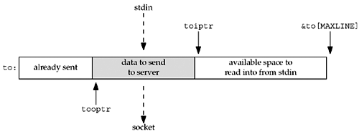
Buffer管理
阻塞echo的buffer管理不可用
非阻塞的buffer管理
其他方案？

Slide 8
The nonblocking version of str_cli that we just showed is nontrivial: about 135 lines of code, compared to 40 lines for the version using select with blocking I/O in Figure 6.13, and 20 lines for our original stop-and-wait version (Figure 5.5).
We know that doubling the size of the code from 20 to 40 lines was worth the effort, because the speed increased by almost a factor of 30 in a batch mode and using select with blocking descriptors was not overly complicated.
But, is it worth the effort to code an application using nonblocking I/O, given the complexity of the resulting code? The answer is no. Whenever we find the need to use nonblocking I/O, it will usually be simpler to split the application into either processes (using fork) or threads (Chapter 26).

Slide 9
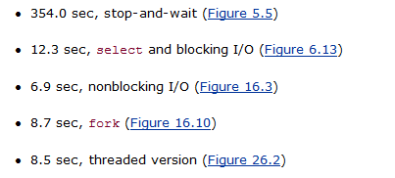
性能对比

Slide 10
4. 非阻塞connect
EINPROCESS
Daytime client，lib/connect_nonb.c
Web client，nonblock/web.c

Slide 11
5. 非阻塞accept
EINTR/EWOULDBLOCK/ECONNABORTED/EPROTO

Slide 12
Thanks. And Your Slogan Here.
Speaker name and title
www.islide.cc

