Slide 1
Do you want to make extra money?
DSN Datacrowd will engage you for some tasks and you get money in return.
Download the app on Play store now!

Slide 2

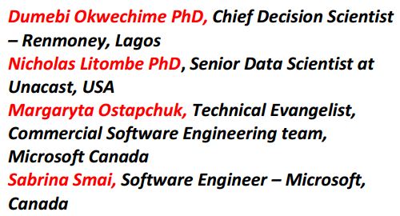
Building a world-class career in AI & Data Science
Speakers

Slide 3
AXA Mansard Competition
http://bit.ly/DSN-AXA

Slide 4
AI On Demand for Instructors
Register your interest:
https://bit.ly/aiondemand

Slide 5
Renmoney internship opportunity.
Send your updated CV to metukudoh@renmoney.com

Slide 6
Malaria Hackathon
https://bit.ly/2KMJ0f4

