Slide 1


SAT Reading
Text Structure and Purpose
Subheading (if necessary)
Objectives:
Subheading

Slide 2

Purpose of the Underlined Portion

Slide 3

Heading
Some helpful features:
Heading
Text
Heading
Text
Heading
Text

Slide 4
Heading
Some helpful features:
Heading
Text
Heading
Text
Heading
Text

Slide 5
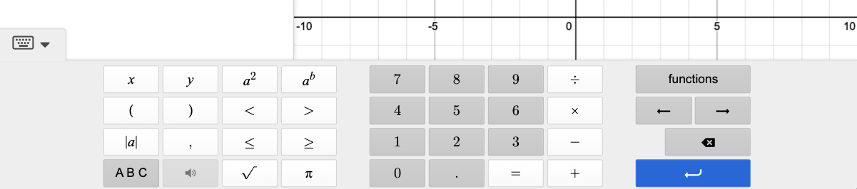
Heading
To a power of
Square
x and y variables
Number and operations
Inequality signs
Parentheses
Absolute value
pi
Square root

Slide 6
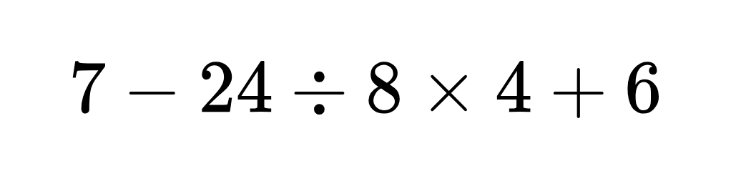
Calculations
Question 1
Note:
Note goes here.

Slide 7
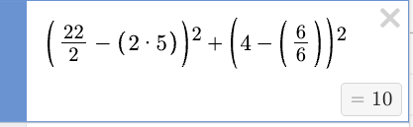
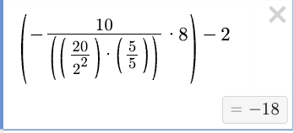
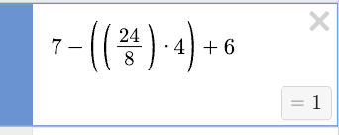
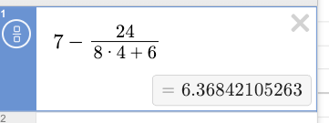
Answer Key
Question 1
Answer: 1
Question 2
Answer: 10
Question 3
Answer: -18
Order of operations!
Wrong answer (if students just type directly without thinking of order of operations)

Slide 8
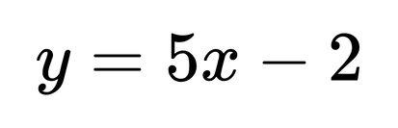
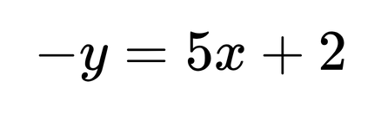
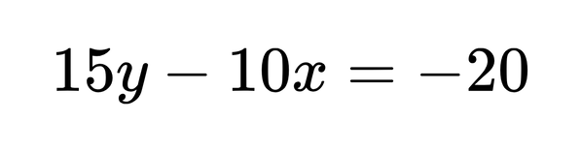
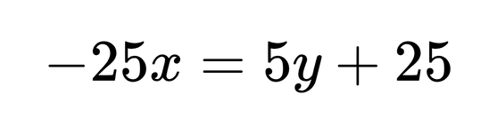
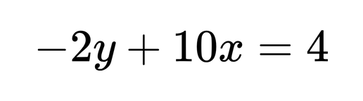
Comparing Equivalent Expressions
We can quickly compare equations in Desmos by comparing the line given to us in the question with the answer choices.
The correct answer will overlap the given line perfectly!
Which of the following is equivalent to the equation above?
A
B
C
D

Slide 9

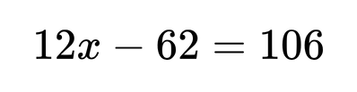

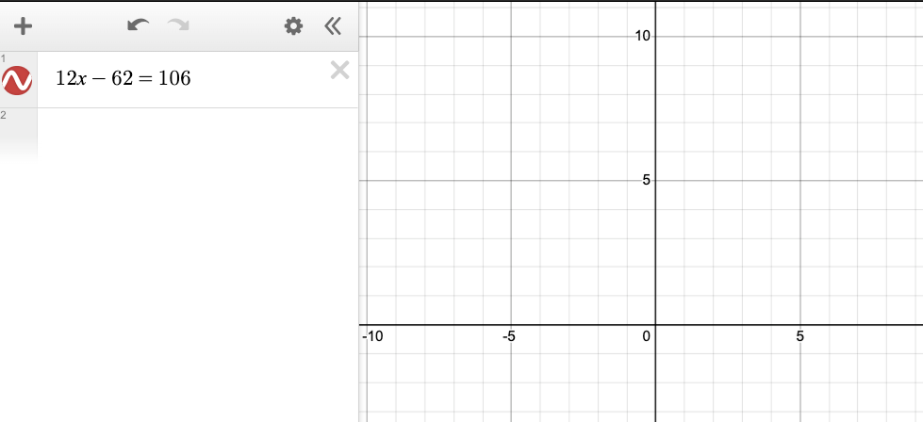

What to do when Desmos doesn’t show a line
SAT Math
What value of x satisfies the equation
?
A common challenge with Desmos is when the SAT asks a question like this:
x
y

Slide 10
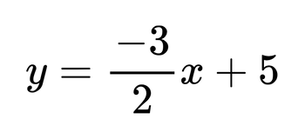
Desmos: Tables
Question 1
Which table gives three values of x and their corresponding y values for the given equation?
A
B
C
D
x | y
-7 | -13
4 | -1
12 | 15.5
x | y
-7 | 5.5
4 | -11
12 | -23
x | y
-7 | 15.5
4 | -1
12 | -13
x | y
-7 | 15.5
4 | 15.5
12 | 15.5

Slide 11
Table
Function | Definition | Button in Desmos
Mean (average) | Sum of all values divided by the number of values | Mean
Median | The middle value in a dataset | Median
Mode | Most common value in a dataset | N/A (look for the # that is present the most)
Range | Difference between the highest and lowest values | N/A (Can input highest # - lowest #)
Standard Deviation | Measure of the “spread” of data (i.e. how far each data point is from the mean) | Stdev

Slide 12


Heading
Subheading
Body

Slide 13
Digital SAT Math
Desmos

