Slide 1
parsac Parallel Sensitivity Analysis and Calibration
Jorn Bruggeman, Karsten Bolding

Slide 2
About parsac
Open source Python package
pip install parsac --user
https://doi.org/10.5281/zenodo.4276111
Key features:
built-in support for yaml configuration and NetCDF output
parallel runs on workstations and clusters
Sensitivity analysis methods:
Built on SALib: Sobol, Morris and more
Calibration methods:
criterion: maximum likelihood based
search algorithm: Differential evolution

Slide 3
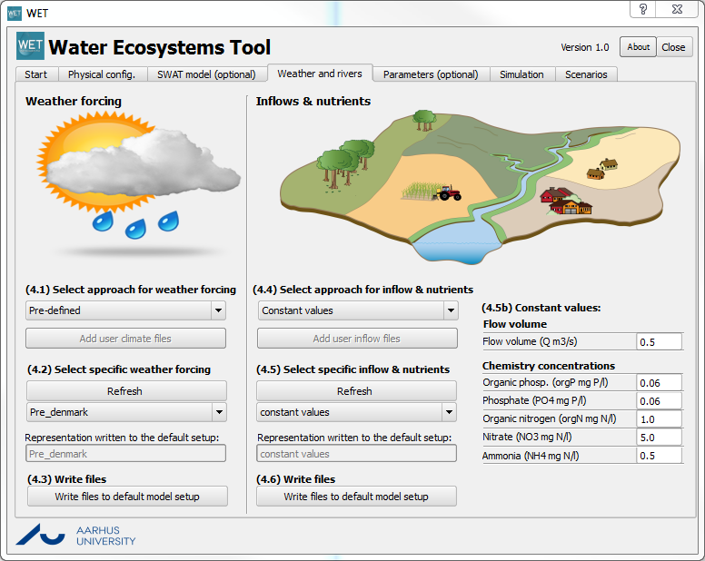
History
2004 – 2009: tools developed for Jorn’s PhD
2014-2018: Water JPI: PROGNOS,
Public release as calibration package “acpy”
2017-2018: Aarhus University MST project
Expanded with sensitivity analysis, renamed “parsac”
Calibration example: Terseleer, N., Bruggeman, J., Lancelot, C., Gypens, N., 2014. Trait-based representation of diatom functional diversity in a plankton functional type model of the eutrophied southern North Sea. Limnol. Oceanogr. 59, 1958–1972. https://doi.org/10.4319/lo.2014.59.6.1958
Sensitivity analysis example: Andersen, T.K., Bolding, K., Nielsen, A., Bruggeman, J., Jeppesen, E., Trolle, D., 2021. How morphology shapes the parameter sensitivity of lake ecosystem models. Environ. Model. Softw. 136, 104945. https://doi.org/10.1016/j.envsoft.2020.104945
Core component of WET – along with GOTM and FABM

Slide 4
parsac: sensitivity analysis
pick parameter values
input
forcing
initialization
parametrization
coupled model
hydrodynamics
GOTM
biogeochemistry
FABM
response
any variable
any depth/time
output
time series
profiles

Slide 5
parsac: calibration
pick parameter values
input
forcing
initialization
parametrization
coupled model
hydrodynamics
GOTM
biogeochemistry
FABM
“goodness of fit”
output
time series
profiles
observations
time series
profiles

Slide 6
Sensitivity analysis
Built on top of SALib: https://salib.readthedocs.io
Supported methods:
Sobol Sensitivity Analysis
Method of Morris, including groups and optimal trajectories
Fourier Amplitude Sensitivity Test (FAST)
Random Balance Designs - Fourier Amplitude Sensitivity Test (RBD-FAST)
Delta Moment-Independent Measure
Derivative-based Global Sensitivity Measure (DGSM)
Fractional Factorial Sensitivity Analysis
High Dimensional Model Representation

Slide 7
Sensitivity analysis: workflow
sample
Generate all required parameter sets (n_{ensemble} x n_{par})
Store as Python pickle
run
In parallel, run GOTM-FABM with each parameter set
Compute the value of each target (n_{ensemble} x n_{target})
Update Python pickle
analyze
Feed values of parameters and targets to SALib for analysis

Slide 8
Configuration: 1 xml file
<?xml version="1.0" encoding="utf-8" ?>
<config xmlns:xsi="http://www.w3.org/2001/XMLSchema-instance" xsi:noNamespaceSchemaLocation="../client/config.xsd">
<transports>
<transport type="sqlite" path="northsea_sa.db"/>
</transports>
<executable path="gotm" shell="True"/>
<setup path="../setups/northsea"/>
<parameters>
<parameter file="fabm.yaml" variable="instances/P1/parameters/phim" minimum="0.042" maximum="0.078" />
<parameter file="fabm.yaml" variable="instances/P2/parameters/phim" minimum=" 0.0175" maximum="0.0325" />
<parameter file="fabm.yaml" variable="instances/P3/parameters/phim" minimum="0.0105" maximum="0.0195" />
<parameter file="fabm.yaml" variable="instances/P4/parameters/phim" minimum="0.0315" maximum="0.0585" />
</parameters>
<targets>
<target expression="(total_chlorophyll_calculator_result[:,:,:,:]).mean()" path="result.nc"/>
<target expression="(total_chlorophyll_calculator_result[:,:,:,:]).min()" path="result.nc"/>
<target expression="(total_chlorophyll_calculator_result[:,:,:,:]).max()" path="result.nc"/>
</targets>
</config>
Biogeochemical parameters
Targets [scalar!]

Slide 9
Commands
In general: use -h to find out what arguments to use!
Typical sensitivity analysis:
parsac sensitivity sample <XMLFILE> <PICKLEPATH> <METHOD> …
parsac sensitivity run <PICKLEPATH>
parsac sensitivity analyze <PICKLEPATH> <METHOD>

Slide 10
Calibration: maximize likelihood
Goodness of fit criterion: likelihood
“joint probability distribution of all observations, given the model prediction”
Currently implemented:
independent, (log)normally distributed observations
mean (median): the model prediction
variance: user-specified or estimated

Slide 11
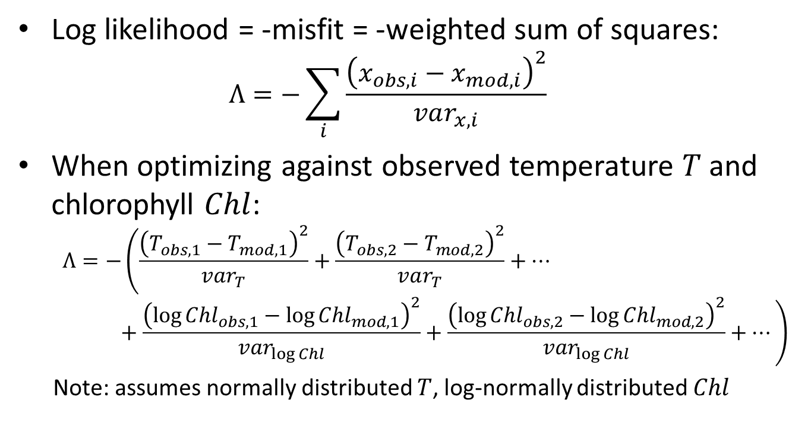
Maximum likelihood in practice
Log likelihood = -misfit = -weighted sum of squares:
$$Λ=−\sum_{i}{\frac{{\left(x_{obs,i}−x_{mod,i}\right)}^{2}}{var_{x,i}}}$$
When optimizing against observed temperature $T$and chlorophyll $Chl$:
$$Λ=−\left(\frac{{\left(T_{obs,1}−T_{mod,1}\right)}^{2}}{var_{T}}+\frac{{\left(T_{obs,2}−T_{mod,2}\right)}^{2}}{var_{T}}+…+\frac{{\left(\log{{Chl}_{obs,1}}−\log{{Chl}_{mod,1}}\right)}^{2}}{var_{\log{Chl}}}+\frac{{\left(\log{{Chl}_{obs,2}}−\log{{Chl}_{mod,2}}\right)}^{2}}{var_{\log{Chl}}}+…\right)$$
Note: assumes normally distributed $T$, log-normally distributed $Chl$

Slide 12
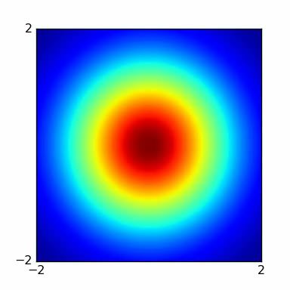
Optimization methods
Wide variety of methods. Why? Trade-offs!
gridding
chance of finding global optimum
information on estimate uncertainty
Markov Chain Monte Carlo
parameter 2
genetic algorithms
Nelder-Mead simplex
Newton’s method
parameter 2
time to convergence/computational cost
parameter 1

Slide 13
Implemented: Differential Evolution
Widely used: >13 languages and commercial software
Mathematica: NMinimize/Nmaximize
Maple: Global Optimization Toolbox
R: DEoptim
Pyac implementation based on reference …
Storn & Price 1997, doi: 10.1023/A:1008202821328
… but parallellized
Parallel Python, http://www.parallelpython.com
SMP (one system with multiple processors or cores)
clusters – can be heterogeneous

Slide 14
parsac design
configuration: XML file
calibration: Python scripts
gotm.yaml, fabm.yaml
*.nml, fabm.yaml
*.nml, fabm.yaml
Nelder-Mead
*.nml, fabm.yaml
Differential Evolution
GOTM-FABM
gotm-lake + fabm
gotm-lake + fabm
gotm-lake + fabm
NetCDF output
NetCDF output
NetCDF output
NetCDF output
results: SQLite database
Multiple simulations in parallel!
processing: Python scripts
show likelihood landscape
show best result

Slide 15
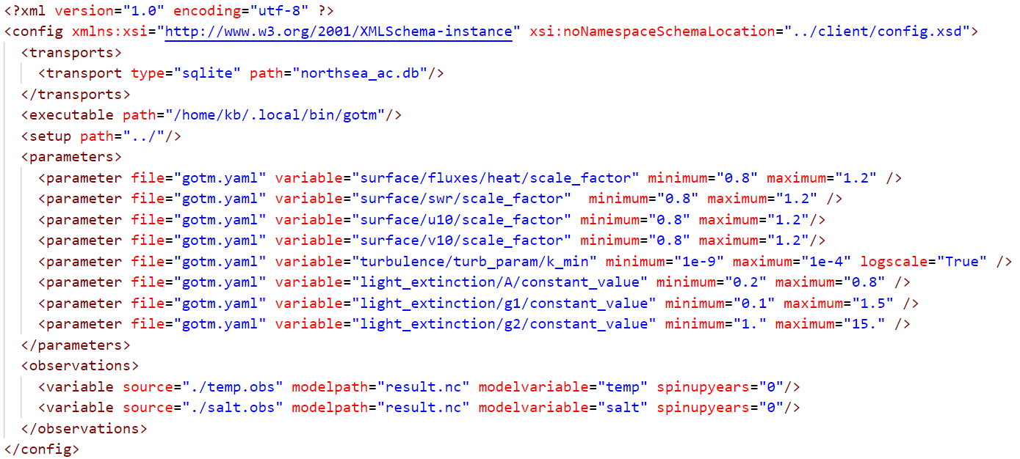
Configuration: 1 xml file

Slide 16
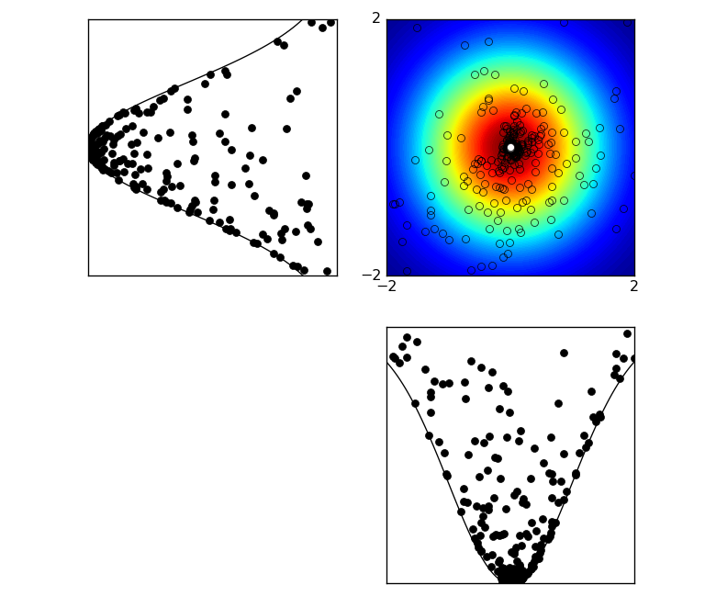
Visualizing the likelihood landscape
parameter 2
parameter 1
marginals of the log likelihood
(per parameter)
These show:
optimum value
uncertainty

Slide 17
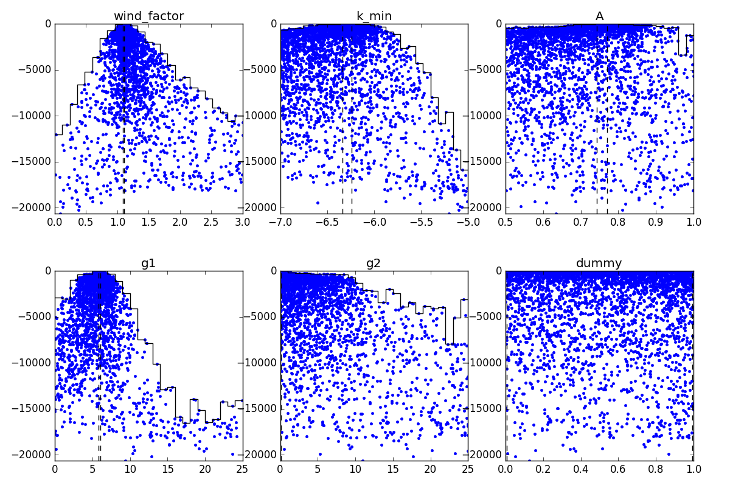
A GOTM likelihood landscape

Slide 18
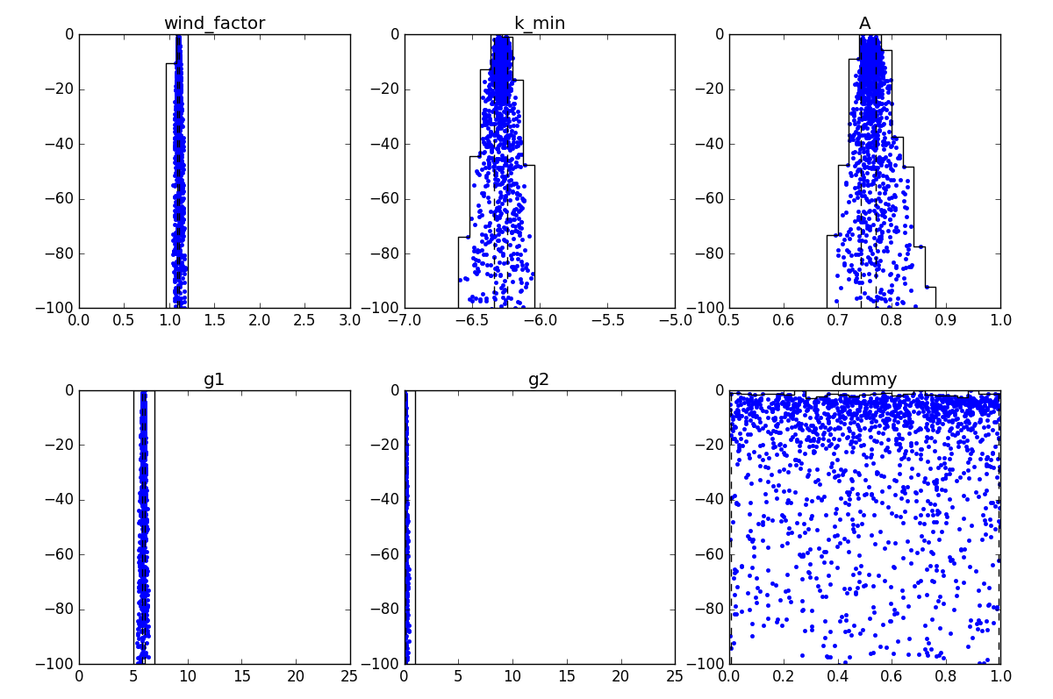
A GOTM likelihood landscape

Slide 19
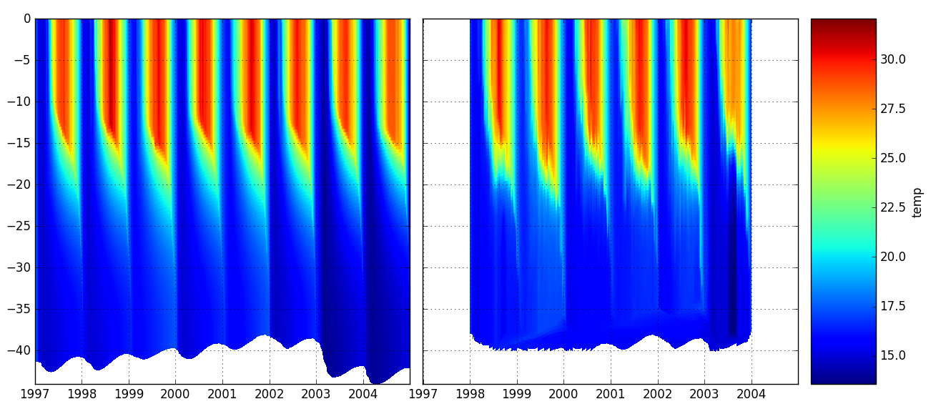
A GOTM example: best results
model
observations

Slide 20
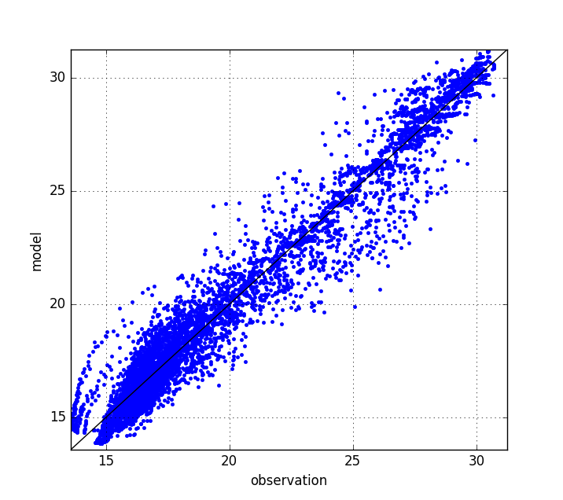
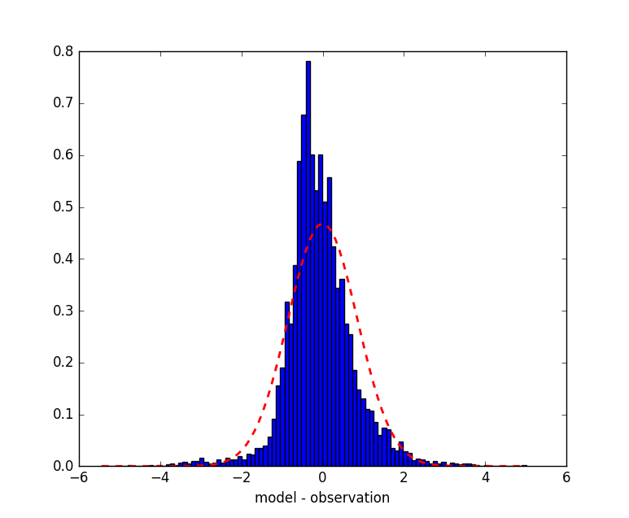
A GOTM example: best results
correlation
errors
bias = -0.07442
mean absolute error = 0.6128
root mean square error = 0.8522
correlation = 0.9841
s.d. model = 4.744
s.d. observations = 4.566

