Slide 1
Introduction to GOTM
Karsten Bolding, Jorn Bruggeman
and Hans Burchard

Slide 2
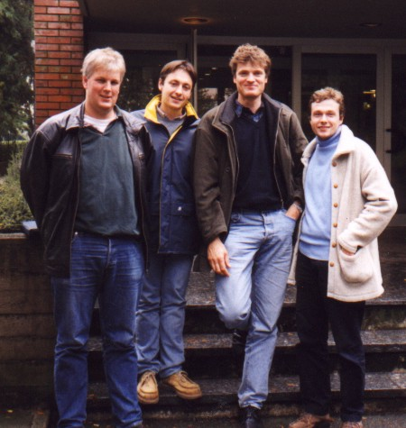

Where it all started – JRC, Italy

Slide 3
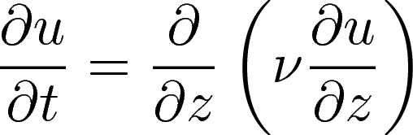
Consider the simple diffusion equation for velocity
The molecular viscosity has a value of ν = 10⁻⁶ m²/s.
How long would it take that a storm mixes the water
column to 30m from an ocean at rest?

Slide 4
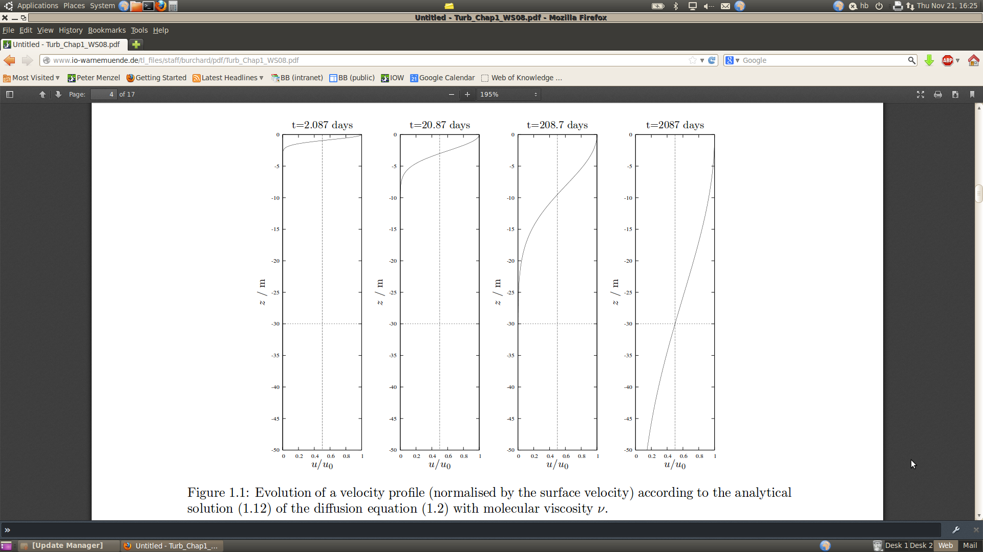
Development of a velocity profile due to surface stress when only molecular viscosity is acting (no turbulence)

Slide 5
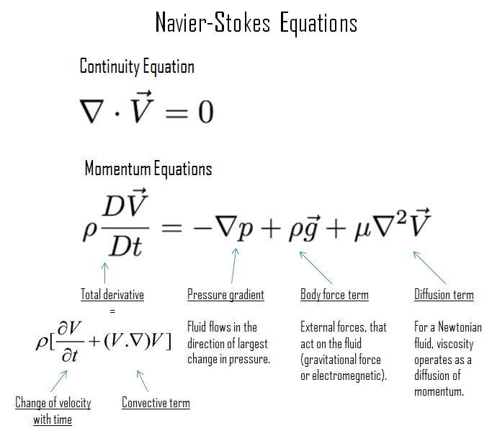
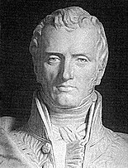
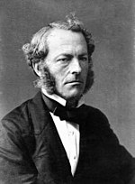
Developed from 1822 to 1850
by Claude-Louis Navier and
George Gabriel Stoke

Slide 6
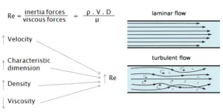
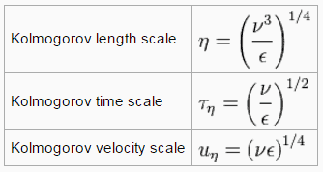

Slide 7
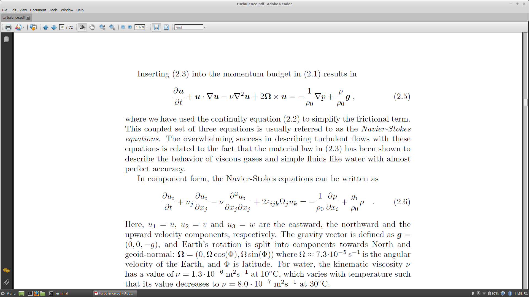
The Navier-Stokes equations (NSE)
The whole story in one equation!
= 0
tendency
advection
stress
divergence
Coriolis
pressure
gradient
gravitaion

Slide 8



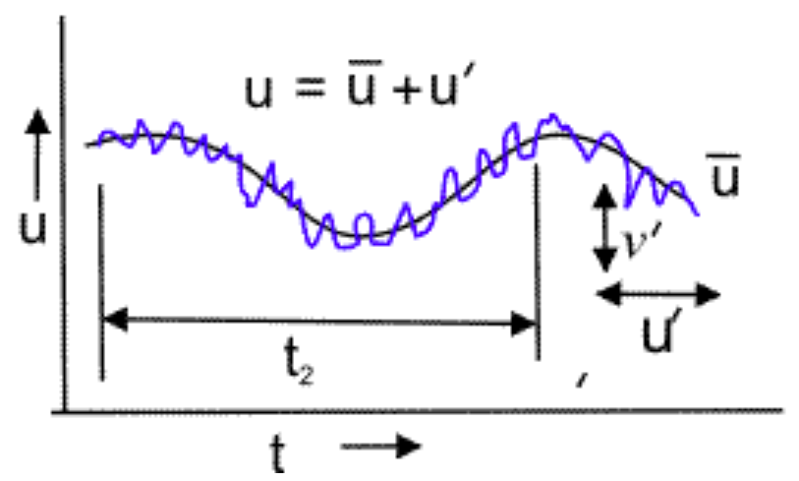


The equations to solve (RANS):

Slide 9
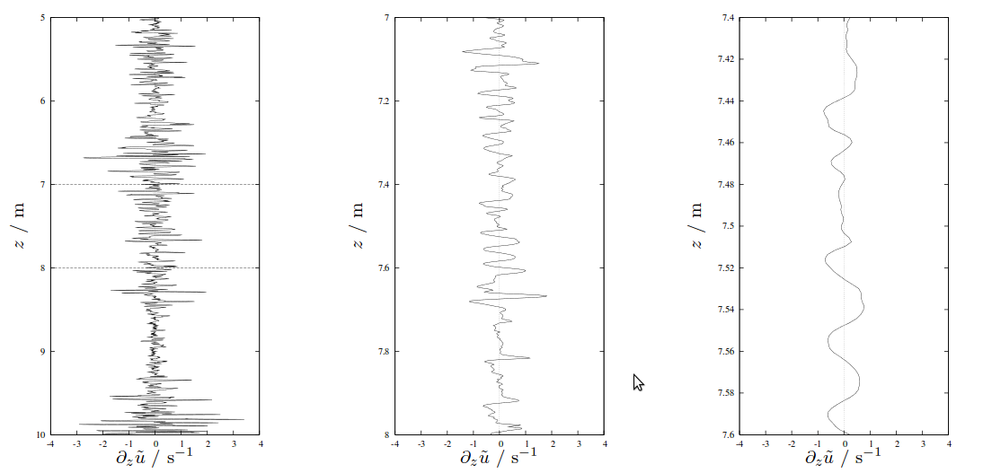
Turbulent fluctuations are seen all over in natural waters
Fluctuations are smooth on the centimetre scale due to the effect of viscosity.
Small-scale velocity shear in Lago Maggiore (observation by Adolf Stips, Ispra, Italy)

Slide 10
What is GOTM?
… a highly configurable 1D water-column model
Solves the Reynolds-averaged Navier-Stokes equations – BUT assumes zero horizontal gradients
Core part written in Fortran03
… a seleclection of vertical mixing schemes
1- and 2-equation formulations
Used as turbulence driver in a number of 3D-models
… a 20+ year (independent) software/science project
OpenSource, public repository, mailing-lists + many publications
Large worldwide user base

Slide 11
Advantages of 1D model
Computational lightweight
Long simulations
Detailed sensitivity analysis (parsac)
Many ensemble members
High vertical resolution
Better resolve e.g. light and temperature
Process studies
Numerical algorithm development/testing

Slide 12
Disadvantages of 1D model
Prognostic treatment of horizontal gradients NOT included
I.e. horizontal advection and diffusion processes
Mobility and patchiness – e.g. fish larvae
Point sources – e.g. nutrient loadings from rivers

Slide 13
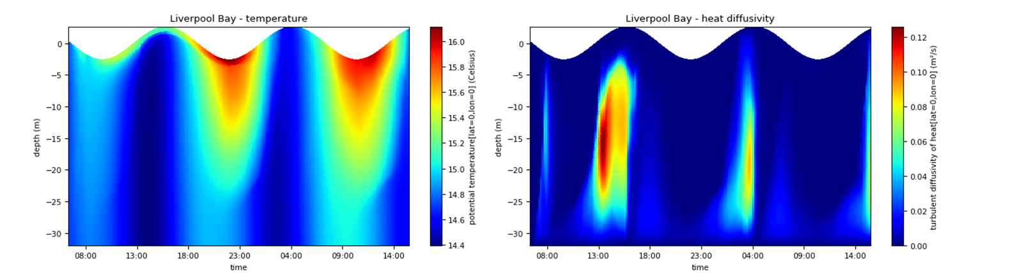
Even if GOTM is a 1D model
Liverpool Bay – Hans Burchard

Slide 14
The GOTM mixing library
Comparison of different mixing schemes – everything else the same
Mellor-Yamada, k-epsilon, k-omega (2-eq. models)
Community Ocean Vertical Mixing (CVMix) – KPP-type
Runtime configurable
Used in a number of 3D models – GOTM can export the turbulence library

Slide 15
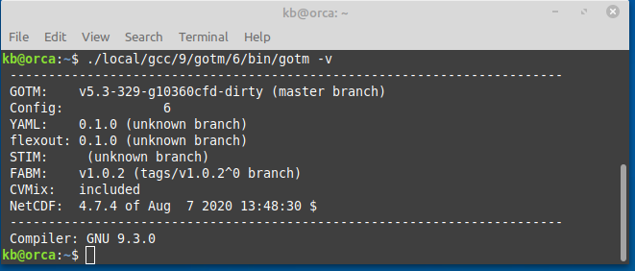
The composition of a GOTM setup
The GOTM executable with relevant features enabled at compile time
FABM, ice, CVMix ….
YAML-formatted configuration file – default gotm.yaml
With inline documentation
A configuration dependent set of ASCII data files
(Time varying?) scalar- and profile-data

Slide 16
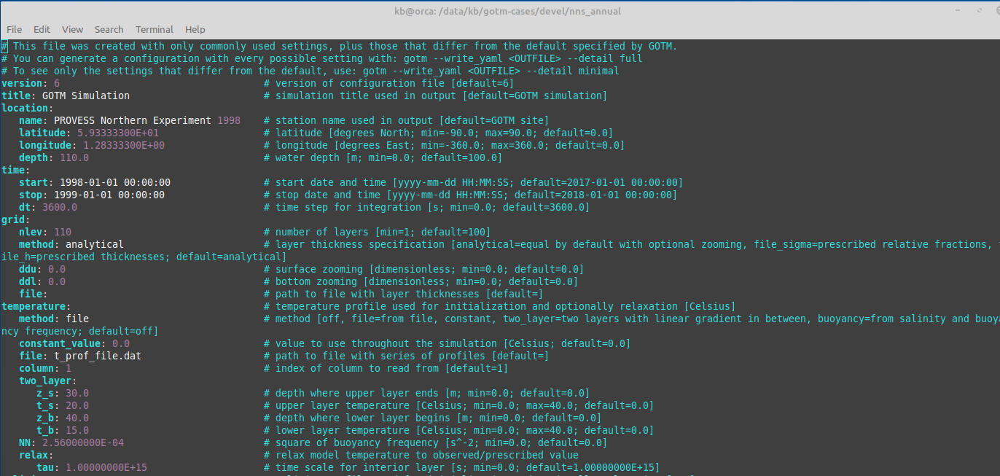
Snippet of gotm.yaml
Liverpool Bay – Hans Burchard

Slide 17
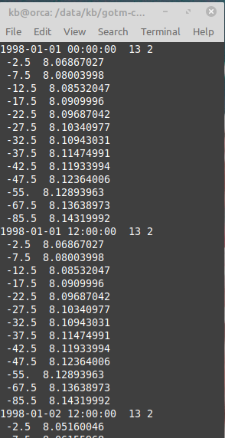
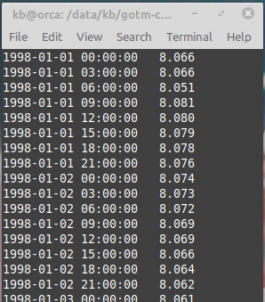
External data files
ASCII files – 2 formats (3)
Configuration in gotm.yaml
File names
Column indices

Slide 18
Air-sea interaction
Surface boundary conditions
Short wave radiation
Momentum- and heat-fluxes
Kondo (1975) and Fairall et. al (1996)
Data from meteorological models – or observations
Temperature – t2
Wind – u10, v10
Air pressure
Humidity – 4 different methods
Cloud cover
... Combined with simulated SST

Slide 19
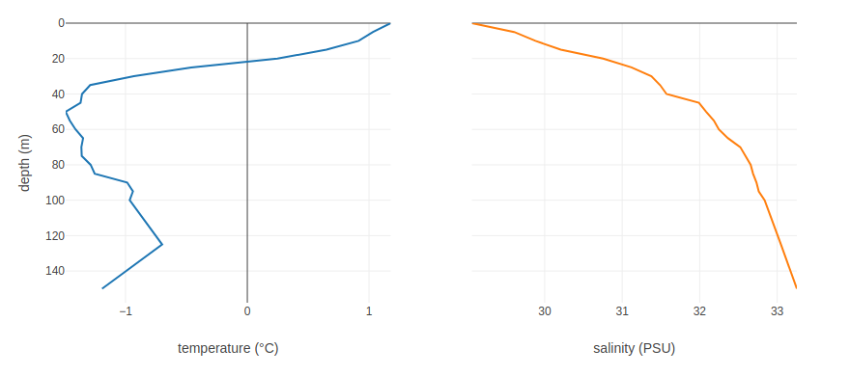
Initial conditions
Constant – from gotm.yaml
Or from file

Slide 20
Ongoing GOTM developments will be in version 7
Using TEOS-10 for all density related calculations
Conservative, potential and in-situ temperatures
Absolute and practical salinity
Adding option to study plumes under ice
Especially melt rates
Burchard et. al – submitted late 2021
Velocity profiles under ice
Effect of ice-friction
Burchard et. al – in preparation

