Slide 1
iGOTM
Karsten Bolding and Jorn Bruggeman

Slide 2
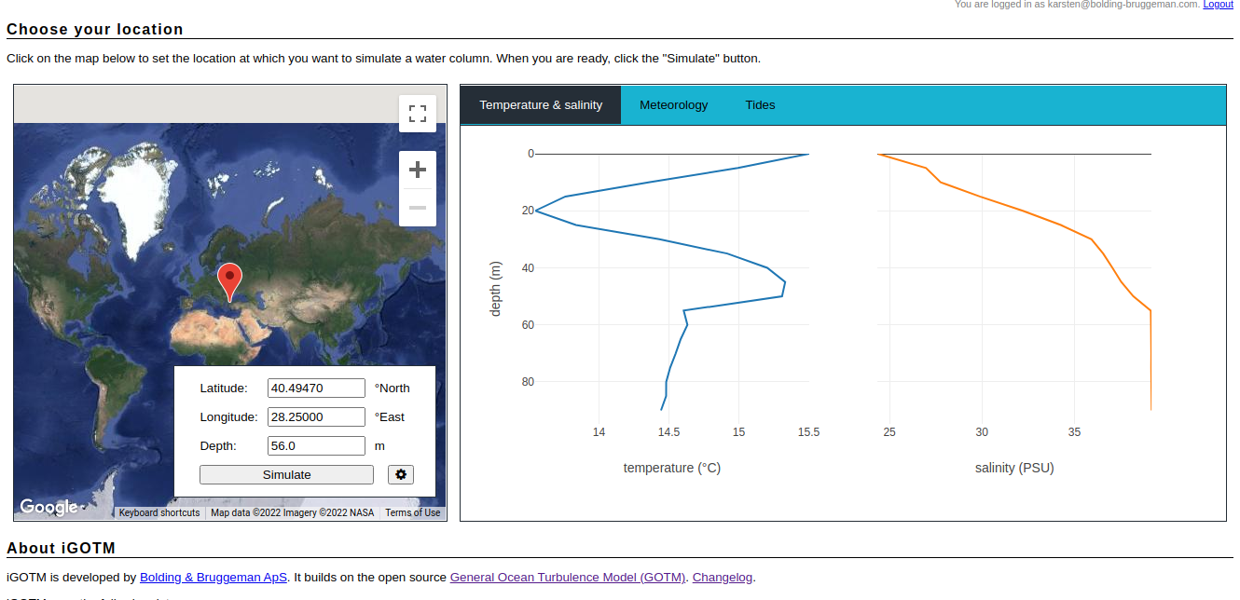
iGOTM: but why?
Started as a demonstration project
Make realistic GOTM simulations world wide
All necessary data available
No technical skills required – online.
igotm.bolding-bruggeman.com

Slide 3
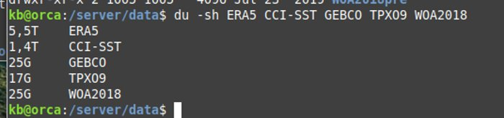
iGOTM: what is under the hood?
Computer(s) reachable from the internet
A web-server: tornado
A load balancer: nginx
A model: GOTM
Custom code to prepare model runs
Various data sources
Meteorology
Bathymetry
Tides
Initial conditions
Verification
A webpage
https://igotm.bolding-bruggeman.com/?key=RUALZHIZ - !!!!

Slide 4
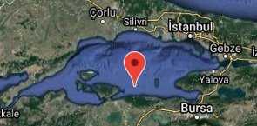
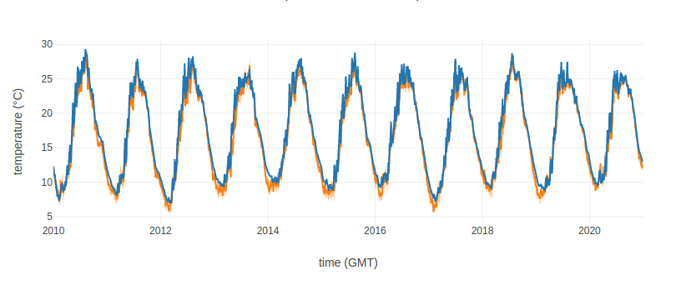
Marmara Sea – shallow station
Optionally login
Select a geographical location
Inspect T/S, meteo and tides
Make configurations
Simulate
Optionally download setup

Slide 5
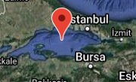
Marmara Sea – deep station

