Slide 1
ParSAC: demo and hands-on (The curse of dimensionality!!!)
Karsten Bolding and Jorn Bruggeman

Slide 2
ParSAC: demo and hands-on
Sensitivity analysis
Work-flow
Auto-calibration
Work-flow
Observations
Command line tool!
Configuration via command line arguments
Scripting friendly
Allows for complex tree structure operation
Main configuration via XML formatted file

Slide 3
ParSAC: demo and hands-on
ParSAC is numerical model indifferent ☺ - presently only requires:
Model configured via YAML/namelist(s)
Model output in NetCDF format
ParSAC has build in help via –h option to all commands and sub-commands

Slide 4
ParSAC: pre-preparations
Different versions of gotm.yaml
minimum, default and full
cd to your setup folder
mv gotm.yaml gotm.yaml.default
gotm gotm.yaml.default –write_yaml gotm.yaml –detail full
ParSAC configuration
mkdir parsac && cd parsac
cp ~/metu.../setups/northsea/parsac/*.xml .
edit both files to reflect the path to your gotm - should be ok
Preparing ParSAC observation files
~/metu..../setups/profile2parsac.py ../tprof.dat temp.obs

Slide 5
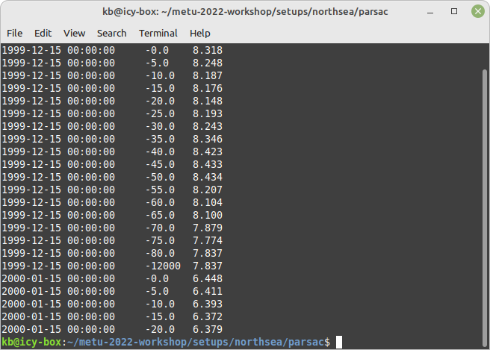
ParSAC obs-file format

Slide 6
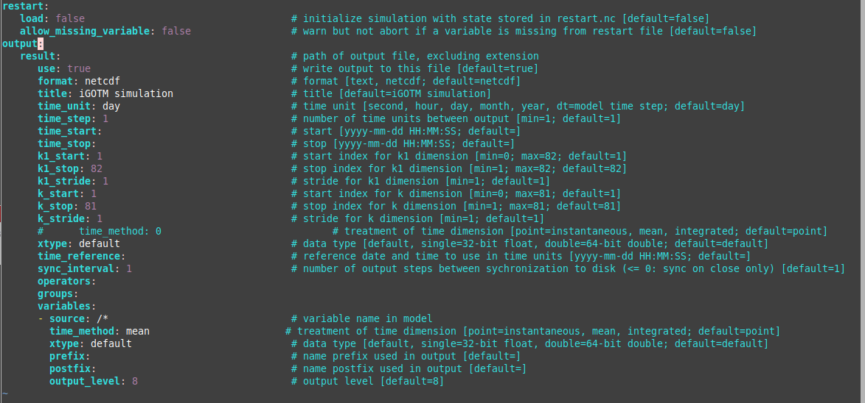
In gotm.yaml

Slide 7
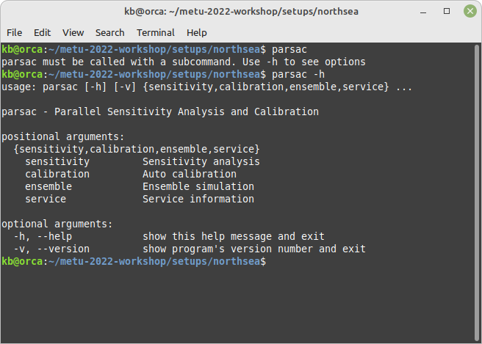

Slide 8
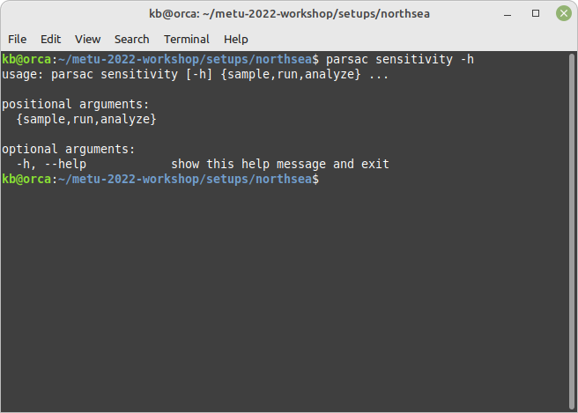

Slide 9
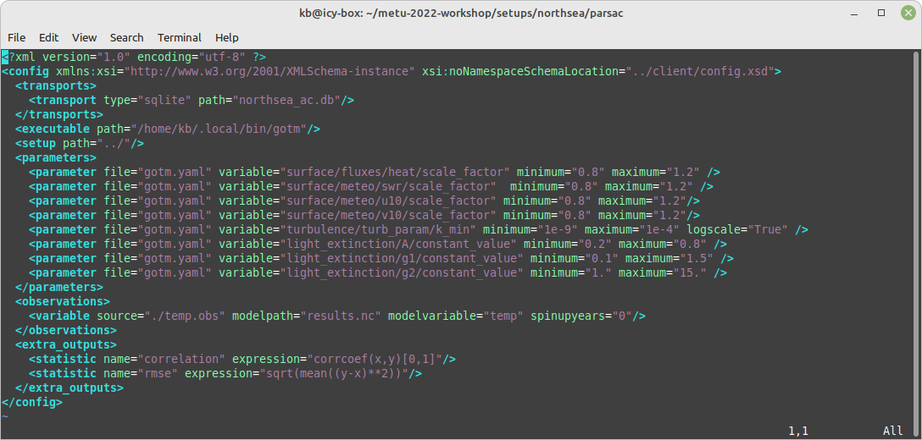
XML-formatted configuration file

Slide 10
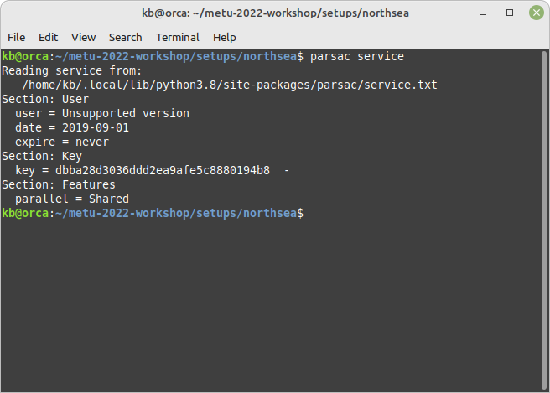

Slide 11
ParSAC: demo and hands-on
Curse of dimensionality
Sensitivity analysis
Work-flow
Auto-calibration
Work-flow
Observations
Command line tool!
Configuration via command line arguments
Scripting friendly
Allows for complex tree structure operation
Main configuration via XML formatted file

Slide 12
Performing sensitivity analysis

Slide 13
Performing sensitivity analysis

Slide 14
Performing auto-calibration

