Slide 1
OCEANICU · ATMOSPHERIC FORCING
CMIP6 Meteo Bias Correction
Quantile Delta Mapping of climate-model forcing against ERA5 — so the ocean model runs on a real climate signal, not model drift.
ocean-prep · bias_correction_guide.md
1 / 5

Slide 2
THE PROBLEM, THE METHOD
Correcting a GCM's systematic bias
CMIP6 captures large-scale climate well but is consistently biased over a given region. Left alone, that bias becomes a spurious trend once it forces the ocean model.
Method
Corrects
Future trend
Cost
Delta
Mean only
Preserved
Low
Quantile Mapping (QM)
Full distribution
Distorted
Medium
Quantile Delta Mapping (QDM)
Full distribution
Preserved
Medium–high
PRODUCTION METHOD — CANNON ET AL. (2015)
At each quantile q, apply the reference-minus-historical delta to the future value: today's distribution is corrected while the GCM's own future climate-change signal survives untouched.
future_bc = future + [ v_ref(q) − v_hist(q) ] — additive (temperature)
future_bc = future × [ v_ref(q) / v_hist(q) ] — multiplicative (precipitation)
Cannon, Sobie & Murdock (2015), J. Climate 28(17)
2 / 5

Slide 3
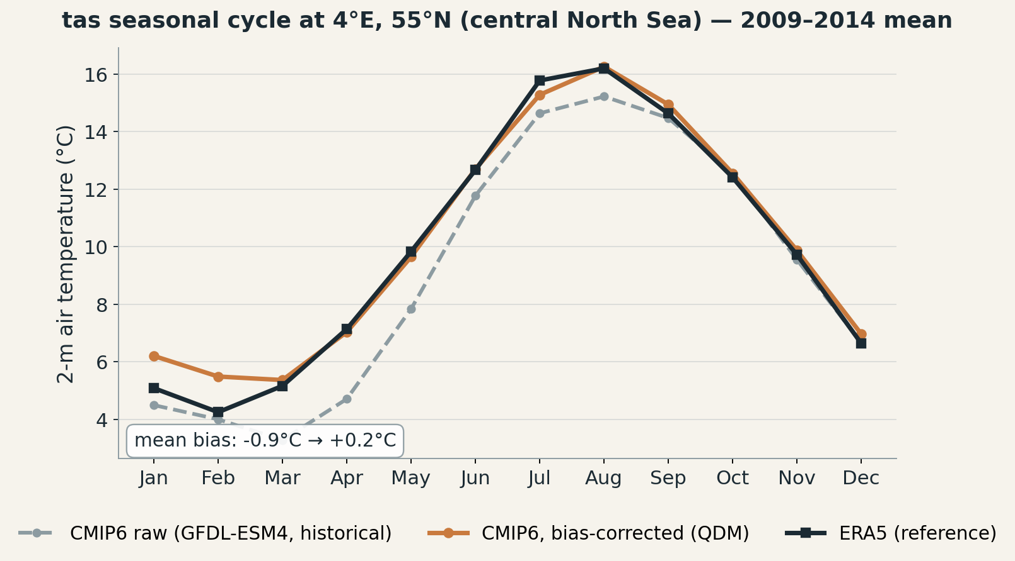
REAL EXAMPLE
Does it actually work? One point, one variable
GFDL-ESM4, historical, 2009–2014 — real production output, not a mock-up
3 / 5

Slide 4
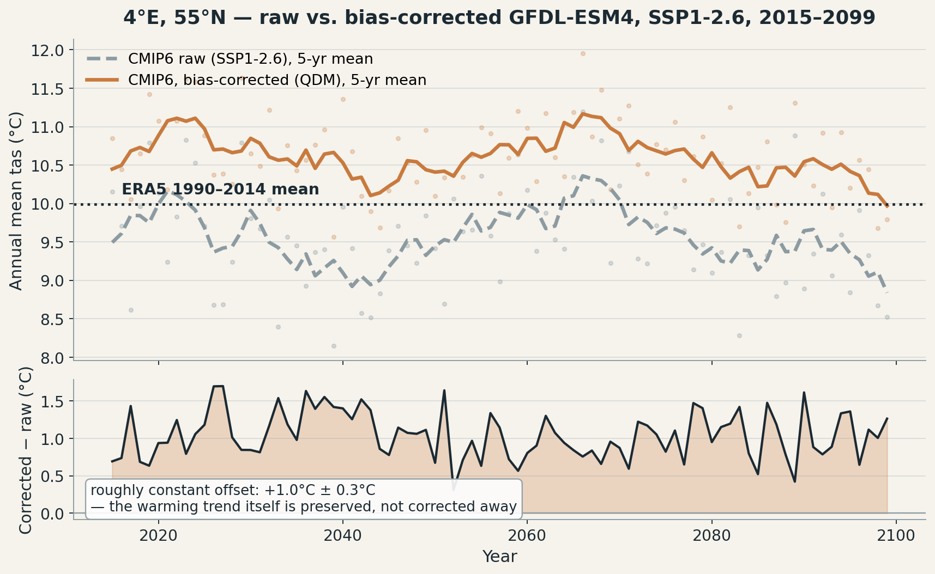
REAL EXAMPLE, FUTURE PERIOD
No ERA5 in the future — so what does correction do there?
GFDL-ESM4, SSP1-2.6, 2015–2099 — real production output
4 / 5

Slide 5
WORKFLOW
From ERA5 and CMIP6 to model-ready forcing
ERA5 (ref)
CMIP6 historical (hist)
CMIP6 future (SSP)
Hourly reanalysis, 1990–2014 calibration window
Same model, same window, Amon
2020–2099 projection to correct
bias_correct_forcings.py — per calendar month, QDM
[correct]
[disaggregate]
daily, bias-corrected — {var}_bc_{year}.nc
+ ERA5 diurnal cycle — hourly {var}_bc_disagg_{year}.nc
1990–2014
≈100 quantiles
Exact
Calibration window — fixed by CMIP6's historical protocol
Daily data, ≈900 samples per calendar month
Daily mean preserved — diurnal anomalies sum to zero
QA: bc diagnostics — calibration maps · seasonal cycle · trend · monthly breakdown
5 / 5

