Slide 1

ULang
Chris Jantzen
Chris Messmer
Robert Bolgzds
Advisor: Dr. Chia Yung Han

Slide 2
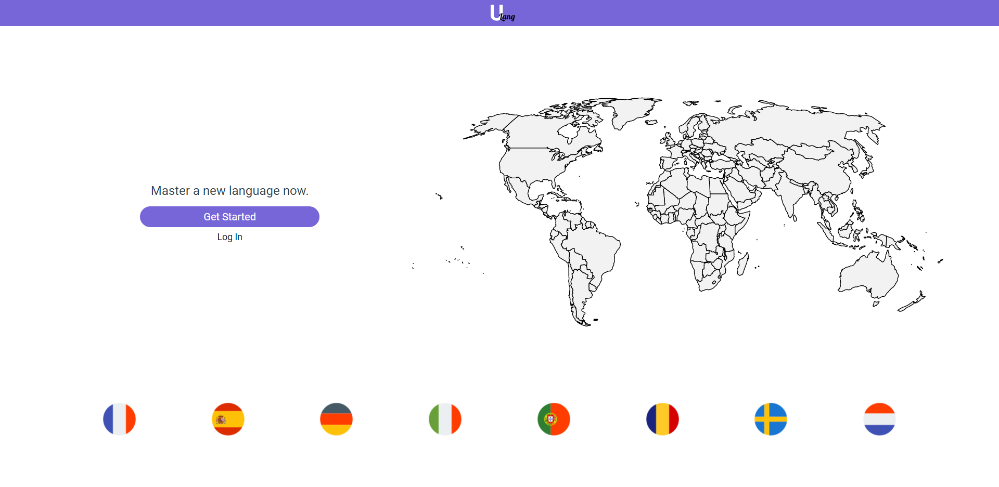
Goals
A resource to practice vocabulary translations, spellings, and pronunciations while learning a foreign language

Slide 3
Intellectual Merits
Pronunciation practice and feedback
Verb conjugation specific practice
Broad language support
Language isolated study materials

Slide 4
Broader Impacts
Can help people moving to new countries that speak another language
Can help people who have international colleagues reduce the language barrier
Can help children to be bilingual early in life
Can help students learning other languages study

Slide 5
Design Specifications
User creates sets of words for practice/study using functionalities provided on the front end
Front-end, back-end, and database servers hosted on unique ports
The client-side interfaces with the server via HTTP requests to get data necessary for the UI

Slide 6
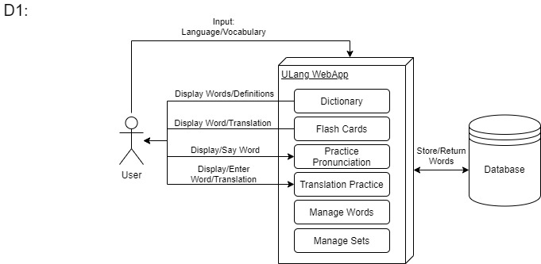
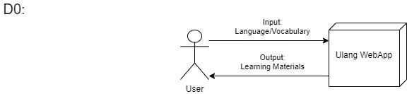
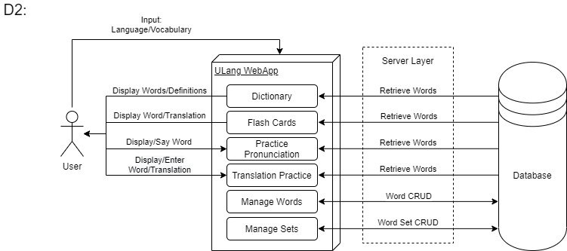

Slide 7



Technologies
VueJS - https://vuejs.org/
NodeJS - https://nodejs.org/en/
MongoDB - https://www.mongodb.com/
ExpressJS - https://expressjs.com/
GitHub - https://github.com/
Json Web Tokens - https://jwt.io

Slide 8
Milestones
1. Complete Research
Research and decide on database paradigm, cloud platforms, natural language processing, and testing frameworks
2. Implementation Design
Create design diagrams and templates for the database, framework, UI, and functionalities of the application.
3. Build Application
Implement the web application, including specified functionalities, and integrate it with the database.
4. Test
Test the beta application for bugs and usability using the testing methods researched in milestone 1.
5. Deploy
Deploy the application to a cloud platform to make it publicly accessible.

Slide 9
Results: Current Progress
Research: Technologies and functionalities fully specified.
Implementation:
Front End: Nearly complete, core functionalities implemented.
Back End: Proportional to front end - core functionalities will be modified to accommodate new front end functionalities.
Testing:
Testing framework set up.
Manual testing done concurrently.
Deploy: Node server ready to deploy.

Slide 10
Results: Remaining Tasks
Implementation:
Word/Dictionary Editing
Pronunciation Practice
Social interactions
Flashcard backend
Testing:
Setup and write autotests & unit tests

Slide 11
Challenges
Architecting the application to integrate well between the client and server-side components
Designing the mockups of the client to be modern, accessible, useful, and easily usable
Redesigning database schemas to adapt to unforeseen requirements in specific implementation details

