Slide 1
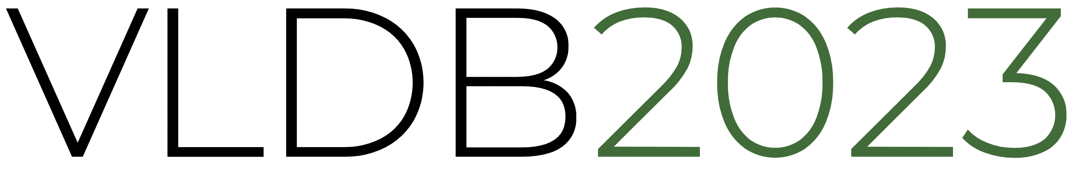


Lero: A Learning-to-Rank Query Optimizer
Rong Zhu, Wei Chen, Bolin Ding, Xingguang Chen,
Andreas Pfadler, Ziniu Wu, Jingren Zhou
Alibaba

Slide 2
Outline
Learned Query Optimizer: Methods and Challenges
Lero: a Learning-to-Rank Optimizer
Benchmark Evaluation
Summary and Next

Slide 3


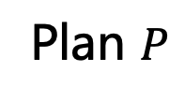
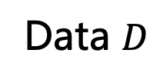
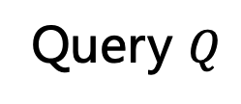
Query Optimizer: A Central Role in DBMS
Directly relates to the system performance
Hard problem due to large search space of join orders
DBMS
Data $D$
Query
Optimizer
Plan Execution
Plan $P$
Query $Q$
SELECT COUNT(*)
FROM s, sc, c
WHERE s.sid = sc.sid AND sc.cid = c.cid
AND s.year < 2009 AND c.credit >= 3
s
sc
c
s
sc
c

Slide 4
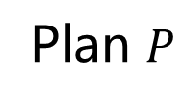
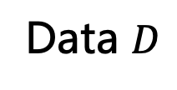
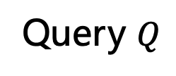
Revisit Existing Query Optimizers
A general cost-based framework
Estimate the number of tuples output by each sub-query
Estimate the execution cost of each sub-query
Query Optimizer
Cardinality Estimation
Cost Model
Data $D$
Plan Execution
Query $Q$
Join Order Selection
Plan $P$
Enumerate all possible candidate plan

Slide 5





Query Optimizer: End-to-End Learning
A general framework of learned query optimizers
Challenges: cost/time prediction is difficult and inaccurate
Data distribution, workload patterns, system environment
Unstable performance, sometimes even worse than baseline
High learning cost
Slow model updating in dynamic settings
Candidate Plans
Plan Exploration
Execution Time Prediction Model
$$P_{1}$$
$$P_{2}$$
$$P^{∗}$$
Query $Q$
Execution Engine
…
…
…
Results
$$P_{n}$$

Slide 6
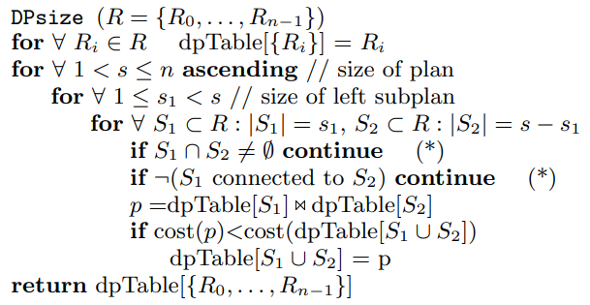
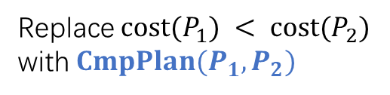
Query Optimizer: Cost v.s. Rank
Is it really necessary to predict the execution time? Actually no…
Bottom-up dynamic programming
Updating optimal solutions for sub-problems
Replace $cost(P_{1}) < cost(P_{2})$ with $CmpPlan(P_{1}, P_{2})$
A dynamic programming algorithm for query optimization [Moerkotte and Neumann, SIGMOD08]

Slide 7
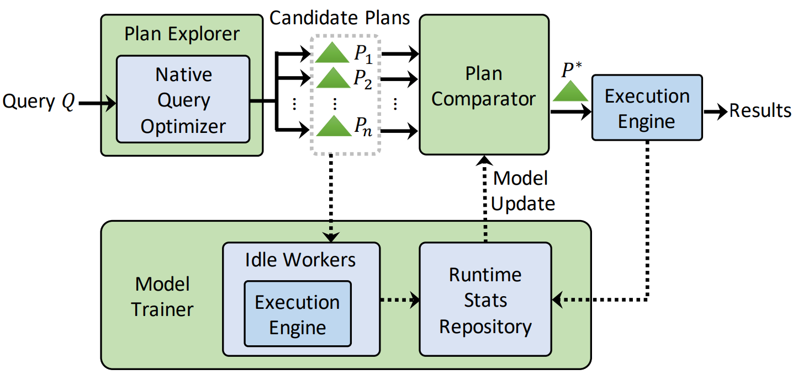

Our Solution: Lero – a learning-to-rank optimizer
Plan Comparator, Plan Explorer, and Model Trainer
Binary classification: a machine learned model targeting on the right goal (e.g., latency is too noisy and depends on many factors; but the relative order is not)
Re-use the native query optimizer
Guess cardinality estimation error
Generate a set of close-to-optimal but diversified candidates
$$CmpPlan(P_{1}, P_{2})$$
Model pre-training with estimated costs
Online pairwise training and updating

Slide 8

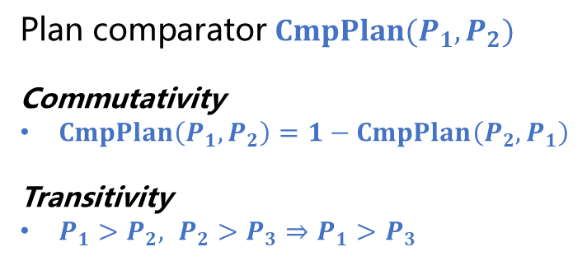









Lero: Ranking via Comparing Plans
Pairwise learning-to-rank model
Embedding pairs of plans with shared parameters
Pre-training the embedding model: align with the existing cost model
A binary classification model: more robust
Plan comparator $CmpPlan(P_{1}, P_{2})$
Commutativity
$CmpPlan\left(P_{1}, P_{2}\right)=1−CmpPlan\left(P_{2}, P_{1}\right)$
Transitivity
$P_{1}>P_{2}, P_{2}>P_{3}⇒P_{1}>P_{3}$
Plan Embedding
Latency($P_{1}$) $≥$ Latency($P_{2}$)
PlanRank($P_{1}$, $Q$)
$$P_{1}$$
Parameter $w$
$$−$$
0/1
Plan Embedding
$$δ\left(x\right)=\frac{1}{1+e^{−x} }$$
$$P_{2}$$
Parameter $w$
PlanRank($P_{2}$, $Q$)
Latency($P_{1}$) $<$ Latency($P_{2}$)

Slide 9






Lero: Ranking via Comparing Plans
Pairwise learning-to-rank model
Embedding pairs of plans with shared parameters
Pre-training the embedding model: align with the existing cost model
A binary classification model: more robust
From learning-to-predict to learning-to-rank
Equivalent but easier to be trained and updated
$$P_{1}$$
$$P_{2}$$
$$P_{3}$$
$$P_{n}$$
$$P_{1}$$
$$P_{2}$$
$$P_{3}$$
$$P_{n}$$
Plans
……
……
……
……
Latency Time Interval
Hidden Rank Score Interval
(a) Learning Exact Latency
(b) Learning Rank Scores

Slide 10
Lero: Plan Exploration
Existing methods
Neo [VLDB19]/Balsa[SIGMOD 22]: best-first search
Bao [SIGMOD21]: tuning traditional query optimizer with different hints
Enable/disable certain operators: hash join, index scan, …
→ resulting in different plans
Our method: cardinality estimator as a tuning knob
Re-use the native plan generator with minimal changes in the engine
Cardinality estimation matters for both join orders and join types
Theoretically, enumerating all cardinality estimates for all subqueries ensures a near-optimal plan is among the plan candidates
?
MJ
MJ
HJ
MJ

Slide 11



























Lero: Plan Exploration
Efficient candidate plan generation
Group sub-queries and tune their cardinalities together
Scale up/down their cardinality estimates and inject them into the query optimizer for different plans
Plan diversity
Different plan shapes
Different join orders
$$P_{1}$$
$$P_{2}$$
$$P_{3}$$
$$⋈$$
$$P_{4}$$
$$⋈$$
$$⋈$$
$$⋈$$
$$⋈$$
$$D$$
$$⋈$$
$$B$$
$$⋈$$
$$D$$
$$⋈$$
$$⋈$$
$$⋈$$
$$C$$
$$⋈$$
$$A$$
$$⋈$$
$$B$$
$$A$$
$$B$$
$$C$$
$$D$$
$$A$$
$$B$$
$$C$$
$$D$$
$$A$$
$$C$$

Slide 12
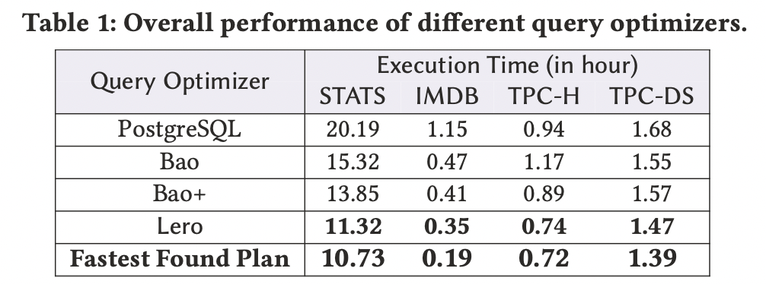
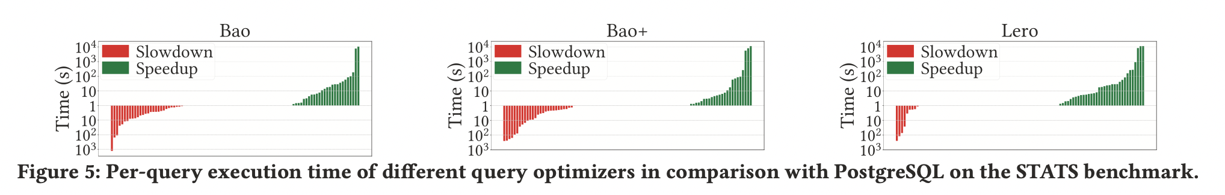
Benchmark Evaluation
Static mode
When model is stable
Near-optimal on benchmarks
Less regressions

Slide 13
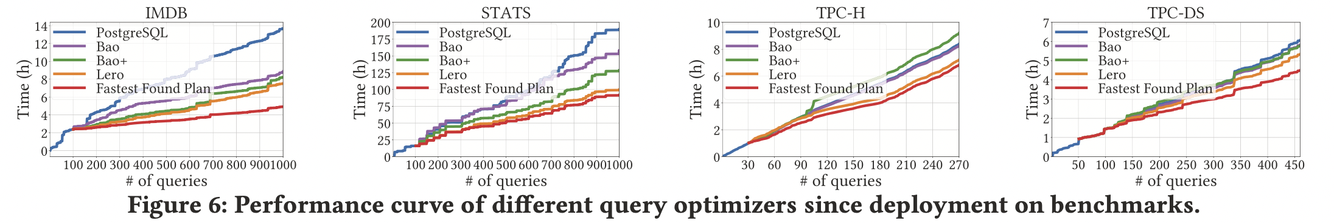
Benchmark Evaluation
Dynamic mode (performance since deployment)
Execute queries and update model in background
More queries executed in the workload
Close to the fastest found plans

Slide 14
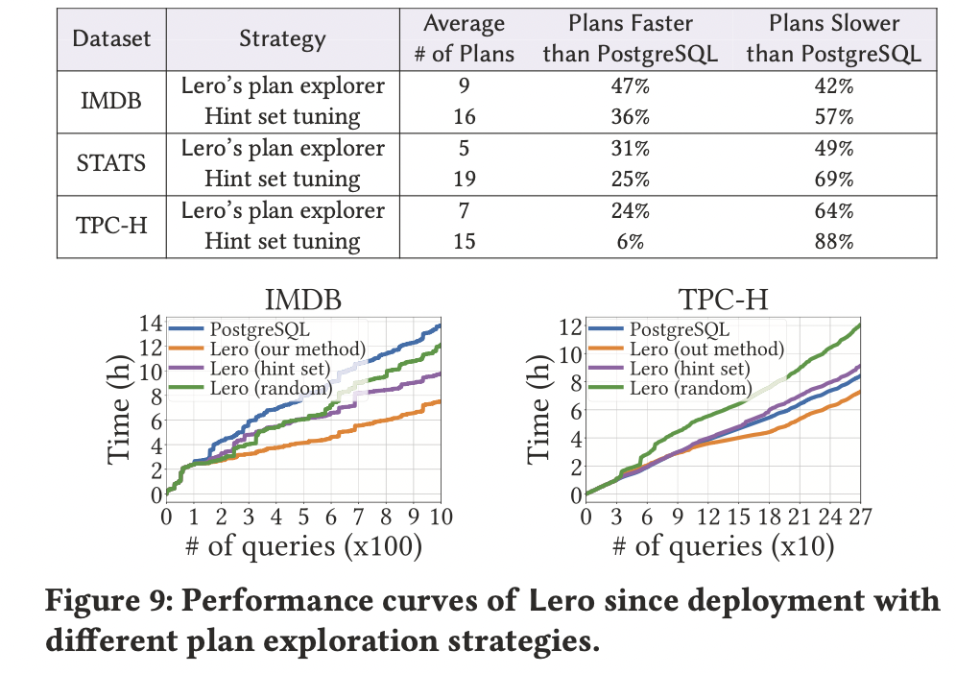
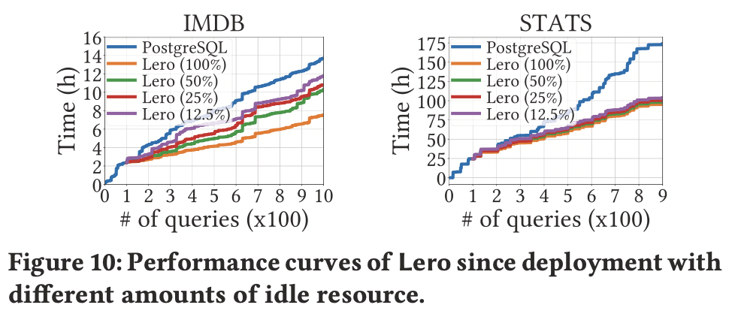
Benchmark Evaluation
Different plan exploration policy
Less candidate plans but higher quality
Impact on the idle resource
Idle resource: collect execution statistics and update model
Tolerate staleness with less resource
No impact on the final quality

Slide 15
Summary and Future Work
A learning-to-rank framework for query optimization
Target at the right goal: efficient in training and more robust
Plan exploration by tuning cardinality
Extending Lero on Spark: execute while optimizing
Learning-to-rank on more AI4DB problems…

Slide 16
Thanks
Q & A
Bolin Ding, Alibaba
bolin.ding@alibaba-inc.com

