Slide 1


Comparing Population Means under Local Differential Privacy: with Significance and Power
Bolin Ding, Harsha Nori, Paul Li, Joshua Allen
{bolind, hanori, paul.li, joshuaa}@microsoft.com
Notes:
Say their names and groups (also on the last slide)

Slide 2




Task: A/B Testing – Many Companies Use Experimentation to Improve Their Software Products and Services
Perform hypothesis testing (e.g. t-test) on data to assess effectiveness of innovations
$$A$$
Average daily usage 1 hour
Is the increase due to the innovation and significant?
$$B$$
Average daily usage 1.2 hour

Slide 3


Privacy Concerns: Users May Not Want To Send Their Data to Companies
http://www.hackersnewsbulletin.com/2015/02/best-hacker-forums-internet-top-5.html
Whether I should trust the company which collects and manages my data
Have to stop collecting telemetry data without consent
Notes:
We are working to ship it into Windows RS4

Slide 4

Tool: Differential Privacy
C. Dwork. Differential privacy. ICALP 2006.
C. Dwork, F. McSherry, K. Nissim, and A. Smith. Calibrating noise to sensitivity in private data analysis. TCC 2006.
The 2017 Gödel Prize
Differential privacy describes a promise, made by a data holder, or curator, to a data subject: “You will not be affected, adversely or otherwise, by allowing your data to be used in any study or analysis, no matter what other studies, data sets, or information sources, are available”.

Slide 5











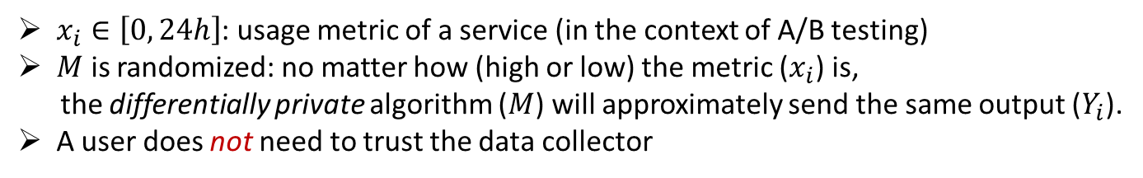



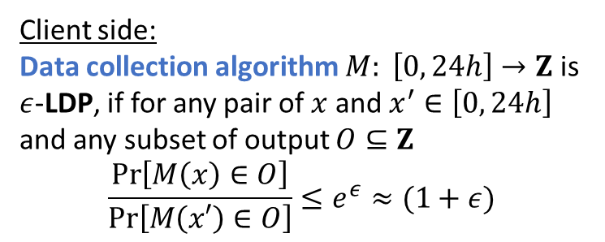
Local Model of Differential Privacy (LDP)
Active line of research since [Duchi, Jordan, and Wainwright 2013]
$$x_{1}$$
Client side:
Data collection algorithm $M: \left[0, 24h\right]→Z$ is $ε$-LDP, if for any pair of $x$ and $x^{′}∈\left[0, 24h\right]$ and any subset of output $O⊆Z$
$$\frac{\operatorname{Pr}\left[M\left(x\right)∈O\right]}{Pr\left[M\left(x′\right)∈O\right]}≤e^{ε}≈(1+ε)$$
$$Y_{1}←M(x_{1})$$
Data collector
$$x_{2}$$
$$Y_{2}←M(x_{2})$$
$$Y_{1}$$
$$Y_{2}$$
… …
$$Y_{N}$$
$$x_{N}$$
$$Y_{N}←M(x_{N})$$
$x_{i}∈\left[0, 24h\right]$: usage metric of a service (in the context of A/B testing)
$M$ is randomized: no matter how (high or low) the metric ($x_{i}$) is,
the differentially private algorithm ($M$) will approximately send the same output ($Y_{i}$).
A user does not need to trust the data collector
Notes:
Use website example

Slide 6


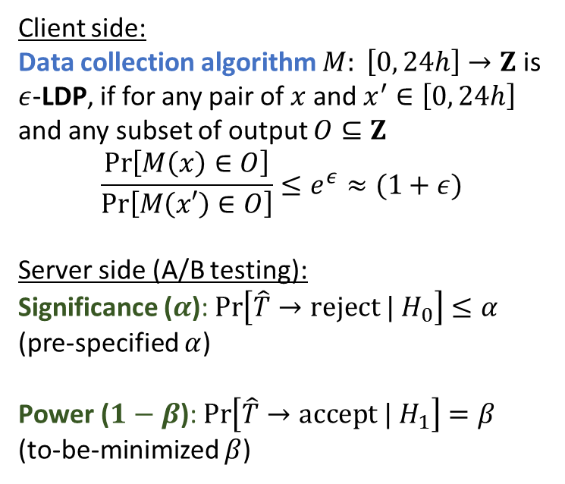




A/B Testing under LDP
$$x_{1}$$
Client side:
Data collection algorithm $M: \left[0, 24h\right]→Z$ is $ε$-LDP, if for any pair of $x$ and $x^{′}∈\left[0, 24h\right]$ and any subset of output $O⊆Z$
$$\frac{\operatorname{Pr}\left[M\left(x\right)∈O\right]}{Pr\left[M\left(x′\right)∈O\right]}≤e^{ε}≈(1+ε)$$
Server side (A/B testing):
Significance ($α$): $\operatorname{Pr}\left[\hat{T}→reject | H_{0}\right]≤α$
(pre-specified $α$)
Power ($1−β$): $\operatorname{Pr}\left[\hat{T}→accept | H_{1}\right]=β$
(to-be-minimized $β$)
$$Y_{1}←M(x_{1})$$
Data collector and analytics
$$A$$
$$Y_{1}$$
$$x_{2}$$
$$Y_{2}←M(x_{2})$$
$$Y_{2}$$
… …
$$T\left(x,A,B;H_{0}\right)$$
$$Y_{N}$$
$$≈\hat{T}\left(Y,A,B;H_{0}\right)$$
$$B$$
$$x_{N}$$
$$Y_{N}←M(x_{N})$$
Testing ($T$ or $\hat{T}$) the null hypothesis
$H_{0}$: $μ_{A}−μ_{B}=d_{0}$
v.s. the alternative hypothesis
$$H_{1}\text{: }μ_{A}−μ_{B}≠d_{0}$$
Notes:
Don’t speak formulas

Slide 7

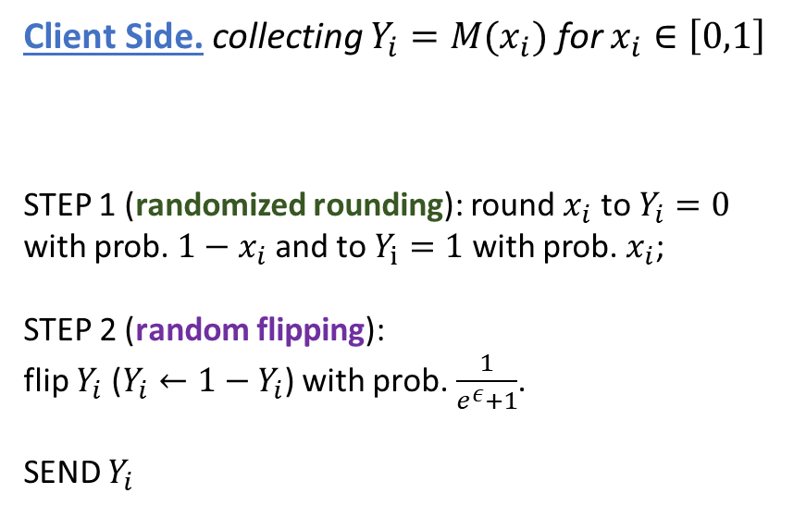

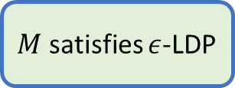



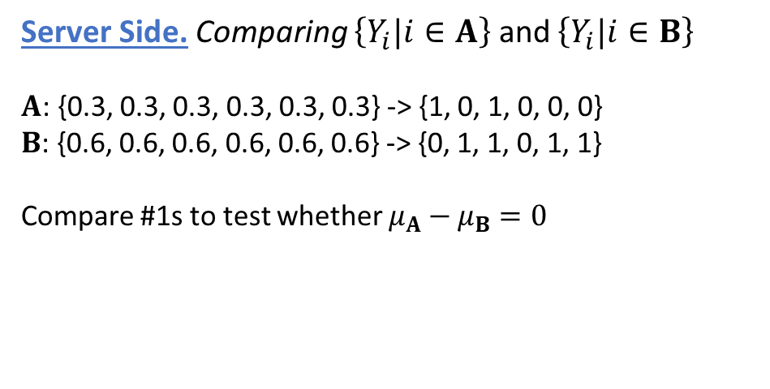


Algorithms: Comparing Population Means
Client Side. collecting $Y_{i}=M(x_{i})$ for $x_{i}∈\left[0,1\right]$
STEP 1 (randomized rounding): round $x_{i}$ to $Y_{i}=0$ with prob. $1−x_{i}$ and to $Y_{i}=1$ with prob. $x_{i}$;
STEP 2 (random flipping):
flip $Y_{i}$ ($Y_{i}←1−Y_{i}$) with prob. $\frac{1}{e^{ε}+1}$.
SEND $Y_{i}$
Server Side. Comparing $\left\{Y_{i}|i∈A\right\}$ and $\left\{Y_{i}|i∈B\right\}$
$A$: {0.3, 0.3, 0.3, 0.3, 0.3, 0.3} -> {1, 0, 1, 0, 0, 0}
$B$: {0.6, 0.6, 0.6, 0.6, 0.6, 0.6} -> {0, 1, 1, 0, 1, 1}
Compare #1s to test whether $μ_{A}−μ_{B}=0$
[Duchi, Jordan, and Wainwright 2013] and [Ding, Kulkarni, and Yekhanin 2017]
$x_{i}$ follows a distribution with mean $μ_{X}$ $⇔$
$Y_{i}$ follows Bernoulli distribution with mean
$$p_{X}=μ_{X}⋅\frac{e^{ε}−1}{e^{ε}+1}+\frac{1}{e^{ε}+1}$$
$$1−x_{i}$$
$$x_{i}$$
$M$ satisfies $ε$-LDP
$$x_{i}$$
$$0$$
$$1$$
$$\frac{1}{e^{ε}+1}$$

Slide 8
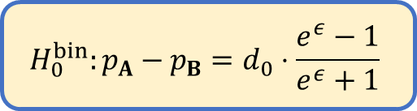





Algorithms: Comparing Population Means
Client Side. collecting $Y_{i}=M(x_{i})$ for $x_{i}∈\left[0,1\right]$
STEP 1 (randomized rounding): round $x_{i}$ to $Y_{i}=0$ with prob. $1−x_{i}$ and to $Y_{i}=1$ with prob. $x_{i}$;
STEP 2 (random flipping):
flip $Y_{i}$ ($Y_{i}←1−Y_{i}$) with prob. $\frac{1}{e^{ε}+1}$.
SEND $Y_{i}$
Server Side. Comparing $\left\{Y_{i}|i∈A\right\}$ and $\left\{Y_{i}|i∈B\right\}$
Conduct $t$-test on $\left\{Y_{i}|i∈A\right\}$ and $\left\{Y_{i}|i∈B\right\}$ with null $H_{0}^{bin}$
[Duchi, Jordan, and Wainwright 2013] and [Ding, Kulkarni, and Yekhanin 2017]
$x_{i}$ follows a distribution with mean $μ_{X}$ $⇔$
$Y_{i}$ follows Bernoulli distribution with mean
$$p_{X}=μ_{X}⋅\frac{e^{ε}−1}{e^{ε}+1}+\frac{1}{e^{ε}+1}$$
$H_{0}$: $μ_{A}−μ_{B}=d_{0}$
$$\left\{x_{i}\right\}$$
Hypothesis transformation
$$1−x_{i}$$
$$x_{i}$$
$$H_{0}^{bin}:p_{A}−p_{B}=d_{0}⋅\frac{e^{ε}−1}{e^{ε}+1}$$
$$x_{i}$$
$$\left\{Y_{i}\right\}$$
$M$ satisfies $ε$-LDP
$$1$$
$$0$$
$$\frac{1}{e^{ε}+1}$$

Slide 9


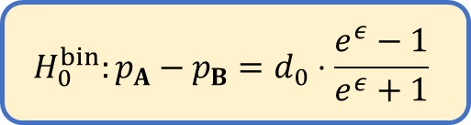
Algorithms: Comparing Population Means (guarantees)
Client Side. collecting $Y_{i}=M(x_{i})$ for $x_{i}∈\left[0,1\right]$
STEP 1 (randomized rounding): round $x_{i}$ to $Y_{i}=0$ with prob. $1−x_{i}$ and to $Y_{i}=1$ with prob. $x_{i}$;
STEP 2 (random flipping):
flip $Y_{i}$ ($Y_{i}←1−Y_{i}$) with prob. $\frac{1}{e^{ε}+1}$.
SEND $Y_{i}$
Server Side. Comparing $\left\{Y_{i}|i∈A\right\}$ and $\left\{Y_{i}|i∈B\right\}$
Conduct $t$-test on $\left\{Y_{i}|i∈A\right\}$ and $\left\{Y_{i}|i∈B\right\}$ with null $H_{0}^{bin}$
Difference from the null $θ≔\left|{(μ}_{A}−μ_{B})−d_{0}\right|$
Sample size $n≔\left|A\right|+\left|B\right|$
(refer to the paper for precise and better lower bounds)
[Duchi, Jordan, and Wainwright 2013] and [Ding, Kulkarni, and Yekhanin 2017]
$$H_{0}^{bin}:p_{A}−p_{B}=d_{0}⋅\frac{e^{ε}−1}{e^{ε}+1}$$
Significance: $α$
Statistical power: at least
$$1−\exp\left(−{\left(θε\sqrt{\frac{n}{2}}−\sqrt{\ln{\frac{1}{α}}}\right)}^{2}\right)$$
$$1−x_{i}$$
$$x_{i}$$
$M$ satisfies $ε$-LDP
$$x_{i}$$
$$0$$
$$1$$
$$\frac{1}{e^{ε}+1}$$

Slide 10
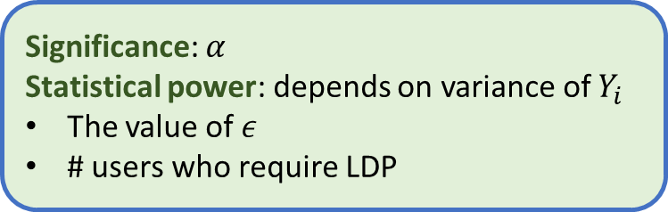
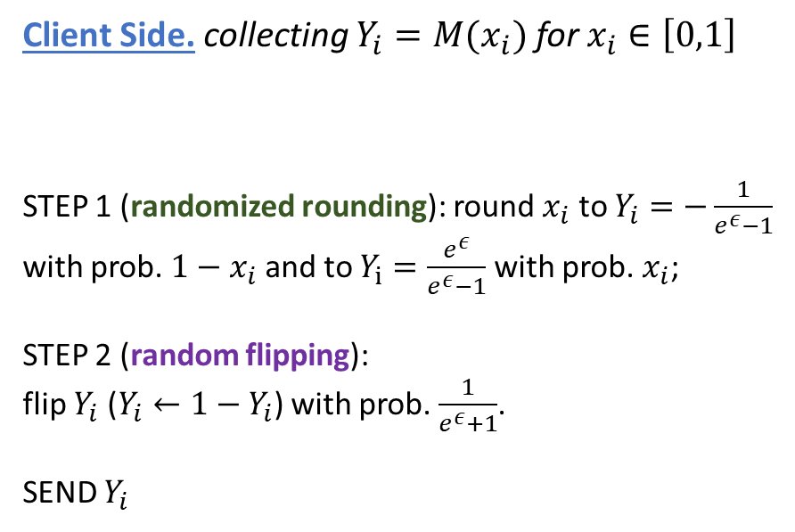



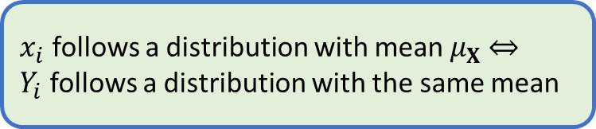



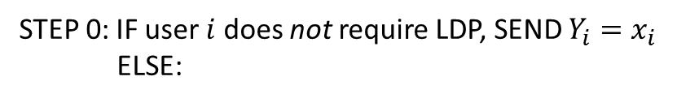
With Hybrid Privacy Requirements
(some users are willing to provide exact data)
Client Side. collecting $Y_{i}=M(x_{i})$ for $x_{i}∈\left[0,1\right]$
STEP 1 (randomized rounding): round $x_{i}$ to $Y_{i}=−\frac{1}{e^{ε}−1}$ with prob. $1−x_{i}$ and to $Y_{i}=\frac{e^{ε}}{e^{ε}−1}$ with prob. $x_{i}$;
STEP 2 (random flipping):
flip $Y_{i}$ ($Y_{i}←1−Y_{i}$) with prob. $\frac{1}{e^{ε}+1}$.
SEND $Y_{i}$
Server Side. Comparing $\left\{Y_{i}|i∈A\right\}$ and $\left\{Y_{i}|i∈B\right\}$
Conduct $t$-test on $\left\{Y_{i}|i∈A\right\}$ and $\left\{Y_{i}|i∈B\right\}$ with null $H_{0}^{hybrid}$
STEP 0: IF user $i$ does not require LDP, SEND $Y_{i}=x_{i}$
ELSE:
$x_{i}$ follows a distribution with mean $μ_{X}$ $⇔$
$Y_{i}$ follows a distribution with the same mean
$H_{0}^{hybrid}$: $μ_{A}−μ_{B}=d_{0}$
Significance: $α$
Statistical power: depends on variance of $Y_{i}$
The value of $ε$
# users who require LDP
$$1−x_{i}$$
$$x_{i}$$
$$x_{i}$$
$$−\frac{1}{e^{ε}−1}$$
$$\frac{e^{ε}}{e^{ε}−1}$$
$$\frac{1}{e^{ε}+1}$$

Slide 11
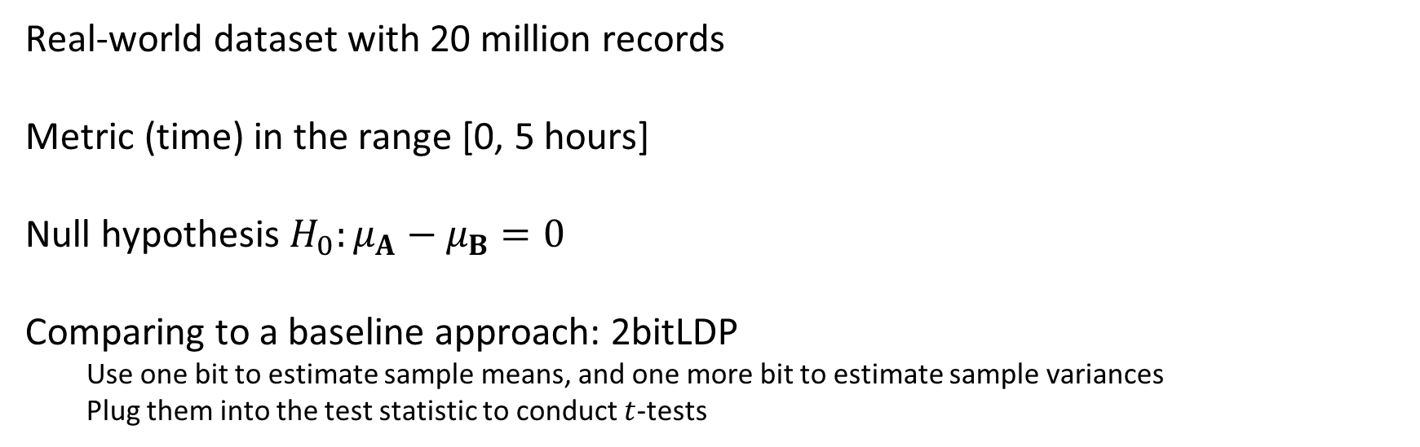
Experiments
Real-world dataset with 20 million records
Metric (time) in the range [0, 5 hours]
Null hypothesis $H_{0}:μ_{A}−μ_{B}=0$
Comparing to a baseline approach: 2bitLDP
Use one bit to estimate sample means, and one more bit to estimate sample variances
Plug them into the test statistic to conduct $t$-tests

Slide 12
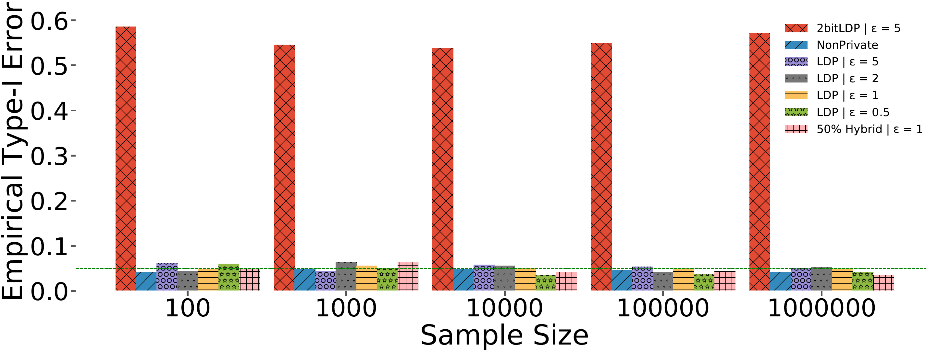

Experiments (confirming $H_{0}$)
When $H_{0}$ holds, all tests except 2bitLDP satisfy the significance requirement $α=0.05$
2bitLDP fails because of the difficulty of estimating variance under LDP (refer to the paper)

Slide 13
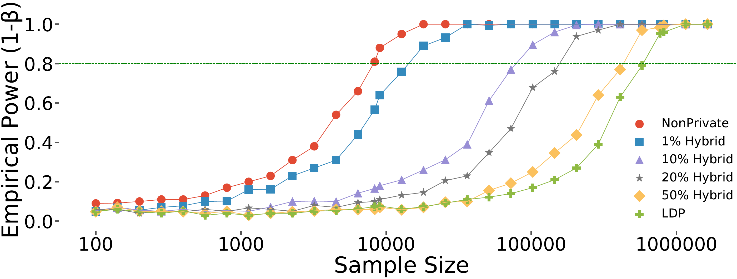

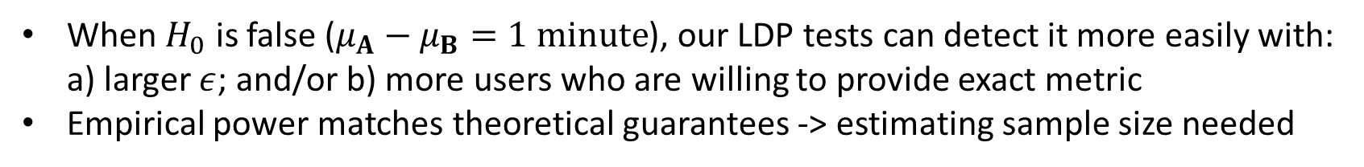
Experiments (detecting $H_{1}$)
When $H_{0}$ is false ($μ_{A}−μ_{B}=1 minute$), our LDP tests can detect it more easily with: a) larger $ε$; and/or b) more users who are willing to provide exact metric
Empirical power matches theoretical guarantees -> estimating sample size needed

Slide 14
Related Work
Hypothesis testing with a trusted data collector under DP
[Garboardi et al., 2016]
[Kakizaki, Fukuchi, and Sakuma, 2017]
[Roger and Kifer, 2017]
…
Parameter estimation under LDP
[Duchi, Jorand, and Wainwright, 2013]
[Ding, Kulkarni, and Yekhanin, 2017]
…
Distinguishing between different distributions under LDP
[Kairouz, Oh, and Viswanath, 2014]
[Rogers, 2017]

Slide 15
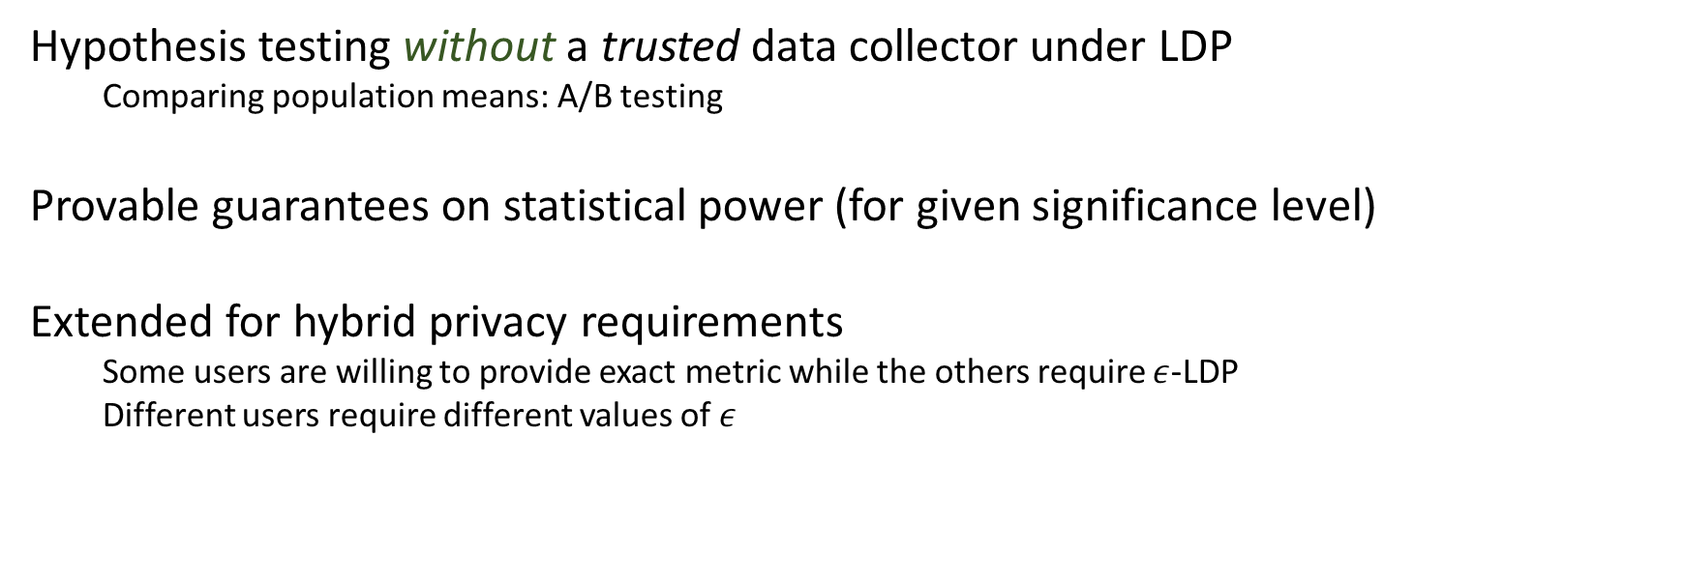
Conclusion
Hypothesis testing without a trusted data collector under LDP
Comparing population means: A/B testing
Provable guarantees on statistical power (for given significance level)
Extended for hybrid privacy requirements
Some users are willing to provide exact metric while the others require $ε$-LDP
Different users require different values of $ε$
Future work: pricing based on $ε$ and minimizing the total cost of testing

