Slide 1
Finding Time-Dependent Shortest Paths over Large Graphs
Bolin Ding, Jeffrey Xu Yu, Lu Qin

Slide 2
Outline
Finding Time-Dependent Shortest Paths
  Time-dependent graphs
  Time-dependent shortest paths
Existing Solutions
A Two-Step Solution
  Recovering paths from arrival-time functions
  Time-refinement for computing arrival-time functions
Experimental Studies
Summary

Slide 3
Outline
Finding Time-Dependent Shortest Paths
  Time-dependent graphs
  Time-dependent shortest paths
Existing Solutions
A Two-Step Solution
  Recovering paths from arrival-time functions
  Time-refinement for computing arrival-time functions
Experimental Studies
Summary

Slide 4
Time-Dependent Graphs
Time-Dependent Graph G_{T}(V, E, W)
  V = {v_{i}}: nodes, or intersections of roads
  E = {(v_{i}, v_{j})} : edges, or road segments
  W = {w_{i,j}(·) | (v_{i}, v_{j})∈E}: edge-delay functions
    Time-dependent edge delay w_{i,j}(·) :
    departing v_{i} at time t → arriving at v_{j} at t+w_{i,j}(t)
Real-Time Traffic Information
  Constructing time-dependent graphs
  Vehicle Information and Communication System
    http://www.vics.or.jp/english/index.html/
  European Traffic Message Channel (TMC)
    http://www.tmcforum.com/

Slide 5
Outline
Finding Time-Dependent Shortest Paths
  Time-dependent graphs
  Time-dependent shortest paths
Existing Solutions
A Two-Step Solution
  Recovering paths from arrival-time functions
  Time-refinement for computing arrival-time functions
Experimental Studies
Summary

Slide 6

Problem Definition
Finding Shortest Paths
  Input: graph G(V, E), source v_{s}, destination v_{e}
  Output: shortest v_{s}-v_{e} path p
  Dijkstra’s algorithm, Bellmen-Ford algorithm, A* algorithm, …
Finding Time-Dependent Shortest Paths
  Query LTT(v_{s}, v_{e}, T)
  Input: (FIFO) time-dependent graph G_{T}(V, E, W), source v_{s}, destination v_{e}, starting-time interval T
  Output: starting time t∈T, v_{s}-v_{e} path p
  Objective: minimizing travel time

Slide 7
Time-Dependent Shortest Paths
v₂
A Time-Dependent Path
  Source v_{s} and Destination v_{e}
  Starting time t
  A v_{s}-v_{e} path p = v₁v₂…v_{k}
  No waiting at each node
Routine
  Arrive(v₁) = t
  Arrive(v₂) = Arrive(v₁) + w_{1,2}(Arrive(v₁))
  …
  Arrive(v_{k}) = Arrive(v_{k-1}) + w_{k-1,k}(Arrive(v_{k-1}))
  Arrival time g_{k}(t) = Arrive(v_{k})
  Travel time g_{k}(t)-t
source
v₄
v₁
destination
v₃

Slide 8

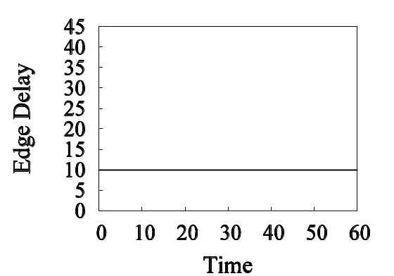
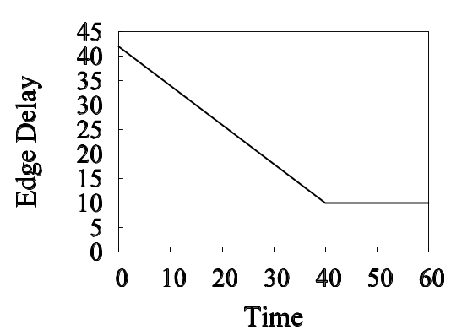
Time-Dependent Shortest Paths
v₂
Example of LTT(v_{s}, v_{t}, T)
  v_{s} = v₁, v_{t} = v₄, T = [0, 60]
  Best starting time t = 20
  Best v₁-v₄ path p = v₁v₂v₃v₄
  Arrival time = 50
  Travel time = 50 – 20 = 30
t=30
source
v₄
t=20
t=50
v₁
destination
v₃
t=40
w_{1,2}(·)
w_{2,3}(·)
w_{3,4}(·)

Slide 9
Time-Dependent Shortest Paths
v₂
Example of LTT(v_{s}, v_{t}, T)
  v_{s} = v₁, v_{t} = v₄, T = [0, 60]
  Starting time t = 10
  p = v₁v₂v₃v₄
  Arrival time = 47.5
  Travel time = 47.5 – 10 = 37.5
Different Starting Time Leads to Different Travel Time
Objective: Minimizing the Travel Time
t=20
source
v₄
t=10
t=47.5
v₁
destination
v₃
t=30
w_{1,2}(·)
w_{2,3}(·)
w_{3,4}(·)

Slide 10
Graph Models and Challenges
FIFO Time-Dependent Graphs
  FIFO edge delay: t₁ + w_{i,j}(t₁) ≤ t₂ + w_{i,j}(t₂), for t₁ ≤ t₂
  No waiting is needed (first depart, first arrive)
Other Models
  Allowing waiting at each node
  Length-speed model
  Non-FIFO model
  1-3 can be reduced to the no-waiting edge-delay FIFO model
Challenges
  Possibly infinite choices of starting time in a continuous starting time interval T
  Selecting the best starting time
  Selecting the best v_{s}-v_{e} path

Slide 11
Outline
Finding Time-Dependent Shortest Paths
  Time-dependent graphs
  Time-dependent shortest paths
Existing Solutions
A Two-Step Solution
  Recovering paths from arrival-time functions
  Time-refinement for computing arrival-time functions
Experimental Studies
Summary

Slide 12
Existing Solutions
Discrete-Time Algorithms
  (Chabini, Transportation Research Record, 1998)
  Continuous time interval T → k Discrete time points
    T = [0, 60] → T = {0, 10, 20, 30, 40, 60}
    Infinite choices of starting time → Finite ones
  G_{T}(V, E, W) → G’(V’, E’, W’)
    |V’| =k·|V|, |E’| = k·|E|, W’ – constant edge delays
    (G’, with constant edge delays, is k times larger than G)
  Run any shortest-path algorithm on G’
A* Algorithms
  (Kanoulas et al., ICDE, 2006)
  Enumerate all v_{s}-v_{e} paths
    p = v₁v₂v₄, v₁v₂v₃v₄, v₁v₃v₄, …
  Lower bound estimation
  Exponential worst-case running time

Slide 13
Existing Solutions
Bellman-Ford Based Algorithm
  Bellman-Ford algorithm: finding single-source shortest paths (with negative edge delays) in time O(|V|·|E|)
    Dijkstra’s algorithm: O(|E| + |V|·log|V|)
  Orda and Rom, JACM, 1990: finding single-source time-dependent shortest paths in time O(|V|·|E|·(T))
    Function g_{i}(t) – the earliest arrival time at v_{i} from v_{s} for starting time t∈T
    Function h_{j,i}(t) – the earliest arrival time at v_{i} from v_{s} via edge (v_{j}, v_{i}) for starting time t∈T
    Repeat |V| times:
    h_{j,i}(t) ← g_{j}(t) + w_{j,i}(g_{j}(t)); g_{i}(t) ← min{h_{j,i}(t) | (v_{j}, v_{i})∈E};
Open Question
  Can we reduce the time to O((|E| + |V|·log|V|)·(T))?

Slide 14
Existing Solutions
Bellman-Ford Based Algorithm
  Bellman-Ford algorithm: finding single-source shortest paths (with negative edge delays) in time O(|V|·|E|)
    Dijkstra’s algorithm: O(|E| + |V|·log|V|)
  Orda and Rom, JACM, 1990: finding single-source time-dependent shortest paths in time O(|V|·|E|·(T))
    Function g_{i}(t) – the earliest arrival time at v_{i} from v_{s} for starting time t∈T
    Function h_{j,i}(t) – the earliest arrival time at v_{i} from v_{s} via edge (v_{j}, v_{i}) for starting time t∈T
    Repeat |V| times:
    h_{j,i}(t) ← g_{j}(t) + w_{j,i}(g_{j}(t)); g_{i}(t) ← min{h_{j,i}(t) | (v_{j}, v_{i})∈E};
Open Question
  Can we reduce the time to O((|E| + |V|·log|V|)·(T))?

Slide 15
Outline
Finding Time-Dependent Shortest Paths
  Time-dependent graphs
  Time-dependent shortest paths
Existing Solutions
A Two-Step Solution
  Recovering paths from arrival-time functions
  Time-refinement for computing arrival-time functions
Experimental Studies
Summary

Slide 16
A Two-Step Solution
Outline
  Input: (FIFO) time-dependent graph G_{T}(V, E, W), source v_{s}, destination v_{e}, starting-time interval T
  Output: starting time t∈T, v_{s}-v_{e} path p
  Objective: minimizing travel time
  Arrival-Time Function g_{i}(t) – the earliest arrival time at v_{i} from v_{s} for starting time t∈T
  Step 1. Compute {g_{i}(t) | v_{i}∈V}
  Step 2. t* = argmin_{t∈T}{g_{e}(t) – t}
  Compute v_{s}-v_{e} path p*, starting from v_{s} at time t*, arriving at v_{e} at time g_{e}(t*)
  (travel time g_{e}(t*) – t* is minimum)

Slide 17
Outline
Finding Time-Dependent Shortest Paths
  Time-dependent graphs
  Time-dependent shortest paths
Existing Solutions
A Two-Step Solution
  Recovering paths from arrival-time functions
  Time-refinement for computing arrival-time functions
Experimental Studies
Summary

Slide 18
Recovering Paths
Recovering Paths From Arrival-Time Functions
(Step 2)
  Best starting time: t* = argmin_{t∈T}{g_{e}(t) – t}
  Repeat
    Find v_{i} s.t. g_{i}(t*) + w_{i,e}(g_{i}(t*)) = g_{e}(t*)
    p* ← p*·(v_{i}, v_{e})
    v_{e} ← v_{i}
  Until v_{s} = v_{e}
g_{e}(t*)
v_{e}
w_{i,e}(g_{i}(t*))
v_{i}
w_{j,e}(g_{i}(t*))
v_{s}-v_{i}: g_{i}(t*)
v_{j}
starting time t*
v_{s}
v_{s}-v_{j}: g_{j}(t*)
g_{i}(t*) + w_{i,e}(g_{i}(t*)) = g_{e}(t*) ≤ g_{j}(t*) + w_{j,e}(g_{j}(t*))
shortest v_{s}-v_{e} path p*
=v_{s} … v_{i}v_{e}

Slide 19
Recovering Paths
Recovering Paths From Arrival-Time Functions
(Step 2)
  Best starting time: t* = argmin_{t∈T}{g_{e}(t) – t}
  Repeat
    Find v_{i} s.t. g_{i}(t*) + w_{i,e}(g_{i}(t*)) = g_{e}(t*)
    p* ← p*·(v_{i}, v_{e})
    v_{e} ← v_{i}
  Until v_{s} = v_{e}
g_{e}(t*)
v_{e}
w_{i,e}(g_{i}(t*))
v_{i}
w_{j,e}(g_{i}(t*))
v_{s}-v_{i}: g_{i}(t*)
v_{j}
starting time t*
v_{s}
v_{s}-v_{j}: g_{j}(t*)
g_{i}(t*) + w_{i,e}(g_{i}(t*)) = g_{e}(t*) ≤ g_{j}(t*) + w_{j,e}(g_{j}(t*))
shortest v_{s}-v_{e} path p*
=v_{s} … v_{i}v_{e}

Slide 20
Outline
Finding Time-Dependent Shortest Paths
  Time-dependent graphs
  Time-dependent shortest paths
Existing Solutions
A Two-Step Solution
  Recovering paths from arrival-time functions
  Time-refinement for computing arrival-time functions
Experimental Studies
Summary

Slide 21
Computing Arrival-Time Functions
How to Compute {g_{i}(t) | v_{i}∈V} (Step 1)
  Starting-time interval refinement
    Recall starting-time interval T=[t_{s}, t_{e}]
    Maintain/Update starting-time subinterval I_{i}=[t_{s}, _{i}] for each v_{i}∈V s.t.
  Arrival-time function refinement
    Update g_{i}(t)
  Termination
    I_{i} = T = [t_{s}, t_{e}] (or _{i} = t_{e})
g_{i}(t) is the earliest arrival time at v_{i} from v_{s} for starting time t∈I_{i}
Loop Invariant

Slide 22
Computing Arrival-Time Functions
How to Compute {g_{i}(t) | v_{i}∈V} (Step 1)
  Starting-time interval refinement
    Recall starting-time interval T=[t_{s}, t_{e}]
    Maintain/Update starting-time subinterval I_{i}=[t_{s}, _{i}] for each v_{i}∈V s.t.
  Arrival-time function refinement
    Update g_{i}(t)
  Termination
    I_{i} = T = [t_{s}, t_{e}] (or _{i} = t_{e})
g_{i}(t) is the earliest arrival time at v_{i} from v_{s} for starting time t∈I_{i}
Loop Invariant

Slide 23
Computing Arrival-Time Functions
Initialization
  g_{s}(t) ← t, g_{i}(t) ← ∞ (v_{i} ≠ v_{s})
  I_{i} ← [t_{s}, t_{s}]
Update I_{i}=[t_{s}, _{i}]
  Pick v_{i}, _{i}’: I_{i} ← [t_{s}, _{i}’] (_{i} ← _{i}’)
Update g_{j}(t)
  g_{j}(t) ← min{g_{i}(t) + w_{i,j}(g_{i}(t)),
  g_{j}(t)}
  for t∈[_{i}, _{i}’], and each (v_{i}, v_{j})∈E
Repeat 2-3 Until I_{i} = T = [t_{s}, t_{e}] for all v_{i}∈V
How to Pick v_{i} and _{i}’?
Maintaining Loop Invariant
g_{i}(t) is the earliest arrival time at v_{i} from v_{s} for starting time t∈I_{i}

Slide 24
Computing Arrival-Time Functions
Pick v_{i} and _{i}’
  Pick v_{i} ← argmin_{j}{g_{j}(_{j})}
  Let v_{k} ← argmin2_{j}{g_{j}(_{j})} (the 2nd minimum g_{j}(_{j}))
  Let  ← min{w_{f,i}(g_{k}(_{k})) | (v_{f}, v_{i})∈E}
  Pick _{i}’ ← max{t | g_{i}(t) ≤ g_{k}(_{k}) + }
Update I_{i} and g_{j}(t)
g_{j}(t) ← min{g_{i}(t) + w_{i,j}(g_{i}(t)), g_{j}(t)}
v_{j}
g_{j}(t)
g_{i}(t)
v_{i}
w_{i,j}(t)
t_{s}
_{i}
_{i}’
t_{e}
t_{s}
_{i}
_{i}’
_{i}
t_{e}

Slide 25
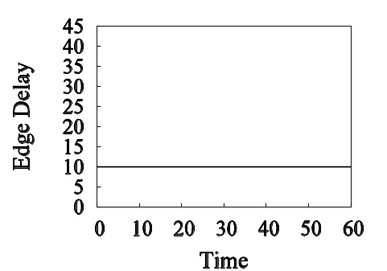
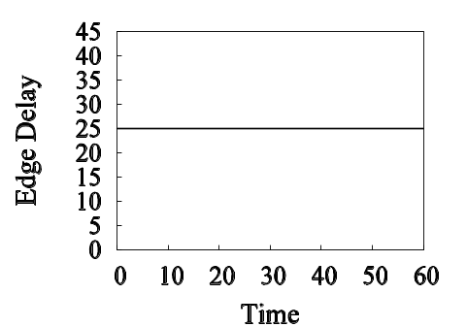
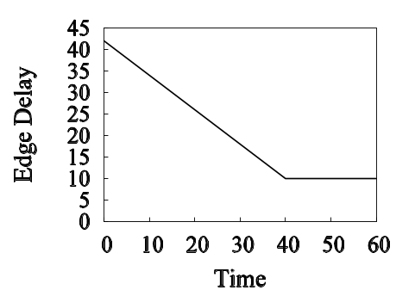
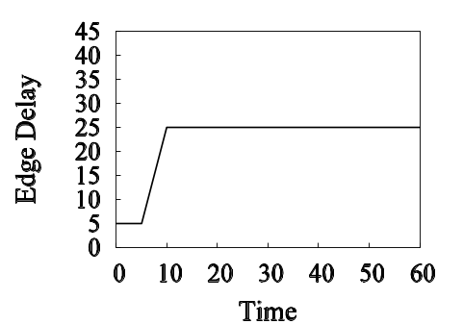
Running Example
w_{1,2}(t)
w_{2,4}(t)
v₂
source
v₄
Query: LTT(v₁, v₄, [0, 60])
v₁
destination
v₃
w_{3,4}(t)
w_{1,3}(t)
w_{2,3}(t)

Slide 26
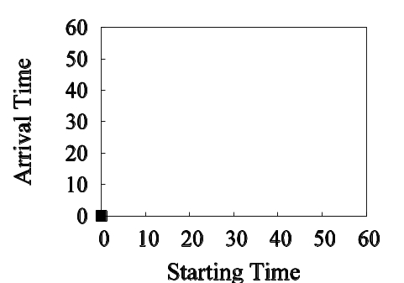
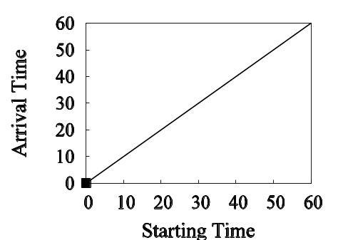
Running Example
g₂(t)
Initialization:
v₂
g₁(t)
source
v₄
g₄(t)
v₁
destination
_{i}
v₃
g₃(t)

Slide 27
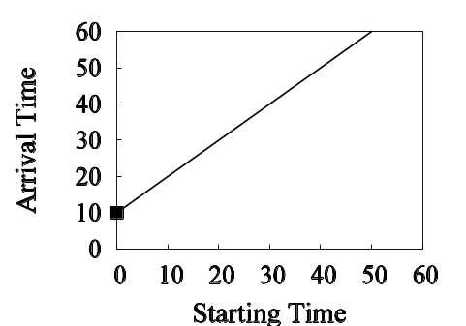
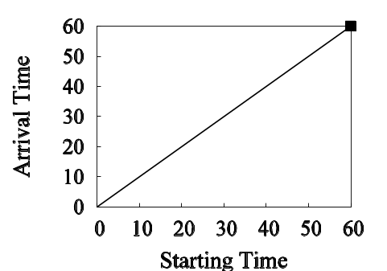
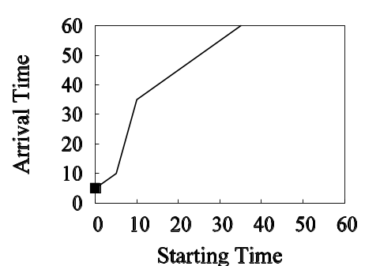
Running Example
g₂(t)
Pick v₁ and ₁’, ₁ ← ₁’
Update g₂(t) and g₃(t)
v₂
g₁(t)
source
v₄
g₄(t)
v₁
destination
v₃
g₃(t)

Slide 28
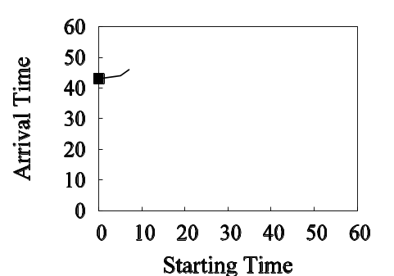
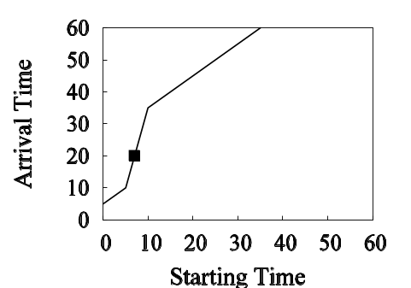
Running Example
g₂(t)
Pick v₃ and ₃’, ₃ ← ₃’
Update g₄(t)
v₂
g₁(t)
source
v₄
g₄(t)
v₁
destination
v₃
g₃(t)

Slide 29
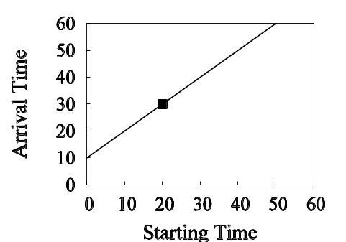
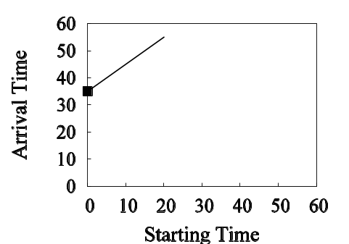
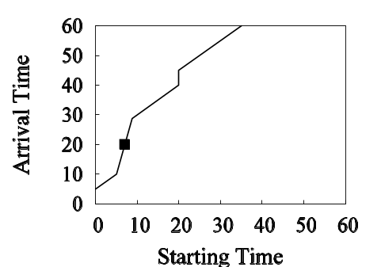
Running Example
g₂(t)
Pick v₂ and ₂’, ₂ ← ₂’
Update g₃(t) and g₄(t)
v₂
g₁(t)
source
v₄
g₄(t)
v₁
destination
v₃
g₃(t)

Slide 30

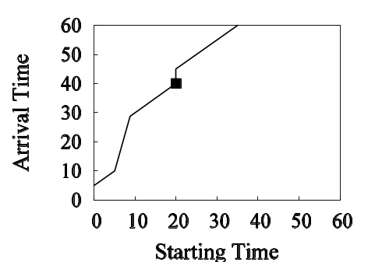
Running Example
g₂(t)
Pick v₃ and ₃’, ₃ ← ₃’
Update g₄(t)
v₂
g₁(t)
source
v₄
g₄(t)
v₁
destination
v₃
g₃(t)

Slide 31
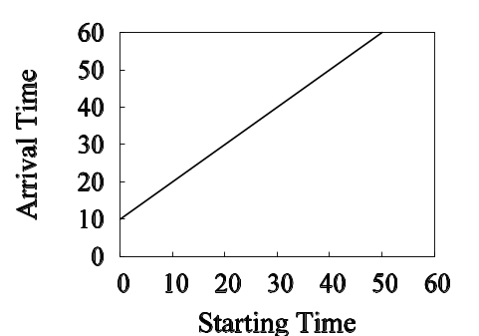
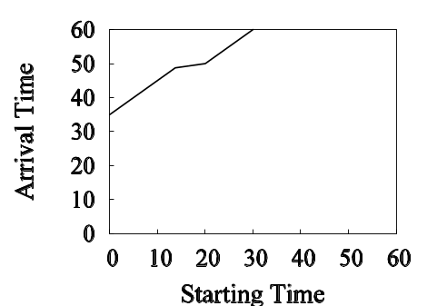

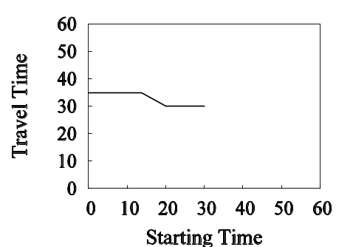
Running Example
g₂(t)
…
Finally,
v₂
g₁(t)
source
v₄
g₄(t)
v₁
destination
v₃
g₃(t)
g₄(t) – t
t*

Slide 32
Correctness and Complexity
Proof of Correctness
  Intuition:
    Because g_{i}(t) ≤ g_{k}(_{k}) + w_{j,i}(g_{k}(_{k})) for any t∈[_{i}, _{i}’]
    (from the choice of v_{k}, , _{i}’, and g_{k}(_{k}) ≤ g_{j}(_{j}))
    We have, for any t∈[_{i}, _{i}’] and each (v_{j}, v_{i})∈E:
    g_{i}(t) ≤ g_{j}(_{j}) + w_{j,i}(g_{j}(_{j}))
    In interval [_{i}, _{i}’], g_{i}(t) cannot be updated any more
    I_{i} ← I_{i} ∪ [_{i}, _{i}’] = [t_{s}, _{i}’]
Complexity Analysis
  Similar to Dijkstra’s algorithm (using Fibonacci heap):
  O((|E| + |V|·log|V|)·(T)) time
  O((|E| + |V|)·(T)) space

Slide 33
Outline
Finding Time-Dependent Shortest Paths
  Time-dependent graphs
  Time-dependent shortest paths
Existing Solutions
A Two-Step Solution
  Recovering paths from arrival-time functions
  Time-refinement for computing arrival-time functions
Experimental Studies
Summary

Slide 34


Experimental Studies
Dataset
  Topologically Integrated Geographic Encoding and Referencing system (TIGER)
    http://www.census.gov/geo/www/tiger/
    2005 road-map of Maryland State in US and its subgraphs
  Edge delays: random piecewise linear functions
Implementation
  Environment: 2.8GHz CPU/1G memory PC running XP
  Compare our solution (2S) with: A* algorithm (KDXZ), discrete-time algorithm (DOT), Bellman-Ford based algorithm (OR)

Slide 35
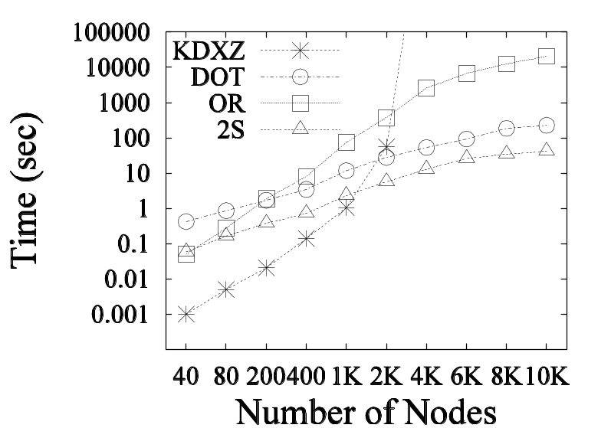
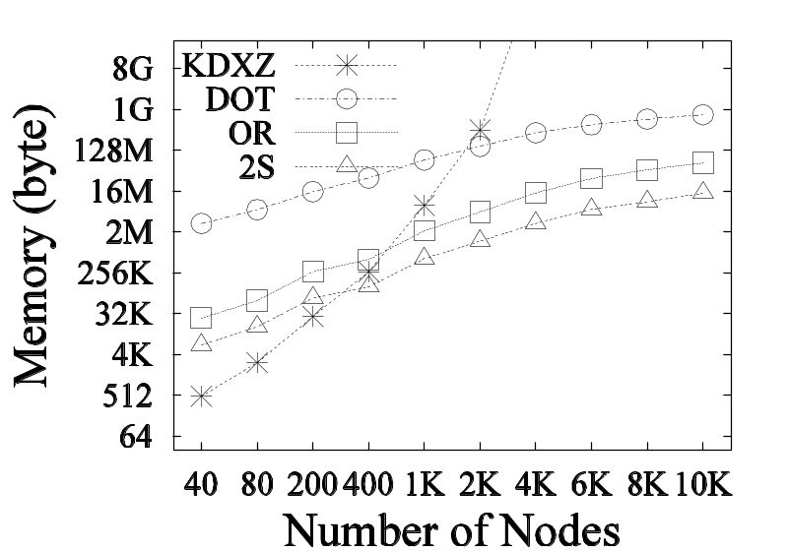
Experimental Studies
Graph Scalability
  Varying the size of graphs
  Fixing v_{s} as the center, and varying v_{e} over all nodes
  Average time/memory consumed

Slide 36
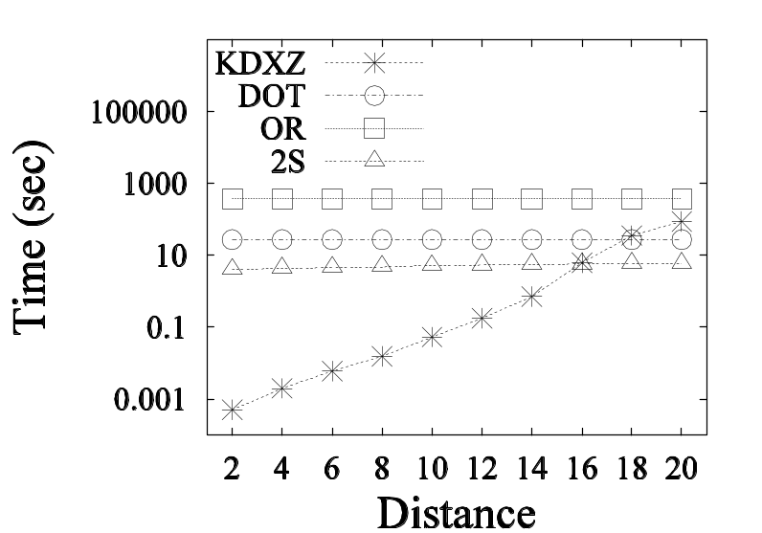
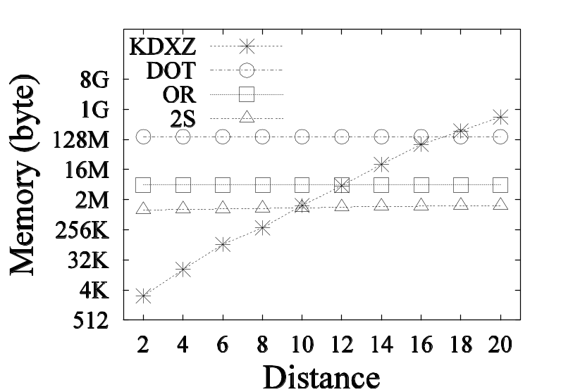
Experimental Studies
Query Scalability
  Using graph G₆ (2K nodes and 3K edges)
  Varying the distance between v_{s} and v_{e}
  Average time/memory consumed

Slide 37
Outline
Finding Time-Dependent Shortest Paths
  Time-dependent graphs
  Time-dependent shortest paths
Existing Solutions
A Two-Step Solution
  Recovering paths from arrival-time functions
  Time-refinement for computing arrival-time functions
Experimental Studies
Summary

Slide 38
Summary
Time-Dependent Shortest Paths
  LLT(v_{s}, v_{e}, T) query in spatial databases with real-time traffic Information
A Two-Step Solution
  Finding the optimal solution
  Outperforming previous methods
    In theory, O((|E| + |V|·log|V|)·(T)) time
    In practice, better experimental results

Slide 39
Appendix
Existing Solutions
  Discrete-Time Algorithm
    I. Chabini: “Discrete dynamic shortest path problems in transportation applications: Complexity and algorithms with optimal run time.” Transportation Research Record, 1645:170–175, 1998
  A* Algorithm
    E. Kanoulas, Y. Du, T. Xia, and D. Zhang: “Finding fastest paths on a road network with speed patterns.” In ICDE, pages 10–19, 2006
  Bellman-Ford Based Algorithm
    A. Orda and R. Rom: “Shortest-path and minimum-delay algorithms in networks with time-dependent edge-length.” Journal of ACM, 37(3):607–625, 1990

