Slide 1

Efficient Mining of Closed Repetitive Gapped Subsequences from a Sequence Database
Bolin Ding¹, David Lo^{2,3}, Jiawei Han¹, and Siau-Cheng Khoo²
¹University of Illinois at Urbana-Champaign
²National University of Singapore
³Singapore Management University

Slide 2

Motivation
A huge wealth of sequence data
  Program execution traces
  Sequences of words (text data)
  Customer purchasing records
  Credit card usage histories
  Protein sequences
A database of long sequences
  Patterns repeat multiple times in a sequence
  How about itemset?

Slide 3
Example
Is pattern AB more frequent then CD?
  S₁ = AABCDABB, S₂ = ABCD
Extract patterns from text
Extract patterns from program execution traces
  … A.lock … A.completeTrans … A.unlock … A.lock … A.unlock … A.lock … A.completeTrans … A.unlock …
LAX LNDG GEAR WOULD NOT RETRACT, GEAR HANDLE WOULD NOT GO PAST MID POS AND GEAR DID NOT RETRACT...
Pattern:
GEAR NOT RETRACT

Slide 4
Mining Sequences-Overview
Sequence S = e₁e₂…e_{len} : S[i] = e_{i}
Subsequence of S’: S[i] = S’[k_{i}] for k₁ < k₂ < … < k_{len}
Input
  Sequence database SeqDB = {S₁, S₂, …, S_{N}}
  Support threshold min_sup
Definition of the support
  # of instances of P in SeqDB
  sup(P)
Output
  All sequence patterns P satisfying
  sup(P) ≥ min_sup
Closed pattern/Maximal pattern

Slide 5
Mining Sequence-Example
Input
  SeqDB =
  {ABAABBCD,
  CABABC,
  ACDEFB}
  Support threshold min_sup = 2
Support
  sup(AB) = 2, sup(AC) = 3, sup(ACD) = 2 …
Output
  AB, AC, ACD, …
  ABD …

Slide 6

Related Work
Sequential pattern mining [Agrawal and Srikant 1995]
  Pattern: subsequence
  Support: # of sequences containing a pattern
  Bad example:
  S₁ = S₂ = … = S₅₀ = CABABABABD
  S₅₁ = S₅₂ = … = S₁₀₀ = ACDB
  Which one is more frequent? AB or CD?

Slide 7
Related Work
Serial Episodes mining [Mannila et al. 1997]
  Only a single sequence
  Pattern: subsequence
  Support: # of width-w/minimal windows containing the pattern
  We want to
    Handle multiple sequences
    Break the window barrier (hard to set right w)
    Mine a compact set of patterns (closed pattern)

Slide 8
Related Work
Iterative pattern mining [Lo et al. 2007]
  A database of program execution traces
  Pattern: subsequence
  Support: # instances obeying the semantics of Message Sequence Chart/Live Sequence Chart (MSC/LSC)
  (e₁ G* e₂ G* … G* e_{n}), where G* = E – {e₁,… e_{n}}
  Problem
    Constraint is too strong
    Closed pattern is not well-defined
    Miss some patterns (e.g. in buggy execution traces)
    Not applicable in other applications

Slide 9
Our Goal
Repetitive pattern/support
  Repetitive non-overlapping instances of a pattern
  Maximum embedding of instances
Examples of mining results
  ASRS dataset
    Text data with anomaly attribute
  Transaction component of JBoss Application Server
    Programming execution sequences (of events)

Slide 10
Examples of Mining Results
ASRS dataset
  Anomaly1 = aircraft equipment problem : critical
  Anomaly2 = inflight encounter : weather
  Anomaly3 = conflict : nmac
Pattern | Support
 | Anomaly1 | Anomaly2 | Anomaly3
LNDG UNEVENTFUL | 11 | 0 | 0
LANDED WITHOUT INCIDENT | 12 | 0 | 0
SHUT DOWN ENG | 12 | 0 | 0
VISIBILITY FOG | 0 | 13 | 0
CEILING VISIBILITY | 0 | 15 | 0
DOWNWIND RWY | 0 | 0 | 12
SAW OTHER ACFT | 0 | 0 | 10
CLRED FOR RWY | 0 | 0 | 44
TOOK EVASIVE ACTION | 0 | 0 | 44
SUPPLEMENTAL FROM | 17 | 10 | 31
CALLBACK WITH REVEALED FOLLOWING | 37 | 13 | 24
CALLBACK WITH REVEALED FOLLOWING HAT | 13 | 0 | 0

Slide 11
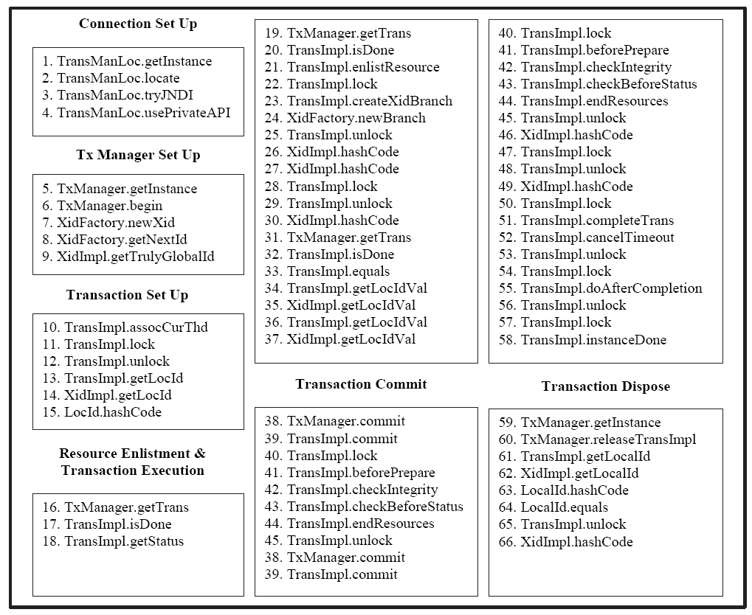
Examples of Mining Results
JBoss Application Server
  Longest repetitive gapped subsequence (of length 66) Mined from JBoss Transaction Component

Slide 12
Problem Statement
Mining (closed) Repetitive Gapped Subsequence
Input SeqDB = {S₁, S₂, …, S_{N}} and min_sup
Output patterns with support sup(P) ≥ min_sup
  Instance of pattern in SeqDB
  Overlapping instances
  sup(P): the maximum NON-overlapping instances set
    Support set INS: |INS| = sup(P)
  {(i, <k₁, k₂, …, k_{m}>): P[1] = S_{i}[k₁], P[2] = S_{i}[k₂], …, P[m] = S_{i}[k_{m}]}
(i, <k₁, k₂, …, k_{m}>) and (i, <k₁’, k₂’, …, k_{m}’>): k_{j} = k_{j}’ for some j
sup(P) = max{|INS|: INS is a set of non-overlapping instances of P}

Slide 13


Repetitive Gapped Subsequence-Support
About the definition of support
  Repetitive instances of a pattern within each sequence
  Why non-overlapping
    Avoid over-estimating the frequency: in AAAABBBBCCCC, 4³ instances of ABC, and 4 non-overlapping ones (4² ABs)
  Maximize the size of the non-overlapping instance set
    Measure how frequent a pattern is
    A unified definition for all patterns
Example
  sup(AB) = 4
S₁ = A A B C D A B B, S₂ = A B C D

Slide 14
Subproblems and Challenges
Computing the support of a pattern
  Is it (NP-)hard to compute sup(P)?
Mining frequent patterns
  How to embed support-computing process into mining?
  How to mine only the closed patterns?
Outline of the rest
  Hardness of support computation
  Properties of repetitive support
  Computing repetitive support
  Mining (closed) repetitive patterns

Slide 15
Hardness of Support Computation
sup(P): the maximum NON-overlapping instances set
Overlapping instances
Weakly overlapping instances
  NP-Hard to compute sup(P)
  Reduction from the iterated shuffle problem
    ABABAA is an iterated shuffle of ABA
    ABABA is NOT an iterated shuffle of ABA
sup(P) = max{|INS|: INS is a set of non-overlapping instances of P}
(i, <k₁, k₂, …, k_{m}>) and (i, <k₁’, k₂’, …, k_{m}’>): k_{j} = k_{j}’ for some j
(i, <k₁, k₂, …, k_{m}>) and (i, <k₁’, k₂’, …, k_{m}’>): k_{p} = k_{q}’ for some p and q

Slide 16
Properties of Repetitive Support
Monotonicity
  If P’ is a super-pattern of P, then sup(P’) ≤ sup(P)
    Each INS’ = a set of non-overlapping instances of P’
    Construct from INS’:
    INS = a set of non-overlapping instances of P
    |INS| = |INS’|
    sup(P’) = max{ |INS’| } ≤ max{ |INS’| } = sup(P)
  Example:
    ABA in ABAABA
    AB in ABAABA
Apriori Property

Slide 17
Properties of Repetitive Support
Closed pattern
  P is non-closed: a super-pattern P’ s.t. sup(P’) = sup(P)
Support set of non-closed pattern is extendable
  P’ is a super pattern of P
  sup(P’) = sup(P) if and only if for any support set INS’ of P’, there exists a support set INS of P, s.t.
    |INS’| = |INS|
    For any (i, <k₁, k₂, …, k_{|P|}>) ∈ INS, there exists (i, <k₁’, k₂’, …, k_{|P’|}’>) ∈ INS’, s.t. <k₁’, k₂’, …, k_{|P’|}’> is a super- sequence of <k₁, k₂, …, k_{|P|}>
  Closed pattern is well defined

Slide 18
Computing Repetitive Support
Greedy instance-growth algorithm
 | 1 | 2 | 3 | 4 | 5 | 6 | 7 | 8 | 9
S₁ | A | B | C | A | C | B | D | D | B
S₂ | A | C | D | B | A | C | A | D | D

Slide 19
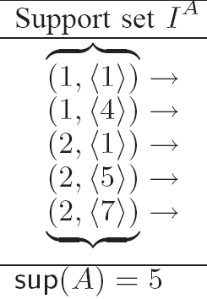
Computing Repetitive Support
Greedy instance-growth algorithm
 | 1 | 2 | 3 | 4 | 5 | 6 | 7 | 8 | 9
S₁ | A | B | C | A | C | B | D | D | B
S₂ | A | C | D | B | A | C | A | D | D

Slide 20
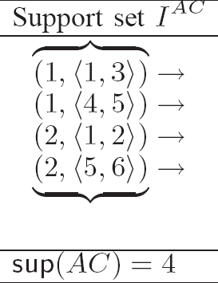
Computing Repetitive Support
Greedy instance-growth algorithm
 | 1 | 2 | 3 | 4 | 5 | 6 | 7 | 8 | 9
S₁ | A | B | C | A | C | B | D | D | B
S₂ | A | C | D | B | A | C | A | D | D

Slide 21
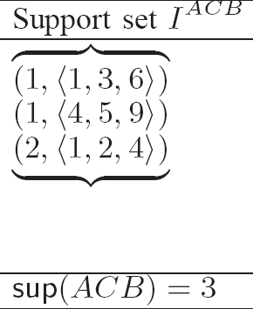
Computing Repetitive Support
Greedy instance-growth algorithm
 | 1 | 2 | 3 | 4 | 5 | 6 | 7 | 8 | 9
S₁ | A | B | C | A | C | B | D | D | B
S₂ | A | C | D | B | A | C | A | D | D

Slide 22
Computing Repetitive Support
Greedy instance-growth algorithm
  Intuition: Extend each instance to the nearest possible event
 | 1 | 2 | 3 | 4 | 5 | 6 | 7 | 8 | 9
S₁ | A | B | C | A | C | B | D | D | B
S₂ | A | C | D | B | A | C | A | D | D

Slide 23
Computing Repetitive Support
Correctness of greedy instance-growth algorithm
  Optimality: sup(P) = max{ |INS| }
    Leftmost support set INS of P →
    Leftmost support set INS⁺ of pattern P○e
  Instance-growth routine INSgrow(P, INS, e):
    Given a support set INS of P, with |INS| = sup(P), and event e
    Extend each instance in INS to the nearest possible event e
    INSgrow(P, INS, e) returns a support set INS⁺ of pattern P○e

Slide 24
Computing Repetitive Support
Example: computing sup(ACB)
  Initialize support set INS^{A} of A
  INS^{AC} ← INSgrow(A, INS^{A}, C)
  INS^{ACB} ← INSgrow(AC, INS^{AC}, B)
  sup(ACB) ← |INS^{ACB}|

Slide 25
Mining All Frequent Patterns
Depth-first search of the pattern space
Closure checking
Instance-border checking
INSgrow(AA, INS^{AA}, A)
A
B
C
AA
AB
AC
… …
Frequent patterns: sup(P) ≥ min_sup
AAA
AAB
… …
Infrequent patterns: sup(P) < min_sup
……
… …

Slide 26
Mining All Frequent Patterns
Complexity
  Sequences: S₁, S₂, …, S_{n}
  L = max{|S₁|, |S₂|, …, |S_{n}|}
  E = # distinct events
  Fre = the set of frequent patterns: sup(P) ≥ min_sup
  INSgrow(P, INS, e): O(sup(P).logL)
  Mining all patterns: O(∑_{P∈Fre}sup(P).E.logL)
  Polynomial-time delay (nearly optimal):
    Ω(∑_{P∈Fre}sup(P)) to output all patterns and support sets
    Delay: O(E.logL)
Bottleneck
  |Fre| is large

Slide 27
Mining Closed Patterns
Pattern extension
  Patterns with one more event in P = e₁ e₂ … e_{m}
  Extension(P, e) = {ee₁e₂…e_{m}, e₁ee₂…e_{m}, …, e₁e₂…e_{m}e}
Closure checking
  Pattern P is NOT closed if and only if sup(P) = sup(Q) for some Q ∈ Extension(P, e)
  Unable to prune the search space
    It is possible that AB is NOT closed but ABAC is closed
Instance-border checking
  Prune the search space

Slide 28
Mining Closed Patterns
(Instance-border checking) Pattern P is prunable if:
  There exists Q ∈ Extension(P, e) for some e s.t.
    sup(P) = sup(Q) (P is NOT closed)
    (leftmost) support set INS^{P} and (lesfmost) support set INS^{Q}:
    for each (i, <k₁, k₂, …, k_{|P|}>) ∈ INS^{P} and (i, <k₁’, k₂’, …, k_{|Q|}’>) ∈ INS^{Q}
    k_{|Q|}’ ≤ k_{|P|}
Example
  S = ACACBBDD
  INS^{AB}: ACACBBDD, ACACBBDD
  INS^{ACB}: ACACBBDD, ACACBBDD
  AB is prunable

Slide 29
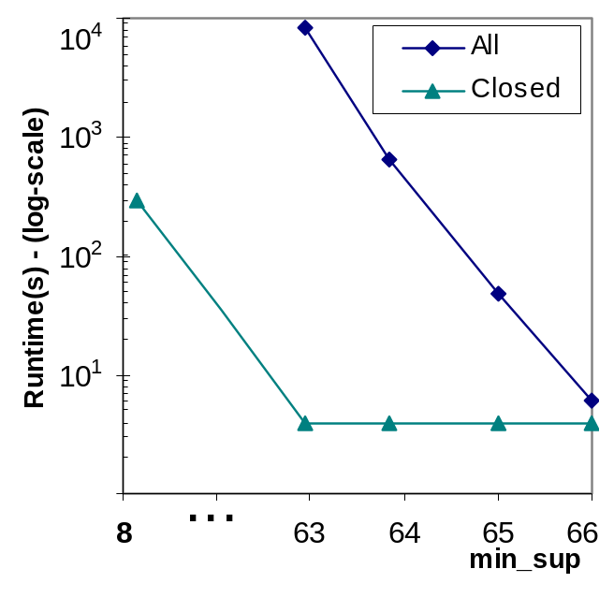
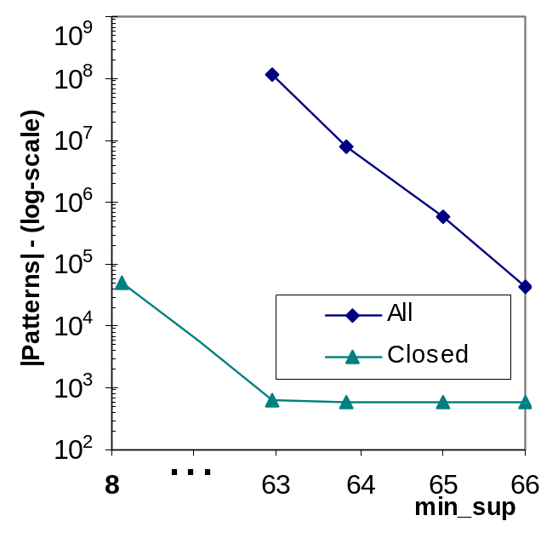
Experimental Study
Gazelle dataset (click stream)
  29369 sequences, 1423 distinct events, sequence length 1-651
  Vary min_sup

Slide 30
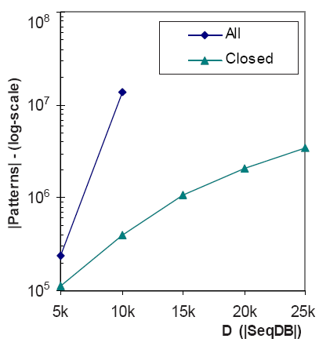
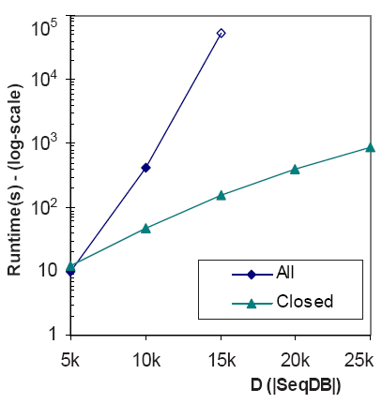
Experimental Study
Vary the number of sequences
  10000 distinct events, sequence length 50
  Vary the number of sequences: 5000-25000

Slide 31
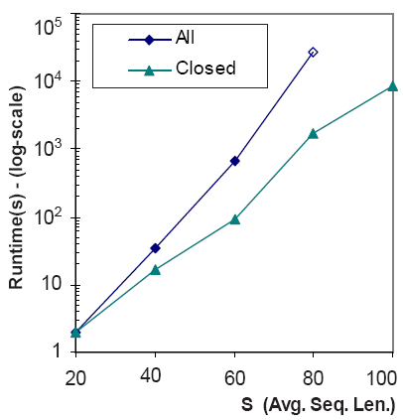
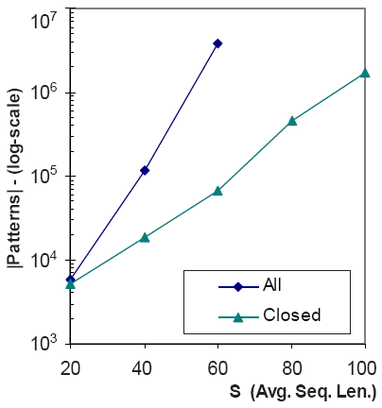
Experimental Study
Vary the average length of sequences
  10000 sequences, 10000 distinct events
  Vary the average length: 20-100

Slide 32
Conclusion
Frequent repetitive-pattern mining
  Capture repetitive non-overlapping instances
  Maximum embedding (repetitive support)
Closed repetitive patterns
Efficient mining algorithms
Future work
  Statistic explanation of repetitive support
  Use repetitive patterns as features for other mining tasks
  Approximate repetitive patterns

