Slide 1
Linear and Range Counting under Metric-based Local Differential Privacy
Zhuolun Xiang Bolin Ding Xi He Jingren Zhou
UIUC Alibaba U of Waterloo Alibaba

Slide 2





Motivation
Differential privacy is adopted in many companies
Two models: centralized/local differential privacy
Difference: No trusted data collector in local DP

Slide 3

Local Differential Privacy (LDP)
Setting: n data owners, each has $x∈X$, sends encoded report $A(x)$ to data collector for analytical tasks

Slide 4
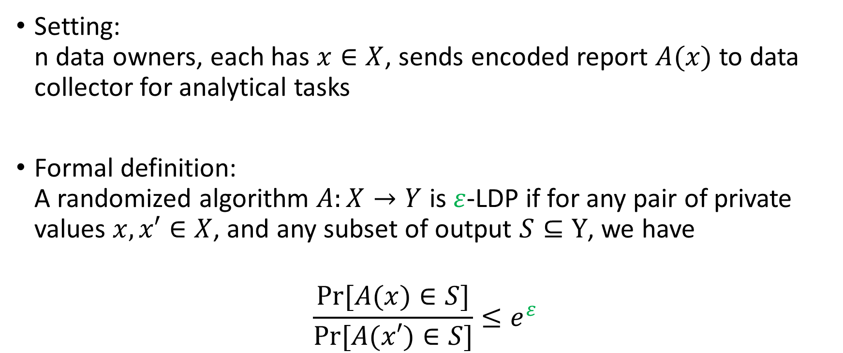
Local Differential Privacy (LDP)
Setting: n data owners, each has $x∈X$, sends encoded report $A(x)$ to data collector for analytical tasks
Formal definition: A randomized algorithm $A:X→Y$ is $ε$-LDP if for any pair of private values $x,x′∈X$, and any subset of output $S⊆Y$, we have
$$\frac{Pr⁡[A(x)∈S]}{Pr⁡[A(x′)∈S]}≤e^{ε}$$

Slide 5

Metric-based LDP [1]
Motivation:$ε$-LDP has same level of protection for any pairs
Lead to high error, i.e., d-dim range query has error O$(\frac{n{(\log{m})}^{2d}}{ε^{2}})$
No need to have same $ε$ for all pairs, i.e., kid/adult less sensitive than exact age
[1] M. Alvim, K. Chatzikokolakis, C. Palamidessi, and A. Pazii, “Local differential privacy on metric spaces: optimizing the trade-off with utility,” in Proceedings of the 31st IEEE Computer Security Foundations Symposium (CSF), 2018, pp. 262–267

Slide 6
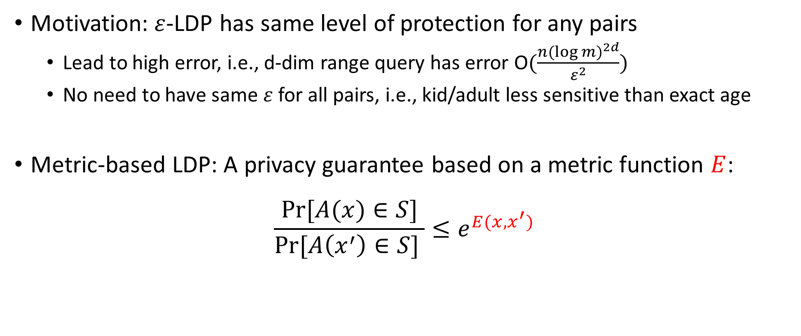
Metric-based LDP [1]
Motivation:$ε$-LDP has same level of protection for any pairs
Lead to high error, i.e., d-dim range query has error O$(\frac{n{(\log{m})}^{2d}}{ε^{2}})$
No need to have same $ε$ for all pairs, i.e., kid/adult less sensitive than exact age
Metric-based LDP: A privacy guarantee based on a metric function $E$:
$$\frac{Pr⁡[A(x)∈S]}{Pr⁡[A\left(x^{′}\right)∈S] }≤e^{E(x,x^{′})}$$
[1] M. Alvim, K. Chatzikokolakis, C. Palamidessi, and A. Pazii, “Local differential privacy on metric spaces: optimizing the trade-off with utility,” in Proceedings of the 31st IEEE Computer Security Foundations Symposium (CSF), 2018, pp. 262–267

Slide 7
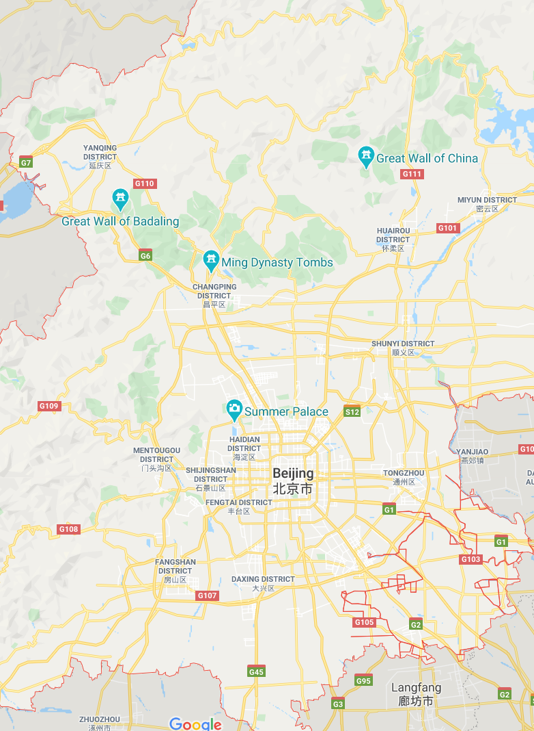
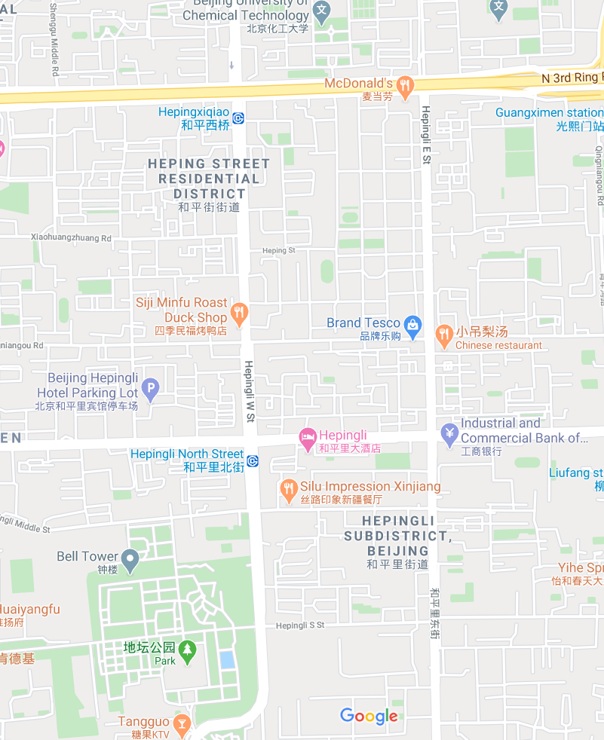


Metric-based LDP [1]
Motivation:$ε$-LDP has same level of protection for any pairs
Lead to high error, i.e., d-dim range query has error O$(\frac{n{(\log{m})}^{2d}}{ε^{2}})$
No need to have same $ε$ for all pairs, i.e., kid/adult less sensitive than exact age
Metric-based LDP: A privacy guarantee based on a metric function $E$:
$$\frac{Pr⁡[A(x)∈S]}{Pr⁡[A\left(x^{′}\right)∈S] }≤e^{E(x,x^{′})}$$
$$E\left(x,x^{′}\right)=ε$$
$$E\left(x,x^{′}\right)=2ε$$
Example：Stronger protection for closer pairs
[1] M. Alvim, K. Chatzikokolakis, C. Palamidessi, and A. Pazii, “Local differential privacy on metric spaces: optimizing the trade-off with utility,” in Proceedings of the 31st IEEE Computer Security Foundations Symposium (CSF), 2018, pp. 262–267

Slide 8
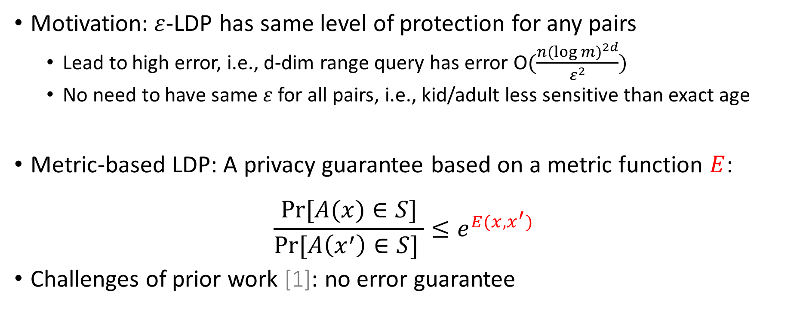
Metric-based LDP [1]
Motivation:$ε$-LDP has same level of protection for any pairs
Lead to high error, i.e., d-dim range query has error O$(\frac{n{(\log{m})}^{2d}}{ε^{2}})$
No need to have same $ε$ for all pairs, i.e., kid/adult less sensitive than exact age
Metric-based LDP: A privacy guarantee based on a metric function $E$:
$$\frac{Pr⁡[A(x)∈S]}{Pr⁡[A\left(x^{′}\right)∈S] }≤e^{E(x,x^{′})}$$
Challenges of prior work [1]: no error guarantee
[1] M. Alvim, K. Chatzikokolakis, C. Palamidessi, and A. Pazii, “Local differential privacy on metric spaces: optimizing the trade-off with utility,” in Proceedings of the 31st IEEE Computer Security Foundations Symposium (CSF), 2018, pp. 262–267

Slide 9
Research Problem
Design metric-LDP algorithm with error guarantee for following tasks:
Linear counting
Multi-dimensional range counting
Applications: quantile queries

Slide 10
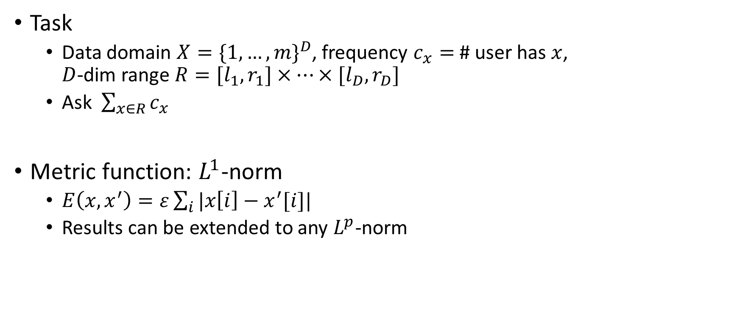
Multi-dimensional Range Query (MRQ)
Task
Data domain $X={\{1,…,m\}}^{D}$, frequency $c_{x}=$ # user has $x$, $D$-dim range $R=[l_{1},r_{1}]×⋯×[l_{D},r_{D}]$
Ask $\sum_{x∈R}{c_{x}}$
Metric function: $L^{1}$-norm
$E\left(x,x^{′}\right)=ε\sum_{i}{|x\left[i\right]−x^{′}[i]|}$
Results can be extended to any $L^{p}$-norm

Slide 11
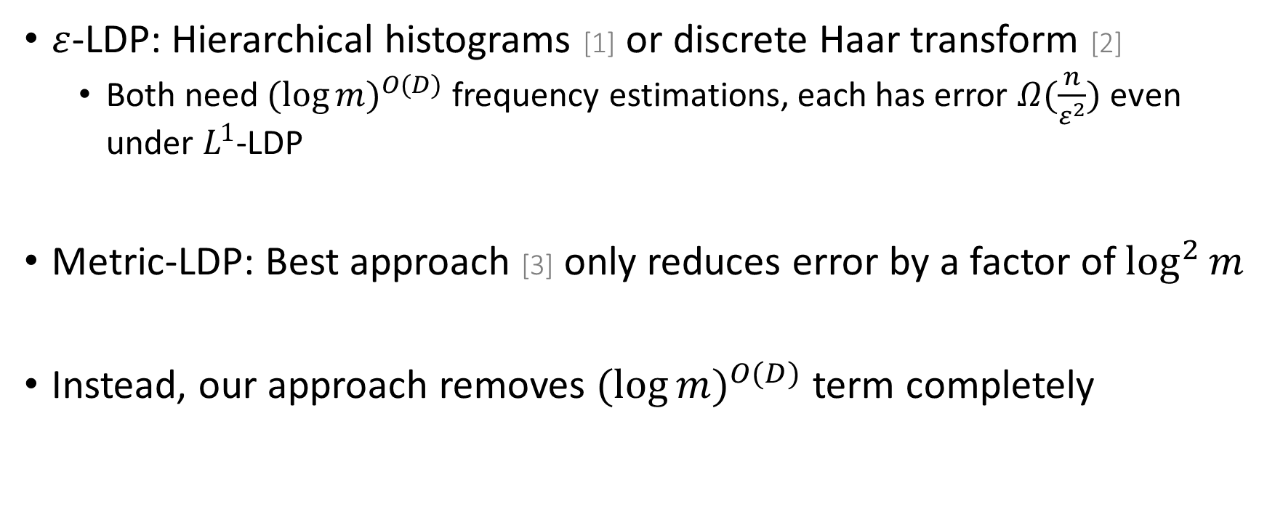
State-of-the-art
$ε$-LDP: Hierarchical histograms [1] or discrete Haar transform [2]
Both need ${(\log{m})}^{O(D)}$ frequency estimations, each has error $Ω(\frac{n}{ε^{2}})$ even under $L^{1}$-LDP
Metric-LDP: Best approach [3] only reduces error by a factor of $\log^{2}{m}$
Instead, our approach removes ${(\log{m})}^{O(D)}$ term completely
[1] T. Wang, B. Ding, J. Zhou, C. Hong, Z. Huang, N. Li, and S. Jha, “Answering multi-dimensional analytical queries under local differential privacy,” in Proceedings of the 2019 International Conference on Management of Data (SIGMOD), 2019, pp. 159–176.
[2] G. Cormode, T. Kulkarni, and D. Srivastava, “Answering range queries under local differential privacy,” PVLDB, vol. 12, no. 10, pp. 1126–1138, 2019.
[3] S. Haney, A. Machanavajjhala, and B. Ding, “Design of policy-aware differentially private algorithms,” PVLDB, vol. 9, no. 4, pp. 264–275, 2015.

Slide 12
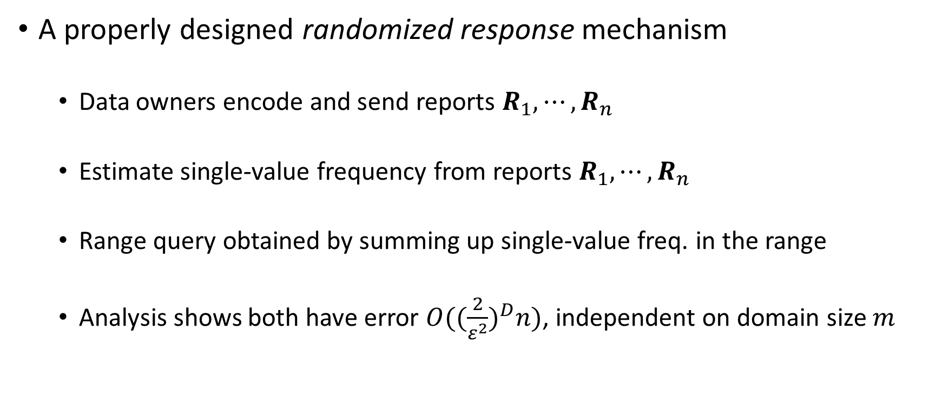
Our Approach
A properly designed randomized response mechanism
Data owners encode and send reports $R_{1},⋯,R_{n}$
Estimate single-value frequency from reports $R_{1},⋯,R_{n}$
Range query obtained by summing up single-value freq. in the range
Analysis shows both have error $O({(\frac{2}{ε^{2}})}^{D}n)$, independent on domain size $m$

Slide 13
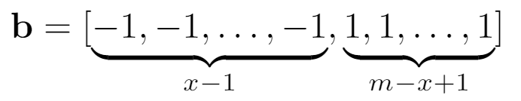


Encoding Algorithm for 1-dim
Each data owner has a $1$-dim value $x$
Encode $x$ into a length-$m$ vector $b$
Example: $m=3, x=2$
$$b=\left[−1, 1, 1\right]$$

Slide 14
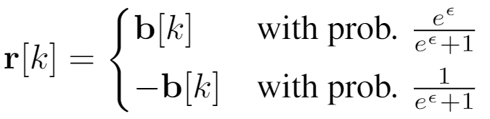


Encoding Algorithm for 1-dim
Each data owner has a $1$-dim value $x$
Encode $x$ into a length-$m$ vector $b$
Perturb $b$into $r$ with random flipping
Example: $m=3, x=2$
$$b=\left[−1, 1, 1\right]$$
Satisfy metric-LDP:
$$\frac{Pr⁡[A\left(x\right)=b]}{Pr⁡[A\left(x^{′}\right)=b] }≤{\left(\frac{\frac{e^{ε}}{e^{ε}+1}}{\frac{1}{e^{ε}+1}}\right)}^{\left|x−x^{′}\right|}=e^{ε\left|x−x^{′}\right|}$$

Slide 15

Encoding Algorithm for 1-dim
Each data owner has a $1$-dim value $x$
Encode $x$ into a length-$m$ vector $b$
Perturb $b$into $r$ with random flipping
Send reports $A\left(x\right)=r$
Example: $m=3, x=2$
$$b=\left[−1, 1, 1\right]$$
Satisfy metric-LDP:
$$\frac{Pr⁡[A\left(x\right)=b]}{Pr⁡[A\left(x^{′}\right)=b] }≤{\left(\frac{\frac{e^{ε}}{e^{ε}+1}}{\frac{1}{e^{ε}+1}}\right)}^{\left|x−x^{′}\right|}=e^{ε\left|x−x^{′}\right|}$$

Slide 16
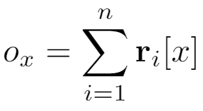


Estimation Algorithm for 1-dim
Data collector receives n reports $r_{1},⋯,r_{n}$
First compute a length-$m$ vector $o={[o_{1},⋯,o_{m}]}^{T}$
Example: $m=3, n=3$
Suppose
$$r_{1}=\left[−1, 1, 1\right]$$
$$r_{2}=\left[1, −1, 1\right]$$
$$r_{3}=\left[1, 1, −1\right]$$
$o_{1}=r_{1}\left[1\right]+r_{2}\left[1\right]$+ $r_{3}\left[1\right]=−1+1+1=1$
$$o_{2}=1−1+1=1$$
$$o_{1}=1+1−1=1$$
So $o=[1, 1, 1]$

Slide 17
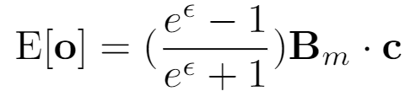
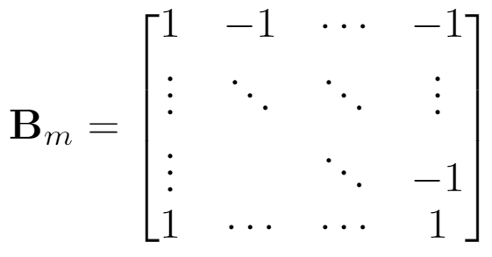

Estimation Algorithm for 1-dim
Data collector receives n reports $r_{1},⋯,r_{n}$
First compute a length-$m$ vector $o={[o_{1},⋯,o_{m}]}^{T}$
There exists relation between $o$ and frequency vector $c$ where $B_{m}$ is $m×m$:

Slide 18
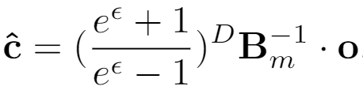
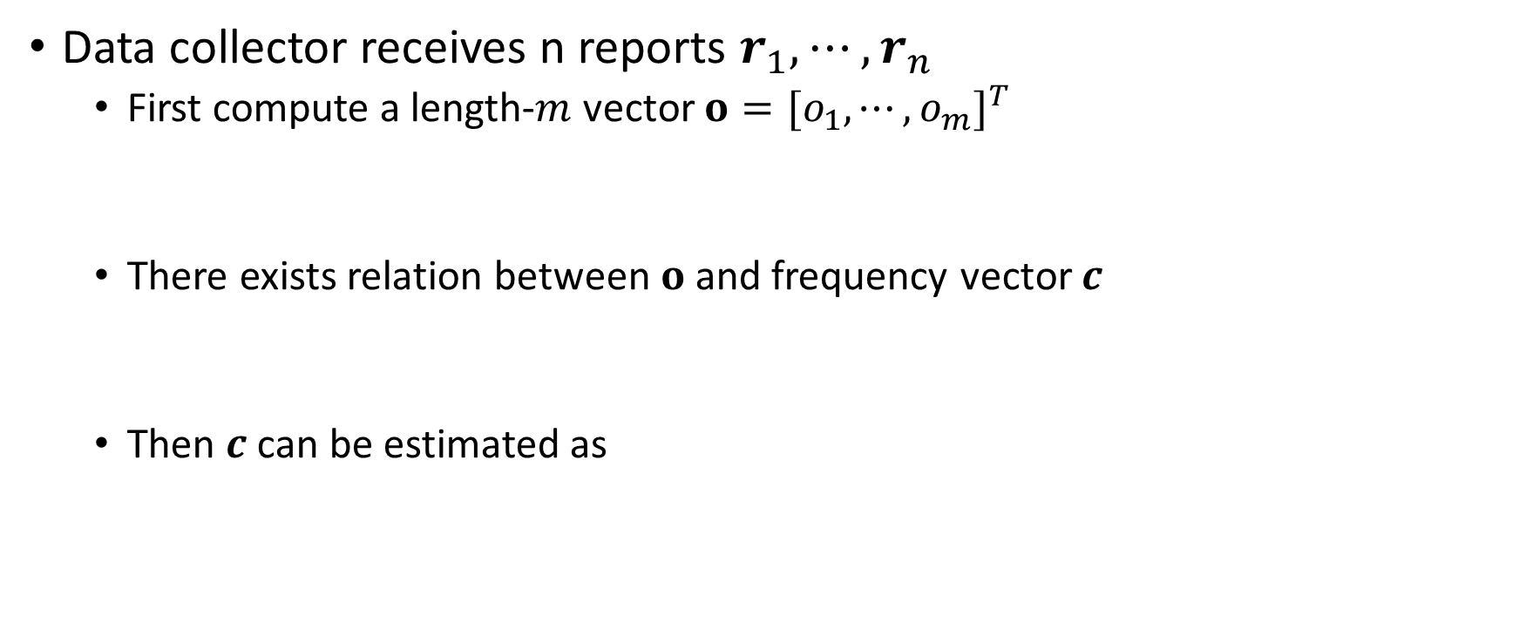
Estimation Algorithm for 1-dim
Data collector receives n reports $r_{1},⋯,r_{n}$
First compute a length-$m$ vector $o={[o_{1},⋯,o_{m}]}^{T}$
There exists relation between $o$ and frequency vector $c$
Then $c$ can be estimated as

Slide 19
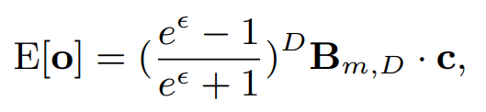
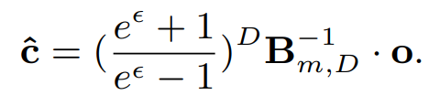
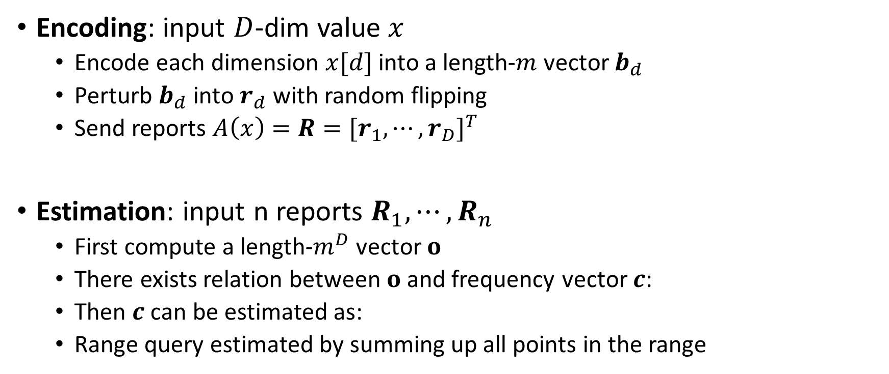
Algorithm for D-dim
Encoding: input $D$-dim value $x$
Encode each dimension $x[d]$ into a length-$m$ vector $b_{d}$
Perturb $b_{d}$ into $r_{d}$ with random flipping
Send reports $A\left(x\right)=R={[r_{1},⋯,r_{D}]}^{T}$
Estimation: input n reports $R_{1},⋯,R_{n}$
First compute a length-$m^{D}$ vector $o$
There exists relation between $o$ and frequency vector $c$:
Then $c$ can be estimated as:
Range query estimated by summing up all points in the range

Slide 20
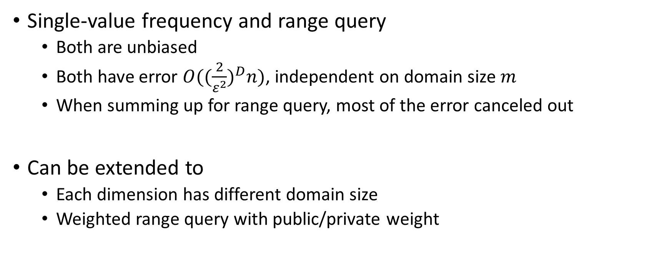
Analysis of Our Approach
Single-value frequency and range query
Both are unbiased
Both have error $O({(\frac{2}{ε^{2}})}^{D}n)$, independent on domain size $m$
When summing up for range query, most of the error canceled out
Can be extended to
Each dimension has different domain size
Weighted range query with public/private weight

Slide 21
Summary
Algorithms with provable error guarantee under metric-LDP, for
Linear counting query
Multi-dimensional range query
Applications: quantile queries
Expected error of our scheme is independent on domain size, and significantly improves the state-of-the-art

Slide 23
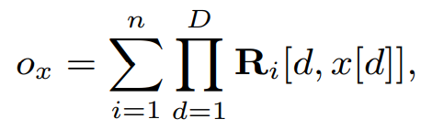
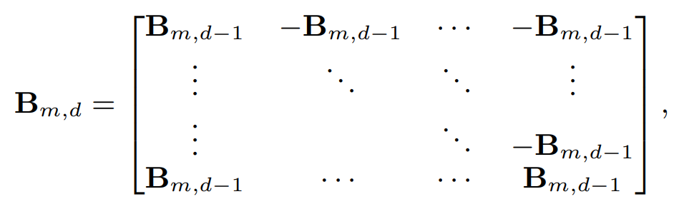
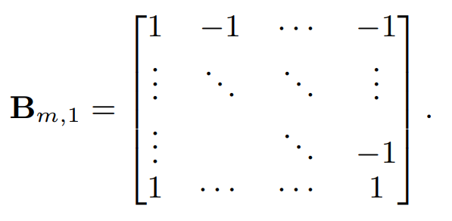


Estimation Algorithm for D-dim
Data collector receives n reports $R_{1},⋯,R_{n}$
First compute a length-$m^{D}$ vector $o={[o_{1},⋯,o_{m^{D}}]}^{T}$
There exists relation between $o$ and frequency vector $c$ where $B_{m,D}$ is $m^{D}×m^{D}$and satisfies
Example:
For $x=[1,1]$
$$o_{x}=R_{1}\left[1,1\right]R_{1}\left[2,1\right]+R_{2}[1,1]R_{2}[2,1]$$

Slide 24

Estimation Algorithm for D-dim
Data collector receives n reports $R_{1},⋯,R_{n}$
First compute a length-$m^{D}$ vector $o={[o_{1},⋯,o_{m^{D}}]}^{T}$
There exists relation between $o$ and frequency vector $c$
Then $c$ can be estimated as

Slide 25
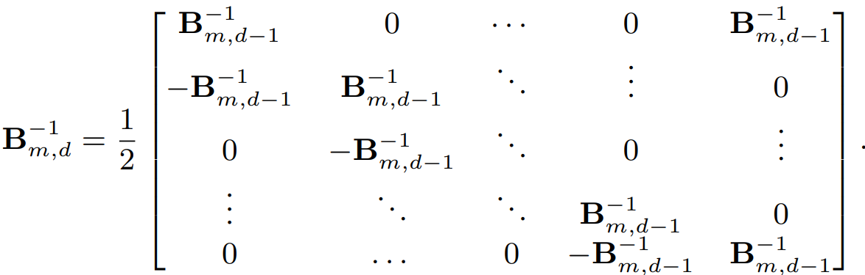
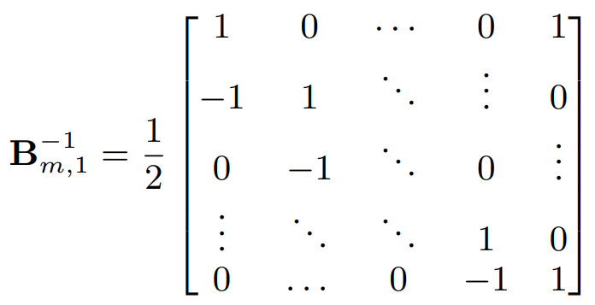


Estimation Algorithm for D-dim
$B_{m,D}^{−1}$ can be computed efficiently:
Data collector receives n reports $R_{1},⋯,R_{n}$
First compute a length-$m^{D}$ vector $o={[o_{1},⋯,o_{m^{D}}]}^{T}$ where
There exists relation between $o$ and frequency vector $c$
Then $c$ can be estimated as

Slide 26
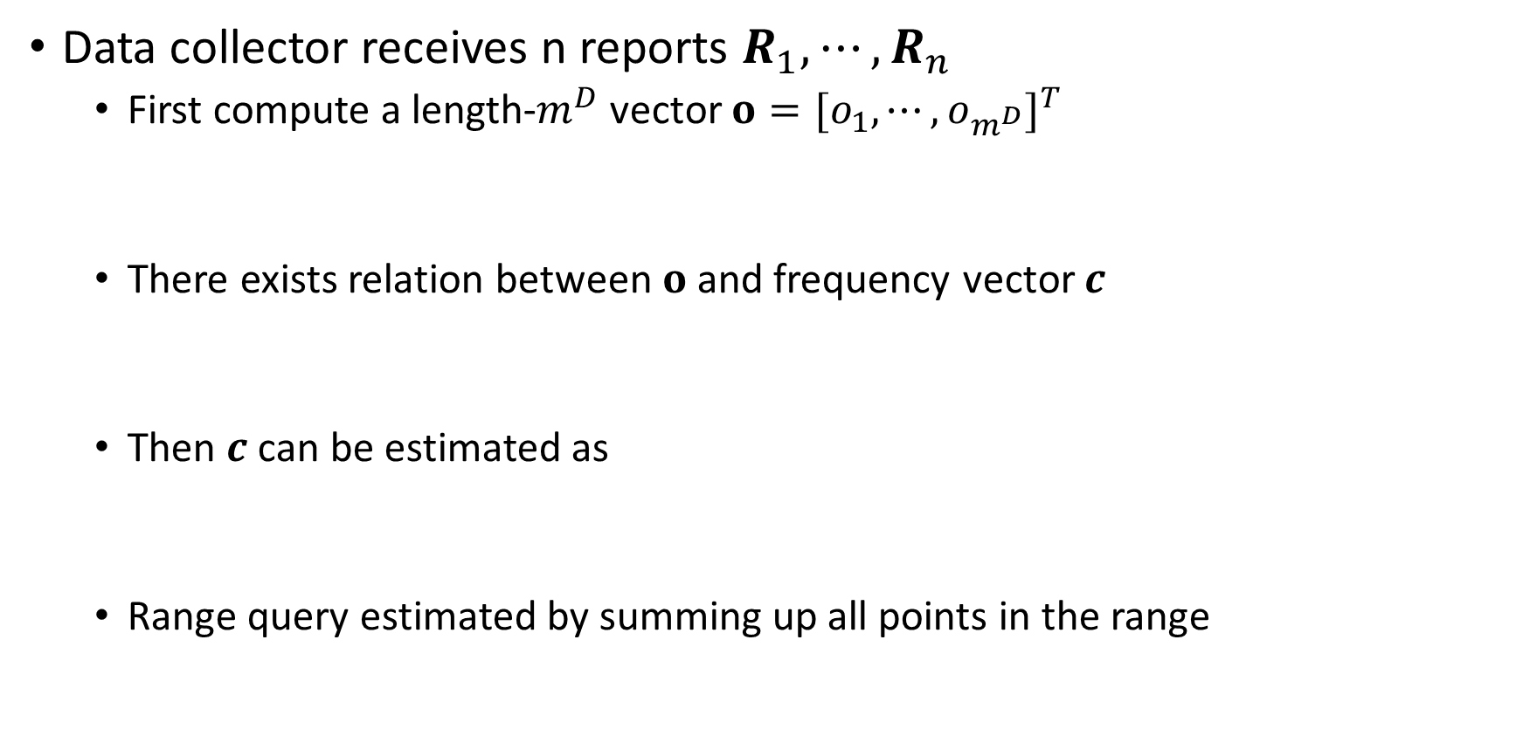
Estimation Algorithm for D-dim
Data collector receives n reports $R_{1},⋯,R_{n}$
First compute a length-$m^{D}$ vector $o={[o_{1},⋯,o_{m^{D}}]}^{T}$
There exists relation between $o$ and frequency vector $c$
Then $c$ can be estimated as
Range query estimated by summing up all points in the range

