Slide 1
Approximate Query Processing (AQP)
SELECT SUM(Price) WHERE Country = ‘CHINA’
Large Data
sampler
small sample

Slide 2


AQP: using Sampler
Data
Sampler
Item | Price | Country
1 | 0 | CHINA
2 | 50 | CA
3 | 300 | CHINA
4 | 100 | CHINA
…
Prob.
0.01
0.02
0.01
0.05
…
Item | Price | Country | Prob.
4 | 100 | CHINA | 0.05
2 | 50 | CA | 0.02
1 | 0 | CHINA | 0.01
Sample size $n$
$$q\left(S\right)=\frac{1}{n}\sum_{i=1}^{n}{\frac{y_{i}}{p_{i}}}$$
Estimator:

Slide 3
AQP: when Multiple Samplers Available
SELECT SUM(Price) WHERE Country = ‘CHINA’
Large Data
Sampler 1
Sample 1
Sampler 2
Sample 2
Sampler 3
Sample 3

Slide 4
Multiple Samplers: One Size Does Not Fit All
Uniform sampler: each tuple sampled with equal prob.
Optimized for COUNT
Measure-biased sampler: prob. is proportional to measure values
Optimized for SUM
Stratified sampler: prob. is equal within each group
Optimized for GROUP-BY
Data
Item | Price | Country
1 | 10 | CHINA
2 | 50 | CA
3 | 300 | CHINA
4 | 100 | CHINA
…
Prob.
0.01
0.01
0.01
0.01
…
Prob.
0.001
0.005
0.03
0.01
…
Prob.
0.02
0.01
0.02
0.01
…
Which sampler(s) should we use?
How should we combine them?

Slide 5




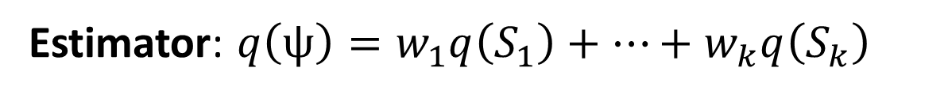












Sampler Combination Problem (SamComb)
$n$
$n_{1}$
$n_{2}$
$n_{3}$
$n_{i}$
$n_{k}$
$${Sampler}_{1}$$
$${Sampler}_{2}$$
$${Sampler}_{3}$$
…
$${Sampler}_{k}$$
$$q(S_{1})$$
$$q(S_{2})$$
$$q(S_{3})$$
$$q(S_{k})$$
Estimator: $q\left(ψ\right)=w_{1}q\left(S_{1}\right)+…+w_{k}q\left(S_{k}\right)$
Goal: minimize $var(q\left(ψ\right))$
Variables: weights $w_{1}$, $w_{2}$, …, $w_{k}$ s.t. $\sum_{i}{w_{i}}=1$;
samples $S_{1}$, $S_{2}$, …, $S_{k}$

Slide 6
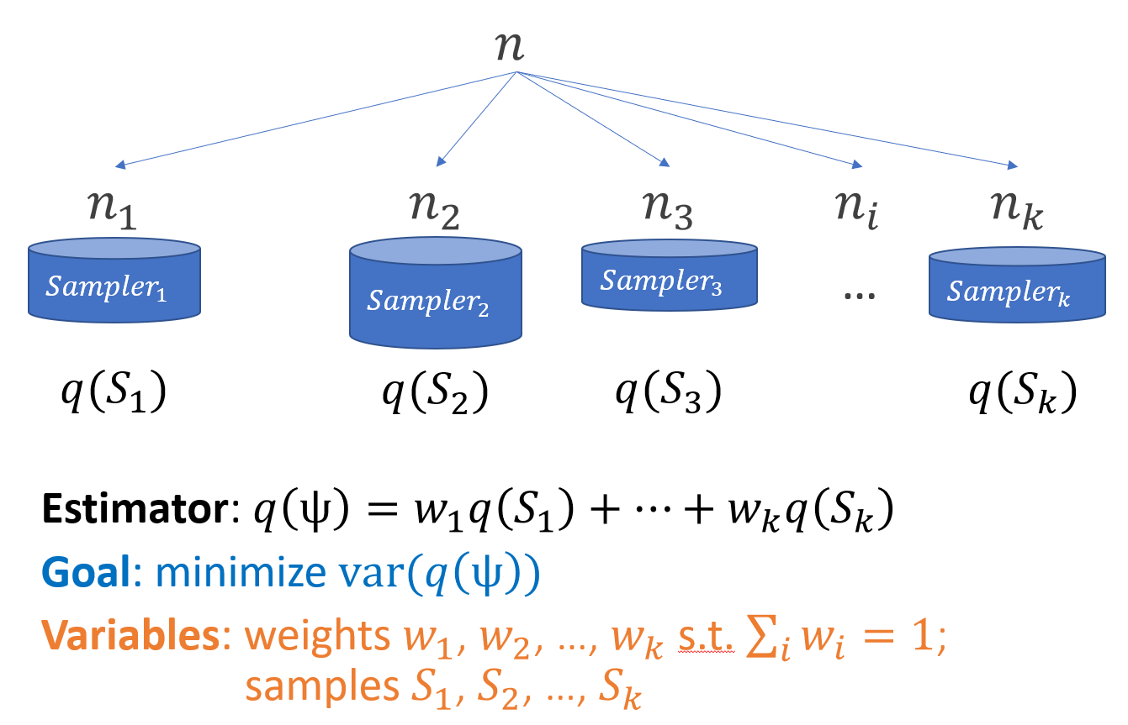
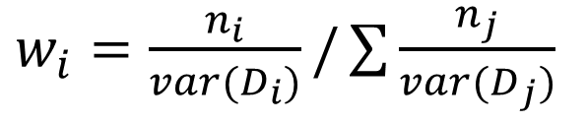


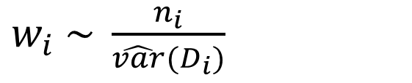
SamComb: two Sub-Problems
Optimal allocation
$w_{i}=\frac{n_{i}}{var(D_{i})}/\sum{\frac{n_{j}}{var(D_{j})}}$
Pseudo-optimal allocation
Budget allocation: how to allocate sample budget$n_{i}=\left|S_{i}\right|$ for each sampler?
Weight allocation: given samples, how to allocate weights $w_{i}$ in the estimator?
$w_{i} \sim \frac{n_{i}}{\hat{var}(D_{i})}$
Prop-to-size allocation
$w_{i} \sim n_{i}$

Slide 7


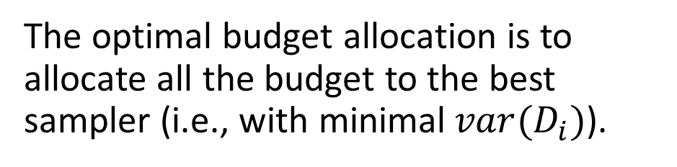
SamComb: two Sub-Problems
The optimal budget allocation is to allocate all the budget to the best sampler (i.e., with minimal$var(D_{i})$).
Don’t know the best sampler in advance?
Budget allocation: how to allocate sample budget$n_{i}=\left|S_{i}\right|$ for each sampler?
Weight allocation: given samples, how to allocate weights $w_{i}$ in the estimator?
Use some budget to estimate the sampler quality
Model as multi-armed bandit (MAB) problem

Slide 8



SamComb-MAP: Exploration & Exploitation
$$S_{1}$$
$$S_{2}$$
…
$$S_{k}$$
Initialization Phase
Initial
Initial
Initial
Exploration
use budget to explore the quality of each sampler
Exploitation
allocate budget to the empirically best sampler
Allocation Phase
Selected
Unselected
Unselected
Selected
Unselected
Unselected
Unselected
Unselected
Selected
…
…
…
Selected
Unselected
Unselected
Combination
$$q\left(S\right)= w_{1}q\left(S_{1}\right)+ …+w_{k}q\left(S_{k}\right)$$

Slide 9
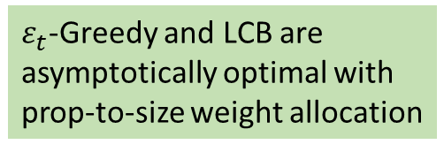
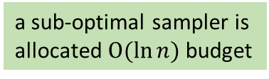
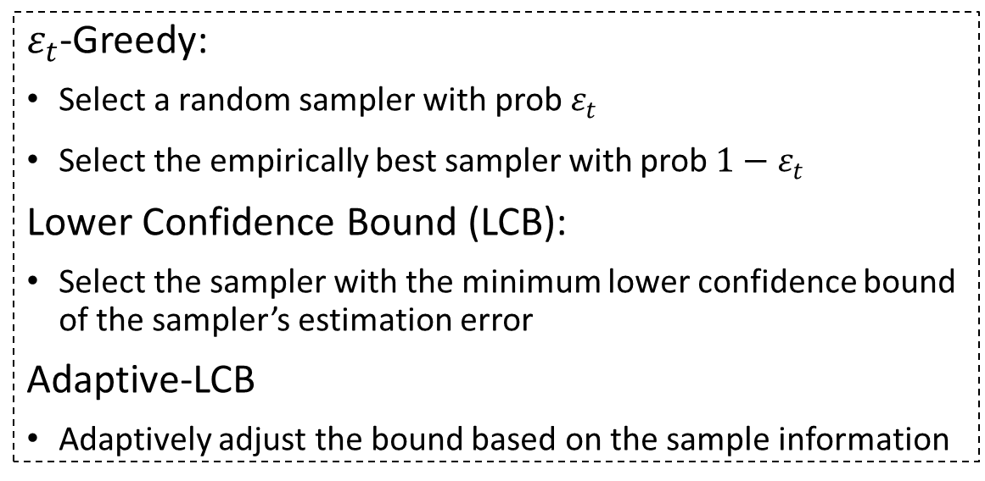
SamComb-MAP: Exploration & Exploitation
$$S_{1}$$
$$S_{2}$$
…
$$S_{k}$$
Initialization Phase
Initial
Initial
Initial
Allocation Phase
$ε_{t}$-Greedy:
Select a random sampler with prob $ε_{t}$
Select the empirically best sampler with prob ${1−ε}_{t}$
Lower Confidence Bound (LCB):
Select the sampler with the minimum lower confidence bound of the sampler’s estimation error
Adaptive-LCB
Adaptively adjust the bound based on the sample information
a sub-optimal sampler is allocated $O(\ln{n})$ budget
$ε_{t}$-Greedy and LCB are asymptotically optimal with prop-to-size weight allocation
Combination
$$q\left(S\right)= w_{1}q\left(S_{1}\right)+ …+w_{k}q\left(S_{k}\right)$$

Slide 10
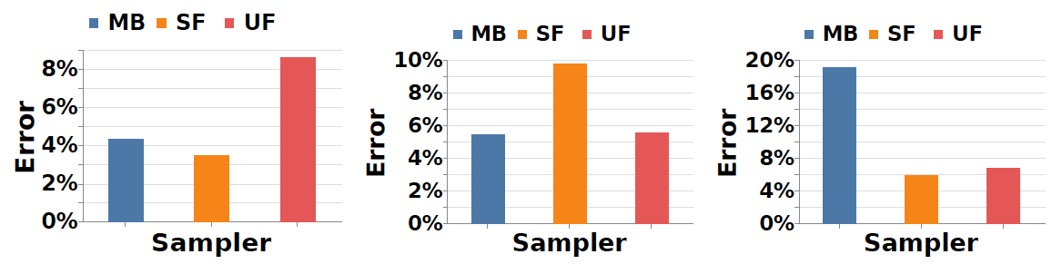
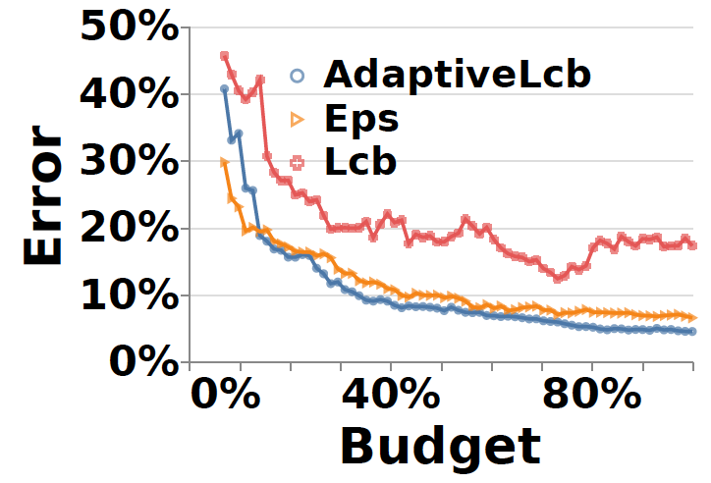
Experiments
TPCH-Skew benchmark:
one size does not fit all
SamComb strategy:
adaptively combine multiple samplers to improve the estimation quality
allocation + combination: no budget waste

