Slide 1

Efficient Estimation of Inclusion Coefficient using HyperLogLog Sketches
Azade Nazi, Bolin Ding, Vivek Narasayya, Surajit Chaudhuri

Slide 2
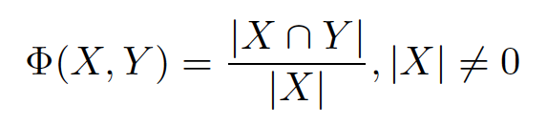

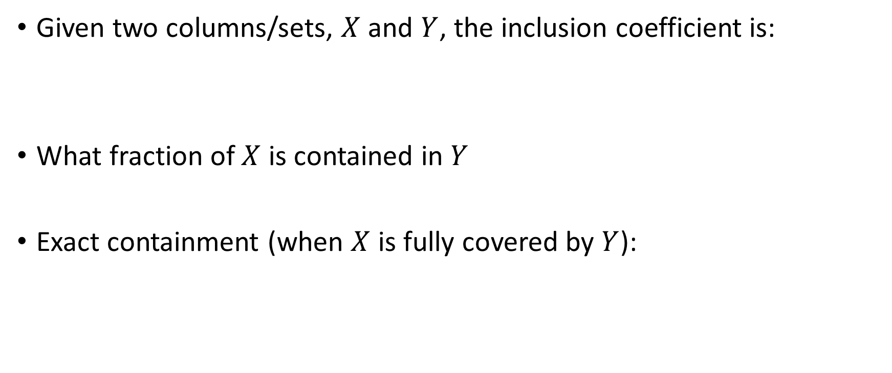
Inclusion Coefficient (INC)
Given two columns/sets, $X$ and $Y$, the inclusion coefficient is:
What fraction of $X$ is contained in $Y$
Exact containment (when $X$ is fully covered by $Y$):

Slide 3
Applications
Data integration
Relaxed containment measure
Detecting data quality issues such as missing values
Foreign-key and FD detection
INC is an important feature in detection algorithms
For example, [Rostin et al, 2009] and [Chen et al., 2014]

Slide 4



Exact vs. Approximate INC Computation
Exact INC computation is expensive
Full scan/join of data [Lopes et al., 2002]
Too expensive for large database schema and tables
Worse if to be computed for all pairs of columns (foreign-key detection)
Approximate (estimated) INC: sketch-based approaches
Based on Bottom-k sketch [Cohen and Kaplan, 2007]: Jaccard -> INC
This paper: better accuracy with error bounds
(based on Hyperloglog sketch [Flajolet et al., 2007])
[Zhang et al., 2010]

Slide 5

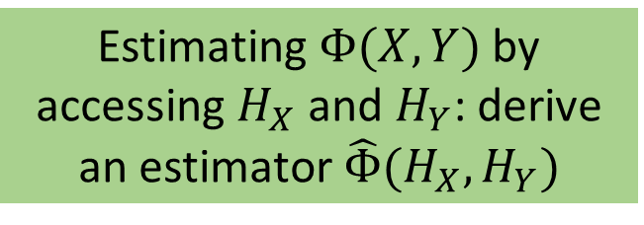




Problem Definition
Estimating INC using per-column sketches
Two goals
The error $\left|Φ\left(X,Y\right)−\hat{Φ}\right|$ bounded
Sketches $H_{X}$ and $H_{Y}$ are small
$$X$$
$$H_{X}$$
$$Y$$
$$H_{Y}$$
Estimating $Φ(X,Y)$ by accessing $H_{X}$ and $H_{Y}$: derive an estimator $\hat{Φ}(H_{X},H_{Y})$
…
…

Slide 6

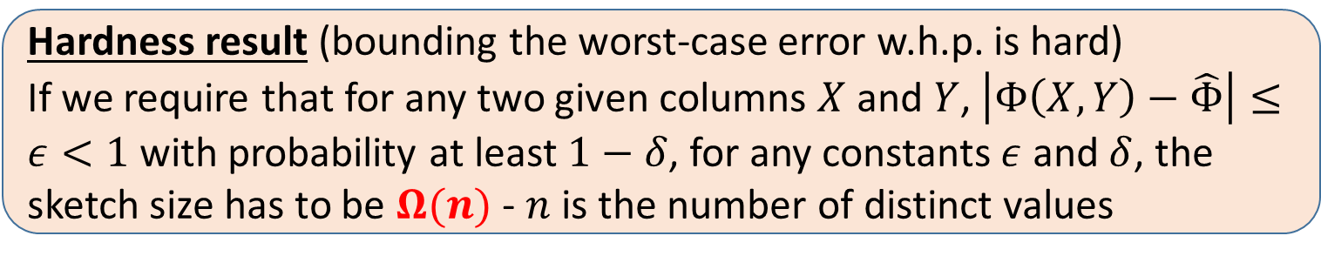
Problem Definition
Estimating INC using per-column sketches
Two goals
The error $\left|Φ\left(X,Y\right)−\hat{Φ}\right|$ bounded
Sketches $H_{X}$ and $H_{Y}$ are small
Bad news: error cannot be bounded with sublinear-size sketches
Estimating $Φ(X,Y)$ by accessing $H_{X}$ and $H_{Y}$: derive an estimator $\hat{Φ}(H_{X},H_{Y})$
Hardness result (bounding the worst-case error w.h.p. is hard)
If we require that for any two given columns $X$ and $Y$, $\left|Φ\left(X,Y\right)−\hat{Φ}\right|≤ε<1$ with probability at least $1−δ$, for any constants $ε$ and $δ$, the sketch size has to be $Ω(n)$ - $n$ is the number of distinct values

Slide 7
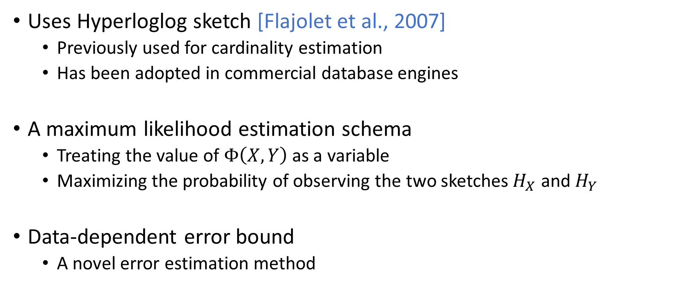
Our Approach: BML (Binomial Mean-Lookup)
Uses Hyperloglog sketch [Flajolet et al., 2007]
Previously used for cardinality estimation
Has been adopted in commercial database engines
A maximum likelihood estimation schema
Treating the value of $Φ\left(X,Y\right)$ as a variable
Maximizing the probability of observing the two sketches $H_{X}$ and $H_{Y}$
Data-dependent error bound
A novel error estimation method

Slide 8
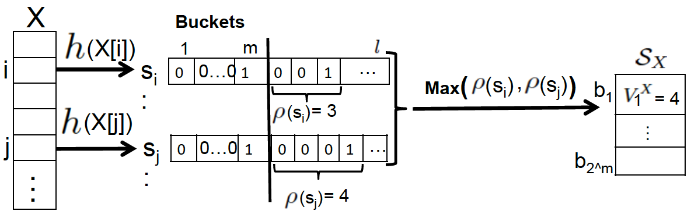
Hyperloglog Sketch Construction (Recap)

Slide 9

Hyperloglog Sketch Construction (Recap)
Find the index $ρ(s)$ of the first “1” in the hash value $s$

Slide 10
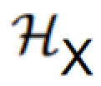
Hyperloglog Sketch Construction (Recap)
Find the index $ρ(s)$ of the first “1” in the hash value $s$

Slide 11
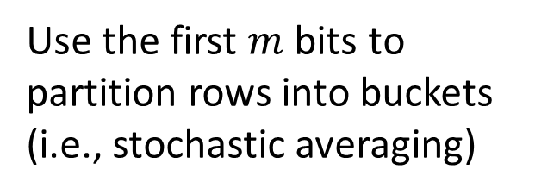
Hyperloglog Sketch Construction (Recap)
Use the first $m$ bits to partition rows into buckets (i.e., stochastic averaging)

Slide 12
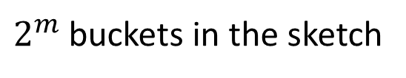
Hyperloglog Sketch Construction (Recap)
Use the first $m$ bits to partition rows into buckets (i.e., stochastic averaging)
$2^{m}$ buckets in the sketch

Slide 13
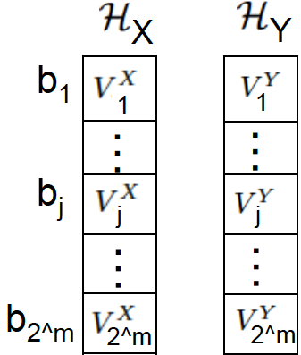
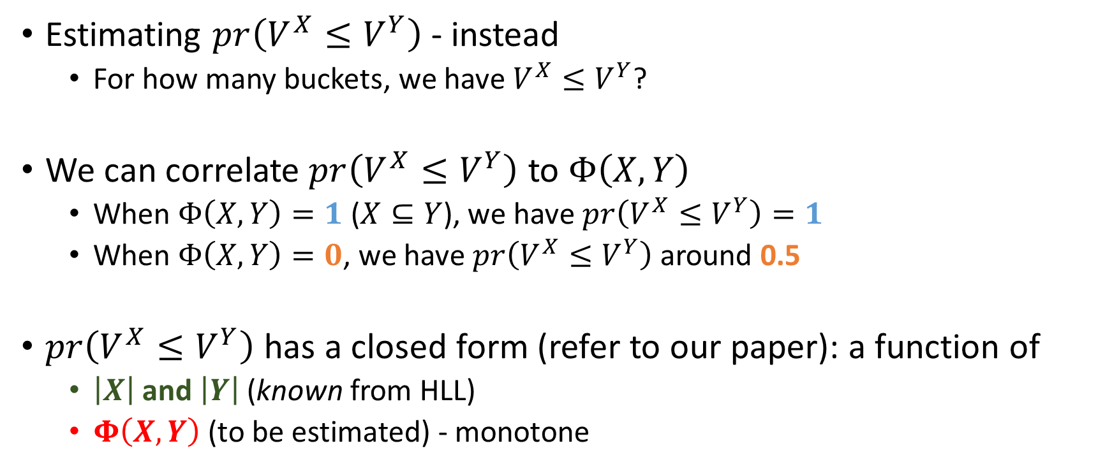

Key Ideas: Estimating INC from HLL Sketches
Estimating $pr\left(V^{X}≤V^{Y}\right)$ - instead
For how many buckets, we have $V^{X}≤V^{Y}$?
We can correlate $pr\left(V^{X}≤V^{Y}\right)$ to $Φ\left(X,Y\right)$
When $Φ\left(X,Y\right)=1$ ($X⊆Y$), we have $pr\left(V^{X}≤V^{Y}\right)=1$
When $Φ\left(X,Y\right)=0$, we have $pr\left(V^{X}≤V^{Y}\right)$ around 0.5
$pr\left(V^{X}≤V^{Y}\right)$ has a closed form (refer to our paper): a function of
$\left|X\right|$ and $\left|Y\right|$ (known from HLL)
$Φ\left(X,Y\right)$ (to be estimated) - monotone
?
$$≤$$

Slide 14
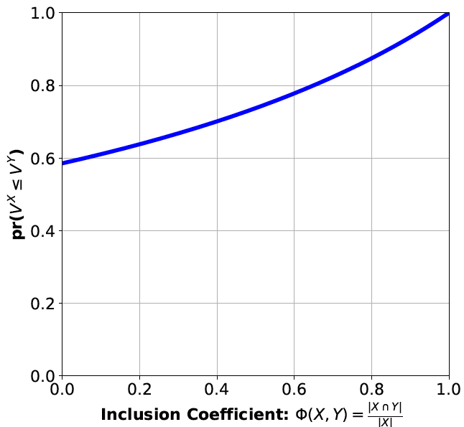





Binomial Mean-Lookup Estimator
Estimated $pr\left(V^{X}≤V^{Y}\right)$ = $\hat{P}$
$$pr\left(V^{X}≤V^{Y}\right)=f\left(Φ\left(X,Y\right)\right)$$
Binomial Mean Estimation
$$\hat{P}=$$
?
$$≤$$
Lookup
$$\hat{Φ}≈0.62$$

Slide 15
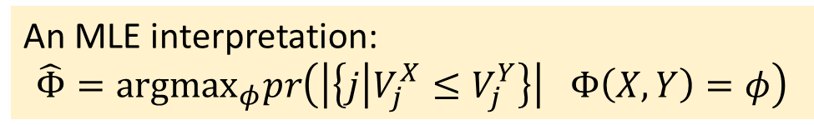
Binomial Mean-Lookup Estimator
Estimated $pr\left(V^{X}≤V^{Y}\right)$ = $\hat{P}$
$$pr\left(V^{X}≤V^{Y}\right)=f\left(Φ\left(X,Y\right)\right)$$
Binomial Mean Estimation
$$\hat{P}=$$
?
$$≤$$
Lookup
An MLE interpretation:
$$\hat{Φ}=argmax_{φ}pr\left(\left|\left\{j | V_{j}^{X}≤V_{j}^{Y}\right\}\right| Φ\left(X,Y\right)=φ\right)$$
$$\hat{Φ}≈0.62$$

Slide 16

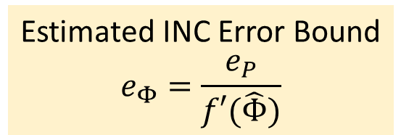



Error Bound Estimation
Estimated $pr\left(V^{X}≤V^{Y}\right)$ = $\hat{P}$
$$pr\left(V^{X}≤V^{Y}\right)=f\left(Φ\left(X,Y\right)\right)$$
Binomial Mean Estimation
$$e_{P}$$
$$f′(0.62)≈\frac{e_{P}}{e_{Φ}}$$
$$\hat{P}=$$
?
Chernoff bound
$$≤$$
Lookup
Error $e_{P}$
$$e_{Φ}$$
Estimated INC Error Bound
$$e_{Φ}=\frac{e_{P}}{f′(\hat{Φ})}$$
$$\hat{Φ}≈0.62$$

Slide 17
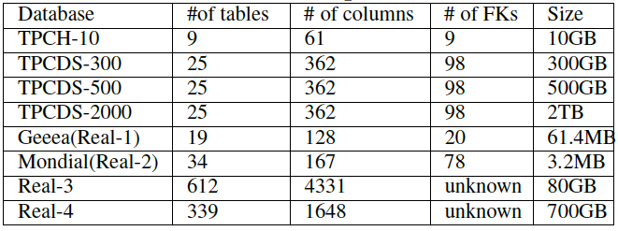
Experiments
Datasets

Slide 18
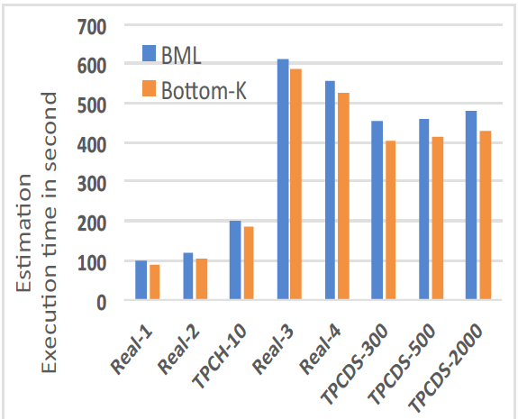
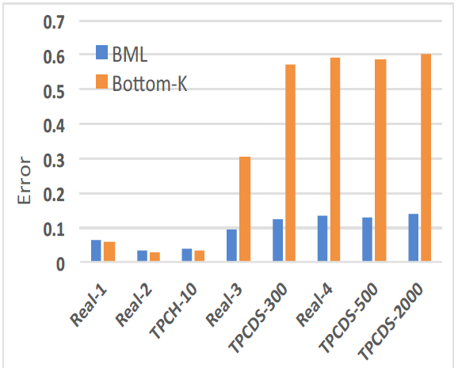
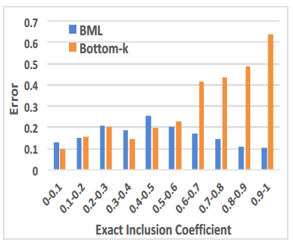
Experiments
Execution Time
Average Error
Average Error (TPCDS-300)
k = 1536

Slide 19
Experiments
Execution Time
Average Error
Average Error (TPCDS-300)
k = 1536

Slide 20
Experiments
Execution Time
Average Error
Average Error (TPCDS-300)
k = 1536

Slide 21
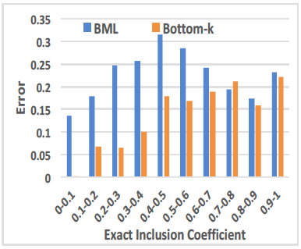
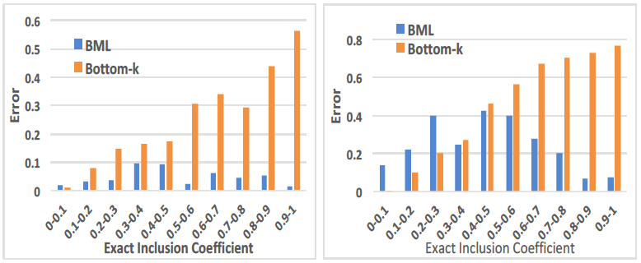
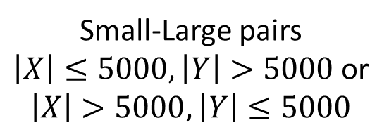
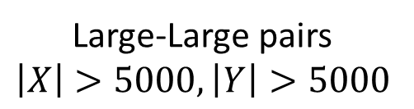
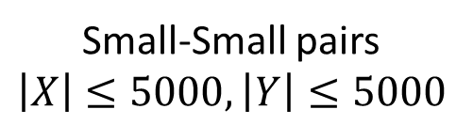
Experiments: Small vs. Large Columns
Small-Small pairs
$$\left|X\right|≤5000, \left|Y\right|≤5000$$
Large-Large pairs
$$\left|X\right|>5000, \left|Y\right|>5000$$
Small-Large pairs
$\left|X\right|≤5000, \left|Y\right|>5000$ or
$$\left|X\right|>5000, \left|Y\right|≤5000$$

Slide 22
Experiments: Small vs. Large Columns
Small-Small pairs
$$\left|X\right|≤5000, \left|Y\right|≤5000$$
Large-Large pairs
$$\left|X\right|>5000, \left|Y\right|>5000$$
Small-Large pairs
$\left|X\right|≤5000, \left|Y\right|>5000$ or
$$\left|X\right|>5000, \left|Y\right|≤5000$$

Slide 23
Experiments: Small vs. Large Columns
Small-Small pairs
$$\left|X\right|≤5000, \left|Y\right|≤5000$$
Large-Large pairs
$$\left|X\right|>5000, \left|Y\right|>5000$$
Small-Large pairs
$\left|X\right|≤5000, \left|Y\right|>5000$ or
$$\left|X\right|>5000, \left|Y\right|≤5000$$

Slide 24
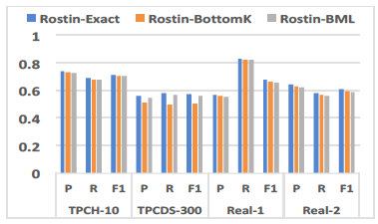
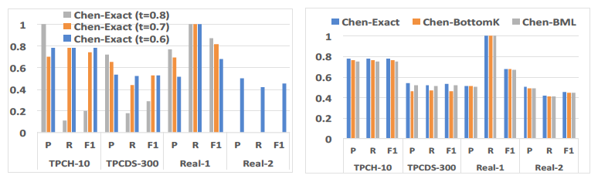
Experiments: Foreign Key Detection
Plug estimated INC into [Rostin et al, 2009] and [Chen et al., 2014]

Slide 25
Conclusion and Future Work
BML estimator for INC using Hyperloglog sketches
A Maximum-Likelihood estimation schema
A novel error estimation method to produce data-dependent bound
Better accuracy than Bottom-k and can be used for FK detection
To be extended for other correlation measures

Slide 26
Thank You! Questions? Comments?

