Slide 1
FlashP: An Analytical Pipeline for Real-time Forecasting of Time-Series Relational Data
Shuyuan Yan¹, Bolin Ding¹, Wei Guo¹, Jingren Zhou¹,
Zhewei Wei², Xiaowei Jiang¹, and Sheng Xu¹
¹Alibaba Group
²Renmin University of China

Slide 2
Outline
Real-time Forecasting Task
Forecasting with Noisy Input
Generalized Weighted Sampler
Experiments

Slide 3
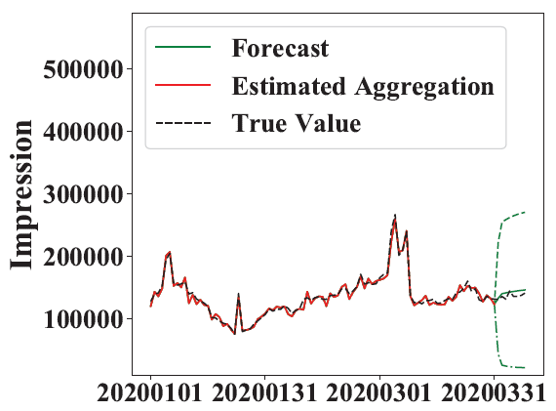
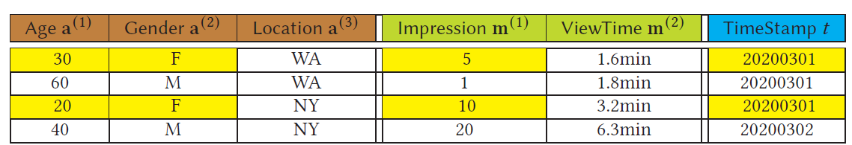

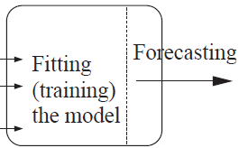
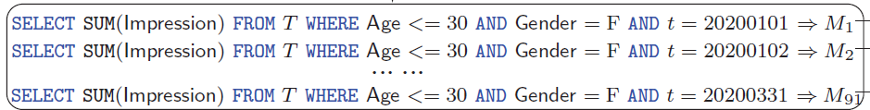
Real-time Forecasting Task
Decision making on online advertising platform
Decide bidding strategy based on the forecasting of Impression
Rewriting it into OLAP aggregation queries
Fitting a forecasting model
Forecasting for a future time stamp

Slide 4
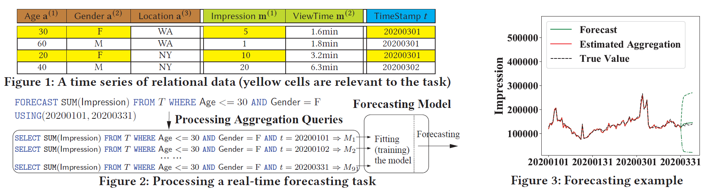
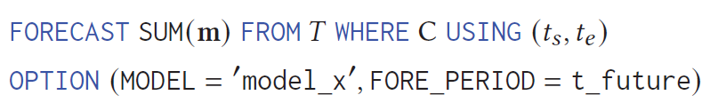
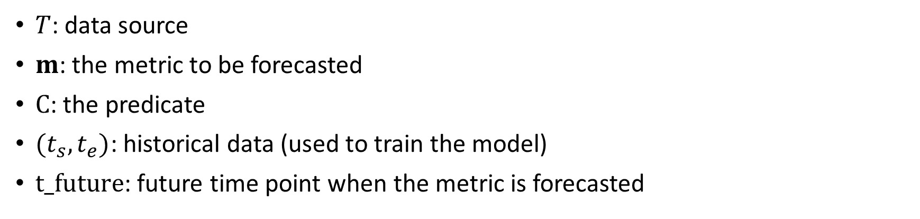
Real-time Forecasting Task
Bottleneck: speedup via sampling?
$T$: data source
$m$: the metric to be forecasted
$C$: the predicate
$(t_{s},t_{e})$: historical data (used to train the model)
$t_future$: future time point when the metric is forecasted

Slide 5
Outline
Real-time Forecasting Task
Forecasting with Noisy Input
Generalized Weighted Sampler
Experiments

Slide 6
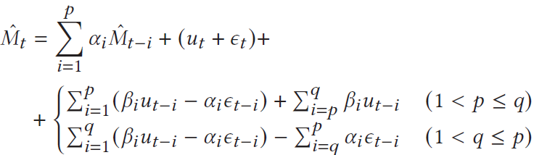
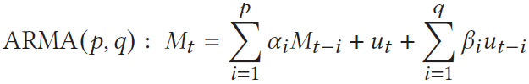
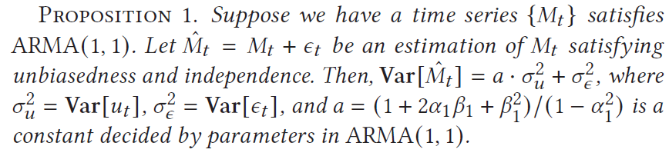
Forecasting with Noisy Input
A simple ARMA model
Prediction error is proportional to a linear combination of model noise and sampling noise
with noisy data points
Historical data points:
from aggregation queries
Model noise
Sampling noise
Noisy data points: from aggregation queries on samples

Slide 7
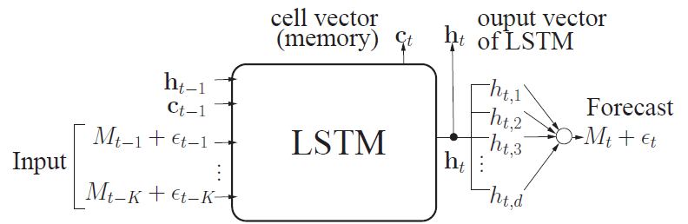
Forecasting with Noisy Input
A more complex forecasting model based on LSTM
Prediction error is proportional to a linear combination of model noise and sampling noise
Sampling noise

Slide 8
Outline
Real-time Forecasting Task
Forecasting with Noisy Input
Generalized Weighted Sampler
Experiments

Slide 9
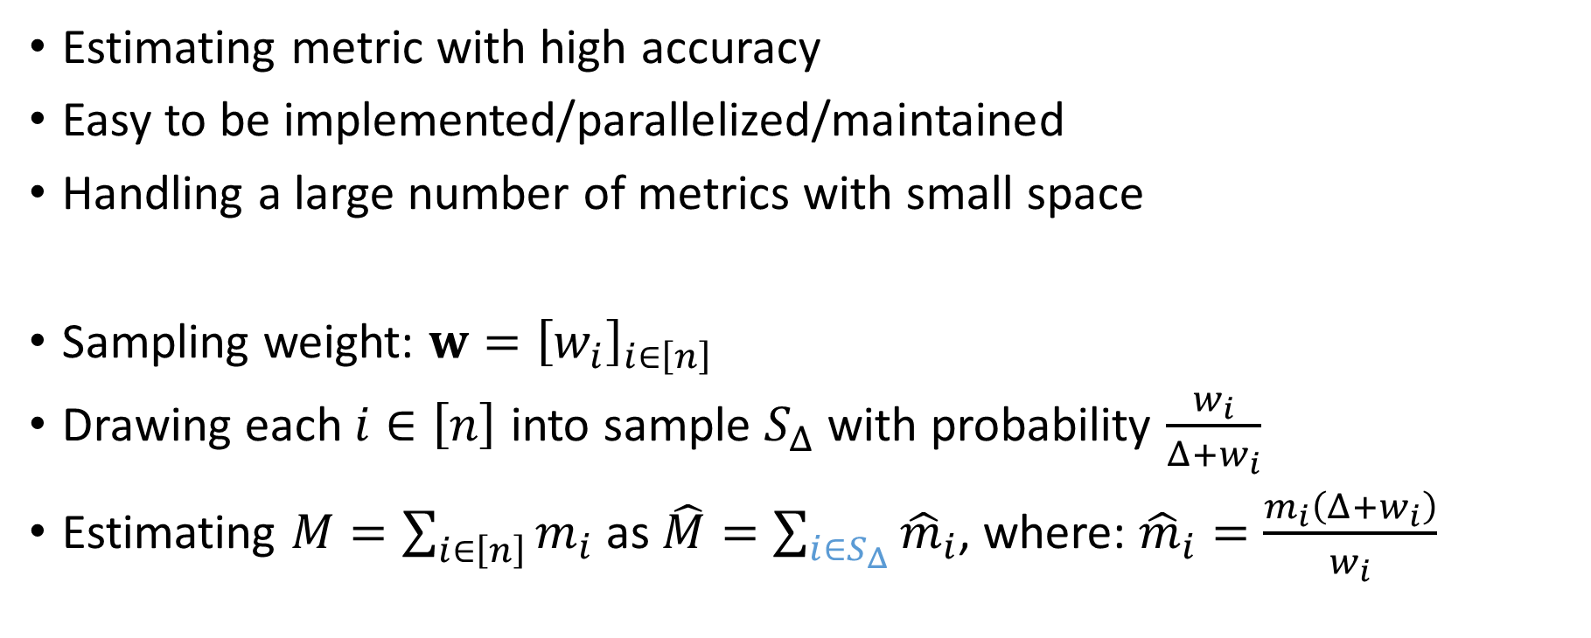
Generalized Weighted Sampler (GSW)
Estimating metric with high accuracy
Easy to be implemented/parallelized/maintained
Handling a large number of metrics with small space
Sampling weight: $w={\left[w_{i}\right]}_{i∈\left[n\right]}$
Drawing each $i∈\left[n\right]$ into sample $S_{Δ}$ with probability $\frac{w_{i}}{Δ+w_{i}}$
Estimating $M=\sum_{i∈\left[n\right]}{m_{i}}$ as $\hat{M}=\sum_{i∈S_{Δ}}{{\hat{m}}_{i}}$, where: ${\hat{m}}_{i}=\frac{m_{i}\left(Δ+w_{i}\right)}{w_{i}}$

Slide 10
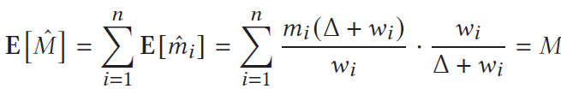
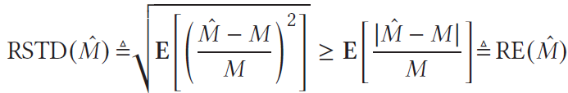
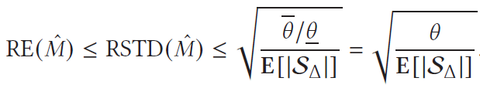
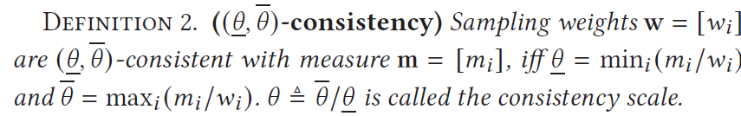

Generalized Weighted Sampler (GSW)
Estimating $M=\sum_{i∈\left[n\right]}{m_{i}}$ as $\hat{M}=\sum_{i∈S_{Δ}}{{\hat{m}}_{i}}$, where: ${\hat{m}}_{i}=\frac{m_{i}\left(Δ+w_{i}\right)}{w_{i}}$
Unbiasedness:
Error is bounded ( ):
as long as $\left[w_{i}\right]$ and $\left[m_{i}\right]$ are close

Slide 11

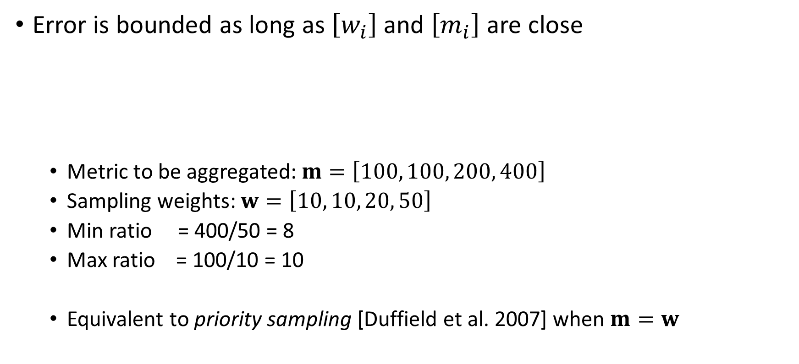
Generalized Weighted Sampler (GSW)
Error is bounded as long as $\left[w_{i}\right]$ and $\left[m_{i}\right]$ are close
Metric to be aggregated: $m=\left[100, 100, 200, 400\right]$
Sampling weights: $w=\left[10, 10, 20, 50\right]$
Min ratio = 400/50 = 8
Max ratio = 100/10 = 10
Equivalent to priority sampling [Duffield et al. 2007] when $m=w$

Slide 12
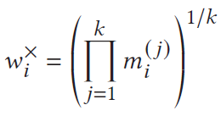
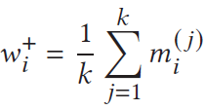
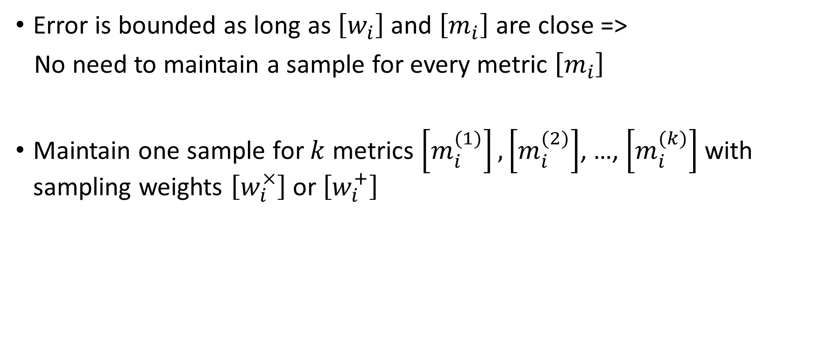
Generalized Weighted Sampler (GSW)
Error is bounded as long as $\left[w_{i}\right]$ and $\left[m_{i}\right]$ are close =>
No need to maintain a sample for every metric $\left[m_{i}\right]$
Maintain one sample for $k$ metrics $\left[m_{i}^{(1)}\right],\left[m_{i}^{(2)}\right]$, …, $\left[m_{i}^{(k)}\right]$ with sampling weights $\left[w_{i}^{×}\right]$ or $\left[w_{i}^{+}\right]$
Geometric compressed GSW
Arithmetic compressed GSW

Slide 13
Outline
Real-time Forecasting Task
Forecasting with Noisy Input
Generalized Weighted Sampler
Experiments

Slide 14
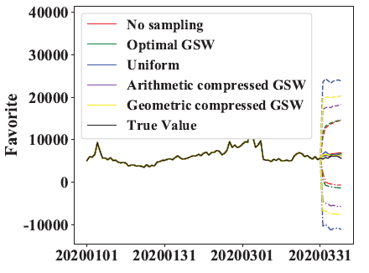
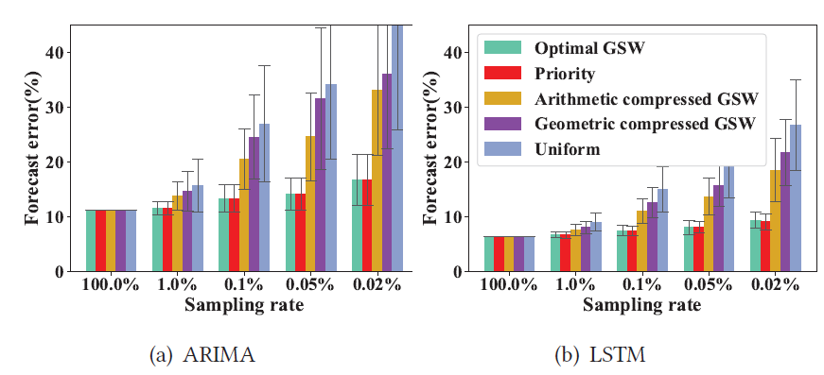
Experiments
100 days of data, 15M rows per day
15 dimensions (4 of them are metrics to be predicted: Favorite, Impression, Click, and Cart)

