Slide 1



Learning to be a Statistician Learned Estimator for Number of Distinct Values
Renzhi Wu^{1,2}, Bolin Ding¹, Xu Chu², Zhewei Wei³
Xiening Dai¹, Tao Guan¹, Jingren Zhou¹
[To appear in VLDB 2022]
1
2
3

Slide 2

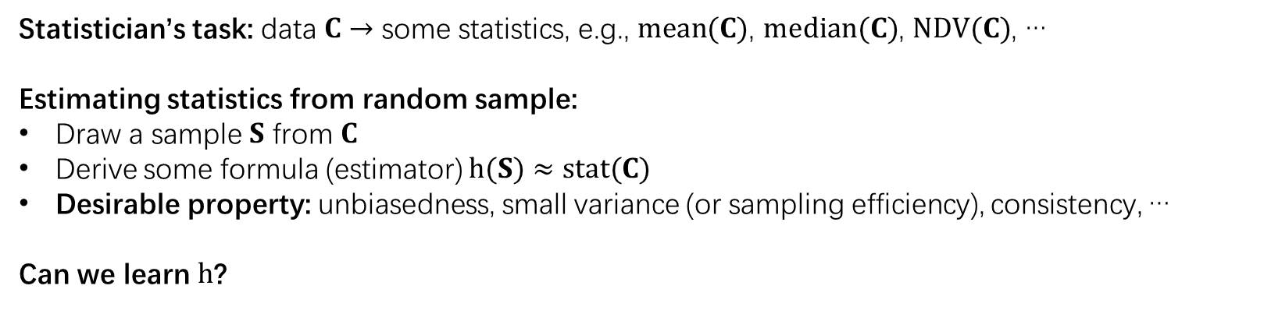

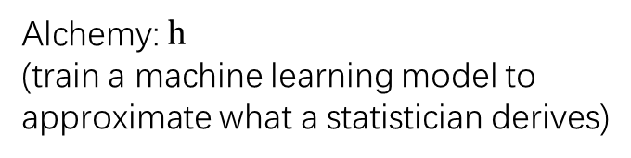
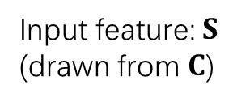
Learning to be a statistician
Statistician’s task: data $C$ $→$ some statistics, e.g., $mean(C)$, $median(C)$, $NDV(C)$, …
Estimating statistics from random sample:
Draw a sample $S$ from $C$
Derive some formula (estimator) $h(S)$ $≈stat(C)$
Desirable property: unbiasedness, small variance (or sampling efficiency), consistency, …
Can we learn $h$?
Input feature: $S$
(drawn from $C$)
Alchemy: $h$
(train a machine learning model to approximate what a statistician derives)
Technical challenges:
How to generate training data?
What are the features?
What model/loss function should be used?
Workload-dependent? (able to be generalized?)
$h(S)$ $≈stat(C)$

Slide 3
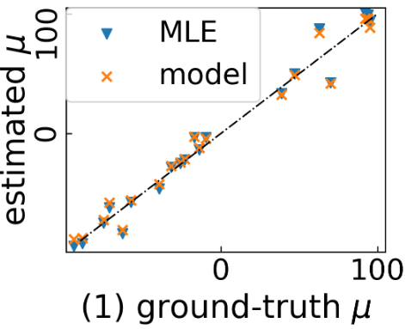
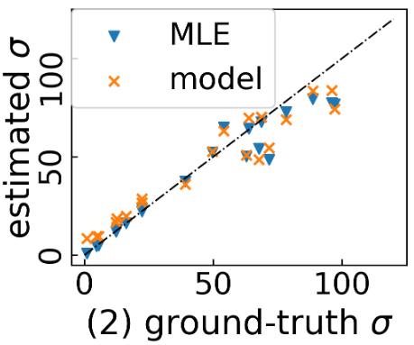
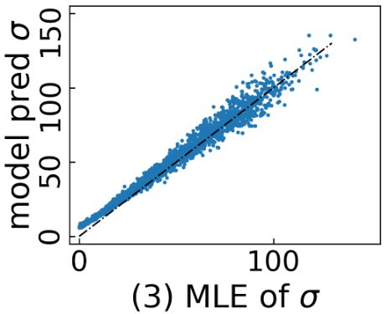
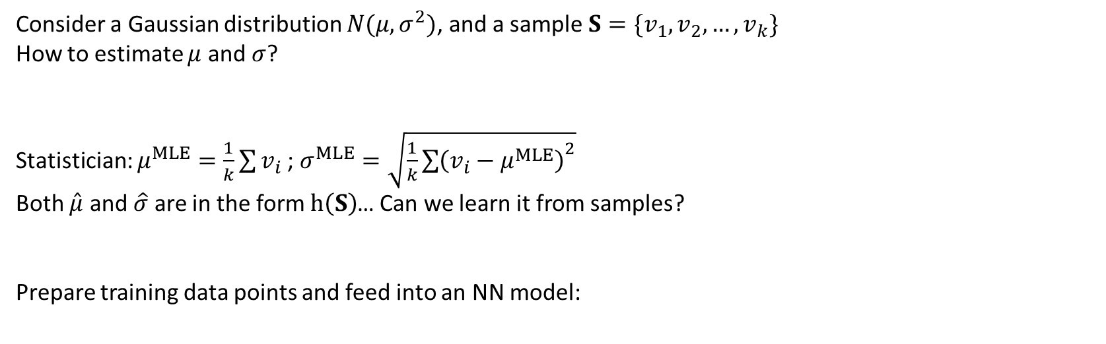
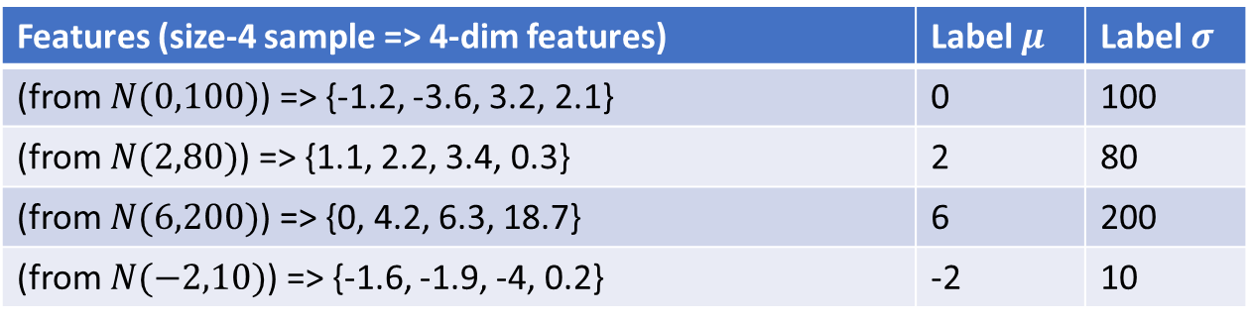
Learning to be a statistician: a toy example
Consider a Gaussian distribution $N(μ,σ^{2})$, and a sample $S=\{v_{1},v_{2},…,v_{k}\}$
How to estimate $μ$ and $σ$?
Statistician: $μ^{MLE}=\frac{1}{k}\sum{v_{i}}$; $σ^{MLE}=\sqrt{\frac{1}{k}{\sum{\left(v_{i}−μ^{MLE}\right)}}^{2}}$
Both $\hat{μ}$ and $\hat{σ}$ are in the form $h\left(S\right)$… Can we learn it from samples?
Prepare training data points and feed into an NN model:
Features (size-4 sample => 4-dim features) | Label $μ$ | Label $σ$
(from $N(0,100)$) => {-1.2, -3.6, 3.2, 2.1} | 0 | 100
(from $N(2,80)$) => {1.1, 2.2, 3.4, 0.3} | 2 | 80
(from $N(6,200)$) => {0, 4.2, 6.3, 18.7} | 6 | 200
(from $N(−2,10)$) => {-1.6, -1.9, -4, 0.2} | -2 | 10

Slide 4

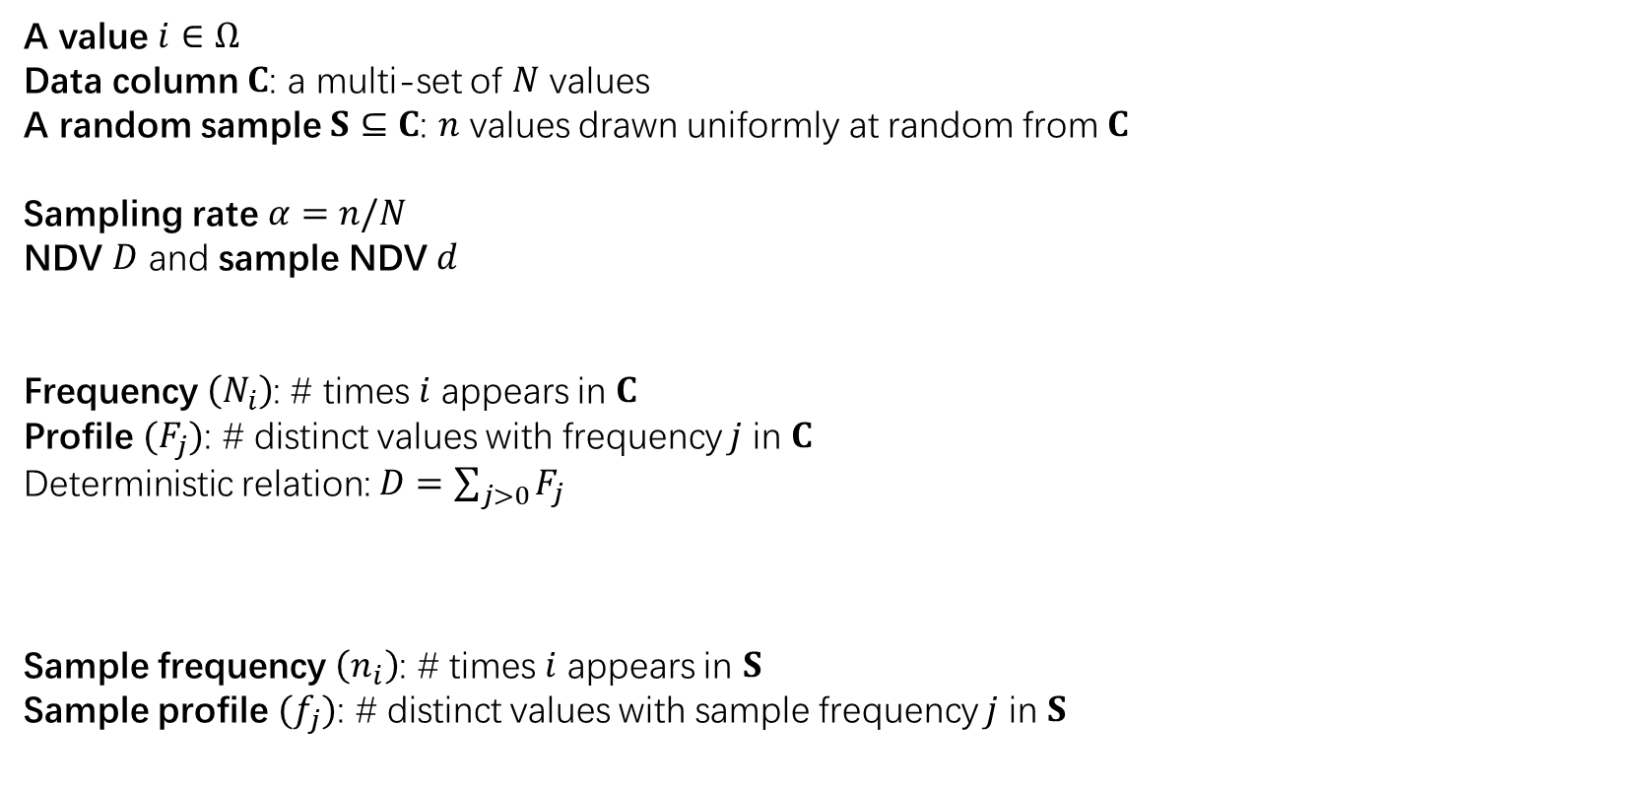
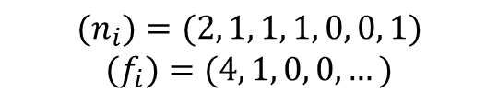
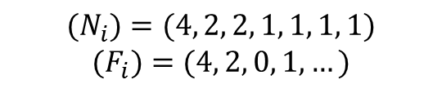
Estimating number of distinct values (NDV) from random sample
A value $i∈Ω$
Data column $C$: a multi-set of $N$ values
A random sample $S⊆C$: $n$ values drawn uniformly at random from $C$
Sampling rate $α=n/N$
NDV $D$ and sample NDV $d$
Frequency $\left(N_{i}\right)$: # times $i$ appears in $C$
Profile $(F_{j})$: # distinct values with frequency $j$ in $C$
Deterministic relation: $D=\sum_{j>0}{F_{j}}$
Sample frequency $\left(n_{i}\right)$: # times $i$ appears in $S$
Sample profile $(f_{j})$: # distinct values with sample frequency $j$ in $S$
$$C=\left\{1, 1, 1, 1, 2, 2, 3, 3, 4, 5, 6, 7\right\}$$
$$S=\{1, 1, 2, 3, 4, 7\}$$
$$D=7$$
$$d=5$$
$$(N_{i})=(4, 2, 2, 1, 1, 1, 1)$$
$$(F_{i})=(4, 2, 0, 1,…)$$
$$(n_{i})=(2, 1, 1, 1, 0, 0, 1)$$
$$(f_{i})=(4, 1, 0, 0,…)$$

Slide 5



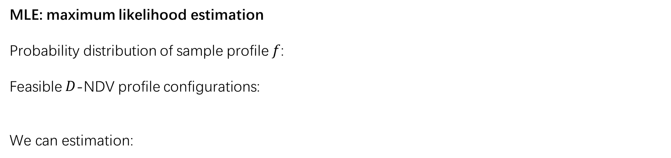
A MLE-based formulation
MLE: maximum likelihood estimation
Probability distribution of sample profile $f$:
Feasible $D$-NDV profile configurations:
We can estimation:
Easy to be formulated but difficult to be solved ;(

Slide 6




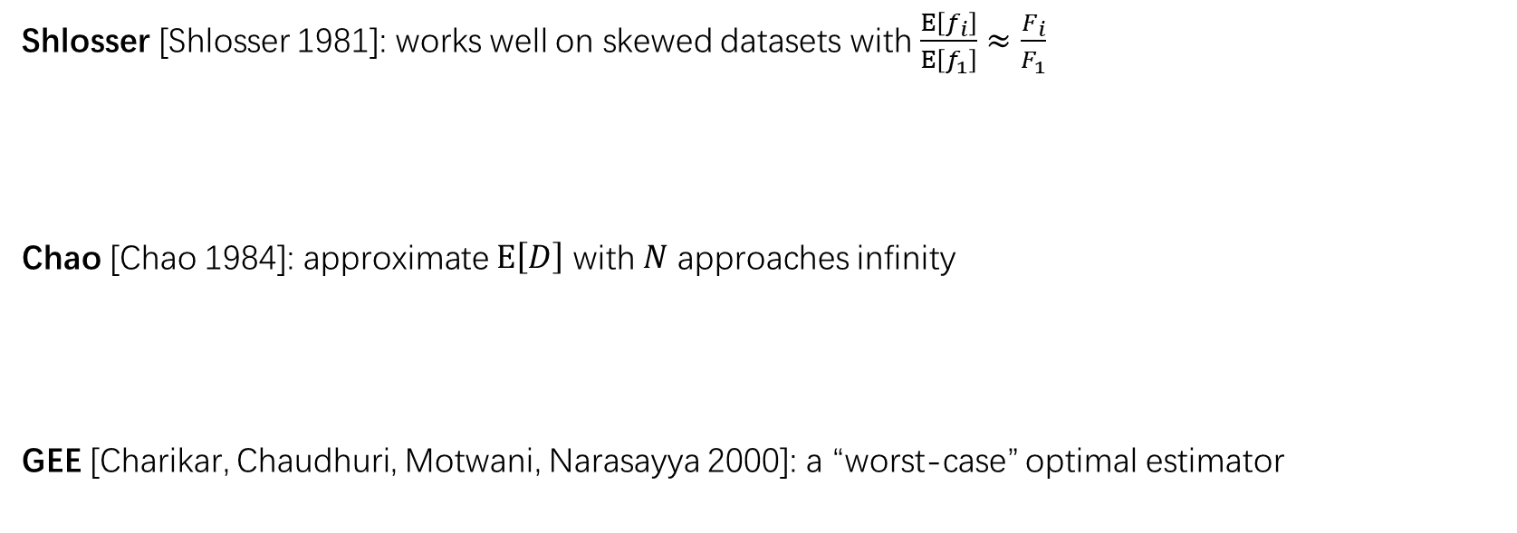

Existing estimators
Negative results [Charikar, Chaudhuri, Motwani, Narasayya 2000]:
w.h.p.
$$error\left(\hat{D}\right)≥Ω\left(\sqrt{N/n}\right)$$
Intuition: hard to distinguish a dataset with NDV = $N$ and one with NDV = $n$
Shlosser [Shlosser 1981]: works well on skewed datasets with $\frac{E\left[f_{i}\right]}{E\left[f_{1}\right]}≈\frac{F_{i}}{F_{1}}$
Chao [Chao 1984]: approximate $E\left[D\right]$ with $N$ approaches infinity
GEE [Charikar, Chaudhuri, Motwani, Narasayya 2000]: a “worst-case” optimal estimator

Slide 7







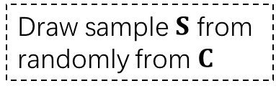
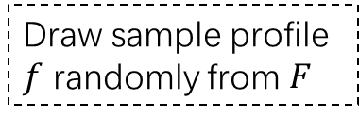
A (workload-agnostic) learning framework
Generating training sample:
Or equivalently:
Train a machine learning model $h$ to approximate (recall the MLE formulation ):
Ratio Error:
Loss function and empirical loss:
Generate data column $C$ from distribution
Draw sample $S$ from randomly from $C$
Input feature $(f,α)$ from $S$
Label (NDV) $D$ from $C$
Generate profile $F$ from distribution
Draw sample profile $f$ randomly from $F$
Input feature $(f,α)$
Label (NDV) $D$ from $C$

Slide 8
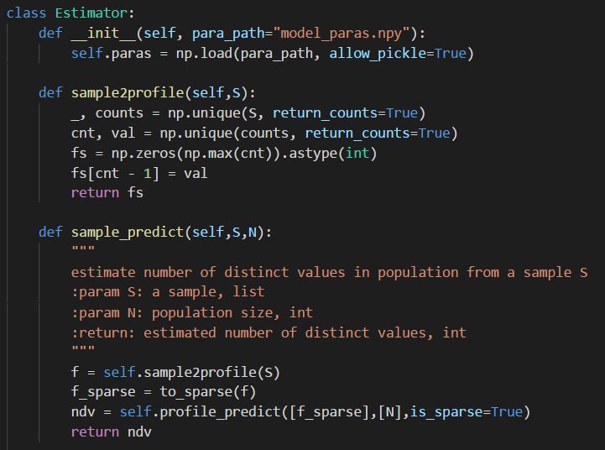

How to use the learned estimator
https://figshare.com/s/0415ccdd6d19645e44b5
Load the learned estimator (“model_paras.npy”)
Generate profile from the sample (sample: pre-drawn/block-level/top-k)
Use profile as the input feature to predict NDV
(implemented in Alibaba MaxCompute-ODPS)
Synthetic training data v.s. estimation on real workload?
Proper feature?
Hardness result?
https://www.consultantsmind.com/2016/07/20/are-you-sure/

Slide 9
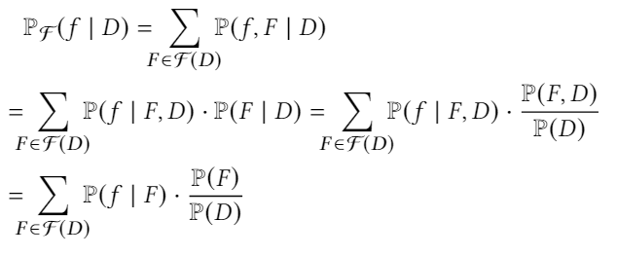



How to make the model workload-agnostic?
What to be learned?
Generate data column $C$ from distribution
Draw sample $S$ from randomly from $C$
Input feature $(f,α)$ from $S$
Label (NDV) $D$ from $C$
Randomness from workload
Randomness from sampling
NDV Estimation
Choose the distribution carefully
If is a constant:
approximation to an MLE estimator

Slide 10
Rest questions
Feature reduction/selection
Training sample generation
Model structure
Hardness results v.s. Model regularization

Slide 11


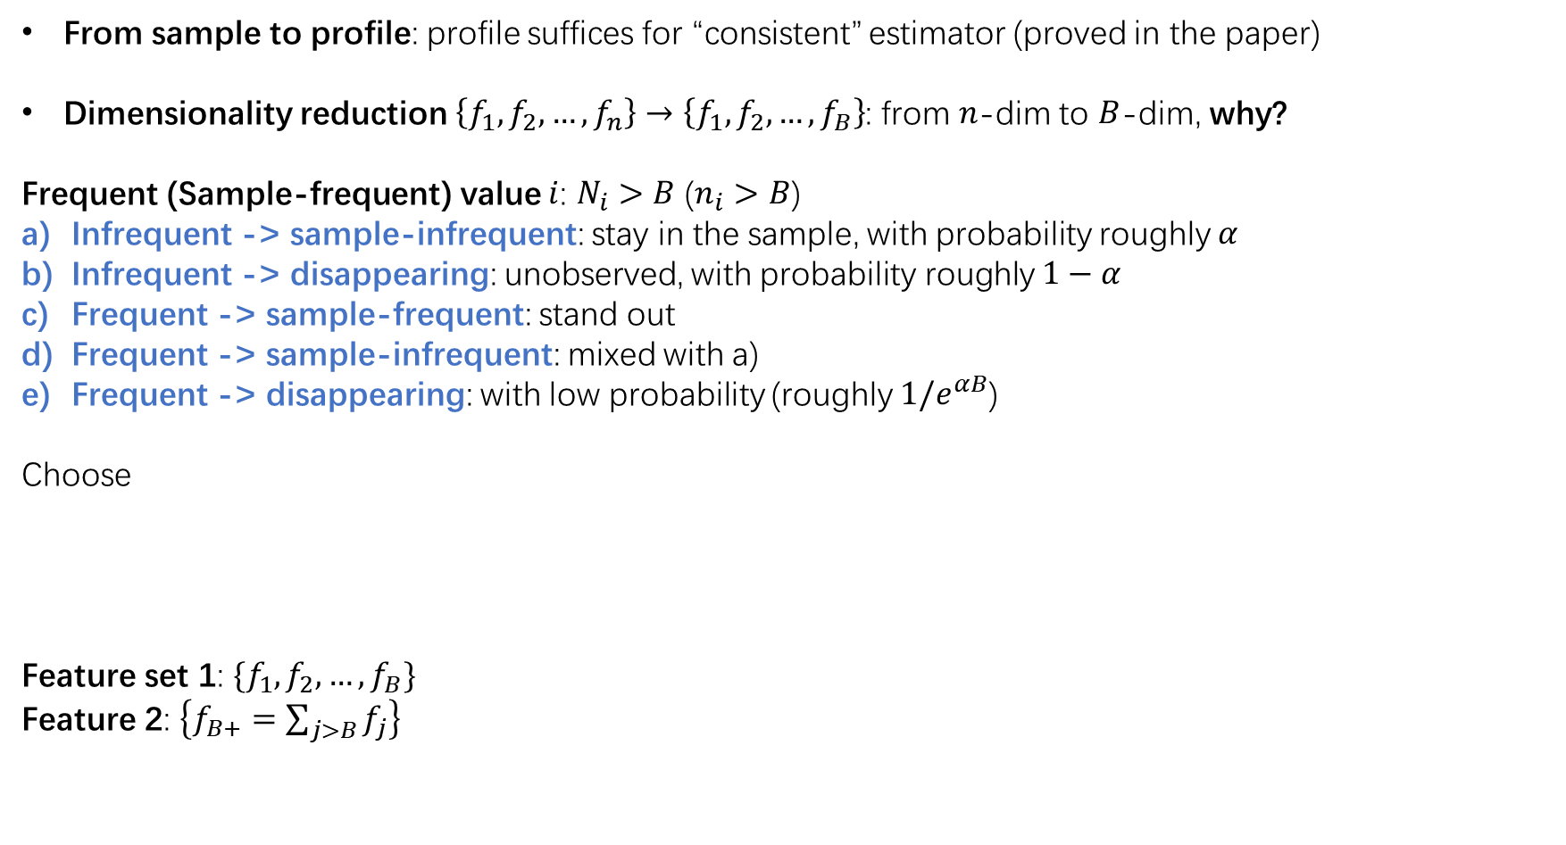
Feature reduction
From sample to profile: profile suffices for “consistent” estimator (proved in the paper)
Dimensionality reduction $\left\{f_{1},f_{2},…,f_{n}\right\}→\left\{f_{1},f_{2},…,f_{B}\right\}$: from $n$-dim to $B$-dim, why?
Frequent (Sample-frequent) value $i$: $N_{i}>B$ ($n_{i}>B$)
Infrequent -> sample-infrequent: stay in the sample, with probability roughly $α$
Infrequent -> disappearing: unobserved, with probability roughly $1−α$
Frequent -> sample-frequent: stand out
Frequent -> sample-infrequent: mixed with a)
Frequent -> disappearing: with low probability (roughly $1/e^{αB}$)
Choose
Feature set 1: $\{f_{1},f_{2},…,f_{B}\}$
Feature 2: $\left\{f_{B+}=\sum_{j>B}{f_{j}}\right\}$
a) + d)
c)
e)

Slide 12


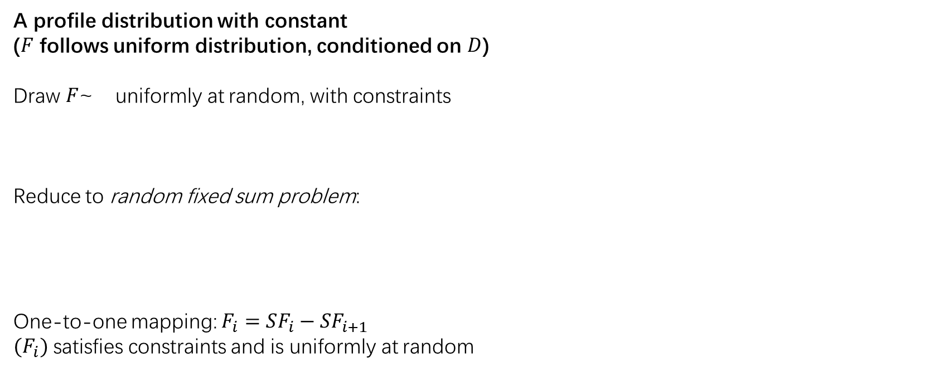
Training sample generation
A profile distribution with constant
($F$ follows uniform distribution, conditioned on $D$)
Draw $F$~ uniformly at random, with constraints
Reduce to random fixed sum problem:
One-to-one mapping: $F_{i}=SF_{i}−SF_{i+1}$
${(F}_{i})$ satisfies constraints and is uniformly at random

Slide 13
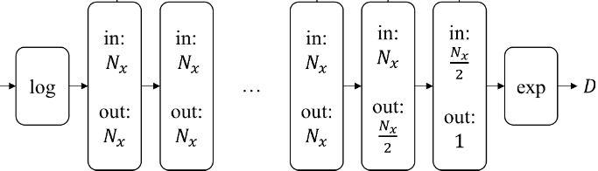

Model structure
Logarithmic -> K + 2 fully connected layers -> Exponential
$$\left(f,α\right)$$

Slide 14


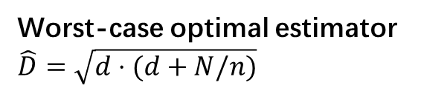





Hardness results v.s. Model regularization
An instance-level hardness result:
Observing a sample with sample NDV $d$
Hard to distinguish two scenarios (w.h.p.):
$D=d$: no unobserved values in the full column
$D=d+Θ(\frac{N}{n})$: there are $\frac{N}{n}$ values unobserved values which appear only once in the full column
Ratio error $error(\hat{D})$ can be as large as: $maxerr\left(d\right)=\sqrt{\frac{d+N/n}{d}}$ (w.h.p.)
Observed sample
$$d$$
Worst-case optimal estimator $\hat{D}=\sqrt{d⋅(d+N/n)}$
$$d$$
$$N/n$$
Underlying data
$$d$$
$$D=d$$
$$D=d+Θ(\frac{N}{n})$$

Slide 15





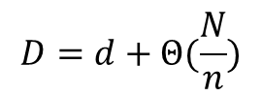
Hardness results v.s. Model regularization
Model regularization:
Intuition:
Observed sample
$$d$$
$$d$$
$$N/n$$
Underlying data
$$d$$
$$D=d$$
$$D=d+Θ(\frac{N}{n})$$
Force to learn $\hat{D}$ in the middle; otherwise adversary may make $\hat{D}$ lie on the boundary

Slide 16
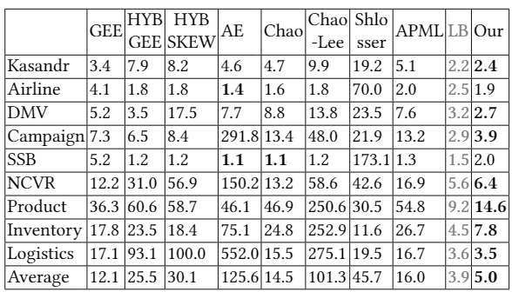
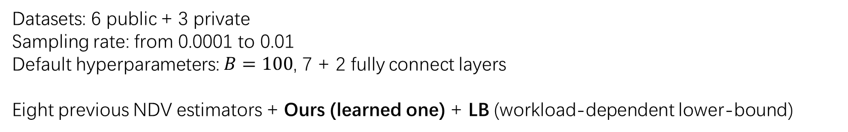
Experimental evaluation
Datasets: 6 public + 3 private
Sampling rate: from 0.0001 to 0.01
Default hyperparameters: $B=100$, 7 + 2 fully connect layers
Eight previous NDV estimators + Ours (learned one) + LB (workload-dependent lower-bound)

Slide 17
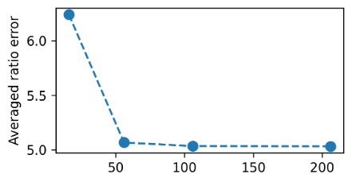
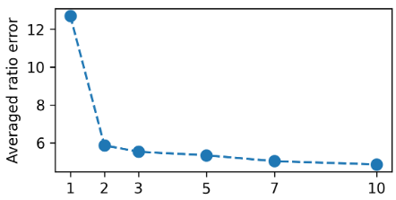
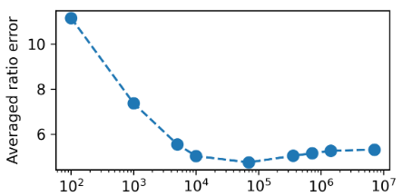


Experimental evaluation
Tuning the model
Feature size $B$
# layers in the model
Data size $N$ in training sample

Slide 18
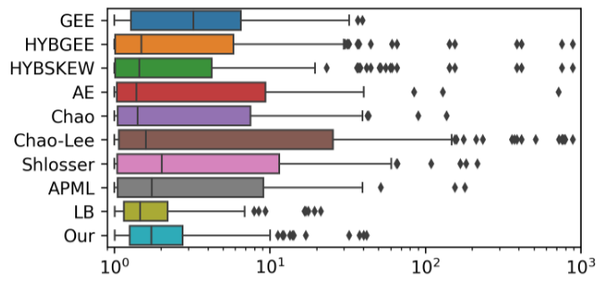
Experimental evaluation
More details
Sampling rate 0.001
Min + 25% + 50% + 75% + Max + Outliers

Slide 19
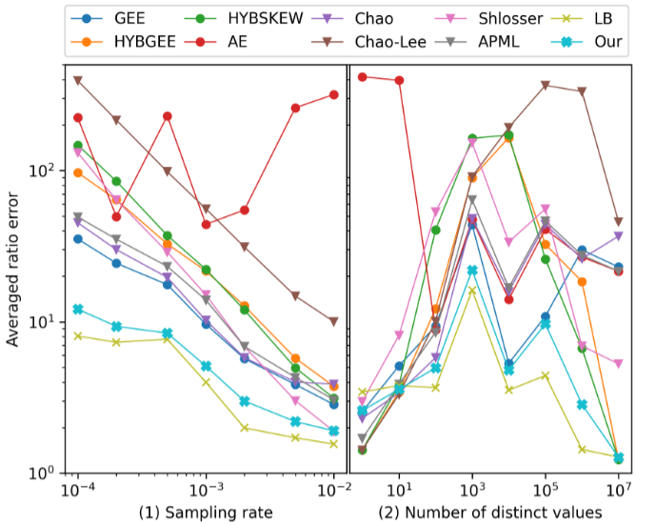
Experimental evaluation
Average error: different sampling rates and NDVs

Slide 20
Conclusion
Attempt to learn an estimator (which is hard to derive)
Synthetic training sample -> workload-agnostic model/estimator
Careful feature engineering and model regularization
Future work
Fine-tuning of the estimator
Pros: even better accuracy
Cons: may not generalize
Learn other statistics
How it works together with other components, e.g., query optimizer

Slide 21
Title
Text

Slide 22
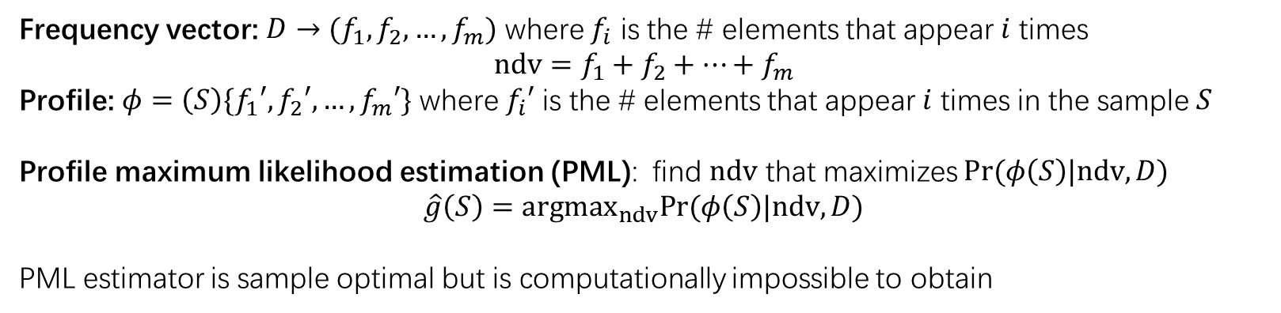
A concrete problem: learning to estimate number of distinct values
Frequency vector: $D→(f_{1},f_{2},…,f_{m})$ where $f_{i}$ is the # elements that appear $i$ times
$$ndv=f_{1}+f_{2}+…+f_{m}$$
Profile: $φ=\left(S\right)\{f_{1}′,f_{2}′, …,f_{m}′\}$ where $f_{i}′$ is the # elements that appear $i$ times in the sample $S$
Profile maximum likelihood estimation (PML): find $ndv$ that maximizes $Pr(φ\left(S\right)|ndv,D)$
$$\hat{g}\left(S\right)=argmax_{ndv}Pr⁡(φ\left(S\right)|ndv,D)$$
PML estimator is sample optimal but is computationally impossible to obtain

Slide 23
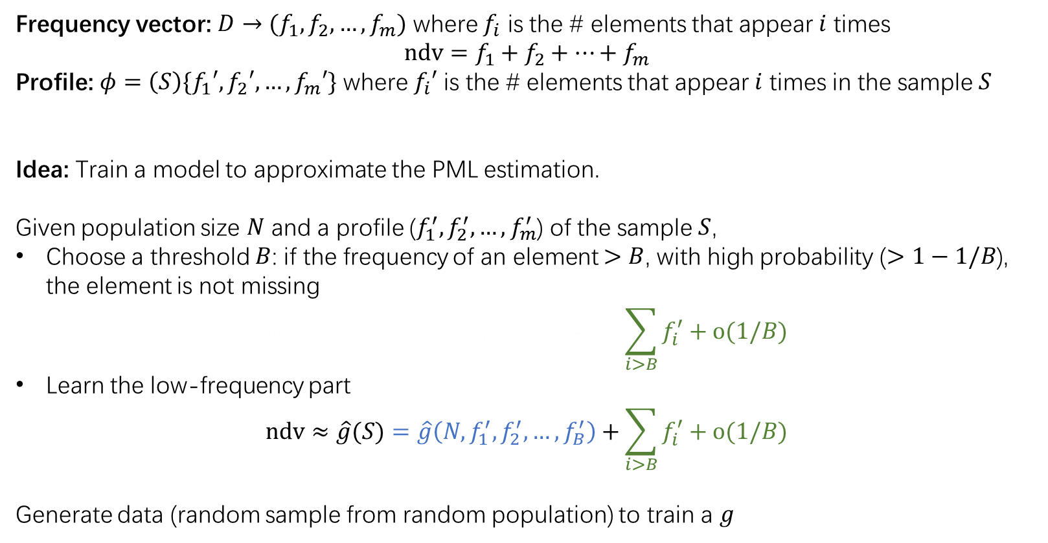
Model design
Frequency vector: $D→(f_{1},f_{2},…,f_{m})$ where $f_{i}$ is the # elements that appear $i$ times
$$ndv=f_{1}+f_{2}+…+f_{m}$$
Profile: $φ=\left(S\right)\{f_{1}′,f_{2}′, …,f_{m}′\}$ where $f_{i}′$ is the # elements that appear $i$ times in the sample $S$
Idea: Train a model to approximate the PML estimation.
Given population size $N$ and a profile ($f_{1}^{′},f_{2}^{′},…,f_{m}^{′}$) of the sample $S$,
Choose a threshold $B$: if the frequency of an element $>B$, with high probability ($>1−1/B$), the element is not missing
$$ndv≈\hat{g}(S)=\hat{g}\left(N, f_{1}^{′},f_{2}^{′},…,f_{B}^{′}\right)+\sum_{i>B}{f_{i}^{′}}+o(1/B)$$
Learn the low-frequency part
$$ndv≈\hat{g}(S)=\hat{g}\left(N, f_{1}^{′},f_{2}^{′},…,f_{B}^{′}\right)+\sum_{i>B}{f_{i}^{′}}+o(1/B)$$
Generate data (random sample from random population) to train a $g$

Slide 24
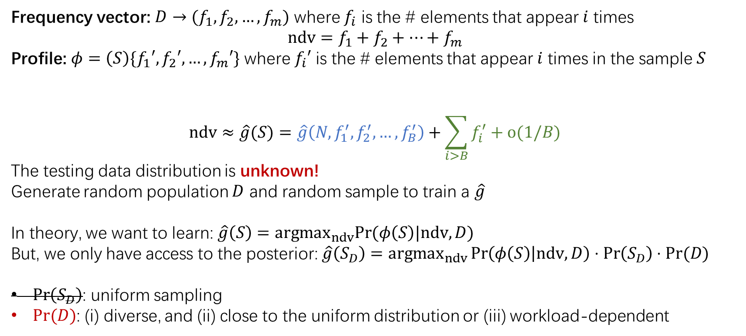
Generating training data
Frequency vector: $D→(f_{1},f_{2},…,f_{m})$ where $f_{i}$ is the # elements that appear $i$ times
$$ndv=f_{1}+f_{2}+…+f_{m}$$
Profile: $φ=\left(S\right)\{f_{1}′,f_{2}′, …,f_{m}′\}$ where $f_{i}′$ is the # elements that appear $i$ times in the sample $S$
$$ndv≈\hat{g}(S)=\hat{g}\left(N, f_{1}^{′},f_{2}^{′},…,f_{B}^{′}\right)+\sum_{i>B}{f_{i}^{′}}+o(1/B)$$
The testing data distribution is unknown!
Generate random population $D$ and random sample to train a $\hat{g}$
In theory, we want to learn: $\hat{g}\left(S\right)=argmax_{ndv}Pr⁡(φ\left(S\right)|ndv,D)$
But, we only have access to the posterior: $\hat{g}\left(S_{D}\right)=argmax_{ndv}\operatorname{Pr}\left(φ\left(S\right) | ndv,D\right)⋅\operatorname{Pr}\left(S_{D}\right)⋅Pr⁡(D)$
$\operatorname{Pr}\left(S_{D}\right)$: uniform sampling
$Pr⁡(D)$: (i) diverse, and (ii) close to the uniform distribution or (iii) workload-dependent

Slide 25
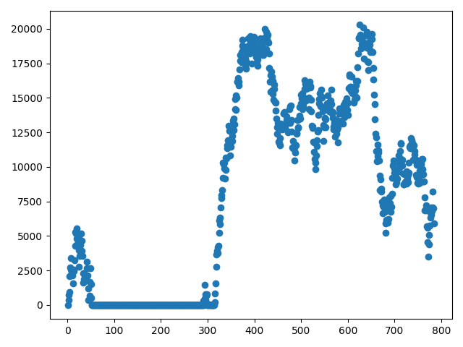
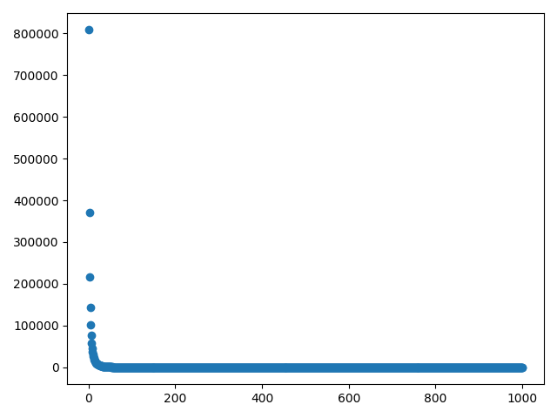
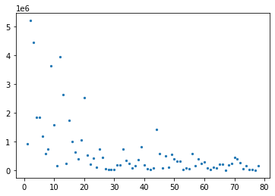
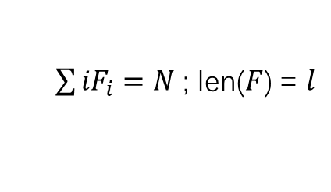
Generating training data
Data generation: randomly generate population profile
1.Random walk
2. Power law
3. Constrained sampling
(random profile with given length population size)
$\sum{{iF}_{i}}=N$ ; len($F$) = $l$

Slide 26
Generating training data
Frequency vector: $D→(f_{1},f_{2},…,f_{m})$ where $f_{i}$ is the # elements that appear $i$ times
$$ndv=f_{1}+f_{2}+…+f_{m}$$
Profile: $φ=\left(S\right)\{f_{1}′,f_{2}′, …,f_{m}′\}$ where $f_{i}′$ is the # elements that appear $i$ times in the sample $S$
$$ndv≈\hat{g}(S)=\hat{g}\left(N, f_{1}^{′},f_{2}^{′},…,f_{B}^{′}\right)+\sum_{i>B}{f_{i}^{′}}+o(1/B)$$
The testing data distribution is unknown!
Generate random population $D$ and random sample to train a $\hat{g}$
In theory, we want to learn: $\hat{g}\left(S\right)=argmax_{ndv}Pr⁡(φ\left(S\right)|ndv,D)$
But, we only have access to the posterior: $\hat{g}\left(S_{D}\right)=argmax_{ndv}\operatorname{Pr}\left(φ\left(S\right) | ndv,D\right)⋅\operatorname{Pr}\left(S_{D}\right)⋅Pr⁡(D)$
$\operatorname{Pr}\left(S_{D}\right)$: uniform sampling
$Pr⁡(D)$: (i) diverse, and (ii) close to the uniform distribution or (iii) workload-dependent

Slide 27
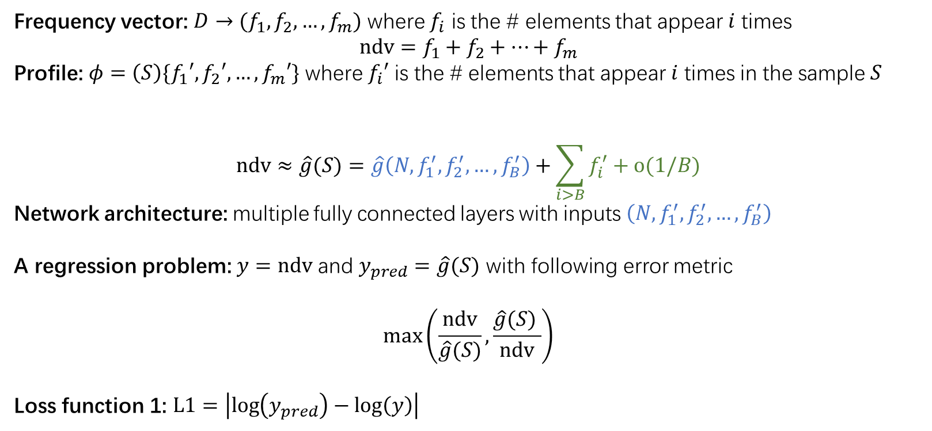
Model and loss
Frequency vector: $D→(f_{1},f_{2},…,f_{m})$ where $f_{i}$ is the # elements that appear $i$ times
$$ndv=f_{1}+f_{2}+…+f_{m}$$
Profile: $φ=\left(S\right)\{f_{1}′,f_{2}′, …,f_{m}′\}$ where $f_{i}′$ is the # elements that appear $i$ times in the sample $S$
$$ndv≈\hat{g}(S)=\hat{g}\left(N, f_{1}^{′},f_{2}^{′},…,f_{B}^{′}\right)+\sum_{i>B}{f_{i}^{′}}+o(1/B)$$
Network architecture: multiple fully connected layers with inputs $\left(N, f_{1}^{′},f_{2}^{′},…,f_{B}^{′}\right)$
A regression problem: $y=ndv$ and $y_{pred}=\hat{g}(S)$ with following error metric
$$\max\left(\frac{ndv}{\hat{g}(S)},\frac{\hat{g}(S) }{ndv}\right)$$
Loss function 1: $L1=\left|\log\left(y_{pred}\right)−\log\left(y\right)\right|$

Slide 28
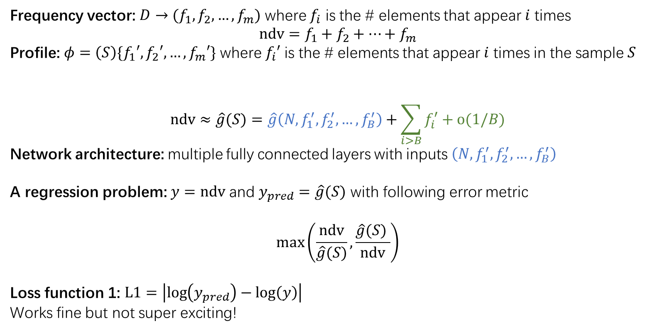
Model and loss
Frequency vector: $D→(f_{1},f_{2},…,f_{m})$ where $f_{i}$ is the # elements that appear $i$ times
$$ndv=f_{1}+f_{2}+…+f_{m}$$
Profile: $φ=\left(S\right)\{f_{1}′,f_{2}′, …,f_{m}′\}$ where $f_{i}′$ is the # elements that appear $i$ times in the sample $S$
$$ndv≈\hat{g}(S)=\hat{g}\left(N, f_{1}^{′},f_{2}^{′},…,f_{B}^{′}\right)+\sum_{i>B}{f_{i}^{′}}+o(1/B)$$
Network architecture: multiple fully connected layers with inputs $\left(N, f_{1}^{′},f_{2}^{′},…,f_{B}^{′}\right)$
A regression problem: $y=ndv$ and $y_{pred}=\hat{g}(S)$ with following error metric
$$\max\left(\frac{ndv}{\hat{g}(S)},\frac{\hat{g}(S) }{ndv}\right)$$
Loss function 1: $L1=\left|\log\left(y_{pred}\right)−\log\left(y\right)\right|$
Works fine but not super exciting!

Slide 29

Model and loss
Frequency vector: $D→(f_{1},f_{2},…,f_{m})$ where $f_{i}$ is the # elements that appear $i$ times
$$ndv=f_{1}+f_{2}+…+f_{m}$$
Profile: $φ=\left(S\right)\{f_{1}′,f_{2}′, …,f_{m}′\}$ where $f_{i}′$ is the # elements that appear $i$ times in the sample $S$
$$ndv≈\hat{g}(S)=\hat{g}\left(N, f_{1}^{′},f_{2}^{′},…,f_{B}^{′}\right)+\sum_{i>B}{f_{i}^{′}}+o(1/B)$$
Network architecture: multiple fully connected layers with inputs $\left(N, f_{1}^{′},f_{2}^{′},…,f_{B}^{′}\right)$
A regression problem: $y=ndv$ and $y_{pred}=\hat{g}(S)$ with following error metric
$$\max\left(\frac{ndv}{\hat{g}(S)},\frac{\hat{g}(S) }{ndv}\right)$$
Loss function 1: $L1=\left|\log\left(y_{pred}\right)−\log\left(y\right)\right|$
Works fine but not super exciting!

Slide 30

Model and loss
Frequency vector: $D→(f_{1},f_{2},…,f_{m})$ where $f_{i}$ is the # elements that appear $i$ times
$$ndv=f_{1}+f_{2}+…+f_{m}$$
Profile: $φ=\left(S\right)\{f_{1}′,f_{2}′, …,f_{m}′\}$ where $f_{i}′$ is the # elements that appear $i$ times in the sample $S$
$$ndv≈\hat{g}(S)=\hat{g}\left(N, f_{1}^{′},f_{2}^{′},…,f_{B}^{′}\right)+\sum_{i>B}{f_{i}^{′}}+o(1/B)$$
Loss function 1: $L1=\left|\log\left(y_{pred}\right)−\log\left(y\right)\right|$
Inherent hardness: Some samples (with small sampling rate) are more difficult than others
Sample $D_{1}→S_{1}$ and $D_{2}→S_{2}$; we have $S_{1}=S_{2}$ (with high probability), but $ndv\left(D_{1}\right)≠ndv(D_{2})$
How large could the gap $ndv\left(D_{1}\right)/ndv\left(D_{2}\right)$ be? $Θ\left(\sqrt{N}\right)$!
It is unfair to hope $L1→0$
Revise the loss function: $L2=abs\left(\left|\log\left(y_{pred}\right)−\log\left(y\right)\right|−gap\right)$
Example difficulty $gap=\left|log\sqrt{\frac{\frac{1−r}{2r}ln\frac{1}{0.9}+d_{s}}{d_{s}} }\right|$, where sampling rate is $r$ and $d_{s}$ is sample ndv

Slide 31

Experiment results
Open datasets: tpch, ad, ncvr
Alibaba datasets: dim_tb_itm_sku, s_ipm_trade_inventory, s_tc_logistics_order

Slide 32

Experiment results

Slide 33
Ideas that didn’t work.
Data generation:
1. model may be biased by the data generation process. -> weight each data point by density ratio
2. Randomly generate values instead of directly generate population profiles
3. Uniformly sample population profile $F$ with given population size and ndv
Model architecture:
1. resnet, attention, bigger, wider …
2. sample profile as composition of sub-profiles generated by $F_{1}$, $F_{2}$…
3. Learn $F$ in middle layer to have a reconstructive loss

Slide 34


Learn to select optimal join order
Dataset: Star schema benchmark (based on tpch), Five tables, the fact table has 300M rows.

Slide 35

Learn to select optimal join order
Dataset: Star schema benchmark (based on tpch), Five tables, the fact table has 300M rows.
Results:
Green denotes better order.

