Slide 1



UniDM: A Unified Framework for Data Manipulation with Large Language Models
Yichen Qian¹, Yongyi He^{1,2}, Rong Zhu¹, Jintao Huang^{1,2}, Zhijian Ma¹, Haibin Wang¹, Yaohua Wang¹, Xiuyu Sun¹, Defu Lian², Bolin Ding¹ , Jingren Zhou¹
¹Alibaba Group, ²University of Science and Technology of China
通义

Slide 2
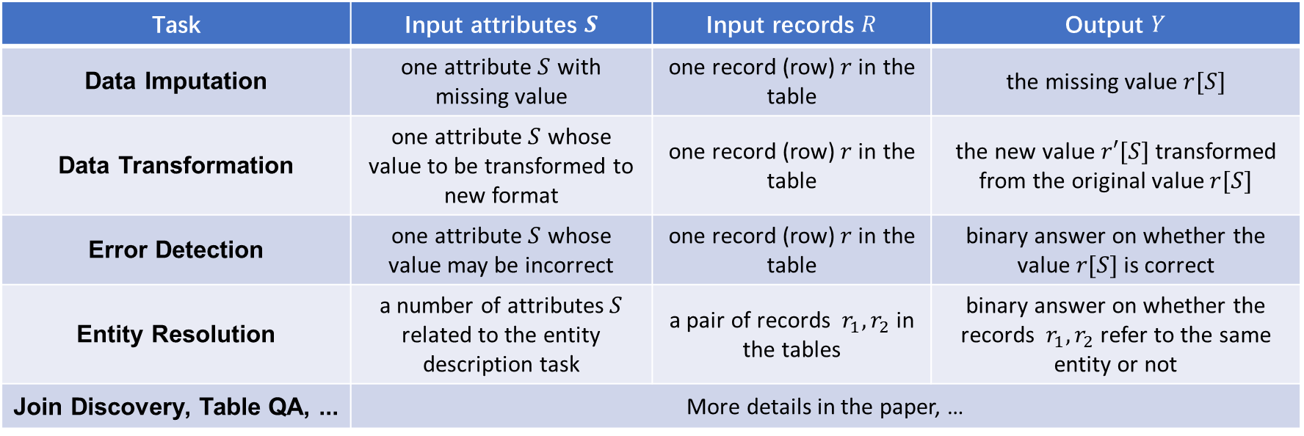
Data Manipulation Tasks (for Relational Data)
Building a data processing tool for a class of data manipulation tasks
Applications: data cleaning/augmentation, data analytics, enrich training data, …
Example: Data Imputation
Task | Input attributes $S$ | Input records $R$ | Output $Y$
Data Imputation | one attribute $S$ with missing value | one record (row)$r$in the table | the missing value $r[S]$
Data Transformation | one attribute $S$ whose value to be transformed to new format | one record (row)$r$in the table | the new value $r′[S]$ transformed from the original value $r[S]$
Error Detection | one attribute $S$ whose value may be incorrect | one record (row)$r$in the table | binary answer on whether the value $r[S]$ is correct
Entity Resolution | a number of attributes $S$ related to the entity description task | a pair of records $r_{1}, r_{2}$ in the tables | binary answer on whether the records $r_{1}, r_{2}$ refer to the same entity or not
Join Discovery, Table QA, ... | More details in the paper, …
city | country | timezone | population | postalcode
Alicante | Spain | Central European Time | 337482 | 3000
Copenhagen | Denmark | ? | 809314 | 1050
… | ... | … | … | …

Slide 3
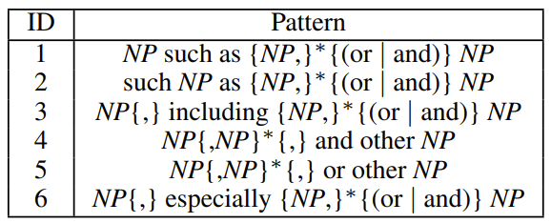

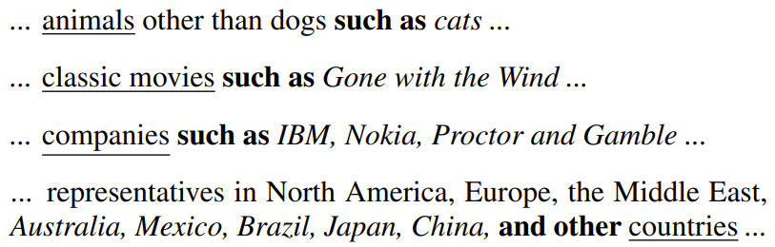
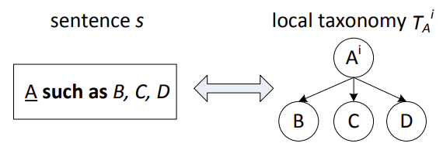
Pre-LLM Attempt: Probase (2010-)
Massive data => large knowledgebase
Generate taxonomy: “InstanceOf”, “AttributeOf”, …
Massive data => large language model
Should LLM be more capable?
https://www.microsoft.com/en-us/research/project/probase/
[Song et al. IJCAI2011]
[Wu et al. SIGMOD2012]

Slide 4
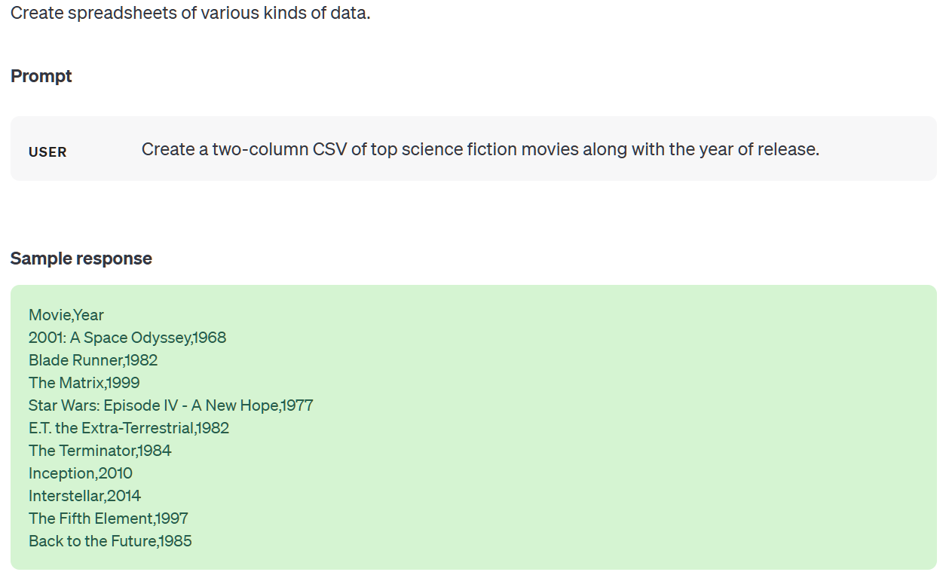
Why LLM?
city | country | timezone | population | postalcode
Alicante | Spain | Central European Time | 337482 | 3000
Copenhagen | Denmark | ? | 809314 | 1050
… | ... | … | … | …
Example: Data Imputation
LLM as a knowledgebase (browsing the knowledgebase via prompting)
Context may help (considering surrounding records as examples in the prompt)
Next-token-prediction => data imputation as a cloze question
E.g., Copenhagen’s timezone is ____
Ability of parsing/formating data:
with instruction and/or examples
unstructured data ⬄ relational data
code generation
https://platform.openai.com/examples/default-spreadsheet-gen

Slide 5
After-LLM Attempts (2022-now)
Can LLMs wrangle your data?
Other related work
Can LLMs predict data correlations from column names?
Table fine-tuned GPT for diverse table tasks
[Narayan et al. VLDB2022]
city | country | timezone | population | postalcode
Alicante | Spain | Central European Time | 337482 | 3000
Copenhagen | Denmark | ? | 809314 | 1050
… | ... | … | … | …
Prompt | Task description | Filling missing data
 | Demonstration | city: Alicante, country: Span, timezone? CET
 | Task input | City: Copenhagen, country: Denmark, timezone?
[Trummer VLDB2022]
[Li et al. SIGMOD2024]

Slide 6
Challenges and Our Contributions
How to write the prompt automatically (we are building a data tool not a chatbot)?
How to retrieve context or construct demonstration automatically from data?
How to construct LLM-friendly prompt from relational data (tables)?
Can LLM itself help us solve the above challenges?
Need of a unified framework for a large class of data manipulation tasks

Slide 7

Our UniDM Framework
Data Manipulation Tasks
Data flow
Data Lake
Parameters pass
Data Pre-process
Task parameters
Use LLM
Our
UniDM
Framework
Retrieve
Parse
Natural
text
Prompt
+
T
T
Automatic Context Retrieval
Context
Data Parsing
Target
Prompt Construction
Result
Large Language Model
Automatic Context Retrieval: identify useful context information while filtering irrelevant data to facilitate the LLMs
Context Data Parsing: transform the context information into a more LLM-friendly format as part of the prompt
Target Prompt Construction: with the retrieved context, the task description, and task inputs, construct the final prompt (using LLMs)

Slide 8
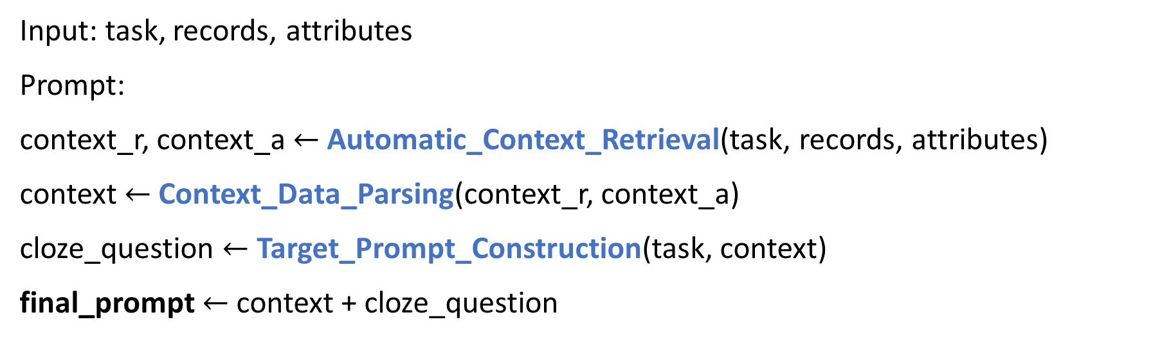
Our UniDM Framework
Data Manipulation Tasks
Data flow
Data Lake
Parameters pass
Data Pre-process
Task parameters
Use LLM
Our
UniDM
Framework
Retrieve
Parse
Natural
text
Prompt
+
T
T
Automatic Context Retrieval
Context
Data Parsing
Target
Prompt Construction
Result
Large Language Model
Input: task, records, attributes
Prompt:
context_r, context_a $←$ Automatic_Context_Retrieval(task, records, attributes)
context $←$ Context_Data_Parsing(context_r, context_a)
cloze_question $←$ Target_Prompt_Construction(task, context)
final_prompt $←$ context + cloze_question

Slide 9
Our UniDM Framework: Example

Slide 10
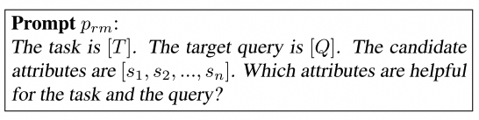

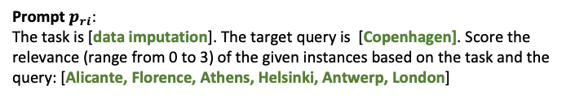




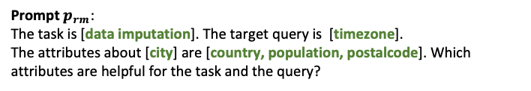
UniDM: Automatic Context Retrieval
Automatic Context Retrieval
Task Parameters
Data Imputation: Copenhagen, timezone
Identify useful information while filtering irrelevant data to facilitate the LLMs
Metadata-wise retrieval: find relevant attributes from the whole table
Instance-wise retrieval: extract useful records as examples
metadata
instances
country, population, …
Alicante, Florence,…
$$\text{P}\text{rompt} p_{rm}$$
$$\text{P}\text{rompt} p_{ri}$$
Metadata-wise
Retrieval
Instance-wise
Retrieval
Iterate
LLM
LLM
$$S^{m}$$
$$R^{m}$$
Select attributes
$$C$$
Select top-k instances
$\text{P}\text{rompt} p_{rm}$:
The task is [data imputation]. The target query is [timezone].
The attributes about [city] are [country, population, postalcode]. Which attributes are helpful for the task and the query?
(Output) country
$\text{P}\text{rompt} p_{ri}$:
The task is [data imputation]. The target query is [Copenhagen]. Score the relevance (range from 0 to 3) of the given instances based on the task and the query: [Alicante, Florence, Athens, Helsinki, Antwerp, London]
(Output) Alicante:3,Florence:2,Athens:1,…

Slide 11
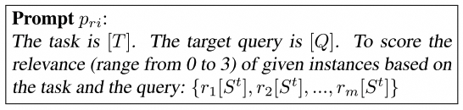
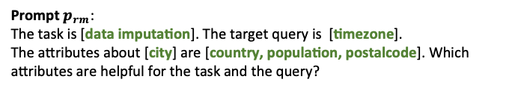
UniDM: Automatic Context Retrieval
Automatic Context Retrieval
Task Parameters
Data Imputation: Copenhagen, timezone
Identify useful information while filtering irrelevant data to facilitate the LLMs
Metadata-wise retrieval: find relevant attributes from the whole table
Instance-wise retrieval: extract useful records as examples
metadata
instances
country, population, …
Alicante, Florence,…
$$\text{P}\text{rompt} p_{rm}$$
$$\text{P}\text{rompt} p_{ri}$$
Metadata-wise
Retrieval
Instance-wise
Retrieval
Iterate
LLM
LLM
$$S^{m}$$
$$R^{m}$$
Select attributes
$$C$$
Select top-k instances
$\text{P}\text{rompt} p_{rm}$:
The task is [data imputation]. The target query is [timezone].
The attributes about [city] are [country, population, postalcode]. Which attributes are helpful for the task and the query?
(Output) country
$\text{P}\text{rompt} p_{ri}$:
The task is [data imputation]. The target query is [Copenhagen]. Score the relevance (range from 0 to 3) of the given instances based on the task and the query: [Alicante, Florence, Athens, Helsinki, Antwerp, London]
(Output) Alicante:3,Florence:2,Athens:1,…

Slide 12
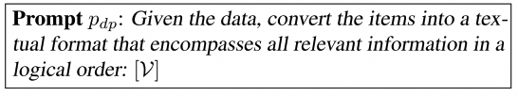
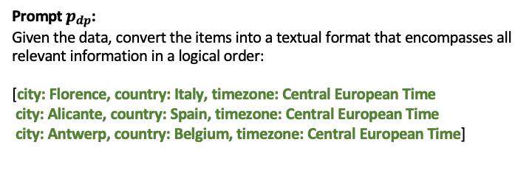




UniDM: Context Data Parsing
Context Data Parsing
$C$: context data
Transform the context information into a more LLM-friendly format (closer to training data)
Serialize relational tuples into text using LLMs
city | country | timezone
Alicante | Spain | Central European Time
Florence | Italy | Central European Time
Antwerp | Belgium | Central European Time
Serialize function
$$𝓥$$
Data Parsing
LLM
Prompt $p_{dp}$
$$C′$$
Prompt $p_{dp}$:
Given the data, convert the items into a textual format that encompasses all relevant information in a logical order:
[city: Florence, country: Italy, timezone: Central European Time
city: Alicante, country: Spain, timezone: Central European Time
city: Antwerp, country: Belgium, timezone: Central European Time]
serialized data
(Output) Florence is a city of Italy and in the timezone Central European Time...

Slide 13
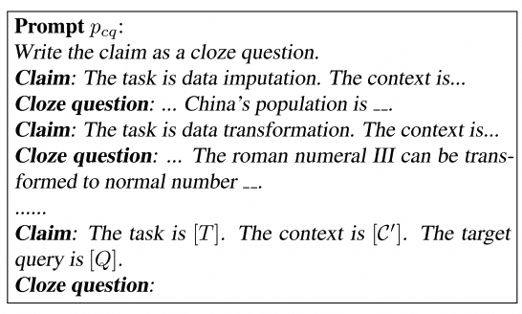

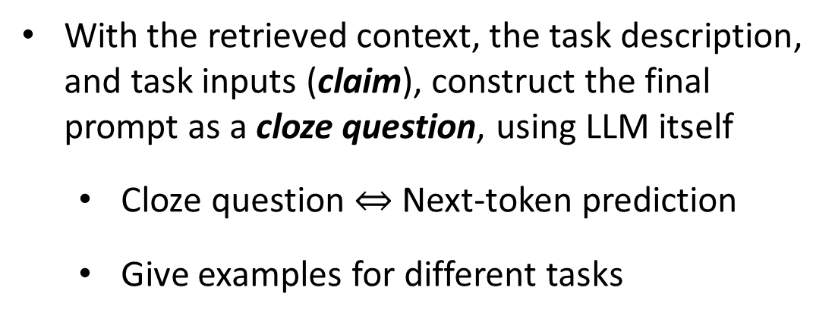




UniDM: Target Prompt Construction
Target Prompt Construction
Data after parsing
Task Parameters
With the retrieved context, the task description, and task inputs (claim), construct the final prompt as a cloze question, using LLM itself
Cloze question $⇔$ Next-token prediction
Give examples for different tasks
$$C′$$
Data Imputation: Copenhagen, timezone
Prompt $p_{cq}$
Prompt $p_{as}$
Prompt Engineering
LLM
LLM
Central European Time
Prompt $p_{cq}$:
Write the claim as a cloze question.
Claim: The task is [data discovery]. The context is [A city is a human settlement…smart city…] The target query is [smart city?].
Cloze question: The task is to discover data from the context. A city is a human settlement… A smart city is __.
Claim: The task is [data imputation]. The context is [Florence is a city of Italy and in the timezone Central European Time…]. The target query is [city: Copenhagen, country:Denmark, timezone:?].
Cloze question:
demonstration
(Output Prompt $p_{as}$) The task is to impute the missing value…The context is … Copenhagen is a city of Denmark and in the timezone __.

Slide 14
Experiment: SOTA Methods
For all of them
LLM-based: FM (Narayan et al., 2022)
and UniDM (ours), on GPT-3
Data Imputation
Statistics-based: HoloClean (Rekatsinas
et al., 2017; Wu et al., 2020)
Clustering: CMI (Zhang et al., 2008)
LLM-based: IPM (Mei et al., 2021)
Data Transformation
Search-based: TDE (He et al., 2018)
Error Detection
HoloClean (Rekatsinas et al., 2017)
HoloDetect (Heidari et al., 2019)
Entity Resolution
Magellan (Konda et al., 2016)
Ditto (Li et al., 2020)
More: refer to our TR
https://arxiv.org/pdf/2405.06510

Slide 15
Experiment: Performance Evaluation
Accuracy on data imputation with SOTA
Accuracy on data transformation with SOTA
Method | Data Imputation Accuracy (%)
Method | Restaurant | Buy
HoloClean | 33.1 | 16.2
CMI | 56.0 | 65.3
IPM | 77.2 | 96.5
FM (random) | 81.4 | 86.2
FM (manual) | 88.4 | 98.5
UniDM (random) | 87.2 | 92.3
UniDM | 93.0 | 98.5
Method | Data Transformation Accuracy (%)
Method | StackOverflow | Bing-QueryLogs
TDE | 63.0 | 32.0
FM (manual) | 65.3 | 54.0
UniDM | 67.4 | 56.0
Format transformation for ip, physical address, phone, etc
Restaurant: city?
Buy: manufacturer?

Slide 16
Experiment: Performance Evaluation
F1-score on error detection with SOTA
F1-score on entity resolution with SOTA
Method | Error Detection F1-Score (%)
Method | Hospital | Adult
HoloClean | 51.4 | 54.5
HoloDetect | 94.4 | 99.1
FM | 97.1 | 99.1
UniDM | 99.8 | 99.7
Method | Entity Resolution F1-Score (%)
Dataset | Beer | iTunes-Amazon | Amazon-Google | Walmart-Amazon
Magellan | 78.8 | 91.2 | 49.1 | 71.9
Ditto | 94.4 | 97.1 | 75.6 | 86.8
FM (random) | 92.3 | 96.3 | 60.7 | 73.8
FM (manual) | 100 | 98.2 | 63.5 | 87.0
UniDM | 96.3 | 96.3 | 64.3 | 88.2
Error rate: 5%
Ground truth is available for eval
A relational tuple is an entity
Entity pairs from two tables
Ground truth is available

Slide 17
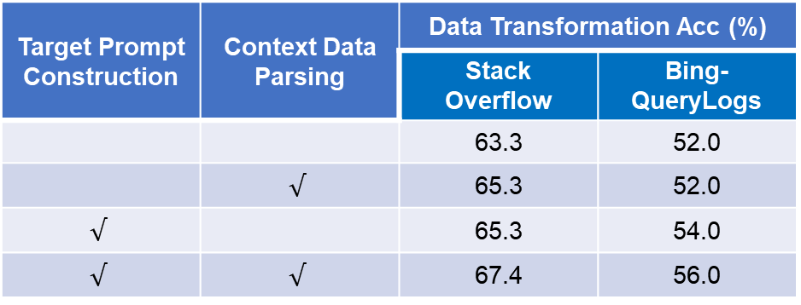
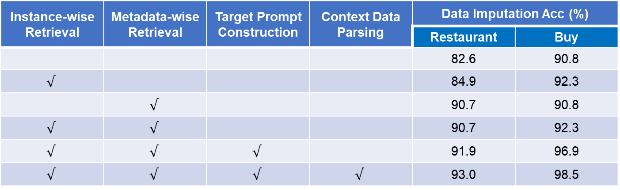
Experiment: Ablation Study
Every step contributes to UniDM
Instance-wise Retrieval | Metadata-wise Retrieval | Target Prompt Construction | Context Data Parsing | Data Imputation Acc (%)
 |  |  |  | Restaurant | Buy
 |  |  |  | 82.6 | 90.8
$$√$$ |  |  |  | 84.9 | 92.3
 | $$√$$ |  |  | 90.7 | 90.8
$$√$$ | $$√$$ |  |  | 90.7 | 92.3
$$√$$ | $$√$$ | $$√$$ |  | 91.9 | 96.9
$$√$$ | $$√$$ | $$√$$ | $$√$$ | 93.0 | 98.5
Target Prompt Construction | Context Data Parsing | Data Transformation Acc (%)
 |  | Stack Overflow | Bing- QueryLogs
 |  | 63.3 | 52.0
 | $$√$$ | 65.3 | 52.0
$$√$$ |  | 65.3 | 54.0
$$√$$ | $$√$$ | 67.4 | 56.0

Slide 18
Experiment: Different Base Models
Larger models are better, while smaller models are also fine…
Model | Data Imputation Acc (%)
LLMs | Restaurant | Buy
GPT-3-175B | 93.0 | 98.5
GPT-4-Turbo | 96.5 | 98.5
Claude2 | 89.5 | 96.9
LLaMA2-7B | 86.0 | 95.4
LLaMA2-70B | 88.4 | 96.9
Qwen-7B | 86.0 | 93.8

Slide 19
Experiment: Finetuning
Finetuning with domain knowledge (i.e., training dataset in benchmark) helps a lot
LLM | Entity Resolution F1-Score (%)
LLMs | UniDM on Walmart-Amazon
GPT-J-6B | 18.4
GPT-J-6B (finetune) | 86.6
LLaMA2-7B | 40.6
LLaMA2-7B (fine-tune) | 89.4
GPT-3-175B | 88.2

Slide 20
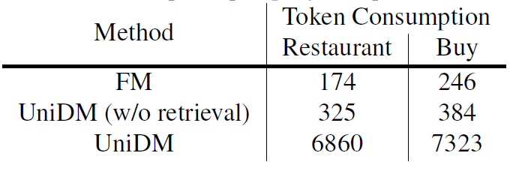
Conclusions & Future Works
Identifying tasks LLMs are truly capable of
A unified and automatical framework for a class of data manipulation tasks
Invoking LLM multiple times: teaching LLMs in the same way of teaching kids
Automatic Context Retrieval (finding examples) ->
Context Data Parsing (understanding the examples) ->
Target Prompt Construction (asking the right question)
Improving efficiency, fine-tuning, RAG, …
Text-to-SQL (Gao et al., VLDB2024)
+ data manipulation (this work)
+ feature augmentation (Lin et al., CIDR2024)
=> a copilot for data scientists? (building)

Slide 21
UniDM: A Unified Framework for Data Manipulation with Large Language Models
Q & A
Bolin Ding
bolin.ding@alibaba-inc.com
通义

