Slide 1


SMARTFEAT: Efficient Feature Construction through Feature-Level Foundation Model Interactions
Yin Lin†, Bolin Ding*, H. V. Jagadish†, Jingren Zhou*
† University of Michigan – Ann Arbor
* Alibaba Group
Notes:
Hi everyone, my name is Yin. I am PhD student from the University of Michigan.
I’ll be presenting smartfeat, which is an Automated Feature Engineering tool that construct useful features using feature-level interaction with foundation models.

Slide 2
Data Preparation Pipelines
Data Integration
Dataset
ML predication
Data cleaning
Feature Engineering
Modeling
…
Raw Data Collection
Reporting & representing
Data scientists spend on average 38% of their time on data preparation .
1
Highly dependent on domain expertise, and usually require considerable manual effort.
1 State of Data Science, Anaconda 2022.
Motivation > Approach > Experiments > Conclusion
Notes:
Raw data collected from various sources are seldom suitable for direct use in ML or data analytics. There is usually a need for appropriate data wrangling.
Traditional data preparation pipelines typically involve several key stages, including data integration, data cleaning, feature engineering, and modeling. Afterwards, these refined datasets are employed for machine learning prediction and reporting purposes.
(Click) However, studies reveals that data scientists spend on average 38% of their time on data preparation, involving both the data cleaning and the feature engineering tasks.
(Click) These processes are usually dependent on domain experti[tai]se and often demand significant manual efforts."

Slide 3
Automated Feature Engineering Tools (AFE)
Predefined ops, integrate multiple relations…
Heuristic algorithms, pre-trained classifier…
Trained the new data to observe performance improvements
Dataset
Candidate Feature Generation
Feature Selection
Candidate Feature Evaluation
Org feature set
Add new Feature
Drawbacks:
(1) Candidate generation step usually generates a power set of non-meaningful features and require extensive feature selection efforts (expansion-selection): ExploreKit [1], DSM [2], OneBM [3].
(2) Feature selection step sometimes have low efficiency: Cognito [4], AutoFEAT [5].
Can we make use of dataset column context and external knowledge to facilitate AFE?
Motivation > Approach > Experiments > Conclusion
Notes:
To assist non-experts in preparing their data, automated feature engineering tools have been developed for constructing high-quality features in datasets.
The process includes candidate feature generation, feature selection, and evaluating performance improvements.
(Click) However, traditional AFE methods have drawbacks. Firstly, in the candidate generation step, a power set of non-meaningful features is often produced, requiring extensive efforts in feature selection. This leads the feature selection step have low search efficiency.
(Click) Given the above drawbacks, one direction to improve the AFE tools involves leveraging column context and external knowledge to minimize the search space.

Slide 4
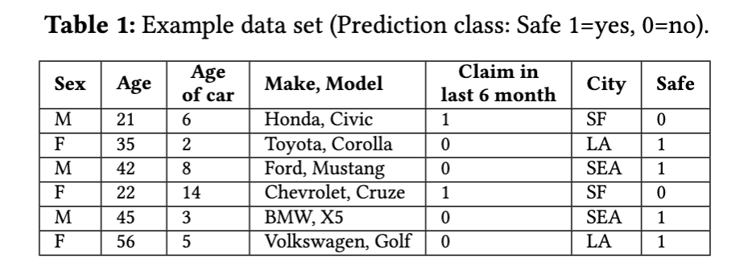
Benefits of FM-based AFE to traditional AFE
Foundation models trained on extensive data and can be applied to new tasks without task-specific fine-tuning.
F1: Bucketize Age: Groups individuals’ ages into predefined bins (e.g. Age >21, Age < 21) using a bucketization function.
F2: Manufacturing Year of Car: (Current Year-Age of the Car) Computes the difference between the car’s age and the current year.
Advantages of utilizing FMs:
F3: Claim Probability per Car Model: (Groupby(Make, model).avg(Claim in last 6 month)) Provides the historical claim probability for each car model.
Broader coverage of operators leveraging encoded knowledge (F1).
2. Better explainability and efficiency (F2).
3. Ability to generate highly correlated features (F3).
4. Ability to access external data and resources (F4).
F4: City Population Density: Extracts population density information from the city feature.
Motivation > Approach > Experiments > Conclusion
Notes:
Foundation models are a natural choice for this purpose.
They are trained on extensive data and can be applied to new tasks without specific fine-tuning.
They can leverage column context and integrate external knowledge gained from large web-crawled training dataset.
Consider the example dataset for an insurance company to quote the insurance rate based on the safe attribute.
Using FMs can have the following advantages,
it has broad coverage of operators, for example, it can bucketize the age attribute based on a frequently used real-world threshold as 21 years old.
It generate features that has better explainability. For example, taking the difference of the current year and the age of the car to compute the manufacturing year of the car.
(3) It has the ability to generate highly correlated features, such as a historical claim probability for each car model.
(4) It also has the access to external data and resources such as fetching the city population density.

Slide 5
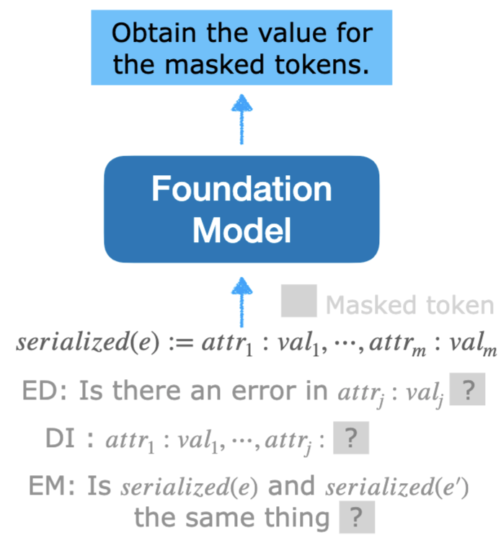
Formulating Data Management Problem using FMs
How to incorporate FMs, designed to process NL input and generate corresponding NL output into data management tasks?
2
Researches have explore the use of FMs for data tasks: error detection, data imputation, entity matching
Row-level interactions:
(1) serialize each entry with a masked token, (2) uses FMs to predict the masked token.
Drawback: Takes ~5min to process only 200 rows. Inefficient for large datasets!
Feature-level FM interactions improves the efficiency of incorporating FMs into data tasks.
Product: iPad, Department: ?
Output: Electronics
2 Narayan et al, CIDR 2022.
Motivation > Approach > Experiments > Conclusion
Notes:
However, a key challenge remaining is how to incorporate foundation models, which process natural language input and generate natural language output into data tasks.
(Click) Previous works have explore the usage of foundation models for data tasks. They mostly follows a row-level interaction method: Firstly they serialize each data entry with a masked token and then use foundation models to predicate the masked token.
(Click) For example, in a data imputation task to fill in the department for a given product, they first serialize each data entry, then set the value to be imputed as a masked token, and ask FM to obtain the masked token.
However, Despite the usefulness, these methods suffer from low efficiency. Because processing each data entry requires an API call, and with models like GPT, this can take about 5 minutes to process 200 rows. It is very inefficient and expensive for large datasets.
In this paper, we look into a more efficient interaction method, which improves the efficiency of incorporating FMs into feature engineering.

Slide 6
Agenda
Motivation
Approach:
Overview
Operator guided feature generation
Transformation function generation
Experiments
Conclusion
Notes:
I’ll first introduce the system overview and then go into the technical details and experiments.

Slide 7
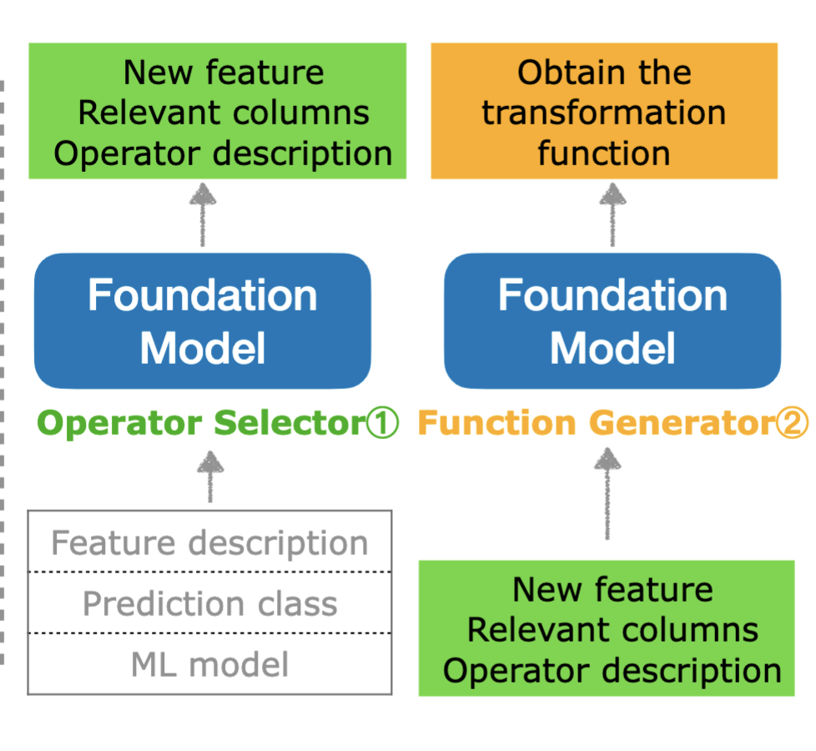
Overview - SMARTFEAT
Operator selector generates the most suitable new feature candidates
Function generator obtains the most appropriate transformation function to construct the new feature.
2. Two core components:
1. System input: Feature description - description of the feature content, data type, and data domain of categorical features.
Motivation > Approach > Experiments > Conclusion
Notes:
Here is the overview of our feature engineering tool, SMARTFEAT.
(Click) The system input comprises three parts: a feature description, the prediction class, and the ML model used downstream. The feature description typically comes with the data card or can be user-specified, providing a concise overview of the feature content, data type, and data domain.
(Click) SMARTFEAT consists of two key components: (click) an operator selector, which generates the most suitable new feature and outputs the name and description of the new feature, along with the relevant columns needed to compute it; and
(click) a function generator, which determines the most appropriate transformation function for constructing the new feature.

Slide 8
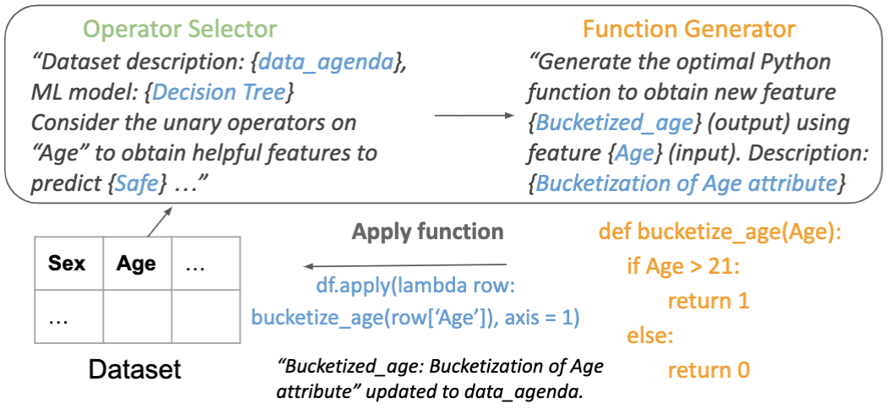
Feature-level interactions with FMs: Running example
Motivation > Approach > Experiments > Conclusion
Notes:
We now illustrate how SMARTFEAT generates each feature using the example.
Given the feature description, prediction class, and the ML model, the operator selector determines a new feature, such as "bucketized age," and identifies the relevant feature ("age") and its description.
These outputs are given to the function generator, which identifies the most suitable transformation function. This function is then applied to the dataset to obtain the values for the new feature.

Slide 9
Agenda
Motivation
Approach:
Overview
Operator guided feature generation
Transformation function generation
Experiments
Conclusion
Notes:
We now look into each component.

Slide 10
Operator Types
3
Instead of using an iterative searching for obtaining new features, we use an operator guided search process to enrich the search space.
Unary operators: encompass normalization, bucketization, and a set of unary operations such as getting dummies, date splitting, etc.
Binary operators: include four basic arithmetic operations: +, −, ×, ÷. The more complex combinations of two original features are discussed by extractor operators.
High-order operators: the 𝐺𝑟𝑜𝑢𝑝𝑏𝑦𝑇ℎ𝑒𝑛𝐴𝑔𝑔 operation.
Extractor: It handles more complex transformations of multiple features and information extractions, such as computing an index as a weighted combination of several features. It can also leverage external knowledge to extract specific information, e.g. obtaining the population density for each city in the motivating example.
3 Hollmann et al, NeurIPS 2023.
Motivation > Approach > Experiments > Conclusion
Notes:
For feature generation, we use an operator guided search process to enrich the search space.
We categorize operators into four types:
(Click) Unary operators, covering normalization, bucketization, and a set of unary operations like getting dummies, date splitting, etc.
(Click) Binary operators, encompassing the four basic arithmetic operations on two features.
(Click) High-order operators, such as the groupby-then-aggregate operator.
(Click) Extractors, which handle more complex transformations, including the weighted combination of multiple features and the extraction of specific information.

Slide 11
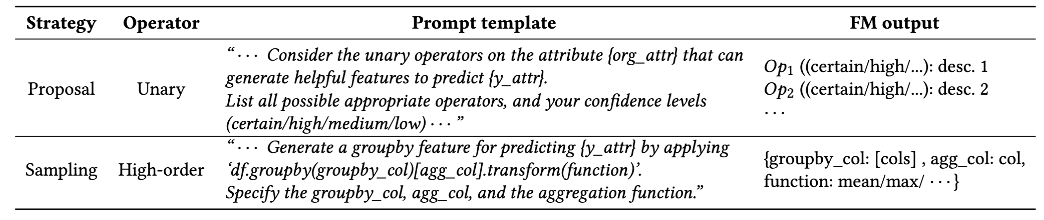
Prompting FM for Operator Selection
Operator selector contains a set of prompt templates for each type of operators. The operators follows two different prompting strategies .
4
Proposal strategy: FMs are prompted to proposal all potential candidates for Op, the SMARTFEAT selects the most probable options. [Small search space] [Avoids duplication].
Sampling strategy: FMs are prompted to provide one candidate Op at a time. [Rich generation space]
[More efficient generation].
3 Yao et al, NeurIPS 2023.
Motivation > Approach > Experiments > Conclusion
Notes:
The operator selector contains a set of prompt templates for each type of operator. We enumerate each potential operator template to generate feature candidates. Two prompting strategies are employed in these templates. (Click)
The first strategy is the proposal strategy, in which the FMs are prompt to propose all potential candidates. It is more suitable for smaller search spaces as it avoids duplication. (Click) For instance, for unary operator, SMARTFEAT prompts the foundation model (FM) to list all possible appropriate unary operations and their confidence levels. The SMARTFEAT parser later selects operators with certain or high probabilities.
(Click) The second strategy is the sampling strategy, where FMs are prompted to provide one candidate at a time. It is more suitable for larger search spaces, as it generate candidates more efficiently. (Click)For instance, when dealing with the high-order operator, the search space would become exponential to the number of current features. In such cases, the sampling strategy is employed to obtain one candidate at a time.

Slide 12
Generating the Candidate Feature Set
We begin by exploring unary operators for each original feature using the proposal strategy. Based on the original and unary features, we apply binary and high-order operators using the sampling strategy.
The sampling process for each type of operator concludes (1) when the number of generation errors reaches a threshold or (2) the number of generated attributes reaches the sampling budget.
Lastly, we consider extractors that can operate on multiple features using the sampling strategy, further enriching the current feature set.
Motivation > Approach > Experiments > Conclusion
Notes:
Now we review the process of candidate feature generation.
We begin by exploring unary operators for each original feature using the proposal strategy.
Based on the original and unary features, we apply binary and high-order operators using the sampling strategy.
The sampling process for each type of operator ends when generation errors or the number of generated attributes reaches a threshold.
Lastly, we consider extractors that can operate on multiple features using the sampling strategy, further enriching the current feature set.

Slide 13
Agenda
Motivation
Approach:
Overview
Operator guided feature generation
Transformation function generation
Experiments
Conclusion
Notes:
Now we talk about the function generator.

Slide 14
Feature Value Generation and Evaluation
Goal: generate the lambda function to obtain the feature value.
Input: new feature name, description, relevant features.
A lambda function can be obtained (external package might be needed).
Return a python code that can be applied to the dataframe. Include external packages when needed.
The new feature value can be obtained from the row-level interaction.
Perform row-level completion attr1:val1, attr2:val2… attr_k, ?
Report the first 3 rows to the users to determine if it is necessary to continue the process.
External data sources are needed.
Suggest potential data sources to assist data users in constructing the new feature.
Feature selection: After a new feature is generated, we check the quality of the new feature. Remove features that are highly null, single-valued, or dummy variables derived from high cardinality original features.
Motivation > Approach > Experiments > Conclusion
Notes:
Our goal is to derive the lambda function for computing the feature value.
We address three situations:
(1) If a lambda function can be obtained, SMARTFEAT returns a Python code as well as any potential library dependencies.
(2) Where such a function does not exist, but the value can be obtained from a row-level interaction, SMARTFEAT reports the first three imputed rows and lets users make a decision.
(3) When external data sources are needed, SMARTFEAT suggests potential data sources to the users.
(Click) We also include a feature selection module to enhance the quality of the new features by removing the features that are highly null, single-valued or less useful dummy variables.

Slide 15
Agenda
Motivation
Approach:
Overview
Operator guided feature generation
Transformation function generation
Experiments
Conclusion
Notes:
Lastly, we talked about the evaluation.

Slide 16
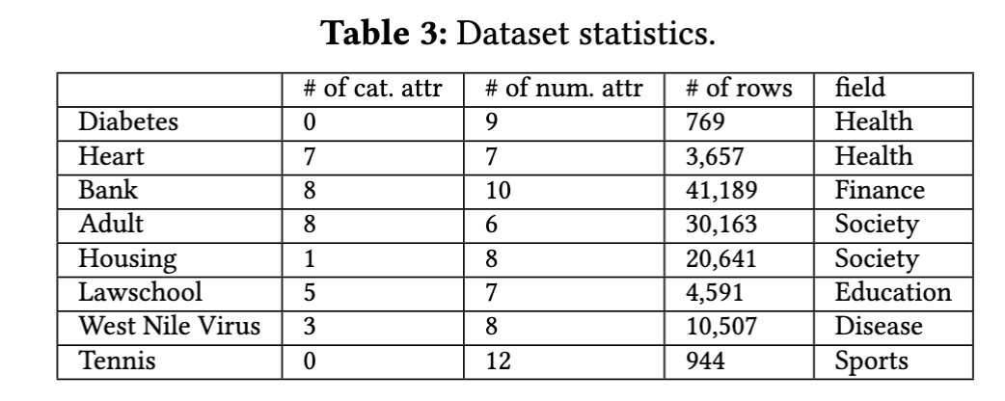
Experimental Settings
FM: GPT-4
Dataset: 8 ML binary classification datasets
ML algorithms: LR, NB, RF, ET, DNN
Metrics: AUC score
Baselines:
ExploreKit. Exhaustively generate new features using pre-defined operators and incorporates feature selection model to remove highly null and single-valued features.
AutoFEAT. Constructing a large set of non-linear features and subsequently performing a search algorithm to select a subset.
CAAFE. Utilizing LLMs to generate Python code for data transformations and then validate if the new features enhance the performance.
Motivation > Approach > Experiments > Conclusion
Notes:
We use GPT-4 as our foundation mode, and we use 8 machine learning binary classification datasets in various fields. We consider 5 classification algorithms, logistic regression, naive bayes, random forest, extra tree, and a deep neural network which posses the ability to learn deep features.
We consider the standard AUC score as the evaluation metric.
We compare with three State of the art AFE tools. Among these tools, CAAFE also utilizes Foundation models to iteratively generate the python code for data transformation.

Slide 17
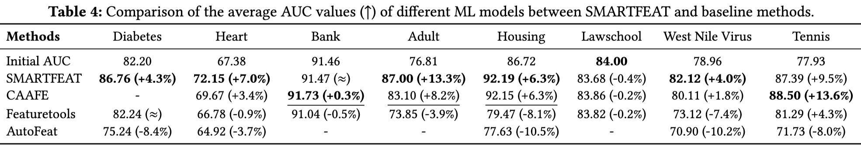
AUC score improvement
1. FM assisted methods (SMARTFEAT, CAAFE) outperforms other baselines.
2. CAAFE experienced a time-out for large datasets on the DNN model because of its feature evalautuon step.
3. Bank and Lawschool dataset have well constructed features and thus the performance improvement is not evident.
Values are expressed in percentage (%).
Motivation > Approach > Experiments > Conclusion
Notes:
We first examine the average AUC scores of various machine learning models.
Methods assisted by foundation models usually outperform other baseline approaches.
CAAFE exhibits better performance on the Bank and Tennis datasets. This is because it performs feature evaluation using the validation set. However, it also sometimes encounters timeout on large datasets due to this time-consuming evaluation. However, in most cases, it generate less useful features than SMARTFEAT.
The Bank and Lawschool datasets demonstrate lower improvement across all baselines, because their original features are well-constructed.

Slide 18
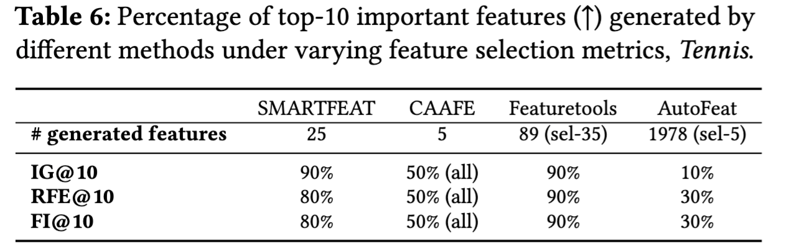
Feature Importance of generated features
Metrics: Information Gain, Recursive Feature Elimination, and Feature Importance.
CAAFE generates less new features, but all new features generated are important under all metrics.
SMARTFEAT generates a small number of new features and indicate the generation of useful features.
Featuretools obtains important features but with a larger number of generated features.
AutoFeat acquires a vast set of new features but the feature selection steps only retain 5 less important features.
Motivation > Approach > Experiments > Conclusion
Notes:
We next look into the feature importance generate by each baseline. We consider three metrics from Sklearn, the information gain, the recursive feature elimination and the feature importance metrics.
We can see that
(Click)CAAFE generates only 5 new features, but all of them prove to be important across all metrics.
(Click)SMARTFEAT also produces a small number of new features and showcases the generation of more useful features.
(Click)Featuretools identifies important features but with a larger number of generated features.
(Click)AutoFeat acquires an extensive set of new features, yet the feature selection steps retain only 5 less important features.

Slide 19
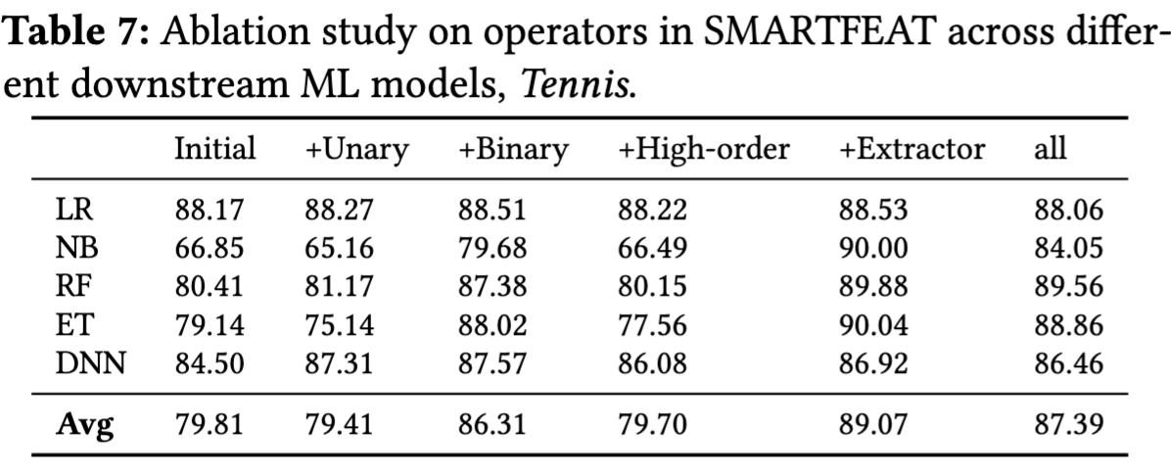
Ablation Study
The binary and extractor operators usually bring performance improvement (NB, RF, and ET).
The extractor mainly generates index-like attributes computed as the combination of a set of attributes.
LR’s performance remains almost unaffected. For DNN, we observed that almost all types of features contribute to enhancing the prediction results.
Because Tennis a relatively small dataset, simple models with well-constructed features usually performs better.
When lacking feature descriptions (only using feature names), SMARTFEAT’s performance dropped from 87.39 (+9.5%) to 77.86 (-2.2.%), highlighting the importance of meaningful feature descriptions especially when clear and informative feature names are not available.
Values are expressed in percentage (%).
Notes:
Lastly, we check how each type of operators in SMARTFEAT affects performance using the Tennis dataset.
Specifically:
(Click) Binary and extractor operations usually boost performance, especially for models like naive bayes, random forest, and extra tree.(Click)
(Click) Logistic regression’s performance doesn't change much, while for DNN, all types of features contribute to better predictions. This is because for this small dataset, simpler models and well-constructed features usually work better.(Click) But the conclusion would various for different dataset characteristic.
(Click)We also tested SMARTFEAT when a detailed feature description is not available.
The AUC score dropped from ~87 to ~78. This emphasizes the importance of meaningful feature descriptions, especially when feature names are not illustrative and clear.

Slide 20
Agenda
Motivation
Approach:
Problem definition
Score computation algorithm
Score explanation and statement refinement
Experiments
Conclusion
Notes:
To sum up/

Slide 21
Conclusion
AFE tool leverages Foundation Models to enable the utilization of column-context and external knowledge.
Feature-level interactions to enhance the efficiency of FM usage.
Handling unpredicted errors of generative AI models?
Apply to other tasks?
Motivation > Approach > Experiments > Conclusion
Notes:
(Click) We proposed an automated feature engineering tool that leverages foundation models, to enable the utilization of column-context and external knowledge.
(Click) The major novelty of SMARTFEAT lies in its feature-level interactions with the foundation model to enhance the efficiency of its usage.
(Click) However, there are still challenges to address in utilizing such generative AI for data tasks, for example, generative AI is prone to unpredictable errors. In our approach, we mitigate this by employing a feature selection procedure to filter out potentially harmful new features. Effectively managing generation errors is an important concern in this context.
In addition, this paper primarily focuses on the feature engineering task. For broader data tasks such as data cleaning, intergration, more input information than the feature description is need. We think exploring the use of higher-level interactions instead of row-level interactions as a future direction.
That’s all for my talk, thank you for your listening.

Slide 22
References
[1] Katz G, Shin E C R, Song D. Explorekit: Automatic feature generation and selection[C]//2016 IEEE 16th International Conference on Data Mining (ICDM). IEEE, 2016: 979-984
[2] Kanter J M, Veeramachaneni K. Deep feature synthesis: Towards automating data science endeavors[C]//2015 IEEE international conference on data science and advanced analytics (DSAA). IEEE, 2015: 1-10.
[3] Kanter J M, Veeramachaneni K. Deep feature synthesis: Towards automating data science endeavors[C]//2015 IEEE international conference on data science and advanced analytics (DSAA). IEEE, 2015: 1-10.
[4] Khurana U, Turaga D, Samulowitz H, et al. Cognito: Automated feature engineering for supervised learning[C]//2016 IEEE 16th International Conference on Data Mining Workshops (ICDMW). IEEE, 2016: 1304-1307.
[5] Horn F, Pack R, Rieger M. The autofeat python library for automated feature engineering and selection[C]//Machine Learning and Knowledge Discovery in Databases: International Workshops of ECML PKDD 2019, Würzburg, Germany, September 16–20, 2019, Proceedings, Part I. Springer International Publishing, 2020: 111-120.

Slide 23
Handling GroupBy Features
We allow the inclusion of 'y_label' in the aggregate column.
The aggregate information from the training set is utilized to impute this groupby feature for the test set.
In cases where the mapping fails for a specific test column, we resort to using the aggregate value from the entire training set for imputation.
If the groupby columns have high cardinality, which could lead to numerous mapping failures during the imputation process, we drop this groupby feature.

