Slide 1
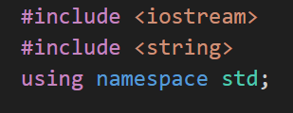
Tic tac toe
Code overview
<Iostream> is a preprocessor directive that includes the Input/Output Stream Library.
<string> includes the string library, enabling the program to use the std::string class, which provides functionality for handling strings in C++.
using namespace std -> This line brings the entire std namespace into the current scope.The std namespace contains all the standard library functions and classes like cout, cin, endl, and string.

Slide 2
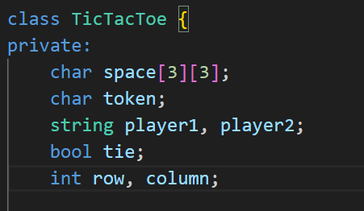
Private Data Members:
char space[3][3]: A 3x3 array representing the Tic Tac Toe board, where each element stores the state of a cell (e.g., empty, 'X', or 'O’).
char token: Indicates whose turn it is ('X' or 'O’).
string player1, player2: Store the names of the two players.
bool tie: A flag to check if the game has ended in a draw.
int row, column: Hold the row and column indices where the current player wants to place their token.

Slide 3
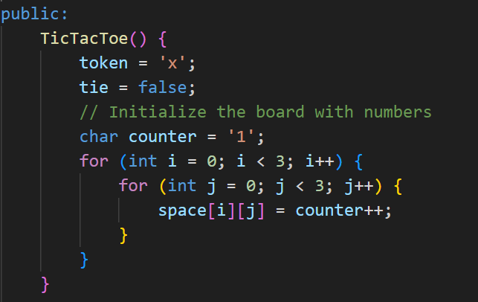
This is the constructor for the Tic-tac-toe class, which
initializes the game:
Set Default Token:
token = 'x': Player 1 starts the game with 'X’.
2. Set Tie Flag:
tie = false: The game is not a draw at the start.
3. Initialize the Board:
Fills the space array with numbers ('1' to '9') to
represent the board's positions, making it easy for
players to select cells by number. - Uses a counter
(char counter = '1') that increments for each cell.

Slide 4
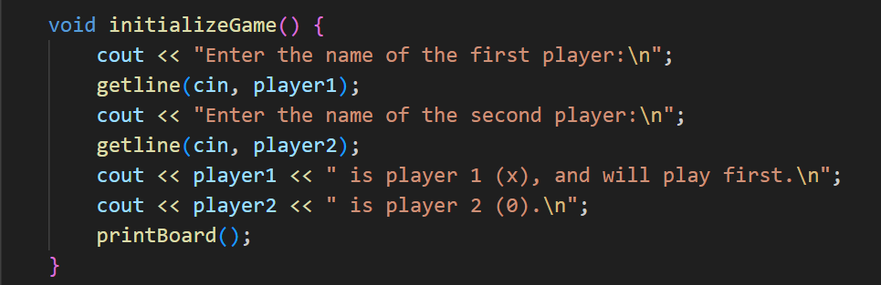
The initialize Game function sets up the Tic Tac Toe game:
Input Player Names:
Prompts the users to enter their names and assigns them to player1 and player2.
Assign Tokens:
Declares player1 as player 1 (using 'X') and player2 as player 2 (using 'O’).
Print Initial Board:
Calls print Board() to display the empty game board at the start.

Slide 5
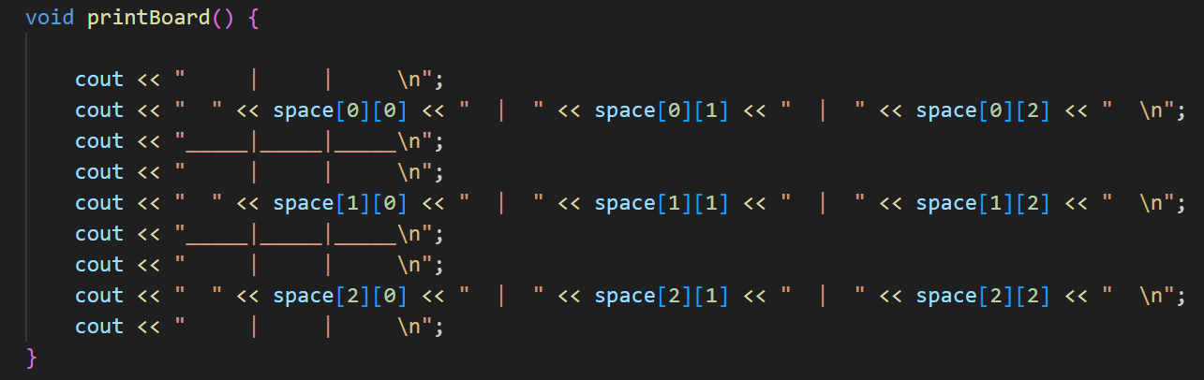
This function printBoard() prints a Tic-Tac-Toe board. It uses the space 2D array to display the current state of the game grid, with three rows and columns separated by lines and spaces for readability.

Slide 6
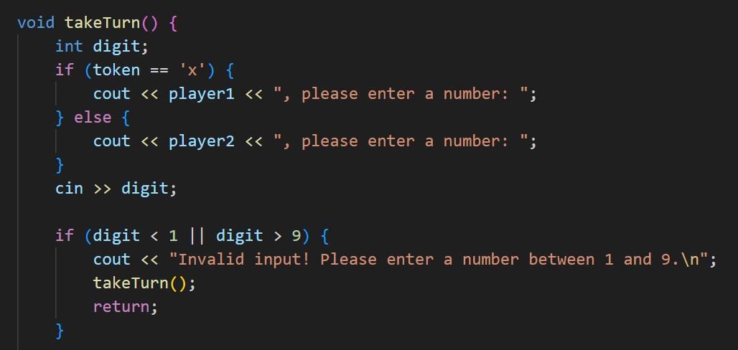
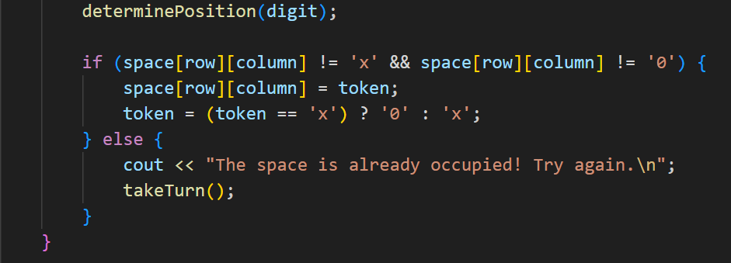

Slide 7
The take Turn function handles a player's move:
Prompt Input:
Asks the current player (based on token) to enter a number (1–9).
Validate Input:
Ensures the number is within the valid range. If not, it recursively asks for input
again.
Determine Position:
Converts the entered number into the corresponding row and column on the
board.
4. Make Move:
Places the player's token ('X' or 'O') if the space is empty.
Switches the turn to the other player.
If the space is occupied, it asks the player to try again.

Slide 8
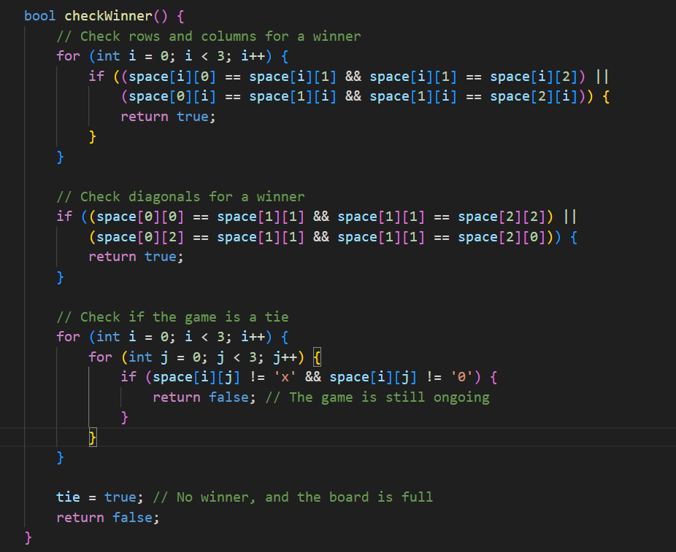

Slide 9
The check Winner() function determines the game state in Tic-Tac-Toe:
Rows and Columns:
Loops through rows and columns to check if any have the same symbol, indicating a win.
2. Diagonals:
Checks the main and anti-diagonals for matching symbols, signaling a win.
3. Return true:
If a row, column, or diagonal has a winner, the function immediately returns true.
4. Board Check:
If no winner, loops through the board to check for empty spaces.
5. Game Ongoing:
Returns false if an empty space is found, meaning the game isn't over.
6. Tie Check:
If no empty spaces remain and no winner, sets the tie variable to true.
7. Return false:
Returns false if the game is a tie or ongoing without a winner.
This function ensures proper game flow by accurately identifying winners, ties, or ongoing states.

Slide 10
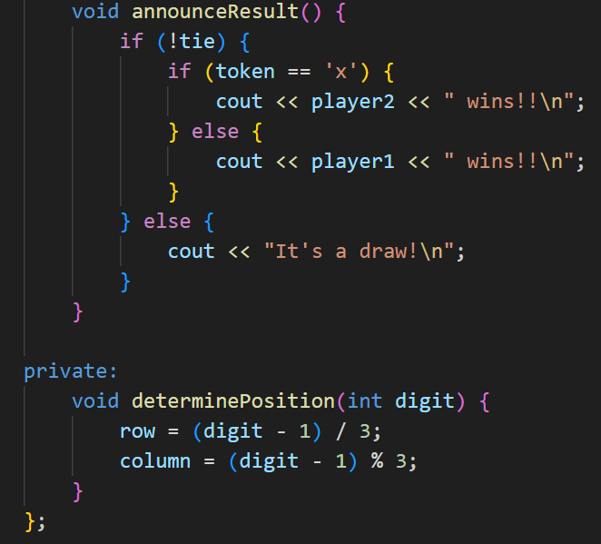
The announce Result function declares the game's outcome:
If Not a Tie:
Announces the winner based on the last player who made a move.
If a Tie:
Displays "It's a draw!"

Slide 11
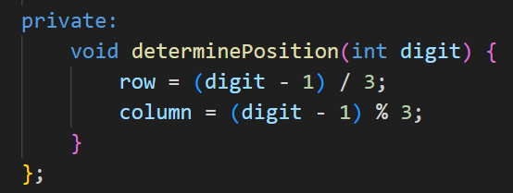
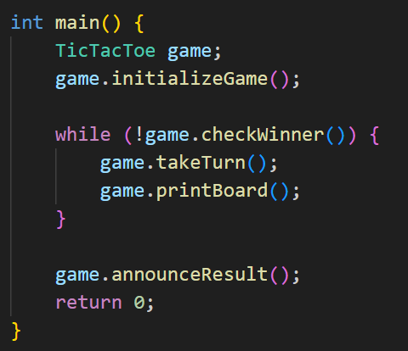
The determinePosition function calculates the row and column of the board based on the player's input number (digit):
Row: (digit - 1) / 3 determines the row index. -
Column: (digit - 1) % 3 determines the column index.
This maps a number (1–9) to the corresponding position on the 3x3 board.
This main() function runs a Tic-Tac-Toe game:
Initialize: Creates a TicTacToe object and sets up the game.
Game Loop: Repeats until there’s a winner or a tie: - Players take turns (take Turn()). - Prints the board after each turn (printBoard()).
3. Result: Announces the game outcome (announce Result()).
Finally, it exits with return 0;.

