Slide 1

AI-Driven Analysis of Climate-Induced Biodiversity Loss: Predicting Species Decline and Conservation Strategies under RCP 8.5
22BIO211 – Intelligence of Biological Systems - 2
TEAM - 2
CH.SC.U4AIE23006 – BOLLIMUNTHA KAVYA SAI
CH.SC.U4AIE23029 – MAMIDI SUMITHRA BHARGAVI
CH.SC.U4AIE23041 – PARVATHY VINOD
CH.SC.U4AIE23057 – V J RENUKA
CH.SC.U4AIE23058 – V V N S POORNA CHANDRIKA

Slide 2
Introduction
Biodiversity is a critical component of ecosystem stability, providing essential services such as pollination, climate regulation, and water purification.
The Representative Concentration Pathway (RCP) 8.5 scenario represents a worst-case climate change trajectory, predicting a global temperature rise of over 4°C by 2100.
Under this scenario, species experience severe habitat loss, range shifts, and an increased risk of extinction. Many species, particularly mammals and birds, are forced to migrate across transboundary regions, where conservation efforts are often fragmented due to inconsistent environmental policies between nations.
Traditional ecological monitoring techniques struggle to keep pace with rapid biodiversity changes. However, advances in Artificial Intelligence (AI), machine learning, and remote sensing offer new opportunities to analyze species distribution patterns, predict extinction risks, and optimize conservation strategies.

Slide 3
Problem statement
Climate change is accelerating species decline, with mammals and birds being among the most affected. Rising temperatures and habitat destruction are forcing species to migrate, often across international borders.
Key challenges include:
Lack of coordinated conservation strategies for transboundary species.
Inability of traditional ecological monitoring techniques to track biodiversity loss in real-time.
Thus, there is an urgent need for data-driven approaches to identify species at risk, predict future biodiversity loss, and formulate effective conservation policies.

Slide 4
Objectives
The primary goal of this study is to analyze and predict species decline under RCP 8.5 using AI-driven methodologies. The specific objectives include:
Quantify species decline under extreme climate scenarios, focusing on mammals and birds.
Identify high-risk transboundary regions experiencing significant biodiversity loss.
Assess conservation gaps in protected areas and ecological corridors.
Propose AI-driven conservation strategies for high-risk regions and transboundary ecosystems.

Slide 5
Literature Review
Theme | Focus | Papers Involved | Insights/Challenges
AI & Modeling in Biodiversity | Use of SDMs, MaxEnt, BRT, RF, GIS tools, and ensemble models for species prediction and conservation mapping | Papers 1, 8, 10, 13, 15, 17 | High predictive power, but limited real-time adaptability, ecological interaction modeling.
Transboundary Conservation Studies | Cross-border species movement, habitat corridors, international policy cooperation | Papers 3, 4, 10, 17, 20 | Emphasize shared biodiversity zones, but lack robust governance frameworks and multinational data sharing
Regional Case Studies | Country/region-specific analysis (e.g., Thailand, Mekong, Yangtze) under climate pressure | Papers 2, 5, 6, 9, 11, 19 | Rich local insights, but limited scalability, policy integration, and dynamic land-use modeling
Climate Scenario-Based Studies (RCP/SSP) | Species/habitat projections under RCP2.6, 4.5, 8.5 or SSP pathways | Papers 2, 4, 5, 10, 13, 16, 17, 19 | Good scenario integration, but limited consideration of species adaptability, extreme events, and dispersal barriers

Slide 6
Common Methodologies Used among all papers:
1. Species Distribution Models (SDMs)
i. MaxEnt (Maximum Entropy Model)
MaxEnt predicts species distribution using presence-only data and environmental variables.
It estimates the most probable distribution with maximum entropy (i.e., least bias).
Popular for its accuracy with small datasets and minimal input requirements.
ii. Ensemble Modeling (BRT, RF, GLM)
Ensemble modeling combines multiple algorithms to improve prediction robustness.
It reduces individual model biases and increases confidence in outputs.
Commonly used for species distribution and climate impact studies.
2. Zonation
Zonation ranks areas based on biodiversity value to identify conservation priorities.
It helps create spatial conservation plans under current and future scenarios.
Used for habitat prioritization and gap analysis in protected areas.

Slide 7
Common Methodologies Used among all papers:
3. InVEST (Integrated Valuation of Ecosystem Services and Tradeoffs)
InVEST models ecosystem services like habitat quality, carbon storage, and water regulation.
It evaluates trade-offs between development and conservation.
Useful for sustainable land-use planning and climate adaptation strategies.
4. Circuitscape
Circuitscape models wildlife movement and connectivity using electrical circuit theory.
It identifies critical corridors that facilitate species migration.
Widely applied in fragmented landscapes to guide conservation infrastructure.
5. FRAGSTATS
FRAGSTATS analyzes spatial patterns of land cover to quantify habitat fragmentation.
It calculates metrics like patch size, shape, and isolation.
Used to assess landscape structure's impact on biodiversity.

Slide 8
Representative Concentration Pathway(RCP)
How is RCP Calculated? RCPs predict future greenhouse gas concentrations & climate impact based on emissions, land use, and socio-economic factors.
RCP Scenarios & Warming Impact
RCP | Radiative Forcing (W/m²) | Expected Warming (°C)
RCP 2.6 | 2.6 W/m² | ~1.5°C (low emissions)
RCP 4.5 | 4.5 W/m² | ~2.4-2.6°C (moderate)
RCP 6.0 | 6.0 W/m² | ~3°C (high)
RCP 8.5 | 8.5 W/m² | ~4.3-5°C (extreme)
Key Factors in RCP Calculation Greenhouse Gas Emissions (CO₂, CH₄, N₂O, HFCs)
Measured in GtCO₂e, varies by RCP scenario. Land Use & Deforestation
RCP 2.6: Reforestation | RCP 8.5: Deforestation
Aerosols & Air Pollution
RCP 2.6: Low pollution | RCP 8.5: High emissions Socio-Economic Factors
Population, GDP, energy use (fossil fuels vs renewables).

Slide 9
Climate Impacts by Country Dataset
Contains country-level species richness data for mammals and birds under different climate scenarios.
Tracks percentage change in species populations under different RCP (Representative Concentration Pathway) scenarios, which model different levels of greenhouse gas emissions.
Includes economic and environmental indicators like GDP per capita, CO₂ emissions, and governance scores to analyze their impact on biodiversity.
Significance:
Helps identify countries most affected by biodiversity loss due to climate change.
Shows how economic growth and environmental policies impact species survival.
Provides future projections to guide conservation planning.

Slide 10
Dataset
Column Name | Description | Data Type
ISO3 | 3-letter country code (e.g., AFG for Afghanistan) | Object
current_mammal_SR | Current species richness for mammals | Float
rcp26_mammal_SR | Predicted species richness under RCP 2.6 scenario | Float
rcp85_mammal_SR | Predicted species richness under RCP 8.5 scenario (worst-case climate change) | Float
rcp85_mammal_pctChange | % change in mammal species richness under RCP 8.5 | Float
current_bird_SR | Current species richness for birds | Float
rcp85_bird_pctChange | % change in bird species richness under RCP 8.5 | Float
GDP_per_capita | Economic indicator (GDP per person) | Float
CO2_per_capita | CO₂ emissions per person | Float
Governance_score | Environmental governance effectiveness (higher score = better policies) | Float
How is it Measured?
Species richness is measured by counting the species in a country.
RCP scenarios simulate future biodiversity changes based on projected climate impacts.
Economic & environmental factors (GDP, CO₂ emissions, governance) are collected from global databases to examine their correlation with biodiversity trends.

Slide 11
Dataset
Transboundary Range Shifts Dataset
Analyzes how species (mammals & birds) are shifting their ranges across country borders due to climate change.
Focuses on transboundary regions, where conservation efforts must be coordinated between multiple nations.
Includes a barrier_species column, which shows the number of species facing migration barriers.
Significance:
Identifies cross-border biodiversity shifts, helping countries coordinate conservation efforts.
Highlights areas where species migration is blocked, indicating the need for wildlife corridors.

Slide 12
Dataset
Key Columns & Their Meaning
Column Name | Description | Data Type
border | Country border (e.g., AFG.CHN = Afghanistan-China) | Object
rcp45_mammals | Number of mammal species shifting under RCP 4.5 scenario | Integer
rcp85_mammals | Number of mammal species shifting under RCP 8.5 scenario | Integer
rcp45_birds | Number of bird species shifting under RCP 4.5 scenario | Integer
rcp85_birds | Number of bird species shifting under RCP 8.5 scenario | Integer
barrier_species | Number of species facing obstacles to migration (e.g., urban areas, mountains) | Float
How is it Measured?
Uses ecological models to predict species range shifts based on temperature & habitat suitability.
Barrier species are determined by analyzing geographical features that block movement (e.g., deserts, rivers, cities).

Slide 13
Transboundary Richness Dataset
Description:
Measures biodiversity richness in transboundary regions, where two or more countries share species.
Helps determine conservation priorities for regions with high species richness & many endangered species.
Significance:
Helps pinpoint biodiversity hotspots that require multinational conservation efforts.
Shows which borders have the highest number of endangered species, guiding conservation priorities.

Slide 14
Key Columns & Their Meaning
Column Name | Description | Data Type
border | Country border (e.g., AFG.CHN = Afghanistan-China) | Object
transboundary_richness | Total species richness shared between two countries | Integer
transboundary_richness_threatened | Number of threatened species shared between two countries | Integer
How is it Measured?
Species richness is determined by counting the total number of species present in border regions.
Threatened species are identified using global conservation databases (e.g., IUCN Red List).

Slide 15
Comparison of the Three Datasets
Dataset Name | Focus Area | Key Data | Purpose
Climate Impacts by Country | Country-level biodiversity trends | Species richness, % change, GDP, CO₂, governance score | Identifies national biodiversity risks and predicts species loss under climate change.
Transboundary Range Shifts | Species movement across borders | Mammal/bird migration under RCP 4.5 & 8.5, migration barriers | Analyzes where species are shifting and what obstacles they face.
Transboundary Richness | Shared biodiversity between countries | Species richness & threatened species in border regions | Identifies biodiversity hotspots requiring cross-border conservation efforts.
Why These Datasets Matter
Climate Impacts by Country → Helps predict biodiversity loss trends at the national level.
Transboundary Range Shifts → Shows how species are migrating across borders due to climate change.
Transboundary Richness → Identifies key regions for cross-border conservation efforts.

Slide 16
Methodology
Flow of the process:
Data Collection: Climate datasets, species richness data, transboundary biodiversity information.
Preprocessing & Analysis: Cleaning, feature selection, correlation analysis, clustering.
Predictive Modeling: Machine learning models for biodiversity loss forecasting.
Conservation Strategy Formulation: Identifying high-risk zones and conservation recommendations.
Tools & Technologies Used:
Libraries: Pandas, NumPy, Matplotlib, Seaborn, Scikit-learn
Machine Learning Models: Regression analysis, clustering, time-series forecasting
Visualization Tools: Heatmaps, histograms, geospatial mapping
Data Sources: Climate impact datasets, species migration records, biodiversity richness metrics

Slide 17
Methodology
Approach
Data Preprocessing
Handling missing values, filtering for high-risk species decline, merging datasets.
Exploratory Data Analysis (EDA)
Correlation heatmaps, distribution analysis, outlier detection.
Predictive Modeling
Regression for species decline trends, clustering for biodiversity risk zones, time-series forecasting for future predictions.
Conservation Strategy Development
Identifying high-priority conservation sites, policy recommendations, international collaboration strategies.

Slide 18
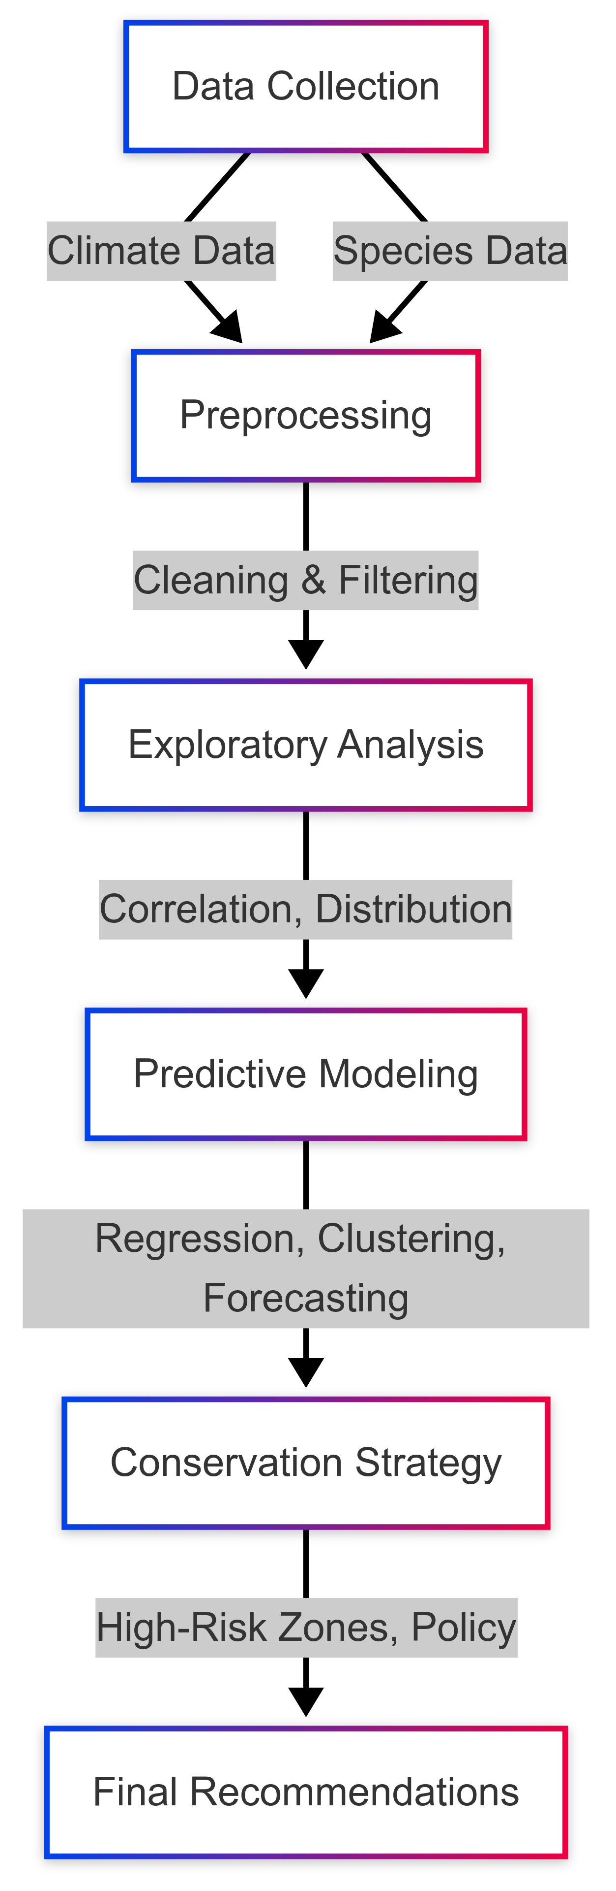
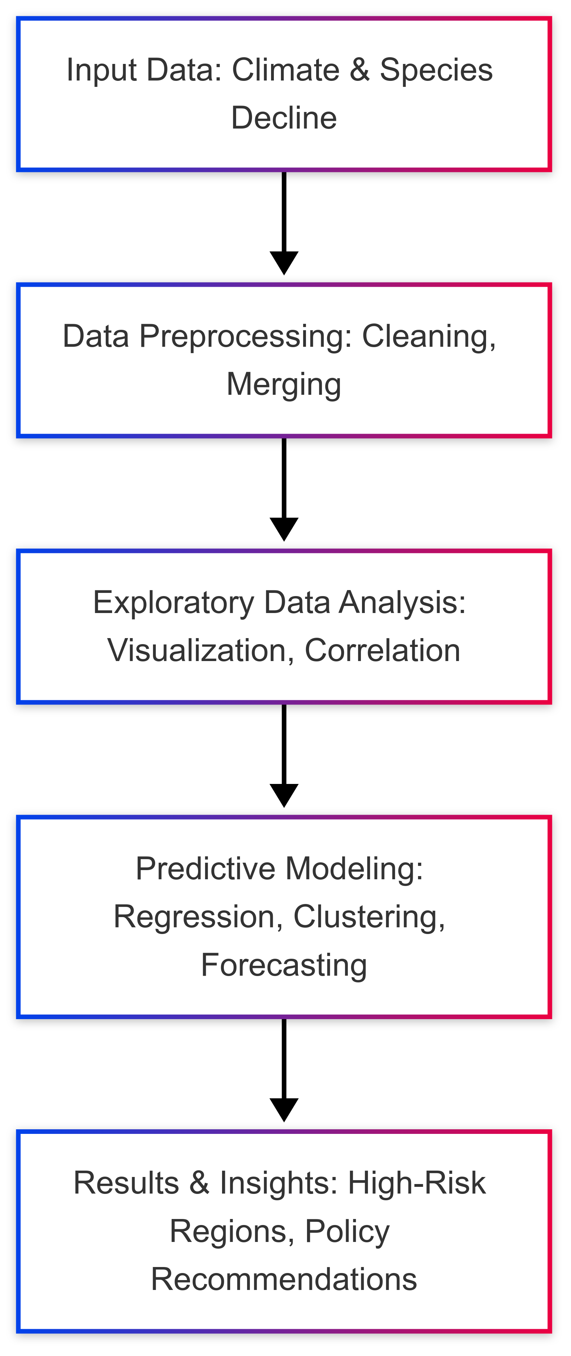
Architecture Diagram for AI-Driven Biodiversity Analysis
Architecture Diagram for AI - driven biodiversity analysis:

Slide 19
Architecture Diagram for AI-Driven Biodiversity Analysis
Architecture Diagram for AI - driven biodiversity analysis:

Slide 20
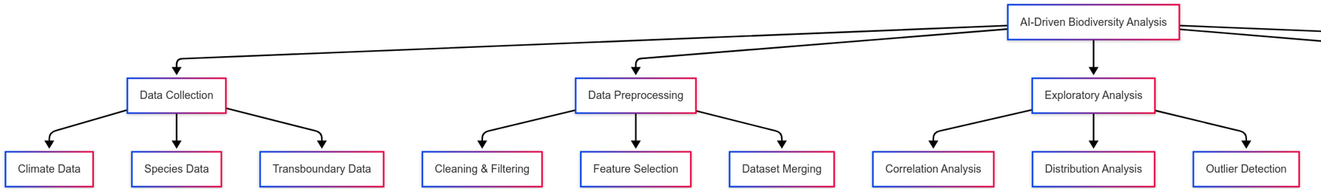
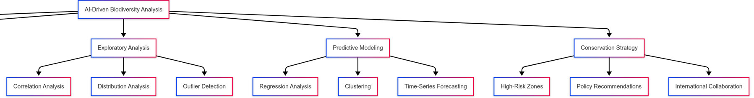
Architecture Diagram for AI-Driven Biodiversity Analysis
Architecture Diagram:

Slide 21
Result analysis and discussion
The study investigates the impact of climate change on biodiversity loss under the RCP 8.5 scenario, highlighting the decline of mammal and bird species across different regions and transboundary areas. Using AI-driven predictive modeling, heatmaps, and clustering techniques, the research identifies high-risk countries and conservation gaps.
Key Findings
A. Correlation Heatmap Analysis
Strong positive correlations were observed between species richness decline in mammals and birds under different climate scenarios (RCP 4.5 & RCP 8.5).
Transboundary richness and threatened species had a high correlation (~0.80), indicating biodiversity hotspots also have a large number of endangered species.
Weak correlation between barrier species movement and species decline, suggesting migration obstacles do not always lead to richness loss.

Slide 22
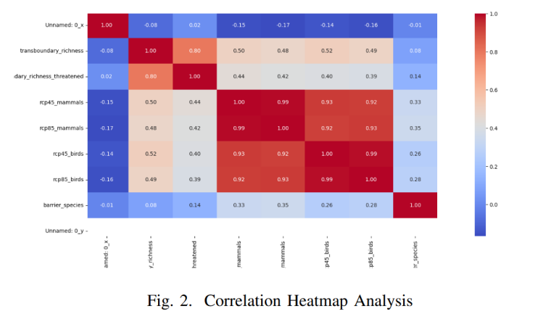
Result analysis and discussion
Key Insight:
Loss of biodiversity is consistent across species groups, with transboundary regions requiring urgent conservation efforts.
The intensity of the color indicates the strength and direction of the correlations.

Slide 23
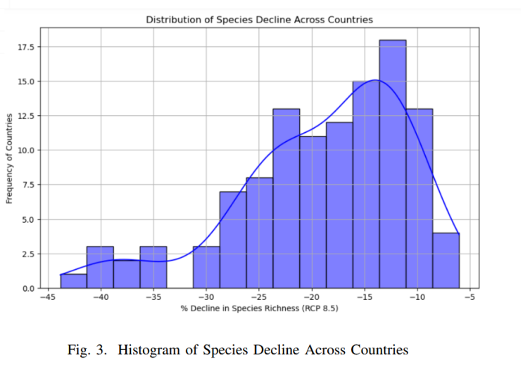
Result analysis and discussion
B. Species Decline Distribution Across Countries
A histogram analysis showed that most countries experienced moderate species decline (10-20%), while some faced severe declines (>30%).
Left-skewed distribution: Extreme losses concentrated in a few countries, highlighting biodiversity hotspots under significant threat.
Outlier countries with 40-45% species richness loss require immediate conservation interventions.
Key Insight: Climate-induced habitat loss is more severe in specific biodiversity-rich countries, necessitating targeted conservation.

Slide 24
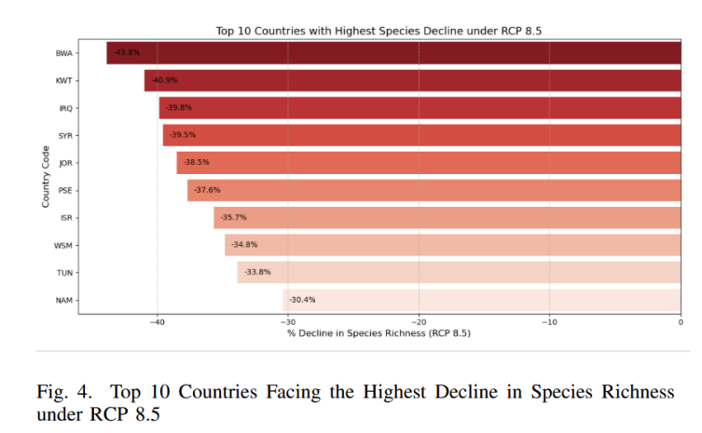
Result analysis and discussion
C. Top 10 Countries with Highest Species Decline (RCP 8.5)
Countries with the most biodiversity loss:
Botswana (-43.82%)
Kuwait (-40.24%)
Iraq (-39.83%)
Syria (-39.54%)
Jordan (-38.50%)
Palestine (-36.31%)
Israel (-35.66%)
Samoa (-34.81%)
Tunisia (-33.82%)
Namibia (-30.38%)
Key Insight: Countries in arid and semi-arid regions are more vulnerable due to rising temperatures and habitat degradation.
The barplot excellently showcases the degree of species decrease by each country with the ISO3 country codes on the y-axis and the percentage decrease on the xaxis.
These declines might be attributed to a myriad of climate change factors, such as increasing temperatures, habitat destruction, and changes in food chains

Slide 25
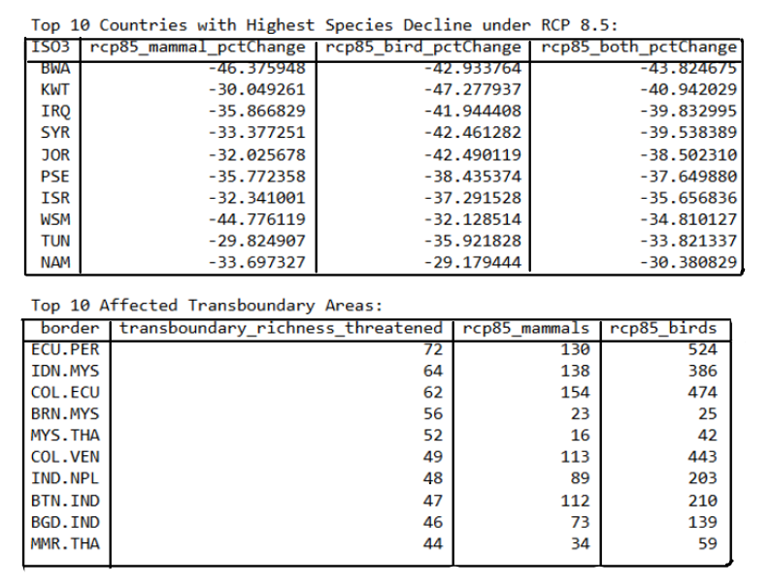
Result analysis and discussion

Slide 26
Result analysis and discussion
D. Top 10 Affected Transboundary Areas
Regions with highest species loss due to cross-border migration barriers:
Ecuador-Peru (ECU.PER): 72 threatened species
Indonesia-Malaysia (IDN.MYS): 64 threatened species
Colombia-Ecuador (COL.ECU): 62 threatened species
Brunei-Malaysia (BRN.MYS): 52 threatened species
Myanmar-Thailand (MMR.THA): 44 threatened species
Key Insight:
Conservation policies must extend beyond national borders to protect migratory species.
An additional ten most affected transboundary regions feature areas where species richness is under siege, with Ecuador-Peru (ECU.PER) showing the highest biodiversity loss.

Slide 27
Result analysis and discussion
A. Regression Analysis
High CO₂ emissions → higher biodiversity loss (positive correlation).
Stronger governance → lower species decline (negative correlation).
AI models accurately predicted species decline, showing climate conditions as the primary driver.
B. Clustering Analysis ( grouping countries based on biodiversity risk)
High-risk countries: Severe species loss (>30%). {Botswana, Kuwait, Syria}
Moderate-risk countries: Some species loss, conservation options available.
Low-risk countries: Relatively stable biodiversity.
C. Time-Series Forecasting (predicting the future biodiversity loss)
Under RCP 8.5, species richness could decline by over 30% in some regions.
Under RCP 4.5, biodiversity loss is slower, proving mitigation strategies can be effective.
Key Insight: AI-based models provide crucial insights for targeted conservation strategies.

Slide 28
Result analysis and discussion
Conservation Strategies and Recommendations
A. High-Priority Conservation Sites
Identified hotspots requiring urgent intervention (e.g., Botswana, Kuwait, and transboundary regions like Ecuador-Peru).
Expansion of protected areas and enforce strict conservation laws to prevent further loss.
B. Policy Interventions
Strengthen climate adaptation strategies (e.g., afforestation, habitat restoration).
Implement sustainable land-use policies to prevent deforestation.
Increase conservation funding for at-risk species.
C. Role of Global Conservation Initiatives
Current treaties lack enforcement—need stronger cross-border collaboration.
AI-driven conservation planning can analyze biodiversity threats and allocate resources efficiently.
Key Insight: International cooperation is essential to mitigate
biodiversity loss.

Slide 29
Future scope
Several avenues for further research and application emerge from this study:
Enhanced Predictive Models
Future AI models can integrate economic, genetic, and climate variables to improve biodiversity risk assessments.
Longitudinal Studies
Establishing long-term ecological monitoring centers to continuously update biodiversity databases and enhance model accuracy.
Transboundary Conservation Initiatives
Developing cross-border conservation policies to address species migration challenges due to climate change.
Policy Integration
Strengthening the link between scientific research, policymakers, and conservation organizations for better implementation of biodiversity protection measures.
Technological Innovations
Leveraging satellite-based AI models, drone monitoring, and blockchain-enabled conservation tracking for real-time biodiversity assessments.
By focusing on these areas, future research can contribute to global conservation efforts and ensure the long-term survival of species in a rapidly changing climate.

Slide 30
Conclusion
This study highlights the severe impact of climate change on biodiversity, particularly under RCP 8.5, which represents an unchecked greenhouse gas emission scenario. The findings reveal that mammals and birds face drastic population declines, with many species forced to migrate across political borders, where inconsistent conservation policies hinder their survival.
By integrating machine learning models, remote sensing, and GIS mapping, this study demonstrates the potential of AI-driven approaches in biodiversity conservation. The predictive models successfully identify biodiversity loss patterns, high-risk regions, and conservation priorities.
Key findings:
Biodiversity hotspots (such as tropical and subtropical regions) are most vulnerable to species decline.
Countries with weak environmental policies face higher biodiversity loss.
AI and machine learning provide effective tools for predicting species extinction risks and optimizing conservation strategies.
To mitigate biodiversity loss, global conservation efforts must be strengthened, focusing on climate adaptation strategies, transboundary cooperation, and AI-driven monitoring systems.

Slide 31
SNO | Title | Author /Journal Year | Methodology/Algorithms/ Architecture | Merits | Demerits | Research gap
1. | Biodiversity Conservation in Climate Change-Driven Transient Communities | Peter Schippers Euridice Leyequien Abarca Jana Verboom G. W. Wieger Wamelink Claire C. Vos Willem F. de Boer Jeffrey A. Harvey Tijl Essens Carla J. Grashof-Bokdam Michiel F. WallisDeVries Marleen M. P. Cobben 2021 | Methodology: Review-based approach examining species responses to climate change and biodiversity conservation. Analyzed spatial escape, local adaptation, species vulnerability, and management strategies. Evaluated conservation measures such as landscape connectivity, assisted colonization, and species protection. Architecture: Impact Assessment: Analyzed species responses in transient communities. Adaptation & Mobility: Evaluated ecological and evolutionary adjustments. Management Strategies: Explored conservation approaches. Policy Recommendations: Suggested monitoring, habitat connectivity, and mitigation measures. Algorithms: No computational algorithms were used. | Comprehensive Review: Covers species adaptation, extinction risks, and conservation strategies. Focus on Community Dynamics: Highlights inter-species dependencies in transient communities. Conservation-Oriented: Provides practical strategies such as assisted colonization and habitat connectivity. Policy Implications: Emphasizes monitoring and adaptive conservation strategies. | Lacks Empirical Data: The study is based on a literature review rather than original data collection. No Specific Species Analysis: Focuses on general species responses rather than detailed case studies. Limited Climate Projections: Does not integrate climate modeling or RCP-based projections. | Lack of Empirical Validation: Requires field studies to confirm proposed conservation strategies. No Spatial Modeling: Does not use GIS or remote sensing for tracking biodiversity shifts. Limited Transboundary Focus: More emphasis is needed on cross-border conservation efforts.

Slide 32
S N O | Title | Author Journal Year | Methodology/ Algorithms/ Architecture | Merits | Demerits | Research gap
2. | Vulnerability to Climate Change of Species in Protected Areas in Thailand" | Nirunrut Pomoim Alice C. Hughes Yongyut Trisurat Richard T. Corlett 2022 | Methodology: Study Area: Protected areas in Thailand. Data Collection: Species occurrence data for 866 vertebrate and 591 plant species. Climate projections under RCP8.5 for 2070. Data sourced from field surveys and biodiversity databases. Analysis: Species Distribution Models (SDMs) used to project future species ranges. Evaluated habitat loss, range shifts, and extinction risk. Architecture: Data Collection: Species occurrence & environmental data. Modeling: SDMs predicted future distributions. Projections: Assessed vulnerability under RCP8.5. Impact Assessment: Evaluated habitat changes & extinction risks. Policy: Suggested conservation strategies. Algorithms Used: MaxEnt (Maximum Entropy Model) – Predicted habitat suitability for species. Species Distribution Models (SDMs) – Used to model future species distributions. Boyce Index – Evaluated SDM model accuracy. | Large Dataset: Covers 1,457 species across different taxa. Future Projections: Assesses biodiversity loss under RCP8.5 (high emissions) for 2070. Protected Area Assessment: Analyzes species vulnerability within Thailand’s PA network. Policy Recommendations: Suggests conservation actions like monitoring, habitat connectivity, and species relocation. | Data Bias: Lowland forest species underrepresented due to habitat loss. No Cross-Border Analysis: Does not assess transboundary biodiversity impacts. Limited Species Interaction Modeling: Does not account for predator-prey or competitor species interactions. No Adaptive Migration Modeling: Assumes static species movement potential. | Lack of Transboundary Focus: Does not analyze species movement across national borders. No Genetic Adaptation Consideration: Does not account for evolutionary responses to climate change. Uncertainty in Habitat Connectivity: Future dispersal pathways not well-defined. Lack of Real-Time Monitoring: Emphasizes projections but lacks long-term field monitoring data.

Slide 33
SNO | Title | Author Journal Year | Methodology/ Algorithms/ Architecture | Merits | Demerits | Research gap
3 | "The Transboundary Nature of the World’s Exploited Marine Species" | Juliano Palacios-Abrantes Gabriel Reygondeau Colette C. C. Wabnitz William W. L. Cheung 2020 | Methodology: Scope: Global study on transboundary marine species. Data: 938 species, fisheries catch (2005–2014) across 280 EEZs, 198 countries (FishBase, GBIF, OBIS, IUCN). Analysis: Assessed species movement, fisheries revenue, and catch trends Architecture: Identification: Defined transboundary species by presence in multiple EEZs. Data Integration: Combined species occurrence, niche models, and fisheries data. Economic Impact: Assessed revenue and fisheries contributions. Catch Trends: Classified species as increasing, stable, or declining. Policy: Emphasized need for international fisheries cooperation. Algorithms: ENM-Nereus: Predicted species distribution from environmental data. SDM-SAU: Estimated ranges using life-history traits. ANOVA & MANOVA: Analyzed revenue, species trends, and catch variations. | Global Scope: Covers 938 transboundary marine species across 198 coastal countries. Comprehensive Fisheries Data: Analyzes fisheries revenue, catch volumes, and species trends. Policy Relevance: Highlights climate-driven species shifts and international fisheries conflicts. Strong Data Integration: Combines species occurrence, catch data, and ecological modeling. | Limited Climate Change Projection: Does not model future species distribution shifts under RCP scenarios. Lack of Genetic Stock Data: Treats species as single units, not distinct genetic populations. No Individual Stock Management Insights: Focuses on species-level trends, not specific fishery regulations. No High-Seas Analysis: Excludes species found exclusively in international waters. | No Climate Change Impact Modeling: Needs RCP-based projections for future transboundary shifts. 🔹 Lack of Adaptive Management Strategies: Requires recommendations for sustainable international fisheries governance. 🔹 Limited Stock Connectivity Analysis: Does not account for larval dispersal & migratory corridors. 🔹 No High-Seas Governance Discussion: Does not address species crossing into non-EEZ regions.

Slide 34
S. NO | Title | Author Journal Year | Methodology/ Algorithms/ Architecture | Merits | Demerits | Research gap
4 | "Considering the Implications of Climate-Induced Species Range Shifts in Marine Protected Areas Planning" | Charlotte K. Whitney William W.L. Cheung Natalie C. Ban 2023 | Methodolgy: Study Area: Northern Shelf Bioregion, BC, including Alaska & Washington. Data: SDMs for 98 species, GFDL ESM2M climate projections, RCP 2.6 & 8.5 (2060). Analysis: Compared current vs. future MPA species, identified gains/losses, used Marxan for conservation planning. Architecture: Range Shift Modeling: Predicted species distributions under RCP 2.6 & 8.5. MPA Analysis: Assessed species presence & turnover in BC MPAs. Spatial Planning: Used Marxan to prioritize conservation areas. Policy: Recommended adaptive MPA planning & transboundary strategies. Algorithms: Dynamic Bioclimate Envelope Model (DBEM) – Predicted species shifts based on ocean conditions. Species Distribution Models (SDMs) – Modeled habitat suitability for 98 species. Marxan (Spatial Optimization Tool) – Identified priority areas for MPAs. | Future-Oriented Conservation: Assesses species shifts in MPAs under climate change. Climate Scenario Integration: Evaluates species persistence under RCP 2.6 & RCP 8.5. Spatial Planning with Marxan: Identifies priority conservation areas for 2060. Transboundary Focus: Includes cross-border species movement into Alaska & Washington. Policy Relevance: Informs adaptive MPA management amid climate change. | Limited Species Coverage: Only includes 98 species, excluding many at-risk species. Uncertainty in Climate Projections: Results depend on climate model accuracy. No Socioeconomic Considerations: Does not assess fishing pressure, economic factors, or human impact on MPAs. Coarse Spatial Resolution: Lacks fine-scale data for nearshore conservation planning. | Lack of Adaptive Management Strategies: Needs MPA flexibility plans for species shifts. No Real-Time Monitoring Data: Lacks ongoing field data to validate projections. Limited Ecosystem Interactions: Does not assess predator-prey dynamics or trophic shifts. Need for Cross-Border Collaboration: Requires international conservation strategies beyond Canada’s EEZ.

Slide 35
S N O | Title | Author Journal Year | Methodology/ Algorithms/ Architecture | Merits | Demerits | Research gap
5. | Unveiling differences in biodiversity conservation efficiency across multi-level ecological networks under future climate change scenarios | Author: Qiqi Liu , Tian Hang, Yunfei Wu , Youngkeun Song , Xiaolan Tang Journal: Ecological Indicators Year: November 2024 DOI: https://doi.org/10.1016/j.ecolind.2024.112933 | Methodology: Data Collection: Household surveys (639 households), Focus Group Discussions (FGDs), Key Informant Interviews (KIIs), and secondary data review. Sampling: Random sampling across four physiographic regions (Mountain, Hill, Tarai, Gangetic Plain) in 12 villages. Analysis: Binary Logistic Regression (BLR) to assess factors influencing farmers’ climate change perceptions and adaptation strategies. Architecture: Problem Identification & Literature Review Study Area Selection & Sampling Strategy Household Surveys, FGDs, KIIs, & Secondary Data Collection Data Processing & Statistical Analysis (BLR in IBM SPSS Statistics 26) Results Interpretation & Discussion Algorithms used: Binary Logistic Regression (BLR) | Holistic Approach: Considers multiple species, climate change, and human impact. Data-Driven Modeling: Uses advanced ecological modeling tools. Practical Application: Aligns with global conservation goals (e.g., Kunming-Montreal Biodiversity Framework). Strategic Prioritization: Highlights the importance of high-priority networks for better conservation efficiency. | Limited Species Scope: Focuses only on terrestrial species, excluding birds and aquatic life. Short Climate History Considered: Uses only ~60 years of climate data, potentially missing long-term trends. Static Protection Model: Does not account for future land use changes dynamically. | Integration of Dynamic Climate Models: Future studies could incorporate real-time climate simulations. Expansion to Other Ecosystems: Inclusion of aquatic and avian species would enhance conservation strategies. Socioeconomic & Policy Factors: Need for integrating human development trends into conservation planning.

Slide 36
S N O | Title | Author Journal Year | Methodology/ Algorithms/ Architecture | Merits | Demerits | Research gap
6. | Identification of biodiversity hotspots for threatened mammal species under future climate | Author: Nafiseh Faghih-sabzevari , Azita Farashi Journal: Journal for Nature Conservation Year: September 2024 DOI: https://doi.org/10.1016/j.jnc.2024.126741 | Methodology: Evaluating Species Vulnerability: Assessing 183 species based on habitat, physiology, and protection status using an MCQ-based scoring system. Habitat Suitability Modeling: Using the MaxEnt model to predict species distribution under SSP126 (low emissions) and SSP585 (high emissions) scenarios. Biodiversity Hotspot Identification: Mapping present and future suitable habitats. Conservation Network Analysis: Comparing protected areas with future biodiversity hotspots to find conservation gaps. Algorithms: Species Distribution Modeling: Predicts suitable habitats using climate and topography. Climate Scenarios Integration: Estimates habitat changes under different climate futures. Biodiversity Hotspot Mapping: Identifies key conservation zones. Conservation Network Evaluation: Assesses the effectiveness of protected areas. Architecture: MaxEnt: Presence-only species distribution modeling. Pearson’s Correlation: Feature selection by removing highly correlated variables. Jackknife Test: Identifies key environmental predictors. ROC Curve & AUC: Evaluates model accuracy. | Data-Driven Conservation Planning: Identifies high-risk species and regions needing protection. Predictive Approach: Uses future climate scenarios to estimate habitat shifts. Quantitative Vulnerability Assessment: Standardized scoring system for species sensitivity to climate change. | Focuses Only on Mammals: Other taxa (birds, reptiles, amphibians) are not considered. Limited Climate Variables: Does not account for additional factors like land-use change or human intervention. Static Conservation Network: Does not integrate dynamic conservation strategies. | Integration of Land-Use Changes: Future studies could consider urbanization and habitat fragmentation effects. Expansion to Other Taxa: Inclusion of other species groups for a more comprehensive conservation strategy. Dynamic Conservation Planning: Need for adaptive conservation strategies based on real-time monitoring.

Slide 37
S N O | Title | Author Journal Year | Methodology/ Algorithms/ Architecture | Merits | Demerits | Research gap
7. | Unveiling mid-century conservation priorities: Co-occurrence of biodiversity, climate change exposure, and carbon storage in the Middle and Lower Yangtze River Basin, China | Authors: Xiaoyang Ou , Xi Zheng , Yang Liu , Yingshuo Lyu , Xin Ai , Xiang Gu Journal: Global Ecology and Conservation Year: 7 October 2024 DOI: https://doi.org/10.1016/j.gecco.2024.e03245 | Methodology: Species Distribution Modeling (SDM): Uses BIOMOD2 (R) for predicting species distributions. Climate Change Exposure Analysis: Uses VoCC (R package) to detect climate change hotspots/coldspots. Carbon Storage Modeling: Uses PLUS and InVEST models to project future carbon storage under SSP1-2.6, SSP2-4.5, SSP5-8.5. Conservation Priority Mapping: Uses Zonation software to prioritize species-rich, climate-stable, and high-carbon areas. Algorithms: SDM: Predicts species habitats under different climate scenarios. Climate Exposure Mapping: Identifies climate risks using velocity analysis. Carbon Storage Simulation: Evaluates future carbon sequestration. Spatial Prioritization: Integrates biodiversity, climate adaptation, and carbon storage. Architecture: BIOMOD2 (R): Uses multiple ML algorithms (GLM, RF, MaxEnt, ANN, CTA, FDA, GBM, SRE) for species modeling. VoCC (R package): Maps climate change risks. PLUS Model: Simulates land use changes. InVEST Model: Estimates carbon storage. Zonation Software: Ranks conservation areas. | Comprehensive Integration: Combines biodiversity, climate adaptation, and carbon storage for a holistic conservation strategy. Predictive Modeling: Uses advanced ensemble modeling to improve species distribution predictions. Data-Driven Prioritization: Identifies conservation hotspots with maximum ecological and climate benefits. Climate Resilience Focus: Incorporates climate velocity analysis to protect species from future climate risks. | Static Conservation Network: Does not dynamically account for future policy or land use changes. Focus on Terrestrial Ecosystems: Lacks consideration of aquatic biodiversity. Limited Socioeconomic Factors: Does not explicitly integrate human activity impacts into conservation priority decisions. | Dynamic Conservation Planning: Need for adaptive management strategies that update conservation priorities based on real-time environmental changes. Integration of Socioeconomic Drivers: Future studies could incorporate human land use trends, urban expansion, and socio-economic factors affecting conservation. Expanding to Other Ecosystems: Research could extend to freshwater and marine biodiversity conservation planning.

Slide 38
S N O | Title | Author Journal Year | Methodology/ Algorithms/ Architecture | Merits | Demerits | Research gap
8. | Identify priority protected areas for biodiversity conservation adapting to future climate and land cover changes | Authors: Ruixue Liu , Huilin Kong , Qixuan Wang , Yun Li , Journal: Ecological Indicators Year: December 2024 DOI: https://doi.org/10.1016/j.ecolind.2024.113068 | Methodology: Species Distribution Modeling (SDM): Uses MaxEnt to predict the distribution of rare species. Habitat Quality Assessment: The InVEST model evaluates habitat conditions using land cover data. Land Cover Prediction: SD & FLUS models simulate land-use changes under climate scenarios (SSP126, SSP245, SSP585). Conservation Prioritization: Zonation model integrates species distribution and habitat quality to map PPAs from 2020 to 2050. Gap Analysis: Compares PPAs with existing protected areas to identify conservation gaps. Algorithms: MaxEnt: Predicts species distribution. InVEST Model: Assesses habitat quality. FLUS Model: Simulates land-use change using Artificial Neural Networks (ANN) & Cellular Automata (CA). Zonation Model: Ranks conservation areas based on biodiversity value. Pearson’s Correlation: Removes highly correlated environmental variables Architecture: SDM: Predicts habitat suitability for rare species. Climate & Land Cover Integration: Models climate and land-use impacts. Habitat Quality Assessment: Evaluates degradation due to human activities. Conservation Mapping: Prioritizes key biodiversity areas for protection. | Comprehensive Integration: Combines biodiversity, climate adaptation, and land use dynamics. Predictive Conservation Planning: Identifies future conservation priorities rather than focusing on static historical data. Systematic Spatial Optimization: Uses advanced modeling techniques for prioritizing biodiversity protection. | Limited to Terrestrial Ecosystems: Aquatic and marine biodiversity are not considered. Uncertain Future Land Use Predictions: Socioeconomic factors may lead to deviations in predicted land cover changes. Simplified Species Interactions: Does not account for species adaptability, inter-species competition, or physiological tolerances. | Integration of Human Activity & Policy Factors: Future studies could incorporate urbanization, economic development, and conservation policies. Dynamic Conservation Planning: Need for adaptive strategies that update based on real-time environmental changes. Multi-Species Interaction Modeling: Expanding the approach to consider predator-prey dynamics, migration patterns, and genetic diversity conservation.

Slide 39
S N O | Title | Author Journal Year | Methodology/ Algorithms/ Architecture | Merits | Demerits | Research gap
9 | "Analysis of Farmers’ Perceptions of Climate Changes and Adaptation Strategies in the Transboundary Gandaki River Basin" | Raju Rai Yili Zhang Basanta Paudel Jianzhong Yan Narendra Raj Khanal 2023 | Methodology: Data Collection: Household surveys (639 households), Focus Group Discussions (FGDs), Key Informant Interviews (KIIs), and secondary data review. Sampling: Random sampling across four physiographic regions (Mountain, Hill, Tarai, Gangetic Plain) in 12 villages. Analysis: Binary Logistic Regression (BLR) to assess factors influencing farmers’ climate change perceptions and adaptation strategies. Architecture: Problem Identification & Literature Review Study Area Selection & Sampling Strategy Household Surveys, FGDs, KIIs, & Secondary Data Collection Data Processing & Statistical Analysis (BLR in IBM SPSS Statistics 26) Results Interpretation & Discussion Algorithms: Binary Logistic Regression (BLR) | Robust Dataset: Data from 639 households across multiple regions enhance reliability. Effective Analysis: BLR identifies key factors influencing climate change perception. Regional Insights: Compares climate perceptions across different geographical areas. Mixed Methods: Combines surveys, FGDs, and KIIs for a comprehensive approach. Policy Impact: Supports region-specific climate adaptation strategies. | Limited Temporal Scope: Relies on survey data rather than long-term climate records. Lack of Real-time Data: Discusses temperature and precipitation trends but lacks direct meteorological analysis. Perception Over Impact: Focuses on farmers' views rather than empirical evidence of climate change effects. Potential Bias: Responses may be influenced by personal experiences rather than objective climate data. | Limited Adaptation Analysis: Identifies farmers' strategies but does not assess their effectiveness. No Climate Model Integration: Lacks validation through climate models or remote sensing data. Incomplete Socio-Economic Analysis: Missing insights on policies, financial conditions, and technology access. Need for Longitudinal Studies: Long-term research could better track changing perceptions. No Crop-Specific Impact Assessment: Does not examine how climate change affects specific crops.

Slide 40
S N O | Title | Author Journal Year | Methodology/ Algorithms/ Architecture | Merits | Demerits | Research gap
10 | "Shifting Shadows: Assessing the Habitat and Climate Change Response of Binturong (Arctictis binturong) in the Conservation Landscape of the Asian Continent" | Imon Abedin Tanoy Mukherjee Ah Ran Kim Hyun-Woo Kim Soo Rin Lee Shantanu Kundu 2025 | Methodology: Study Area: 13 countries in South and Southeast Asia. Data Collection: 246 species occurrence points (GBIF, iNaturalist, GeoCAT); bioclimatic, habitat, and topographic data (WorldClim, Copernicus, NASA SRTM). Modeling: SDMs for habitat suitability; future projections (SSP245, SSP585). Habitat & Connectivity: FRAGSTATS 4.2.1 (fragmentation analysis); Circuitscape (ArcGIS 10.6) (corridor connectivity). Architecture: Data Collection: Species occurrences & environmental variables. Modeling: SDMs for species distribution & future habitat (2041–2080, SSP scenarios). Habitat Analysis: Landscape metrics for fragmentation & suitability. Corridor Assessment: Identified 9 transboundary corridors & future connectivity. Algorithms: Maximum Entropy (MaxEnt) Random Forest (RF) Boosted Regression Tree (BRT) Generalized Linear Model (GLM) Multivariate Adaptive Regression Splines (MARS) | Comprehensive SDM Analysis: First habitat study of binturong across 13 transboundary regions. Ensemble Modeling: Used multiple algorithms for higher prediction accuracy. Climate Impact Assessment: Modeled species distribution under SSP245 & SSP585. Transboundary Conservation: Identified 9 key corridors for habitat connectivity. Policy Implications: Supports conservation planning for threatened species. | Single-Species Focus: Findings specific to binturong, not generalized to other species. No Direct RCP 8.5 Analysis: Uses SSP585 instead of traditional RCP models. Limited Ecological Factors: Lacks detailed analysis of deforestation and human-wildlife conflict. No Field Validation: Relies on remote sensing and modeling without ground-truth verification | 🔹 Limited Multi-Species Analysis: Future studies should assess multiple species decline across transboundary landscapes. 🔹 No Genetic or Behavioral Data: The study does not consider genetic diversity or species migration patterns. 🔹 Uncertainty in Future Projections: The study acknowledges high uncertainty in habitat shifts due to climate change. 🔹 Need for Field-Based Conservation Strategies: Suggests camera trapping & AI-based monitoring to validate model predictions.

Slide 41
S N O | Title | Author Journal Year | Methodology/ Algorithms/ Architecture | Merits | Demerits | Research gap
11 | Efficacy of Fisheries Management Strategies in Mitigating Ecological, Social, and Economic Risks of Climate Warming in China" | Jie Yin Ying Xue Yunzhou Li Chongliang Zhang Binduo Xu Yiping Ren Yong Chen 2025 | Methodology: Study Area: Haizhou Bay, China (Yellow Sea) Data: Fisheries & ecosystem data (2011–2019), SSP1-2.6 & SSP5-8.5 projections, economic & biological reports. Model: Ecosim (EwE) for species interactions, trophic dynamics, and socio-economic analysis. Architecture: Modeling: Used Ecopath (2011) for baseline; Ecosim for species, fishing, and climate effects. Projections: Simulated SSP1-2.6 & SSP5-8.5 (2020–2099). Strategies: Evaluated Status Quo, No Fishing, fMSY, fMEY, HCR. Assessment: Compared ecological, economic, and social impacts. Algorithms: EwE: Mass-balance & time-dynamic ecosystem modeling. Gaussian Curves: Modeled temperature effects on fish biomass. fMSY & fMEY: Optimized sustainable fishing limits. HCRs: Adjusted fishing pressure based on population dynamics. | Ecosystem-Wide Analysis: Simulates fisheries management at a regional scale. Climate Scenarios: Assesses sustainability under SSP5-8.5. Multi-Impact Assessment: Evaluates ecological, economic, and food security effects. Adaptive Strategies: Identifies measures to reduce biodiversity loss and fisheries collapse. Policy Insights: Guides sustainable fisheries management in China and beyond. | China-Specific Scope: Findings may not apply to other transboundary ecosystems. Limited Biodiversity Focus: Emphasizes fisheries sustainability over species conservation. Spatial Limitations: Ecosim lacks geospatial modeling for species migration predictions. No Habitat Adaptation Measures: Does not assess Marine Protected Areas (MPAs) or conservation zones | Limited Cross-Border Biodiversity Analysis: Does not address transboundary species movement under climate change. Lack of Detailed High-Risk Species Assessment: Does not focus on specific vulnerable marine species. Absence of Geospatial Climate Models: Does not use GIS-based or remote sensing data for spatial fisheries predictions. Uncertainty in Long-Term Projections: Management effectiveness declines under extreme emissions scenarios (SSP5-8.5).

Slide 42
S N O | Title | Author Journal Year | Methodology/ Algorithms/ Architecture | Merits | Demerits | Research gap
12 | A Delphi Assessment of Climate Change Risks in Southern Africa in the 21st Century | Robert J. Scholes Kaera L. Coetzer Ruwadzano Matsika Bernard W.T. Coetzee Yolandi Ernst Anita Etale Nzalalemba Serge Kubanza Khangelani Moyo Bright Nkrumah Francois A. Engelbrecht Mulala Danny Simatele Coleen H. Vogel 2023 | Methodology: Study Area: Southern Africa (10 countries). Data: Expert-driven Delphi assessment of 50+ climate risks. Scope: Mid-term risk analysis (2041–2060) under RCP 8.5. Scoring: Likelihood × Impact, adjusted by confidence and expert rankings. Key Risk Clusters: Food, water, energy, heat stress, and biodiversity loss Architecture: Risk List: Experts identified key climate risks. Scoring: Delphi panel ranked risks by likelihood and impact. Clustering: Grouped into five major categories. Scenario Analysis: Assessed under RCP 8.5. Policy Review: Evaluated mitigation and adaptation strategies. Algorithms used: Modified Delphi Method: Iterative expert-based risk ranking. Risk Scoring Model: Weighted risk scores based on expert consensus. | Broad Risk Coverage: Assesses climate threats across key sectors. Expert-Driven: Uses Delphi method for credible, consensus-based findings. Scenario Analysis: Evaluates risks under RCP 8.5 high-emission projections. Holistic Approach: Integrates biodiversity, food, water, and energy risks. Policy Relevance: Offers governance recommendations for climate adaptation. 4o | Regional Scope: Limited to Southern Africa, not globally applicable. Lack of Species-Specific Analysis: Focuses on biodiversity broadly, not individual species. Qualitative Approach: Lacks detailed ecological modeling or quantitative data. No Spatial Mapping: Does not include geospatial risk assessments. Limited Ecosystem Strategies: Lacks in-depth ecosystem-based adaptation plans. 4o | Limited Transboundary Focus: Lacks cross-border conservation strategies. No Species-Level Analysis: Does not assess high-risk species in detail. Lack of Ecosystem Strategies: Missing targeted adaptation plans for ecosystems. No Climate Model Integration: Does not use downscaled projections for higher accuracy.

Slide 43
S.No | Title | Author Journal Year | Methodology/ Algorithms/ Architecture | Merits | Demerits | Research gap
13 | Biodiversity loss reduces global terrestrial carbon storage | Authors: Sarah R. Weiskopf, Forest Isbell, Maria Isabel Arce-Plata, Moreno Di Marco, Mike Harfoot, Justin Johnson, Susannah B. Lerman, Brian W. Miller, Toni Lyn Morelli, Akira S. Mori, Ensheng Weng, Simon Ferrier Journal: Nature Communications Year: 2024 | Used the Biogeographic Infrastructure for Large‐scaled Biodiversity Indicators (BILBI) model to project changes in plant species richness under different climate and land-use scenarios Linked BILBI model outputs with empirical biodiversity-biomass relationships from experimental data Applied the biodiversity-biomass relationships to global carbon storage maps from CMIP5 climate models to estimate carbon loss due to biodiversity loss Analyzed two scenarios: "global sustainability" (SSP1/RCP2.6) and "fossil-fueled development" (SSP5/RCP8.5) | Provides a novel approach to quantify potential carbon storage losses due to biodiversity loss at a global scale Incorporates both climate change and land-use change impacts on biodiversity Uses empirical biodiversity-ecosystem functioning relationships to estimate carbon losses Considers a range of uncertainty in species-area and biodiversity-biomass relationships Identifies potential hotspots of biodiversity-driven carbon loss | Relies on experimental biodiversity-biomass relationships that may not fully represent natural ecosystems Does not account for potential species gains or adaptations in new climate conditions Uses slightly different input data for biodiversity and carbon storage models Does not fully account for changes in soil carbon or litter carbon | Need for improved understanding of how biodiversity-ecosystem functioning relationships vary across space and time in natural ecosystems Lack of knowledge on how climate change may affect plant functional traits and biodiversity-biomass relationships in the future Limited information on biodiversity-soil carbon relationships across different ecosystem types Need for better integration of biodiversity effects into Earth System Models and ecosystem service models

Slide 44
S.No | Title | Author Journal Year | Methodology/ Algorithms/ Architecture | Merits | Demerits | Research gap
14 | Interconnecting Global Threats: Climate Change, Biodiversity Loss, and Infectious Diseases | Authors: Alaina Pfenning-Butterworth Lauren B. Buckley John M. Drake Johannah E. Farner Maxwell J. Farrell Alyssa-Lois M. Gehman Erin A. Mordecai Patrick R. Stephens John L. Gittleman T. Jonathan Davies Journal: The Lancet Planetary Health Year: 2024 | Conducted a literature assessment of research on climate change, biodiversity loss, and infectious disease emergence. Utilized case studies to exemplify interactions between climate, biodiversity, and disease. Analyzed mechanistic pathways linking these pressures using scientific reports and ecological models. Investigated the geographical overlap of global pressures using data on climate change risk, biodiversity loss, and zoonotic host richness. | Provides a comprehensive framework connecting climate change, biodiversity loss, and disease emergence. Highlights feedback loops and interdependencies, offering insights for planetary health policies. Advocates for interdisciplinary collaboration across environmental science, epidemiology, and public health. Identifies key data gaps and challenges in research on interconnected global threats. | Some mechanistic links remain speculative due to limited empirical data. Scale mismatches in research (e.g., climate studies operate on large scales, while disease ecology is often local). Relies on existing literature, limiting novel experimental validation of hypotheses. | Need for better integration of climate change, biodiversity, and disease modeling. Lack of research on how biodiversity changes impact disease transmission across different ecosystems. Limited data on how disease-driven biodiversity loss affects long-term carbon sequestration and climate feedbacks. Insufficient understanding of non-linear interactions between global pressures.

Slide 45
S.No | Title | Author Journal Year | Methodology/ Algorithms/ Architecture | Merits | Demerits | Research gap
15 | The Impact of Climate Change on Biological Systems and Biodiversity | Author: Fatemeh Kouhestani Journal: International Journal of Science and Research Archive Year: 2025 | Utilized literature review and analytical perspectives to assess the effects of climate change on biodiversity. Examined species distribution shifts, reproductive cycle alterations, and ecosystem stability changes due to climate change. Integrated remote sensing, GIS, and predictive modeling tools (CLIMEX, MaxEnt, BioMod2) to analyze habitat loss. Conducted field-based observations in the Amazon Rainforest and Caribbean coral reefs. Employed satellite imagery (Sentinel-2, MODIS) to monitor vegetation cover and ocean temperature anomalies. Used AI and machine learning models (Random Forest, Neural Networks) to predict biodiversity loss patterns. | Combines multiple methodologies (remote sensing, field studies, and computational modeling) for a holistic view. High model accuracy (MaxEnt AUC score: 0.91; BioMod2 AUC score: 0.93). Addresses terrestrial and marine biodiversity impacts, providing broad ecological insights. Suggests practical conservation strategies like wildlife corridors and coral reef restoration. | Relies on existing datasets, which may have inherent biases or missing data. Model predictions are based on specific climate scenarios, which may not fully capture unexpected variables. Uncertainties in species adaptation mechanisms are not fully addressed. | Need for better real-time biodiversity monitoring using advanced AI and satellite-based systems. Limited understanding of long-term adaptation potential of species under extreme climate stress. Lack of research on cross-trophic interactions in response to climate change. More localized studies required for high-risk biodiversity hotspots beyond Amazon and Caribbean.

Slide 46
S.No | Title | Author Journal Year | Methodology/ Algorithms/ Architecture | Merits | Demerits | Research gap
16 | Biodiversity losses associated with global warming of 1.5 to 4 °C above pre-industrial levels in six countries | Authors: J. Price, R. Warren, N. Forstenhäusler Journal: Climatic Change Year: 2024 | Used the Wallace Initiative database containing projections of climate change impacts on over 125,000 plant and vertebrate species Analyzed impacts at global warming levels of 1.5°C, 2°C, 3°C and 4°C above pre-industrial levels Quantified climate refugia (areas retaining >75% of modeled species) in six countries: China, Brazil, Egypt, Ethiopia, Ghana and India Incorporated 21 alternative regional climate projections to account for uncertainty Overlaid current land use and protected area data to assess realistic refugia extent | Provides detailed, country-level analysis of climate change impacts on biodiversity Considers multiple warming scenarios relevant to policy targets Accounts for regional climate uncertainty using multiple models Incorporates current land use to give realistic estimates of remaining natural habitat Identifies potential priority areas for conservation and restoration | Does not consider species dispersal or adaptation potential Excludes impacts of extreme events, which may accelerate biodiversity loss Cannot capture disruptions to species interactions or ecosystem functioning CO2 fertilization effects on plants not included, which could alter projections Coarse spatial resolution may miss microrefugia | Need for improved understanding of species' adaptive capacity and dispersal abilities Lack of information on how climate change may disrupt species interactions and ecosystem functioning Limited knowledge of extreme event impacts on biodiversity at regional scales Need for higher resolution modeling to identify potential microrefugia Gap in understanding how CO2 fertilization may interact with climate impacts on plants

Slide 47
S.No | Title | Author Journal Year | Methodology/ Algorithms/ Architecture | Merits | Demerits | Research gap
17. | Habitat Loss in the IUCN Extent: Climate Change-Induced Threat on the Red Goral (Naemorhedus baileyi) in the Temperate Mountains of South Asia. | Imon Abedin, Tanoy Mukherjee, Joynal Abedin, Hyun-Woo Kim, Shantanu Kundu 2024 MDPI | It integrates four machine learning models: Boosted Regression Trees (BRT), Generalized Linear Model (GLM), Multivariate Adaptive Regression Splines (MARS), and Maximum Entropy (MaxEnt) to improve prediction accuracy. The study uses species occurrence data from GeoCAT, GBIF, and iNaturalist and considers bioclimatic, topographic, and habitat variables as predictors. Climate change projections (SSP245 & SSP585) are based on the HadGEM3-GC31 LL model from CMIP6 datasets. Landscape fragmentation and connectivity are assessed using FRAGSTATS and Circuitscape tools to identify key biological corridors and conservation priorities. | First comprehensive assessment of Red Goral habitat using an ensemble SDM approach. Identifies key protected areas (Dibang Wildlife Sanctuary & Hkakaborazi National Park) for conservation efforts. Highlights future habitat loss risks due to climate change. Suggests strategic conservation interventions (corridor connectivity, habitat restoration). | Relies on limited species occurrence data (only 31 locations). The impact of human-induced factors (e.g., hunting, land-use change) is not explicitly modeled. Future habitat projections assume constant non-climatic variables, which may not reflect real-world changes. | Lack of extensive field surveys outside known IUCN ranges to improve model accuracy. Limited transboundary cooperation among India, Myanmar, and China for conservation efforts. Need for reassessment of Red Goral’s IUCN status (potentially "Endangered" instead of "Vulnerable").

Slide 48
S.No | Title | Author Journal Year | Methodology/ Algorithms/ Architecture | Merits | Demerits | Research gap
18. | Consequence of Habitat Specificity: A Rising Risk of Habitat Loss for Endemic and Sub-Endemic Woody Species under Climate Change in the Hyrcanian Ecoregion. | Katarzyna Sękiewicz, Montserrat Salvà-Catarineu, Łukasz Walas, Angel Romo, Hamid Gholizadeh, Alireza Naqinezhad, Vahid Farzaliyev, Małgorzata Mazur, Adam Boratyński 2024 Regional Environmental Change | The study employs an ensemble species distribution modeling (SDM) approach to estimate habitat loss for 15 endemic woody taxa in the Hyrcanian ecoregion. Uses MaxEnt (Maximum Entropy) modeling to predict current and future habitat suitability under RCP4.5 and RCP8.5 climate scenarios. Species occurrence data is gathered from GBIF, literature sources, and vegetation databases. Environmental predictors include bioclimatic, topographic, and soil variables processed from CHELSA and SoilGrid datasets. Spatial prioritization and conservation assessment are performed using Zonation software to identify high-priority areas for protection under climate change. | First comprehensive climate risk assessment for multiple Hyrcanian endemic species. Identifies key climatic refugia and priority conservation areas for biodiversity protection. Highlights severe habitat losses in eastern Golestan and Talysh Mountains while suggesting stable areas in Mazandaran. Provides actionable data for climate adaptation and conservation planning | Limited taxonomic resolution for some species with unresolved classifications. Potential modeling uncertainties due to assumptions on species' static environmental tolerance. Excludes biotic interactions and anthropogenic pressures like deforestation and land-use change. | Need for integrative conservation strategies, including ex situ and in situ management. Lack of genetic and demographic studies to assess species' adaptive potential. Current protected areas inadequately cover future refugia, requiring urgent expansion of conservation networks.

Slide 49
S.No | Title | Author Journal Year | Methodology/ Algorithms/ Architecture | Merits | Demerits | Research gap
19 | Climate Change Drives Contrasting Shifts in Fish Species Distribution in the Mekong Basin. | Vanna Nuon, Ratha Chea, Sovan Lek, Nam So, Bernard Hugueny, Gaël Grenouillet. 2024 Ecological Indicators | The study employs species distribution models (SDMs) to analyze shifts in fish species distributions under climate change and human population growth. Four modeling algorithms are used: GLM, GBM, RF and Multivariate Adaptive Regression Splines Species occurrence data from GBIF, IUCN, and the Mekong River Commission are used to train and validate models. Environmental variables include bioclimatic (temperature & precipitation), topographic, and human population density factors from the WorldClim database. Future climate projections for 2050 are based on RCP8.5 using multiple climate models (GFDL-CM3, GISS-E2-R, and IPSL-CM5A-LR). Spatial analyses such as Principal Component Analysis (PCA) and ensemble modeling approaches are applied for robust predictions. | First large-scale climate change impact assessment on Mekong fish species. Highlights northward distribution shifts and species richness hotspots for conservation focus. Uses ensemble modeling to improve predictive accuracy. Identifies key environmental drivers affecting fish distribution. | Does not consider hydropower dams and other human-made barriers affecting fish migration. Assumes fish can migrate freely, which may not be true due to physical and ecological constraints. Lacks genetic and behavioral data to assess species adaptability. | Need for integrating hydropower and habitat fragmentation effects into models. Requires field validation and genetic studies to refine predictions. Policy-level conservation planning is missing, despite critical insights from the study.

Slide 50
S.No | Title | Author Journal Year | Methodology/ Algorithms/ Architecture | Merits | Demerits | Research gap
20. | Assessment and mapping of priority areas for transboundary ecological conservation: Suggestions for the protection of the Altai Mountains in Central Asia | Shuaifei Duan, Zhaoping Yang, Fang Han, Batbayar Bayarhuu, Ordenbek Mazbayev, Aleksandr Dunets, Mikhail Shishin 2024 Nature Conservation | Weighted Overlay Analysis: Combines various ecological factors like ecosystem services, vulnerability, and integrity using equal weight distribution. Data Collection: Utilized climate, land cover, digital elevation, and soil type data with tools like ArcGIS and ENVI for spatial analysis. Quantitative Models: Assessed ecosystem services such as water retention, soil conservation, and biodiversity maintenance | Provides a robust framework for identifying ecological protection priority areas across borders. Highlights the importance of transboundary cooperation for biodiversity conservation in high-value ecological areas. Successfully integrates ecological, social, and political aspects for holistic conservation planning | Reliance on publicly available datasets introduces potential inaccuracies. The grid size used for ecosystem evaluation (10 km x 10 km) might overlook finer spatial details | Future studies could refine the spatial resolution of the analysis and incorporate additional ecological and social variables. There is a need for real-time data to improve the accuracy of priority area assessments and conservation planning efforts

