Slide 1
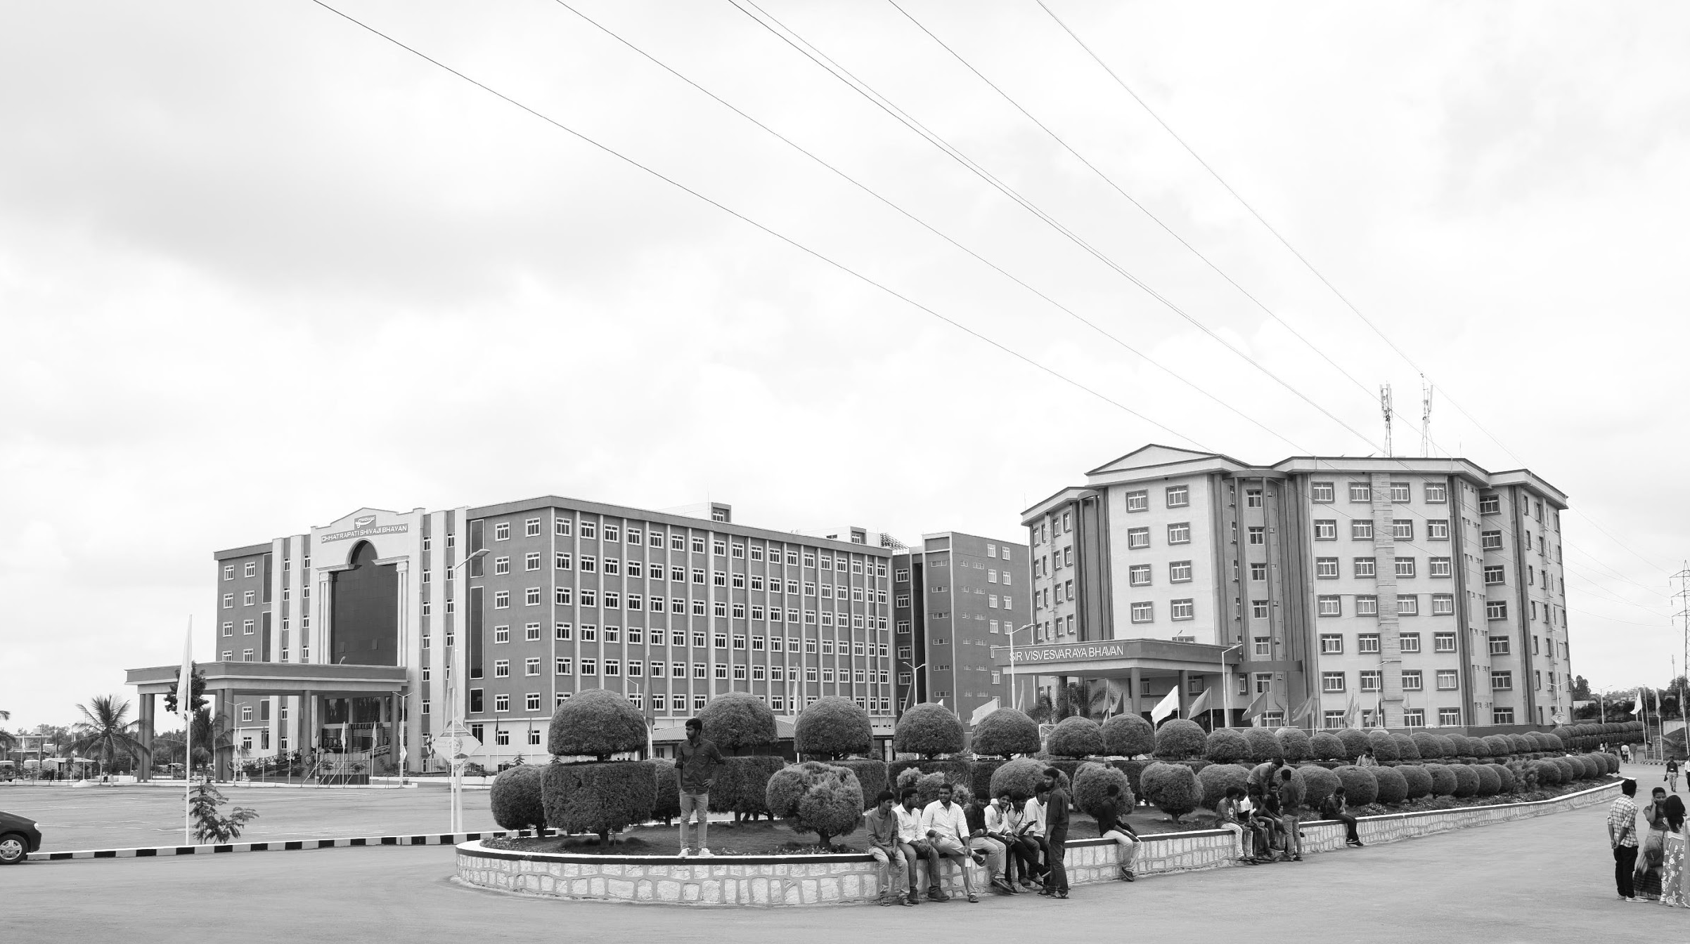

Medical Image Enhancement based on CLAHE approach
AY 2020-24
GITAM UNIVERSITY
Major Project
CS-10
A University should be a place of light, of liberty, and of learning.
Department of Electrical Electronics and Communication Engineering
Project Team:
B Satish Chandra
Akhil S
Ansar S
Project Mentor:
Dr. Pankaj Kandhway
www.gitamedu.com

Slide 2

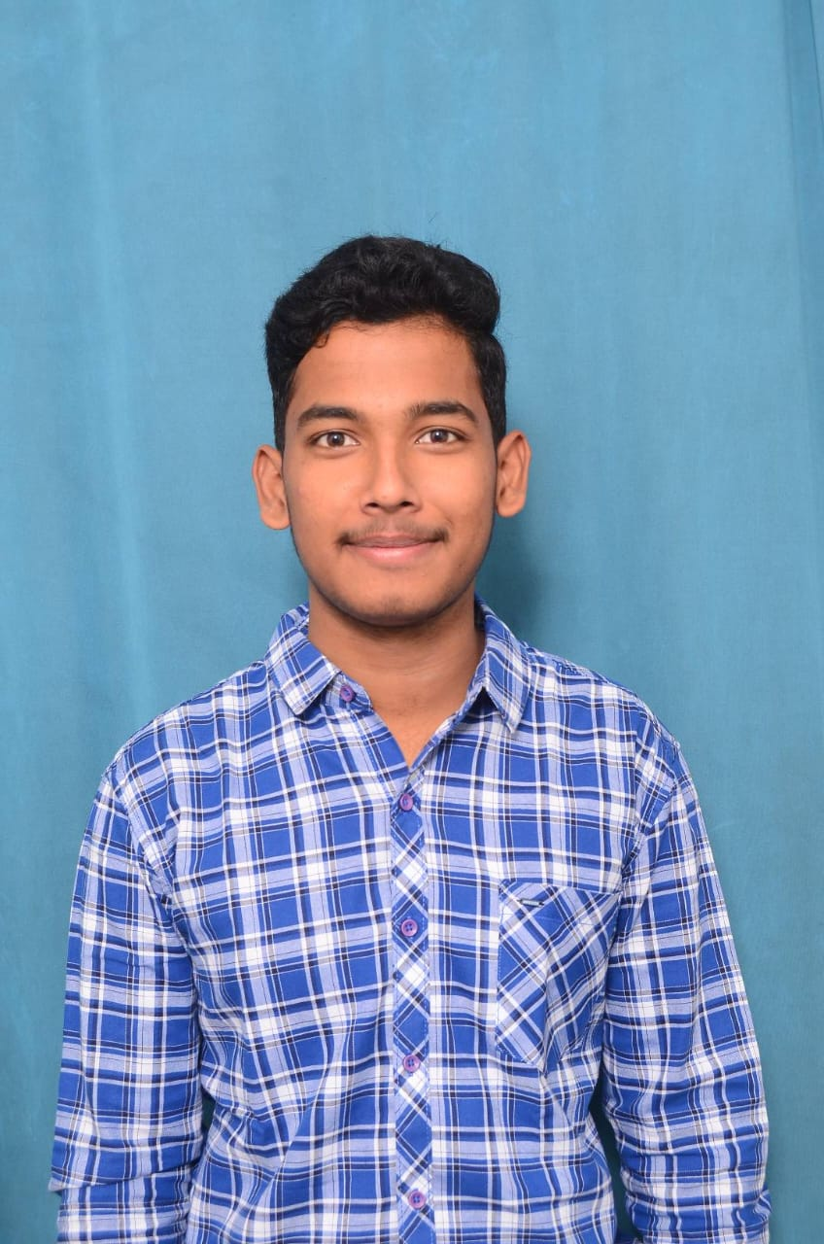
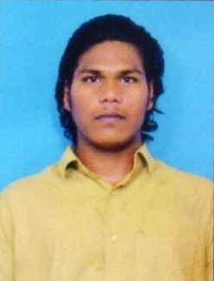
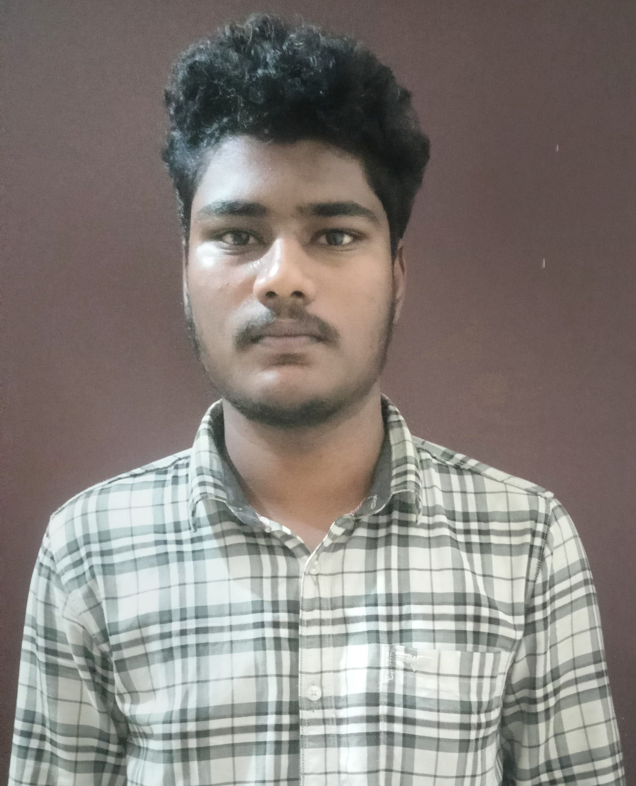
Project Group – Details
Photo
Track
Roll No
Name
Photo
EECE AI/ML
BU21EECE0100338
B Satish Chandra
Photo
EECE AI/ML
BU21EECE0100411
Akhil S
Photo
EECE AI/ML
BU21EECE0100358
Ansar S

Slide 3
Objective and Goals
Objective
The objective is to develop and evaluate a medical image enhancement algorithm based on Contrast-Limited Adaptive Histogram Equalization (CLAHE) that effectively improves the contrast, brightness, and edge preservation of medical images. The approach integrates noise removal and contrast enhancement techniques and is assessed using performance metrics such as PSNR, SSIM, CoC, and EPI to ensure better image quality and improve the accuracy of clinical diagnoses.
Goals
Main Goals:
1. Enhance contrast and brightness.
2. Reduce noise.
3. Preserve and enhance edges.
4. Evaluate performance with key metrics.
5. Improve diagnostic accuracy.

Slide 4
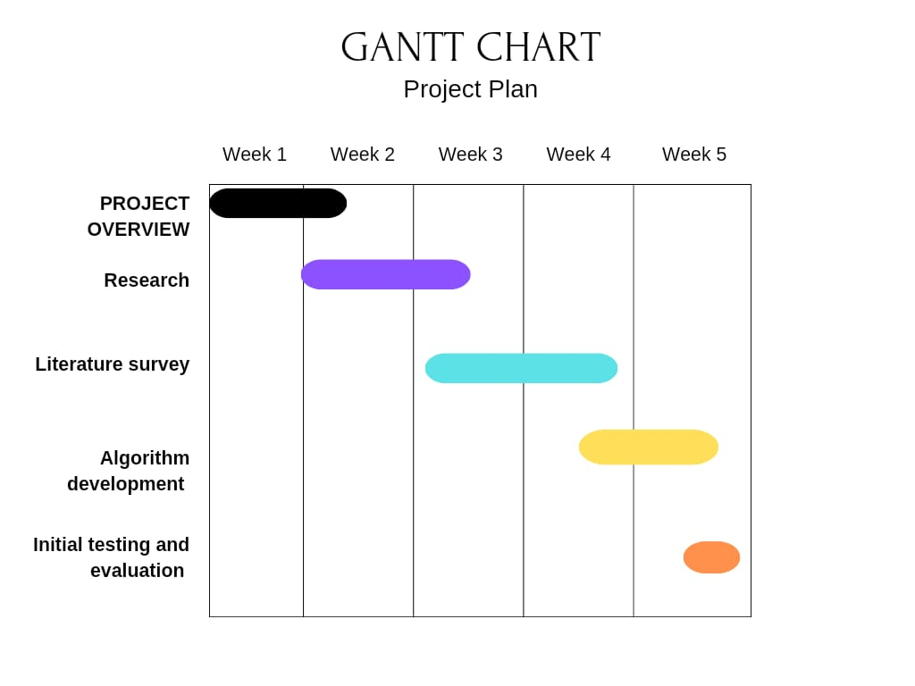

Slide 5
Literature Survey
Literature Review on Medical Image Enhancement based on CLAHE approach
Abstract :
Medical image enhancement approach is a challenging task in digital image processing techniques due to the characteristics of medical images. Generally, images are degraded by noise and suffer from low contrast issues. To improve the medical image quality, a medical image enhancement algorithm based on contrast adaptive histogram equalization (CLAHE) work is suggested. The CLAHE-based model improves the efficiency of the contrast and brightness, along with edges. The Enhancing procedure consists of three stages. The initial step involves medical image generation using a text-to-image generative model. In the second step, the estimation of the clip limit which controls the enhancing performance. Finally, the enhanced medical image is obtained using two steps. The algorithm presents a noise removal and contrast enhancement algorithm for medical images. Integration of filters and the contrast-limited adaptive histogram equalization (CLAHE) technique is applied to solve the issues of de-noising and enhancement of medical images. The efficiency of the method is evaluated through different performance parameters like Peak Signal to Noise Ratio (PSNR), Structural Similarity Index (SSIM), Correlation Coefficient (CoC), and Edge Preservation Index (EPI). Moreover, using this algorithm to improve the quality of medical imagesresults in clearer visuals and increases the accuracy of clinical diagnoses. The CLAHE-based framework reveals the structure and details in medical images, increasing overall contrast and enhancing visual perception.

Slide 6
S.no | TITLE | AUTHOR | Year of Publishing | Drawbacks
1. | Retinex-Centered Contrast Enhancement Method for Histopathology Images with Weighted CLAHE | Karishma Rao, Manu Bansal and Gagandeep Kaur | January 2022 | Color Distortion Noise Amplification Over-Enhancement Risk Suboptimal for Complex Histopathology Images
2. | An approach for de-noising and contrast enhancement of retinal fundus image using CLAHE | Sonali a, Sima Sahu Amit Kumar Singh a, S.P. Ghrera and Mohamed Elhoseny | June 2018 | Noisy Image Dependency Filter Sensitivity Limited Evaluation Metrics Performance Variability
3. | A novel medical image enhancement algorithm based on CLAHE and pelican optimization | Yasser Radouane · Boualem Mansouri andFatima Zohra | March 2024 | Computational Complexity Sensitivity to Parameter Selection Limited Robustness increased Processing Time

Slide 7
Analysis – 4W1H
Why: To improve medical image quality and diagnostic accuracy by overcoming the limitations of traditional enhancement methods like CLAHE and AHE.
What: CLAHE-POA combines Contrast Limited Adaptive Histogram Equalization (CLAHE) with the Pelican Optimization Algorithm (POA) to optimize contrast enhancement.
Where: Applied in medical imaging to enhance images for better clinical diagnosis.
When: Used during the pre-processing stage of medical image analysis.
How: Generates medical images with a text-to-image model, then enhances contrast using CLAHE with an optimized clip-limit value determined by POA
Refined Objective: To achieve superior image enhancement by optimizing contrast limits with POA, improving image quality and diagnostic accuracy.

Slide 8
Analysis - SWOT
Strengths
Weaknesses
W1. Noise Amplification
W2. Computational Complexity
W3. Parameter Sensitivity
W4. Increased Processing Time
S1. Enhanced Image Quality
S2. Local Detail Preservation
S3. Optimized Clip-Limit
S4. Metaheuristic Advantage
Opportunities
Threats
O1. Adaptability to Various Modalities
02. Integration with Advanced Imaging Techniques
O3. Real-Time Processing Enhancements
04. Research and Development
T1. Implementation Challenges
T2. Variability in Performance:
T3. Competitive Technologies

Slide 9
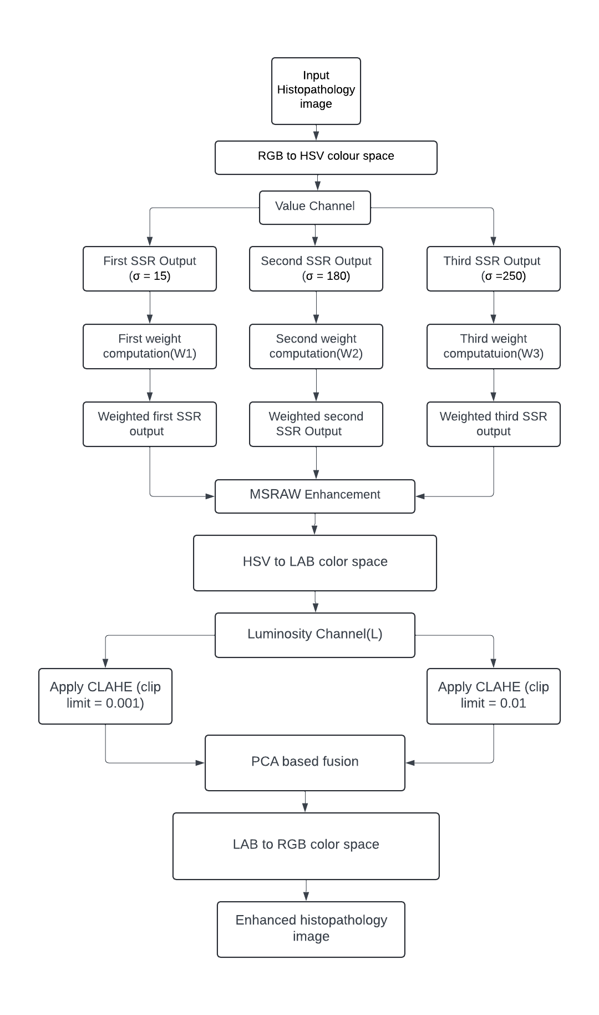
Structural Diagram

Slide 10
Use Cases & Testing
Use Cases:
Improving Diagnostic accuracy in Histopathology.
Pre-Processing for Automated Histopathological Analysis(AI/ML).
Enhancing Low – Quality Archived Histology Slides.
Virtual Staining in Digital Pathology.
Telemedicine and Remote Pathology.
Test Cases:
Illumination Variation in Histopathology Images.
Enhancing Low-Contrast Cancerous Tissue Samples
Noise Robustness in Poor-Quality Slides
Comparison with Traditional CLAHE on Histopathology Images
Performance on Histopathology Images with Different Staining Methods

Slide 11
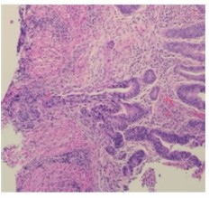
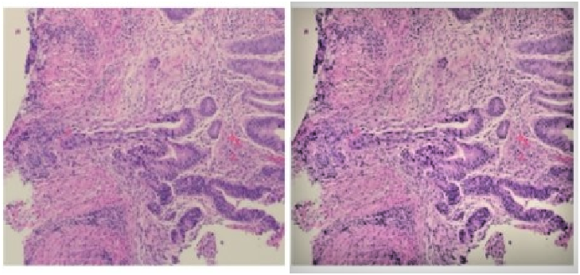
Implementation and Expected Results – Iteration 1
Input Image: Output Image :

Slide 12
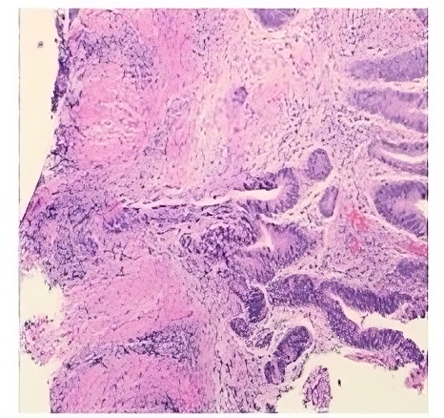
Expected Output:

Slide 13
Contribution
Team Progress and Movement:
We made significant progress on the medical image enhancement project using the CLAHE approach, completing approximately 40-50% of the work.
Key milestones achieved include a comprehensive literature review, initial algorithm development, and preliminary testing on histopathology images.
However, we are facing challenges as the enhanced images are not meeting expected quality levels, with issues such as excessive noise and non-uniform illumination.
To address these concerns, we will conduct thorough data analysis, optimize CLAHE parameters, and incorporate feedback from team members.
Regular meetings will facilitate collaboration and task delegation, ensuring we refine the enhancement algorithm effectively and continue moving towards our project goals.

Slide 14
Individual Contribution:
Key contributions: B Satish Chandra Kumar
Algorithm Development and Implementation and Data Analysis:
Designing and coding the CLAHE algorithm tailored for histopathology images.
Collaborated with other team members to integrate the enhancement algorithm into existing image processing frameworks.
Key contributions: Akhil S
Testing and Research
Focused on gathering and preparing a diverse dataset of histopathology images for testing.
Conducted a comprehensive literature review on image enhancement techniques, particularly CLAHE and its applications in medical imaging.
Key contributions: Syed Mohammad Ansar
Documentation
Documented the entire development process, including methodologies, challenges, and results, ensuring clear communication within the team.

Slide 15
Conclusion & Future Work
Summary and Conclusion
The medical image enhancement project using CLAHE is about 40-50% complete, but the expected results have not been fully achieved. The team has faced challenges, including noise, uneven illumination, and suboptimal contrast in the enhanced images. To address these issues, the plan has been revised to focus on parameter optimization and testing with diverse datasets. While the project is still ongoing, the revised approach and continued testing will help refine the enhancement method. With further adjustments, the project is expected to improve image quality for better diagnostic outcomes.
Future Work
Future work will focus on continuing the optimization of CLAHE parameters to achieve the desired results. Expanding testing to a larger variety of medical images is essential to ensure the method’s reliability. Additionally, refining the tool for real-time processing and making it easier to use in clinical settings will be important steps once the core enhancement challenges are addressed

Slide 16

THANK YOU

