Slide 1

Fault-Tolerant Flash ADC Architecture for Edge IoT Devices
Submitted by:
- Pranav.M (2310040008)
- Rohan.M (2310040010)
- Rizwan (2310040027)
- Sayooj (2310040095)
Under the guidance of:
Dr. Ngangbam Phalguni Singh and Dr. Vijay Rao Kumbhare
Department of Electronics and Communication Engineering
Koneru Lakshmaiah Education Foundation

Slide 2

Introduction: ADCs in IoT and Edge Devices
The Internet of Things (IoT) demands low-power, reliable data converters for edge devices. Analog-to-Digital Converters (ADCs) are crucial interfaces for digital processing units, as sensors produce analog signals.
Why ADCs Matter in IoT
Bridge between analog sensors and digital processors
Enable local signal processing at the edge
Critical for real-time decision making
Directly impact system reliability and accuracy
Key Challenges
Power constraints in battery-operated devices
Balancing speed, resolution, and power
Reliability under varying environmental conditions
Compact size for integration in small devices

Slide 3




ADC Roles and Requirements in IoT
IoT edge devices interface with diverse sensors, converting analog signals under strict resource constraints.
Ultra-low Power
Sufficient Resolution
Essential for battery-powered or energy-harvested devices.
Accuracy tailored to sensor type and application needs.
Sampling Rate & Latency
Low Cost & Compact Area
Optimized for specific application demands.
Critical for mass-produced IoT devices.

Slide 4

Comparative Analysis of ADC Architectures for IoT
Architecture
Resolution
Speed
Power
Strengths
Limitations
IoT Suitability
8-12 bits
Moderate
Low
Balanced performance
Limited for high precision
Most common in IoT nodes
SAR
Sigma-Delta
16-24 bits
Low
Medium
Excellent accuracy
Too slow for fast signals
Medical & environmental
3-4 bits
Very High
High (low-bit manageable)
Ultra-fast conversion
Impractical for high resolution
Edge event detection
Flash
Pipeline
8-12 bits
High
High
Higher bandwidth
Complex, power-hungry
Rare in IoT (comms/vision)
Flash ADCs offer the highest speed but are typically limited to low resolution applications, making them ideal for event detection in IoT edge devices.

Slide 5




Motivation for Low-Bit Flash ADCs
For immediate event detection or threshold monitoring, high-speed conversion is prioritized over high resolution. Flash ADCs are ideal due to their near-instantaneous conversion, especially at low resolutions (3-4 bits).
Why Flash ADCs for IoT Edge?
Single-step conversion with zero latency
Low-bit designs (3-4 bits) keep power and area manageable
Ideal for biomedical signal threshold detection
Critical for industrial safety monitoring
Key Applications
Event detection in wearables
Voltage glitch monitoring
Trigger circuits for higher-resolution ADCs
Real-time threshold crossing detection

Slide 6

Problem Statement: Speed + Fault Detection
Edge devices face varying conditions like supply noise and temperature changes. Conventional Flash ADCs can fail under reference drift.
Key Challenges
Flash ADCs are vulnerable to reference voltage drift
Comparator mismatches lead to incorrect thermometer codes
Unpredictable operating environments at the edge
Conventional designs lack built-in fault tolerance
Proposed Solution
A solution balancing speed, low power, and robustness against reference faults is needed. Our approach integrates fault detection directly into the ADC architecture to ensure reliable operation even under non-ideal conditions.

Slide 7

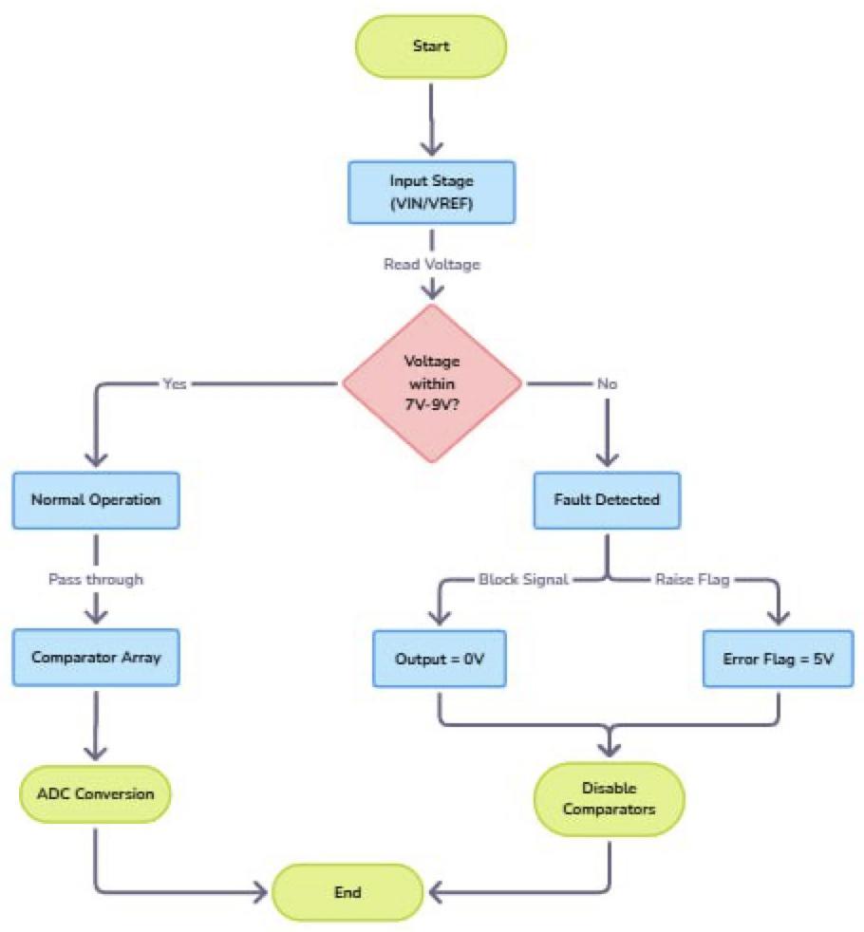
System-Level Overview: 3-bit Flash ADC
The proposed 3-bit Flash ADC system processes analog input, converts it to binary, and includes a fault detection mechanism.
Input analog voltage (Vin) is compared against reference ladder points.
Comparator outputs form thermometer code.
Encoder block converts thermometer to binary.
Fault detection monitors Vref and generates an error flag if instability occurs.

Slide 8

Project Objective: Fault-Tolerant 3-bit Flash ADC
This project implements a 3-bit Flash ADC in Cadence Virtuoso, built with analog blocks (resistor ladder, comparators, encoder). A fault-detection block monitors the reference voltage (Vref) and flags instability.
Why 3-bit Resolution for IoT?
Design Advantages
Keeps comparator count low (7 comparators)
Simplicity: Straightforward structure
Provides fast response with minimal silicon area
Speed: One-step conversion
Sufficient for threshold-based IoT sensing and edge-triggered applications
Fault Tolerance: Reference monitoring enhances robustness
Educational Value: Demonstrates key ADC concepts in a compact design
Primary Goal:
Design a Flash ADC that preserves ultra-fast latency while adding a layer of robustness traditionally absent in
such designs, making it suitable for IoT edge devices operating in unpredictable environments.

Slide 9
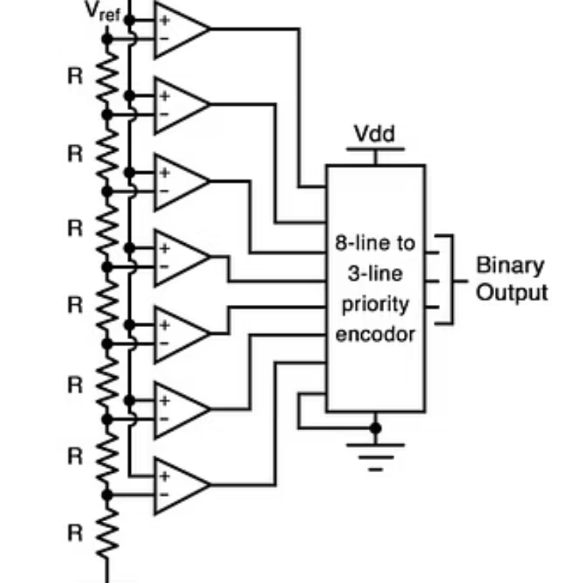
Architecture of 3-bit Flash ADC

Slide 10
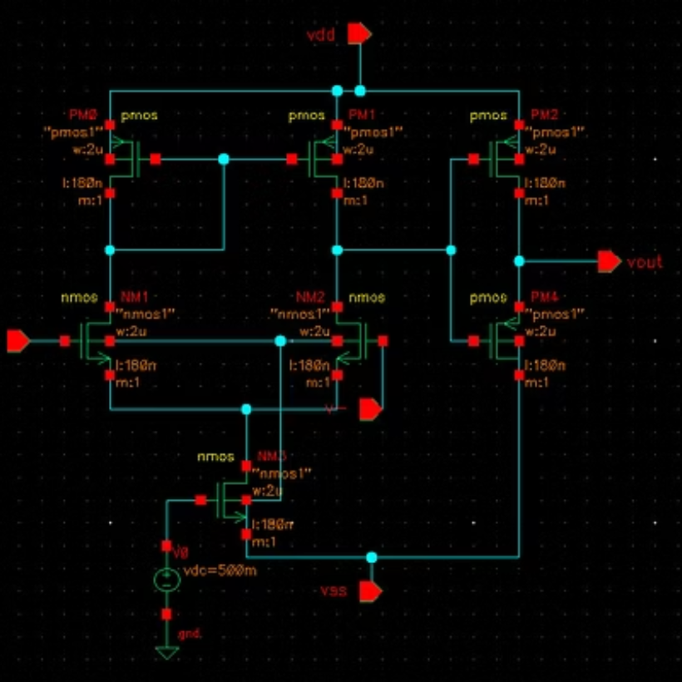
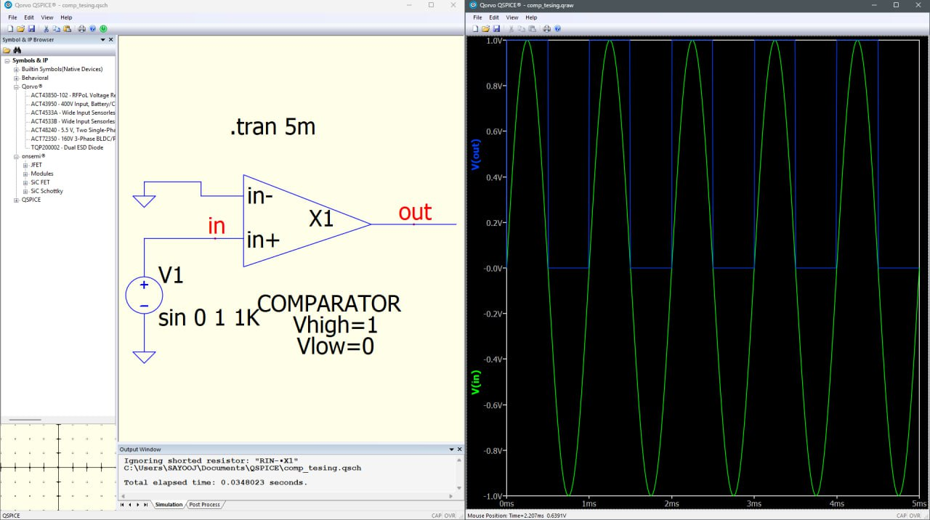
Comparator
Essential for comparing input voltage with reference levels.

Slide 11
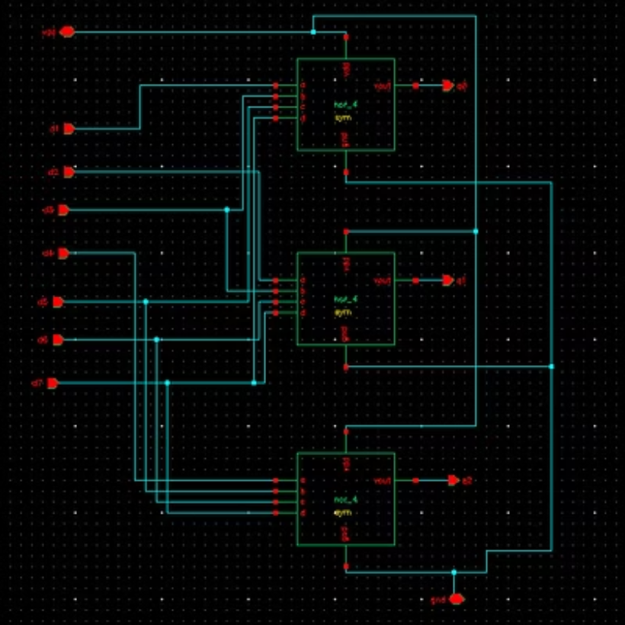
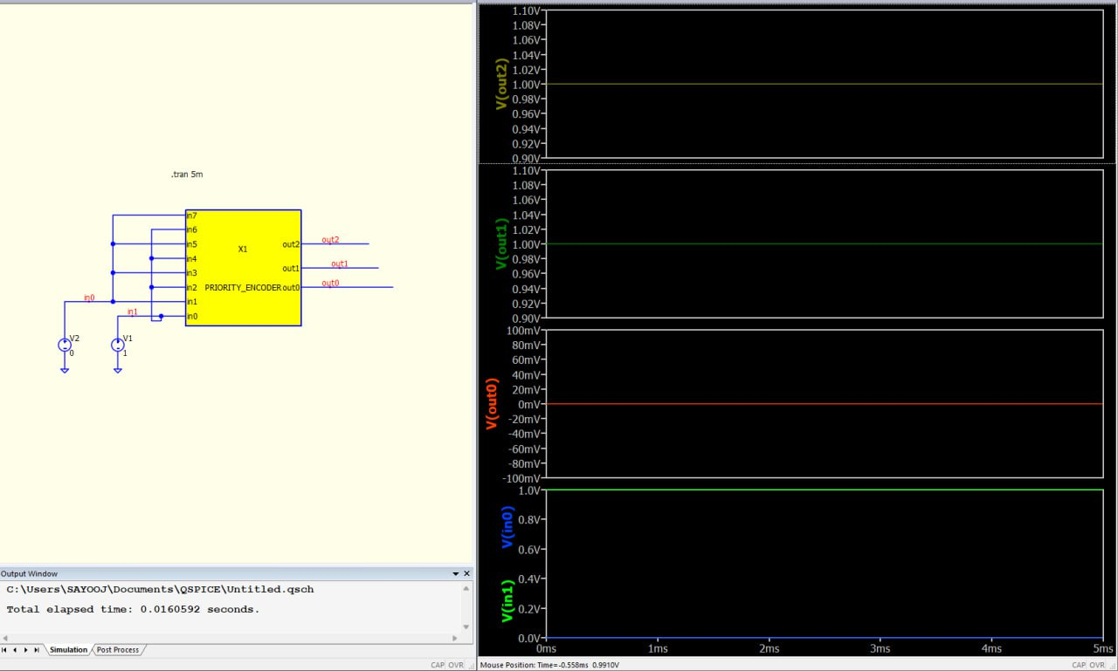
Priority Encoder
Converts the thermometer code from comparators into binary output

Slide 12

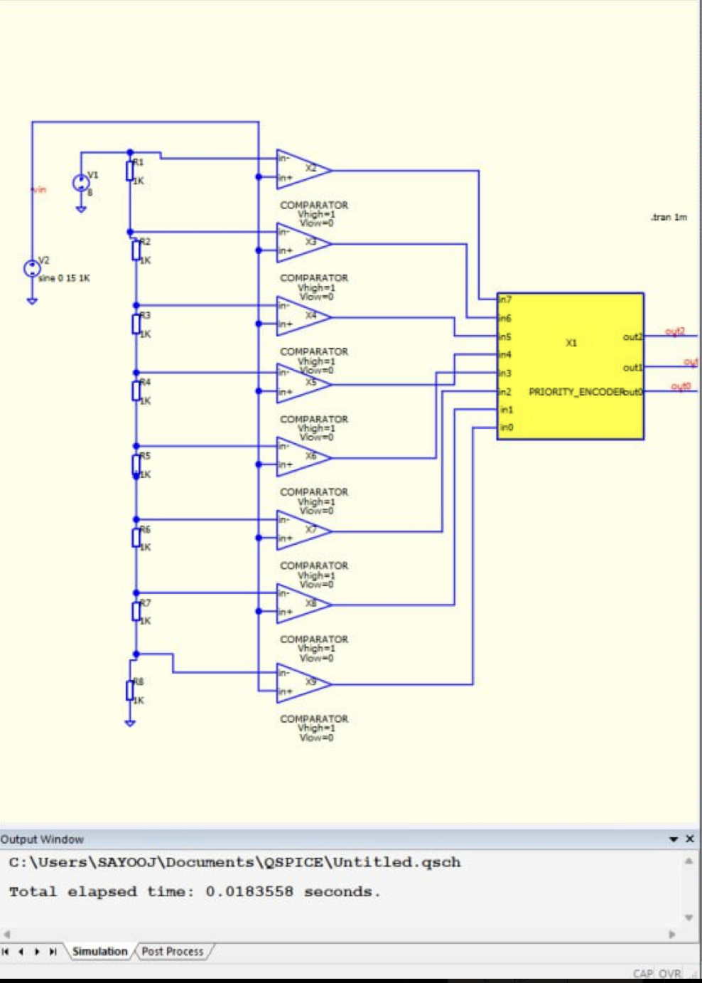
Flash ADC Architecture
A Flash ADC (also known as parallel ADC) performs conversion in a single step by comparing the input voltage simultaneously against multiple reference thresholds.
Key Components
Resistor Ladder Network
Divides reference voltage into equally spaced thresholds for comparison
Comparator Array
7 comparators for 3-bit resolution, each comparing input against a reference level
Thermometer-to-Binary Encoder
Converts thermometer code output from comparators into 3-bit binary code
Fault Detection Block
Monitors reference voltage stability and generates error flag when instability is detected

Slide 13
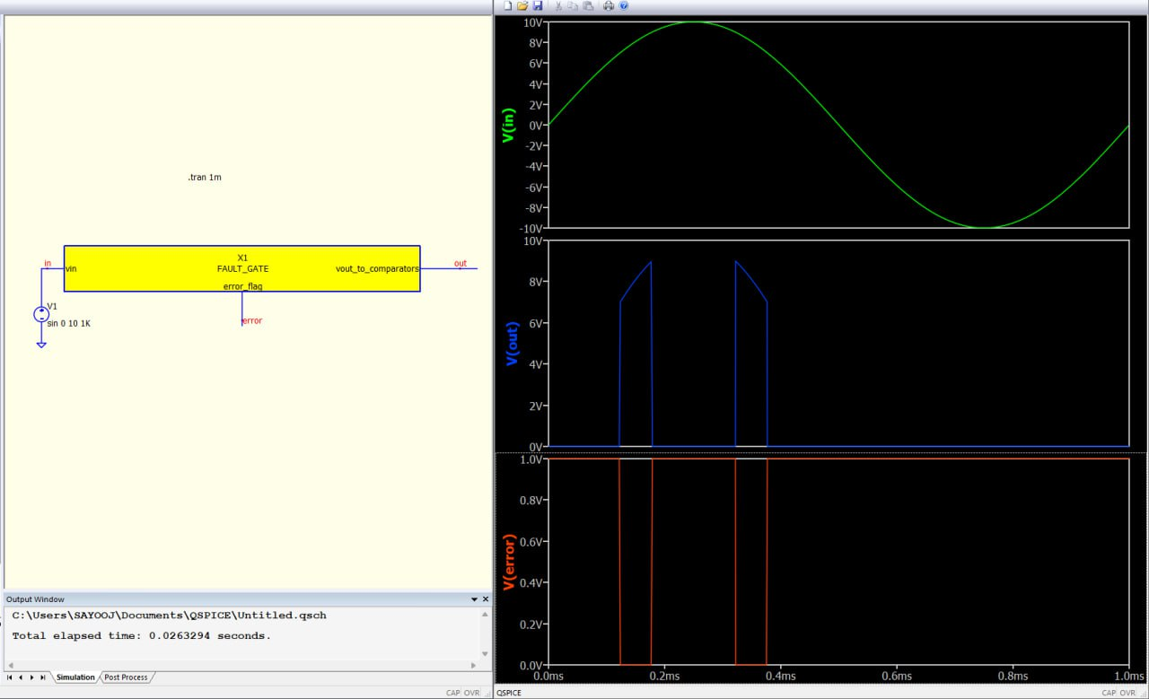
Fault Detection Mechanism
The proposed fault detection block continuously monitors the reference voltage ladder for stability and drift, providing an early warning system to prevent erroneous conversions.
How Fault Detection Works
1
Continuous monitoring of reference voltage (Vref)
2
Detection of voltage drift beyond acceptable thresholds
3
Generation of error flag when instability is detected
4
Prevention of erroneous data propagation
Benefits
Enhances reliability in unstable environments
Prevents false triggers in critical applications
Enables system-level fault handling
Maintains high-speed operation when conditions are stable

Slide 14
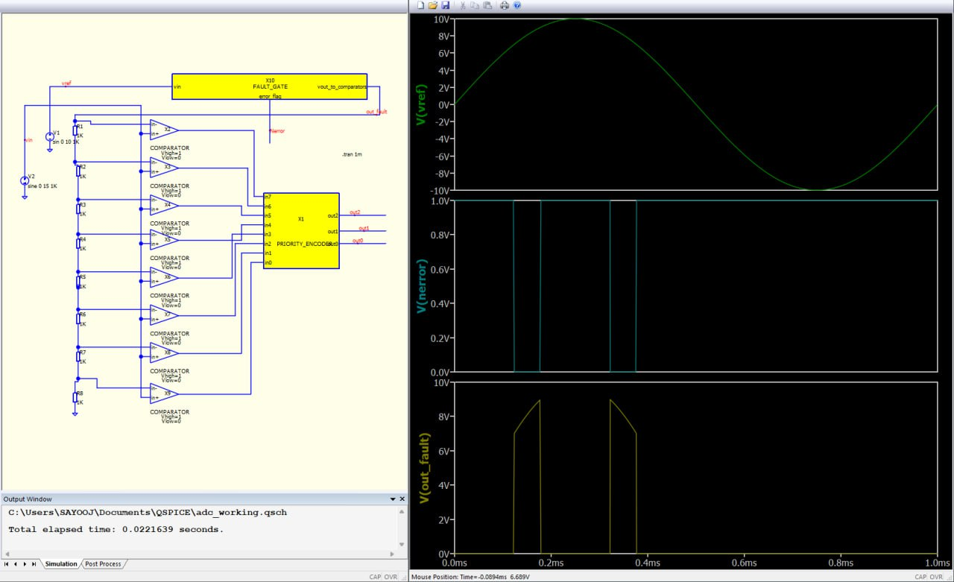
Finalized design

Slide 15


Conclusion and Future Work
Future Work
Explore hybrid architectures combining Flash ADC with SAR or Sigma-Delta for both speed and precision
Implement advanced fault correction mechanisms beyond detection
Optimize power consumption further for energy-harvested IoT applications
Fabricate and test the design in real-world IoT deployment scenarios
Thank You!

