Slide 1


KL Deemed to be University Aziz Nagar Campus Department of ECE
1st Review
MD Sameer Ahmed - 2310040004
Sayooj S - 2310040095
Supervised by:
Dr. Ngangbam Phalguni Singh, Assoc. Prof./ECE

Slide 2
Introduction :
Edge AI applications require efficient processors for fast, low-power computation on embedded devices.
RISC-V enables customizable processor architectures through flexible instruction set extensions and open-source designs.
This project develops a configurable FPGA-based AI accelerator integrated with a PicoRV32 RISC-V processor.

Slide 3
Problem Statement :
Embedded RISC-V processors execute AI workloads with high latency and limited computational efficiency.
Software execution of matrix operations increases execution cycles, power consumption, and processing time.
Configurable hardware acceleration is required for efficient AI processing in embedded systems.

Slide 4
Objectives :
Design a configurable MAC-based accelerator for an embedded PicoRV32 RISC-V processor.
Integrate custom RISC-V instructions to accelerate AI-oriented computational kernels efficiently.
Evaluate performance, area, and power across multiple FPGA accelerator configurations.

Slide 5
Scope of the Project :
Develop a configurable AI accelerator integrated with the PicoRV32 RISC-V processor on FPGA.
Implement and verify custom instructions using SystemVerilog through simulation and hardware testing.
Evaluate performance, resource utilization, and power across multiple accelerator configurations.

Slide 6
Literature Review :
Studied existing RISC-V processors and custom instruction extension techniques.
Reviewed hardware accelerator architectures for AI and embedded computing applications.
Research Gap :
Existing AI accelerators lack flexibility for different embedded application requirements.
Efficient custom instruction integration for embedded AI applications requires further investigation.

Slide 7
Methodology :
Initialize PicoRV32 processor with firmware and custom instruction support.
Decode instructions and dispatch AI operations to the configurable MAC accelerator.
Verify functionality and evaluate performance using simulation and FPGA implementation.

Slide 8
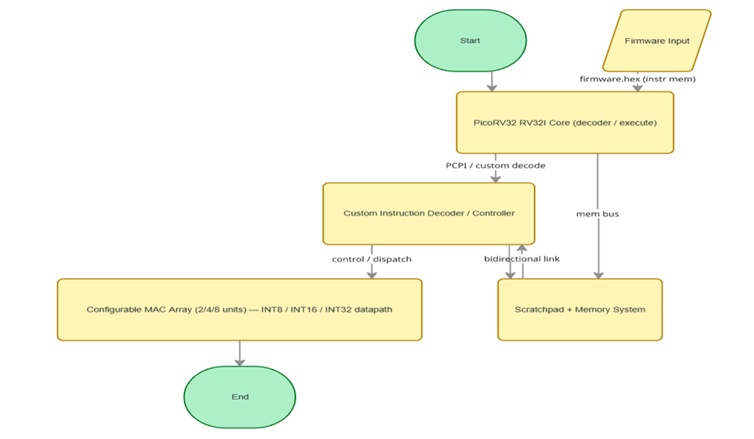
Proposed architecture — configurable AI acceleration extension for an embedded RISC-V processor on FPGA.

Slide 9
Expected Outcomes :
Develop a configurable AI accelerator integrated with the PicoRV32 RISC-V processor.
Demonstrate improved performance using custom instructions and hardware acceleration on FPGA.
Analyze speed, area, and power trade-offs across multiple accelerator configurations.

Slide 10
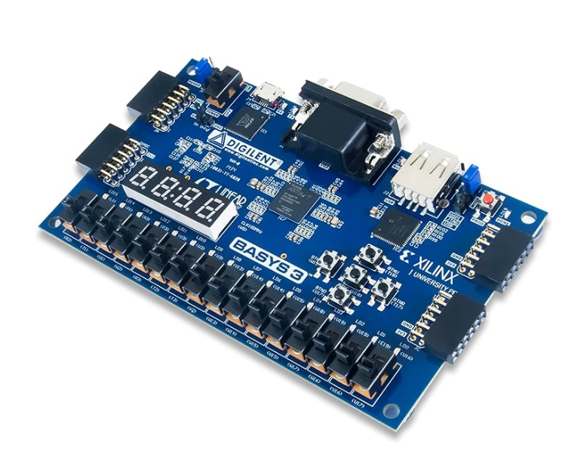
Financial Arrangements :
Basys 3 FPGA board allocated for hardware implementation and prototyping.
Required accessories include USB cable, power supply, and jumper wires.
Estimated project budget is approximately ₹27,578

Slide 11
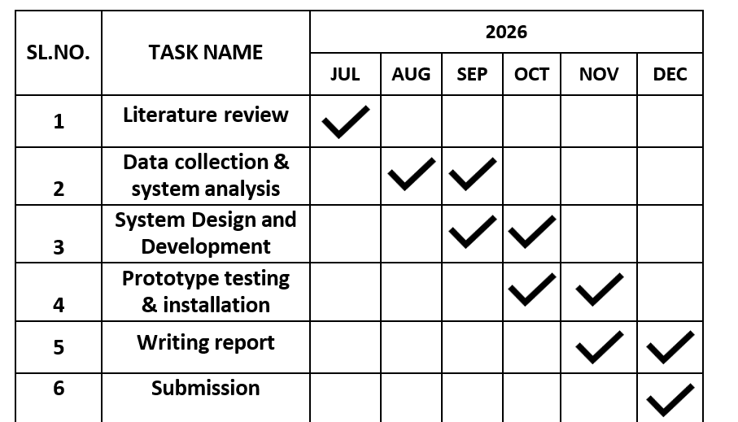
Duration :
Expected time line schedule

Slide 12
References :
E. Rezunov, N. Zurstraßen, L. M. Reimann, and R. Leupers, "Automatic Microarchitecture-Aware Custom Instruction Design for RISC-V Processors," in Proc. IEEE/ACM Int. Conf. Computer-Aided Design (ICCAD), Munich, Germany, 2025, pp. 1–9. doi: 10.1109/ICCAD66269.2025.11240781.
K. S. Gorde, S. M. Sonavane, S. Hutke, and A. Hutke, "Analog artificial intelligence hardware for neural networks: Design trends and considerations," Bulletin of Electrical Engineering and Informatics, vol. 14, no. 6, pp. 4399–4410, Dec. 2025. doi: 10.11591/eei.v14i6.10842.
M. Damian, J. Oppermann, C. Spang, and A. Koch, "SCAIE-V: An Open-Source SCAlable Interface for ISA Extensions for RISC-V Processors," in Proc. 59th ACM/IEEE Design Automation Conf. (DAC), San Francisco, CA, USA, 2022, pp. 1–6. doi: 10.1145/3489517.3530432.

