Slide 1
Wishbone Bus Protocol
Team Memebers
Sayooj S
MD Sameer Ahmed
KL UNIVERSITY, Aziznagar, Hyderabad

Slide 2
Abstract
Open-source on-chip interconnect protocol
Enables communication between IP cores
Simple, flexible, and widely used in SoC design
Supports master-slave architecture

Slide 3
Objective
Understand Wishbone protocol architecture
Implement basic master-slave communication
Simulate read/write transactions
Analyze timing and control signals

Slide 4
Introduction
Wishbone is a hardware bus standard for SoC interconnection.
Developed by the OpenCores project.
Allows IP cores to communicate using a standard interface.
Supports single read/write transactions and pipelined transfers.
Commonly used in FPGA and ASIC designs.

Slide 5
Wishbone Ports and Functions
Signals | Type | Description
clk | Input | System clock used to synchronize bus operations
rst | Input | Resets the master/slave modules
cyc | Control | Indicates that a valid bus cycle is in progress
stb | Control | Strobe signal showing a valid data transfer request
we | Control | Write enable signal (1 = write, 0 = read)
ack | Response | Acknowledge signal from slave confirming completion
adr | Address | Address bus used to select slave register/memory
Dat_i | Data Input | Data sent from slave to master (read operation)
Dat_o | Data Output | Data sent from master to slave (write operation)
sel | Select | Byte select lines for data bus

Slide 6
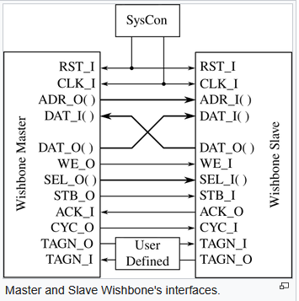
Block Diagram

Slide 7
Code Implementation
https://www.edaplayground.com/x/TT2e

Slide 8
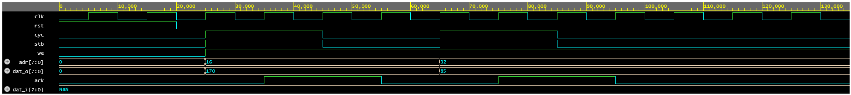
Output

Slide 9
Comparisons
Parameter | Wishbone | UART | APB | AXI
Purpose | On-chip interconnect | Serial communication | Peripheral bus | High-performance interconnect
Speed / Performance | Medium | Very Low | Low | Very High
Data Type | Parallel | Serial | Parallel | Parallel
Complexity | Moderate | Very Low | Very Low | High
Key Feature | Simple, open standard | Minimal hardware, long-distance | Low-power peripheral access | Burst + pipelining + multi-channel

Slide 10
Advatages
Simple architecture Easy to design, implement, and debug.
Open standard No licensing or royalty issues (unlike ARM Holdings AMBA protocols).
Easy IP integration Standard interface allows quick connection of modules.
Low overhead Minimal control logic → smaller area and power usage.

Slide 11
Disadvantages
Lower performance No advanced features like burst transfers or pipelining (compared to AXI).
Limited scalability Not ideal for large, complex SoCs.
Less industry adoption Fewer commercial IPs compared to AMBA-based systems.

Slide 12
Conclusion
Successfully implemented basic Wishbone protocol communication.
Verified read and write operations using simulation.
Useful for open-source hardware development and FPGA projects.

