Slide 1
STUDENTS MANAGEMENT SYSTEM
Final_PROJECT.c
PROGRAMMING_FUNDAMENTALS
Made by: Abdul Rafy & Muhammad Taha

Slide 2
Administration Menu; {
Final_PROJECT.c
PROGRAMMING_FUNDAMENTALS
In this menu the admin has to login into his admin User name, password and has the privilege to access Students database which can be displayed on the output screen.
}

Slide 3
User Menu; {
Final_PROJECT.c
PROGRAMMING_FUNDAMENTALS
Here are the following options in the user menu:
Student Information
New Admission
Search Student
Total Student Records
Exit of function
}

Slide 4
01 {
[Student Information ]
Final_PROJECT.c
PROGRAMMING_FUNDAMENTALS
In this option, user can look at information about students in their school. They can see information of all student or certain classes by entering class number.
}

Slide 5
02 {
[New Admission]
Final_PROJECT.c
PROGRAMMING_FUNDAMENTALS
In this Option User can enter a new student into Students record.
}

Slide 6
03 {
[Search Student]
Final_PROJECT.c
PROGRAMMING_FUNDAMENTALS
In this Option User can search any Student From Students Record by entering his roll number.
}

Slide 7
04 {
[Total Students Record]
Final_PROJECT.c
PROGRAMMING_FUNDAMENTALS
From this Option, User can See Total Number Of Records from Students REcords.How Many Students are in their under.
}

Slide 8
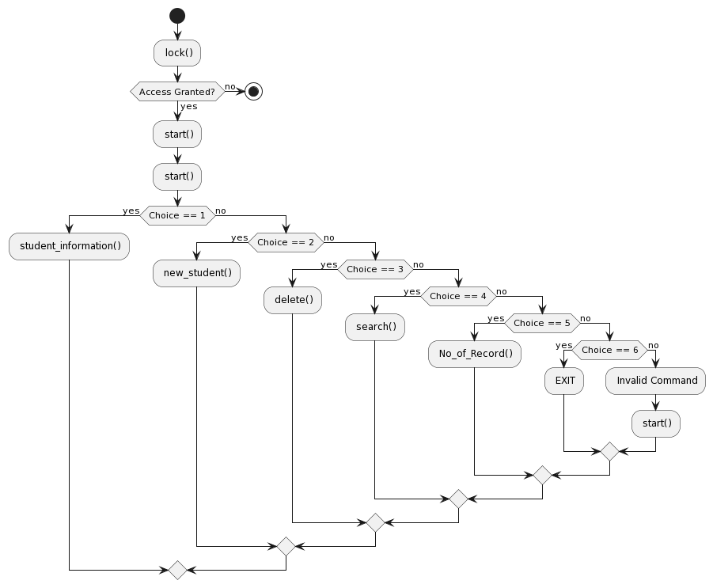
Flowchart; {
Final_PROJECT.c

Slide 9
The End {
Final_PROJECT.c
PROGRAMMING_FUNDAMENTALS
Printf(“ Thanks ”);
}

