Slide 1

Advanced Python Programming for GIS
By Caleb Mackey

Slide 2
Course Materials
Username: MN_GIS_LIS Password: gis2015 To connect to the FTP site, type ftp://ftp2.bolton-menk.com in the address field of Internet Explorer or Windows Explorer.

Slide 3
ArcPy Geometry Objects
All Geometry objects are inherited from the Geometry base class. This includes:
Points
Polylines
Polygons
Multipoints
The geometry class contains all the spatial relationship methods and utilities such as intersect, contains, clip, buffer, convex hull, etc.

Slide 4
Geometry Objects Continued
Geometry objects are composed of points or arrays of points.
PointGeometry is comprised of a single arcpy.Point() object
MultiPoint, Polygon, and Polyline are made up of an array(s) of arcpy.Point objects.
For multipart features, each part resides within its own arcpy.Array() object.
This is also true for interior rings (donut holes)

Slide 5
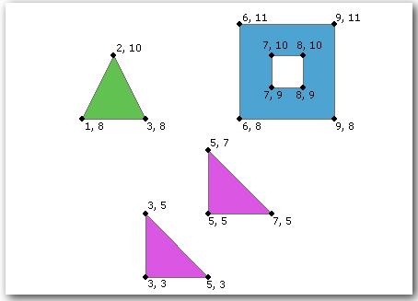
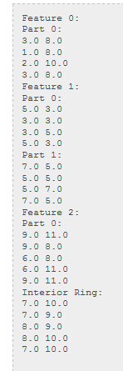
Polygons
When reading/writing polygon geometries, an interior ring or donut hole is represented by an empty arcpy.Array() object. When reading through the geometry, the placeholder for the donut hole will have a value of None.
Images from Esri help docs

Slide 6
Geometry Demos

Slide 7
ArcGIS REST API Crash Course
The ArcGIS REST API provides an interface and API to query web based GIS Services.
Common Service Examples:
MapService – general map service, allows for displaying and querying data
FeatureService – same capabilities as MapService, but also allows the user to edit the data through the REST API
ImageService – provides access to raster data, can perform operations such as clip and mosiac
HTTP requests can be made against an ArcGIS REST endpoint by any programming language that can make HTTP requests.
Request parameters are passed through either the body or query string in URL through HTTP requests.
Behind the sceneson the admin side of the service, connection strings and file paths are used by the service to query the database/image and return the proper results to the user.

Slide 8
Making Requests against the ArcGIS REST API
Python has many libraries for doing this:
urllib, urllib2, urllib3
httplib
SimpleHTTPServer
requests <- my favorite!
Requests can be made against ArcGIS REST endpoints to obtain information about the map service (service type, capabilities, layers, spatial reference, etc.)
Can also use REST endpoint GUI forms through web browser (good for testing!)
Tip: use Fiddler or other web inspectors to monitor traffic/requests

Slide 9
REST API requests continued
When using Python, it is easiest to handle results when returned as JavaScript Object Notation (JSON)
Translates nicely to a python dictionary
Python can be used to query a map service layer (spatially and by attributes) and the results can easily be converted to shapefiles or feature classes.
Response is a Feature Set (JSON)
The REST API can handle requests very quickly and efficiently

Slide 10
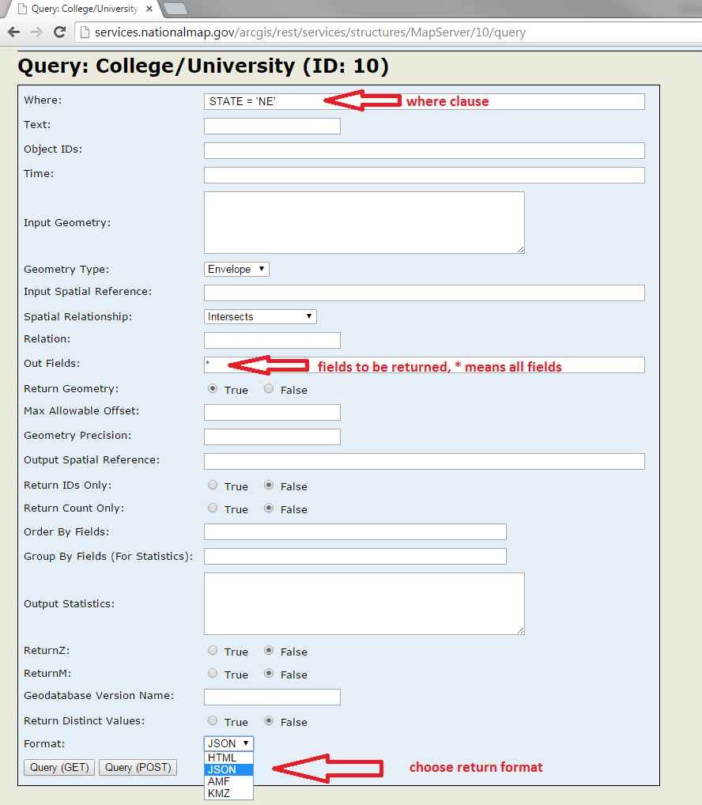
The REST API query form user interface can be used to perform queries against a layer. The user can choose to use a GET or POST request. The results are returned at the bottom of the page in the specified format.

Slide 11
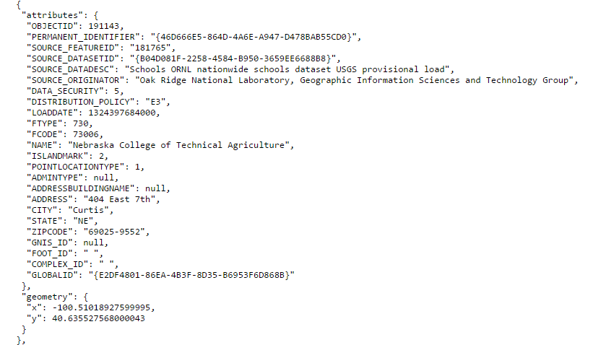
Example JSON response. This is one feature where the attributes are listed first, then the geometry. This is easy to feed into an insert cursor!

Slide 12
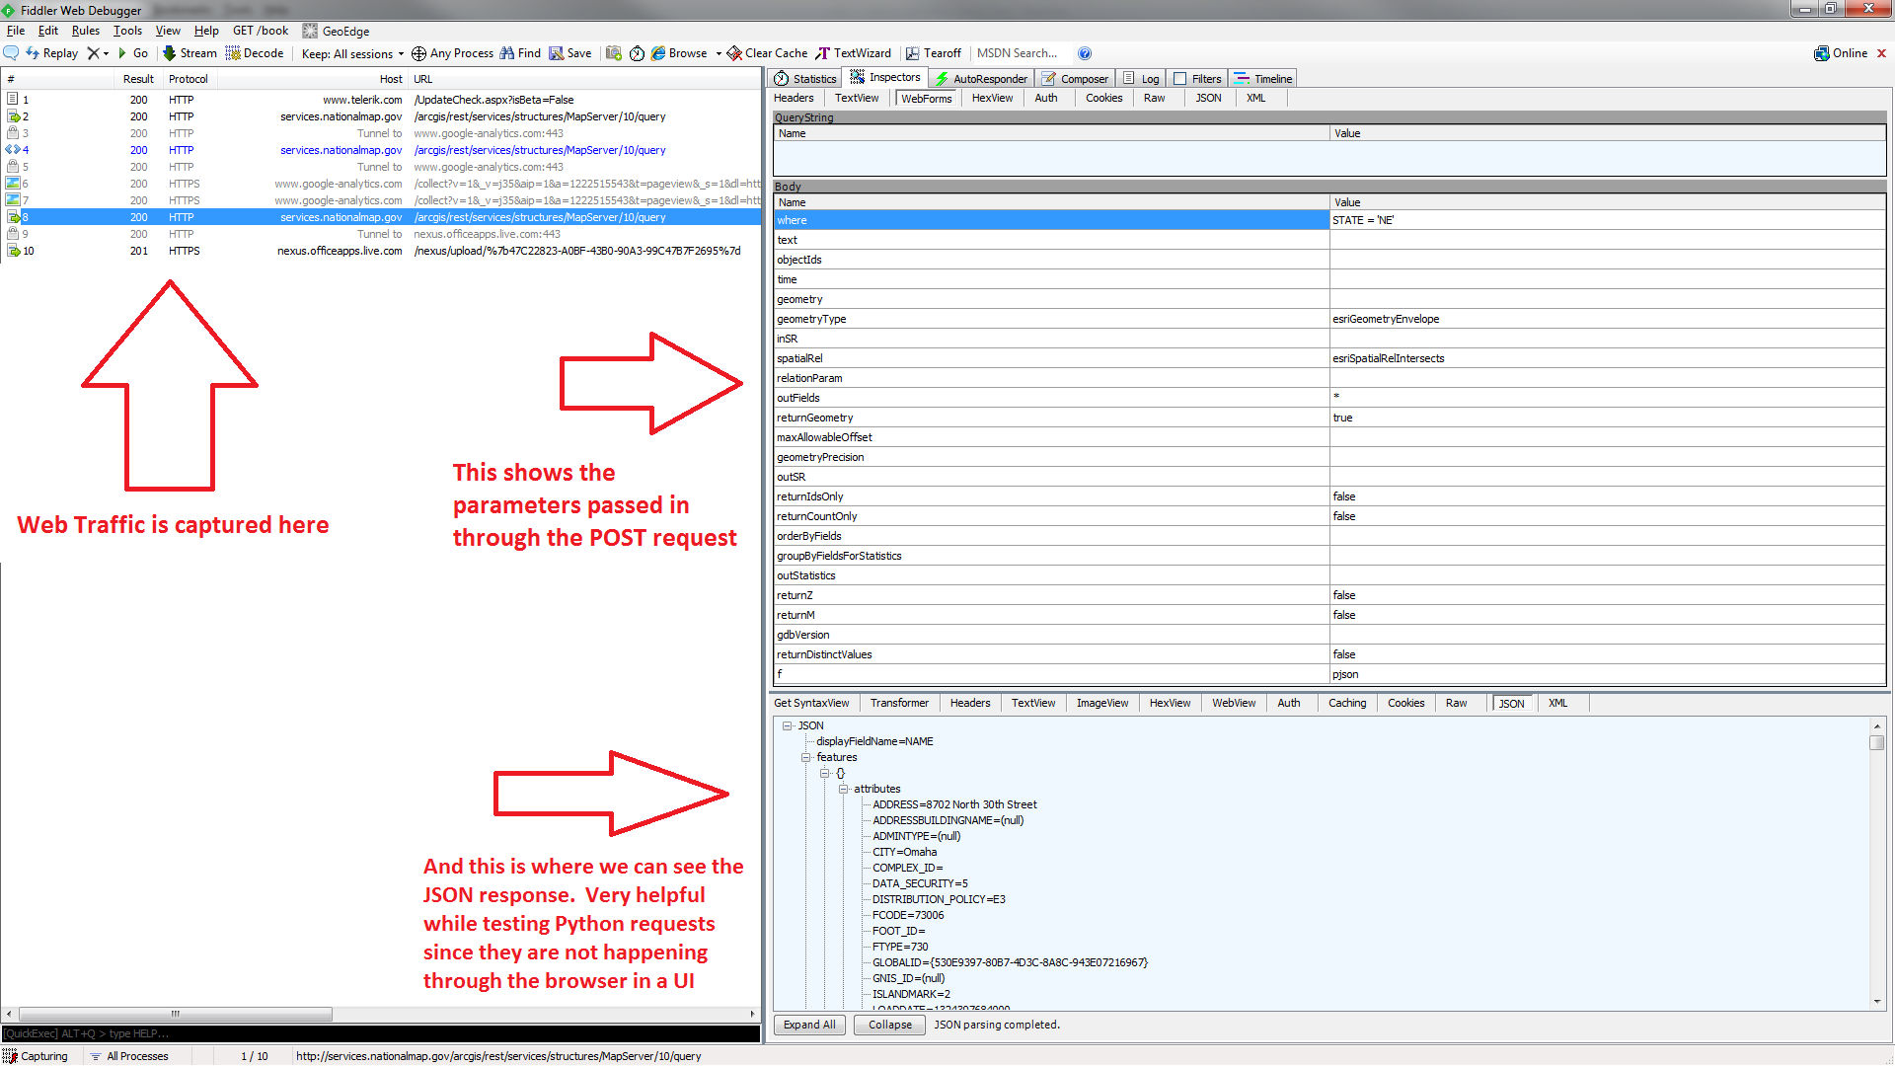

Slide 13
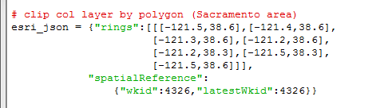
REST endpoint Query
When making requests against a REST endpoint, a dictionary is used to form a JSON object that defines the criteria.
For any spatial queries, the geometry must be passed in as JSON too.
Polygon geometry as JSON

Slide 14
Introducing the “restapi” package
This project can be found on GitHub.
Full Python API designed to work externally with ArcGIS REST Services to query data, extract data, and view service properties. Uses arcpy for some functions if available, otherwise uses open source alternatives to interface with the ArcGIS REST API.
Utilizes classes to treat REST services as objects.
Includes powerful functionality to walk through services, list layers, list fields, query layers, extract data to shapefiles/feature classes, clip image services, and even a search cursor.

Slide 15
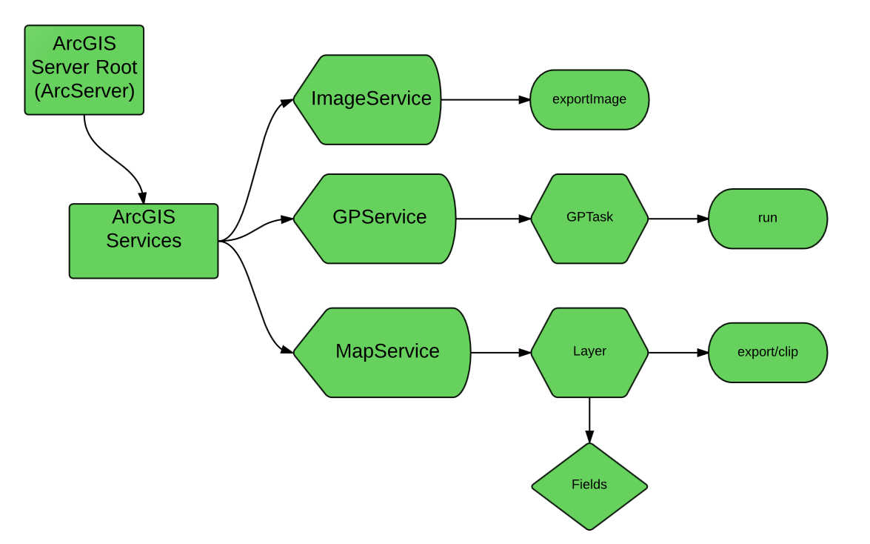
Using classes to represent objects
The restapi package started out as just a series of utility functions to gather information about a service. As more functionality was introduced, it made sense to treat services and layers as objects.

Slide 16

Python Classes
Classes can be used to represent objects. With classes, you can assign attributes and methods.
Classes support attribute references and instantiation (__init__)
In the restapi package, many classes are inherited from the RESTEndpoint base class.

Slide 17
Class inheritance
Python, like most other OOP languages supports class inheritance.
Allows derived classes to be inherited from base classes and they automatically receive all the properties/attributes and class methods.
Class methods are just like functions, except they are specific to the class and cannot be called from outside the scope of the object.

Slide 18
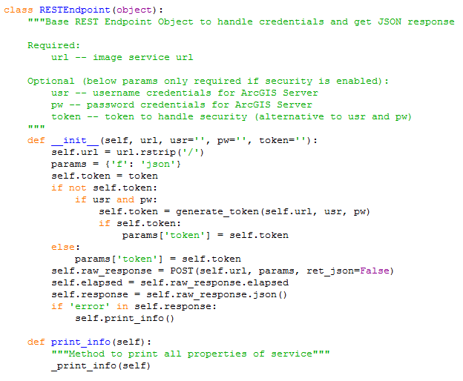
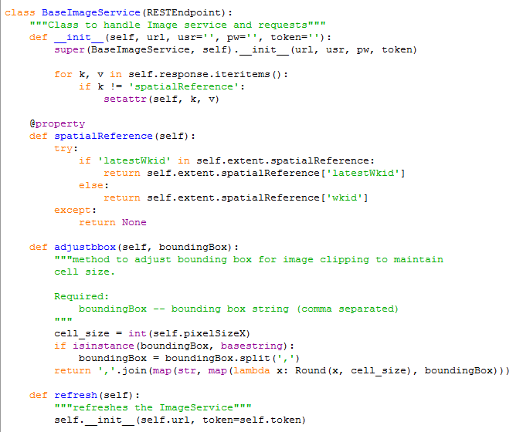
Base class
Derived class, inherited from RESTEndpoint

Slide 19
requests/restapi demo

Slide 20
Python Add-Ins
Starting at ArcGIS version 10.1, Esri provided support for creating Desktop Add-Ins with Python. Add-Ins at version 10.0 can only be created using the .NET framework.
Python Add-Ins are created using an Add-In wizard. When a Python Add-In is created and installed, all contents are contained within a zip file with an “esriaddin” extension.
Python Add-Ins are useful because it allows for user interaction with the map. There are methods to draw rectangles, points, lines and many more. There are also event listeners such as clicking and hitting a key.
Help documentation

Slide 21
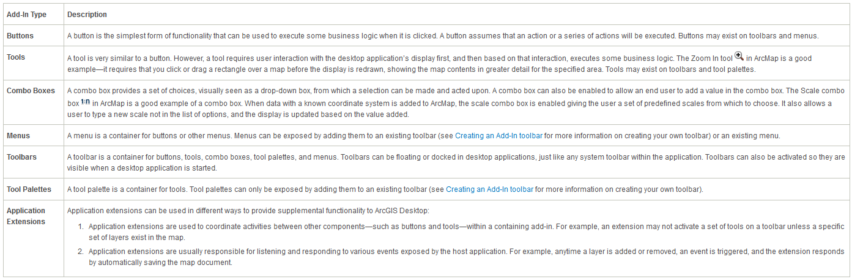
Types of Add-Ins
From the ArcGIS Help Docs

Slide 22
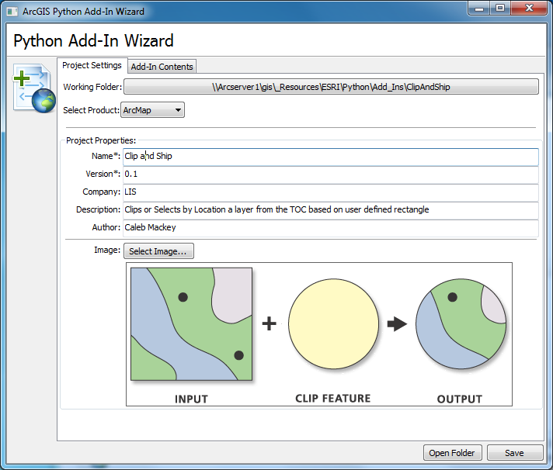
Add-In Wizard

Slide 23
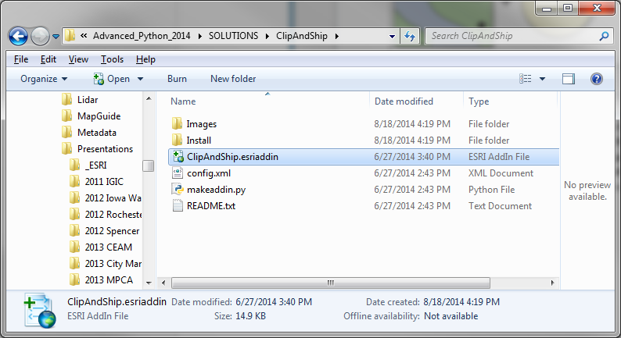
Python Add-In contents

Slide 24
Add In Exercise

Slide 25
Questions?
calebma@bolton-menk.com
Python customization or consultation available!

