Slide 1


KioMed
Sales prediction for better inventory management

Slide 2
Problem
Warehouses cannot meet the demand of the medicines in stores in respective cities
—Use machine learning to solve the problem

Slide 3
Mindset to approach machine learning
Most of the gains comes from great features, and not great machine learning algorithms. So follow basic approaches:
Make sure your pipeline is solid end to end.
Start with a reasonable objective.
Add common sense features in simple way.
Make sure your pipeline stays solid.
— GOOGLE

Slide 4
Mindset to approach machine learning
Most of the gains comes from great features, and not great machine learning algorithms. So follow basic approaches:
Make sure your pipeline is solid end to end. = Start simple make a submission
Start with a reasonable objective. =set a target accordingly
Add common sense features in simple way. =Add more and more features
Make sure your pipeline stays solid. =Keep iterating(keep RMSE score in mind)
— GOOGLE

Slide 5
Basic info(Personal)
Work station = Apple macbook m1 air (Ram=8, core=8)
Platform and coding language= Jupyter + python
Due to the limitations with my work station i have to improvise a lot of things. Like looking for a proper way to shorten the data and make sure it doesn’t affect my predictions.

Slide 6
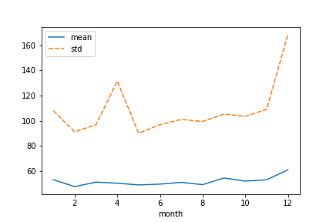
Data Visualisation
(mean and std of sales with respect to months)
Due to the fact that mean and standard deviation is very linear For month 6-7, and my target month also falls under this, i decided to use these months only.
Not only did this shorten the data, but it also gave me better prediction than to use full data.(Further analysis required)
1 Linear model with full data= 74/78
2 linear model with shorten data=72/77

Slide 7
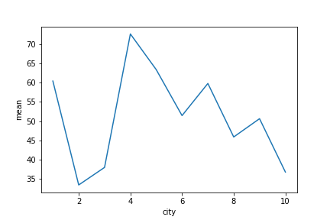
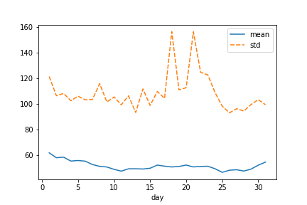
Visualisation-2
(City and Day of month)
City
City 2 has the lowest sales while city 4 has the highest . The variation between different city is a lot, so it can help us a lot.
Day of month
Unlike city this follows a smooth pattern with highest sales being at start and at the end of the month. There is a sudden spike in the second half of the month so it can mean something(Further analysis required)

Slide 8
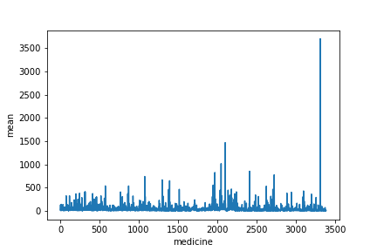
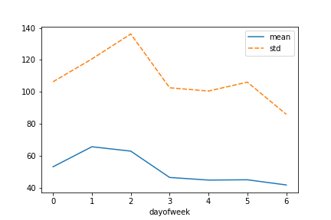
Visualisation-3
(Medicine and Day of week)
Medicine
The distribution is good and varying. This is normal and will be very helpful for prediction.
Day of week
The sales start of very high in the beginning of week, and then start to become lower. This is a interesting observation and one that we need to look at in the future.

Slide 9
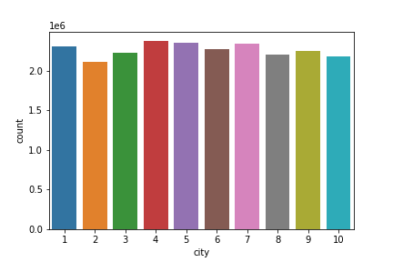
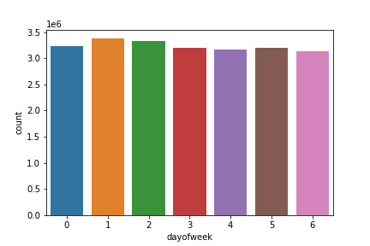
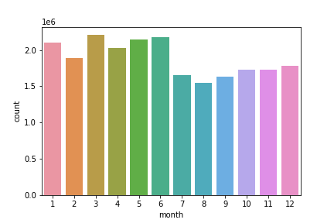
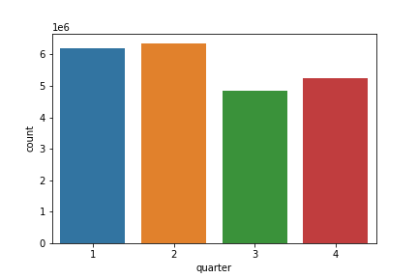
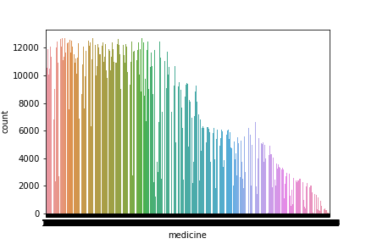
Visualisation-4
The distribution of data is good, so there is no issue there, as for medicine, more expensive medicines tends to sell less so that should be ok too.

Slide 10
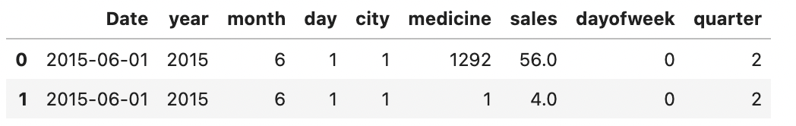
Feature Engineering
Main Dataset=(Year,Month,Day,City,Medicine,Sales)
Using Datetime to create other variables= (Date, quarter,Day of week)
We also have Footfall data, which can be helpful for training.
Sales is our target variable, and the main dataset looks as below,
We don’t have any NA or Null values.

Slide 11
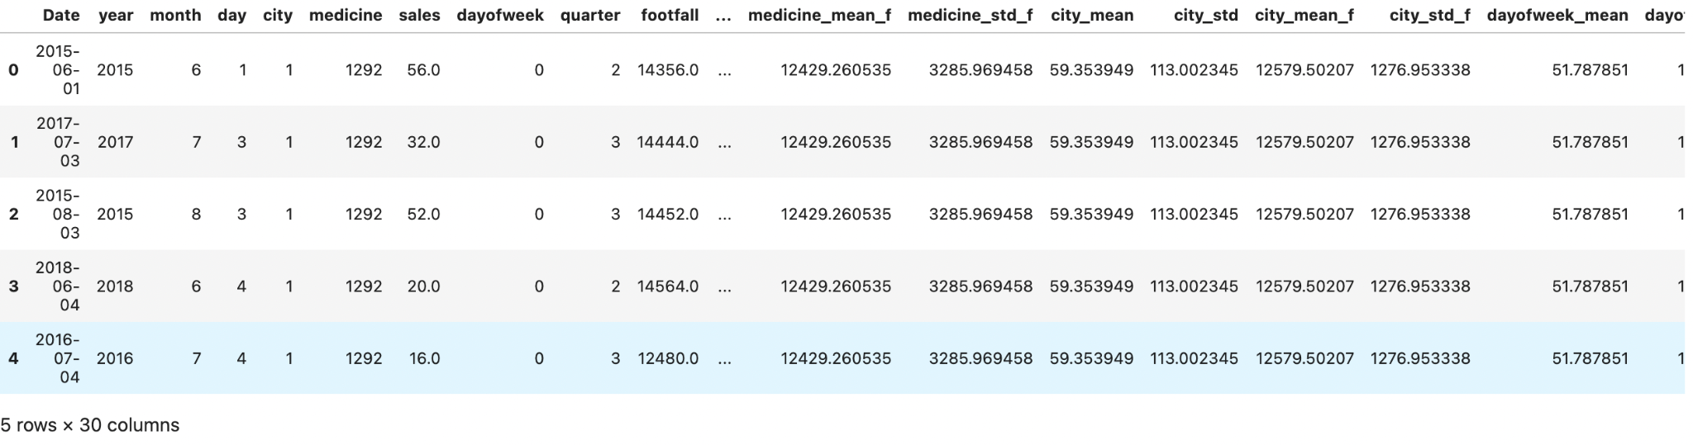
Feature Engineering
Using groupby and aggregation calculate the mean and standard deviation for (Day,month,day of week,medicines,city) on the basis of sales.
This will help us find any kind of pattern or seasonality for the respective variables.
We can also use Footfall data in similar manner to find the mean with respect to all the variables, it may also help us in finding some kind of pattern. Total features created around 22

Slide 12
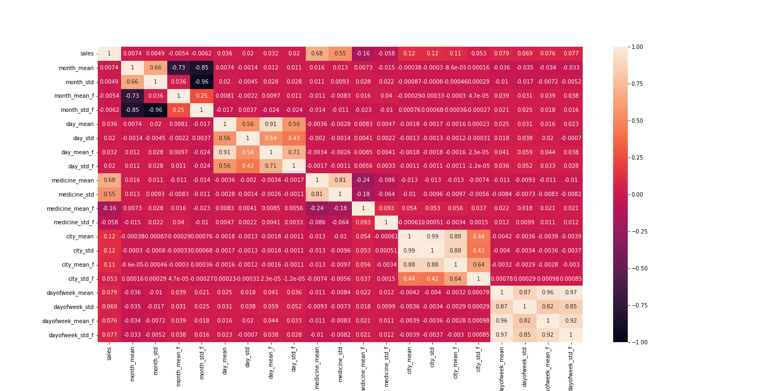
Feature selection
Selecting the most meaningful and helpful features with the help of corelation matrix and heatmap. Anything with the correlation of above 70-75 we can consider heavily correlated and choose appropriately.

Slide 13
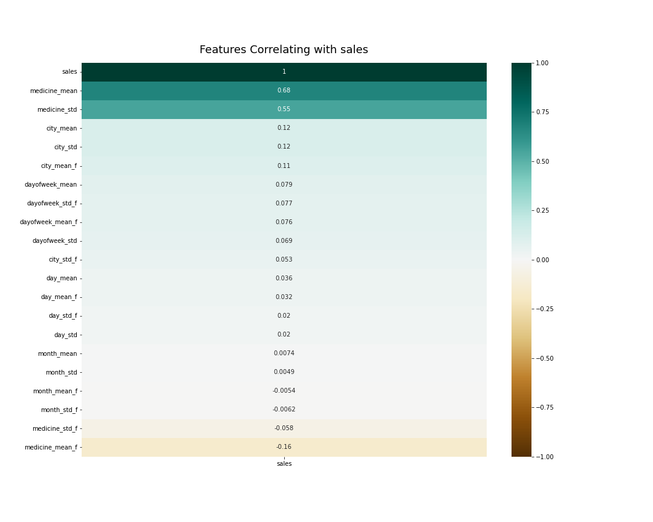
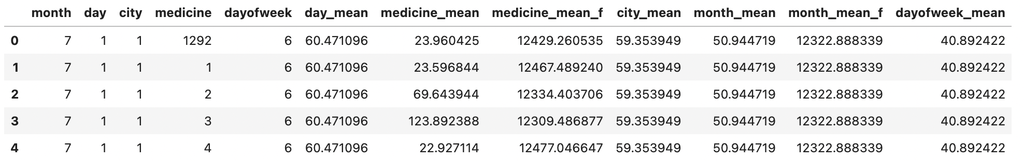
Feature selection
We can also check correlation with our target variable(sales) to get some understanding.
This gives us some understanding on how our numerical variables correlate with our target variable.
Based on everything ,these are the final variables i selected for training.
Categorical =5
Numerical =7 Total = 13

Slide 14
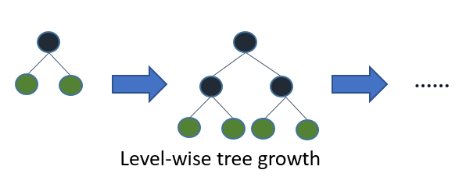
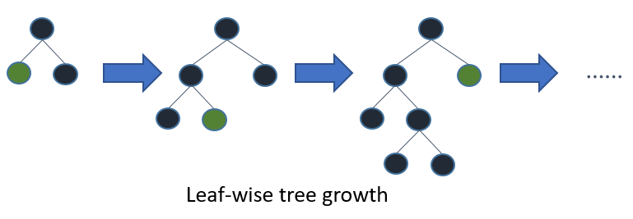
Model training, validation, inference
Train/Validation split: time splits ,last 20% used as validation(no shuffle to keep time aspect ),(no cross-validation)
Training: LightGBM(Gradient boosting Trees) with some hyperparameter tuning.
Most decision tree learning algorithms grow trees by level (depth)-wise, but LightGBM grows trees leaf-wise (best-first). It will choose the leaf with max delta loss to grow. Holding fixed, leaf-wise algorithms tend to achieve lower loss than level-wise algorithms. To know further = (https://lightgbm.readthedocs.io/en/latest/Features.html#optimal-split-for-categorical-features)

Slide 15
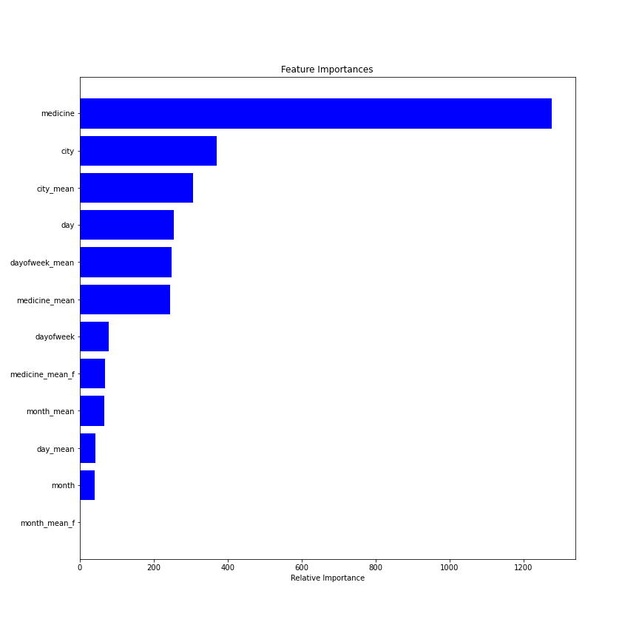
Model training, validation, inference.
Test score(Best)= 50.9(RMSE)
Feature importance
Medicine is the strongest feature, followed by city,city mean,day, day of week mean and medicine mean.
Footfall mean by medicine is a little helpful, but in general footfall data does not helps a lot . month doesn’t matter much coz we are using only 3 month of data.
With better machine and more time further advancement can be make.

Slide 16
Problems faced during the process
Merge function= whenever we merge 2 dataframes, the function will change the order based on the on function,(eg, on= month, then the order will become monthly.)
But that is a big issue when we want to predict in a particular order.
Other issue is the machine, which is not powerful hence limits me in what i can do. Still i tried my best .
Thank you for the opportunity.

