Slide 1

Machine learning models that bridge mind and world
Weikang Qiu
Advisor: Rex Ying
2026/08/18

Slide 2






Language as the "Communication" Modality
Text-to-X
  Text-to-image generation
  Text-to-Speech generation
  Text-to-video generation
  …
X-to-text
  Vision large language model
  ….
Voice Assistant
  Siri
  Alexa
  …
Language is considered the communication among modalities
However, is this the most efficient/effective way??
Latent diffusion for image generation
Video generation
OneLLM, a multimodal LLM that handles 8 modalities
Notes:
Nowadays there are extensive works on multimodal foundation models
Communication user <-> model
example:
image generation conditioned on text
Multimodal LLM
products of virtual assistants
give language instruction by speaking to perform action

Slide 3





Gaps between Mind and World
1️⃣ bandwidth: Thinking >> Speaking
2️⃣ Not everything can be spoken
Speaking
100-150 words/min
Thinking
400-800 words/min
Thinking is much faster than speaking (Hargie, 2011)
Whereof one cannot speak, thereof one must be silent.
There is indeed inexpressible. This shows itself.
Composition VII, 1913 - Wassily Kandinsky
Long prompt required for image generation
Ludwig Wittgeinstein (1889-1951)

Slide 4

RepQA · What It Costs to Get There
KDD 2025 HealthDay, Best Paper · Weikang Qiu*, Tinglin Huang*, Ryan Rullo, Giselle OConnor, Yuchen Kuang, Ali Maatouk, S. Raquel Ramos, Rex Ying
Readability bought and informativeness paid trade off almost perfectly: r = −0.96.
How to read it
One point = one strategy on one model · every run paid for readability in content
Readability is bought with content — language is not a neutral channel
Direct communication between Mind and World
Notes:
Reading the chart, if asked: three base models (LLaMA3.1-8B, Qwen3-8B, Qwen3-4B) were run under five readability strategies -- Prompt, CoT, Lookahead decoding, GRPO, DAPO. Plotted here are the two Qwen models; each point is one run minus its own base, averaged over the four question categories.
Scope of the correlation: r = -0.96 across the eight non-CoT runs (Prompt, Lookahead, GRPO, DAPO on Qwen3-8B and Qwen3-4B). Chain-of-thought is the one strategy off the line -- it pays far more than the rate.
Does RL escape the trade-off? No -- DAPO lands on the same line as the training-free controls, on both models. GRPO barely moved readability at all, so it never really tests the trade-off. Only go here if asked.
Headline readability gains, if asked: DAPO cut the grade level by 41.4% and the professional-language score by 73.3% on average -- the larger gains of the two RL methods.
Mechanism, if asked: simplification collapses structure. The DAPO model compressed lists and collapsed categories, keeping only a salient term -- "statins" for cholesterol drugs, with bile-acid sequestrants, fibrates, niacin and PCSK9 inhibitors merged into a single undifferentiated sentence; "craving" for alcohol use disorder.
Expert evaluation: 8 domain experts, blind pairwise comparison of Qwen2.5-7B and LLaMA3.1-8B, both post-trained with DAPO. Experts favoured LLaMA3.1-8B in 75% of cases -- the reverse of the static-metric ranking, which the paper reads as static readability metrics deviating from human perception.
If asked whether RL escapes the trade-off: DAPO does not -- it buys reading levels and pays content like the training-free controls. GRPO is not evidence either way: it barely moved readability at all (dIC = +0.0025 on both Qwen models), so it never tests the exchange. Do not say RL in general pays the same rate -- one method does, one was not tested.
Do not claim a constant exchange rate. Across the eight non-CoT runs the per-run rate spans -0.0041 to -0.0097 dIC per grade, a 2.4x range, and CoT sits off the line entirely -- the figure says so itself. The claim that survives is the direction: no configuration bought reading levels for free.
Closing line in full: language is not a neutral channel -- readability is bought with content.
/slide[5]/shape[@id=2] (title) "RepQA · What It Costs to Get There" [full sentences cut from the slide] Readability is bought with content — language is not a neutral channel One point = one strategy on one model · every run paid for readability in content

Slide 5

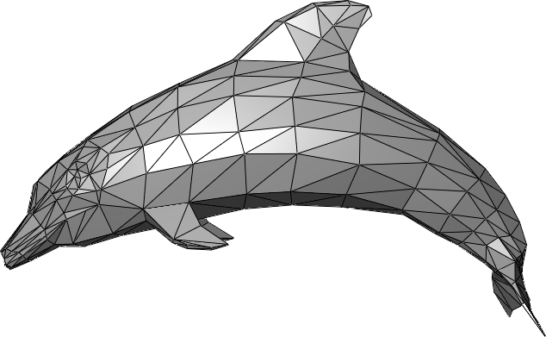




Modalities of World
Image
Video
Mesh
Music
Text
Speech

Slide 6



Modalities of Mind
Various neural recording techniques
Capture
  Different noise level (from scalp to in-brain)
  Different spatial and temporal resolutions
Various Data Formats
  Multi-channel time series
  Volumetric time series (shown later)
PET
Structural MRI
Functional MRI
Notes:
Actual format of the modalities

Slide 7

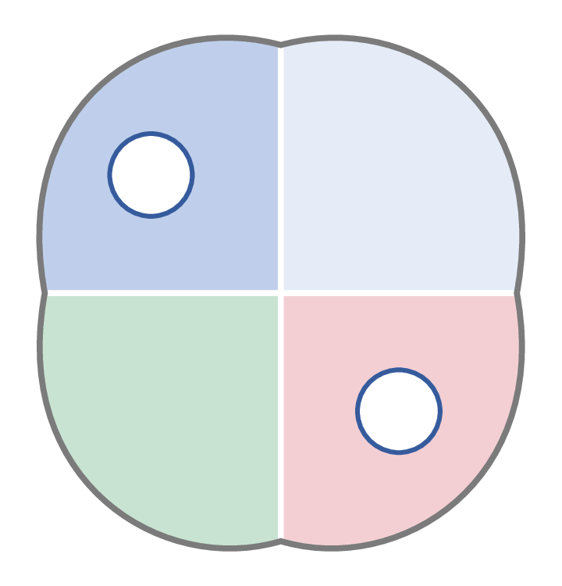




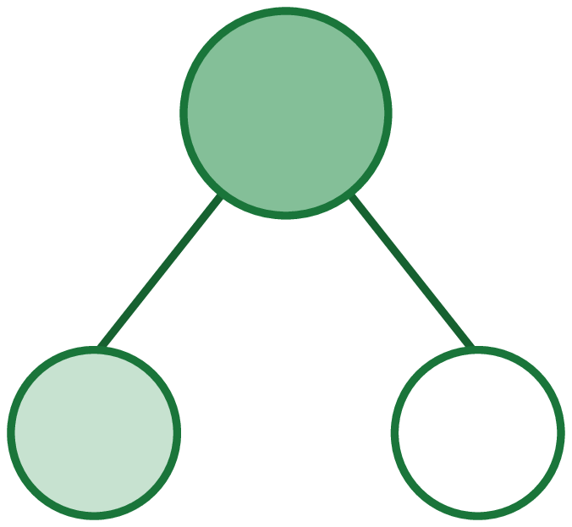





Overall
PART 1 The Foundation
PART 2 The Bridge
PART 3 The Embodiment
Models for Brain Signals
From Signals to Representations
From Representations to Interactions
HyBRiD ¹
Neuro-attn ²
FA-EEG ³
PRISM — I ⁵
Brain Instruction
Tuning ²
Mind World Model ⁷
ML → prior
prior → ML
signals →
semantics
which space?
semantics →
action
step-by-step actions
a goal, not a trajectory
neural priors — how the brain is organised
dog
fluffy
on grass
obj
attr
rel
the prior travels
back out
SWA ⁴
DySta ⁸
PHIL ⁹
PRISM — II ⁵
D-Edit ⁶
VLA control
the fast loop
a path to the goal
the slow loop
the direct path: brain signals → semantics → action, never through language
[1] Qiu et al. Learning High-Order Relationships of Brain Regions. ICML 2024. [2] Qiu et al. MindLLM: A Subject-Agnostic and Versatile Model for fMRI-to-Text Decoding. ICML 2025.
[3] Qiu et. al. Mind World Models. In preparation. [4] Huang et al. Small-world structure in LLM attention heads. In preparation.
[5] Huang et al. Seeing Through the Brain: New Insights from Decoding Visual Stimuli with fMRI. ICLR 2026 Oral. [6] Feng et al. An Item Is Worth a Prompt: Versatile Image Editing with Disentangled Control. AAAI 2025.
[7] Label-free motor decoding from EEG and ego-view video. In preparation. [8] Qiu et al. Static-Dynamic Disentanglement for Efficient Multi-Frame Vision-Language-Action Models. arXiv 2026. [9] Pándy et al. Learning Graph Search Heuristics. LoG 2022.
Notes:
Per-work one-liners (cut from the figure so the labels could be read from the back of the room):
HyBRiD - discover what no atlas records. Neuro-attn - position is the key, atlas is the prior. FA-EEG - symmetry made exact, not learned. SWA - small-worldness predicts fluid reasoning; the prior improves a model with no brain in it.
PRISM I - fMRI sits closer to text than to visual latents. Brain Instruction Tuning - 980k dialogues via MSCOCO, not one new scan. PRISM II - object-centric reconstruction. D-Edit - one prompt per item, not per image.
Mind World Model - no labels; the only supervision is the world model's error on the next frame. DySta - static tokens kept once and their KV cache reused; a recache gate decides when to refresh. PHIL - slow loop, a learned cost-to-go truncates the lookahead.

Slide 8
Part 1: The Foundation
Models for Brain Signals
Two directions between neuroscience and machine learning.
1
Discover
2
Incorporate
Discover neural priors, e.g., connectivity.
Build in known organization — don't spend scarce data relearning it
HyBRiD · ICML 2024
high-order relations among brain regions
FA-EEG · ongoing — mirror symmetry
Neuro-informed attention · ICML 2025 — functional anatomy
3
…and the prior travels back out
And back out — a brain-network property improves a model with no brain in it
SWA · ongoing — small-world organisation in the attention-head network of an LLM
Notes:
The cut is by where the structure comes from, not by what it buys. HyBRiD has to search: no atlas says which regions act as a group and the candidate space is exponential, so the structure is learned end-to-end under the MIMR objective. The other three each start from something neuroscience has already established and hand it to the model. SWA carries the network-level prior, small-world organisation, over to LLM attention heads and tests it by pruning against it. FA-EEG makes the left-right mirror symmetry exact by frame averaging instead of learning it from scarce data. Neuro-informed attention uses learnable queries over region encodings from brain parcellations; serving a new subject is the payoff of that prior, not a separate question, which is why it sits under the same heading rather than beside it.
/slide[10]/shape[@id=2] (title) "Part 1: The Foundation\nModels for Brain Signals" [full sentences cut from the slide] Discover structure no atlas records — in a form a neuroscientist can read Build in known organisation — don't spend scarce data relearning it And back out — a brain-network property improves a model with no brain in it

Slide 9
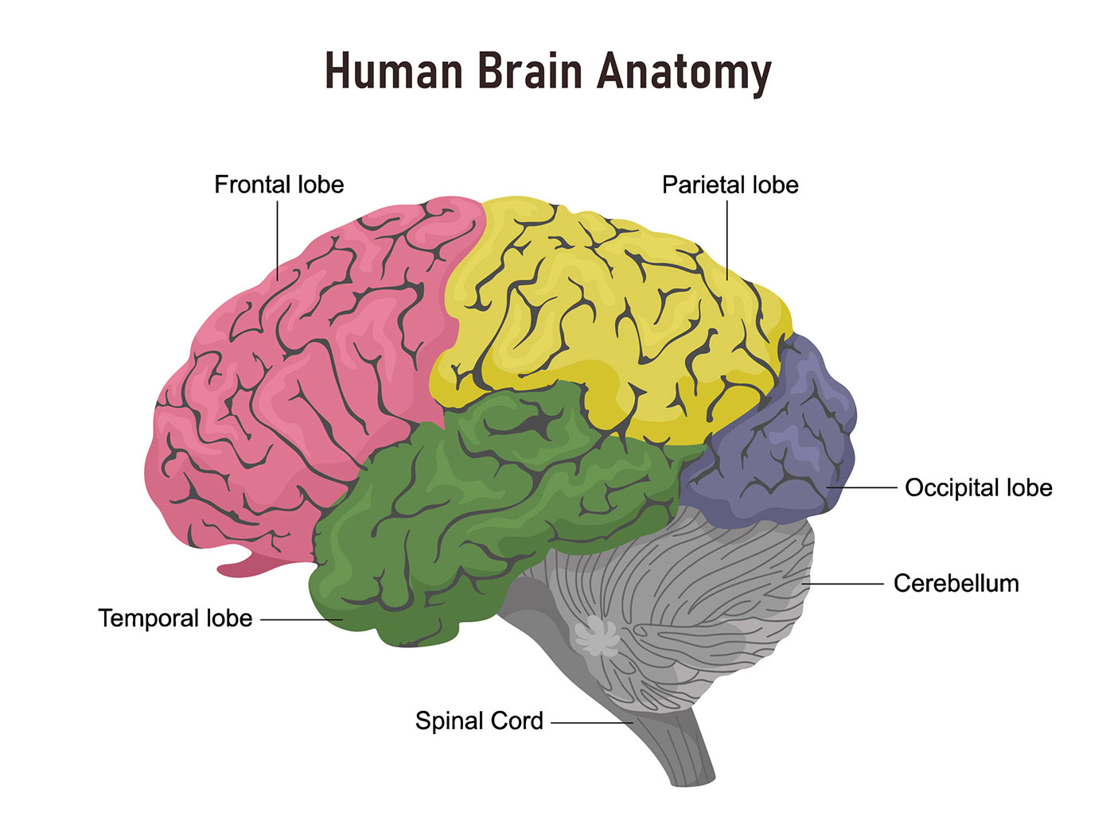
Preliminary · Brain Networks
Built the same way everywhere: regions are nodes, every edge joins exactly two.
Nodes — brain regions
Parcellated by an atlas · voxels inside a region averaged
Edges — pairwise Pearson correlation
One number per pair, from their averaged time courses
What it is used for
Clinical diagnosis and treatment · Study how the brain works
Notes:
Brain Network is a tool to study the brain at the region level

Slide 10

HyBRiD · Cognition Is Not Pairwise
ICML 2024 · Weikang Qiu, Huangrui Chu, Selena Wang, Haolan Zuo, Xiaoxiao Li, Yize Zhao, Rex Ying
Imaging biomarkers score pairwise edges — but brain function is distributed over many regions
They do not decompose
Cannot be broken into pairs — they carry what pairs cannot
So: weighted hyperedges
A hyperedge joins any number of regions · its weight is the strength
And the search space is exponential
Exponentially many candidates · prior work prunes first, blind to the target — the informative ones are gone before selection starts
Regions → high-order relationships → their strengths → the cognition score. (HyBRiD Figure 1)
Notes:
Premise, HYBRID/000intro.tex:6-7: biomarker detection scores pairwise connectivity, but brain function is distributed across many regions at once, and high-order relations cannot always be decomposed into pairwise ones, so they capture information beyond the reach of pairs. Formulation, 000intro.tex:33: regions are nodes, a hyperedge joins any number of them, and the hyperedge weight is the strength of the relationship. The cost, 000intro.tex:12: the number of possible high-order relations is exponential; 000intro.tex:8: prior high-order work enumerates only a small portion of the space, or clusters without reference to the target, so the most informative relations are gone before feature selection starts. That sets up slide 13.

Slide 11
Existing Works · Three Ways It Breaks
ICML 2024 · Weikang Qiu, Huangrui Chu, Selena Wang, Haolan Zuo, Xiaoxiao Li, Yize Zhao, Rex Ying
Hypergraph construction relies on neighbour distance and reconstruction.
CURRENT HYPERGRAPH CONSTRUCTION
HyBRiD
No objective
Multi-head drop-bottleneck
No tractable objective for learning maximally informative, minimally redundant hyperedges.
→
A tractable bound on the MIMR objective, so the hyperedges are learned end-to-end.
No consistency across subjects
Feature-agnostic masks
Structures differ per subject — contradicting the belief that healthy cognition works alike.
→
The mask never reads a subject’s features, so every subject gets the same structure.
At most N hyperedges
K parallel heads
The number of hyperedges is capped at the number of nodes, which can be sub-optimal.
→
One head per hyperedge, so K is a free hyperparameter.
Notes:
All six claims: HYBRID/000intro.tex:40 (the three failures) against 000intro.tex:44 (the three answers). Failure 1: neighbour-distance and neighbour-reconstruction construction has no tractable objective for MIMR hyperedges. Failure 2: it does not learn consistent structures across subjects, which contradicts the belief that the cognitive mechanism of healthy human beings should be similar. Failure 3: the number of hyperedges is restricted to the number of nodes, which may lead to sub-optimal performance. HyBRiD's answers, same order: multi-head drop-bottleneck gives a tractable IB objective; the feature-agnostic masking mechanism is exactly what buys consistency across subjects; K parallel heads, one per hyperedge, so K is free. Also from :40 — existing IB methods extract compressed representations of the input, not structures, so applying IB here needed both architectural innovation and theoretical derivation.

Slide 12
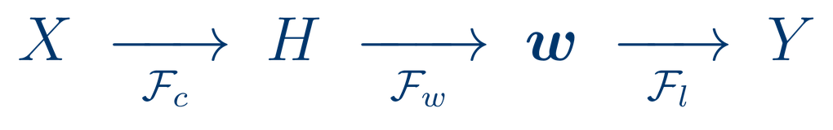
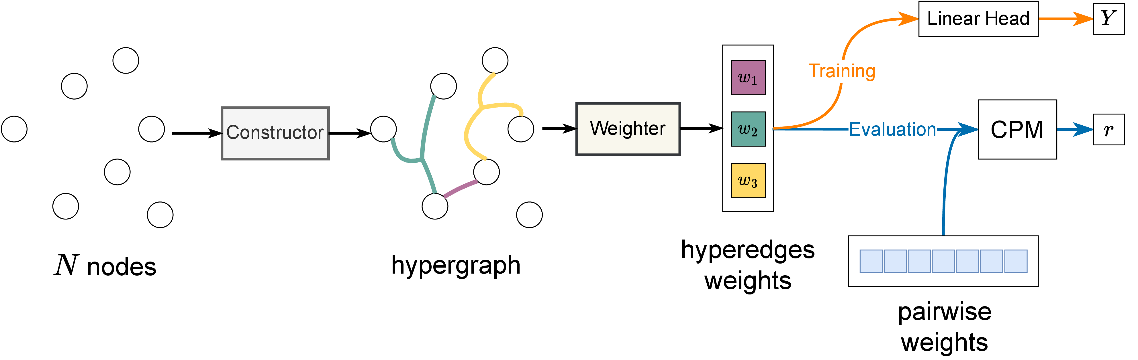

HyBRiD · Constructor → Weighter → Head
ICML 2024 · Weikang Qiu, Huangrui Chu, Selena Wang, Haolan Zuo, Xiaoxiao Li, Yize Zhao, Rex Ying
One forward pass. Three modules; the last two are the predictor.
Training supervises the whole chain with Y; the learned weights then go into CPM. (HyBRiD Fig. 2)
Constructor
Weighter
LinearHead
$${O(N}^{2} K)$$
learns which regions form each hyperedge
scores each hyperedge from its members
predicts the outcome from the K weights
the same scale as an MLP
Notes:
003approach.tex:5-11 names the three modules the old deck never named: Constructor F_c identifies the hyperedges H, Weighter F_w gives each one a weight, LinearHead F_l predicts Y from the weights — X -> H -> w -> Y. The figure is the paper's Figure 1 (figures/pipeline2.drawio.pdf, caption at 003approach.tex:20): note the two phases on the right, training under Y and evaluation through CPM. Complexity, 003approach.tex:86-88: O(N^2 K), 'just the same scale as that of MLPs even though we are addressing a more challenging task: identifying high-order relationships in an exponential space'; appendix.tex:149-150 derives it as O(NKd + d^2) with d = N because a region's features are its correlations to all regions. The runtime that follows from it is on the results slide.

Slide 13



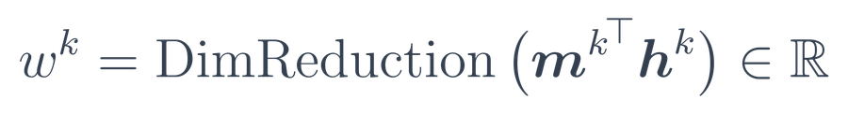
HyBRiD · The Structure Is a Learned Mask
ICML 2024 · Weikang Qiu, Huangrui Chu, Selena Wang, Haolan Zuo, Xiaoxiao Li, Yize Zhao, Rex Ying
K heads, one per hyperedge. Head k decides which regions belong to hyperedge k.
1
One learnable probability per region, cut at 0.5.
2
The indicator has no gradient — so: stop-gradient.
3
Mask features; unmasked nodes are the members.
4
Weighter: sum unmasked nodes, then MLP to a scalar.
The mask never looks at X
N = 6 regions, K = 3 hyperedges. (HyBRiD Figure 3)
Feature-agnostic masking is what makes one structure hold across subjects — only the weights change.
Notes:
003approach.tex:33-43: K is a predefined hyperparameter and each head owns one hyperedge. Head k carries N learnable probabilities p^k_theta,i; the indicator thresholds them at 0.5 into a binary mask m^k in {0,1}^N over the N regions. There is no gradient defined for the indicator, so they use the stop-gradient technique (van den Oord et al.; Bengio et al.). 003approach.tex:55-61: h^k = m^k elementwise-times X, and the non-masked nodes are the hyperedge's members. 003approach.tex:71-78: the Weighter's Readout sums over all non-masked nodes feature-wise, then a DimReduction MLP with ReLU takes that to a single scalar w^k. The only learnable components in the whole model are those shallow embeddings, that MLP and the linear head (003approach.tex:144). Feature-agnostic masking is 000intro.tex:44 — the answer to failure 2 on the previous slide. Figure is HyBRiD Figure 2, 003approach.tex:45-53.

Slide 14
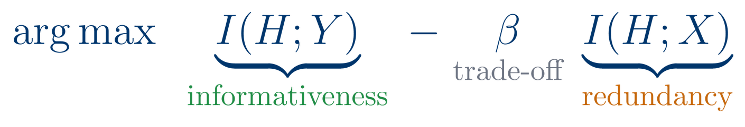
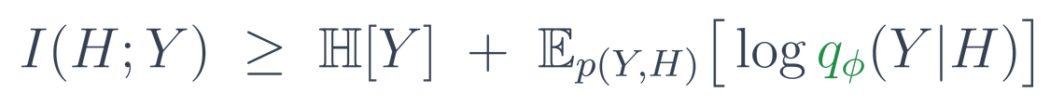
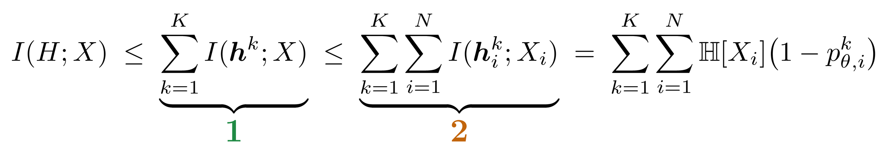
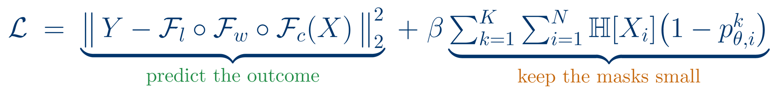
HyBRiD · Multi-Head Drop-Bottleneck
ICML 2024 · Weikang Qiu, Huangrui Chu, Selena Wang, Haolan Zuo, Xiaoxiao Li, Yize Zhao, Rex Ying
No existing IB framework identifies a structure — it compresses an input. So we derive one: multi-head drop-bottleneck.
Informativeness — lower bound
qφ is exactly the Weighter followed by the LinearHead.
Proposition 1 — our bound. 1 across the K heads, the multi-head; 2 inside one head, the drop-bottleneck. Proof in the appendix.
Notes:
This slide is the theoretical contribution, so say it out loud. The information bottleneck is the standard way to learn maximally informative, minimally redundant representations -- but every existing IB method compresses an INPUT into a representation. None of them identifies a STRUCTURE such as a hypergraph (000intro.tex). So there was no framework to apply: 003approach.tex:92, 'Since there are no existing IB frameworks that can be applied in our context, we propose a new IB framework named multi-head drop-bottleneck'. The name is the derivation: Proposition 1 bounds I(H;X) twice -- first across the K heads, which is the multi-head part, then within a head, which is the drop-bottleneck step inspired by Kim et al. (003approach.tex:120-129). Equality holds iff nodes are independent and hyperedges do not overlap, and the paper is explicit that optimising the bound does NOT penalise overlap -- worth knowing if someone asks whether hyperedges are forced apart. Proof is in the appendix.

Slide 15

HyBRiD · Predictive Performance
ICML 2024 · Weikang Qiu, Huangrui Chu, Selena Wang, Haolan Zuo, Xiaoxiao Li, Yize Zhao, Rex Ying
CPM (Shen et al., 2017): the field’s standard connectivity–phenotype test.
Baselines: pairwise CPM · kNN/ℓ1/ℓ2 hypergraphs · BrainNetGNN, BrainGB, BrainGNN, BrainNetTF
r on the eight ABCD datasets, averaged over 10 runs. Bold = best, underline = second best. (HyBRiD Table 1)
+12.1%
+8.8%
+11.9%
87%
average gain on ABCD — best on 7 of 8 datasets
average gain on ABIDE, across all three IQ targets
lower MSE on 9 of 11 datasets
faster per batch than BrainNetTF
Notes:
The metric first, because it is the defence. CPM, Shen et al. 2017, 004experiments.tex:57 — 'a standard model that could evaluate the relevance between the connectivity and the prediction target, due to its high impact in the community'. We did not invent it; we swapped the pairwise weights it normally consumes for our hyperedge weights (004experiments.tex:65-72). Three classes of baselines at 004experiments.tex:157-159; for the deep baselines their last-layer embeddings are fed to CPM, exactly as our weights are. Numbers: ABIDE +8.8% average over the state of the art on FIQ, VIQ and PIQ (004experiments.tex:168); ABCD best on 7 of the 8 datasets, average +12.1% (004experiments.tex:169, macro defined at macros.tex:78) — Rest 1 is the single loss and is analysed in the appendix; MSE better on 9 of 11 datasets, +11.9% (004experiments.tex:211); runtime 87% faster per batch than the second-fastest deep model BrainNetTF and at least 1255% faster than the GNN baselines (004experiments.tex:173, appendix.tex:473). Datasets, 004experiments.tex:40-43: ABIDE (Craddock 200 atlas, three IQ targets) and ABCD (AAL3v1, fluid intelligence, 2 timepoints x 4 conditions = 8 datasets).

Slide 16
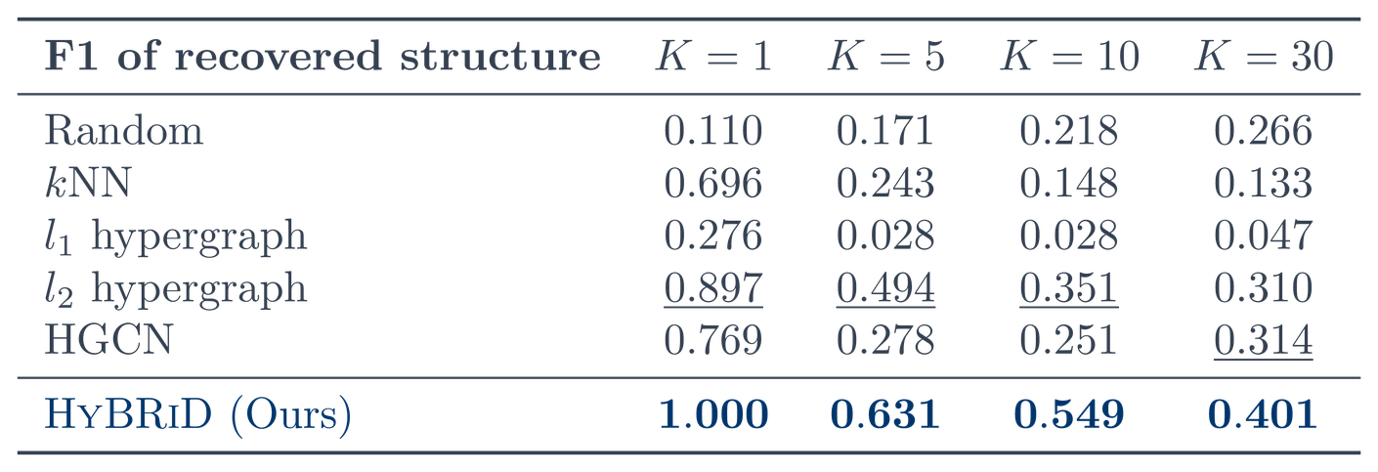
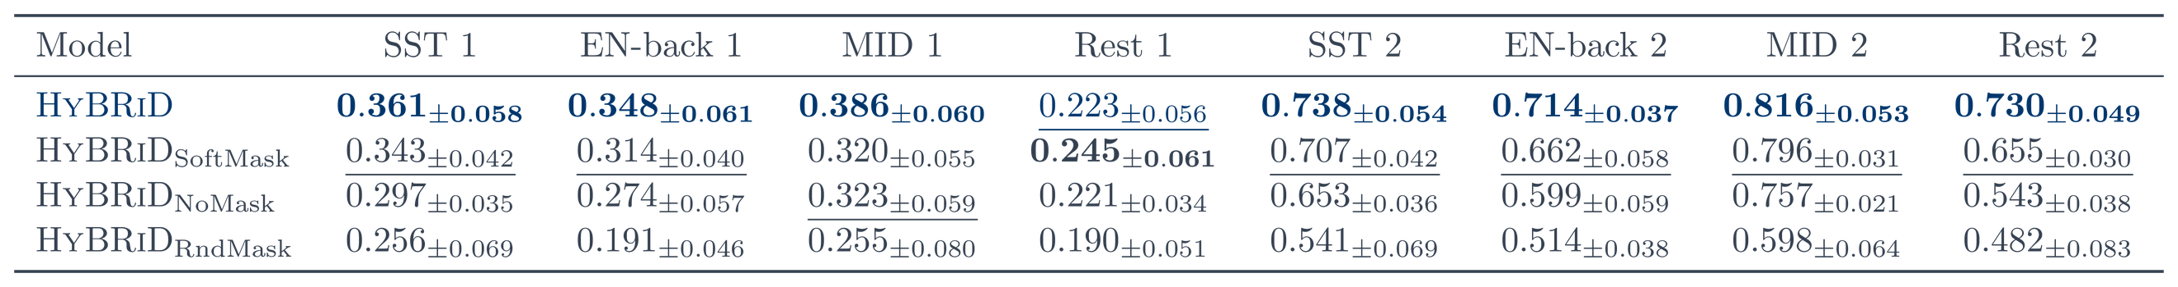
HyBRiD · What Makes the Hyperedges Real
ICML 2024 · Weikang Qiu, Huangrui Chu, Selena Wang, Haolan Zuo, Xiaoxiao Li, Yize Zhao, Rex Ying
Real fMRI has no ground-truth hyperedges — so we built data that does
K hyperedges over 164 nodes with degree up to 34; the label summarises each hyperedge's members. Recovery is scored by macro-F1 after Hungarian matching to the ground truth.
+28.3%
average F1 improvement over the strongest baseline
Supervised only by the task label
The model is never shown a hyperedge. The structure falls out of the MIMR objective.
And the masking is what does the work. Learnable beats random and beats none; the hard mask beats the soft one on 7 of the 8 datasets — sparse, succinct representations preserve information better than smooth ones.
Notes:
This answers 'how do you know the hyperedges are real', and it replaces the brain-map visualisations. 004experiments.tex:207-208: there are no ground-truth hyperedges in real data, so a synthetic dataset is constructed where the structure is known and precision, recall and F1 of the recovered hyperedges are measured — average +28.3% F1 over the strongest baselines, learned 'only supervised by the task label'. Construction, appendix.tex:330-338: degree sampled uniformly between 2 and d_max = 34, members sampled at random, node features from U(0,2v) per hyperedge, and the label is the sum over hyperedges of the max member feature; 164 nodes to match AAL3v1, K in {1,5,10,30}. Hyperedge order is arbitrary so matching uses the Hungarian algorithm (appendix.tex:340). Baselines include a learnable HGCN whose incidence matrix is trained (appendix.tex:345), which is the strongest structure-learning comparison. Ablation, 004experiments.tex:176-177: RndMask = random masks at the same sparsity, NoMask = every node and feature visible to every head, SoftMask = drop the indicator and use p directly. HyBRiD and SoftMask beat the other two, which demonstrates the effect of learnable masks; HyBRiD beats SoftMask, which the paper reads as sparse succinct representations preserving information better than smooth ones. Table 3, 004experiments.tex:138-154.

Slide 17

MindLLM · Challenges in fMRI Decoding
ICML 2025 · Weikang Qiu, Zheng Huang, Haoyu Hu, Aosong Feng, Yujun Yan, Rex Ying
Subject agnostic decoding
fMRI at a specific moment (no time series in this work)
Select Responsive Voxels
Model
Responsive tokens are different (both in number and in distribution) for different subjects
Existing works:
Non-learnable pooling/sampling process, risk of information loss
Sampling: over- or under-representation of certain areas.
(Pooling)
(Sampling)

Slide 18


MindLLM · Learnable Queries over Voxels
ICML 2025 · Weikang Qiu, Zheng Huang, Haoyu Hu, Aosong Feng, Yujun Yan, Rex Ying
cross attention
Learnable queries
Each query -> a specific pattern. E.g.
  gather information of low-level vision area
  communication between low- and high-level areas
A standard cross attention?
query 1
query 2
query 3
Bad performance!
(Compared to a non-cross-subject MLP baseline)
query 4
query 5
query 6
Notes:
Subject-agnostic argument, half 1 of 2 (the author's CC note on slide 24 asks for it; the block itself is on 24). This slide is where the VALUE path is set: values are the raw fMRI signal of each voxel, one token per voxel. Parts/part1.tex line 46: "For values, we directly use the fMRI signal of each voxel... Making each voxel a value token maximally prevents information loss compared to pooling- [MindBridge] or sampling-based [UniBrain] methods." That is what lets one architecture eat a voxel set whose size and spatial layout differ per subject - N ranges 12,682 to 17,907 over the 8 NSD subjects (line 41). The alternative, standardising the input by pooling or sampling, is what MindBridge and UniBrain do, and line 29 says those "still suffer from the loss of spatial information and uneven representations of certain areas."

Slide 19


MindLLM · Keys from Position Alone
ICML 2025 · Weikang Qiu, Zheng Huang, Haoyu Hu, Aosong Feng, Yujun Yan, Rex Ying
Image: query should know the pixel value
fMRI: only needs to know the position (a voxel’s position reflects its functional role)
-> Use Positional Encoding alone.
Notes:
Images are translational invariant, which means a query needs to know the actual pixel value to compute the attention weight
Subject-agnostic argument, half 2 of 2. This is where the KEY path is set, and it is the half that actually buys cross-subject transfer. Parts/part1.tex line 49: the positions of voxels "carry specific brain functional information, as voxels in different areas are associated with distinct brain functions", so position alone is a sufficient key; putting the fMRI value into the keys "introduces additional noise instead of valuable information". Same line: "since brain regions tend to serve similar functions across individuals, decoupling voxel positions from fMRI signals can facilitate the sharing of priors across subjects, potentially improving generalization to unseen subjects." So the subject-specific quantity (the fMRI value) flows only through V, and everything the query matches against is anatomy/function that a new brain also has. Slide 24 states the whole argument in one block.

Slide 20
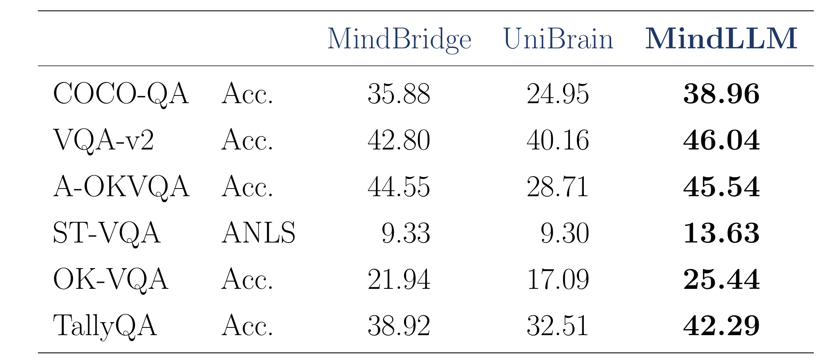
MindLLM · Region Encodings as Neural Priors
ICML 2025 · Weikang Qiu, Zheng Huang, Haoyu Hu, Aosong Feng, Yujun Yan, Rex Ying
Why this transfers to an unseen subject
Learnable Region Encodings from multiple brain parcellations
Incorporate neural priors (region encodings)
Improve convergence speed
Grounded to established neuroscientific theory
Value path — one token per voxel; no pooling or sampling.
Key path — position and parcellation only; consistent across individuals.
Held-out subject 8 (trained on 1–7, no finetuning): +24.5% average over the second-best subject-agnostic model, across all 38 metrics (6 shown).
Parcellations
Notes:
Result brought up per the review comment. The table is the first block of Table "tab:subj8" in the MindLLM paper (git 9d4c342:MINDLLM/04experiments.tex lines 105-136), compiled standalone from the paper's own LaTeX - a contiguous prefix of the table, nothing retyped and no rows cherry-picked. The +24.5% is the paper's sentence at line 224. Architecture-level result: no brain-instruction-tuning ablation is involved. The full 38-metric version of the same table is still on slide 35. Scope is now disclosed on the slide face: tab:subj8 has 38 metric rows, the table here is the first 8, and the +24.5% is the average over all 38 - the band says so in the same sentence as the number. An 8-row average was deliberately NOT substituted: the paper's aggregation is not reproducible from the printed table (relative gain over the better baseline, averaged over the 38 rows, comes to 21.2%), so any recomputed figure would be ours, not the paper's. VG-QA and TallyQA RMSE, the two rows MindLLM does not win, stay visible. Red frame re-registered to native px x 638-985, y 421-807 of image48.png (1321x844) - the fine-scale positional-encoding row plus the coarse-scale region-encoding block that build K.
"Why this is subject-agnostic" block added to answer the author's note (CC: 这两页需要补充一下为什么这样可以有更好的subject agnostic); that textbox has been deleted. Two mechanisms, both from Parts/part1.tex. (1) VALUE PATH - one token per voxel, no pooling or sampling, so any voxel count fits: line 46 "Making each voxel a value token maximally prevents information loss compared to pooling- or sampling-based methods"; the pooling/sampling baselines cited there are MindBridge and UniBrain, the same two columns as in the table on this slide, and line 29 says they "suffer from the loss of spatial information and uneven representations of certain areas". The 12,682-17,907 range is line 41 (number of voxels per subject in NSD). (2) KEY PATH - keys exclude the fMRI value and are the concatenation of Fourier positional encoding of the voxel coordinates with learnable region embeddings from multiple parcellations (lines 51, 55, 58-60); line 49 "since brain regions tend to serve similar functions across individuals, decoupling voxel positions from fMRI signals can facilitate the sharing of priors across subjects, potentially improving generalization to unseen subjects", restated at line 66 "This attention design separates a voxel's functional information - which is largely consistent across individuals - from its fMRI value, thereby enhancing generalization." The closing arrow is the design claim only; its evidence is the +24.5% band and table already on the slide (git 9d4c342:MINDLLM/04experiments.tex line 224), so the block does not restate the number.

Slide 21
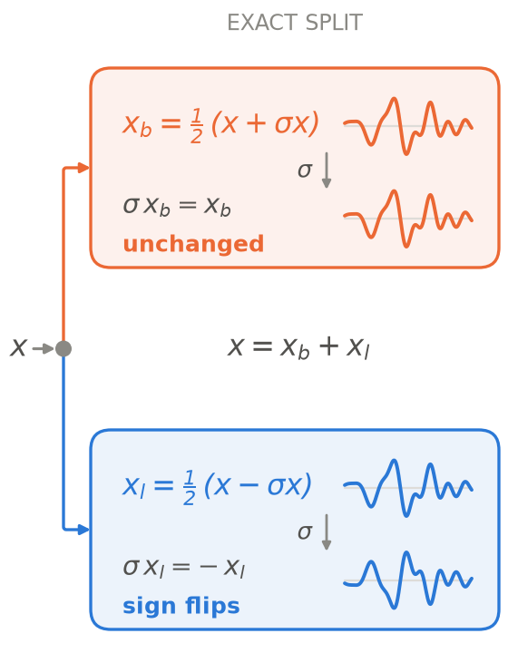
FA-EEG · EEG Has a Left–Right Symmetry
ongoing
Left/right imagery gives mirror-image EEG — a plain encoder relearns it from scarce data
Bilateral half — nuisance
volume conduction and global rhythms — genuinely shared by both sides.
σ
→
Lateralized half — signal
LEFT
MIDLINE
RIGHT
electrode montage
which hemisphere desynchronizes tells left from right.
Notes:
Montage detail (was drawn on the slide at 8.5 pt, now spoken): the left group is F3/C3/P3, the midline group Fz/Cz/Pz, the right group F4/C4/P4. sigma maps F3<->F4, C3<->C4, P3<->P4 and leaves the midline channels fixed.
Motivation, as originally written: imagining a left-hand movement and a right-hand movement produce mirror-image EEG. Nothing in a standard encoder knows this: it has to learn the mirror from data — and EEG data is scarce.
Lateralized half, full sentence: motor imagery is lateralized — which hemisphere desynchronizes tells left from right.
/slide[23]/shape[@id=2] (title) "FA-EEG · EEG Has a Left–Right Symmetry" [full sentences cut from the slide] Left/right imagery gives mirror-image EEG — a plain encoder relearns it from scarce data

Slide 22
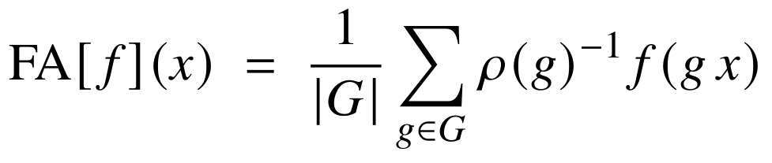
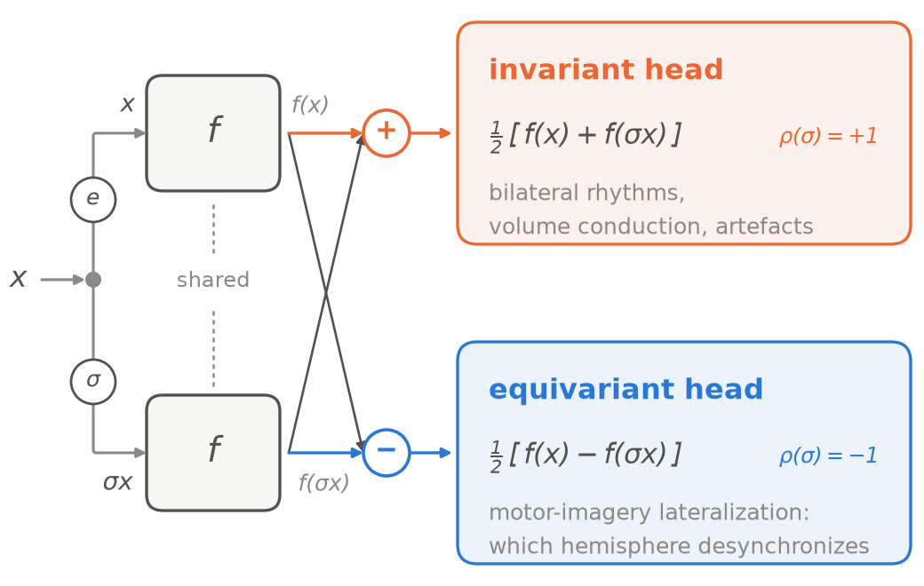
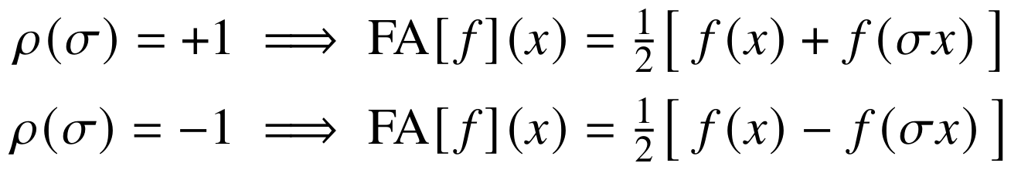
FA-EEG · Frame Averaging over the Mirror Group
ongoing
ρ(g): how the swap acts on the output space.
Holds for every input and backbone, so capacity goes to lateralization.
Motor-imagery decoding (%)
Dataset | FA off | FA on
PhysioNet | 61.7 ± 0.3 | 63.3 ± 0.5
FineMI | 19.2 ± 0.5 | 20.0 ± 1.1
In progress · vs. EEG foundation models on motor-imagery decoding.
Notes:
FA on vs FA off (mean +/- sd): PhysioNet-MI 0.6330 +/- 0.0050 vs 0.6166 +/- 0.0026 -> 63.3 +/- 0.5% vs 61.7 +/- 0.3%, +2.7% relative. FineMI 0.2000 +/- 0.0110 vs 0.1917 +/- 0.0048 -> 20.0 +/- 1.1% vs 19.2 +/- 0.5%, +4.3% relative. Same direction on both datasets, but only PhysioNet-MI separates outside the error bars; the FineMI gain is within noise.

Slide 23

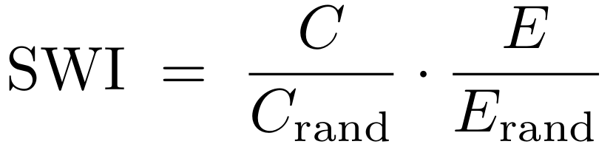
SWA · A Small-World Structure in Attention Heads
ongoing · Zheng Huang, Enpei Zhang, Weikang Qiu, Rex Ying, Elynn Chen, Yaoqing Yang, Dawei Zhou, Yujun Yan
In the brain, small-worldness tracks intelligence · does an LLM organize the same way?
What is a small-world network? (Watts–Strogatz)
High local clustering and short global paths at once:
average clustering coefficient
global efficiency (short paths)
the same two quantities on degree-matched random graphs
How the graph is built
Nodes = attention heads · edges = activation similarity · fixed density — a functional brain graph
Higher small-world index → better fluid reasoning · same ordering in both families
Six open-source LLMs on DRE-Bench; NLL per answer token, lower is better.
Fluid intelligence
Notes:
Motivation first: in neuroscience, functional brain networks built over ROIs show small-world organisation, and stronger small-world structure goes with higher Raven's-style test scores. Definition: high local clustering AND short global paths at once -- neither a lattice nor a random graph -- quantified relative to degree-matched randomised graphs. The graph here: one node per attention head, edge weight from activation similarity on DRE-Bench fluid-reasoning questions, thresholded to a fixed density exactly as a functional brain graph is. (Similarity is SVCCA rather than Pearson because a head emits a vector, not a scalar -- only if asked.) The finding: Qwen3-14B highest SWI and lowest answer NLL, Llama-3.2-1B lowest and highest; the ordering holds within both families.
/slide[25]/shape[@id=2] (title) "SWA · A Small-World Structure in Attention Heads" [full sentences cut from the slide] Nodes = attention heads · edges = activation similarity · fixed density — a functional brain graph Higher small-world index → better fluid reasoning · same ordering in both families

Slide 24
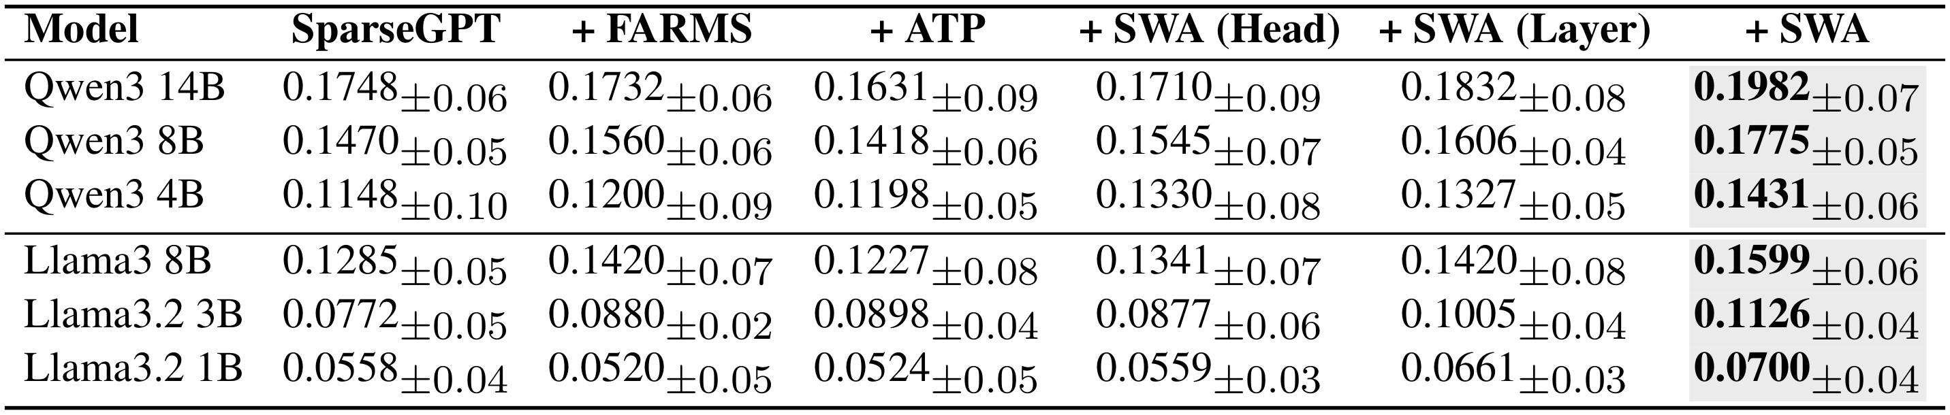
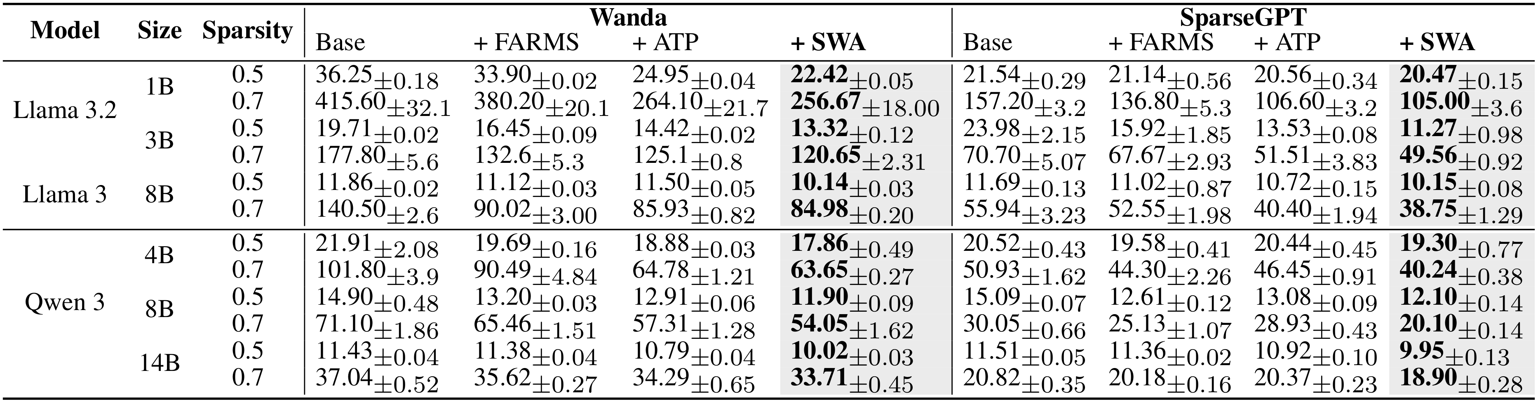
SWA · Method and Results
ongoing · Zheng Huang, Enpei Zhang, Weikang Qiu, Rex Ying, Elynn Chen, Yaoqing Yang, Dawei Zhou, Yujun Yan
SWA, in one line
Core + bridge scores rank every head; central heads and layers get less sparsity.
SparseGPT @ 0.5 · SWA highest on all six · mean ± std, 3 seeds
WikiText perplexity ↓ — SWA is best in every model × sparsity cell
Notes:
Method, said aloud: core score = share of a head's connection strength that stays inside its own Louvain community (local clustering); bridge score = how evenly it spreads across the other communities (short paths). Both are turned into percentile ranks and multiplied, p = (1-B)(1-C); sparsity is allocated in proportion to p, at the head level and again at the layer level, so structurally important parts are cut least. Numbers worth quoting: SWI on Qwen3-14B 0.175 -> 0.198; perplexity on Qwen3-8B at sparsity 0.7, 25.13 -> 20.10, a 20.0% cut against the best baseline. Two results not shown: best zero-shot accuracy in every cell over seven benchmarks, and the lowest shape-mismatch rate on all six held-out ARAOC operations. Ablation: dropping the layer-level signal costs +19.6 perplexity at sparsity 0.7.
/slide[26]/shape[@id=2] (title) "SWA · Method and Results" [full sentences cut from the slide] SparseGPT @ 0.5 · SWA highest on all six · mean ± std, 3 seeds

Slide 25
Part 2: The Bridge
From Signals to Representations
Part 1 stayed inside the brain · Part 2 connects it to world semantics
What space should brain signals be aligned to?
How can one representation capture different brain functions?
Can generation be controlled at that granularity?
Objects–attributes–relations fits fMRI better than a visual latent
Perception, memory, language, reasoning — read out in one format
Per-item representation needs a per-item editable generator
How we address them
PRISM
Brain Instruction Tuning
D-Edit
fMRI matches object–attribute–relation space, not a visual latent
a task-flexible decoder trained on ~1M brain conversations
item-level control of a diffusion model through per-item soft prompts
Notes:
Lead line in full: aligning brain activity to world-level semantics is harder than image–text alignment — the data is scarce, expensive, and highly variable across subjects. Q1 also asks for adaptation to tasks the model was never trained on. Q2: which changes what the bridge should aim at. Q3: otherwise the granularity is lost at the last step. Brain Instruction Tuning: the ~1M conversations span four families of brain function.
/slide[27]/shape[@id=2] (title) "Part 2: The Bridge\nFrom Signals to Representations" [full sentences cut from the slide] Objects–attributes–relations fits fMRI better than a visual latent Perception, memory, language, reasoning — one subject-agnostic model Per-item representation needs a per-item editable generator

Slide 26

PRISM · Which Space Do We Align To?
ICLR 2026 Oral · Zheng Huang, Enpei Zhang, Weikang Qiu, Yinghao Cai, Carl Yang, Elynn Chen, Xiang Zhang, Rex Ying, Dawei Zhou, Yujun Yan
Which modality of the world should the brain be aligned with? We measured it.
Text wins on all three
Every text space beats every image space — the field's default is a visual latent
text spaces: T5, Llama3, CLIP-text · image spaces: CLIP-img, LDM, ResNet50
Notes:
The field's default is modality matching: the subject saw an image, so align to a vision latent. This table is the test. CKA and CCA measure representational similarity; Generalization Gap measures learnability -- the train-test loss difference when an MLP maps fMRI into the target space. Source: PRISM/03method.tex. If asked about the comparison being unfair: one side embeds human-written captions and the other embeds images, so the defensible claim is which available representation space fMRI is most learnable from -- not that the brain is literally language-like.
/slide[28]/shape[@id=2] (title) "PRISM · Which Space Do We Align To?" [full sentences cut from the slide] Every text space beats every image space — the field's default is a visual latent

Slide 27
fMRI-Text Alignment
Prior decoders — one kind of output
Not speech decoding.
fMRI
→
“The subject is seeing a man on a horse.”
The goal is not the words a person is saying or reading. Text is as the unified format in which many brain functions can be read out and compared.
MindLLM — many questions, one format
“The subject is seeing a man on a horse.”
“The subject remembers an earlier kitchen.”
What prior decoders do
fMRI
“The subject knows the animal is a horse.”
Caption the stimulus and stop — SDRecon, BrainChat, OneLLM. A proxy image, then an off-the-shelf VLM — UMBRAE.
→
“The subject is reading the word STOP.”
“The subject infers the rider is in danger.”
“The subject intends to reach for a cup.”
Notes:
Cut from the slide, keep in the mouth: what SDRecon / BrainChat / OneLLM output depends on nothing but the image on the screen right now - not on memory, not on text inside the scene, not on inference. And UMBRAE's proxy image is the ceiling: whatever the image does not contain - for instance what the subject saw a minute ago - cannot be recovered downstream, however good the off-the-shelf VLM is.

Slide 28

MindLLM · Overview
ICML 2025 · Weikang Qiu, Zheng Huang, Haoyu Hu, Aosong Feng, Yujun Yan, Rex Ying
fMRI-to-text is not translating what the subject wants to say. It is learning as rich a representation as possible — and every task shares one unified output format.
An off-the-shelf LLM
fMRI encoder (subject agnostic)
  Map fMRI signals to tokens (prepend to instruction tokens)
  Powered by neuroscience-informed attention (in part 1)
Brain Instruction Tuning (capture multiple functions)
  “What did you previously see?” (memory)
  “What does the board read?” (language)
  …
voxels

Slide 29




MindLLM · Four Families of Brain Function
ICML 2025 · Weikang Qiu, Zheng Huang, Haoyu Hu, Aosong Feng, Yujun Yan, Rex Ying
One example per family, and the pipeline that produced the pairs.
Perception & Scene Understanding
Memory & Knowledge Retrieval
Q What eats leaves from a basket in an enclosure?
A Giraffe.
Q Caption the image the subject saw before this one.
A A neat bedroom pairs modern chairs with a glass table.
(previous image)
Language & Symbolic Processing
Complex Reasoning
Q What are the two white letters?
A H and U.
Q Why is only the near rail sharp?
A The camera moves with it — this was shot from a moving vehicle.
980,610 conversations
Notes:
Source datasets per family. Perception & scene understanding: COCO Caption, Paragraph Caption, COCO-QA, Visual Genome QA, VQAv2, TallyQA. Memory & knowledge retrieval: Previous Caption, OK-VQA, A-OKVQA. Language & symbolic processing: ST-VQA, TallyQA. Complex reasoning: VQA-E, A-OKVQA, LLaVA-Instruct-150K, LVIS-Instruct4V.
TWO CARDS TO KNOW THE PROVENANCE OF:
Language & symbolic -- the stimulus and its Q/A are the VQAv2 row of the appendix (verbatim), not ST-VQA. The ST-VQA stimulus was swapped out because its shirt text is half-hidden by the player's arm and unreadable at thumbnail size. The task shown is still scene-text reading, which is what ST-VQA does; if pressed, say the image is the VQAv2 example and the family is ST-VQA + TallyQA.
Complex reasoning -- the image is the VQA-E stimulus from the appendix, but the question and answer are written for the talk, not lifted from the dataset. Say 'illustrative' if asked which sample it is. VQA-E's own annotation for this image describes the scene as people 'passing by as they ride in a vehicle', so the vehicle reading is the dataset's too.
The line to make out loud on the reasoning card: nothing in the picture states that the camera is moving. You infer it from which parts are streaked and which are not. That inference is what separates this family from the other three -- recognising an object, recalling an earlier one, and reading letters are all things the stimulus hands you; this one it does not.

Slide 30
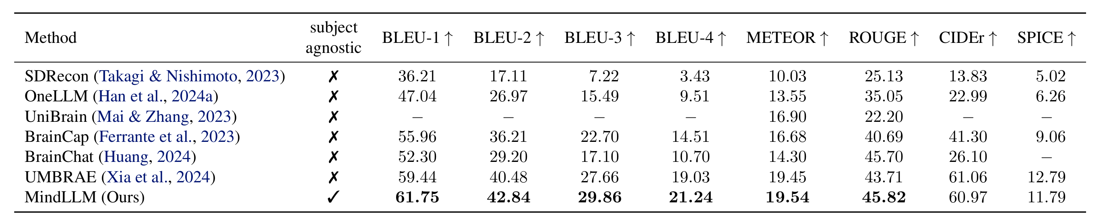
MindLLM · Brain Captioning
ICML 2025 · Weikang Qiu, Zheng Huang, Haoyu Hu, Aosong Feng, Yujun Yan, Rex Ying
Dataset: Natural Scene Dataset (NSD)
  A large-scale dataset consisting of fMRI measurements of 8 healthy adult subjects. During data collection, subjects viewed images from the MS-COCO dataset and were instructed to press buttons to indicate whether they had previously seen each image.
Brain Captioning Benchmark
3.32% average improvement

Slide 31

MindLLM · Versatile Decoding
ICML 2025 · Weikang Qiu, Zheng Huang, Haoyu Hu, Aosong Feng, Yujun Yan, Rex Ying
■ w/o brain instruction tuning
■ w/ brain instruction tuning
Our model outperforms baselines with 12.0% average improvement.
Brain Instruction Tuning brings 28.0% improvement
Some tasks are disconnected from real-world applications...
Always able to be adapted to new tasks

Slide 32
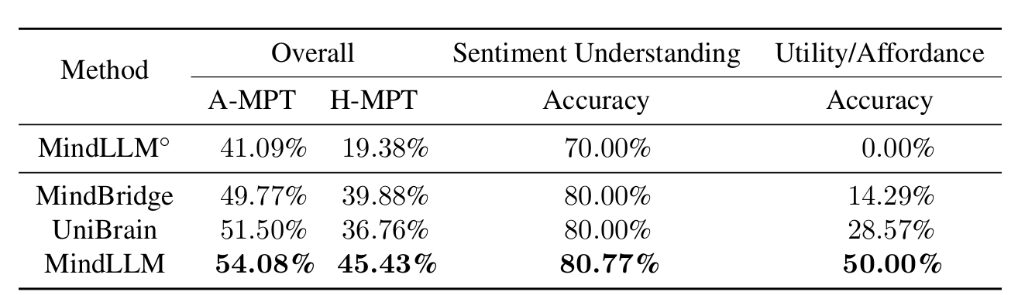
MindLLM · New Task Adaptation
ICML 2025 · Weikang Qiu, Zheng Huang, Haoyu Hu, Aosong Feng, Yujun Yan, Rex Ying
Adapt MindLLM to one’s own use cases. (e.g., more relevant to BCI applications)
  Utility/Affordance: Identify useful objects in the scene (and automatically decide to use them by the model)
  Sentiment Understanding: Understand what other people’s feelings (and help the users to adjust their communication strategies accordingly)
Our model improves 13.5%. Brain instruction tuning improves 25.0%.
w/o brain instruction tuning
w/ brain instruction tuning

Slide 33
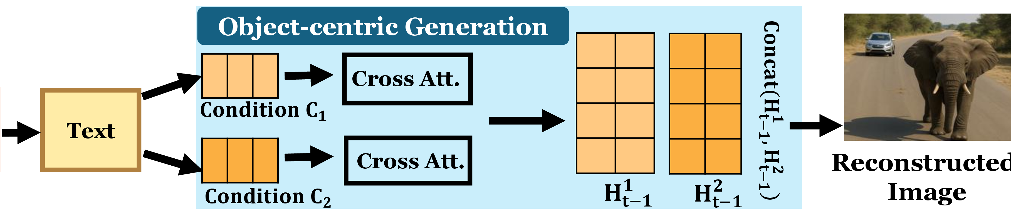
PRISM · Method
ICLR 2026 Oral · Zheng Huang, Enpei Zhang, Weikang Qiu, Yinghao Cai, Carl Yang, Elynn Chen, Xiang Zhang, Rex Ying, Dawei Zhou, Yujun Yan
1
Structured Description — one tuple per object, not one caption
Which attributes? Nobody picked them — a search did.
[Obj: Some cars] [V: follow]
INITIAL SET
AFTER 30 ROUNDS
[R(spatial): elephant's path] [A: white and grey]
Spatial Configuration
Spatial Layout
[Obj: The elephant] [V: walks]
Positional Relation
→
Spatial Patterns
Location Relation
Spatial Organization
[R(spatial): along the road] [A: Grey]
Descriptive Attribute
Relative Position
Inclusion Dependency
Spatial Relationships
The VLM's description of one training image, from the paper's Figure 2.
Top-5 before / after the search · kept while CKA(fMRI, text) stays above threshold
2
Object-Centric Generation — compose the scene one object at a time
One object, one condition.
Per-object cross-attention · latents placed at predicted locations — attributes cannot drift
Workflow diagram; 12 disonnects
Notes:
Two modules, per PRISM/01introduction.tex:27. Module 1 produces a structured description: one tuple per object with a verb, a spatial relation and attributes, instead of a single caption for the whole scene. The example is transcribed from the paper's framework figure. Which attribute types go in the tuple was not chosen by hand -- a search maximises reconstruction similarity subject to CKA between fMRI and the caption embeddings staying above a threshold (03method.tex:141-147), and the top-5 keywords converge on spatial ones by round 30 (05relatedworks.tex Table 3; 04experiments.tex:412 ties this to prior findings that neural representations are sensitive to spatial arrangement and relative position). Module 2: each object description becomes its own conditioning matrix, guides denoising through its own cross-attention, and the object latents are resized and concatenated according to their predicted locations (03method.tex:248-252). Results are the next slide.
/slide[37]/shape[@id=2] (title) "PRISM · Method" [full sentences cut from the slide] Top-5 before / after the search · kept while CKA(fMRI, text) stays above threshold Per-object cross-attention · latents placed at predicted locations — attributes cannot drift

Slide 34
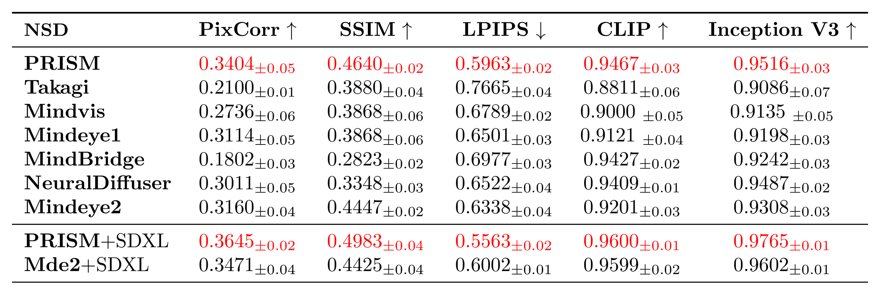
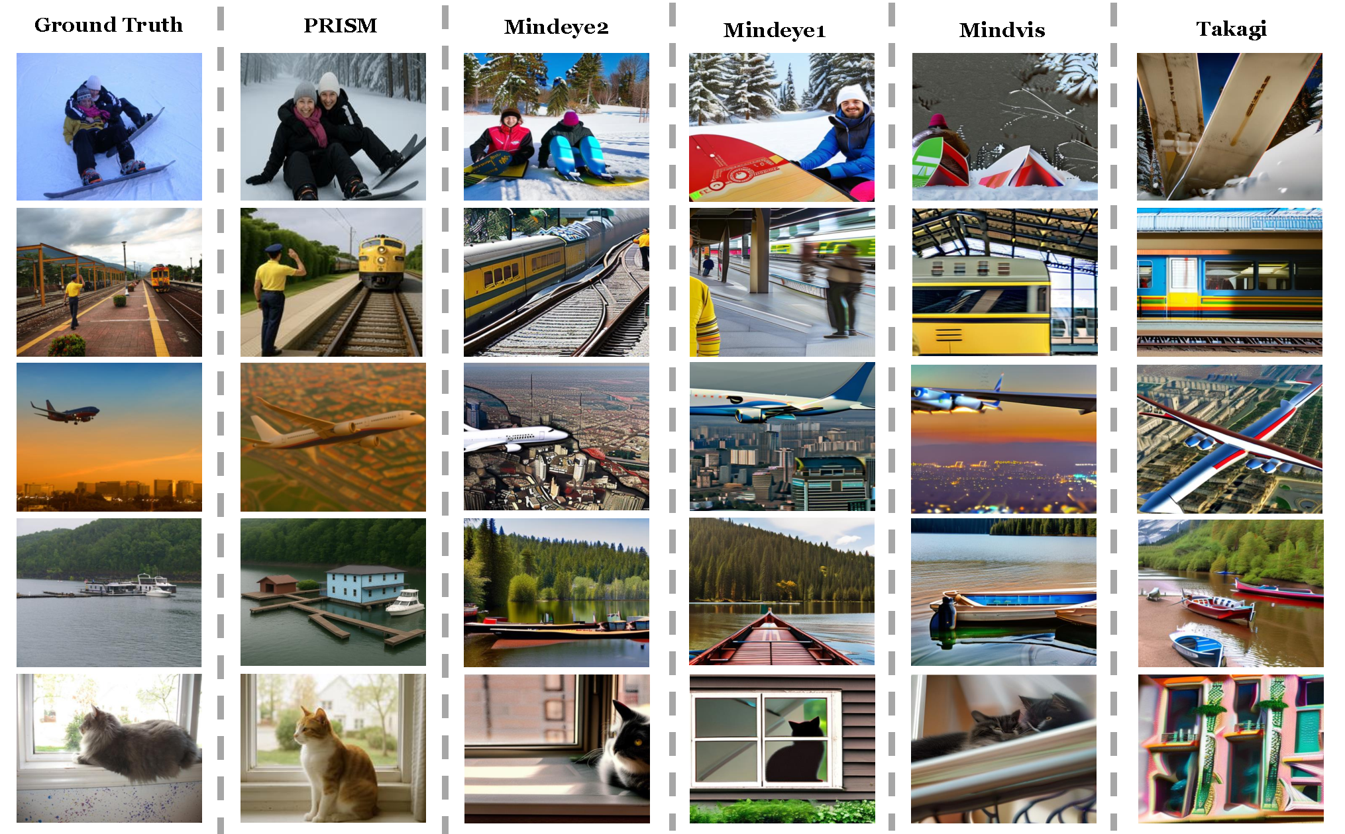
PRISM · Results
ICLR 2026 Oral · Zheng Huang, Enpei Zhang, Weikang Qiu, Yinghao Cai, Carl Yang, Elynn Chen, Xiang Zhang, Rex Ying, Dawei Zhou, Yujun Yan
Same backbone for every method. Best on all five metrics.
NSD. All methods use SD 2.1; last two rows use SDXL.
LPIPS 0.5963 vs 0.6338 · reconstruction QA 60.54% vs 57.65%
A structured representation needs item-disentangled generation.
Ground truth, PRISM, then baselines.
Notes:
[full sentences cut from the slide] One prompt for the whole image — change the cat and the sofa moves with it

Slide 35
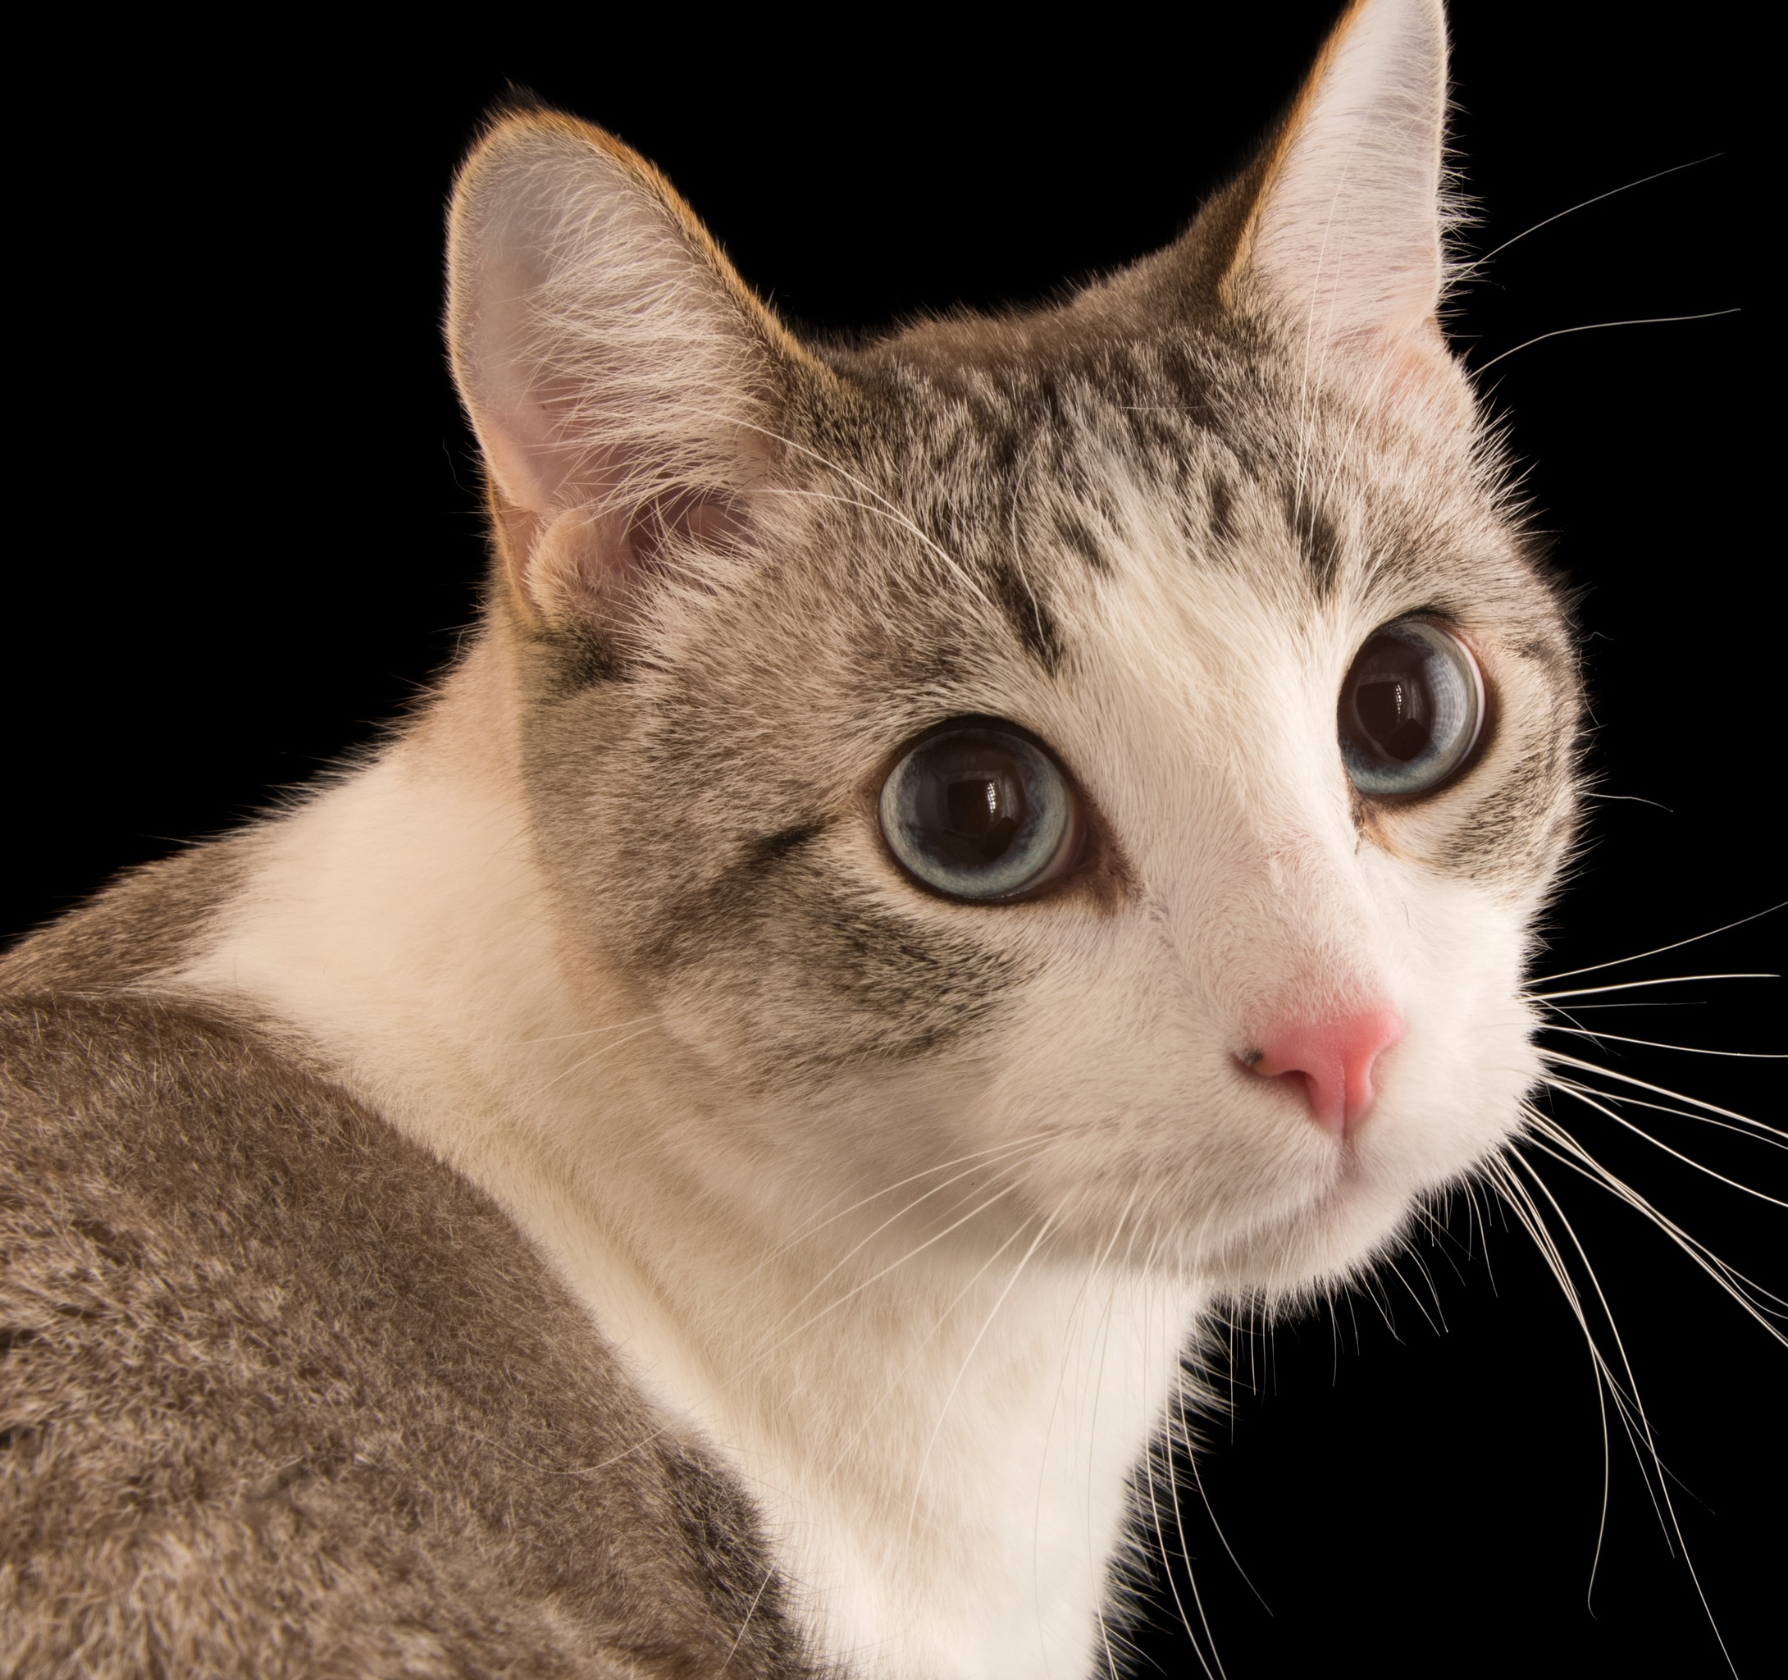
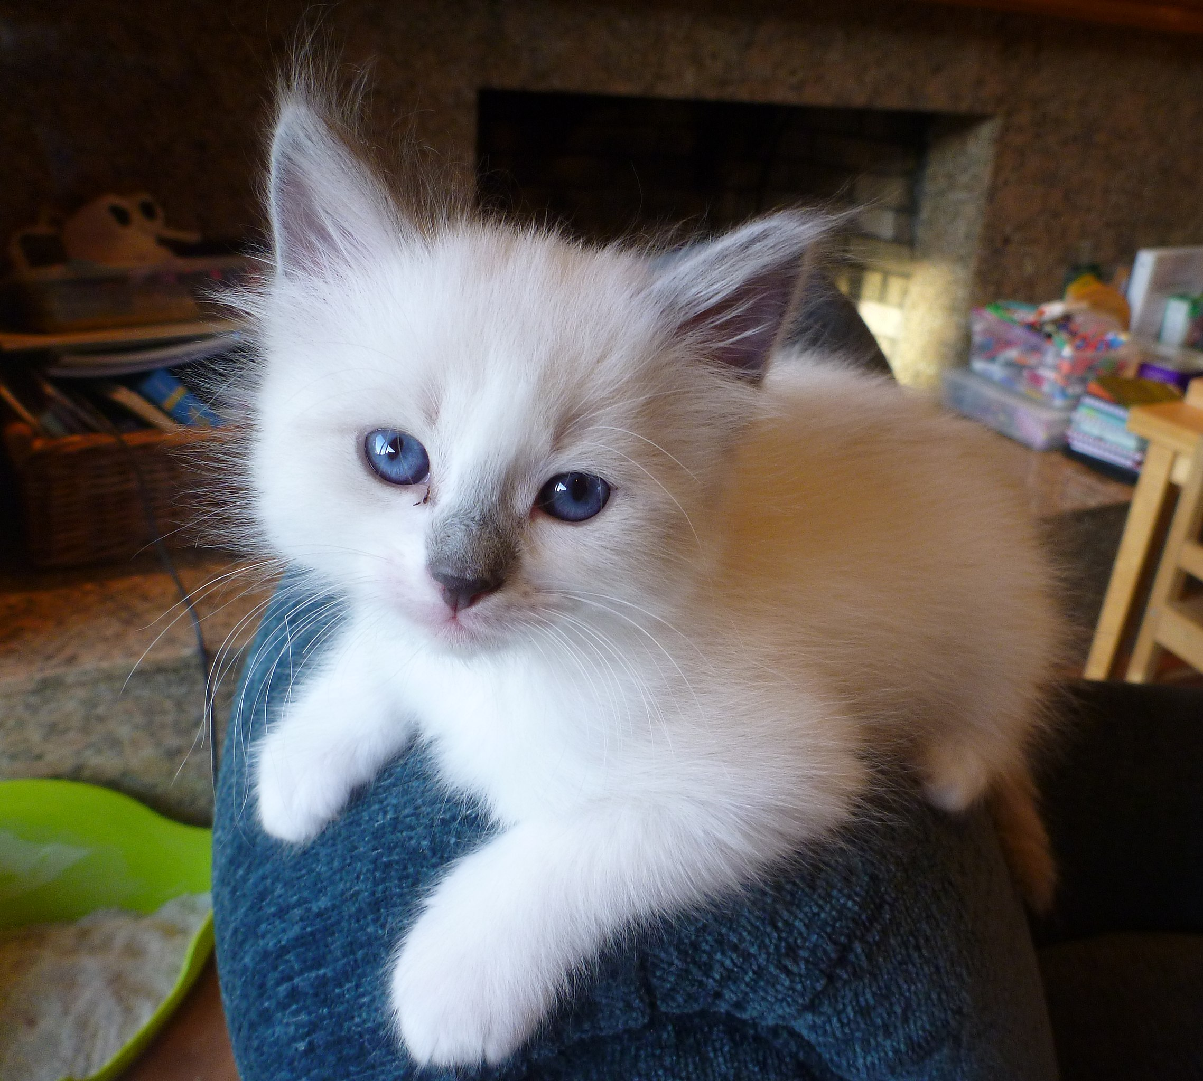
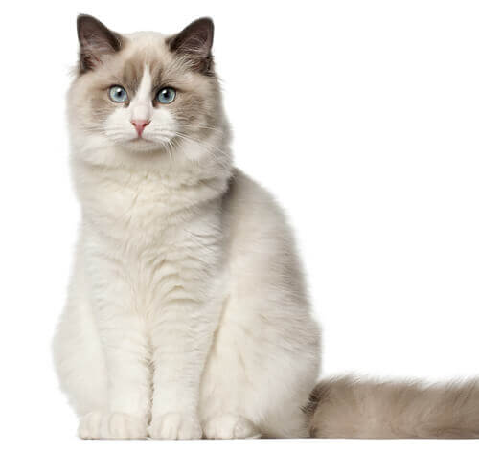
D-Edit · Precise Control via Soft Prompts
AAAI 2025 · Aosong Feng, Weikang Qiu, Jinbin Bai, Zhen Dong, Kaicheng Zhou, Xiao Zhang, Rex Ying, Leandros Tassiulas
noise 1
noise 1
“A cat”
“A ragdoll cat”
noise 2
noise 2
noise 1
“A ragdoll cat, blue eyes, short tail, sitting, with white background ……”
Soft prompt? (continuous optimizable)
Produced by neural signals
noise 2
A perfect prompt can never be exhausted by language

Slide 36
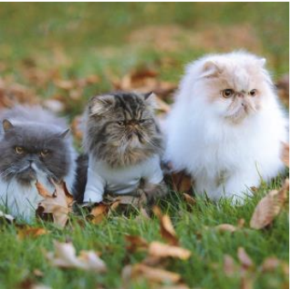
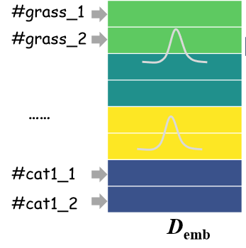

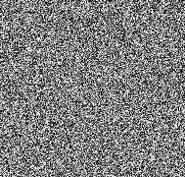
D-Edit · Prompt-Item Binding
AAAI 2025 · Aosong Feng, Weikang Qiu, Jinbin Bai, Zhen Dong, Kaicheng Zhou, Xiao Zhang, Rex Ying, Leandros Tassiulas
Learn soft prompt of each item
Soft prompt (Learn)
segmentation
Diffusion Model
(no positional enc. In soft prompts)
condition
Diffusion Loss
(learn perfect reconstruction)
noise
Notes:
mention positional

Slide 37
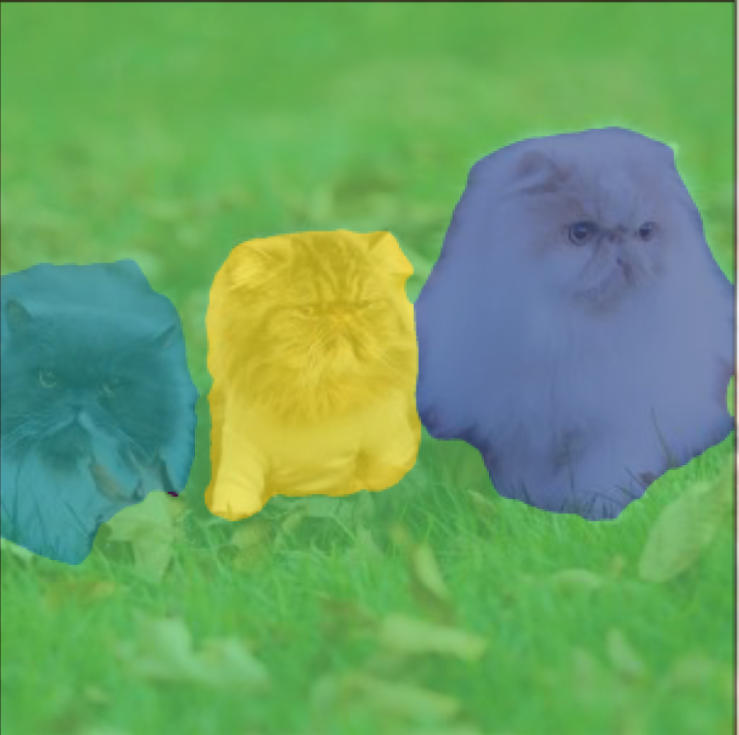
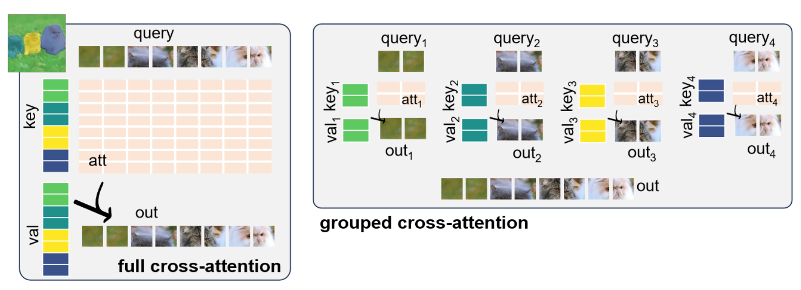
D-Edit · Grouped Cross-Attention
AAAI 2025 · Aosong Feng, Weikang Qiu, Jinbin Bai, Zhen Dong, Kaicheng Zhou, Xiao Zhang, Rex Ying, Leandros Tassiulas
“#cat1_1 #cat1_2 ”
“#cat1_1 #cat1_2 ”
Pixel interacts with all item prompts!
Pixel interacts with corresponding item prompt only!
Notes:
Therefore, any changes in one object's prompt will not affect other objects
positional encoding

Slide 38
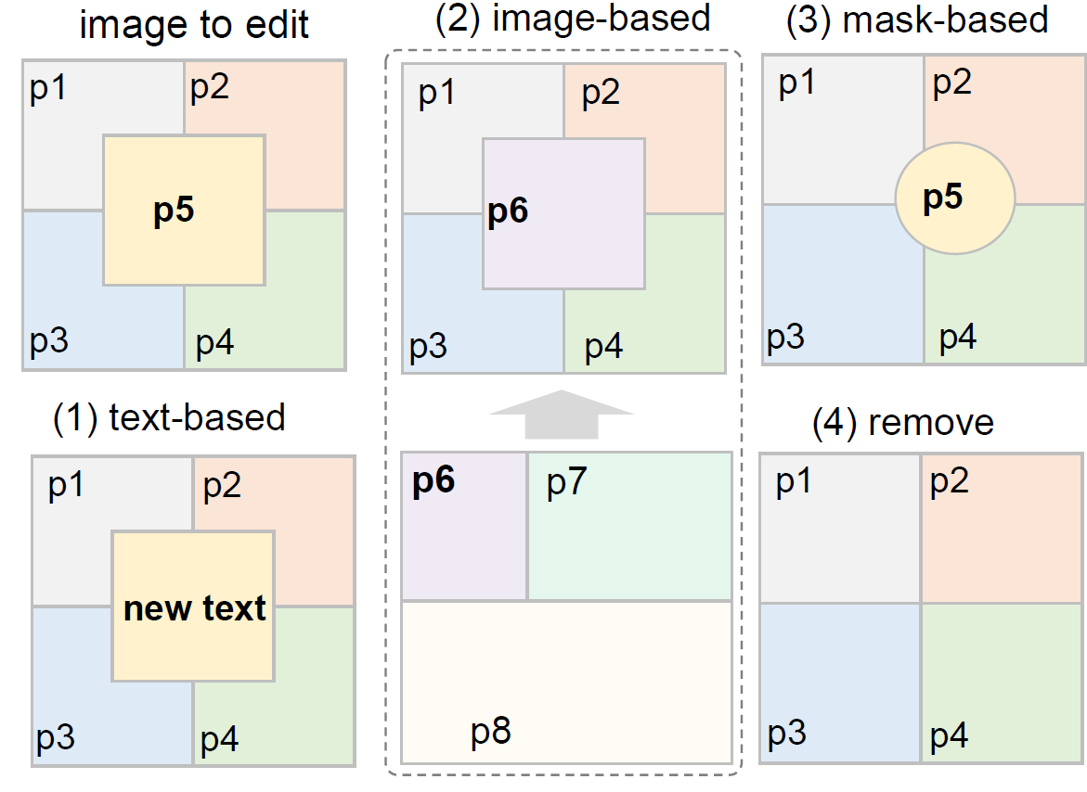
D-Edit · Versatile Image Editing
AAAI 2025 · Aosong Feng, Weikang Qiu, Jinbin Bai, Zhen Dong, Kaicheng Zhou, Xiao Zhang, Rex Ying, Leandros Tassiulas
Train on one image (and the reference image if any)
Learn associated soft prompts
Apply grouped cross attention
Image editing can be achieved by ----
Image to edit
(1) text-based
(2) mask-based
(3) remove
(4) image-based
reference image

Slide 39
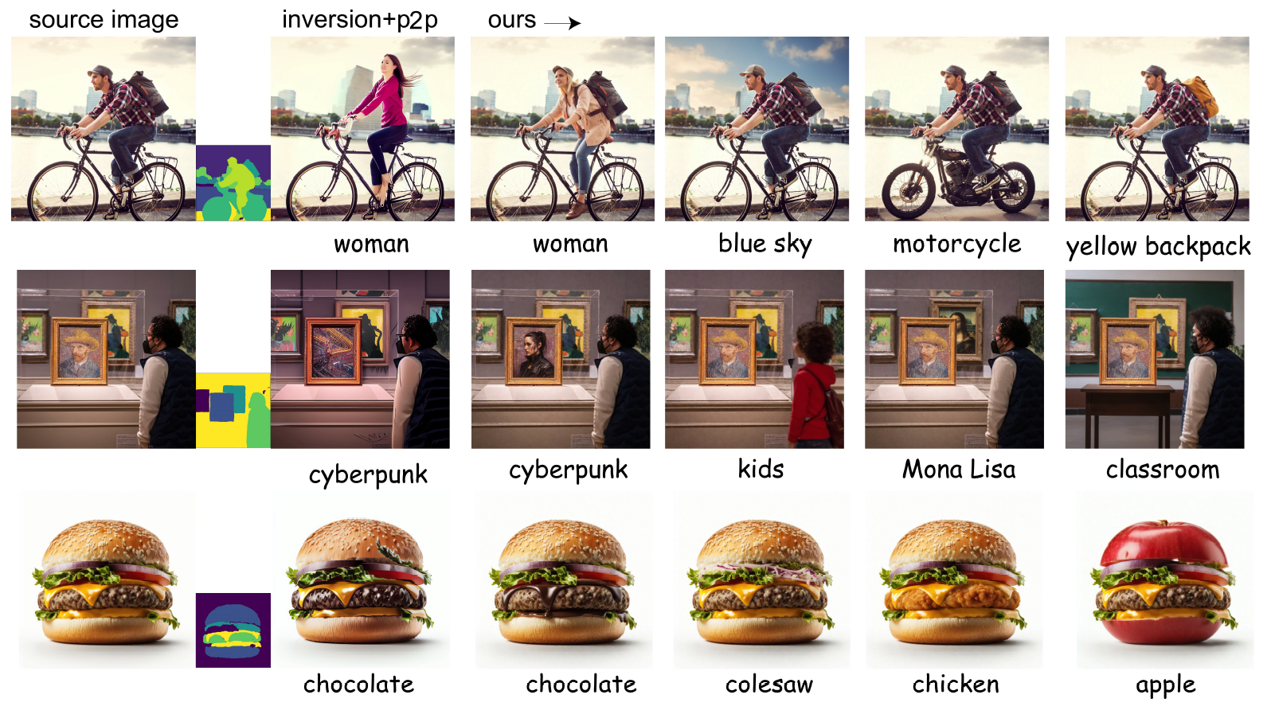
D-Edit · Text-Based Editing
AAAI 2025 · Aosong Feng, Weikang Qiu, Jinbin Bai, Zhen Dong, Kaicheng Zhou, Xiao Zhang, Rex Ying, Leandros Tassiulas
Disentangled editing
Arbitrary text changes

Slide 40
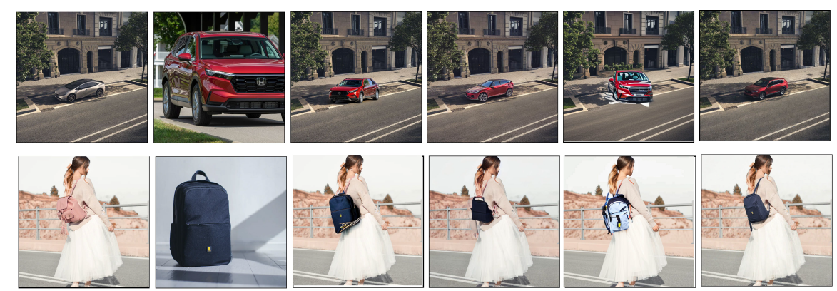
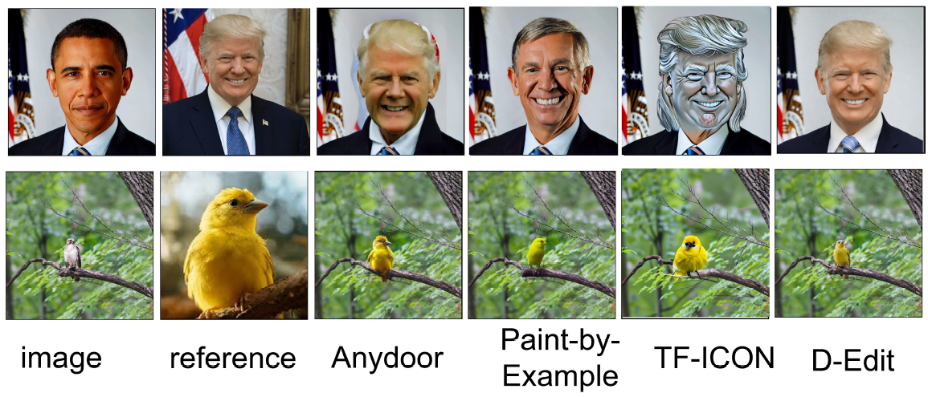
D-Edit · Image-Based Editing
AAAI 2025 · Aosong Feng, Weikang Qiu, Jinbin Bai, Zhen Dong, Kaicheng Zhou, Xiao Zhang, Rex Ying, Leandros Tassiulas
Anydoor (encoder-based) is good at preserving reference identity
Paint-by-example is good at harmonizing with background
D-Edit achieves better fidelity with respect to reference and harmony to background

Slide 41
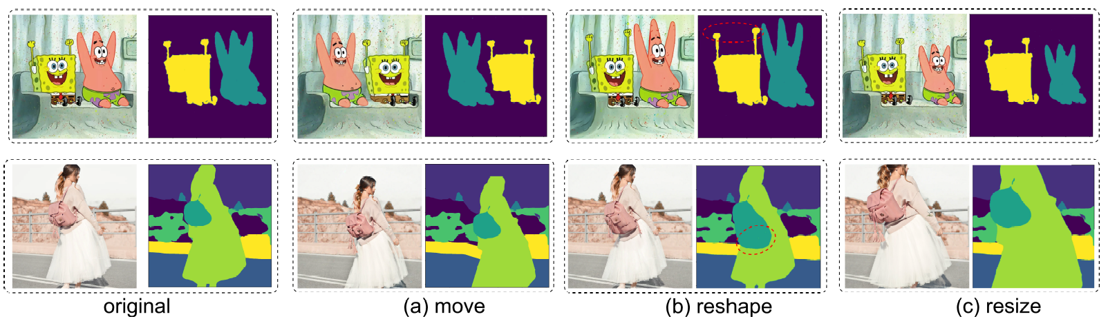
D-Edit · Mask-Based Editing
AAAI 2025 · Aosong Feng, Weikang Qiu, Jinbin Bai, Zhen Dong, Kaicheng Zhou, Xiao Zhang, Rex Ying, Leandros Tassiulas
Pixel-level item editing can be achieved by editing the shape of the binary mask

Slide 42
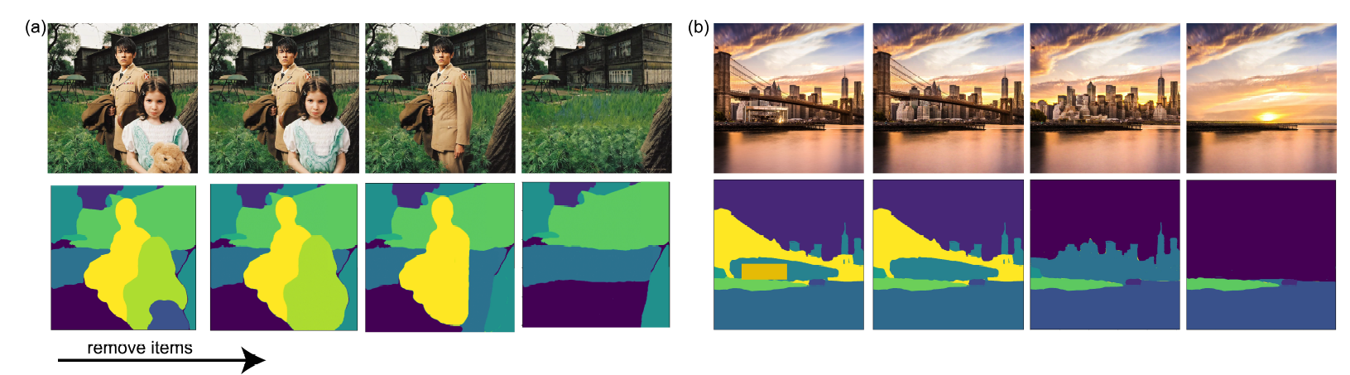
D-Edit · Item Removal
AAAI 2025 · Aosong Feng, Weikang Qiu, Jinbin Bai, Zhen Dong, Kaicheng Zhou, Xiao Zhang, Rex Ying, Leandros Tassiulas
Item removal can be achieved by removing the corresponding item-prompt pair

Slide 43
Part 3: The Embodiment
From Representations to Interactions
Intent is represented · turning it into action hits the same obstacle: supervision
Supervision for action does not scale
Too heavy to close the loop in real time
And if the signal is a goal, not a trajectory
Cue-locked trials and hand annotation do not scale
A full vision-language pass every control step — too slow
A goal must be completed into behaviour — rollout planning is too slow
How we address them
Mind World Models
SD-VLA
PHIL
label-free pretraining · scales mind and world together
static–dynamic disentanglement · long-horizon context · 2.26× faster
a learned cost-to-go for graph search
Notes:
Lead line in full: Parts 1 and 2 produce a semantic representation of what a person intends. Q1: no pretraining paradigm scales both sides together; labelled neural data is the bottleneck, and it is the one thing that cannot be collected at web scale. Q2: the machine has to complete a sparse target into full behaviour, and fast enough to stay inside the control loop. Q3: the latency rules out real-time neural control, makes RL training expensive, and leaves no headroom for urgent events.
/slide[47]/shape[@id=2] (title) "Part 3: The Embodiment\nFrom Representations to Interactions" [full sentences cut from the slide] Intent is represented · turning it into action hits the same obstacle: supervision Cue-locked trials and hand annotation do not scale A full vision-language pass every control step — too slow A goal must be completed into behaviour — rollout planning is too slow

Slide 44
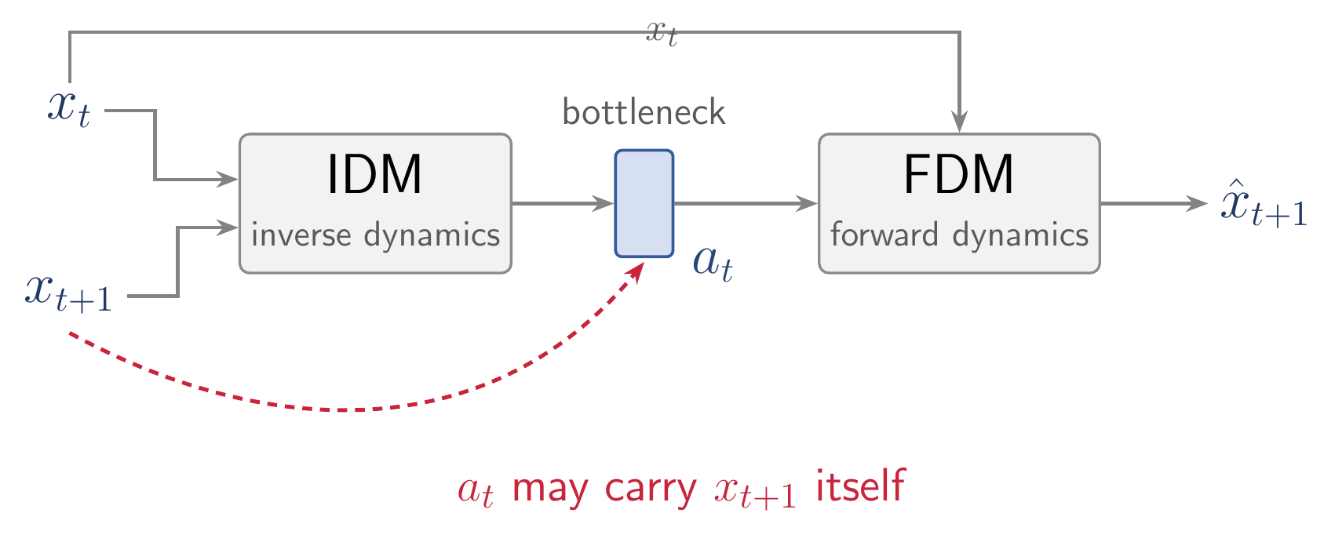
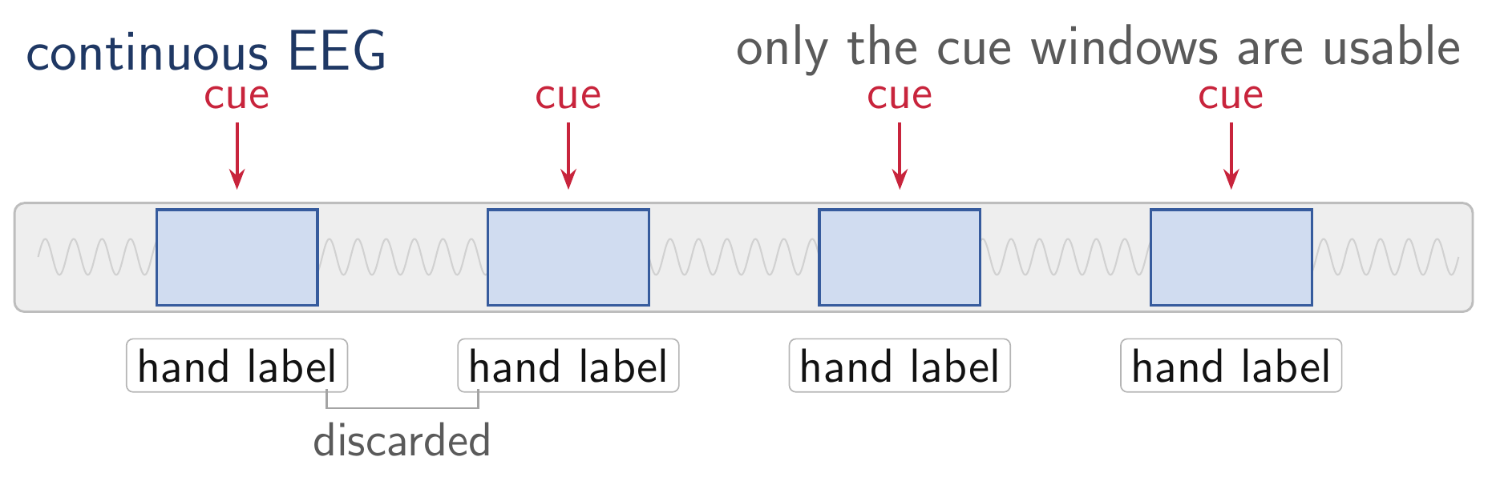
Mind World Models · The Scaling
ongoing
Compute-optimal scaling grows data with parameters (Hoffmann et al., 2022) — a method's ceiling is set by how much data it can consume.
Task: Train a foundation model for motor decoding
A Scalable data collection paradigm
Pretext & Downstream objective match
The world side — action labels
The mind side — trial by trial
Data collection paradigm of motor imagery
LAWM (Garrido et al., 2026) drops action labels by inferring a latent action with an inverse dynamics model. But the IDM sees the next frame, so the bottleneck can carry the answer instead of an action.
Every usable example is a cue-locked trial with a hand label. Hours of recording yield minutes of data.
Make more slides for the context
Notes:
Scaling-law framing: Hoffmann et al. 2022 (Chinchilla) corrected Kaplan 2020 -- for compute-optimal training, model size and training tokens should scale roughly equally, which is what promoted data to the binding constraint. Caveat to have ready: there is no established scaling law for EEG or fMRI, so do not claim the exponents transfer. The claim on the slide is weaker and safer -- a data source whose cost is human hours has no scaling curve at all, which is a precondition argument, not an exponent argument. If asked about the Bitter Lesson: Part 1 builds in priors, which looks opposed. The defence is exact vs approximate -- frame averaging is an exact symmetry (like translation equivariance in a CNN, which Sutton's own winning example keeps), not a hand-crafted feature that caps the asymptote.

Slide 45


Mind World Models · Actions from the Mind
ongoing
EEG
Mind model
a_{t}
intention
No labels, so both sides scale
→
→
y_{t}
EEG + ego-view video · one unlabelled stream · no cue-locked trials, no annotation
↓
Ego-view x_{t}
Next frame x_{t+1}
World model
→
→
Why this fits motor imagery
EgoBrain · arXiv:2506.01353 · frames from a single episode
Only what changes the next frame counts
a_{t} = Mind(y_{t}) x_{t+1} = World(x_{t}, a_{t})
No label of its own — the only signal is next-frame prediction error
Evaluation
One stream trains both sides
Motor-imagery benchmarks, compared against EEG foundation models.
Notes:
World-model family deliberately left unspecified on the slide (per note: 先别写，后续再补). Fill in the architecture once it is fixed. The mind side is what is claimed here: a = Mind(y_t), x_t+1 = World(x_t, a), trained on unlabelled neural + ego-view streams, evaluated on motor imagery against EEG foundation models.
Cut from the slide in the typography pass (say these aloud):
• The mind model receives no label of its own. It is trained only through the world model's prediction error on the next egocentric observation.
• The EgoBrain dataset is neural recording paired with egocentric video; both models scale on the same unlabelled stream.
• The objective is action-conditioned, so the only thing the mind model can contribute is whatever changes the next observation. That rewards movement-related temporal dynamics and gives no credit to volume conduction or other stationary artefacts.
/slide[48]/shape[@id=2] (title) "Mind World Models · Actions from the Mind" [full sentences cut from the slide] Part 2: brain–text supervision, no new scan · now brain–action, with no labels EEG + ego-view video · one unlabelled stream · no cue-locked trials, no annotation Only what changes the next frame counts → movement dynamics, not volume conduction No label of its own — the only signal is next-frame prediction error

Slide 46
Mind World Models · Results
ongoing
Next-frame prediction on held-out episodes, and motor-imagery transfer.
World model · next-frame prediction
Motor imagery · vs EEG encoders
vs LAWM and a random-init encoder, measured by prediction errors
seven benchmarks, measured by F1.
split · arm | L1 ↓ | cos ↑ | Δact ↑
within · ours | 0.50 | 0.88 | 7.9
within · LAWM | 0.65 | 0.85 | 2.1
within · random | 0.73 | 0.83 | 0.0
cross-subj · ours | 0.49 | 0.89 | 5.7
cross-subj · LAWM | 0.55 | 0.87 | 2.9
cross-subj · random | 0.72 | 0.84 | 0.0
dataset | CSBrain | CBraMod | Ours (WM)
pretraining EEG | >9,000 h | >9,000 h | 61 h
PhysioNet-MI | 59.90 | 61.99 | 63.30
FineMI | 18.58 | 19.72 | 20.00
Kaya5F | 38.03 | 39.04 | 41.89
Weibo2014 * | 16.76 | 18.45 | 18.61
Forenzo2024 | 30.74 | 30.64 | 31.91
Jeong2020 | 15.44 | 15.32 | 16.01
Forenzo2024Reg | 21.33 | 19.77 | 22.07
Δact in units of 10⁻³
Best in every cell. both splits, all three metrics.
Δact is 0 for random-init: the EEG-derived action is doing work, not being bypassed.

Slide 47
Preliminary · Vision-Language Models
arXiv 2026 · Weikang Qiu*, Huashuo Lei*, Tinglin Huang, Rex Ying
VLM
VLM computation flow
A model that takes images and text as input and outputs text tokens.
Vision Encoder + LLM backbone
images → visual tokens → LLM → language output
Image
Text prompt
Examples
LLM Backbone
GPT-4V, Gemini, LLaVA, Qwen-VL
Typical tasks: image captioning, visual QA, OCR,
document understanding, grounding
Text output (language tokens)

Slide 48



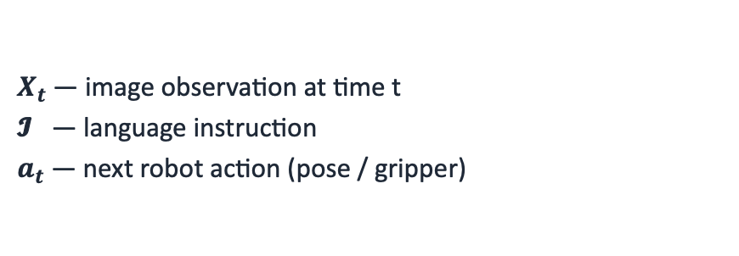
Preliminary · From VLM to VLA
arXiv 2026 · Weikang Qiu*, Huashuo Lei*, Tinglin Huang, Rex Ying
VLA: VLM adapted for robotics. Replace the text output with robot actions.
Formulation
Typical VLA architecture
At each timestep t, the policy π observes images and a language instruction, and predicts the next action:
Image
Text Prompt
$$π\left(X_{t}, 𝓘\right) → a_{t},a_{t+1}, a_{t+2},⋯$$
LLM Backbone ($π_{LLM}$)
$X_{t}$— image observation at time t
𝓘 — language instruction
$a_{t}$— next robot action (pose / gripper)
Action head → $a_{t}$ (robot control)

Slide 49

Preliminary · The VLA Inference Loop
arXiv 2026 · Weikang Qiu*, Huashuo Lei*, Tinglin Huang, Rex Ying
VLAs are run in a closed-loop at every single timestep of the rollout.
Rollout pseudocode
instruction = "put the apple on the plate"
while not success:
image = camera_capture(env)
action = VLA(image, instruction)
env.step(action)

Slide 50
SD-VLA · Two Challenges in Today's VLAs
arXiv 2026 · Weikang Qiu*, Huashuo Lei*, Tinglin Huang, Rex Ying
State-of-the-art VLAs suffer from two intertwined problems:
Multi-frame Integration
Inefficient Inference
Context length budget is much tighter than in pure text LLM
Visual tokens are more expensive (e.g., 256 tokens for each image), so VLAs typically input only the current frame.
Consequence:
• Fails on tasks needing memory ("what was there before?")
• Can't reason over episodic history
The large-scale parameters of the VLM
Quadratic attention over hundreds of visual tokens
Pick a coke can (~100 steps in SimplerEnv)
Consequence:
• Cannot keep up with neural signals
• Expensive in RL training
• Unable to handle urgent tasks (e.g., fire, liquid spill)

Slide 51



Existing Works · Long-Horizon Memory
arXiv 2026 · Weikang Qiu*, Huashuo Lei*, Tinglin Huang, Rex Ying
Visual Traces Prompt
Compression-based
Leave to action head (diffusion)
Limited information capacity
Visual clutter / occlusion from traces
Do not leverage LLM’s reasoning ability
Lossy Compression

Slide 52
Existing Works · Accelerating VLAs
arXiv 2026 · Weikang Qiu*, Huashuo Lei*, Tinglin Huang, Rex Ying
Most prior speed-ups are generic compression techniques that ignore VLAs' structure.
Generic ML acceleration
VLA-specific temporal caching
• Quantization (Shukor et al., 2025; Park et al., 2024)
• Layer / token pruning (Yang et al., 2025; Zhang et al., 2025)
• Distillation / small backbones
→ Treat the VLA as a generic transformer.
→ Do NOT exploit the unique characteristics of VLAs
• TTF-VLA, VLA-Cache, FlashVLA
identify reusable patches via heuristics
Issues with prior work:
• Rely on hand-designed, non-learnable rules
• Assume pixel-space similarity = feature-space similarity (false in attention-based transformers)

Slide 53


SD-VLA · Most Visual Input Is Redundant
arXiv 2026 · Weikang Qiu*, Huashuo Lei*, Tinglin Huang, Rex Ying
Static Components: background, table, object appearances, etc.…
Dynamic Components: object positions & pose
We propose to disentangle these components to
static and dynamic tokens.

Slide 54

SD-VLA · At a Glance
arXiv 2026 · Weikang Qiu*, Huashuo Lei*, Tinglin Huang, Rex Ying
Efficient Inference:
By reusing KV cache of static tokens across timesteps.
Long-horizon temporal context:
By keeping only one copy of the static tokens.

Slide 55

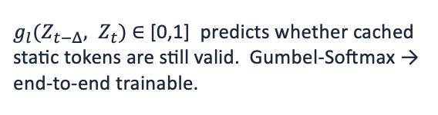
SD-VLA · Multi-Level Cache + Recache Gate
arXiv 2026 · Weikang Qiu*, Huashuo Lei*, Tinglin Huang, Rex Ying
Identical across timesteps
Key ideas
Cache KV of static tokens
Since static tokens come first, their KV cache is identical across timesteps — reuse it directly in the LLM backbone.
Learned recache gate
$g_{l}(Z_{t−Δ}, Z_{t})$∈ [0,1] predicts whether cached static tokens are still valid. Gumbel-Softmax → end-to-end trainable.
Multi-level cache (L1 / L2)
L1 = highly persistent background; L2 = semi-static (e.g., drawer). If L1 is refreshed, L2 must be too.

Slide 56

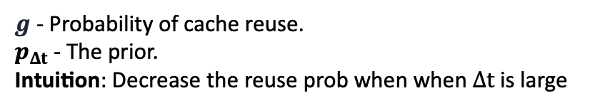



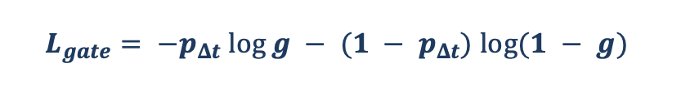
SD-VLA · Making Static Tokens Static
arXiv 2026 · Weikang Qiu*, Huashuo Lei*, Tinglin Huang, Rex Ying
Contrastive objective for static tokens
Recache gate regularizer
Encourages static tokens to be temporally persistent
Without it, the gate would trivially refresh the cache every step. A time-aware prior biases the gate toward reuse when observations are close in time.
Negative pairs
Static tokens from different trajectories — push them apart to preserve scene-specific content.
$$L_{gate}= −p_{Δt} log⁡g − (1 − p_{Δt}) log⁡(1 − g)$$
$g$ - Probability of cache reuse.
$p_{Δt}$ - The prior.
Intuition: Decrease the reuse prob when when $Δt$ is large
Positive pairs
Static tokens from different timesteps of the same trajectory — pull their representations together.
Full training objective
$$L = L_{Task} + Σ α_{l}L_{InfoNCE} + βL_{gate}$$
InfoNCE loss at level $l$ → $L_{InfoNCE}^{l}$
$α_{l}$and $β$ weight the auxiliary losses. $L_{Task}$is the standard VLA imitation loss.
Notes:
contrastive learning -- cache, more explanation and intuition
use figure to illustrate the static and dynamic

Slide 57
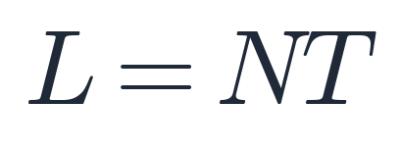
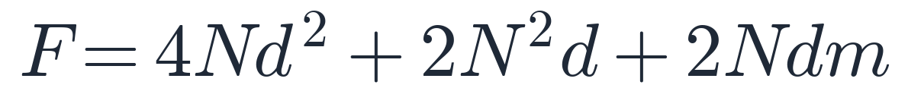

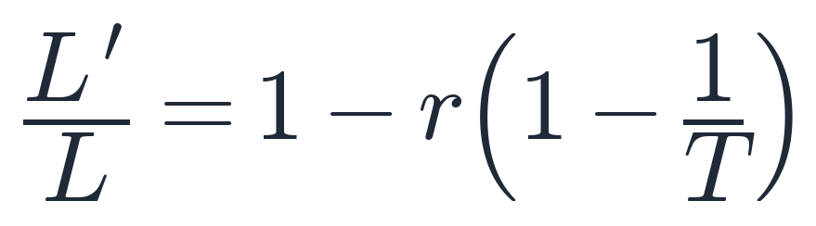
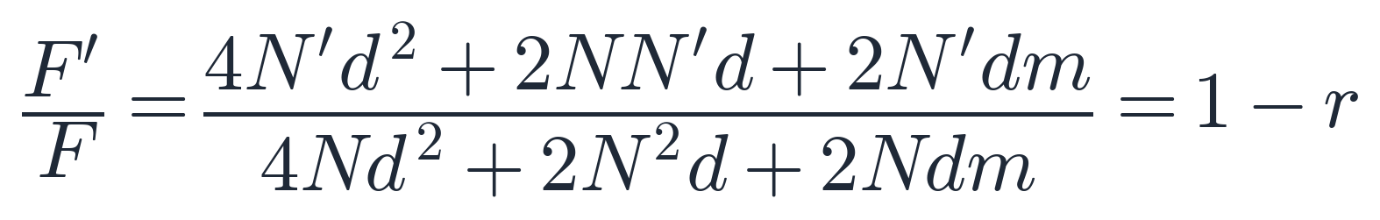
SD-VLA · Context Length and Acceleration
arXiv 2026 · Weikang Qiu*, Huashuo Lei*, Tinglin Huang, Rex Ying
Static-dynamic disentanglement reduces both the context length (by reusing one copy of static tokens across timesteps) and the per-step LLM FLOPs (by reusing the KV cache of static tokens).
Context Length Reduction
Acceleration Rate (LLM FLOPs)
Only one copy of static tokens is kept across T past observations.
Per-layer cost: QKV projection + self-attention + FFN.
Vanilla VLA (concatenate all past tokens):
Vanilla VLA (recompute every token):
SD-VLA (share one copy of static tokens):
SD-VLA (only N′ dynamic tokens through MHA / FFN):
Ratio (as T grows):
Ratio:
Context drops from NT to NT − rN(T − 1); with r = 0.9 and T = 20, that is a ~85% reduction.
LLM FLOPs scale linearly with the un-cached fraction (1 − r). Gate overhead ≈ 1.27%.
$N$: number of tokens; $T$: steps of past observations; $r$: cached fraction
$d, m$: hidden dim; $N^{′}=rN$

Slide 58

SD-VLA · Long-Horizon Temporal Reasoning
arXiv 2026 · Weikang Qiu*, Huashuo Lei*, Tinglin Huang, Rex Ying
37.4% ⬆️
6.4% ⬆️
29.7% ⬆️
Settings:
20 past observations
Interval = 20 frames (1 frame per second)
Static level: 1
Static ratio: 0.9

Slide 59


SD-VLA · Inference Acceleration
arXiv 2026 · Weikang Qiu*, Huashuo Lei*, Tinglin Huang, Rex Ying
Task success is preserved (often improved) while FLOPs and latency drop sharply.
Settings:
Static level: 2
Static ratio: 0.52, 0.42
SimplerEnv (base: CogACT)
SimplerEnv
2.26x speedup
+3.9% success
LIBERO
LIBERO (base: OpenVLA-OFT)
1.70x speedup
+0.7 % success
Real robot
2.21x speedup +10.6% success

Slide 60

SD-VLA · Ablations
arXiv 2026 · Weikang Qiu*, Huashuo Lei*, Tinglin Huang, Rex Ying
Ablations on SimplerEnv (SR %)
w/o Contrast: remove the contrastive learning
w/o L2 cache: use single-level static cache
Fixed step: non-learnable recache gate, refresh at fixed intervals
Takeaways:
• Contrastive loss is needed to enforce temporal consistency of static tokens.
• Multi-level cache (L1+L2) captures both stable and semi-static content.
• A learned gate clearly beats any fixed-interval refresh.

Slide 61

SD-VLA · Attention Maps across Time
arXiv 2026 · Weikang Qiu*, Huashuo Lei*, Tinglin Huang, Rex Ying
Attention maps across time
L1 static:
stable, global scene context.
Sink tokens on areas with no foreground objects.
L2 static:
semi-static (drawer)
Remain stationary in most time, refresh on state changes.
Dynamic:
the gripper and the object being manipulated.

Slide 62


PHIL · A Goal Is a Node, a Plan Is a Path
LoG 2022 · Michal Pándy, Weikang Qiu, Gabriele Corso, Petar Veličković, Rex Ying, Jure Leskovec, Pietro Liò
The brain names where to end up
Searching a real 3D space
Searching a world model‘s state space
now
goal
Same problem, no room
Nodes = latent states seen · edges = predicted transitions
Notes:
Transition into PHIL. The point of the left half is that this is not a toy: PHIL's own final experiment plans collision-free indoor drone flight in CoppeliaSim, discretised into a 50 x 50 x 25 grid graph with five random 5 x 5 x 5 obstacles removed during training and testing (PHIL/004experiments.tex:176). Node features are the 3D grid coordinates; the reported metric is expanded nodes relative to the Euclidean heuristic. The right half is the connection this thesis needs, and it is a claim about where PHIL fits, not a result from the paper -- say so. A learned world model encodes experience into latent states and predicts which states reach which; that is a graph, and long-horizon planning in it is best-first search. The expensive part in both halves is the same: scoring a node by rolling forward. PHIL replaces that rollout with a learned cost-to-go.
/slide[64]/shape[@id=2] (title) "PHIL · A Goal Is a Node, a Plan Is a Path" [full sentences cut from the slide] The brain names where to end up · finding the way there costs one expansion at a time Nodes = latent states seen · edges = predicted transitions · scoring by rollout is the slow part 50 × 50 × 25 grid · five random 5³ obstacles

Slide 63

PHIL · Graph Search, and What a Heuristic Buys
LoG 2022 · Michal Pándy, Weikang Qiu, Gabriele Corso, Petar Veličković, Rex Ying, Jure Leskovec, Pietro Liò
One expansion: OPEN → CLOSE, unseen neighbours in. Cost is expansions, not path length.
CLOSE — the nodes already expanded
start
goal
OPEN — every candidate for the next expansion
REST — everything the search has not seen yet
Add a heuristic h(v, goal) — a guess at what is left — and order the frontier by it.
no heuristic · BFS
ordered by h(v, goal)
$$f(v) = g(v) + h(v, \text{goal})$$
19 expansions, still not there
6 expansions
g = cost so far, known · h = what is left, a guess · order OPEN by f → A*
Perfect h → opens only the shortest path. So that is what we learn.
start
goal
CLOSE
OPEN
Less results, how is it related, empowered, extended
Notes:
Refresher first. Three sets: CLOSE is what has been expanded, OPEN is the frontier, REST is unseen. One expansion is the only move -- pop a node from OPEN, put it in CLOSE, pull its unseen neighbours into OPEN, repeat until the goal enters CLOSE. Cost is the size of CLOSE, not the length of the path: on a robot each expansion is a collision check on limited onboard compute, in a world model each expansion is a rollout. BFS pops in arrival order, so it has no idea where the goal is and the frontier grows as even rings -- 19 expansions on this grid and it still has not arrived, for a path that is 6 edges long. A* adds h, an estimate of the remaining cost, and orders OPEN by f = g + h. If h never overestimates, the shortest-path guarantee survives. One honest note if asked: PHIL actually trains for greedy best-first search, which drops g and orders by h alone -- it forfeits optimality to minimise expansions, which is the right trade under a real-time budget. The limit case is the whole point of the next slide: a perfect h is the true remaining distance h*, and it would expand only the shortest path. So h* is the regression target.
/slide[65]/shape[@id=2] (title) "PHIL · Graph Search, and What a Heuristic Buys" [full sentences cut from the slide] One expansion: OPEN → CLOSE, unseen neighbours in. Cost is expansions, not path length. g = cost so far, known · h = what is left, a guess · order OPEN by f → A* Perfect h → opens only the shortest path. So that is what we learn.

Slide 64
PHIL · Predicting the Oracle
LoG 2022 · Michal Pándy, Weikang Qiu, Gabriele Corso, Petar Veličković, Rex Ying, Jure Leskovec, Pietro Liò
Target: h*(v, goal), the oracle's true distance. What may the model look at?
one step of the search
trained to match
1
the node and the goal
features + Euclidean/cosine distance
goal
h_{θ}
h*(v, goal)
2
a bounded sample of neighbours
with edge features · at most n
the oracle distance
3
the graph opened so far
a memory vector z · the graph is only partly observed
v, the node being scored
sampled neighbours
The three challenges
Search is not i.i.d.
Hand-designed features
h must not slow the search
Train on our own roll-outs, not a fixed dataset (40× worse).
Prior IL needs hand-designed features → raw node + edge features.
An h that scales with the graph breaks it → bounded neighbourhood, O(1).
Notes:
This is the method slide: to predict the oracle's distance for a fringe node, what may the model look at? Three inputs. One, the node and the goal -- raw features plus the Euclidean and cosine distance between them, which hands the classical hand-designed heuristic to the model for free. Two, a bounded sample of the one-hop neighbourhood with edge features, through a GNN; bounded is the operative word, at most n neighbours means one evaluation is constant time in the size of the graph. Three, a memory vector z, a GRU state over the search trace -- the paper's Approach section motivates this as partial observability: PHIL cannot afford to look at the whole graph, so it keeps a belief over the part it has opened. Output is h-hat, regressed onto h*. The three cards below are the three challenges the paper's introduction enumerates for learning-based heuristics, in order: the data distribution is not i.i.d. because newly encountered nodes depend on past heuristic values, so supervised learning does not apply directly and a fixed sampled dataset is up to 40x worse; the heuristic must run in constant time or it raises the search's own asymptotic complexity; and prior work does not transfer -- RL degrades as graphs grow, and state-of-the-art imitation learning still relies on feature engineering for a specific domain. PHIL answers the third by learning from raw node and edge features, which is why one architecture runs across twelve real graph domains.

Slide 65




Future: AI for BCI
Multi-Modal Brain Foundation Models
Today's objective: mask patches, then reconstruct them.
Capacity goes to reconstructing noise, and in-filling one window is never a rollout.
A BRAIN WORLD MODEL — ENCODE ANY MODALITY, ROLL THE LATENT FORWARD
fUS
fUS
imagined — no observation from here on
fMRI
encode
z_{t}
z_{t+1}
z_{t+2}
z_{t+3}
decode
fMRI
⋯
EEG
EEG
observed
MEG
decode
a
a
a
encode
MEG
stimulus now · stimulation later
⋯
⋯
A foundation model
A brain simulator
One latent behind every modality — encode from any, decode into any, and share it across subjects.
Roll forward with no input, or under a stimulation we choose: the counterfactual a controller needs.
BrainLM · LaBraM · Brain-OF (masked) · Brain-JEPA (masked latent) · NeuroWorld (fMRI rollout)
Notes:
The claim here is about the pretraining objective, not the architecture.
WHAT IS ACTUALLY DONE TODAY. BrainLM (ICLR 2024) is a masked autoencoder over fMRI parcel time series — mask spatiotemporal patches, reconstruct them. LaBraM (ICLR 2024) trains a vector-quantised neural tokenizer and then predicts the codes of masked EEG channel patches. Brain-OF (2026) is the first model to pretrain jointly on fMRI, EEG and MEG, and its objective is masked reconstruction in both the time and the frequency domain. So the multi-modal case is already occupied, and it is still mask-and-reconstruct.
THE TWO CRITICISMS, AND THEIR SOURCES. First, reconstruction is a bad fit for low-SNR signals: Brain-JEPA's stated motivation is that direct reconstruction is not suitable for data that is noisy and low in information density, and NeuroWorld puts it as reconstruction spending latent capacity on measurement fluctuations and weakly predictable components. Second — and this is the part that is mine — the objective is in-filling. Brain-JEPA does move the target into latent space and its Cross-Time mask does forecast a later block from an observation block, so do not claim that nobody predicts forward. What none of them do is roll the state forward autoregressively, and none of them condition on anything. One shot inside one window, unconditioned, is not a world model.
WHAT THE FIGURE PROPOSES. Per-modality encoders and decoders on a shared latent, so any modality can go in and any modality can come out. One observation at t; after that the latent is rolled forward by the dynamics with no observation at all, which is why the box is dashed. Each transition takes an action token: during training that is the stimulus the subject is receiving, and at deployment it becomes the stimulation we apply.
WHAT IS ALREADY TAKEN, AND SAY IT BEFORE THEY DO. NeuroWorld (arXiv, August 2026) is the first brain world model: two stages, next-latent prediction with no fMRI reconstruction, then autoregressive latent rollout decoded back to whole-brain responses, conditioned on movie stimuli. It works, which is the point — the direction is not speculative. What it does not do: it is fMRI only, ROI-level, movie stimuli only, with subject-specific output heads, and its conditioning is sensory input rather than an intervention. Multi-modality, subject-agnostic decoding and intervention conditioning are the gaps, and its own future-work section names extension to other modalities.
WHY THESE MODALITIES. They differ by orders of magnitude in resolution, which is the hard part and also the reason a shared latent is worth something: fUS reaches roughly 100 microns and 100 milliseconds with about a 7 cm field of view and has already been used for closed-loop decoding at Caltech, EEG has milliseconds and centimetres, fMRI has millimetres and seconds. Cheap, deployable modalities and high-resolution ones would train the same representation.
THE SECOND CARD IS THE HANDOFF. A model that can roll forward without observation and be conditioned on an intervention is exactly the imagination model the next slide's Dreamer loop trains its policy inside. Without it, closed-loop neuromodulation has to learn on the subject in real time.
HONEST FRAMING IF PUSHED. Supervising cross-modal decoding needs simultaneous recordings, and those are scarce — simultaneous EEG-fMRI exists but is small, and MEG cannot be recorded simultaneously with fMRI at all. The fallback is per-modality encoders and decoders against one shared dynamics, using the paired data only for alignment.

Slide 66

Future: AI for BCI
Dreamer over Brain Frames
Closed-loop focused ultrasound
for chronic pain
r reward
r = decoded
pain state
r reward
v value
v value
z latent state
h recurrent
h
h
⋯
h
h
⋯
a
π policy
π policy
x brain frame
tFUS
(a) world model learning
(b) actor–critic learning
Also: depression · anxiety · addiction · stroke rehabilitation · motor control
v and π decoded from the brain
Notes:
DreamerV3's Figure 3, redrawn with brain frames instead of game frames. The algorithm is unchanged.
Panel (a), world model learning:
sequence model h_t = f(h_{t-1}, z_{t-1}, a_{t-1})
encoder z_t ~ q(z_t | h_t, x_t)
reward predictor r_t ~ p(r_t | h_t, z_t)
Three things from the original are deliberately gone. The continue predictor -- it exists because Atari and DMC have episodes; a neuromodulation loop is continuous, so the flag would be identically one. The reconstruction branch -- it shapes representations by pixel reconstruction, which is not where the signal is here. And the prior / KL pair, cut to keep the slide readable; the prior is what lets the model roll forward with no observation, which is what makes panel (b) possible, so say that aloud if asked.
The point about the observation: it is a brain frame in every application. This is a brain-computer interface, so the thing the world model observes is always the brain -- what changes between applications is only the action space and the reward. Pain relief, anxiety relief and dream steering all share the same action: a stimulation command. Dream steering is not image generation -- the subject is asleep and cannot see a screen -- it is sensory cueing or direct stimulation during sleep. Motor decoding is the one variant where the action points outward at an effector instead of inward at the brain; the loop is longer, but the observed variable is still the brain.
On the action itself, which is what people will ask about: where to focus, how hard, pulse repetition frequency, duty cycle, and when to fire relative to the ongoing rhythm. With a phased array that is a spatiotemporal pattern over the whole brain, not a single target -- which is exactly why it cannot be hand-tuned and needs a policy.
On the reward: for anxiety or chronic pain there is no objective, continuous, immediate measure of "is this working" -- scales are weekly and subjective -- which is why r has to be decoded from the neural signal rather than read off an instrument, with the sparse clinical scale used only as a weak-supervision anchor.
On V, if challenged: V is not a separate design choice. Given r, the dynamics and the policy, V = E[sum of discounted r] is determined, and it is fit by TD. Only a and r get specified per application. Decoding V from the brain is worth doing for a different reason -- sample efficiency. Reward here is sparse and episodes cannot be reset, so fitting V from r alone needs rollouts we cannot afford; the cortex has already integrated the future into its valuation of the current state, so reading it gives a bootstrap for free. It is an auxiliary regression target alongside the TD target, not a replacement for r. A useful side effect: if the decoded V and the TD-fit V disagree systematically, that is evidence the reward proxy is misspecified.
The "field not a point" argument attaches to the reward function, not to V: r(s) assigns a value to every state, so a handful of bits can specify a landscape rather than a target coordinate, and the model works out the trajectory through it. That is how a low-bandwidth neural channel still specifies rich behaviour.
Why also decode pi: the motor side (motor imagery, mu/beta desynchronisation) is fast but rigid, while the evaluative side (feedback-related negativity, error-related potentials, frontal theta) is slower but transferable across tasks. And if both heads read one bottleneck they must stay consistent -- pi roughly greedy with respect to V under the model -- which is a training signal that needs no labels and so can also run at test time against session drift.
Honest framing: this is not reading the brain's own value function. It is inverse RL -- infer a reward from neural response over a state space we chose, then validate behaviourally.
Step one, training the brain world model itself, is separate work. This slide assumes it.
WHY THIS SLIDE MATTERS FOR AN ULTRASOUND-BCI COMPANY. Panel (a) is literally their loop. The observation is fUS -- ultrafast ultrasound imaging of microvascular blood flow, which is the read side of a phased-array ultrasound BCI. The action is the tFUS stimulation itself: which focus, what intensity, pulse repetition frequency, duty cycle, and when to fire relative to the ongoing rhythm. With a phased array that is a spatiotemporal pattern over the whole brain rather than one target, and that is exactly why it cannot be hand-tuned and needs a learned policy. Chronic pain is the first indication for both Gestala and BCI-Sonics, which is why it is the headline on the figure.
THE REWARD ARGUMENT IS THE SHARPEST POINT. Reported efficacy is a pain scale dropping about 50% and holding for one to two weeks. That is a sparse, subjective, slowly sampled measurement -- fine as a trial endpoint, useless as a per-step reward. A closed loop needs r at the rate the stimulation is adjusted, so r has to be decoded from the neural signal, with the clinical scale used only as a weak-supervision anchor. That is the r tag.
WHY THE WORLD MODEL AND NOT JUST A CONTROLLER. Episodes cannot be reset and stimulation parameters cannot be explored freely on a patient. Learning the policy inside a learned model of the brain's response is what makes that search affordable -- which is the previous slide, so the two slides are one argument.

Slide 67

Future: BCI for AI
Brain Grounding for AIs
[1] shows instruction-tuning improves alignment between LLM and brain signals
Q: Improve human preference alignment by improving brain-alignment?
[1] Aw, Khai Loong, et al. "Instruction-tuning aligns LLM to the human brain." arXiv preprint arXiv:2312.00575 (2023).

Slide 68




Future: BCI for AI
Geometric Grounding for AIs
Learn the neuron’s activation
Learn the neuron’s spatial information
jointly learn weights
and positions of neurons
Rasterize
(differentiable)
3D CNN /
Transformer
 | mAP | Brain Alignment
Baseline | 0.6760 | 0.0773
w/ Splat | 0.7207 | 0.4039
Shuffled fMRI | 0.6581 | 0.0618
downstream tasks on the stimulus
(e.g. image classification)
“cat”
fMRI
EEG
fUS
MEG
fNIRS · ECoG · ⋯

Slide 69
Q&A
Thanks!
Notes:
still stronger connections (VLA still less)
innovations emphasize more
- hypergraph: more performance? what can we do
reduce the table, more bullet points of each table
philosophical: be more brief, skip some parts
architecture not clear (don't use more slides)

