Slide 1

Machine Learning Models that Bridge Mind and World
Weikang Qiu
Advisor: Rex Ying
2026/09/23

Slide 2






Language as the "Communication" Modality
Text-to-X
  Text-to-image generation
  Text-to-Speech generation
  Text-to-video generation
  …
X-to-text
  Vision large language model
  ….
Voice Assistant
  Siri
  Alexa
  …
Language is considered the communication among modalities
However, is this the most efficient/effective way??
Latent diffusion for image generation
Video generation
OneLLM, a multimodal LLM that handles 8 modalities
Notes:
Nowadays there are extensive works on multimodal foundation models
Communication user <-> model
example:
image generation conditioned on text
Multimodal LLM
products of virtual assistants
give language instruction by speaking to perform action

Slide 3





Gaps between Mind and World: Human -> Machine
1️⃣ bandwidth: Thinking >> Speaking
2️⃣ Not everything can be spoken
Speaking
100-150 words/min
Thinking
400-800 words/min
Thinking is much faster than speaking (Hargie, 2011)
Whereof one cannot speak, thereof one must be silent.
There is indeed inexpressible. This shows itself.
Composition VII, 1913 - Wassily Kandinsky
Long prompt required for image generation
Ludwig Wittgeinstein (1889-1951)

Slide 4

Gaps between Mind and World: Machine -> Human
KDD 2025 HealthDay, Best Paper · Weikang Qiu*, Tinglin Huang*, Ryan Rullo, Giselle OConnor, Yuchen Kuang, Ali Maatouk, S. Raquel Ramos, Rex Ying
GRPO/DAPO reward
= accuracy + readability
Direct communication between Mind and World
One point = one strategy on one model · every run paid for readability in content
Readability is bought with content: language is not a neutral channel

Slide 5





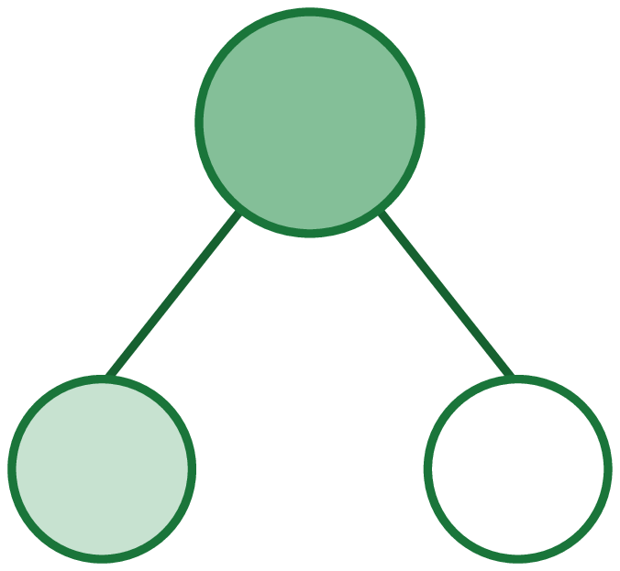





Overall
PART 1 The Foundation
PART 2 The Bridge
PART 3 The Embodiment
Models for Brain Signals
From Signals to Representations
From Representations to Interactions
HyBRiD ¹
FA-EEG ³
PRISM · I ⁵
MindLLM ²
Mind World Model ³
ML → prior
prior → ML
signals →
semantics
which space?
semantics →
action
action intentions
a goal, not a trajectory
neural priors
dog
fluffy
on grass
obj
attr
rel
the prior travels
back out
SWA ⁴
DySta ⁷
PHIL ⁸
PRISM · II ⁵
D-Edit ⁶
VLA control
the fast loop
a path to the goal
the slow loop
the direct path: brain signals → semantics → action, never through language
[1] Qiu et al. Learning High-Order Relationships of Brain Regions. ICML 2024. [2] Qiu et al. MindLLM: A Subject-Agnostic and Versatile Model for fMRI-to-Text Decoding. ICML 2025.
[3] Qiu et al. Mind World Models. In preparation. [4] Huang et al. Small-world structure in LLM attention heads. In preparation.
[5] Huang et al. Seeing Through the Brain: New Insights from Decoding Visual Stimuli with fMRI. ICLR 2026 Oral. [6] Feng et al. An Item Is Worth a Prompt: Versatile Image Editing with Disentangled Control. AAAI 2025.
[7] Qiu et al. Static-Dynamic Disentanglement for Efficient Multi-Frame Vision-Language-Action Models. arXiv 2026. [8] Pándy et al. Learning Graph Search Heuristics. LoG 2022.

Slide 6



Preliminaries: Brain Signals
Various neural recording techniques
Capture
  Different noise level (from scalp to in-brain)
  Different spatial and temporal resolutions
Various Data Formats
  Multi-channel time series
  Volumetric time series (shown later)
PET
Structural MRI
Functional MRI
Notes:
Actual format of the modalities

Slide 7
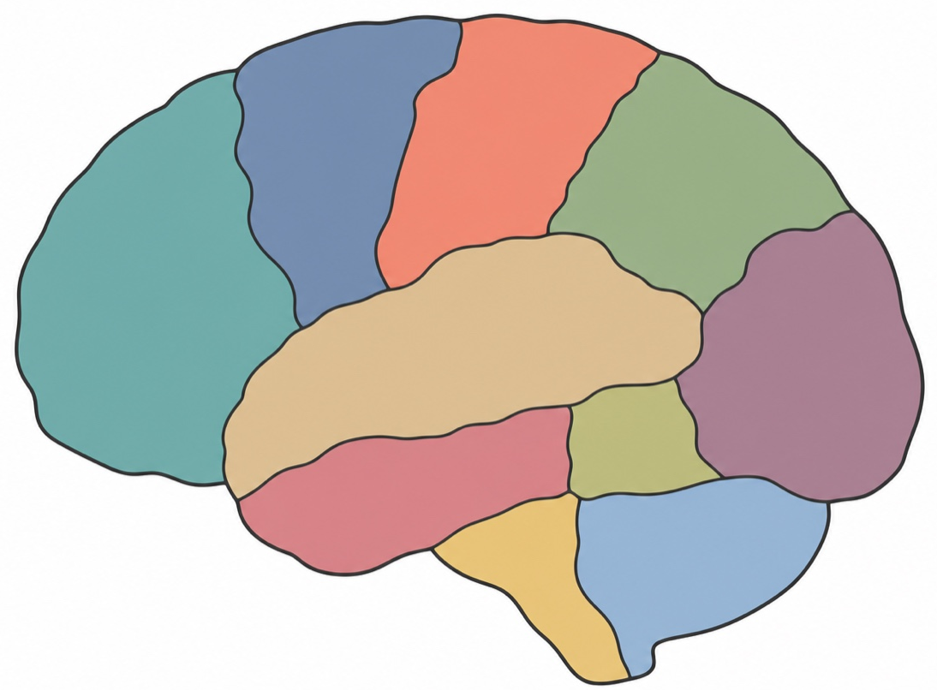
Preliminary · Parcellation & Brain Networks
Built the same way everywhere: regions are nodes, every edge joins exactly two.
Nodes: brain regions
Parcellated by an atlas · voxels inside a region averaged
Edges: pairwise Pearson correlation
One number per pair, from their averaged time courses
What it is used for
region
Clinical diagnosis and treatment · Study how the brain works
Pearson
correlation
Notes:
Brain Network is a tool to study the brain at the region level

Slide 8
Part 1: The Foundation
Models for Brain Signals
Two directions between neuroscience and machine learning.
1
Discover
Discover neural priors, e.g., connectivity.
HyBRiD · ICML 2024 · high-order relations among brain regions
HyBRiD ¹
FA-EEG ³
2
Incorporate
Build in known organization; don't spend scarce data relearning it
ML → prior
prior → ML
neural priors
FA-EEG · ongoing · mirror symmetry
3
…and the prior travels back out
the prior travels
back out
SWA ⁴
And back out: a brain-network property improves a model with no brain in it
SWA · ongoing · small-world organisation in the attention-head network of an LLM
Notes:
The cut is by where the structure comes from, not by what it buys. HyBRiD has to search: no atlas says which regions act as a group and the candidate space is exponential, so the structure is learned end-to-end under the MIMR objective. The other three each start from something neuroscience has already established and hand it to the model. SWA carries the network-level prior, small-world organisation, over to LLM attention heads and tests it by pruning against it. FA-EEG makes the left-right mirror symmetry exact by frame averaging instead of learning it from scarce data. Neuro-informed attention uses learnable queries over region encodings from brain parcellations; serving a new subject is the payoff of that prior, not a separate question, which is why it sits under the same heading rather than beside it.
/slide[10]/shape[@id=2] (title) "Part 1: The Foundation\nModels for Brain Signals" [full sentences cut from the slide] Discover structure no atlas records — in a form a neuroscientist can read Build in known organisation — don't spend scarce data relearning it And back out — a brain-network property improves a model with no brain in it

Slide 9

HyBRiD · Cognition Is Not Pairwise
ICML 2024 · Weikang Qiu, Huangrui Chu, Selena Wang, Haolan Zuo, Xiaoxiao Li, Yize Zhao, Rex Ying
Imaging biomarkers score pairwise edges, but brain function is distributed over many regions
They do not decompose
Cannot be broken into pairs: they carry what pairs cannot
So: weighted hyperedges
A hyperedge joins any number of regions · its weight is the strength
And the search space is exponential
Exponentially many candidates · prior work prunes first, blind to the target, so the informative ones are gone before selection starts
Regions → high-order relationships → their strengths → the cognition score. (HyBRiD Figure 1)
Notes:
Premise, HYBRID/000intro.tex:6-7: biomarker detection scores pairwise connectivity, but brain function is distributed across many regions at once, and high-order relations cannot always be decomposed into pairwise ones, so they capture information beyond the reach of pairs. Formulation, 000intro.tex:33: regions are nodes, a hyperedge joins any number of them, and the hyperedge weight is the strength of the relationship. The cost, 000intro.tex:12: the number of possible high-order relations is exponential; 000intro.tex:8: prior high-order work enumerates only a small portion of the space, or clusters without reference to the target, so the most informative relations are gone before feature selection starts. That sets up slide 13.

Slide 10
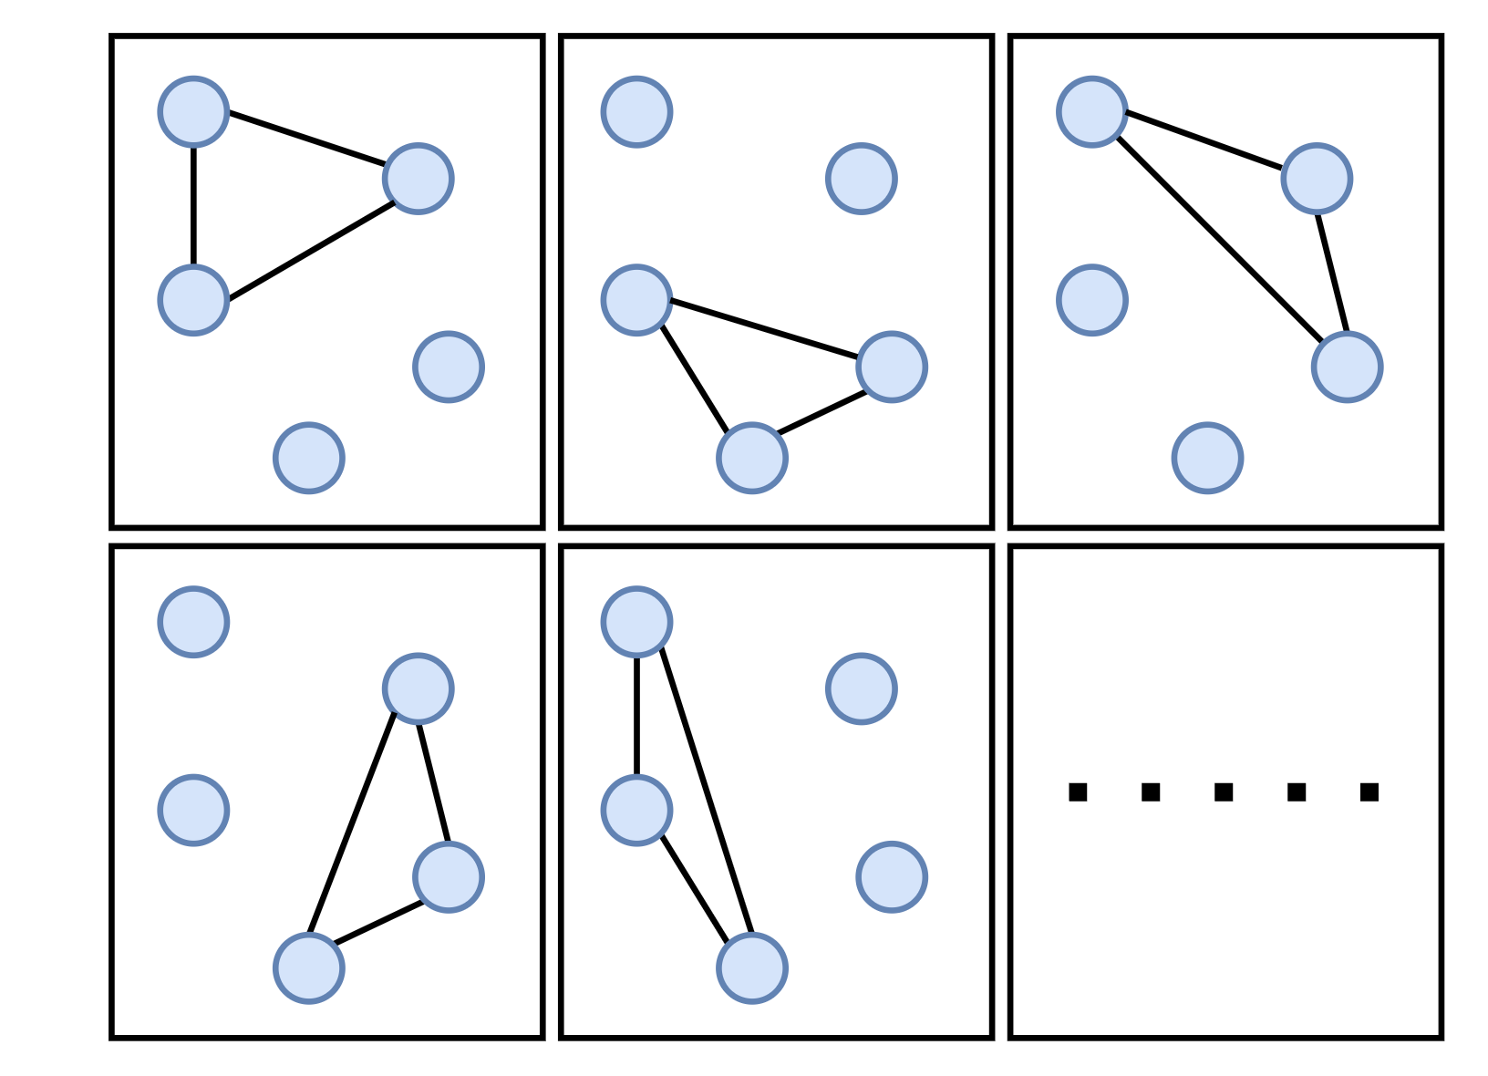
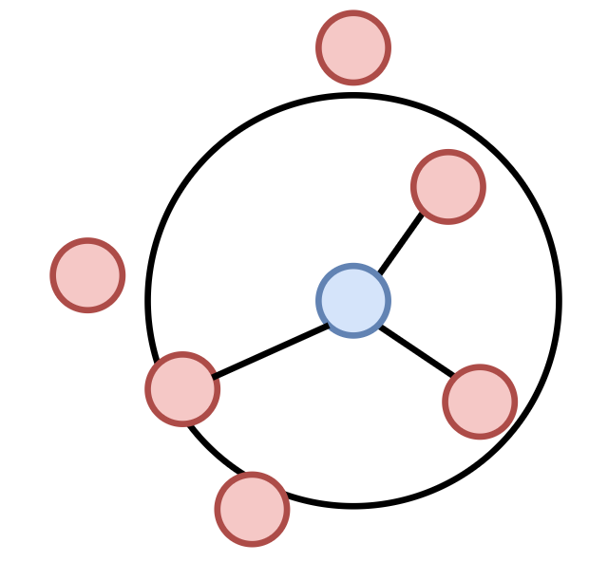
Existing Works · How Hyperedges Are Built Today
ICML 2024 · Weikang Qiu, Huangrui Chu, Selena Wang, Haolan Zuo, Xiaoxiao Li, Yize Zhao, Rex Ying
Exponentially many candidate hyperedges
Enumerate low-degree subsets
Neighbour-based construction
Take every subset with degree ≤ 3. (Zu et al., 2016; Santoro et al., 2023)
One hyperedge per node — its nearest or mutually reconstructing neighbours. (Huang et al., 2009; Wang et al., 2015)
Covers a vanishing fraction of the space; does not scale past degree 3.
Hyperedge count fixed to the number of nodes; structure differs per subject.
Notes:
Grounds the claim on the next slide. HYBRID/001related_work.tex, 'Hypergraph Construction' and 'High-Order Relationships in fMRI'. Two families, and both prune the exponential space before they ever look at the target. (1) Enumeration — Zu et al. 2016 and Santoro et al. 2023 enumerate every hyperedge of degree below 3; that is a tiny portion of an exponential space and does not scale to larger degree. (2) Neighbour-based — Huang et al. 2009 (kNN) connects a centroid node to its k nearest neighbours in feature space; Wang et al. 2015, Liu et al. 2017, Jin et al. 2019 and Xiao et al. 2019 refine those connections with various regularizers. Because there is one hyperedge per centroid, the count is pinned to the number of nodes, and the hyperedges come out inconsistent across instances. Zhang et al. 2022/2018 iteratively refine a hypergraph obtained this way, so they inherit the same limitations. Neither family has a tractable objective for MIMR hyperedges — that is the third failure, and it is the one the next slide opens with.

Slide 11
Existing Works · Three Ways It Breaks
ICML 2024 · Weikang Qiu, Huangrui Chu, Selena Wang, Haolan Zuo, Xiaoxiao Li, Yize Zhao, Rex Ying
Hypergraph construction relies on neighbour distance and reconstruction.
CURRENT HYPERGRAPH CONSTRUCTION
HyBRiD
Blind to target
Multi-head drop-bottleneck
The structure comes from feature itself, not from any objective.
→
The structure is derived from an explicit MIMR objective, learned end-to-end.
No consistency across subjects
Feature-agnostic masks
Structures differ per subject, contradicting the belief that healthy cognition works alike.
→
The mask never reads a subject’s features, so every subject gets the same structure.
At most N hyperedges
K parallel heads
The number of hyperedges is capped at the number of nodes, which can be sub-optimal.
→
One head per hyperedge, so K is a free hyperparameter.
Notes:
All six claims: HYBRID/000intro.tex:40 (the three failures) against 000intro.tex:44 (the three answers). Failure 1: neighbour-distance and neighbour-reconstruction construction has no tractable objective for MIMR hyperedges. Failure 2: it does not learn consistent structures across subjects, which contradicts the belief that the cognitive mechanism of healthy human beings should be similar. Failure 3: the number of hyperedges is restricted to the number of nodes, which may lead to sub-optimal performance. HyBRiD's answers, same order: multi-head drop-bottleneck gives a tractable IB objective; the feature-agnostic masking mechanism is exactly what buys consistency across subjects; K parallel heads, one per hyperedge, so K is free. Also from :40 — existing IB methods extract compressed representations of the input, not structures, so applying IB here needed both architectural innovation and theoretical derivation.

Slide 12
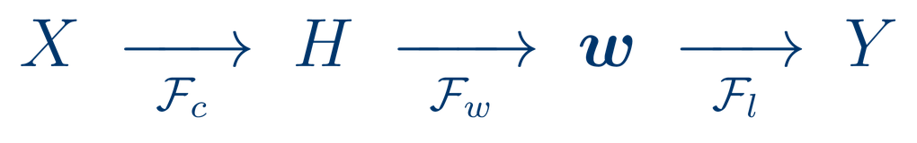
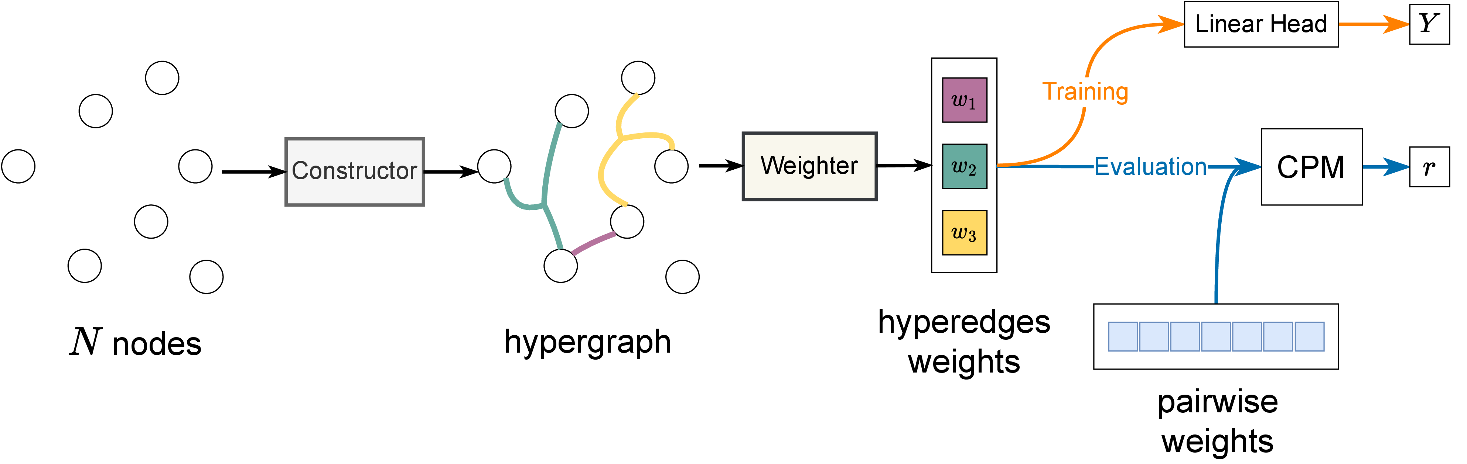
HyBRiD · Constructor → Weighter → Head
ICML 2024 · Weikang Qiu, Huangrui Chu, Selena Wang, Haolan Zuo, Xiaoxiao Li, Yize Zhao, Rex Ying
One forward pass. Three modules; the last two are the predictor.
A standard evaluation protocol
Training supervises the whole chain with Y; the learned weights then go into CPM.
Constructor
Weighter
LinearHead
learns which regions form each hyperedge
scores each hyperedge from its members
predicts the outcome from the K weights
Notes:
003approach.tex:5-11 names the three modules the old deck never named: Constructor F_c identifies the hyperedges H, Weighter F_w gives each one a weight, LinearHead F_l predicts Y from the weights — X -> H -> w -> Y. The figure is the paper's Figure 1 (figures/pipeline2.drawio.pdf, caption at 003approach.tex:20): note the two phases on the right, training under Y and evaluation through CPM. Complexity, 003approach.tex:86-88: O(N^2 K), 'just the same scale as that of MLPs even though we are addressing a more challenging task: identifying high-order relationships in an exponential space'; appendix.tex:149-150 derives it as O(NKd + d^2) with d = N because a region's features are its correlations to all regions. The runtime that follows from it is on the results slide.

Slide 13



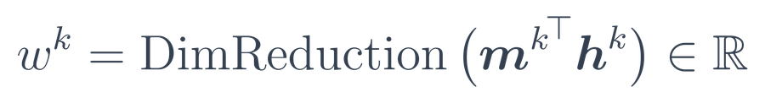
HyBRiD · The Structure Is a Learned Mask
ICML 2024 · Weikang Qiu, Huangrui Chu, Selena Wang, Haolan Zuo, Xiaoxiao Li, Yize Zhao, Rex Ying
K heads, one per hyperedge. Head k decides which regions belong to hyperedge k.
1
One learnable probability per region, cut at 0.5.
2
The indicator has no gradient, hence the stop-gradient.
3
Mask features; unmasked nodes are the members.
4
Weighter: sum unmasked nodes, then MLP to a scalar.
The mask never looks at X
N = 6 regions, K = 3 hyperedges
Feature-agnostic masking is what makes one structure hold across subjects; only the weights change.
Notes:
003approach.tex:33-43: K is a predefined hyperparameter and each head owns one hyperedge. Head k carries N learnable probabilities p^k_theta,i; the indicator thresholds them at 0.5 into a binary mask m^k in {0,1}^N over the N regions. There is no gradient defined for the indicator, so they use the stop-gradient technique (van den Oord et al.; Bengio et al.). 003approach.tex:55-61: h^k = m^k elementwise-times X, and the non-masked nodes are the hyperedge's members. 003approach.tex:71-78: the Weighter's Readout sums over all non-masked nodes feature-wise, then a DimReduction MLP with ReLU takes that to a single scalar w^k. The only learnable components in the whole model are those shallow embeddings, that MLP and the linear head (003approach.tex:144). Feature-agnostic masking is 000intro.tex:44 — the answer to failure 2 on the previous slide. Figure is HyBRiD Figure 2, 003approach.tex:45-53.

Slide 14
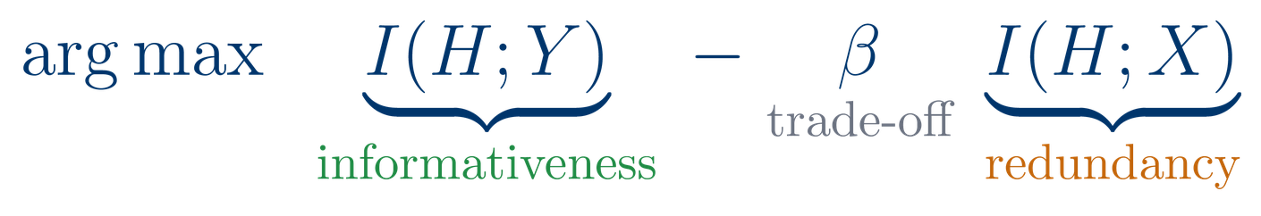
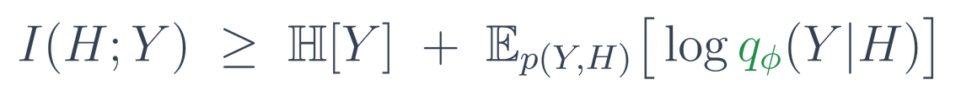
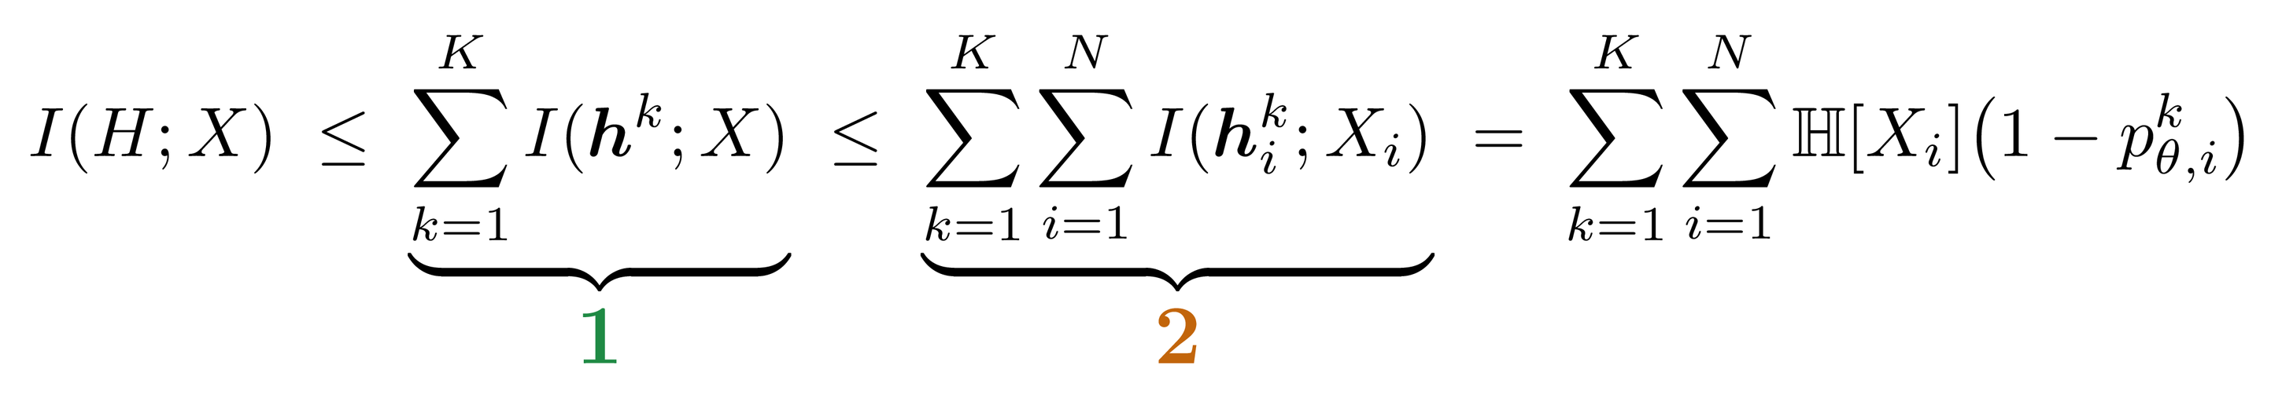
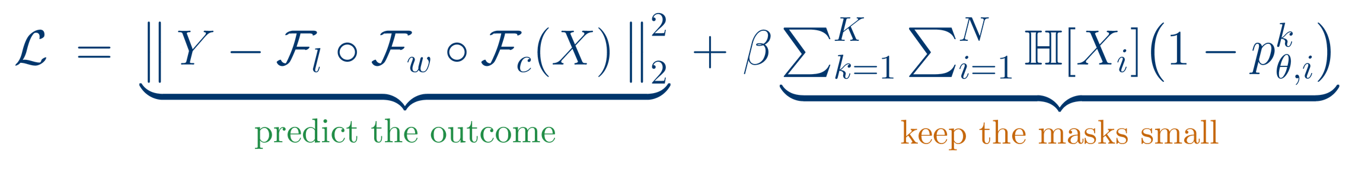
HyBRiD · Multi-Head Drop-Bottleneck
ICML 2024 · Weikang Qiu, Huangrui Chu, Selena Wang, Haolan Zuo, Xiaoxiao Li, Yize Zhao, Rex Ying
No existing IB framework identifies a structure; it compresses an input. So we derive one: multi-head drop-bottleneck.
Informativeness: lower bound
qφ is exactly the Weighter followed by the LinearHead.
Proposition 1: our bound. 1 across the K heads, the multi-head; 2 inside one head, the drop-bottleneck. Proof in the appendix.
Notes:
This slide is the theoretical contribution, so say it out loud. The information bottleneck is the standard way to learn maximally informative, minimally redundant representations -- but every existing IB method compresses an INPUT into a representation. None of them identifies a STRUCTURE such as a hypergraph (000intro.tex). So there was no framework to apply: 003approach.tex:92, 'Since there are no existing IB frameworks that can be applied in our context, we propose a new IB framework named multi-head drop-bottleneck'. The name is the derivation: Proposition 1 bounds I(H;X) twice -- first across the K heads, which is the multi-head part, then within a head, which is the drop-bottleneck step inspired by Kim et al. (003approach.tex:120-129). Equality holds iff nodes are independent and hyperedges do not overlap, and the paper is explicit that optimising the bound does NOT penalise overlap -- worth knowing if someone asks whether hyperedges are forced apart. Proof is in the appendix.

Slide 15

HyBRiD · Predictive Performance
ICML 2024 · Weikang Qiu, Huangrui Chu, Selena Wang, Haolan Zuo, Xiaoxiao Li, Yize Zhao, Rex Ying
CPM (Shen et al., 2017): the field’s standard connectivity–phenotype test.
Baselines: pairwise CPM · kNN/ℓ1/ℓ2 hypergraphs · BrainNetGNN, BrainGB, BrainGNN, BrainNetTF
r on the eight ABCD datasets, averaged over 10 runs. Bold = best, underline = second best. (HyBRiD Table 1)
+12.1%
+8.8%
+11.9%
87%
average gain on ABCD, best on 7 of 8 datasets
average gain on ABIDE, across all three IQ targets
lower MSE on 9 of 11 datasets
faster per batch than BrainNetTF
Notes:
The metric first, because it is the defence. CPM, Shen et al. 2017, 004experiments.tex:57 — 'a standard model that could evaluate the relevance between the connectivity and the prediction target, due to its high impact in the community'. We did not invent it; we swapped the pairwise weights it normally consumes for our hyperedge weights (004experiments.tex:65-72). Three classes of baselines at 004experiments.tex:157-159; for the deep baselines their last-layer embeddings are fed to CPM, exactly as our weights are. Numbers: ABIDE +8.8% average over the state of the art on FIQ, VIQ and PIQ (004experiments.tex:168); ABCD best on 7 of the 8 datasets, average +12.1% (004experiments.tex:169, macro defined at macros.tex:78) — Rest 1 is the single loss and is analysed in the appendix; MSE better on 9 of 11 datasets, +11.9% (004experiments.tex:211); runtime 87% faster per batch than the second-fastest deep model BrainNetTF and at least 1255% faster than the GNN baselines (004experiments.tex:173, appendix.tex:473). Datasets, 004experiments.tex:40-43: ABIDE (Craddock 200 atlas, three IQ targets) and ABCD (AAL3v1, fluid intelligence, 2 timepoints x 4 conditions = 8 datasets).

Slide 16
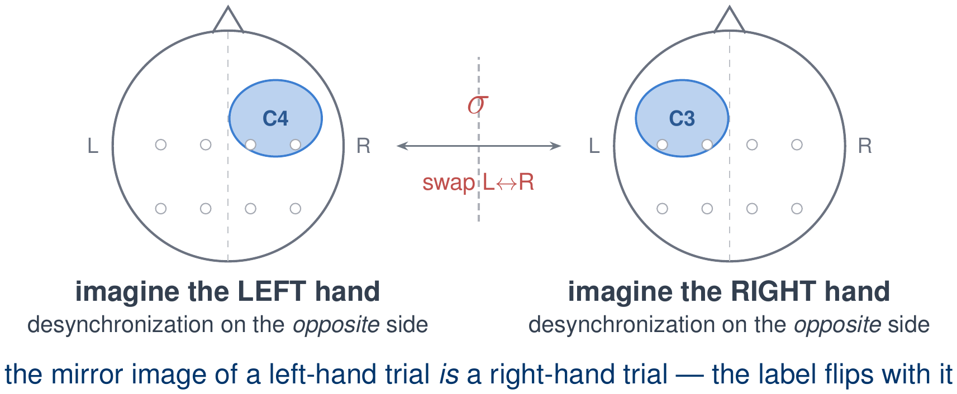
FA-EEG · Motor Control Is Lateralized
ongoing · Weikang Qiu, Zheng Huang, Tinglin Huang, Yujun Yan, Rex Ying
Motor control is lateralized — left hand, right cortex, and vice versa. So mirroring the montage swaps the two classes: a symmetry a plain encoder must rediscover from scarce data.
LEFT
MIDLINE
RIGHT
electrode montage
Notes:
Montage detail (was drawn on the slide at 8.5 pt, now spoken): the left group is F3/C3/P3, the midline group Fz/Cz/Pz, the right group F4/C4/P4. sigma maps F3<->F4, C3<->C4, P3<->P4 and leaves the midline channels fixed.
Motivation, as originally written: imagining a left-hand movement and a right-hand movement produce mirror-image EEG. Nothing in a standard encoder knows this: it has to learn the mirror from data — and EEG data is scarce.
Lateralized half, full sentence: motor imagery is lateralized — which hemisphere desynchronizes tells left from right.
/slide[23]/shape[@id=2] (title) "FA-EEG · EEG Has a Left–Right Symmetry" [full sentences cut from the slide] Left/right imagery gives mirror-image EEG — a plain encoder relearns it from scarce data

Slide 17
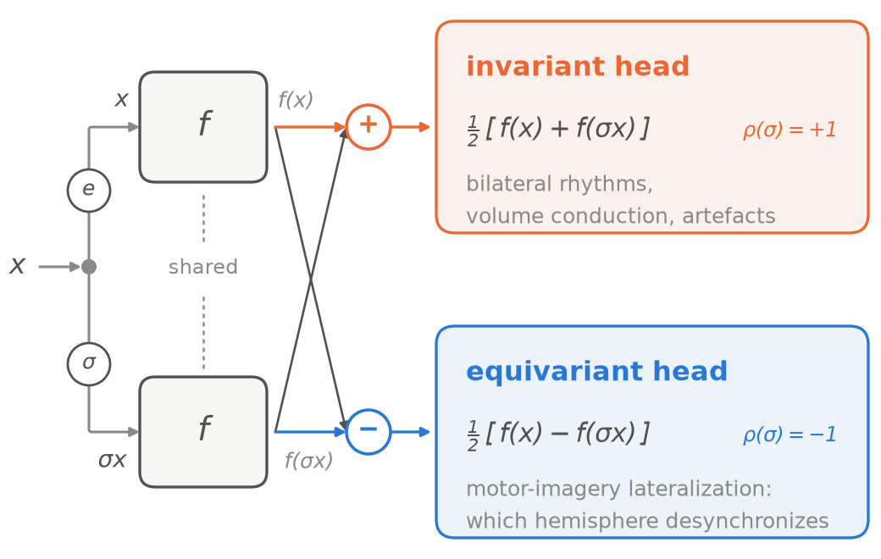
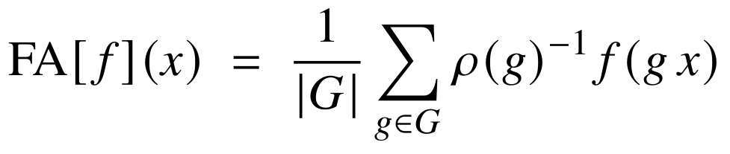
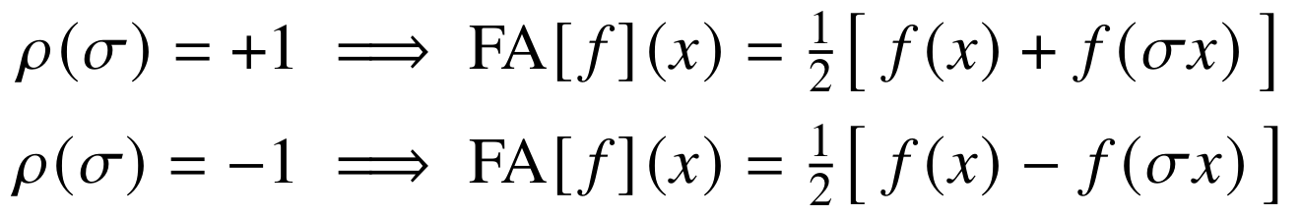
FA-EEG · Building In the Mirror Symmetry
ongoing · Weikang Qiu, Zheng Huang, Tinglin Huang, Yujun Yan, Rex Ying
ρ(g): how the swap acts on the output space.
The −1 branch keeps f(x) − f(σx): the lateralization the task turns on.
Motor-imagery decoding (%)
Dataset | FA off | FA on
PhysioNet | 61.7 ± 0.3 | 63.3 ± 0.5
FineMI | 19.2 ± 0.5 | 20.0 ± 1.1
Notes:
FA on vs FA off (mean +/- sd): PhysioNet-MI 0.6330 +/- 0.0050 vs 0.6166 +/- 0.0026 -> 63.3 +/- 0.5% vs 61.7 +/- 0.3%, +2.7% relative. FineMI 0.2000 +/- 0.0110 vs 0.1917 +/- 0.0048 -> 20.0 +/- 1.1% vs 19.2 +/- 0.5%, +4.3% relative. Same direction on both datasets, but only PhysioNet-MI separates outside the error bars; the FineMI gain is within noise.

Slide 18
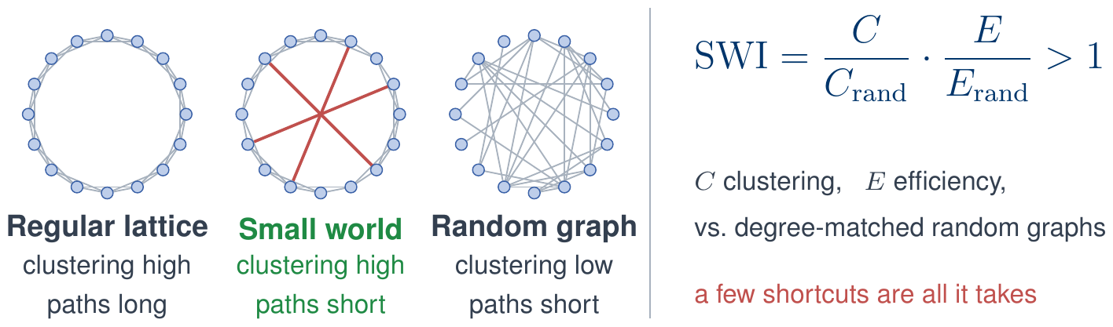

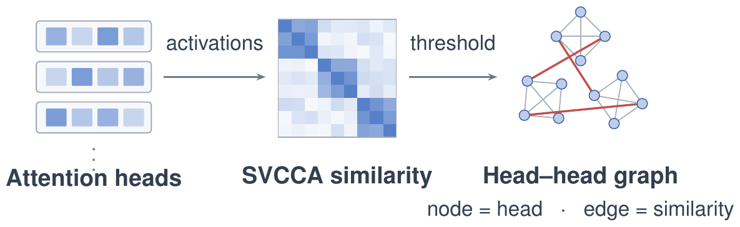
SWA · Small-Worldness in Attention Heads
ongoing · Zheng Huang, Enpei Zhang, Weikang Qiu, Rex Ying, Elynn Chen, Yaoqing Yang, Dawei Zhou, Yujun Yan
In the brain, small-worldness tracks intelligence · does an LLM organize the same way?
1
What is a small-world network?
3
Small-worldness tracks fluid reasoning
Six open-source LLMs on DRE-Bench
Higher small-world index → lower answer NLL.
2
The same graph, built on an LLM
Same ordering inside both model families.
4
Prune by small-worldness
SparseGPT pruning | best baseline | + SWA | Δ
Small-world index ↑ · Qwen3-14B @ 50% | 0.175 | 0.198 | +13%
WikiText PPL ↓ · Qwen3-8B @ 70% | 25.13 | 20.10 | −20%
Core (strength kept inside its own community) + bridge (spread across others) rank every head; sparsity allocated in proportion, per head and per layer.
best baseline = strongest of SparseGPT / +FARMS / +ATP · SWA wins in every cell
Notes:
Four beats. (1) What a small-world network is: a lattice is clustered but paths are long; a random graph has short paths but no clustering; rewire a handful of lattice edges into long-range shortcuts and you get both at once. That is quantified by the small-world index -- clustering C and global efficiency E, each divided by the same quantity on degree-matched random graphs; greater than one means small-world. This is not our definition, it is the standard one from neuroscience, where functional brain networks over ROIs are small-world and stronger small-worldness goes with higher Raven's-style scores. (2) The same construction, on an LLM: one node per attention head across all layers; the edge weight is the SVCCA similarity of the two heads' activations on DRE-Bench fluid-reasoning questions; threshold to a fixed density so graphs stay comparable. SVCCA rather than Pearson because a head emits a vector, not a scalar, and heads in different layers live in different latent spaces -- only if asked. The analogy is exact: brain region maps to head, BOLD correlation maps to SVCCA similarity. (3) The finding: across six open-source LLMs, a higher small-world index goes with a lower mean answer NLL. Qwen3-14B has the highest SWI and the lowest NLL, Llama-3.2-1B the lowest and the highest, and the ordering holds inside both families. (4) Put the structure to work in pruning. Core score = the share of a head's connection strength that stays inside its own Louvain community; bridge score = how evenly it spreads across the other communities. Both are percentile-ranked and multiplied, p = (1-B)(1-C); sparsity is allocated in proportion, at the head level and again at the layer level, so structurally central parts are cut least. Numbers if asked: SWI on Qwen3-14B 0.175 -> 0.198, best preserved on all six models; WikiText perplexity on Qwen3-8B at sparsity 0.7, 25.13 -> 20.10, a 20.0 percent cut against the best baseline, and SWA is best in every model x sparsity cell. Not shown: best zero-shot accuracy in every cell over seven benchmarks, lowest shape-mismatch rate on all six held-out ARAOC operations, and dropping the layer-level signal costs +19.6 perplexity at sparsity 0.7.

Slide 19
Part 2: The Bridge
From Signals to Representations
Part 1 stayed inside the brain · Part 2 connects it to world semantics
What space should brain signals be aligned to?
How can one representation serve every subject and every brain function?
Can generation be controlled at that granularity?
Objects–attributes–relations fits fMRI better than a visual latent
Voxel layouts differ per subject; perception, memory, language and reasoning must read out in one format
Per-item representation needs a per-item editable generator
PRISM · I ⁵
MindLLM ²
which space?
How we address them
dog
fluffy
on grass
obj
attr
rel
PRISM
MindLLM
D-Edit
fMRI matches object–attribute–relation space, not a visual latent
a subject-agnostic fMRI encoder + a task-flexible decoder, ~1M conversations
item-level control of a diffusion model through per-item soft prompts
PRISM · II ⁵
D-Edit ⁶
Notes:
Lead line in full: aligning brain activity to world-level semantics is harder than image–text alignment — the data is scarce, expensive, and highly variable across subjects. Q1 also asks for adaptation to tasks the model was never trained on. Q2: which changes what the bridge should aim at. Q3: otherwise the granularity is lost at the last step. Brain Instruction Tuning: the ~1M conversations span four families of brain function.
/slide[27]/shape[@id=2] (title) "Part 2: The Bridge\nFrom Signals to Representations" [full sentences cut from the slide] Objects–attributes–relations fits fMRI better than a visual latent Perception, memory, language, reasoning — one subject-agnostic model Per-item representation needs a per-item editable generator

Slide 20

PRISM · Which Space Do We Align To?
ICLR 2026 Oral · Zheng Huang, Enpei Zhang, Weikang Qiu, Yinghao Cai, Carl Yang, Elynn Chen, Xiang Zhang, Rex Ying, Dawei Zhou, Yujun Yan
Which modality of the world should the brain be aligned with? We measured it.
Text wins on all three
Every text space beats every image space, yet the field's default is a visual latent
text spaces: T5, Llama3, CLIP-text · image spaces: CLIP-img, LDM, ResNet50
Notes:
The field's default is modality matching: the subject saw an image, so align to a vision latent. This table is the test. CKA and CCA measure representational similarity; Generalization Gap measures learnability -- the train-test loss difference when an MLP maps fMRI into the target space. Source: PRISM/03method.tex. If asked about the comparison being unfair: one side embeds human-written captions and the other embeds images, so the defensible claim is which available representation space fMRI is most learnable from -- not that the brain is literally language-like.
/slide[28]/shape[@id=2] (title) "PRISM · Which Space Do We Align To?" [full sentences cut from the slide] Every text space beats every image space — the field's default is a visual latent

Slide 21
fMRI-Text Alignment
Prior decoders: one kind of output
Not speech decoding.
fMRI
→
“The subject is seeing a man on a horse.”
The goal is not the words a person is saying or reading. Text is as the unified format in which many brain functions can be read out and compared.
MindLLM: many questions, one format
“The subject is seeing a man on a horse.”
“The subject remembers an earlier kitchen.”
What prior decoders do
fMRI
“The subject knows the animal is a horse.”
Caption the stimulus and stop: SDRecon, BrainChat, OneLLM. A proxy image, then an off-the-shelf VLM: UMBRAE.
→
“The subject is reading the word STOP.”
“The subject infers the rider is in danger.”
“The subject intends to reach for a cup.”
Challenge: How to design training/dataset recipe for such objectives
Notes:
Cut from the slide, keep in the mouth: what SDRecon / BrainChat / OneLLM output depends on nothing but the image on the screen right now - not on memory, not on text inside the scene, not on inference. And UMBRAE's proxy image is the ceiling: whatever the image does not contain - for instance what the subject saw a minute ago - cannot be recovered downstream, however good the off-the-shelf VLM is.

Slide 22

MindLLM · Subject-Agnostic Decoding
ICML 2025 · Weikang Qiu, Zheng Huang, Haoyu Hu, Aosong Feng, Yujun Yan, Rex Ying
fMRI at a specific moment (no time series in this work)
Select Responsive Voxels
Model
Responsive tokens are different (both in number and in distribution) for different subjects
Existing works:
Non-learnable pooling/sampling process, risk of information loss
Sampling: over- or under-representation of certain areas.
(Pooling)
(Sampling)

Slide 23

MindLLM · Overview
ICML 2025 · Weikang Qiu, Zheng Huang, Haoyu Hu, Aosong Feng, Yujun Yan, Rex Ying
An off-the-shelf LLM (vicuna-1.7B in practice)
fMRI encoder (subject agnostic)
  Map fMRI signals to tokens (prepend to instruction tokens)
  Powered by neuroscience-informed attention
Brain Instruction Tuning (capture multiple functions)
  ~1M multi-turn conversations, four families of brain function
voxels

Slide 24




MindLLM · Four Families of Brain Function
ICML 2025 · Weikang Qiu, Zheng Huang, Haoyu Hu, Aosong Feng, Yujun Yan, Rex Ying
One example per family, and the pipeline that produced the pairs.
Perception & Scene Understanding
Memory & Knowledge Retrieval
Q What eats leaves from a basket in an enclosure?
A Giraffe.
Q Caption the image the subject saw before this one.
A A neat bedroom pairs modern chairs with a glass table.
(previous image)
Language & Symbolic Processing
Reasoning & Association
Q What are the two white letters?
A H and U.
Q Why is only the near rail sharp?
A The camera moves with it: this was shot from a moving vehicle.
980,610 conversations
Notes:
Source datasets per family. Perception & scene understanding: COCO Caption, Paragraph Caption, COCO-QA, Visual Genome QA, VQAv2, TallyQA. Memory & knowledge retrieval: Previous Caption, OK-VQA, A-OKVQA. Language & symbolic processing: ST-VQA, TallyQA. Complex reasoning: VQA-E, A-OKVQA, LLaVA-Instruct-150K, LVIS-Instruct4V.
TWO CARDS TO KNOW THE PROVENANCE OF:
Language & symbolic -- the stimulus and its Q/A are the VQAv2 row of the appendix (verbatim), not ST-VQA. The ST-VQA stimulus was swapped out because its shirt text is half-hidden by the player's arm and unreadable at thumbnail size. The task shown is still scene-text reading, which is what ST-VQA does; if pressed, say the image is the VQAv2 example and the family is ST-VQA + TallyQA.
Complex reasoning -- the image is the VQA-E stimulus from the appendix, but the question and answer are written for the talk, not lifted from the dataset. Say 'illustrative' if asked which sample it is. VQA-E's own annotation for this image describes the scene as people 'passing by as they ride in a vehicle', so the vehicle reading is the dataset's too.
The line to make out loud on the reasoning card: nothing in the picture states that the camera is moving. You infer it from which parts are streaked and which are not. That inference is what separates this family from the other three -- recognising an object, recalling an earlier one, and reading letters are all things the stimulus hands you; this one it does not.

Slide 25


MindLLM · Learnable Queries over Voxels
ICML 2025 · Weikang Qiu, Zheng Huang, Haoyu Hu, Aosong Feng, Yujun Yan, Rex Ying
cross attention
Learnable queries
Each query -> a specific pattern. E.g.
  gather information of low-level vision area
  communication between low- and high-level areas
A standard cross attention?
query 1
query 2
query 3
Bad performance!
(Compared to a non-cross-subject MLP baseline)
query 4
query 5
query 6
Notes:
Subject-agnostic argument, half 1 of 2 (the author's CC note on slide 24 asks for it; the block itself is on 24). This slide is where the VALUE path is set: values are the raw fMRI signal of each voxel, one token per voxel. Parts/part1.tex line 46: "For values, we directly use the fMRI signal of each voxel... Making each voxel a value token maximally prevents information loss compared to pooling- [MindBridge] or sampling-based [UniBrain] methods." That is what lets one architecture eat a voxel set whose size and spatial layout differ per subject - N ranges 12,682 to 17,907 over the 8 NSD subjects (line 41). The alternative, standardising the input by pooling or sampling, is what MindBridge and UniBrain do, and line 29 says those "still suffer from the loss of spatial information and uneven representations of certain areas."

Slide 26


MindLLM · Keys from Position Alone
ICML 2025 · Weikang Qiu, Zheng Huang, Haoyu Hu, Aosong Feng, Yujun Yan, Rex Ying
Image: query should know the pixel value
fMRI: only needs to know the position (a voxel’s position reflects its functional role)
-> Build the key from position, never from the fMRI value.
Notes:
Images are translational invariant, which means a query needs to know the actual pixel value to compute the attention weight
Subject-agnostic argument, half 2 of 2. This is where the KEY path is set, and it is the half that actually buys cross-subject transfer. Parts/part1.tex line 49: the positions of voxels "carry specific brain functional information, as voxels in different areas are associated with distinct brain functions", so position alone is a sufficient key; putting the fMRI value into the keys "introduces additional noise instead of valuable information". Same line: "since brain regions tend to serve similar functions across individuals, decoupling voxel positions from fMRI signals can facilitate the sharing of priors across subjects, potentially improving generalization to unseen subjects." So the subject-specific quantity (the fMRI value) flows only through V, and everything the query matches against is anatomy/function that a new brain also has. Slide 24 states the whole argument in one block.

Slide 27
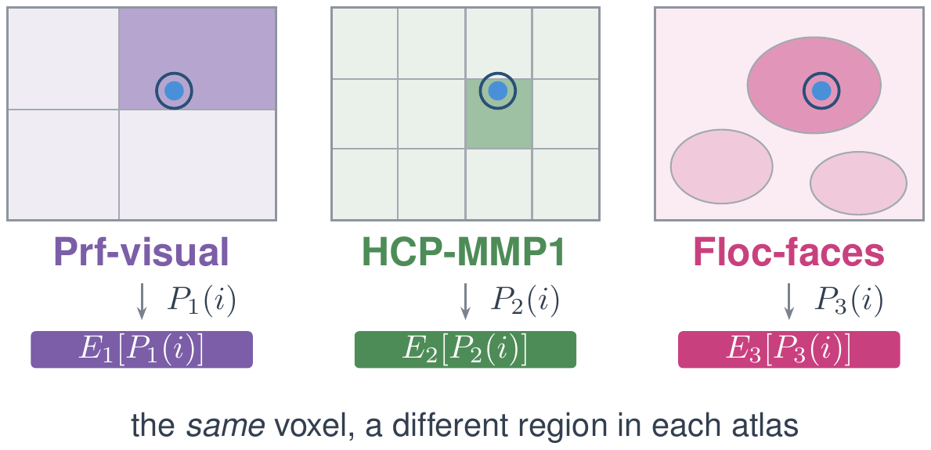
MindLLM · Region Encodings as Neural Priors
ICML 2025 · Weikang Qiu, Zheng Huang, Haoyu Hu, Aosong Feng, Yujun Yan, Rex Ying
1
A voxel belongs to multiple parcellations
2
Augment key with region embeddings from multiple parcellations
Parcellations
Ablation on the key
fMRI value in the key → worse
region encodings → fastest early
position + region → best
Notes:
Third and last piece of the encoder. The previous slide established that the key carries position, not the fMRI value. Position alone, though, has no neuroscientific grounding, so the model has to rediscover functional anatomy from scarce data. So we add it. Read the figure left to right. One voxel contributes two things to its key. Fine scale: its (x,y,z) coordinates through a Fourier positional encoding -- Tancik et al. 2020, chosen for how well it encodes coordinates. Coarse scale: look the voxel up in an established parcellation, get the index of the region it falls in, and fetch that region's learnable embedding row, E[P(i)]. Because the lookup only ever contributes an index, we are free to stack several parcellations -- the paper's architecture figure names Prf-visual, HCP-MMP1 and Floc-faces -- and concatenate all of them: k_i = k_pos || k_reg^P1 || k_reg^P2 || ... Prior region-based methods had to commit to a single atlas arbitrarily; this design does not. The fMRI value itself goes only to V, one token per voxel. Why this matters for the next slide: a region index means the same thing in every brain, so an encoding fitted on subjects 1-7 already applies to subject 8. If asked for visual evidence, the paper has attention maps of one learned query across subjects 2 to 7 (figures subj2to7 / brainmaps2): different voxel counts, different anatomy, same functional regions selected each time. Bottom band: the ablation on key design, Figure 'ablation' in the paper -- four findings from one plot. Putting the fMRI value into the key (Pos Enc. + fMRI) is clearly worse than leaving it out (Pos Enc.), which is the evidence for the previous slide. Region encodings alone converge fastest in the early epochs because they are grounded in known anatomy, but they saturate and are eventually overtaken by positional encoding, which carries finer-grained detail. The two combined are best throughout. And replacing the positional encoding with an MLP over raw coordinates is much worse, which says there is real high-frequency spatial structure in the signal. If asked why the paper's prose cites HCP-MMP1 and AAL3 while the figure names three other atlases: the figure is the paper's own; say 'multiple parcellations' rather than committing to a count.

Slide 28
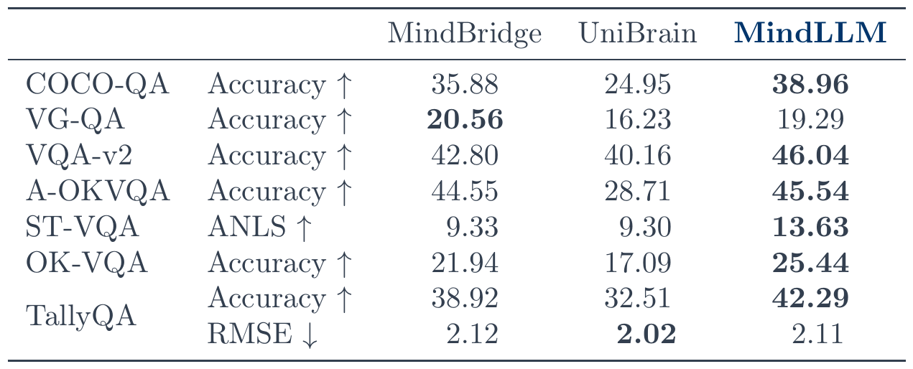
MindLLM · Generalizing to a Held-Out Subject
ICML 2025 · Weikang Qiu, Zheng Huang, Haoyu Hu, Aosong Feng, Yujun Yan, Rex Ying
Train on subjects 1–7, evaluate on subject 8: no finetuning, no per-subject parameters.
+24.5%
over the second-best subject-agnostic model
Best on 6 of the 8 rows shown; the other two go to MindBridge and UniBrain.
Notes:
The payoff for the whole encoder design, and the slide to linger on. Setup: instruction-tune on seven of the eight NSD subjects and evaluate on the held-out eighth. No finetuning on subject 8, no per-subject parameters, nothing about that subject in training -- so this measures the architecture, not adaptation. The number: the paper's sentence is 'an average improvement of 24.5% compared to the second-best model', i.e. per row, against whichever of MindBridge and UniBrain is better on that row, averaged over the metric rows of Table tab:subj8. Do NOT say 'across all 38 metrics' -- the paper never states that denominator, and recomputing the relative gain over the better baseline across the printed rows gives 21.2%, not 24.5%. Quote the paper's phrasing and stop there. The table is the first eight metric rows of tab:subj8, unedited, including the two rows we do not win: MindBridge takes VG-QA 20.56 to our 19.29, and UniBrain takes TallyQA RMSE 2.02 to our 2.11. Show them. A committee member who knows the paper will look for them, and six of eight with two narrow losses is a stronger claim than a clean sweep that invites the question. The full table continues with COCO-Caption BLEU/METEOR/ROUGE/CIDEr rows; it is in the paper, not in this deck, so if someone wants it, point at the paper rather than at a backup slide. Bottom band closes the argument opened five slides ago: subject-agnosticism needs both paths. Value path -- one token per voxel, no pooling and no sampling, so a subject with 17,907 voxels and one with 12,682 both fit without resizing anything, and nothing is averaged away. Key path -- position and atlas region only, never the fMRI value, so a key computed in one brain means the same thing in another. Neither half alone is sufficient: pooling would destroy the first, and putting fMRI values in the key would destroy the second.

Slide 29

MindLLM · Versatile Decoding
ICML 2025 · Weikang Qiu, Zheng Huang, Haoyu Hu, Aosong Feng, Yujun Yan, Rex Ying
■ w/o brain instruction tuning
■ w/ brain instruction tuning
Our model outperforms baselines with 12.0% average improvement.
Brain Instruction Tuning brings 28.0% improvement
Some tasks are disconnected from real-world applications...
Always able to be adapted to new tasks

Slide 30
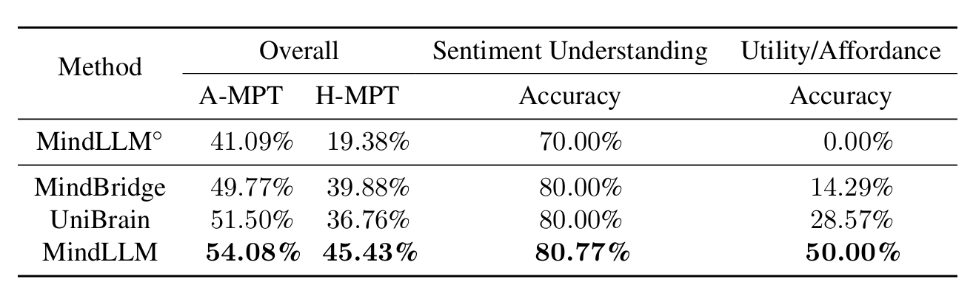
MindLLM · New Task Adaptation
ICML 2025 · Weikang Qiu, Zheng Huang, Haoyu Hu, Aosong Feng, Yujun Yan, Rex Ying
Adapt MindLLM to one’s own use cases. (e.g., more relevant to BCI applications)
  Utility/Affordance: Identify useful objects in the scene (and automatically decide to use them by the model)
  Sentiment Understanding: Understand what other people’s feelings (and help the users to adjust their communication strategies accordingly)
Our model improves 13.5%. Brain instruction tuning improves 25.0%.
w/o brain instruction tuning
w/ brain instruction tuning

Slide 31
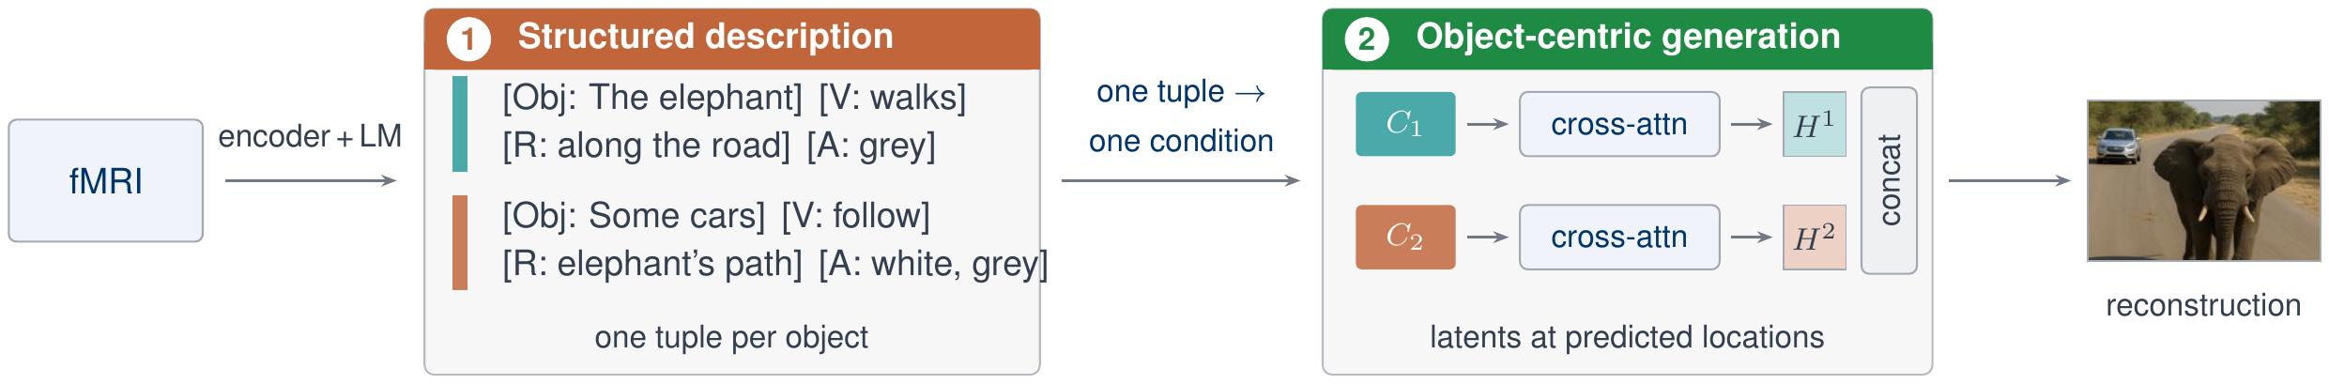
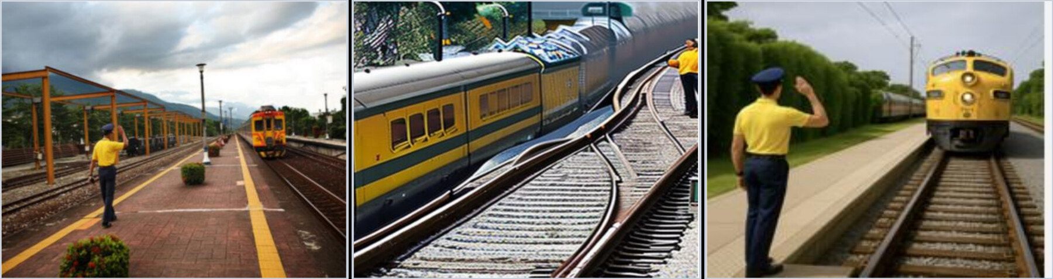
PRISM · Method
ICLR 2026 Oral · Zheng Huang, Enpei Zhang, Weikang Qiu, Yinghao Cai, Carl Yang, Elynn Chen, Xiang Zhang, Rex Ying, Dawei Zhou, Yujun Yan
Which attributes? A search picked them.
Why object-centric?
INITIAL SET
AFTER 30 ROUNDS
Spatial Configuration
Spatial Layout
Positional Relation
Spatial Patterns
Location Relation
→
Spatial Organization
Descriptive Attribute
Relative Position
Inclusion Dependency
Spatial Relationships
viewed image
MindEye2
PRISM
Top-5 before / after the search · CKA(fMRI, text) kept above threshold
one latent keeps the scene, not its objects

Slide 32
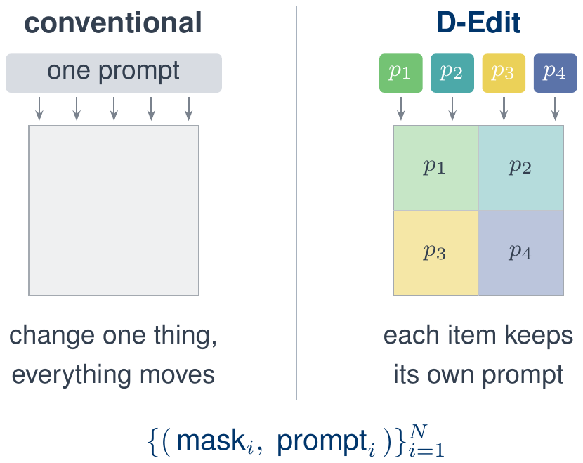
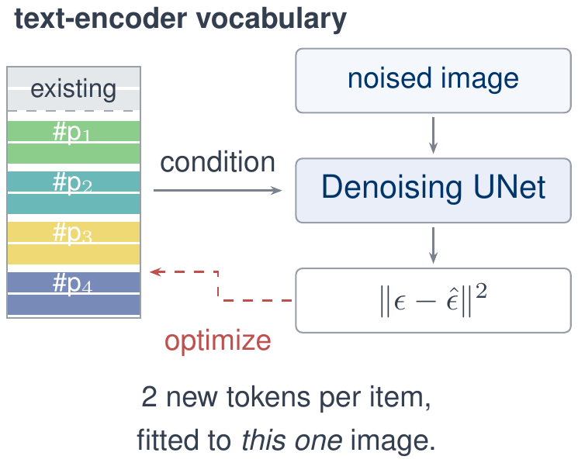
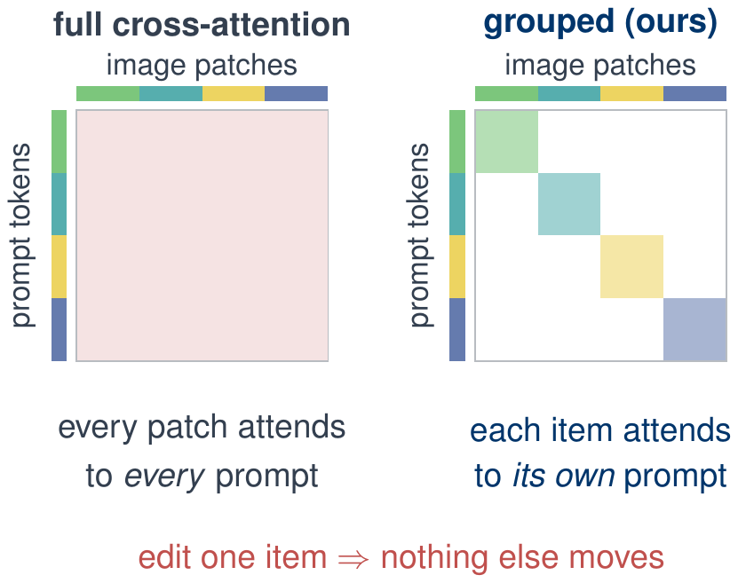
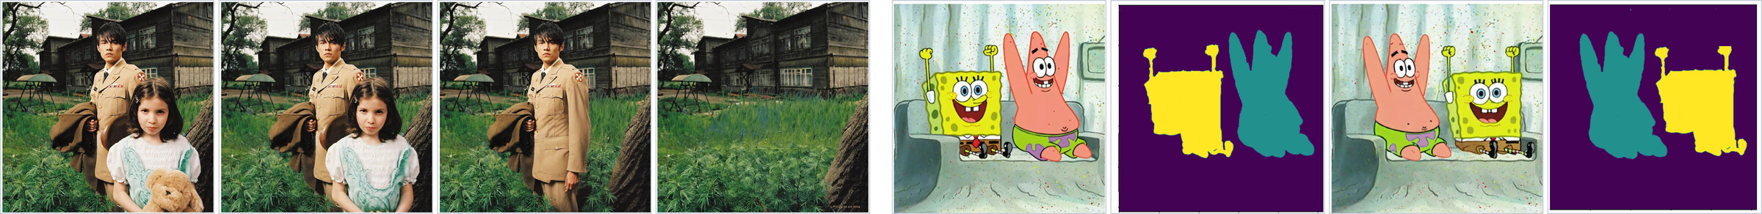
D-Edit ·Item-Disentangled Generation
AAAI 2025 · Aosong Feng, Weikang Qiu, Jinbin Bai, Zhen Dong, Kaicheng Zhou, Xiao Zhang, Rex Ying, Leandros Tassiulas
One prompt drives every pixel, so an edit meant for one object leaks into the whole image.
1
Item-disentangled generation
2
Item–prompt association
3
Grouped cross-attention
4
Item-level editing: text, image, mask, removal
remove items →
edit the mask, swap the items
Removal: quality 3.26 → 4.01, fidelity 2.42 → 4.44
15 annotators × 30 pairs, against SDXL-inpaint
Notes:
Four beats. (1) The formulation. A diffusion model conditions the whole latent on a single prompt, so the control is entangled: ask for a different cat and the sofa, the lighting and the background come along. D-Edit re-formulates generation at the item level -- segment the image once, and treat it as a set of (mask, prompt) pairs, one prompt per item. Everything else follows from that. (2) Item-prompt association. Each item gets two brand-new tokens inserted into the text-encoder vocabulary, initialised from a Gaussian matched to the existing embedding statistics -- deliberately random, not semantic, so they do not interfere with the existing vocabulary and we never have to caption the image. Those embedding rows are then optimised with the ordinary diffusion loss to reconstruct this one image; a second stage finetunes only the cross-attention layers, since that is the only place we disentangle. Contrast with Textual Inversion / Imagic, which need semantically initialised tokens, and DreamBooth, which needs rare tokens that are hard to find. (3) Grouped cross-attention. Association alone is not enough: in ordinary cross-attention every image patch attends to every prompt token, so a prompt still leaks everywhere. We keep only the block diagonal -- an item's patches attend to its own prompt and nothing else. That is what makes the edit local by construction rather than by tuning. (4) Editing is then just editing the item-prompt relation: change a prompt (text-based), swap in a prompt learned from a reference image (image-based), edit the mask itself (mask-based -- move, reshape, resize), or delete a mask-prompt pair (removal). Numbers on the slide: item removal, scored by a user study in which 15 annotators rated 30 image pairs from 1 to 5 -- D-Edit 4.01 on quality and 4.44 on fidelity, against SDXL-inpaint at 3.26 and 2.42. Quality is how well the region left behind harmonises with the scene, fidelity is whether the filling is reasonable. The strip shows the two operations that fall straight out of the formulation. Left: items deleted one at a time -- delete a (mask, prompt) pair and the freed region is re-partitioned to the neighbouring masks, which then imagine the filling from their own prompts. Right: the mask itself is edited -- swap the two masks and the two characters swap, because the association is to the mask, not to the pixels. Moving, reshaping and resizing all work the same way, and the paper claims D-Edit is the first framework to support mask-based editing at all. If asked for more: text-guided editing, LPIPS 0.401 for P2P with DDIM inversion versus 0.179 for D-Edit, a 55 percent cut, CLIP-T up 39.5 to 42.0; image-guided editing, LPIPS_t 0.465 for Paint-by-Example and 0.608 for AnyDoor versus 0.340, CLIP-I 66.4 versus 50.8 and 60.2. Built on Stable Diffusion v1.5 and SDXL. Connecting the prompt to brain signals is written up as future work, not claimed here.

Slide 33
Part 3: The Embodiment
From Representations to Interactions
Intent is represented · turning it into action hits the same obstacle: supervision
Supervision for action does not scale
Too heavy to close the loop in real time
And if the signal is a goal, not a trajectory
Cue-locked trials and hand annotation do not scale
A full vision-language pass every control step: too slow
A goal must be completed into behaviour, but rollout planning is too slow
Mind World Model ³
action intentions
a goal, not a trajectory
How we address them
Mind World Models
SD-VLA
PHIL
DySta ⁷
PHIL ⁸
label-free pretraining · scales mind and world together
static–dynamic disentanglement · long-horizon context · 2.26× faster
a learned cost-to-go for graph search
VLA control
the fast loop
a path to the goal
the slow loop
Notes:
Lead line in full: Parts 1 and 2 produce a semantic representation of what a person intends. Q1: no pretraining paradigm scales both sides together; labelled neural data is the bottleneck, and it is the one thing that cannot be collected at web scale. Q2: the machine has to complete a sparse target into full behaviour, and fast enough to stay inside the control loop. Q3: the latency rules out real-time neural control, makes RL training expensive, and leaves no headroom for urgent events.
/slide[47]/shape[@id=2] (title) "Part 3: The Embodiment\nFrom Representations to Interactions" [full sentences cut from the slide] Intent is represented · turning it into action hits the same obstacle: supervision Cue-locked trials and hand annotation do not scale A full vision-language pass every control step — too slow A goal must be completed into behaviour — rollout planning is too slow

Slide 34
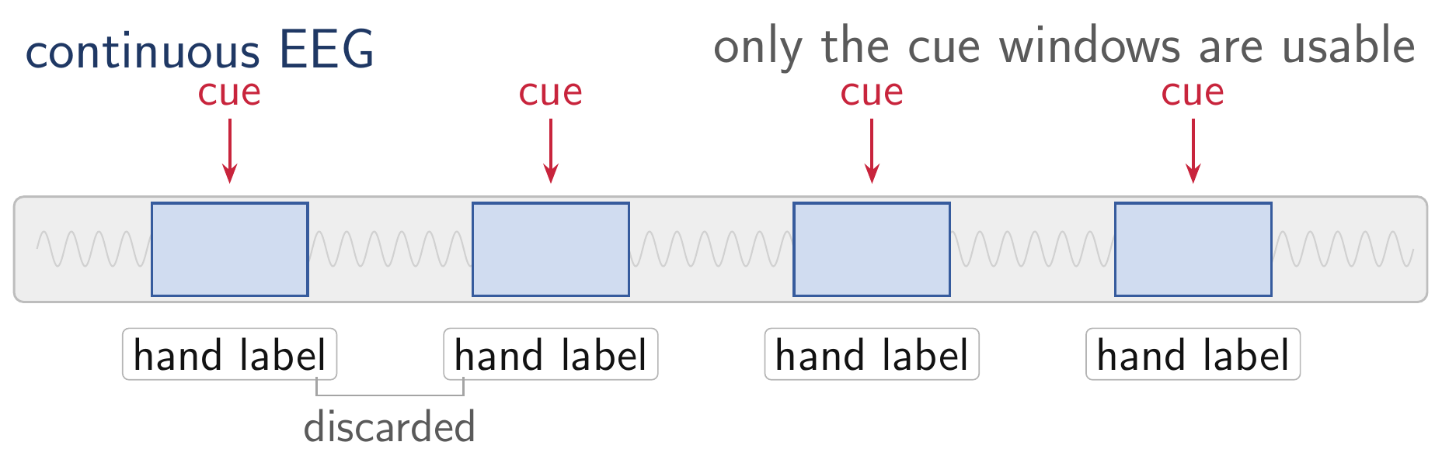
Mind World Models · Scaling the Mind Side
ongoing · Weikang Qiu, Zheng Huang, Tinglin Huang, Yujun Yan, Rex Ying
Compute-optimal scaling grows data with parameters (Hoffmann et al., 2022), so a method's ceiling is set by how much data it can consume.
Task: Train a foundation model for motor decoding
The mind side: trial by trial
Every usable example is a cue-locked trial with a hand label. Hours of recording yield minutes of data.
Requirement: a scalable data-collection paradigm
Data collection paradigm of motor imagery
Notes:
Scaling-law framing: Hoffmann et al. 2022 (Chinchilla) corrected Kaplan 2020 -- for compute-optimal training, model size and training tokens should scale roughly equally, which is what promoted data to the binding constraint. Caveat to have ready: there is no established scaling law for EEG or fMRI, so do not claim the exponents transfer. The claim on the slide is weaker and safer -- a data source whose cost is human hours has no scaling curve at all, which is a precondition argument, not an exponent argument. If asked about the Bitter Lesson: Part 1 builds in priors, which looks opposed. The defence is exact vs approximate -- frame averaging is an exact symmetry (like translation equivariance in a CNN, which Sutton's own winning example keeps), not a hand-crafted feature that caps the asymptote.

Slide 35
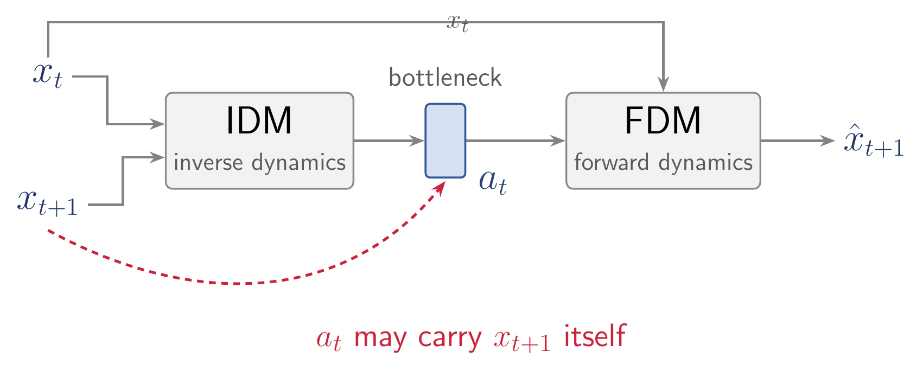
Mind World Models · Scaling the World Side
ongoing · Weikang Qiu, Zheng Huang, Tinglin Huang, Yujun Yan, Rex Ying
A world model normally needs action labels, and those come from teleoperation. The video that actually scales, in-the-wild footage from the internet, carries none.
The world side: action-free video at scale
LAWM (Garrido et al., 2026) makes such video usable by learning a latent action space from video alone. But its inverse dynamics model sees the next frame, so the bottleneck can carry the answer instead of an action.
Latent-action world model: the IDM already sees the next frame
Notes:
World-side note. The reason to care about latent actions is data, not elegance: a world model normally needs action labels, and those come from teleoperation or instrumented rigs, so the only corpus that scales is in-the-wild video, which has none. LAWM (Garrido, Nagarajan, Terver, Ballas, LeCun, Rabbat; arXiv:2601.05230, ICML 2026) is the reference point -- it learns a latent action space from video alone and is the first to push this to in-the-wild video rather than simulation, video games, or manipulation data, and it shows the latent action can serve as a universal interface for planning. The objection to have ready is the shortcut: their inverse dynamics model is conditioned on x_{t+1}, so nothing in the objective forces the bottleneck to encode an action rather than a compressed copy of the next frame -- a forward model that reconstructs well is then not evidence that the latent is an action. That is why the results slide reports delta-act, the drop in prediction quality when the action channel is ablated, and not next-frame error alone. Our version replaces the IDM with the EEG-driven mind model, which never sees x_{t+1}, so the shortcut is closed by construction rather than by a regulariser. If asked why not just regularise the bottleneck: a capacity limit bounds how much of x_{t+1} can leak, but it does not make what leaks an action.

Slide 36


Mind World Models · Actions from the Mind
ongoing · Weikang Qiu, Zheng Huang, Tinglin Huang, Yujun Yan, Rex Ying
EEG
Mind model
a_{t}
action
intention
No labels, so both sides scale
→
→
y_{t}
EEG + ego-view video · one unlabelled stream · no cue-locked trials, no annotation
↓
Ego-view x_{t}
Next frame x_{t+1}
World model
→
→
Why this fits motor control
EgoBrain · arXiv:2506.01353 · frames from a single episode
Only what changes the next frame counts
a_{t} = Mind(y_{t}) x_{t+1} = World(x_{t}, a_{t})
No label of its own: the only signal is next-frame prediction error
Evaluation
One stream trains both sides
Motor-imagery benchmarks, compared against EEG foundation models.
Notes:
World-model family deliberately left unspecified on the slide (per note: 先别写，后续再补). Fill in the architecture once it is fixed. The mind side is what is claimed here: a = Mind(y_t), x_t+1 = World(x_t, a), trained on unlabelled neural + ego-view streams, evaluated on motor imagery against EEG foundation models.
Cut from the slide in the typography pass (say these aloud):
• The mind model receives no label of its own. It is trained only through the world model's prediction error on the next egocentric observation.
• The EgoBrain dataset is neural recording paired with egocentric video; both models scale on the same unlabelled stream.
• The objective is action-conditioned, so the only thing the mind model can contribute is whatever changes the next observation. That rewards movement-related temporal dynamics and gives no credit to volume conduction or other stationary artefacts.
/slide[48]/shape[@id=2] (title) "Mind World Models · Actions from the Mind" [full sentences cut from the slide] Part 2: brain–text supervision, no new scan · now brain–action, with no labels EEG + ego-view video · one unlabelled stream · no cue-locked trials, no annotation Only what changes the next frame counts → movement dynamics, not volume conduction No label of its own — the only signal is next-frame prediction error

Slide 37
Mind World Models · Results
ongoing · Weikang Qiu, Zheng Huang, Tinglin Huang, Yujun Yan, Rex Ying
Next-frame prediction on held-out episodes, and motor-imagery transfer.
World model · next-frame prediction
Motor imagery · vs EEG encoders
vs LAWM and a random-init encoder, measured by prediction errors
seven benchmarks, measured by F1.
split · arm | L1 ↓ | cos ↑ | Δact ↑
within · ours | 0.50 | 0.88 | 7.9
within · LAWM | 0.65 | 0.85 | 2.1
within · random | 0.73 | 0.83 | 0.0
cross-subj · ours | 0.49 | 0.89 | 5.7
cross-subj · LAWM | 0.55 | 0.87 | 2.9
cross-subj · random | 0.72 | 0.84 | 0.0
dataset | CSBrain | CBraMod | Ours (WM)
pretraining EEG | >9,000 h | >9,000 h | 61 h
PhysioNet-MI | 59.90 | 61.99 | 63.30
FineMI | 18.58 | 19.72 | 20.00
Kaya5F | 38.03 | 39.04 | 41.89
Weibo2014 | 16.76 | 18.45 | 18.61
Forenzo2024 | 30.74 | 30.64 | 31.91
Jeong2020 | 15.44 | 15.32 | 16.01
Forenzo2024Reg | 21.33 | 19.77 | 22.07
Δact: diff by using a negative-sampled EEG segment
Best in every cell. both splits, all three metrics.
An action intention is decoded. Turning it into movement needs a VLA that is both accurate and fast.

Slide 38



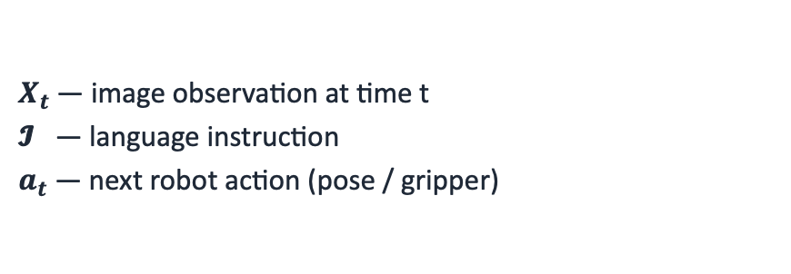
Preliminary · Vision-Language-Action Models
arXiv 2026 · Weikang Qiu*, Huashuo Lei*, Tinglin Huang, Aosong Feng, Rex Ying
VLA: VLM adapted for robotics. Replace the text output with robot actions.
Formulation
Typical VLA architecture
At each timestep t, the policy π observes images and a language instruction, and predicts the next action:
Image
Text Prompt
$$π\left(X_{t}, 𝓘\right) → a_{t},a_{t+1}, a_{t+2},⋯$$
LLM Backbone ($π_{LLM}$)
$X_{t}$· image observation at time t
𝓘 · language instruction
$a_{t}$· next robot action (pose / gripper)
Action head → $a_{t}$ (robot control)

Slide 39

Preliminary · The VLA Inference Loop
arXiv 2026 · Weikang Qiu*, Huashuo Lei*, Tinglin Huang, Aosong Feng, Rex Ying
VLAs are run in a closed-loop at every single timestep of the rollout.
Rollout pseudocode
instruction = "put the apple on the plate"
while not success:
image = camera_capture(env)
action = VLA(image, instruction)
env.step(action)

Slide 40
SD-VLA · Two Challenges in Today's VLAs
arXiv 2026 · Weikang Qiu*, Huashuo Lei*, Tinglin Huang, Aosong Feng, Rex Ying
State-of-the-art VLAs suffer from two intertwined problems:
Multi-frame Integration
Inefficient Inference
Context length budget is much tighter than in pure text LLM
Visual tokens are more expensive (e.g., 256 tokens for each image), so VLAs typically input only the current frame.
Consequence:
• Fails on tasks needing memory ("what was there before?")
• Can't reason over episodic history
The large-scale parameters of the VLM
Quadratic attention over hundreds of visual tokens
Pick a coke can (~100 steps in SimplerEnv)
Consequence:
• Cannot keep up with neural signals
• Expensive in RL training
• Unable to handle urgent tasks (e.g., fire, liquid spill)

Slide 41



Existing Works · Long-Horizon Memory
arXiv 2026 · Weikang Qiu*, Huashuo Lei*, Tinglin Huang, Aosong Feng, Rex Ying
Visual Traces Prompt
Compression-based
Leave to action head (diffusion)
Limited information capacity
Visual clutter / occlusion from traces
Do not leverage LLM’s reasoning ability
Lossy Compression

Slide 42
Existing Works · Accelerating VLAs
arXiv 2026 · Weikang Qiu*, Huashuo Lei*, Tinglin Huang, Aosong Feng, Rex Ying
Most prior speed-ups are generic compression techniques that ignore VLAs' structure.
Generic ML acceleration
VLA-specific temporal caching
• Quantization (Shukor et al., 2025; Park et al., 2024)
• Layer / token pruning (Yang et al., 2025; Zhang et al., 2025)
• Distillation / small backbones
→ Treat the VLA as a generic transformer.
→ Do NOT exploit the unique characteristics of VLAs
• TTF-VLA, VLA-Cache, FlashVLA
identify reusable patches via heuristics
Issues with prior work:
• Rely on hand-designed, non-learnable rules
• Assume pixel-space similarity = feature-space similarity (false in attention-based transformers)

Slide 43


SD-VLA · Most Visual Input Is Redundant
arXiv 2026 · Weikang Qiu*, Huashuo Lei*, Tinglin Huang, Aosong Feng, Rex Ying
Static Components: background, table, object appearances, etc.…
Dynamic Components: object positions & pose
We propose to disentangle these components to
static and dynamic tokens.

Slide 44

SD-VLA · At a Glance
arXiv 2026 · Weikang Qiu*, Huashuo Lei*, Tinglin Huang, Aosong Feng, Rex Ying
Efficient Inference:
By reusing KV cache of static tokens across timesteps.
Long-horizon temporal context:
By keeping only one copy of the static tokens.

Slide 45

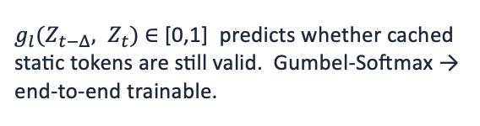
SD-VLA · Multi-Level Cache + Recache Gate
arXiv 2026 · Weikang Qiu*, Huashuo Lei*, Tinglin Huang, Aosong Feng, Rex Ying
Identical across timesteps
Key ideas
Cache KV of static tokens
Since static tokens come first, their KV cache is identical across timesteps, so reuse it directly in the LLM backbone.
Learned recache gate
$g_{l}(Z_{t−Δ}, Z_{t})$∈ [0,1] predicts whether cached static tokens are still valid. Gumbel-Softmax → end-to-end trainable.
Multi-level cache (L1 / L2)
L1 = highly persistent background; L2 = semi-static (e.g., drawer). If L1 is refreshed, L2 must be too.

Slide 46

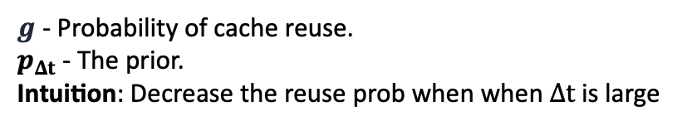



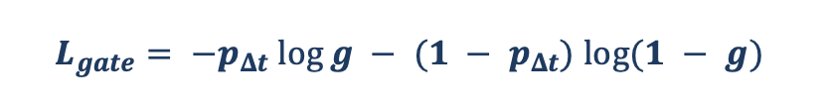
SD-VLA · Making Static Tokens Static
arXiv 2026 · Weikang Qiu*, Huashuo Lei*, Tinglin Huang, Aosong Feng, Rex Ying
Contrastive objective for static tokens
Recache gate regularizer
Encourages static tokens to be temporally persistent
Without it, the gate would trivially refresh the cache every step. A time-aware prior biases the gate toward reuse when observations are close in time.
Negative pairs
Static tokens from different trajectories: push them apart to preserve scene-specific content.
$$L_{gate}= −p_{Δt} log⁡g − (1 − p_{Δt}) log⁡(1 − g)$$
$g$ - Probability of cache reuse.
$p_{Δt}$ - The prior.
Intuition: Decrease the reuse prob when when $Δt$ is large
Positive pairs
Static tokens from different timesteps of the same trajectory: pull their representations together.
Full training objective
$$L = L_{Task} + Σ α_{l}L_{InfoNCE} + βL_{gate}$$
InfoNCE loss at level $l$ → $L_{InfoNCE}^{l}$
$α_{l}$and $β$ weight the auxiliary losses. $L_{Task}$is the standard VLA imitation loss.
Notes:
contrastive learning -- cache, more explanation and intuition
use figure to illustrate the static and dynamic

Slide 47
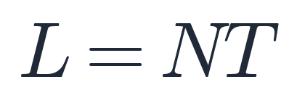
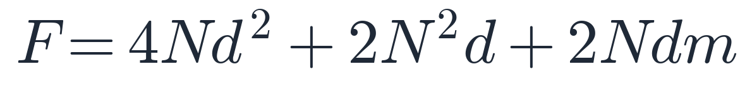
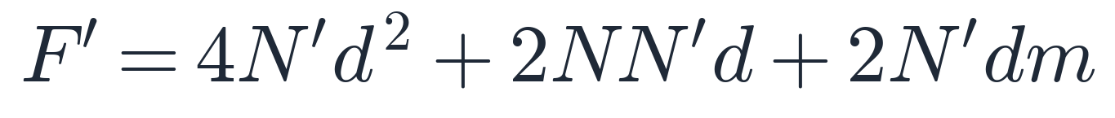
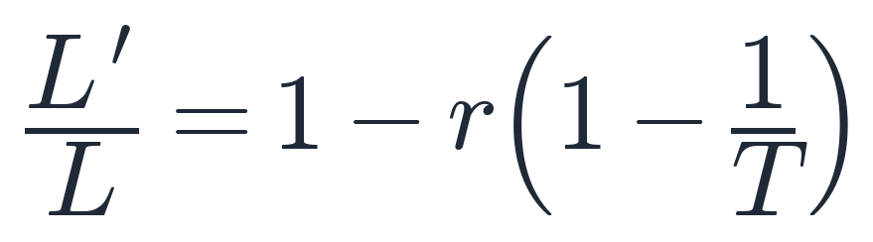
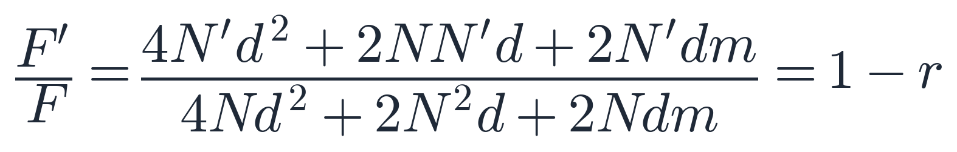
SD-VLA · Context Length and Acceleration
arXiv 2026 · Weikang Qiu*, Huashuo Lei*, Tinglin Huang, Aosong Feng, Rex Ying
Static-dynamic disentanglement reduces both the context length (by reusing one copy of static tokens across timesteps) and the per-step LLM FLOPs (by reusing the KV cache of static tokens).
Context Length Reduction
Acceleration Rate (LLM FLOPs)
Only one copy of static tokens is kept across T past observations.
Per-layer cost: QKV projection + self-attention + FFN.
Vanilla VLA (concatenate all past tokens):
Vanilla VLA (recompute every token):
SD-VLA (share one copy of static tokens):
SD-VLA (only N′ dynamic tokens through MHA / FFN):
Ratio (as T grows):
Ratio:
Context drops from NT to NT − rN(T − 1); with r = 0.9 and T = 20, that is a ~85% reduction.
LLM FLOPs scale linearly with the un-cached fraction (1 − r). Gate overhead ≈ 1.27%.
$N$: number of tokens; $T$: steps of past observations; $r$: cached fraction
$d, m$: hidden dim; $N^{′}=rN$

Slide 48

SD-VLA · Long-Horizon Temporal Reasoning
arXiv 2026 · Weikang Qiu*, Huashuo Lei*, Tinglin Huang, Aosong Feng, Rex Ying
37.4% ⬆️
6.4% ⬆️
29.7% ⬆️
Settings:
20 past observations
Interval = 20 frames (1 frame per second)
Static level: 1
Static ratio: 0.9

Slide 49


SD-VLA · Inference Acceleration
arXiv 2026 · Weikang Qiu*, Huashuo Lei*, Tinglin Huang, Aosong Feng, Rex Ying
Task success is preserved (often improved) while FLOPs and latency drop sharply.
Settings:
Static level: 2
Static ratio: 0.52, 0.42
SimplerEnv (base: CogACT)
SimplerEnv
2.26x speedup
+3.9% success
LIBERO
LIBERO (base: OpenVLA-OFT)
1.70x speedup
+0.7 % success
Real robot
2.21x speedup +10.6% success

Slide 50
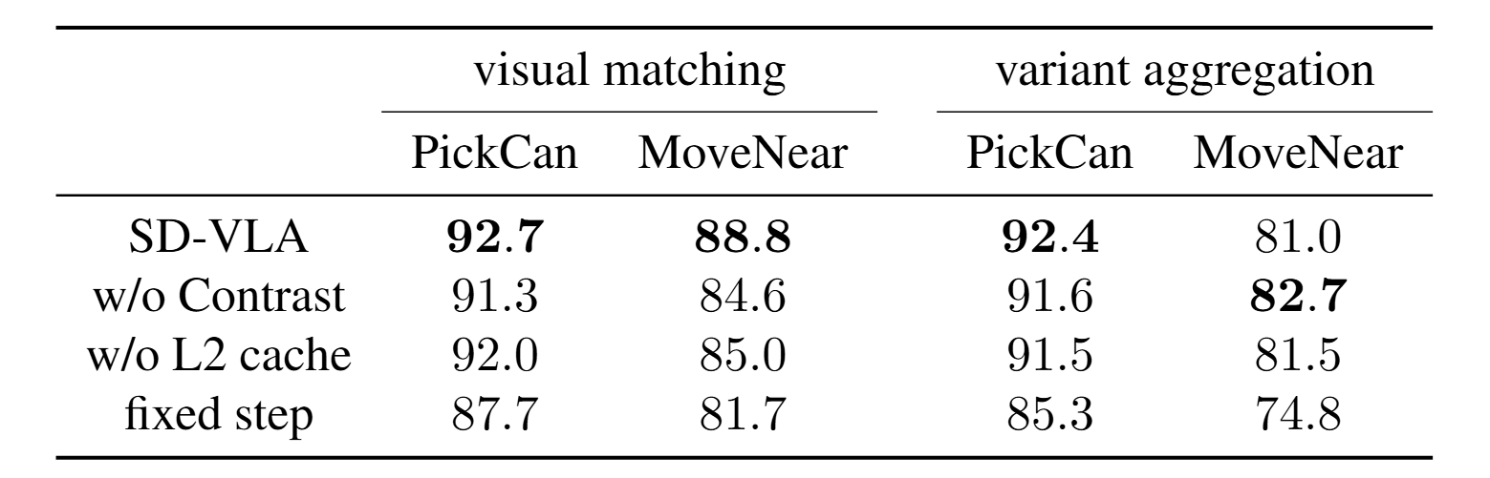
SD-VLA · Ablations
arXiv 2026 · Weikang Qiu*, Huashuo Lei*, Tinglin Huang, Aosong Feng, Rex Ying
Ablations on SimplerEnv (SR %)
w/o Contrast: remove the contrastive learning
w/o L2 cache: use single-level static cache
Fixed step: non-learnable recache gate, refresh at fixed intervals
Takeaways:
• Contrastive loss is needed to enforce temporal consistency of static tokens.
• Multi-level cache (L1+L2) captures both stable and semi-static content.
• A learned gate clearly beats any fixed-interval refresh.

Slide 51
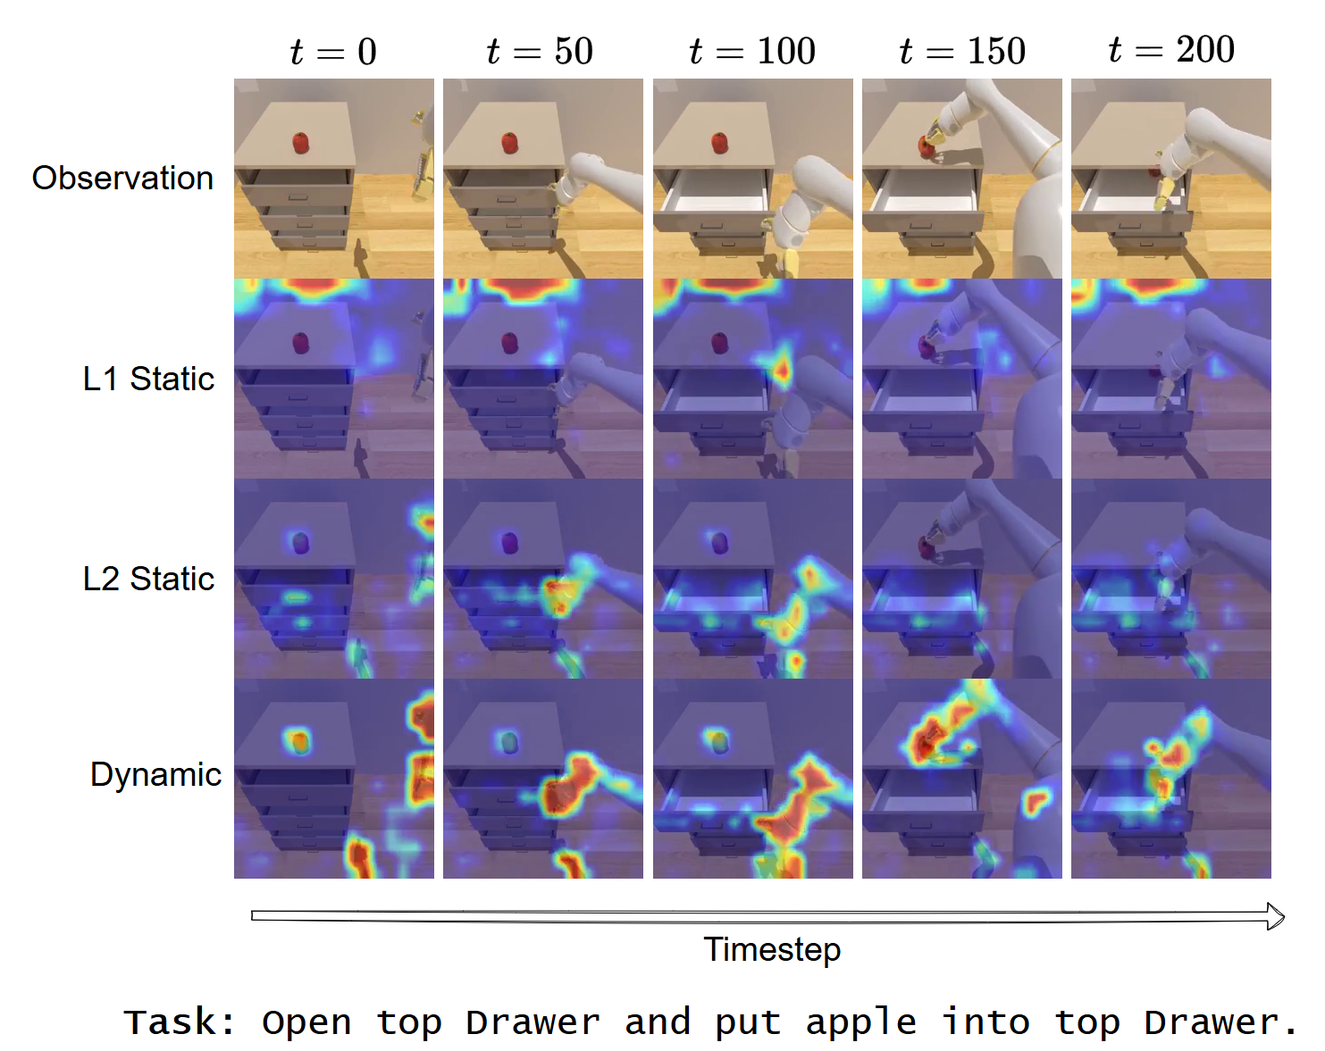
SD-VLA · Attention Maps across Time
arXiv 2026 · Weikang Qiu*, Huashuo Lei*, Tinglin Huang, Aosong Feng, Rex Ying
Attention maps across time
L1 static:
stable, global scene context.
Sink tokens on areas with no foreground objects.
L2 static:
semi-static (drawer)
Remain stationary in most time, refresh on state changes.
Dynamic:
the gripper and the object being manipulated.

Slide 52
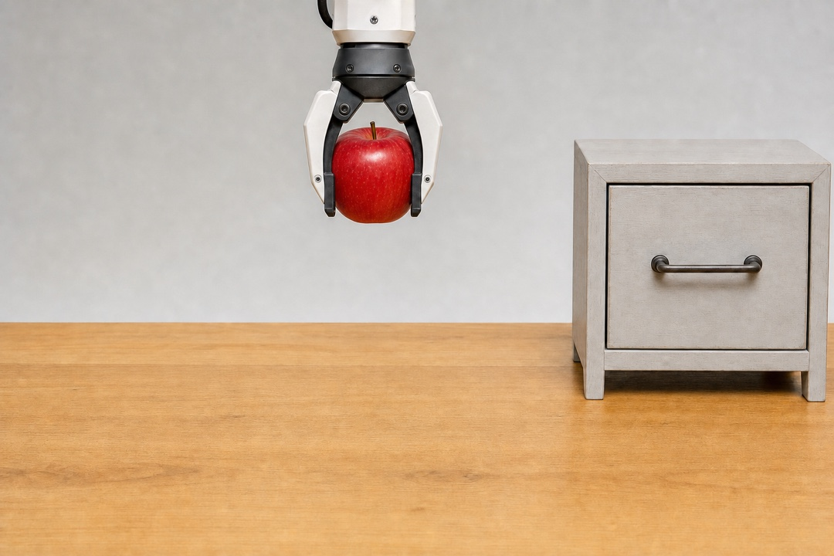

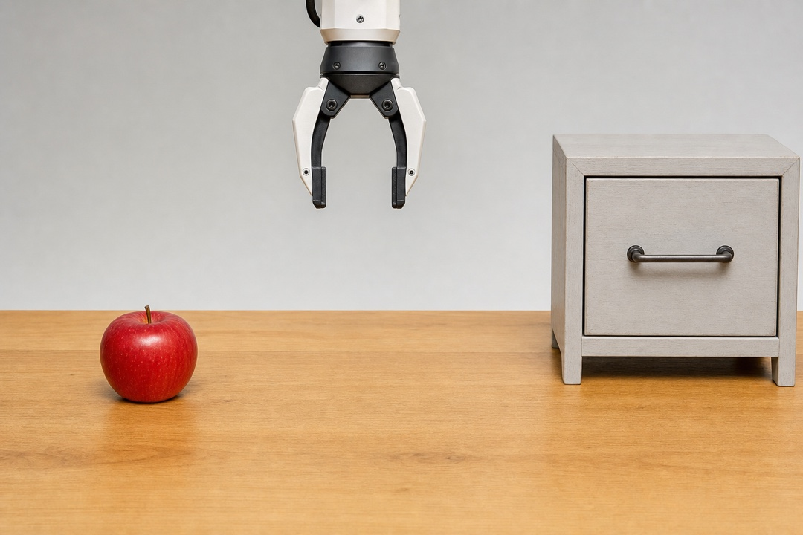
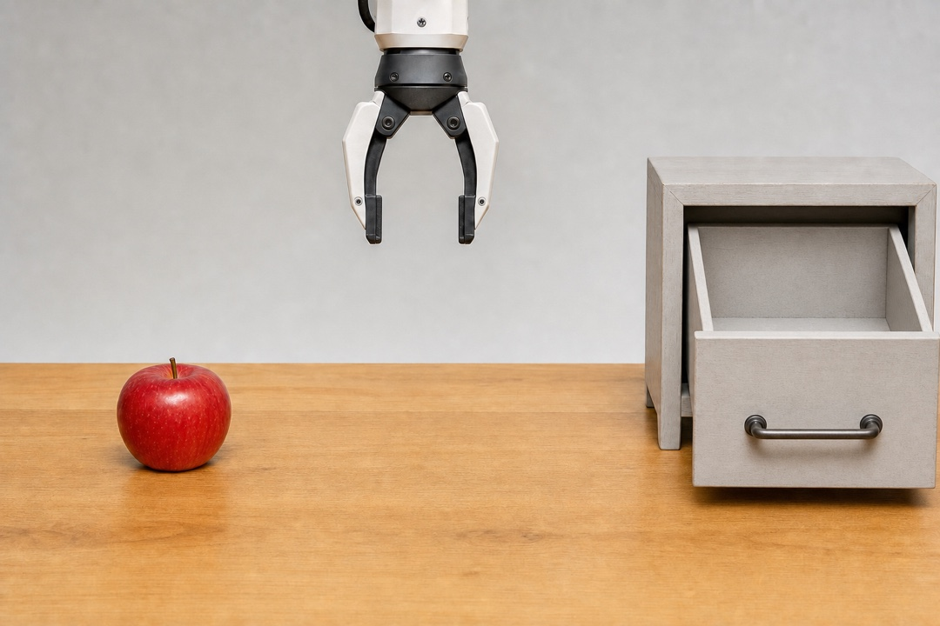
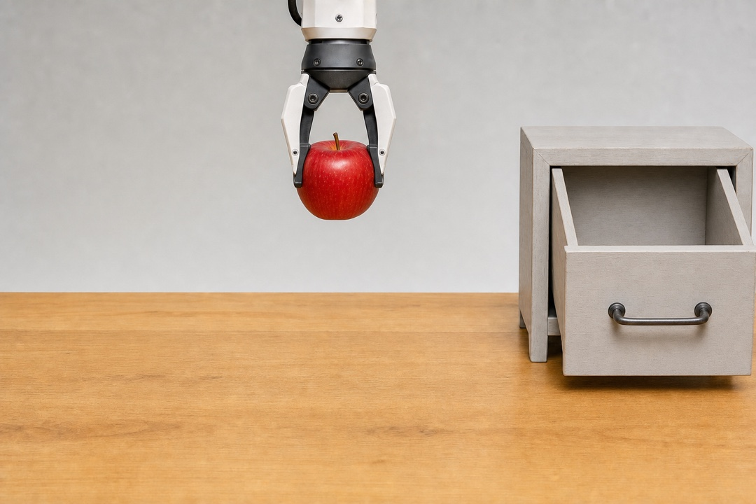

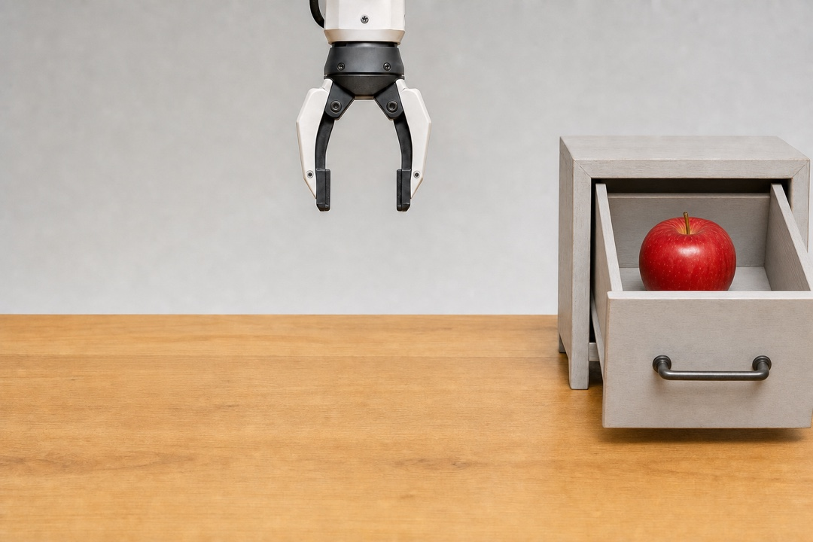
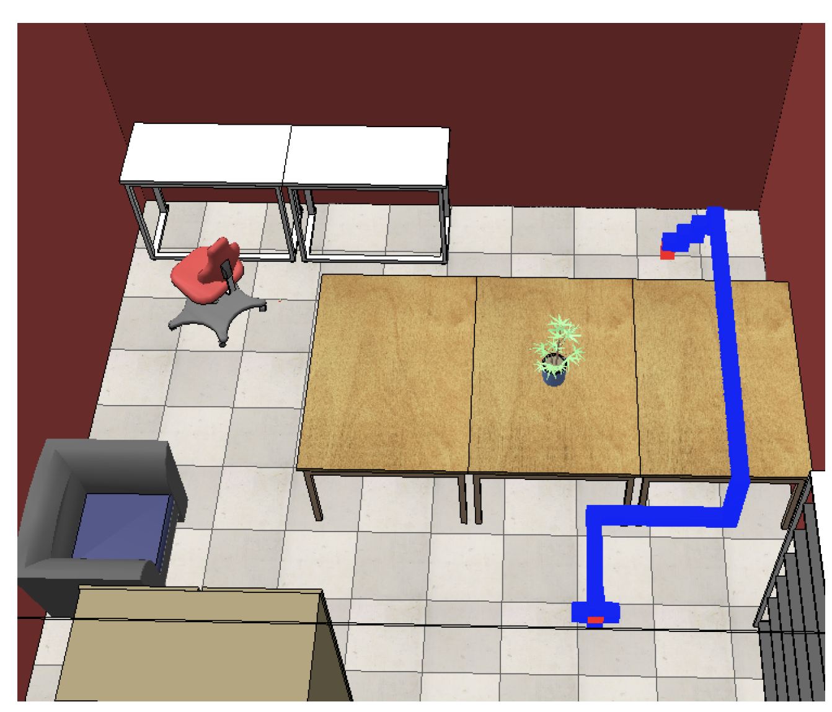
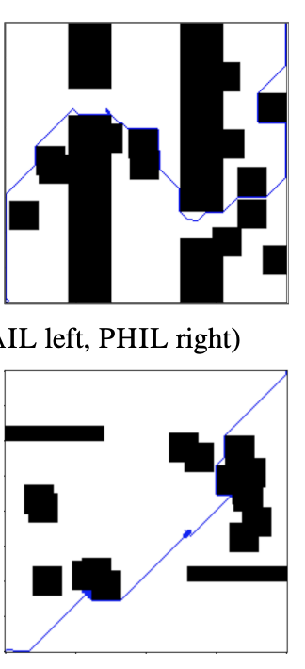
PHIL · A Goal Is a Node, a Plan Is a Path
LoG 2022 · Michal Pándy, Weikang Qiu, Gabriele Corso, Petar Veličković, Rex Ying, Jure Leskovec, Pietro Liò
The mind can name where to end up instead of what to do next
When the mind names a goal, not an action
Searching a world model’s state space
An action intention
Task: put the apple in the drawer — three subgoals
Nodes = latent states · edges = predicted transitions
VLA
(so far)
×
the drawer was never opened
now
next
Mind World Model decodes it · DySta executes it
A goal — where to end up, imagined
now
drawer open
apple grasped
over drawer
goal
?
PHIL itself · collision-free indoor flight on a 50 × 50 × 25 grid
now
goal
The end state is decoded; nothing in between is.
A goal is a node. Completing it into a path is a search — over the transitions a world model already predicts.
Notes:
Left half is the hand-off from the rest of Part 3, and it is a claim about where PHIL fits, not a result from the paper -- say so. Row A is what Part 3 has done so far: Mind World Model decodes a_t = Mind(y_t), one action per step, and DySta executes it. Row B is the case this chapter opens: the mind names only the end state, and nothing between now and there is decoded. The dim lattice is the point -- those states exist, none has been visited or scored. Slide 5 already labels the two branches 'action intentions' and 'a goal, not a trajectory'; use those words so the callback lands.
Right half is one task planned out: put the apple in the drawer. Chosen because the goal decomposes -- drawer open, apple grasped, apple over the drawer -- and because the subgoals are ORDERED. That ordering constraint is what makes it a search problem instead of a sequence.
Bottom row, green: the plan the search returns, five states, three subgoals labelled underneath. Top row, faded and dashed: the branch that grabbed the apple first and left the drawer shut. It was expanded twice and then dropped -- the x and the note say why. Point at the two rows and say the tell out loud: the whole top branch has a closed drawer. That is the ordering constraint made visible.
If asked how the branch was scored: that is exactly the cost-to-go, and it is the next slide. Scoring a node by rolling the world model forward is the expensive part; PHIL learns a heuristic that replaces the rollout.
Be honest about what is rendered: the frames stand for latent states the world model rolls forward. Only the start is really an observation; the rest are predictions drawn as pictures so the audience can read them.
Bottom-right images are PHIL's own final experiment, so it is not an analogy: collision-free indoor drone flight in CoppeliaSim, discretised into a 50 x 50 x 25 grid graph with five random 5 x 5 x 5 obstacles removed during training and testing (PHIL/004experiments.tex:176). Node features are the 3D grid coordinates; the metric is expanded nodes relative to the Euclidean heuristic.
Do not present PHIL as a stage between Mind World Model and DySta. It is the slow loop, a parallel branch, and the talk ends on it.

Slide 53
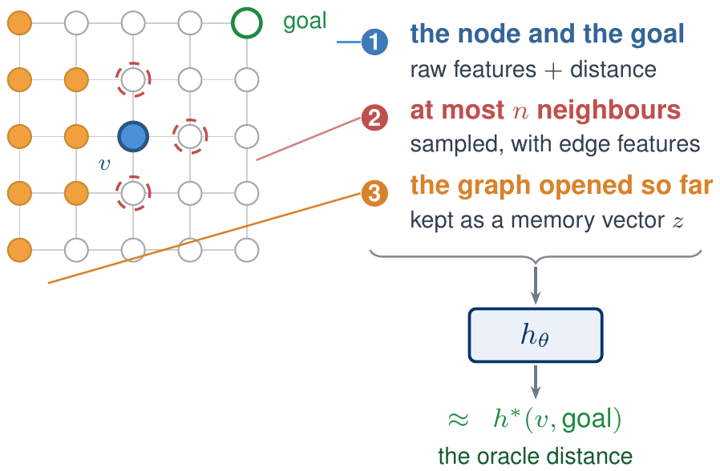

PHIL · Learning the Search Heuristic
LoG 2022 · Michal Pándy, Weikang Qiu, Gabriele Corso, Petar Veličković, Rex Ying, Jure Leskovec, Pietro Liò
Search cost is expansions, not path length; a perfect heuristic expands only the shortest path.
1
BFS with heuristics
2
Learn h to match the oracle
no heuristic · BFS
ordered by heuristics
19 expansions, still not there
6 expansions
start
goal
CLOSE
OPEN
$$f(v) = g(v) + h(v, \text{goal})$$
g = cost so far · h = what is left
Search is not i.i.d.
No hand-designed features
h must not slow the search
Train on our own roll-outs, not a fixed dataset; 40× worse otherwise.
Prior imitation learning needs them; PHIL takes raw node + edge features.
An h that scales with the graph breaks it: bounded neighbourhood, O(1).
Notes:
PHIL is the slow loop and a side branch -- keep it short. The setup from the previous slide: if the brain names a goal rather than a step-by-step action, something has to turn that goal into a path, and rollout planning is too expensive to close the loop. Left: what a heuristic buys. In A* the unit of cost is expansions, not path length. Order the frontier by f(v) = g(v) + h(v, goal), where g is the cost already paid and h is a guess at what is left. With no heuristic, breadth-first opens 19 nodes and still has not arrived; ordered by a good h it opens 6 and is done. In the limit a perfect h expands only the nodes on the shortest path -- which is precisely the target worth learning. Right: so learn it. The regression target is h*(v, goal), the oracle's true distance, and h_theta is trained to match it. What the model is allowed to look at: the node and the goal with their raw features plus Euclidean or cosine distance; a bounded sample of neighbours with edge features, at most n of them; and a memory vector z summarising the part of the graph opened so far, since the graph is only partly observed. Three constraints made this hard. Search is not i.i.d.: the states the heuristic sees depend on the heuristic itself, so we train on our own roll-outs rather than a fixed dataset -- training on a fixed dataset is about 40 times worse. Prior imitation-learning heuristics need hand-designed features; PHIL takes raw node and edge features. And the heuristic must not slow the search down: an h whose cost grows with the graph destroys the saving, hence the bounded neighbourhood and O(1) evaluation. Connecting this to a neural goal signal is future work, not claimed here.

Slide 54




Future: AI for BCI
Multi-Modal Brain Foundation Models
Today's objective: mask patches, then reconstruct them.
Capacity goes to reconstructing noise, and in-filling one window is never a rollout.
A BRAIN WORLD MODEL: ENCODE ANY MODALITY, ROLL THE LATENT FORWARD
fUS
fUS
imagined: no observation from here on
fMRI
encode
z_{t}
z_{t+1}
z_{t+2}
z_{t+3}
decode
fMRI
⋯
EEG
EEG
observed
MEG
decode
a
a
a
encode
MEG
stimulus now · stimulation later
⋯
⋯
A foundation model
A brain simulator
One latent behind every modality: encode from any, decode into any, and share it across subjects.
Roll forward with no input, or under a stimulation we choose: the counterfactual a controller needs.
BrainLM · LaBraM · Brain-OF (masked) · Brain-JEPA (masked latent) · NeuroWorld (fMRI rollout)
Notes:
The claim here is about the pretraining objective, not the architecture.
WHAT IS ACTUALLY DONE TODAY. BrainLM (ICLR 2024) is a masked autoencoder over fMRI parcel time series — mask spatiotemporal patches, reconstruct them. LaBraM (ICLR 2024) trains a vector-quantised neural tokenizer and then predicts the codes of masked EEG channel patches. Brain-OF (2026) is the first model to pretrain jointly on fMRI, EEG and MEG, and its objective is masked reconstruction in both the time and the frequency domain. So the multi-modal case is already occupied, and it is still mask-and-reconstruct.
THE TWO CRITICISMS, AND THEIR SOURCES. First, reconstruction is a bad fit for low-SNR signals: Brain-JEPA's stated motivation is that direct reconstruction is not suitable for data that is noisy and low in information density, and NeuroWorld puts it as reconstruction spending latent capacity on measurement fluctuations and weakly predictable components. Second — and this is the part that is mine — the objective is in-filling. Brain-JEPA does move the target into latent space and its Cross-Time mask does forecast a later block from an observation block, so do not claim that nobody predicts forward. What none of them do is roll the state forward autoregressively, and none of them condition on anything. One shot inside one window, unconditioned, is not a world model.
WHAT THE FIGURE PROPOSES. Per-modality encoders and decoders on a shared latent, so any modality can go in and any modality can come out. One observation at t; after that the latent is rolled forward by the dynamics with no observation at all, which is why the box is dashed. Each transition takes an action token: during training that is the stimulus the subject is receiving, and at deployment it becomes the stimulation we apply.
WHAT IS ALREADY TAKEN, AND SAY IT BEFORE THEY DO. NeuroWorld (arXiv, August 2026) is the first brain world model: two stages, next-latent prediction with no fMRI reconstruction, then autoregressive latent rollout decoded back to whole-brain responses, conditioned on movie stimuli. It works, which is the point — the direction is not speculative. What it does not do: it is fMRI only, ROI-level, movie stimuli only, with subject-specific output heads, and its conditioning is sensory input rather than an intervention. Multi-modality, subject-agnostic decoding and intervention conditioning are the gaps, and its own future-work section names extension to other modalities.
WHY THESE MODALITIES. They differ by orders of magnitude in resolution, which is the hard part and also the reason a shared latent is worth something: fUS reaches roughly 100 microns and 100 milliseconds with about a 7 cm field of view and has already been used for closed-loop decoding at Caltech, EEG has milliseconds and centimetres, fMRI has millimetres and seconds. Cheap, deployable modalities and high-resolution ones would train the same representation.
THE SECOND CARD IS THE HANDOFF. A model that can roll forward without observation and be conditioned on an intervention is exactly the imagination model the next slide's Dreamer loop trains its policy inside. Without it, closed-loop neuromodulation has to learn on the subject in real time.
HONEST FRAMING IF PUSHED. Supervising cross-modal decoding needs simultaneous recordings, and those are scarce — simultaneous EEG-fMRI exists but is small, and MEG cannot be recorded simultaneously with fMRI at all. The fallback is per-modality encoders and decoders against one shared dynamics, using the paired data only for alignment.

Slide 55
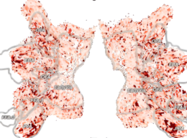
Future: AI for BCI
Dreamer over Brain Frames
Closed-loop focused ultrasound
for chronic pain
r reward
r = decoded
pain state
r reward
v value
v value
z latent state
h recurrent
h
h
⋯
h
h
⋯
a
π policy
π policy
x brain frame
tFUS
(a) world model learning
(b) actor–critic learning
Also: depression · anxiety · addiction · stroke rehabilitation · motor control
v and π decoded from the brain
Notes:
DreamerV3's Figure 3, redrawn with brain frames instead of game frames. The algorithm is unchanged.
Panel (a), world model learning:
sequence model h_t = f(h_{t-1}, z_{t-1}, a_{t-1})
encoder z_t ~ q(z_t | h_t, x_t)
reward predictor r_t ~ p(r_t | h_t, z_t)
Three things from the original are deliberately gone. The continue predictor -- it exists because Atari and DMC have episodes; a neuromodulation loop is continuous, so the flag would be identically one. The reconstruction branch -- it shapes representations by pixel reconstruction, which is not where the signal is here. And the prior / KL pair, cut to keep the slide readable; the prior is what lets the model roll forward with no observation, which is what makes panel (b) possible, so say that aloud if asked.
The point about the observation: it is a brain frame in every application. This is a brain-computer interface, so the thing the world model observes is always the brain -- what changes between applications is only the action space and the reward. Pain relief, anxiety relief and dream steering all share the same action: a stimulation command. Dream steering is not image generation -- the subject is asleep and cannot see a screen -- it is sensory cueing or direct stimulation during sleep. Motor decoding is the one variant where the action points outward at an effector instead of inward at the brain; the loop is longer, but the observed variable is still the brain.
On the action itself, which is what people will ask about: where to focus, how hard, pulse repetition frequency, duty cycle, and when to fire relative to the ongoing rhythm. With a phased array that is a spatiotemporal pattern over the whole brain, not a single target -- which is exactly why it cannot be hand-tuned and needs a policy.
On the reward: for anxiety or chronic pain there is no objective, continuous, immediate measure of "is this working" -- scales are weekly and subjective -- which is why r has to be decoded from the neural signal rather than read off an instrument, with the sparse clinical scale used only as a weak-supervision anchor.
On V, if challenged: V is not a separate design choice. Given r, the dynamics and the policy, V = E[sum of discounted r] is determined, and it is fit by TD. Only a and r get specified per application. Decoding V from the brain is worth doing for a different reason -- sample efficiency. Reward here is sparse and episodes cannot be reset, so fitting V from r alone needs rollouts we cannot afford; the cortex has already integrated the future into its valuation of the current state, so reading it gives a bootstrap for free. It is an auxiliary regression target alongside the TD target, not a replacement for r. A useful side effect: if the decoded V and the TD-fit V disagree systematically, that is evidence the reward proxy is misspecified.
The "field not a point" argument attaches to the reward function, not to V: r(s) assigns a value to every state, so a handful of bits can specify a landscape rather than a target coordinate, and the model works out the trajectory through it. That is how a low-bandwidth neural channel still specifies rich behaviour.
Why also decode pi: the motor side (motor imagery, mu/beta desynchronisation) is fast but rigid, while the evaluative side (feedback-related negativity, error-related potentials, frontal theta) is slower but transferable across tasks. And if both heads read one bottleneck they must stay consistent -- pi roughly greedy with respect to V under the model -- which is a training signal that needs no labels and so can also run at test time against session drift.
Honest framing: this is not reading the brain's own value function. It is inverse RL -- infer a reward from neural response over a state space we chose, then validate behaviourally.
Step one, training the brain world model itself, is separate work. This slide assumes it.
WHY THIS SLIDE MATTERS FOR AN ULTRASOUND-BCI COMPANY. Panel (a) is literally their loop. The observation is fUS -- ultrafast ultrasound imaging of microvascular blood flow, which is the read side of a phased-array ultrasound BCI. The action is the tFUS stimulation itself: which focus, what intensity, pulse repetition frequency, duty cycle, and when to fire relative to the ongoing rhythm. With a phased array that is a spatiotemporal pattern over the whole brain rather than one target, and that is exactly why it cannot be hand-tuned and needs a learned policy. Chronic pain is the first indication for both Gestala and BCI-Sonics, which is why it is the headline on the figure.
THE REWARD ARGUMENT IS THE SHARPEST POINT. Reported efficacy is a pain scale dropping about 50% and holding for one to two weeks. That is a sparse, subjective, slowly sampled measurement -- fine as a trial endpoint, useless as a per-step reward. A closed loop needs r at the rate the stimulation is adjusted, so r has to be decoded from the neural signal, with the clinical scale used only as a weak-supervision anchor. That is the r tag.
WHY THE WORLD MODEL AND NOT JUST A CONTROLLER. Episodes cannot be reset and stimulation parameters cannot be explored freely on a patient. Learning the policy inside a learned model of the brain's response is what makes that search affordable -- which is the previous slide, so the two slides are one argument.

Slide 56
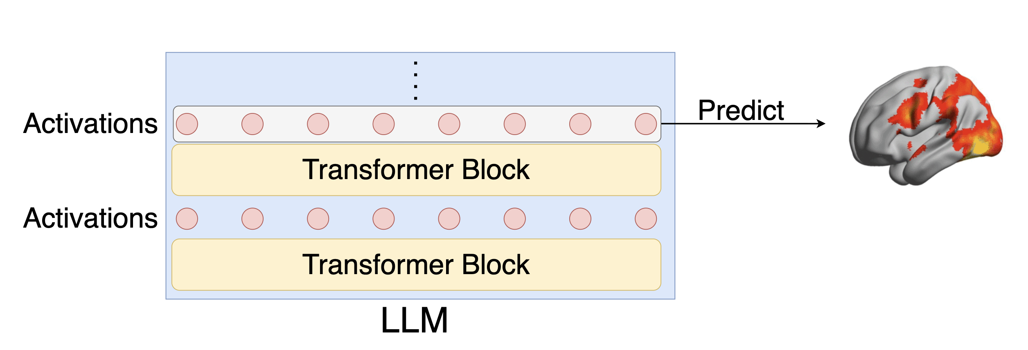
Future: BCI for AI
Brain Grounding for AIs
[1] shows instruction-tuning improves alignment between LLM and brain signals
Q: Improve human preference alignment by improving brain-alignment?
[1] Aw, Khai Loong, et al. "Instruction-tuning aligns LLM to the human brain." arXiv preprint arXiv:2312.00575 (2023).

Slide 57
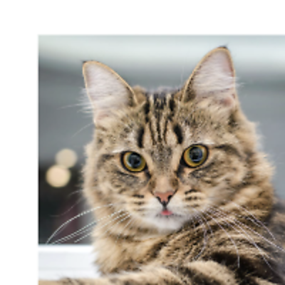



Future: BCI for AI
Geometric Grounding for AIs
Learn the neuron’s activation
Learn the neuron’s spatial information
jointly learn weights
and positions of neurons
Rasterize
(differentiable)
3D CNN /
Transformer
downstream tasks on the stimulus
(e.g. image classification)
“cat”
fMRI
EEG
fUS
MEG
fNIRS · ECoG · ⋯

Slide 58
Q&A
Thanks!
Notes:
More transition slides
connections between slides
minor suggestions:
1. presentation style, right volume, right eye contact, the way you speak/interact
less is more
2. be less philosophy, be more practical
3. existing work is important
4. brain signal is a central role
5. preliminary for all slides, not one work

