Slide 1

Machine Learning Models that Bridge Mind and World
Weikang Qiu
Advisor: Rex Ying
2026/09/23
Notes:
Thank you all for being here. Today, I'll present my dissertation, Machine Learning Models that Bridge Mind and World.
The main question is simple. How can we connect what happens in the brain with what we perceive and do in the world? I'll explore this through brain modeling, neural decoding, and embodied intelligence.

Slide 2






Language as the "Communication" Modality
Text-to-X
  Text-to-image generation
  Text-to-Speech generation
  Text-to-video generation
  …
X-to-text
  Vision large language model
  ….
Voice Assistant
  Siri
  Alexa
  …
Language is considered the communication modality between machines and humans
However, is this the most efficient/effective way??
Latent diffusion for image generation
Video generation
OneLLM, a multimodal LLM that handles 8 modalities

Slide 3

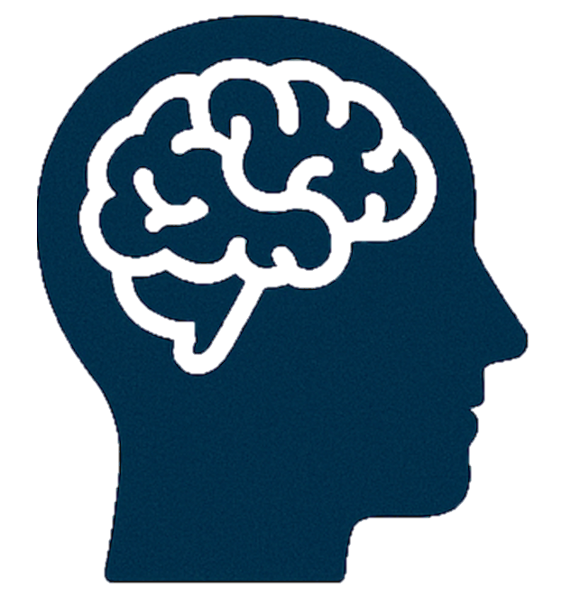




Gaps between Mind and World: Human $→$ Machine
1️⃣ bandwidth: Thinking >> Speaking
2️⃣ Not everything can be spoken
Speaking
100-150 words/min
Thinking
400-800 words/min
Thinking is much faster than speaking (Hargie, 2011)
Whereof one cannot speak, thereof one must be silent.
There is indeed the inexpressible. This shows itself.
Composition VII, 1913 - Wassily Kandinsky
Long prompt required for image generation
Ludwig Wittgenstein (1889-1951)
Notes:
There are two gaps on the human-to-machine side. First, putting an idea into words takes time. We may already know what a scene should look like, or what movement we want to make. But we still have to describe it one detail at a time.
The long image-generation prompt here is one example. Second, some parts of an experience are hard to describe at all. Think about the feeling or composition of an abstract painting. Even a long prompt may miss something.
This motivates another source of information: brain signals. Could they help us capture more of what a person perceives or intends?

Slide 4


Gaps between Mind and World: Machine $→$ Human
RepQA: Evaluating Readability of Large Language Models in Patient Education Question Answering · KDD HealthDay 2025 (Best Paper)
Weikang Qiu*, Tinglin Huang*, Ryan Rullo, Giselle OConnor, Yuchen Kuang, Ali Maatouk, S. Raquel Ramos, Rex Ying
GRPO/DAPO reward
= accuracy + readability
Direct communication between Mind and World
One point = one strategy on one model · every run paid for readability in content
Readability is bought with informativeness
Notes:
There is also a gap in the other direction, when a model gives information to a person. In RepQA, we measure how easy an answer is to read and how much information it contains under different strategies. Each point here represents one strategy on one model.
Moving right means the answer is easier to read. Falling below the horizontal line means it has lost information. In these results, better readability often comes with less information. Even reinforcement learning that rewards both accuracy and readability does not remove this trade-off.
Together, these two gaps motivate our goal: a more direct connection between the mind and the world.

Slide 5
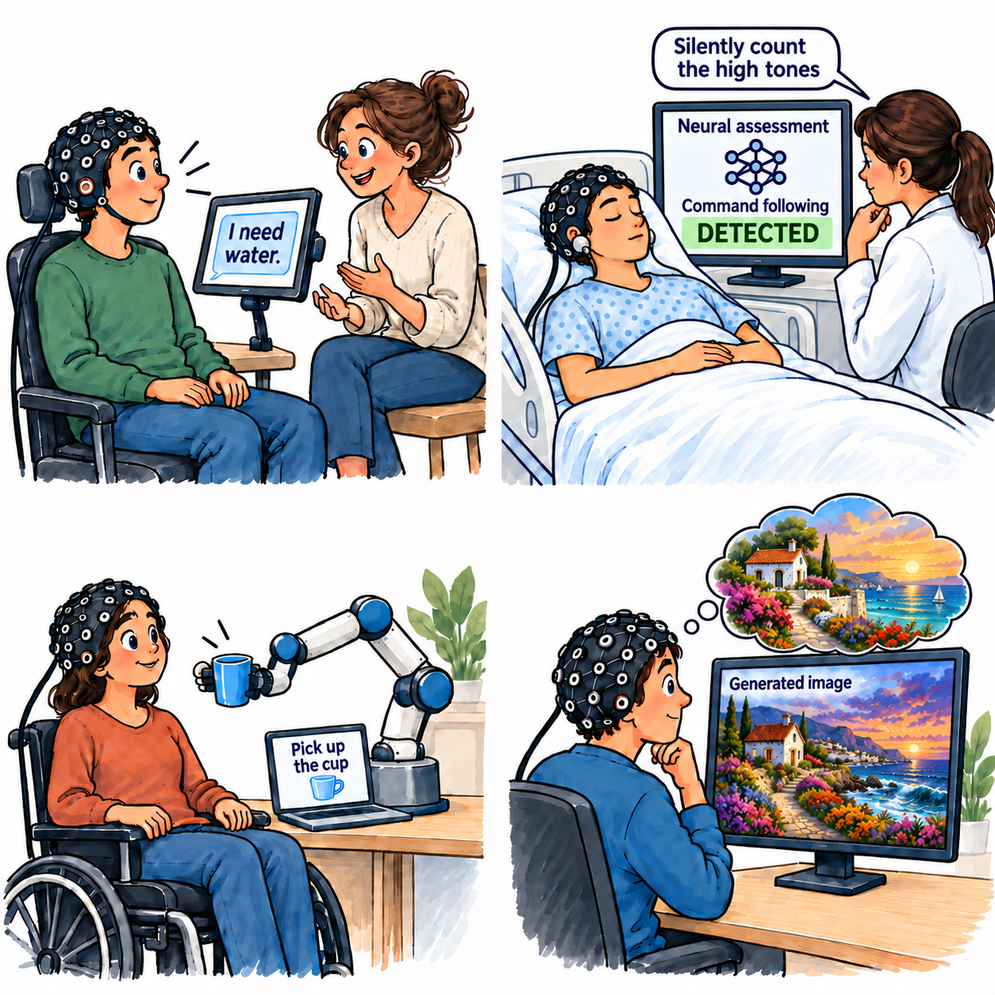
Practical Impact
Restore
communication
Regain
independence
“I need water.”
“Pick up the cup.”
Express needs without
speaking
Control a robot or
neuroprosthetics
Support clinical
assessment
Support visual
creation
Followed instructions
Imagine a vivid scene
Despite no visible
response
Turn visual ideas
into new images
Notes:
Realizing this goal will enable a range of practical applications. First, someone who cannot speak could say, “I need water,” through a neural interface.
Second, a person can use an assistive robot to bring a cup and help with daily tasks through thought.
Third, consider a patient who shows no visible response. The doctor asks them to count only the high-pitched beeps, in their head. A model checks for brain activity linked to that task, and provides evidence that the patient followed the instruction. This gives the doctor another way to assess awareness.
Finally, a person could imagine a vivid scene and turn that idea into an image, without the need for complex drawing techniques or laborious processes.
[References - not spoken]
Speech communication: Littlejohn et al., A streaming brain-to-voice neuroprosthesis to restore naturalistic communication, Nature Neuroscience, 2025. https://www.nature.com/articles/s41593-025-01905-6
Clinical assessment sources: Lulé et al., Probing command following in patients with disorders of consciousness using a brain-computer interface, Clinical Neurophysiology, 2013. https://doi.org/10.1016/j.clinph.2012.04.030 . Chennu et al., Dissociable endogenous and exogenous attention in disorders of consciousness, NeuroImage: Clinical, 2013. https://pmc.ncbi.nlm.nih.gov/articles/PMC3830059/ . These studies investigate active auditory attention and covert command following; their paradigms include instructed target-word selection/counting. Nonverbal tone-counting task context: The effect of neural pre-stimulus oscillations on post-stimulus auditory ERPs in disorders of consciousness, Frontiers in Neuroscience, 2025. https://www.frontiersin.org/journals/neuroscience/articles/10.3389/fnins.2025.1547167/full . This task context does not by itself validate a diagnostic classifier. This conceptual example illustrates nonmotor command following through an active auditory attention task. The displayed positive result is illustrative, not measured patient data or a result from this dissertation. Establishing covert command following requires appropriate controls and reproducible task-dependent evidence; an absent result does not establish absence of awareness.
Assistive control: Hochberg et al., Reach and grasp by people with tetraplegia using a neurally controlled robotic arm, Nature, 2012. https://www.nature.com/articles/nature11076
Visual creation: PRISM validates reconstruction of viewed visual stimuli. Generating imagined scenes is an application direction, not a demonstrated PRISM result. The thought bubble schematically represents a vivid imagined scene. The illustration depicts generation of an entire new image rather than cursor control or moving selected objects.
Visuals: conceptual illustrations of applications, not experimental images or additional measured results. Recording caps schematically represent neural recording, not a claim that every depicted capability has been validated with EEG.

Slide 6










Overall
PART 1 The Foundation
PART 2 The Bridge
PART 3 The Embodiment
Models for Brain Signals
From Signals to Representations
From Representations to Interactions
HyBRiD [1]
PRISM I [5]
MWM [3]
Action level
Learn and use neural structure
Choose the alignment space
EEG grounded in
action consequences
Predict
cognition
MindLLM [2]
Brain signals
Learned structure
Informative · nonredundant
fMRI → language
Specify the outcome
signals →
semantics
Semantics
→ actions
Goal level · desired outcomes
If structure is already known
Known structure
→ EEG encoding
PHIL [8]
DySta [7]
LAT [3]
PRISM II [5]
Goal image
Language
instruction
Preserve visual structure
Beyond brain signals?
SWA [4]
Brain principles
→ LLMs
D-Edit [6]
Search
efficiency + memory
Control objects independently
[1] Qiu et al. Learning High-Order Relationships of Brain Regions. ICML 2024. [2] Qiu et al. MindLLM: A Subject-Agnostic and Versatile Model for fMRI-to-Text Decoding. ICML 2025.
[3] Qiu et al. Mind World Models: Joint Learning of Motor EEG Representations and Action-Conditioned World Dynamics. [4] Huang et al. What Makes Language Models Intelligent? Small-World Structure in Attention Head Networks.
[5] Huang et al. Seeing Through the Brain: New Insights from Decoding Visual Stimuli with fMRI. ICLR 2026 (Oral). [6] Feng et al. An Item Is Worth a Prompt: Versatile Image Editing with Disentangled Control. AAAI 2025.
[7] Qiu et al. Static-Dynamic Disentanglement for Efficient Multi-Frame Vision-Language-Action Models. [8] Pándy et al. Learning Graph Search Heuristics. LoG 2022.
Notes:
The dissertation has three parts. In the first two, I will focus on one main work in each part. These are HyBRiD and MindLLM, both first-author works. The larger boxes mark that focus.
Part 1 asks how neural structure can improve prediction. HyBRiD learns useful groups of brain regions and uses their weights to predict cognitive outcomes. LAT asks how to build a known neural principle into the model. SWA asks whether brain-inspired principles can also help language models.
Part 2 asks how brain signals connect to meaning. MindLLM learns an fMRI-to-language decoder that works across subjects and tasks. PRISM helps motivate the representation we use and explores visual recovery. D-Edit addresses the need to keep objects separate during generation.
Part 3 turns to interaction. MWM connects motor EEG representations to the consequences of actions. We then move to specifying goals. PHIL plans toward a target state, illustrated here by a goal image. DySta uses a language instruction. These works address successive questions about connecting brain signals, meaningful representations, and behavior.
[References - not spoken]
Image source: Human-brain.SVG, Hugh Guiney (based on James.mcd.nz), https://commons.wikimedia.org/wiki/File:Human-brain.SVG . CC BY-SA 3.0: https://creativecommons.org/licenses/by-sa/3.0/ . Colors changed to gray-blue; original geometry retained. Adapted illustration also licensed CC BY-SA 3.0.

Slide 7



Preliminary: Brain Signals
Various neural recording techniques
Capture
  Different noise levels (from scalp to in-brain)
  Different spatial and temporal resolutions
Data Formats
  Multi-channel time series
  Volumetric time series (shown later)
PET
Structural MRI
Functional MRI

Slide 8
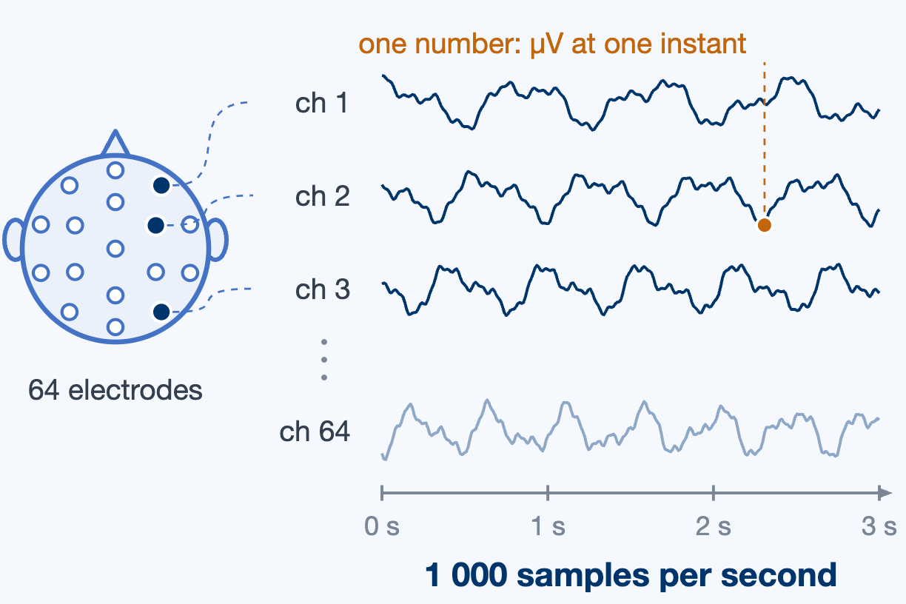
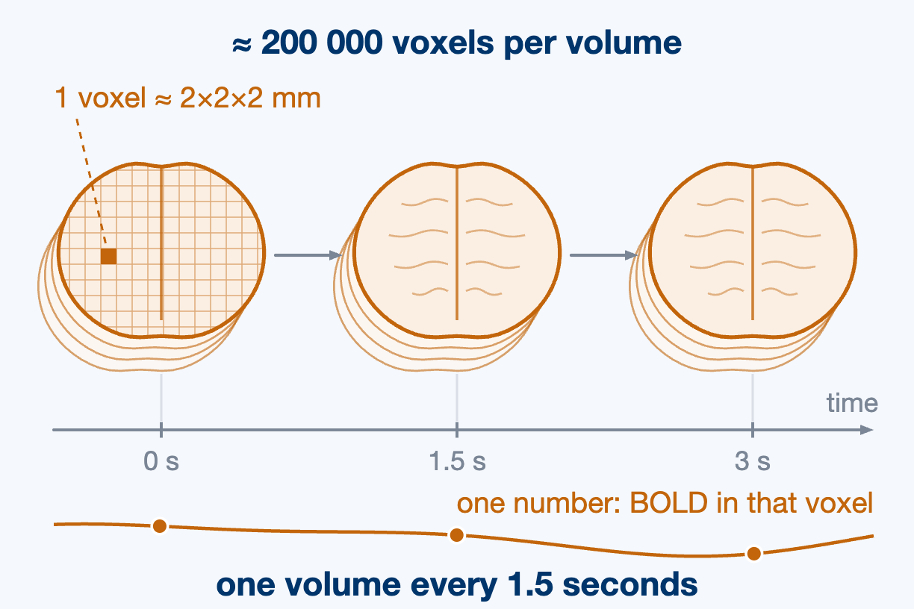
Preliminary · What Brain Signals Look Like
Channels × time
Voxels × time
EEG · MEG · ECoG · fNIRS
fMRI · PET
BOLD = blood-oxygen-level-dependent signal
Notes:
These are the two data formats we'll use most often. On the left, EEG looks like a set of time series. Each row is a recording channel. Each column is a point in time. A model needs to capture how the signal changes, as well as how channels relate to each other.
On the right, fMRI is a sequence of three-dimensional brain volumes. Each voxel has its own time series. The BOLD signal tracks changes in blood oxygenation, so it measures neural activity indirectly.
Working with every voxel can be expensive. One common approach is to group voxels into brain regions. That's what I'll show next.
[References - not spoken]
NIH Functional MRI Facility course: https://fmrif.nimh.nih.gov/images/e/e6/2016_08_Dan_20160617.pdf .

Slide 9
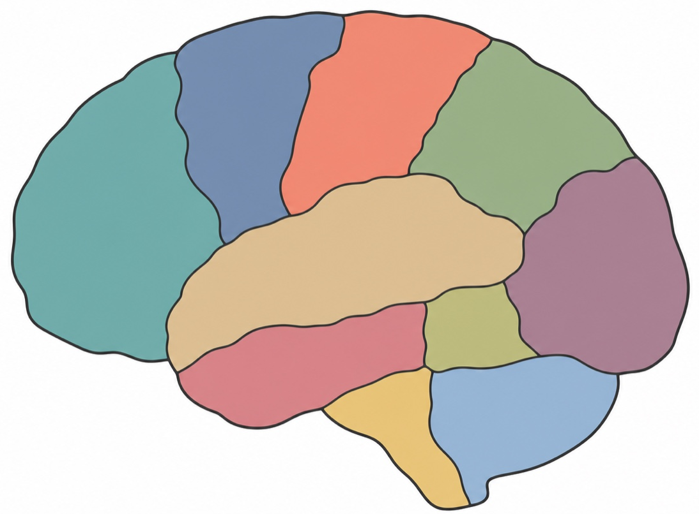
Preliminary · Parcellation & Brain Networks
Study brains at a coarse level: regions are nodes, every edge joins exactly two.
Nodes: brain regions
Parcellated by an atlas · voxels inside a region averaged
Edges: pairwise Pearson correlation
One number per pair, from their averaged time courses
What it is used for
region
Clinical diagnosis and treatment · Study how the brain works
Pearson
correlation
Notes:
We can use a brain atlas to group fMRI voxels into regions. Within each region, we average the voxel signals. This gives us one time series per region. We then calculate the correlation between each pair of time series.
Now we have a network. The regions are nodes, and the correlations are edge weights. We can use this network to study how brain organization relates to behavior or clinical outcomes.
But every edge still connects just two regions. Brain functions often involve several regions working together. What do we miss when we only look at pairs? That is the question behind HyBRiD.

Slide 10
Part 1: The Foundation
Models for Brain Signals
We first build a foundation for modeling brain signals:
learn informative, nonredundant structure and use it for prediction.
Two extension questions
HyBRiD [1]
LAT [3]
Learn neural structure that supports prediction
What if the structure
is already known?
Motor lateralization
→ EEG encoding
Predict cognition
SWA [4]
Brain signals
Learned high-order
relationships
Can neural principles help
models beyond brain signals?
Informative about outcomes · Avoid redundant relationships
Small-world structure
→ LLM analysis and pruning
Notes:
This part asks how neural structure can guide learning and improve prediction. HyBRiD is the main work. It learns groups of brain regions that are informative about a target and avoid capturing the same information repeatedly. It then uses the strength of those relationships to predict an outcome. So learning the structure and using it for prediction are both part of the contribution.
The two related studies ask how far this idea can go. LAT asks what we should do when neuroscience already tells us a useful structure. We build motor lateralization directly into the EEG encoder. SWA asks whether brain-inspired principles can also help models beyond brain signals. There, small-world structure guides the analysis and pruning of language models.
[References - not spoken]
Image source: Human-brain.SVG, Hugh Guiney (based on James.mcd.nz), https://commons.wikimedia.org/wiki/File:Human-brain.SVG . CC BY-SA 3.0: https://creativecommons.org/licenses/by-sa/3.0/ . Colors changed to gray-blue; original geometry retained. Adapted illustration also licensed CC BY-SA 3.0.

Slide 11

HyBRiD · Cognition Is Not Pairwise
Learning High-Order Relationships of Brain Regions · ICML 2024
Weikang Qiu, Huangrui Chu, Selena Wang, Haolan Zuo, Xiaoxiao Li, Yize Zhao, Rex Ying
Existing works score pairwise edges, but brain function is distributed over many regions
They do not decompose
Cannot be broken into pairs: they carry what pairs cannot
So: weighted hyperedges
A hyperedge joins any number of regions · its weight is the strength
And the search space is exponential
Exponentially many candidates · prior work prunes first, blind to the target, so the informative ones are gone before selection starts
Regions → high-order relationships → their strengths → the cognition score.
(hyperedges)
Notes:
Let me begin with HyBRiD, the main contribution in this part. The goal is to learn brain structure that helps prediction. Cognition involves groups of brain regions working together, and some group relationships carry information that individual pairs cannot capture. We represent a group with a hyperedge.
The model learns shared groups of regions, then computes a different weight for each person from that person's features. Those weights are used to predict an outcome, such as a cognitive score. The challenge is to find useful groups in an exponentially large search space. HyBRiD learns groups that are informative about the target, while encouraging different groups to capture different information.

Slide 12
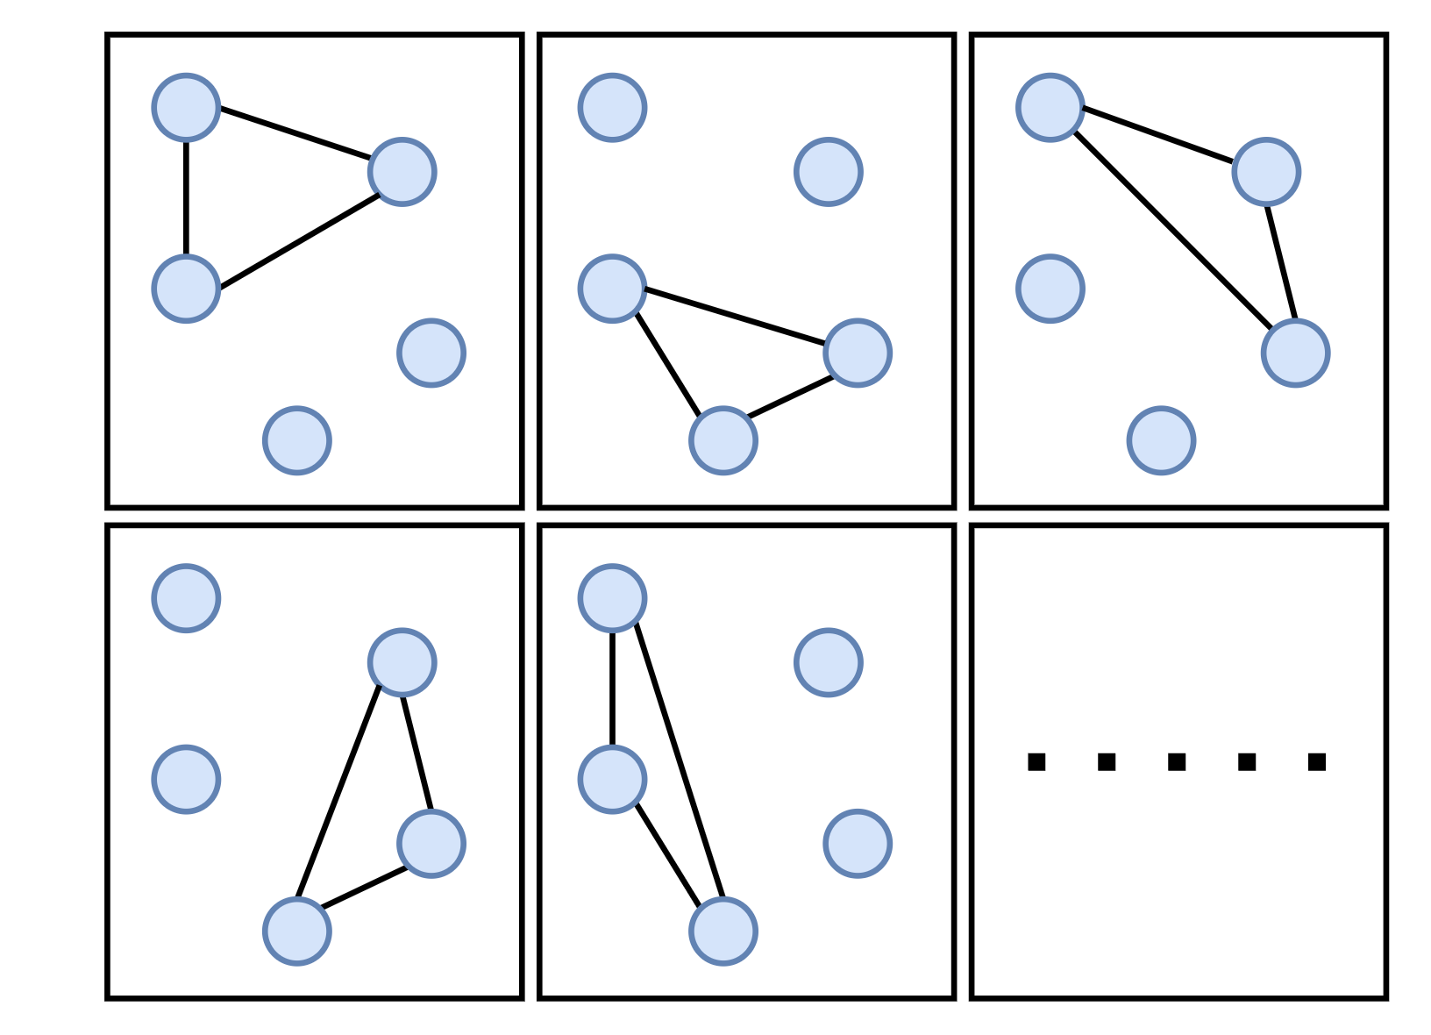
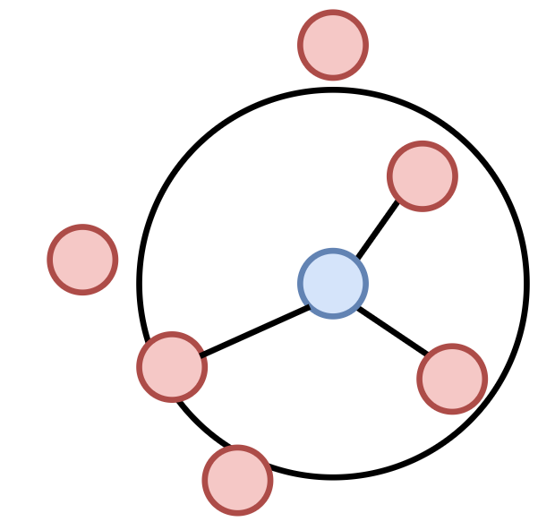
Existing Works · Hyperedge Construction
Learning High-Order Relationships of Brain Regions · ICML 2024
Weikang Qiu, Huangrui Chu, Selena Wang, Haolan Zuo, Xiaoxiao Li, Yize Zhao, Rex Ying
Exponentially many candidate hyperedges
Enumerate low-degree subsets
Neighbour-based construction
Take every subset with degree ≤ 3. (Zu et al., 2016; Santoro et al., 2023)
One hyperedge per node — its nearest or mutually reconstructing neighbours. (Huang et al., 2009; Wang et al., 2015)
Covers a vanishing fraction of the space; does not scale past degree 3.
Hyperedge count fixed to the number of nodes; structure differs per subject.
Blind to a target: a neurological outcome of interest
Notes:
Earlier work usually makes this search manageable in one of two ways. The first is to list only small subsets of brain regions. This is simple, but it leaves most larger groups unexplored. The second is to build one group around each region. It chooses neighbors based on feature similarity or how well they reconstruct that region.
In the second approach, group membership can change from one subject to another. More broadly, both approaches decide much of the structure before considering the prediction target. We want to bring the target into this decision. The groups themselves should be learned according to how useful they are for the prediction task.

Slide 13
Existing Works · Three Ways It Breaks
Learning High-Order Relationships of Brain Regions · ICML 2024
Weikang Qiu, Huangrui Chu, Selena Wang, Haolan Zuo, Xiaoxiao Li, Yize Zhao, Rex Ying
Hypergraph construction relies on neighbour distance and reconstruction.
CURRENT HYPERGRAPH CONSTRUCTION
HyBRiD
Blind to target
Objective: maximally informative and minimally redundant
The structure comes from the features themselves, not from any objective.
→
an objective and its tractable lower bound (multi-head drop bottleneck); learn end-to-end
No consistency across subjects
Feature-agnostic masks
Structures differ per subject, contradicting the belief that healthy cognition works alike.
→
The mask never reads a subject’s features, so every subject gets the same structure.
At most N hyperedges
K parallel heads
The number of hyperedges is limited, which can be sub-optimal.
→
One head per hyperedge, so K is a free hyperparameter.
Notes:
HyBRiD addresses these problems with three design choices. First, our Multi-Head Drop-Bottleneck framework lets the prediction task guide how we learn the groups. The objective encourages them to retain information about the target while limiting how much input information they keep.
Second, each membership mask is a learned model parameter shared across subjects. So the same hyperedge always refers to the same group of brain regions. Its weight can still vary with each person's features. Third, we freely choose the number of mask heads. It does not depend on the number of brain regions. These choices give us comparable groups that are useful for prediction. Let me show you how the model works.

Slide 14

HyBRiD · Learning Shared Hyperedges
Learning High-Order Relationships of Brain Regions · ICML 2024
Weikang Qiu, Huangrui Chu, Selena Wang, Haolan Zuo, Xiaoxiao Li, Yize Zhao, Rex Ying
A hyperedge groups brain regions that jointly predict the target
1
Select brain regions
One head per hyperedge.
2
Compute each subject’s weights
Member-region features determine
each hyperedge’s weight.
3
Predict the target
Combine the hyperedge weights.
Freely chosen hyperedge count K
A hyperparameter, independent of region count.
Shared structure across subjects
Example: N = 6 regions, K = 3 hyperedges
Only the hyperedge weights vary.
Notes:
The model has three steps. Each mask head first selects a group of brain regions. That group is one hyperedge. For each subject, we combine the selected regions' features and use a small neural network to compute the hyperedge's weight. A linear head then combines these weights to predict the target.
The two boxes highlight separate properties. We choose the number of heads, K, as a hyperparameter. It does not have to match the number of brain regions. Here we have six regions and three heads. Different heads can select different groups. But each learned mask is shared across subjects. The groups stay the same across people, while their weights change with each person's brain features.
[References - not spoken]
Source: HYBRID/003approach.tex, Learning the Hypergraph by Multi-head Masking; Figure 2. Feature-agnostic masking is also described in HYBRID/000intro.tex.

Slide 15
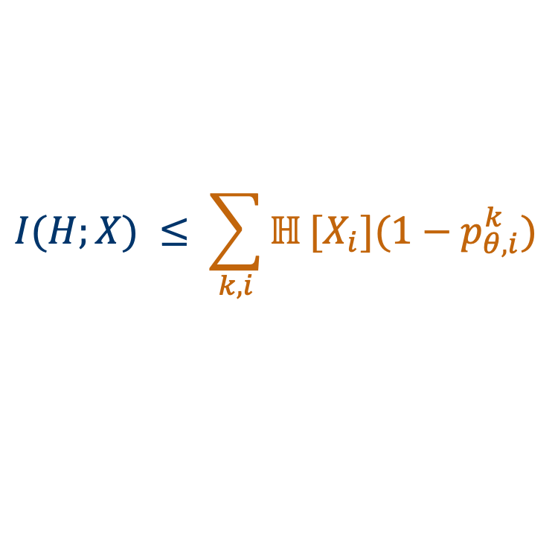
HyBRiD · Multi-Head Drop-Bottleneck
Learning High-Order Relationships of Brain Regions · ICML 2024
Weikang Qiu, Huangrui Chu, Selena Wang, Haolan Zuo, Xiaoxiao Li, Yize Zhao, Rex Ying
Learning objective: maximally informative and minimally redundant
$$\text{max} I(H;Y) − β I(H;X)$$
X: region features
Y: target
H: hyperedge features
I: mutual information
β: trade-off weight
I(H;Y): informativeness ↑
I(H;X): redundancy ↓
Direct mutual-information optimization is intractable.
Optimize the original objective by optimizing its lower bound
First term: a standard variational lower bound is easy to optimize.
Second Term: Our Multi-Head Drop-Bottleneck bound
$$I(H;X) ≤ \sum_{k,i}{ℍ}[X_{i}]{(1−p}_{θ,i}^{k})$$
k: mask head · i: brain region
θ: model parameters
ℍ[Xᵢ]: region entropy
p: learnable mask probability
Notes:
Let me unpack the objective. I means mutual information. X contains the input region features, Y is the target, and H contains the masked features from all hyperedge heads. We want H to retain information about Y while limiting how much it retains about X. Beta balances these two goals. We cannot optimize these information terms directly. For the first term, we can use a standard variational lower bound.
Our contribution is the Multi-Head Drop-Bottleneck upper bound shown below. The sum goes over heads, indexed by k, and brain regions, indexed by i. The blackboard H means entropy: uncertainty in a region's features. The mask probability p is learned through the model parameters, theta. These quantities bound the information retained across all heads. This guides membership learning without requiring the hyperedges to be disjoint.
[References - not spoken]
Sources: HYBRID/003approach.tex, Optimization Framework and Proposition 1; HYBRID/appendix.tex, proof of the multi-head upper bound; HYBRID/000intro.tex, Proposed Work.

Slide 16

HyBRiD · Predictive Performance
Learning High-Order Relationships of Brain Regions · ICML 2024
Weikang Qiu, Huangrui Chu, Selena Wang, Haolan Zuo, Xiaoxiao Li, Yize Zhao, Rex Ying
ABCD: CPM Pearson r over 10 runs.
Average gain: 12.1% on ABCD and 8.8% on ABIDE
Can known neural structure guide the architecture?
HyBRiD: learn + predict
LAT: build in known structure
Task-relevant brain relationships
Motor lateralization for EEG
Notes:
Do these learned relationships improve prediction? We evaluate their weights using the same CPM prediction framework as the baselines. The table shows the correlation between predicted and observed cognitive scores on ABCD, averaged over ten runs. HyBRiD performs best in seven of the eight settings shown.
The average relative gains are about twelve percent on ABCD and nine percent on ABIDE. This completes the main point: HyBRiD learns informative, nonredundant structure, and that structure provides useful features for prediction. Our multi-head drop-bottleneck formulation supports the structure-learning objective.
But not every useful structure needs to be learned from scratch. What if neuroscience already gives us a relevant principle? LAT asks how we can build that knowledge directly into the architecture.

Slide 17
LAT · Motor Lateralization + Frame Averaging
Mind World Models: Joint Learning of Motor EEG Representations and Action-Conditioned World Dynamics
Weikang Qiu, Zheng Huang, Tinglin Huang, Yujun Yan, Rex Ying
Use known motor lateralization to structure the EEG encoder.
motor lateralization
Frame averaging
Left hand
Right hand
Original
features
Bilateral · invariant
Average both encodings
Transformer
Mirrored
features
Lateral · equivariant
Align, then signed average
C4
C3
Mirror learned lateral features only;
raw EEG and bilateral features stay unchanged.
Accuracy (%)
Dataset | Without FA | With FA
PhysioNet | 61.7 ± 0.3 | 63.3 ± 0.5
FineMI | 19.2 ± 0.5 | 20.0 ± 1.1
Brain, top view
Mean ± std
FA: frame averaging
C3 and C4 are EEG electrode names.
Beyond brain signals?
SWA: small-world structure for LLMs
Notes:
LAT builds known motor lateralization into the EEG encoder. Imagining a hand movement often changes sensorimotor rhythms more strongly on the opposite side. C3 and C4 are electrode names.
Frame averaging uses original and mirrored learned features, not mirrored raw EEG. Both views share one Transformer. Averaging gives a bilateral representation that stays invariant. Aligning and taking a signed average gives a lateral representation that tracks left–right changes. Both mean scores improve here, although FineMI’s gain is small relative to its variability.
Can neural principles also help beyond brain signals? SWA studies small-world structure in LLMs.
[References - not spoken]
Illustration: Brain Upper View Outline, SVG Repo, CC0. https://www.svgrepo.com/svg/95799/brain-upper-view-outline . Original vector paths recolored to gray-blue; editable schematic EEG annotations added.
Hand silhouette: SVG Repo, Palm of the hand, CC0. https://www.svgrepo.com/svg/20885/palm-of-the-hand . Original path mirrored and recolored for this schematic.
MWM/003_method.tex: LAT frame averaging mirrors learned lateral features; bilateral features and raw EEG stay unchanged. Bilateral output averages the encodings; lateral output aligns the mirrored encoding, subtracts it, and divides by two. Results copied unchanged from original slide18: PhysioNet 61.7 ± 0.3 → 63.3 ± 0.5; FineMI 19.2 ± 0.5 → 20.0 ± 1.1.

Slide 18

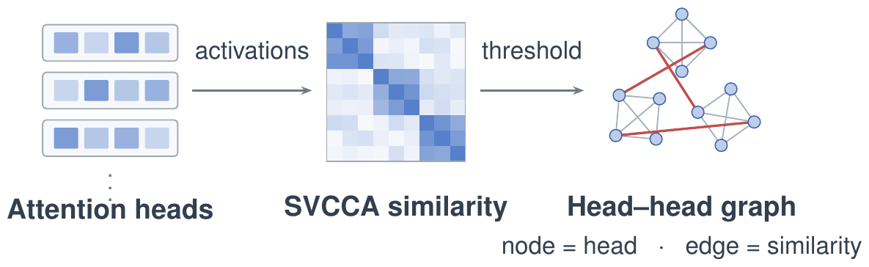
SWA · Small-World in LLMs
What Makes Language Models Intelligent? Small-World Structure in Attention Head Networks
Zheng Huang, Enpei Zhang, Weikang Qiu, Rex Ying, Elynn Chen, Yaoqing Yang, Dawei Zhou, Yujun Yan
Positive correlation in humans: small-world index <-> intelligence
1
A graph of attention heads
2
Associated with reasoning
Six LLMs on DRE-Bench
Nodes: attention heads
Edges: activation similarity
Higher small-world index
↔ lower answer NLL
3
Pruning with SWA
SparseGPT pruning | best baseline | + SWA | Δ
WikiText PPL ↓ · Qwen3-8B @ 70% | 25.13 | 20.10 | −20%
Preserve useful structure while pruning
Notes:
[16min] HyBRiD learns structure for prediction, and LAT builds a known structure into an EEG encoder. SWA asks whether the same research principle can help models beyond brain signals. Small-world networks combine dense local groups with short paths between them. We find that stronger small-world organization in attention-head networks is associated with better reasoning across six LLMs. SWA uses this structure to guide pruning and better preserve model quality. Together, these studies show different ways to make neural structure useful for learning.
[References - not spoken]
SWA/02prelim.tex, small-worldness definition; SWA/03method.tex, graph construction and sparsity allocation; SWA/tables/tab_ppl.tex. The displayed baseline is the strongest of SparseGPT, SparseGPT+FARMS, and SparseGPT+ATP for the displayed setting. This slide shows Qwen3-8B at 70% sparsity.

Slide 19
Part 2: The Bridge
From Signals to Representations
With this foundation, we align brain representations
with language and images of the real world.
PRISM I [5]
Choose the fMRI alignment space
Language space
PRISM II [5]
MindLLM [2]
Recover visual structure
through language
fMRI → language
Object-wise descriptions
One decoder across
subjects and tasks
D-Edit [6]
Independent
object control
Notes:
MindLLM is the main work in this part. It learns one fMRI-to-language decoder that works across subjects and tasks. I will spend most of the time on its training recipe, encoder, and results.
The other studies address important issues around that language bridge. PRISM I provides evidence for choosing language as the alignment space. PRISM II asks whether structured language can preserve visual content when we recover an image. D-Edit tackles interference between objects during generation. I will keep each of these brief and focus on the issue it resolves. These studies support the research direction; they are not modules of one evaluated system.

Slide 20

PRISM I · Choosing the Alignment Space
Seeing Through the Brain: New Insights from Decoding Visual Stimuli with fMRI · ICLR 2026 (Oral)
Zheng Huang, Enpei Zhang, Weikang Qiu, Yinghao Cai, Carl Yang, Elynn Chen, Xiang Zhang, Rex Ying, Dawei Zhou, Yujun Yan
Choosing MindLLM's alignment space
Text leads on all
three measures
Across the evaluated spaces
How do we align
fMRI to language?
text spaces: T5, Llama3, CLIP-text · image spaces: CLIP-img, LDM, ResNet50
Notes:
MindLLM needs a representation space that captures useful information from fMRI. This supporting PRISM study helps answer that question. It compares language and visual representations. T5 leads on all three measures shown, and language spaces are generally stronger among the tested candidates. This gives us evidence for using language as the bridge. MindLLM addresses the main challenge: learning that mapping across people and decoding tasks.

Slide 21
MindLLM · Aligning fMRI with Language
MindLLM: A Subject-Agnostic and Versatile Model for fMRI-to-Text Decoding · ICML 2025
Weikang Qiu, Zheng Huang, Haoyu Hu, Aosong Feng, Yujun Yan, Rex Ying
Prior decoders: one kind of output
Multiple brain functions,
One unified language format
fMRI
→
“The subject is seeing a man on a horse.”
MindLLM: many brain functions, one format
Perception: a man on a horse
fMRI
Knowledge: horses are herbivores
A shared language space
for versatile decoding.
→
Language: reads “STOP”
Reasoning: the rider may be in danger
Challenge 1: How do we design the training and data recipe?
Notes:
MindLLM is the main contribution in Part 2. We want one model to answer different kinds of questions from fMRI, using language as the common output. A caption can tell us that a person sees a man on a horse. Other tasks ask about knowledge, written text, or relationships that require reasoning. These examples illustrate the range of tasks we want to support.
Our contribution has two main pieces. Brain instruction tuning gives the model supervision beyond captions. A shared encoder handles the different sets of voxels recorded from different people. Together, these support versatile decoding across subjects and tasks. I will first introduce these two challenges, then explain the model and its results.

Slide 22

MindLLM · Subject-Agnostic Decoding
MindLLM: A Subject-Agnostic and Versatile Model for fMRI-to-Text Decoding · ICML 2025
Weikang Qiu, Zheng Huang, Haoyu Hu, Aosong Feng, Yujun Yan, Rex Ying
Challenge 2: How can one encoder handle different voxel sets and data distributions across subjects?
fMRI at a specific moment (no time series in this work)
Select Responsive Voxels (preprocess)
Model
Responsive tokens are different (both in number and in distribution) for different subjects
Existing works:
Non-learnable pooling process; risk of information loss
Sampling: over- or under-representation of certain areas.
Ours:
Learnable aggregation
Grounded in neural priors
(Pooling)
(Sampling)
Notes:
Our second challenge is to share one encoder across different people. After we select responsive voxels, each person gives us a different set of measurements. Both the number of voxels and their locations can change. In the figure, pooling compresses these measurements into a fixed size. Sampling selects or groups a subset to make the input easier to handle.
Both approaches can lose information or change how strongly different brain areas are represented. We want to use the available voxels while keeping track of where each measurement comes from. So the encoder needs to accept a variable set of inputs. It cannot depend on a fixed vector designed for one person.

Slide 23

MindLLM · Overview
MindLLM: A Subject-Agnostic and Versatile Model for fMRI-to-Text Decoding · ICML 2025
Weikang Qiu, Zheng Huang, Haoyu Hu, Aosong Feng, Yujun Yan, Rex Ying
An off-the-shelf LLM (Vicuna-7B in practice)
fMRI encoder (subject agnostic)
  Prepend fMRI tokens to instruction tokens
  Neuroscience-informed attention
Brain Instruction Tuning (capture multiple functions)
  ~1M multi-turn conversations, four families of brain function
Specify the brain
function to decode
voxels
Example instructions
“Describe the image the subject is viewing.”
“Describe the image the subject saw previously.”
Notes:
This overview brings the encoder and the training recipe together. The fMRI encoder takes a variable set of voxels from each person. Our attention module uses knowledge of brain structure to turn that set into a fixed collection of tokens. We place these before the instruction tokens in an existing language model.
The instruction tells the model what to decode. For example, we can ask it to describe the image the subject is viewing. Or we can ask about the image seen previously. These are different decoding tasks expressed through the same language interface.
Brain Instruction Tuning supplies questions and answers for those recordings. We connect existing image annotations to fMRI through the stimulus images, giving us nearly a million conversations. Next, I'll show the four families of tasks. Then I'll explain how the encoder handles differences across subjects.
[References - not spoken]
Instruction examples paraphrase the current-image captioning and Previous Caption tasks in MINDLLM/10appendix.tex (instruction prompt table) and MINDLLM/03method.tex (Brain Instruction Tuning). The examples illustrate task instructions, not new evaluation results.

Slide 24




MindLLM · Brain Instruction Tuning
MindLLM: A Subject-Agnostic and Versatile Model for fMRI-to-Text Decoding · ICML 2025
Weikang Qiu, Zheng Huang, Haoyu Hu, Aosong Feng, Yujun Yan, Rex Ying
Perception & Scene Understanding
Memory & Knowledge Retrieval
Inst. What eats leaves from a basket in an enclosure?
Resp. Giraffe.
Inst. Caption the image the subject saw before this one.
Resp. A neat bedroom pairs modern chairs with a glass table.
(previous image)
Language & Symbolic Processing
Reasoning & Association
Inst. What are the two white letters?
Resp. H and U.
Inst. Why is only the near rail sharp?
Resp. The camera moves with it: this was shot from a moving vehicle.
980,610 conversations, Training with Next Token Prediction
Notes:
These four cards show the different kinds of information we ask the decoder to recover. Recognizing the giraffe uses the current scene. The memory example instead asks about the image shown just before it. Reading letters requires the model to preserve symbolic information. The last example asks for an explanation based on what we can see.
Here, the rail is sharp while the surroundings are blurred. That difference suggests the camera is moving with the vehicle. Existing image datasets provide many of these annotations. We connect them to brain recordings through the same stimulus images. Together, these questions give the model broader training than asking for an image caption every time.
[References - not spoken]
Source datasets per family. Perception & scene understanding: COCO Caption, Paragraph Caption, COCO-QA, Visual Genome QA, VQAv2, TallyQA. Memory & knowledge retrieval: Previous Caption, OK-VQA, A-OKVQA. Language & symbolic processing: ST-VQA, TallyQA. Complex reasoning: VQA-E, A-OKVQA, LLaVA-Instruct-150K, LVIS-Instruct4V.

Slide 25


MindLLM · Learnable Queries over Voxels
MindLLM: A Subject-Agnostic and Versatile Model for fMRI-to-Text Decoding · ICML 2025
Weikang Qiu, Zheng Huang, Haoyu Hu, Aosong Feng, Yujun Yan, Rex Ying
cross attention
Learnable queries
Each query -> a specific pattern. E.g.
  gather information from low-level visual areas
  communication between low- and high-level areas
Standard cross-attention?
query 1
query 2
query 3
Bad performance!
(Compared to a non-cross-subject MLP baseline)
query 4
query 5
query 6
Notes:
We start with learnable queries to handle the different voxel sets. Each query can attend to all the measurements available for that person. The measured fMRI activity goes through the value path. The queries then produce a fixed number of output tokens. The patterns here show how queries can collect information from different regions, or combinations of regions.
This avoids pooling or sampling every person's data into the same input size. But standard cross-attention alone performs poorly compared with an MLP designed for one subject. So accepting variable inputs is only the first step. We also need to decide how attention should choose which measurements to use. That brings us to the attention keys.

Slide 26


MindLLM · Keys from Position Alone
MindLLM: A Subject-Agnostic and Versatile Model for fMRI-to-Text Decoding · ICML 2025
Weikang Qiu, Zheng Huang, Haoyu Hu, Aosong Feng, Yujun Yan, Rex Ying
Coordinates alone: no region priors
Functional roles must be learned from data
→ Suboptimal performance & slow convergence
Image: queries need content at each position.
fMRI: position offers the most functional information
-> Position determines the key; measured activity remains the value.
Notes:
The key tells a query which measurements to attend to. In an image, content matters because the same object can appear in different places. In fMRI, a voxel's location gives us a clue about its functional role. So we use spatial information for the key, and measured activity for the value. This keeps the attention weights from depending directly on noisy activity values.
But coordinates alone do not tell the model which functional region a voxel belongs to. Without region priors, it has to learn that organization from the data. This is the limitation highlighted below the key. Position-only keys help, but they are suboptimal in our ablation. Coordinates give us fine spatial detail. Region information adds the broader structure that coordinates alone leave implicit.

Slide 27
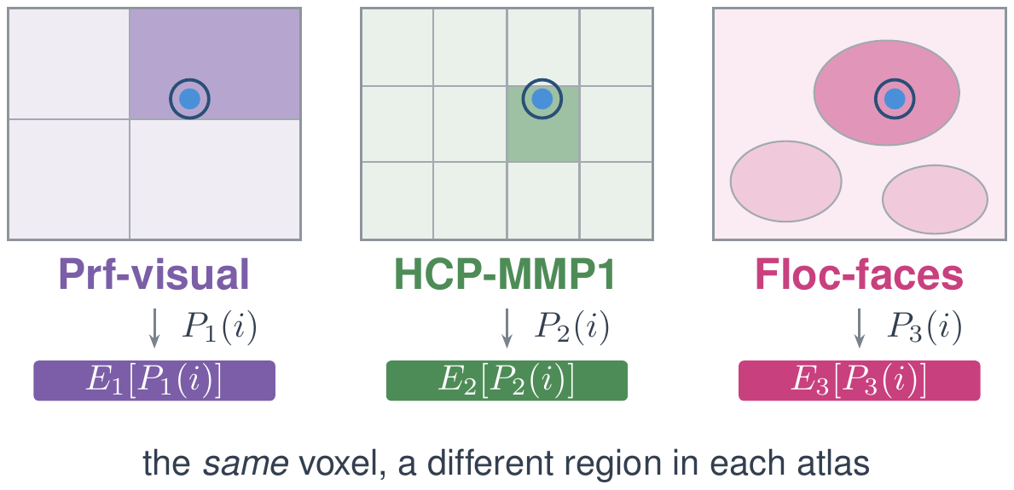
MindLLM · Region Encodings as Neural Priors
MindLLM: A Subject-Agnostic and Versatile Model for fMRI-to-Text Decoding · ICML 2025
Weikang Qiu, Zheng Huang, Haoyu Hu, Aosong Feng, Yujun Yan, Rex Ying
1
A voxel belongs to multiple parcellations
2
Augment key with region embeddings from multiple parcellations
Parcellation 1
Parcellation 2
Parcellation 3
Parcellation 1
Parcellation 2
Parcellations
Parcellation 3
Ablation on the key
fMRI value in the key → worse
region encodings → fastest early
position + region → best
Notes:
Coordinates give us fine spatial detail, while region encodings add knowledge about brain organization. On the left, we follow the same voxel through three different parcellations. Each parcellation divides the brain in a different way. The voxel therefore gets a separate region assignment and a learned embedding for each one. On the right, we concatenate these embeddings with the positional encoding to form the key. Measured fMRI activity still goes through the value path.
The bottom ablation shows why we use both kinds of spatial information. Adding activity to the key hurts performance. Region encodings help the model learn faster early on. Combining positions and regions gives the best final result. Together, they provide both fine detail and broader functional structure.

Slide 28
MindLLM · Generalizing to a Held-Out Subject
MindLLM: A Subject-Agnostic and Versatile Model for fMRI-to-Text Decoding · ICML 2025
Weikang Qiu, Zheng Huang, Haoyu Hu, Aosong Feng, Yujun Yan, Rex Ying
Train on subjects 1–7, evaluate on subject 8: no finetuning, no per-subject parameters.
Selected results from Table 3 in the paper
Task | Metric | MindBridge | UniBrain | MindLLM
ST-VQA | ANLS | 9.33 | 9.30 | 13.63
OK-VQA | Accuracy | 21.94 | 17.09 | 25.44
VQA-E | Accuracy | 41.78 | 38.53 | 46.19
COCO-Caption | CIDEr | 8.70 | 6.40 | 13.22
Paragraph Caption | CIDEr | 0.71 | 1.56 | 5.61
FSVQA | CIDEr | 428.39 | 587.78 | 646.30
+24.5%
Reported average gain
over the best baseline
in the full evaluation
Best on 36 of 38 metrics
in the full held-out
subject evaluation
Notes:
A strong test of a shared encoder is a person it has never seen during training. We train on subjects one through seven, then test on subject eight. We do not finetune the model or add parameters for that person. These selected rows cover text recognition, knowledge questions, explanatory QA, captioning, and full-sentence answers. MindLLM beats both comparison models in every row shown here. The captioning gains are especially clear.
Across the full evaluation, the paper reports a 24.5 percent average gain over the best competing subject-agnostic baseline. MindLLM leads on 36 of the 38 metrics in Table 3. Together, these results show that the shared encoder carries useful decoding structure over to a new subject.
[References - not spoken]
Qiu et al., MindLLM: A Subject-Agnostic and Versatile Model for fMRI-to-Text Decoding, ICML 2025, Table 3 (p. 8), Section 4.4. https://proceedings.mlr.press/v267/qiu25e.html
Original published PDF: https://raw.githubusercontent.com/mlresearch/v267/main/assets/qiu25e/qiu25e.pdf
Local source: MINDLLM/04experiments.tex, tab:subj8. This slide displays six selected task-metric rows; the 24.5% statistic is the paper-reported average for the full held-out evaluation, not an average of these six rows. Counting all 38 rows in Table 3 gives 36 MindLLM wins; exceptions are VG-QA accuracy (MindBridge) and TallyQA RMSE (UniBrain). MindBridge is the shared-parameter adaptation used in this paper, and UniBrain refers to Wang et al. (2024). Values retain the original table's units and scaling.

Slide 29

MindLLM · Versatile Decoding
MindLLM: A Subject-Agnostic and Versatile Model for fMRI-to-Text Decoding · ICML 2025
Weikang Qiu, Zheng Huang, Haoyu Hu, Aosong Feng, Yujun Yan, Rex Ying
■ w/o brain instruction tuning
■ w/ brain instruction tuning
Our model outperforms baselines with a 12.0% average improvement.
Brain Instruction Tuning brings a 28.0% improvement
Notes:
We can now separate what comes from the encoder and what comes from the training recipe. The table includes several kinds of question answering and captioning. Some tasks also ask about an image the person saw earlier. Compare the columns with and without Brain Instruction Tuning. The broader training generally improves decoding.
The reported average gain from instruction tuning is 28 percent. The model also improves over the competing methods. This suggests that different kinds of questions help it use the same brain measurements more effectively. Next, I'll use ablations to show why we designed the attention keys this way.

Slide 30
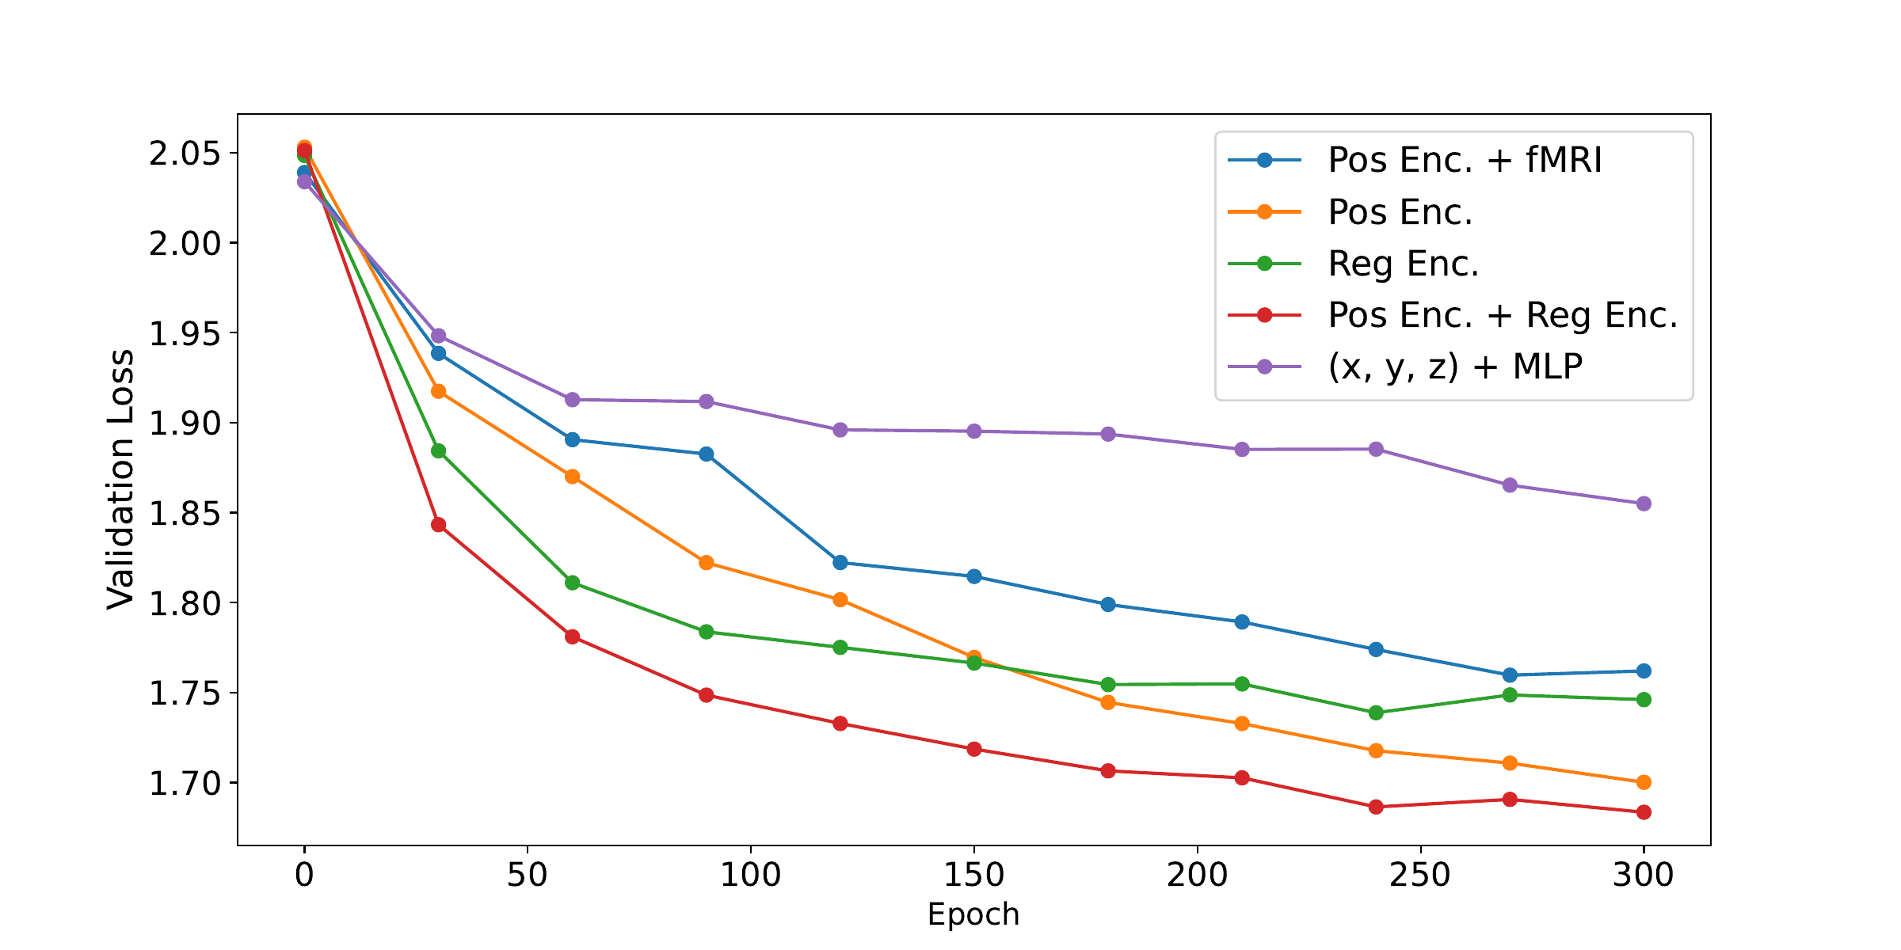
MindLLM · Ablation Studies
MindLLM: A Subject-Agnostic and Versatile Model for fMRI-to-Text Decoding · ICML 2025
Weikang Qiu, Zheng Huang, Haoyu Hu, Aosong Feng, Yujun Yan, Rex Ying
Attention key design
vs.
Excluding fMRI from keys
Improves validation loss
vs.
Brain-region encodings
Faster early convergence
vs.
&
Position + region encodings
The full model achieves the best performance
Beyond text answers: preserve visual structure
MindLLM: language alignment
PRISM II: visual recovery
Notes:
This ablation tests what information should go into the attention keys. The plot shows validation loss during training, so lower is better.
First, compare the blue and orange curves. The blue curve includes both position and fMRI signals in the keys. Removing the fMRI signals gives us the orange curve and improves the result. We still use the fMRI signals in the values. The change is how we decide where to attend.
Next, compare green with orange. The green curve uses brain-region encodings. It learns faster early on, but the orange curve, using position alone, eventually does better. Region identity gives useful brain structure, while position gives finer spatial detail. Finally, compare red with both orange and green. The red curve combines position and region encodings and has lower validation loss than either one alone. Comparing purple with orange also shows that simply mapping coordinates through an MLP works worse than positional encoding.
So this supports our design: use both position and brain-region information to guide attention to the fMRI signals.
MindLLM gives us a language representation of brain activity. To recover an image, we also need that language to preserve the objects and layout of the scene. That brings us to PRISM II.

Slide 31
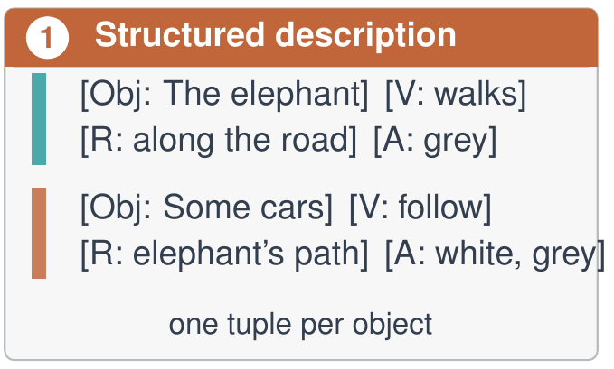
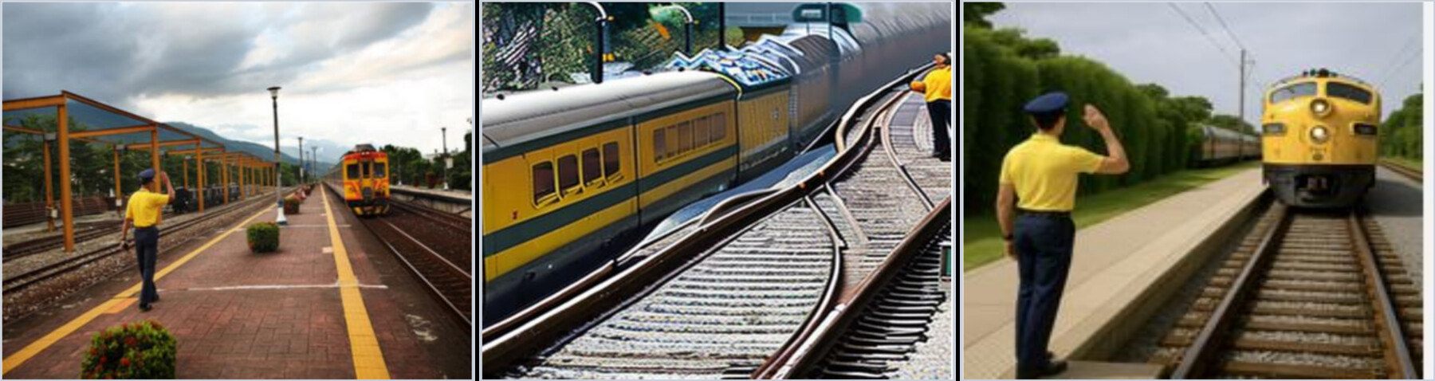
PRISM II · Object-wise Reconstruction
Seeing Through the Brain: New Insights from Decoding Visual Stimuli with fMRI · ICLR 2026 (Oral)
Zheng Huang, Enpei Zhang, Weikang Qiu, Yinghao Cai, Carl Yang, Elynn Chen, Xiang Zhang, Rex Ying, Dawei Zhou, Yujun Yan
Beyond MindLLM's text answers: recover visual structure through language.
fMRI
Image recovery
Brain activity
Preserve objects and layout
Faithful recovery of scene structure
NSD reconstruction results
MindEye2
PRISM
Perceptual
error ↓
0.6338
± 0.04
0.5963
± 0.02
Image QA
accuracy ↑
57.65%
60.54%
Viewed image
MindEye2
PRISM
LPIPS error; same SD 2.1 backbone
Next: object-disentangled text space -> object-disentangled generation
Notes:
MindLLM is our main work on the language bridge. PRISM II addresses a related issue: can that kind of language representation also preserve visual structure? The high-level idea is simple. We map fMRI to structured descriptions of objects, their attributes, and their spatial relationships. Those descriptions then guide image reconstruction.
In this example, MindEye2 recovers a train but loses the person. PRISM recovers both and better preserves the scene. The NSD results also show lower perceptual error and higher question-answering accuracy on the reconstructed images. This supports structured language as a useful bridge for visual recovery.
There is still a generation issue: changing or generating one object can affect another. D-Edit studies how to control objects more independently. These are supporting studies around MindLLM's representation question; the PRISM results come from its own decoder and generator.
[References - not spoken]
PRISM/04experiments.tex, Table tb:main: NSD, same Stable Diffusion 2.1 backbone, MindEye2 LPIPS 0.6338 ± 0.04, PRISM 0.5963 ± 0.02; averages across subjects over five runs. Table tb:qa: question-answering accuracy on reconstructed NSD images, MindEye2 57.65%, PRISM 60.54%; Qwen2.5 answers COCO questions about generated images. Existing train comparison figure retained unchanged.

Slide 32
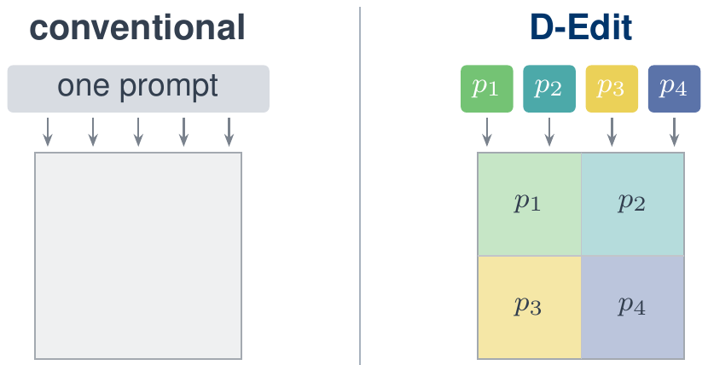
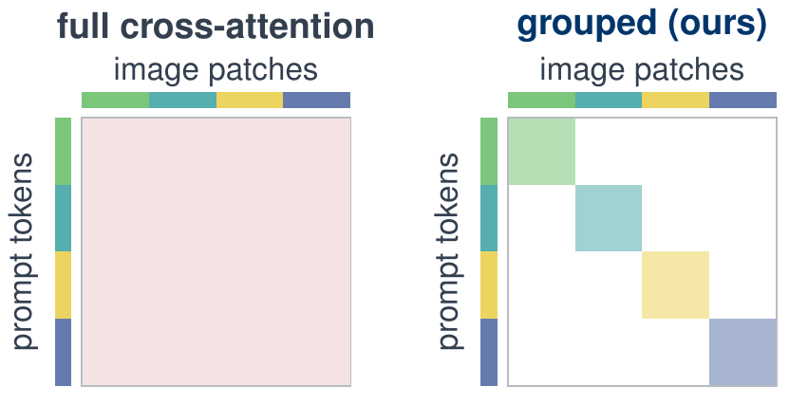
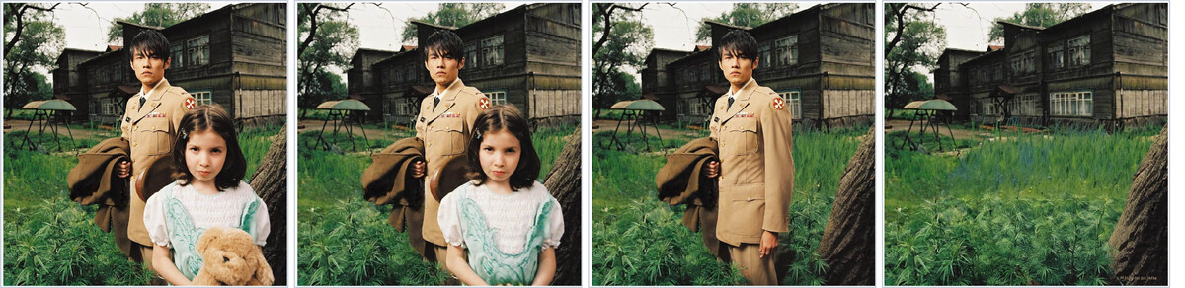
D-Edit · Stronger Disentangled Generation
An Item Is Worth a Prompt: Versatile Image Editing with Disentangled Control · AAAI 2025
Aosong Feng, Weikang Qiu, Jinbin Bai, Zhen Dong, Kaicheng Zhou, Xiao Zhang, Rex Ying, Leandros Tassiulas
Prevent interference between objects during generation.
Item–prompt association
Grouped cross-attention
Each item keeps its own prompt
Each item attends to its own prompt
Independent item removal
Quality 3.26 → 4.01 · Fidelity 2.42 → 4.44
15 annotators × 30 pairs, against SDXL-inpaint
Notes:
[26:30]
This final supporting study addresses object interference during generation. If language describes each object separately, we also want the generator to keep those objects separate. D-Edit gives each item its own prompt and limits attention to the corresponding region. That lets us change or remove one item with less impact on the others.
The editing examples and user study provide evidence for this independent control. The role of this work in the thesis is to address a generation issue around the language-to-image direction. MindLLM remains the main contribution in this part. D-Edit is a separate generator study, not an end-to-end brain-decoding result.

Slide 33
Part 3: The Embodiment
From Representations to Interactions
We use world representations to ground motor decoding
and guide embodied intelligence through image or language goals.
Action level
EEG grounded in action consequences
Action-conditioned world dynamics
MWM [3]
Specify the outcome; let the machine determine the steps
Goal level: specify the desired outcome
PHIL [8]
Goal image
DySta [7]
Language instruction
Part 2: images
Part 2: text
Target-state search
Learned heuristic
Efficient inference
Multi-frame memory
Notes:
Part 2 showed how we can express information from the brain as images and language. In Part 3, I ask how these representations can help us interact with the world. We start at the action level. MWM connects EEG representations to the visual consequences of actions, and uses those consequences as a learning signal.
But a user should not have to specify every movement needed to finish a task. That brings us to the goal level. PHIL searches toward a target state specified by an image. DySta learns action policies guided by language and visual history. These two goal interfaces connect back to the images and text from Part 2.

Slide 34
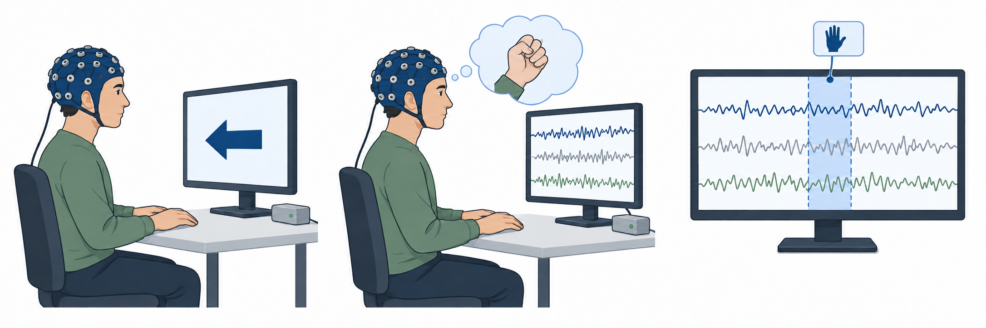
Mind World Models · Scaling the Mind Side
Mind World Models: Joint Learning of Motor EEG Representations and Action-Conditioned World Dynamics
Weikang Qiu, Zheng Huang, Tinglin Huang, Yujun Yan, Rex Ying
A key to LLM success: vast amounts of text accumulated over decades on the Internet
Our goal: scale up training data for motor EEG decoding
Current bottleneck: cue-based trial-by-trial collection + manually annotated action labels
1 See the cue
2 Imagine + record
3 Save labeled EEG
Label from cue: left hand
Conventional motor-imagery protocol
Requirement: a training paradigm that learns from data collected at scale
Notes:
A key part of LLM success is the ability to learn from vast amounts of text. That gives us a motivation for motor EEG: we need a way to scale up the data used to train a foundation model for motor decoding.
But conventional motor-imagery data is collected one trial at a time. A participant sees a cue and imagines a movement. We assign an action label to that cue window. Only those selected windows enter this supervised training setup, even though we record EEG continuously. Getting more labeled examples means running more controlled trials.
So the bottleneck here is data collection. We need a way to learn from continuous motor behavior without labeling every action. The next slide looks at how world models approach this problem in video.
[References - not spoken]
Hoffmann et al. (2022), Training Compute-Optimal Large Language Models, highlights the importance of training data scale for language models. MWM/001_intro.tex describes the cost of cue-based motor trials and the need to learn from naturalistic EEG and video without action annotations. The figure illustrates conventional supervised trial windows, not a claim that all data outside them is unusable for every learning objective.

Slide 35


Mind World Models · Scaling the World Side
Mind World Models: Joint Learning of Motor EEG Representations and Action-Conditioned World Dynamics
Weikang Qiu, Zheng Huang, Tinglin Huang, Yujun Yan, Rex Ying
A world model predicts how the world changes when an action is taken.
World model:
Current
frame state
+
Action
World model
Next
frame state
No action labels in general video (e.g., YouTube)
LAWM · Learn latent actions from unlabeled video
Garrido et al., 2026 · No action annotations
Current
frame
Inverse dynamics
(IDM)
Pseudo
action
Forward dynamics
(FDM)
Predicted next
visual state
Next
frame
⚠️ Potential information leakage: The pseudo action is actually just the compression of the future frame
Notes:
A world model asks a simple question: given the current state and an action, what happens next? The photos show an example of a person turning a Rubik's cube. The next frame illustrates the target state, rather than a model-generated result. But the arrow points to a scaling problem: general video usually has no action labels.
LAWM learns an action representation from the video itself. In the lower diagram, both observed frames go into the inverse dynamics model. It uses both frames to infer a latent action. The forward dynamics model takes that action and the current frame to predict the next visual state. The possible shortcut is that the inverse model already sees the future target. Its code could carry information from that target. This motivates using synchronized EEG as the action input, without looking at the future frame.
[References - not spoken]
Source: Garrido et al., Learning Latent Action World Models In The Wild, arXiv:2601.05230v2, Sections 1–3 and Figure 2. https://arxiv.org/html/2601.05230v2 .
Dissertation context: MWM/003_method.tex, world-model formulation and temporal-leakage control.
[Image provenance - not spoken]
The two observed example frames are reused from slide 37 of this deck: ppt/media/image69.png (current) and ppt/media/image70.png (next), credited there to EgoBrain, arXiv:2506.01353, and shown as frames from a single episode. They illustrate the current/next inputs and target; they are not LAWM evaluation data or generated predictions.

Slide 36
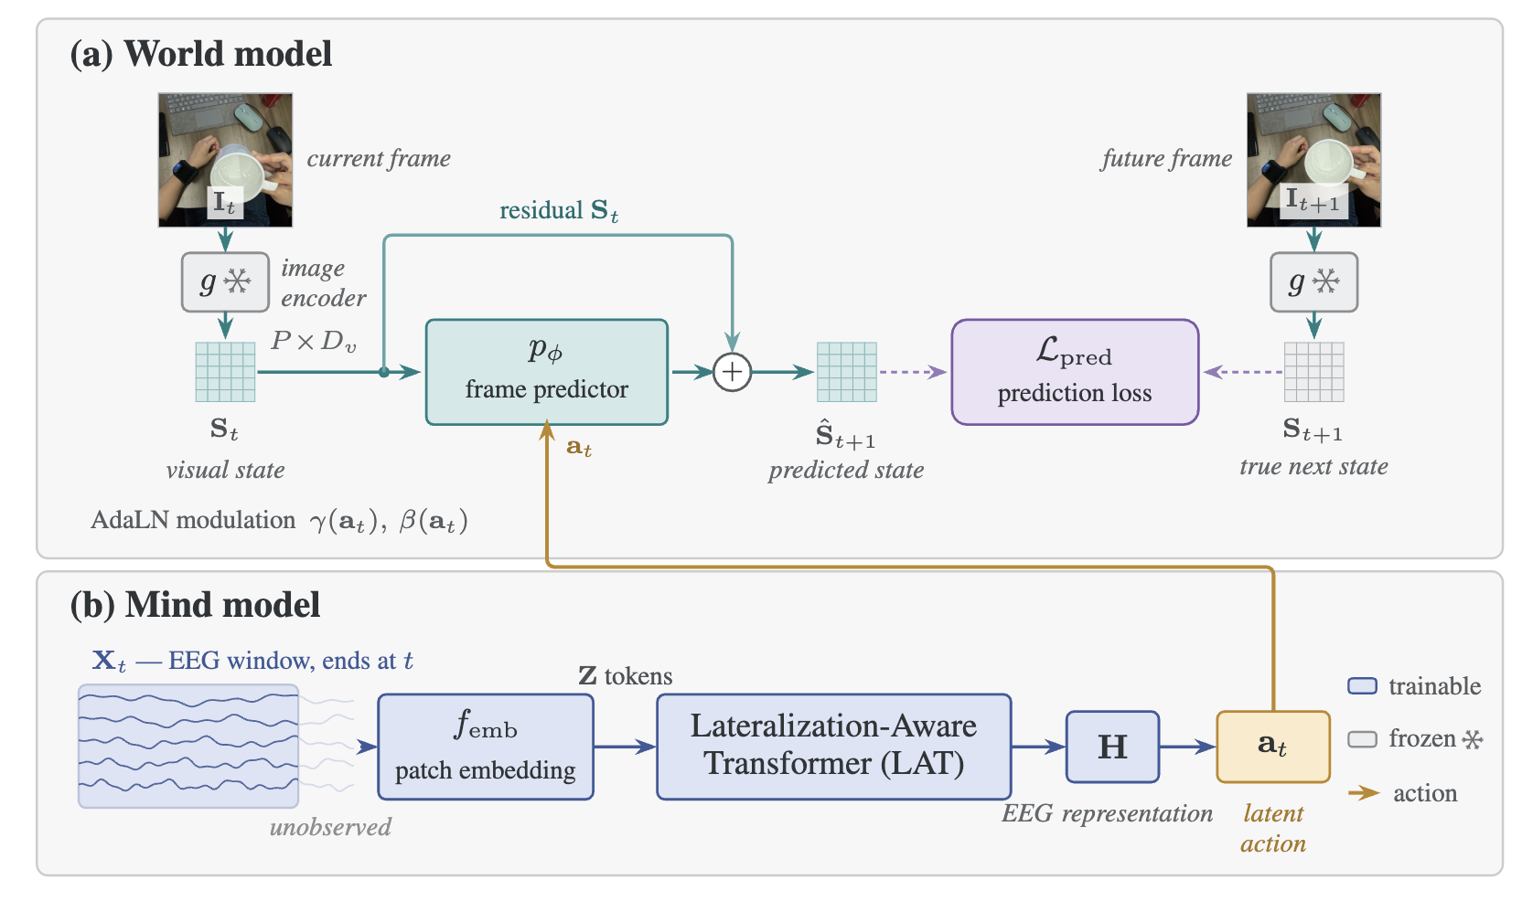
MWM · Linking EEG to Action Consequences
Mind World Models: Joint Learning of Motor EEG Representations and Action-Conditioned World Dynamics
Weikang Qiu, Zheng Huang, Tinglin Huang, Yujun Yan, Rex Ying
Scale both mind and world models with the same EEG–video stream.
No manual annotation → scalable
Learn from synchronized EEG + video
Two deliverables
Mind model
EEG representations
grounded in actions
World model
Action-conditioned world dynamics
Notes:
MWM connects the two sides using synchronized EEG and egocentric video. Let me follow the arrows. The mind model takes an EEG segment and turns it into a latent action representation. The world model then combines that representation with the current visual state to predict what comes next.
The video shows the visible consequences of the action. Those consequences connect the EEG representation to the physical world. We train the two models together through this connection, without asking someone to label every action in the recording. The same data stream gives us two models: an EEG encoder grounded in actions, and a world model that predicts how actions change the scene.
This gives us a way to scale training on both sides. As we collect more synchronized EEG and video, the same stream supports learning both the mind model and the action-conditioned world model. We do not need a separate set of action annotations for each side.

Slide 37
Mind World Models · Results
Mind World Models: Joint Learning of Motor EEG Representations and Action-Conditioned World Dynamics
Weikang Qiu, Zheng Huang, Tinglin Huang, Yujun Yan, Rex Ying
Next-frame prediction on held-out episodes, and motor-imagery transfer.
World model · next-frame prediction
Motor imagery · vs EEG encoders
vs LAWM and a random-init encoder, measured by prediction errors
seven benchmarks, measured by F1.
split · arm | L1 ↓ | cos ↑ | Δact ↑
within · ours | 0.50 | 0.88 | 7.9
within · LAWM | 0.65 | 0.85 | 2.1
within · random | 0.73 | 0.83 | 0.0
cross-subj · ours | 0.49 | 0.89 | 5.7
cross-subj · LAWM | 0.55 | 0.87 | 2.9
cross-subj · random | 0.72 | 0.84 | 0.0
dataset | CSBrain | CBraMod | Ours (WM)
pretraining EEG | >9,000 h | >9,000 h | 61 h
PhysioNet-MI | 59.90 | 61.99 | 63.30
FineMI | 18.58 | 19.72 | 20.00
Kaya5F | 38.03 | 39.04 | 41.89
Weibo2014 | 16.76 | 18.45 | 18.61
Forenzo2024 | 30.74 | 30.64 | 31.91
Jeong2020 | 15.44 | 15.32 | 16.01
Forenzo2024Reg | 21.33 | 19.77 | 22.07
Δact: diff by using a negative-sampled EEG segment
Best in every cell across both splits and all three metrics.
Notes:
Here we evaluate both models that come out of joint training. On the left, we test how well the world model predicts a future state. We compare it with a latent-action baseline and a randomly initialized encoder, including tests across subjects. The lower prediction errors show that it learns useful world dynamics. The action-sensitivity test also asks whether changing the action input changes the prediction.
On the right, we transfer the EEG encoder to motor-decoding tasks. This tests whether joint training also helps the mind representation. Together, the results support learning EEG representations through action consequences. We get an encoder useful for motor decoding, and a world model whose predictions depend on the action input.

Slide 38
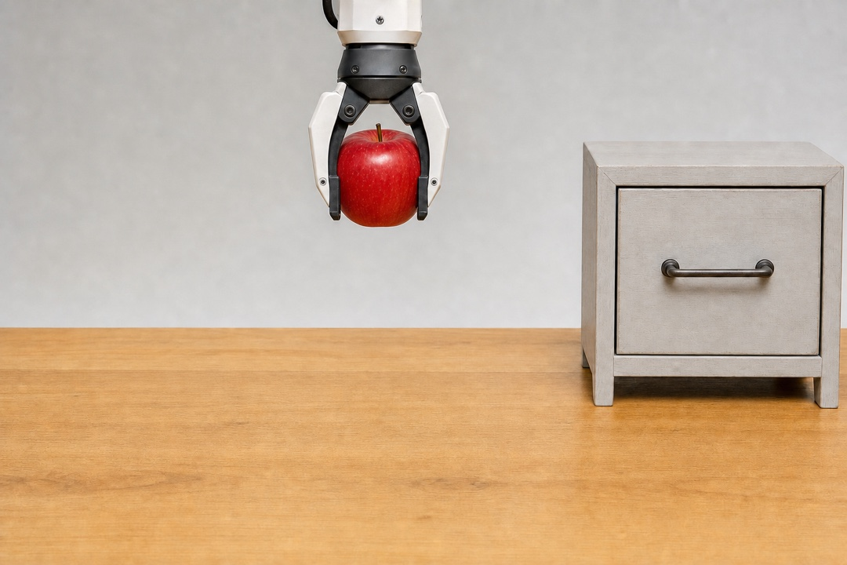

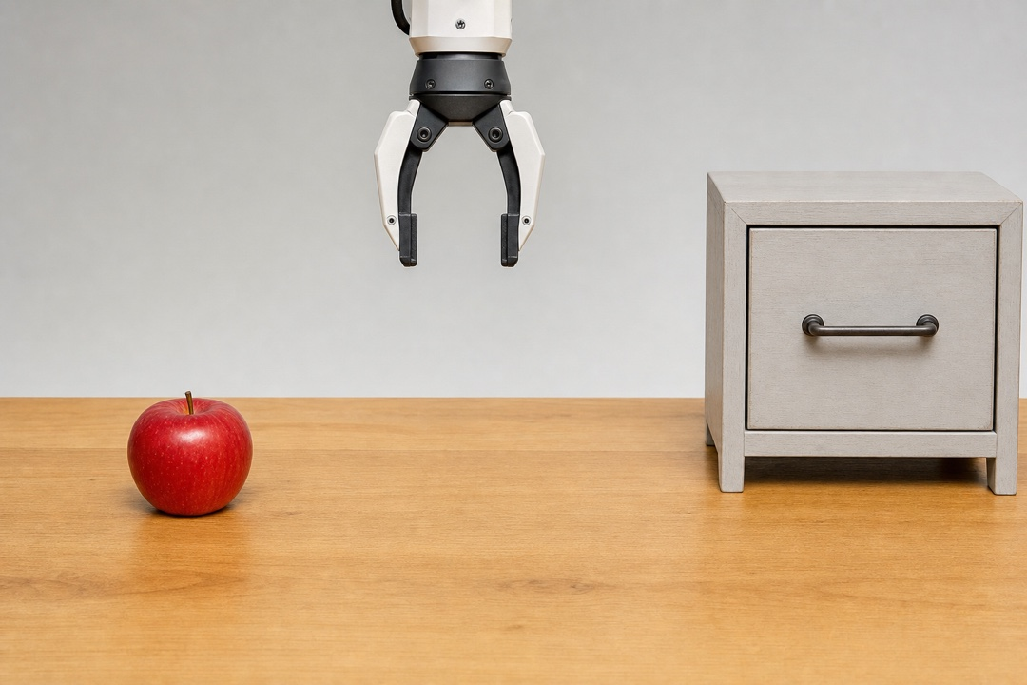
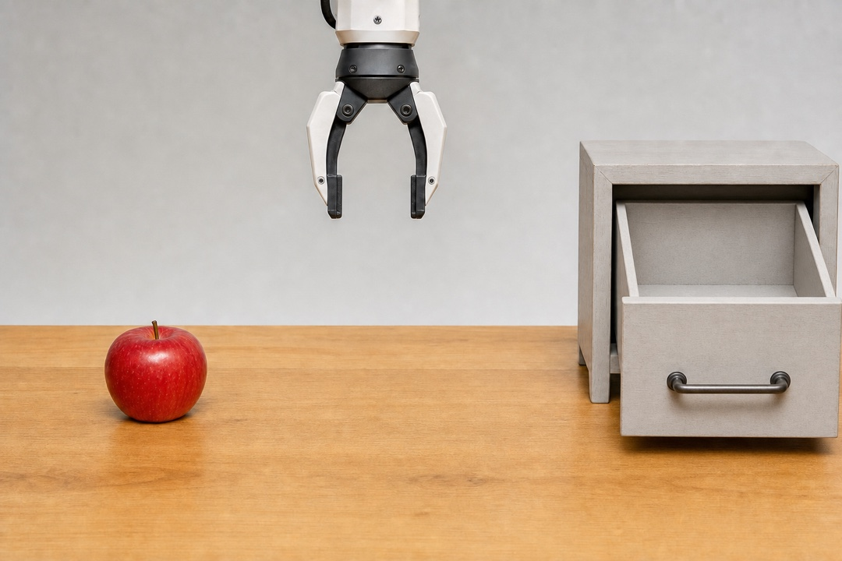
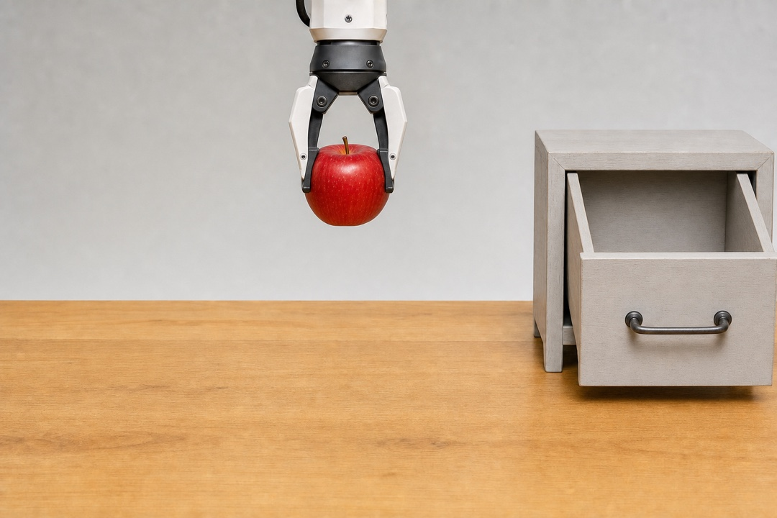


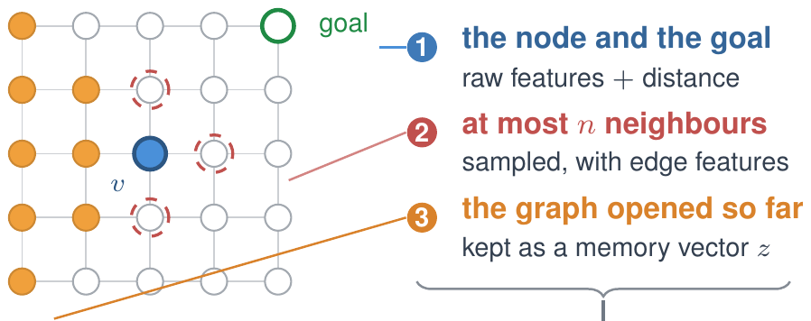
PHIL · Explicit Goal-Directed Planning
Learning Graph Search Heuristics · LoG 2022
Michal Pándy, Weikang Qiu, Gabriele Corso, Petar Veličković, Rex Ying, Jure Leskovec, Pietro Liò
A goal image specifies the desired outcome. How can a machine find a path to it?
From action meaning to goal specification
Planning toward a goal image
Action level · MWM
×
the drawer was never opened
Action intention from EEG
now
e.g., open drawer
next
Ground actions in their visual consequences.
now
drawer open
apple grasped
over drawer
goal image
PHIL learns a cost-to-go function
Goal level · specify the desired outcome
cost-to-go
?
h_{θ}
now
target
learn to match
Let the machine determine the intermediate steps.
Oracle distance
Notes:
MWM predicts the direct actions based on the current intent. However, there is also an alternative: At the goal level, we specify the desired outcome and let the machine choose the intermediate steps. The drawer example is a concrete example: to place the apple inside, the machine must first open the drawer.
To this end, we propose PHIL, which learns a cost-to-go function on a graph. The diagram on the right shows its inputs: the current node and goal, nearby nodes and edges, and memory of the search so far. These inputs produce an estimate of the remaining cost. We train it to match oracle distances on search rollouts, then use it to prioritize promising states.
[References - not spoken]
PHIL/003approach.tex: imitation learning of a goal-conditioned heuristic from oracle node-to-goal distances, used in greedy best-first search. The goal-image manipulation example illustrates the thesis connection; it is not a PHIL evaluation of decoded brain images.

Slide 39



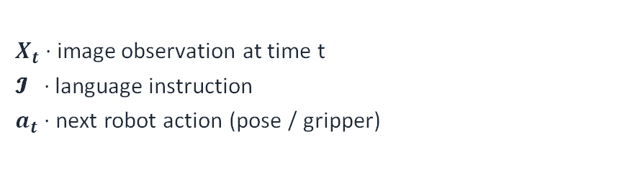
Preliminary · Vision–Language–Action Models
Static-Dynamic Disentanglement for Efficient Multi-Frame Vision-Language-Action Models
Weikang Qiu*, Huashuo Lei*, Tinglin Huang, Aosong Feng, Rex Ying
PHIL
DySta
Target-state planning
Language-guided execution
specifies
Target state
“Pick up the cup.”
VLA
Goal image
Graph-search plan
Language instruction
Robot actions
Formulation
VLA architecture
Predict an action chunk:
Current observation
Language instruction
$$π\left(X_{t}, 𝓘\right) → a_{t},a_{t+1}, a_{t+2},⋯$$
LLM Backbone ($π_{LLM}$)
$X_{t}$· image observation at time t
𝓘 · language instruction
$a_{t}$· next robot action (pose / gripper)
Action head → $a_{t}$ (robot control)
Notes:
We now turn from a target image to a language instruction. On the left, the goal image specifies the desired state, and PHIL's learned heuristic guides graph search toward it. On the right, an instruction like “pick up the cup” guides a visual policy that predicts robot actions. These are two ways to realize a goal.
The VLA below takes the instruction and the current camera image, then predicts a short sequence of actions. A vision-language backbone processes the inputs. An action head turns its output into motion and gripper commands. DySta builds on this policy setting and adds visual history. That brings us to the next two problems: remembering useful information and making inference efficient.

Slide 40

Preliminary · The VLA Inference Loop
Static-Dynamic Disentanglement for Efficient Multi-Frame Vision-Language-Action Models
Weikang Qiu*, Huashuo Lei*, Tinglin Huang, Aosong Feng, Rex Ying
A visual policy repeatedly observes the scene and directly predicts actions.
Closed-loop visual policy
while not success:
image = camera_capture(env)
action = VLA(image, instruction)
env.step(action)
A visual policy needs useful history and low inference latency.
Notes:
This code shows the basic interaction loop. The robot captures an image and combines it with the instruction. It predicts an action and carries it out. The next camera image shows the result, and the robot makes another decision. This loop runs throughout the task, so inference delays add up over many steps. The policy also needs useful information from earlier observations. That leads to DySta's two goals: memory and efficiency.

Slide 41
DySta · Memory and Inference Efficiency
Static-Dynamic Disentanglement for Efficient Multi-Frame Vision-Language-Action Models
Weikang Qiu*, Huashuo Lei*, Tinglin Huang, Aosong Feng, Rex Ying
Visual policies need useful history and fast decisions to complete tasks.
Multi-frame Integration
Inefficient Inference
Context length budget is much tighter than in text-only LLMs
Visual tokens are more expensive (e.g., 256 tokens for each image), so VLAs typically input only the current frame.
Consequence:
• Fails on tasks needing memory ("what was there before?")
• Can't reason over episodic history
The VLM’s large parameter count
Quadratic attention over hundreds of visual tokens
Pick a coke can (~100 steps in SimplerEnv)
Consequence:
• Expensive in RL training
• Hard to react quickly (e.g., liquid spills)
Notes:
The two columns show why memory and inference speed are closely linked. On the left, images use many more tokens than a short text instruction. A single image can take 256 tokens, so adding a long history quickly fills the context. Using only the current frame avoids that cost, but loses information about what happened earlier.
On the right, a large vision-language model processes hundreds of visual tokens at every step. Even picking up a can can involve around 100 steps, so the delay adds up. This also makes repeated rollouts expensive and limits quick reactions. We need to keep the changes that matter for memory while avoiding repeated computation on information that stays the same.

Slide 42



Existing Works · Multi-Frame Integration
Static-Dynamic Disentanglement for Efficient Multi-Frame Vision-Language-Action Models
Weikang Qiu*, Huashuo Lei*, Tinglin Huang, Aosong Feng, Rex Ying
Visual Traces Prompt
Compression-based
Leave memory to the action head (diffusion)
Limited information capacity
Visual clutter / occlusion from traces
Do not leverage LLM’s reasoning ability
Lossy Compression
Notes:
These examples show different ways to add memory to a policy. Compression methods summarize earlier frames in a smaller representation. That saves space, but the summary may lose details that matter later. Visual traces take another approach: they draw motion history over the current image. But they can hold only limited information, and the traces can hide parts of the scene.
Another option passes multiple frames to the action head, while the language backbone handles each frame separately. The action head can then use the history. But the backbone has less opportunity to reason across time. DySta instead gives the backbone a useful sequence of frames in a compact context.

Slide 43
Existing Works · Accelerating VLAs
Static-Dynamic Disentanglement for Efficient Multi-Frame Vision-Language-Action Models
Weikang Qiu*, Huashuo Lei*, Tinglin Huang, Aosong Feng, Rex Ying
Most prior speed-ups are generic compression techniques that ignore VLAs' structure.
Generic ML acceleration
VLA-specific temporal caching
• Quantization (Shukor et al., 2025; Park et al., 2024)
• Layer / token pruning (Yang et al., 2025; Zhang et al., 2025)
• Distillation / small backbones
→ Treat the VLA as a generic transformer.
→ Do NOT exploit the unique characteristics of VLAs
• TTF-VLA, VLA-Cache, FlashVLA
identify reusable patches via heuristics
Issues with prior work:
• Rely on hand-designed, non-learnable rules
• Assume pixel-space similarity = feature-space similarity (false in attention-based transformers)
Notes:
One way to speed up a VLA is to use quantization, pruning, or a smaller backbone. These methods reduce the cost of each forward pass. They are useful, but they do not necessarily take advantage of how similar consecutive robot observations are. Temporal caching targets that repeated information by reusing earlier computation or actions.
The key question is when reuse is appropriate. Existing methods often answer it with hand-designed rules. A patch may look almost unchanged, yet its hidden representation can change because attention brings in information from elsewhere in the scene. So we learn a representation that supports reuse, along with a decision about when to refresh its cache.

Slide 44


DySta · Most Visual Input Is Redundant
Static-Dynamic Disentanglement for Efficient Multi-Frame Vision-Language-Action Models
Weikang Qiu*, Huashuo Lei*, Tinglin Huang, Aosong Feng, Rex Ying
Static Components: background, table, object appearances, etc.…
Dynamic Components: object positions & pose
We propose to disentangle these components into
static and dynamic tokens.
Notes:
Look at the images across the top. The robot arm moves, and some objects change position. But the table, the background, and much of the objects' appearance stay similar. If we process everything again at every step, we treat that persistent context just like the changes that matter for the next action.
DySta separates the representation into static and dynamic tokens, shown in two colors here. Static tokens hold information that can remain useful for a while. Dynamic tokens capture what is changing now. This does not mean the static part must stay fixed forever. When the scene changes enough, the model can refresh it too.

Slide 45

DySta · Efficiency and Multi-Frame Memory
Static-Dynamic Disentanglement for Efficient Multi-Frame Vision-Language-Action Models
Weikang Qiu*, Huashuo Lei*, Tinglin Huang, Aosong Feng, Rex Ying
Advantage 1: Efficient inference
Reuse the KV cache of static
tokens across steps.
Advantage 2: Multi-frame memory
Keep one static context and
the history of dynamic tokens.
Notes:
This separation helps with both memory and inference. For memory, we keep one copy of the scene information that persists. We then add dynamic tokens from each new observation. The backbone can follow the sequence of changes without seeing the same background repeated throughout its context.
For inference, we put the static tokens first, in a shared prefix. As long as that prefix remains valid, we reuse its key-value cache. The model can process new dynamic information without computing the persistent context all over again. When the scene changes, a refresh mechanism updates the cached representation so it stays useful.

Slide 46

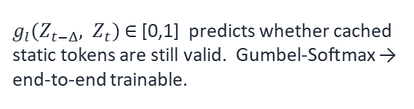
DySta · Multi-Level Cache + Recache Gate
Static-Dynamic Disentanglement for Efficient Multi-Frame Vision-Language-Action Models
Weikang Qiu*, Huashuo Lei*, Tinglin Huang, Aosong Feng, Rex Ying
Identical across timesteps
Key ideas
Cache KV of static tokens
Since static tokens come first, their KV cache is identical across timesteps, so reuse it directly in the LLM backbone.
Learned recache gate
$g_{l}(Z_{t−Δ}, Z_{t})$∈ [0,1] predicts whether cached static tokens are still valid. Gumbel-Softmax → end-to-end trainable.
Multi-level cache (L1 / L2)
L1 = highly persistent background; L2 = semi-static (e.g., drawer). If L1 is refreshed, L2 must be too.
Notes:
The model puts a static prefix before the dynamic information from the observations. With causal attention, later dynamic tokens cannot change the earlier prefix's computation. So while the prefix stays fixed, we can reuse its key-value cache. A learned gate compares the current observation with the cached reference. It decides whether to keep using the cache or refresh the static representation.
We use Gumbel-Softmax so these discrete decisions can be trained with the rest of the model. We also divide the static context into levels. The first holds information that changes very slowly, like the background. The second holds information that may change more often, like a drawer. Refreshing the first level also requires refreshing the second, because its cached computation depends on the earlier prefix.

Slide 47

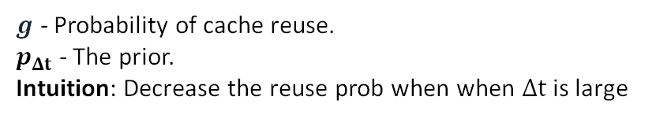



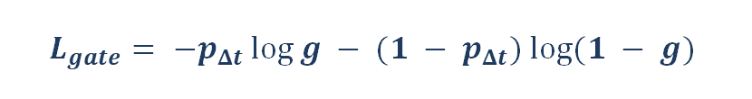
DySta · Making Static Tokens Static
Static-Dynamic Disentanglement for Efficient Multi-Frame Vision-Language-Action Models
Weikang Qiu*, Huashuo Lei*, Tinglin Huang, Aosong Feng, Rex Ying
Contrastive objective for static tokens
Recache gate regularizer
Encourages static tokens to be temporally persistent
Without it, the gate would trivially refresh the cache every step. A time-aware prior biases the gate toward reuse when observations are close in time.
Negative pairs
Static tokens from different trajectories: push them apart to preserve scene-specific content.
$$L_{gate}= −p_{Δt} log⁡g − (1 − p_{Δt}) log⁡(1 − g)$$
$g$ - Probability of cache reuse.
$p_{Δt}$ - The prior.
Intuition: Decrease the reuse prob when $Δt$ is large
Positive pairs
Static tokens from different timesteps of the same trajectory: pull their representations together.
Full training objective
$$L = L_{Task} + Σ α_{l}L_{InfoNCE} + βL_{gate}$$
InfoNCE loss at level $l$ → $L_{InfoNCE}^{l}$
$α_{l}$and $β$ weight the auxiliary losses. $L_{Task}$is the standard VLA imitation loss.
Notes:
We want static tokens to keep useful information consistent over time. The positive pairs on the right come from different times in the same trajectory. Contrastive learning pulls those static representations together. Negative pairs come from different trajectories. They stop the model from using the same constant representation for every scene.
The gate also needs a reason to save computation. With task supervision alone, it could take the easy route and refresh at every step. A time-aware prior favors reuse when observations are close in time. As the gap grows, it makes a refresh more likely. We combine these two extra objectives with the standard action-prediction loss to balance useful representations, task performance, and efficient reuse.

Slide 48
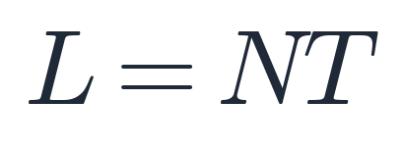
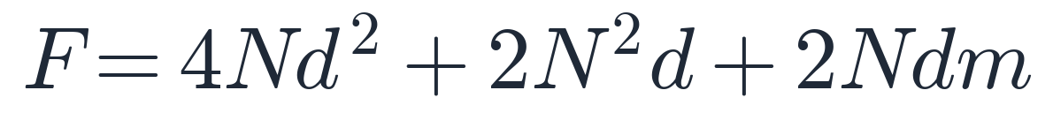

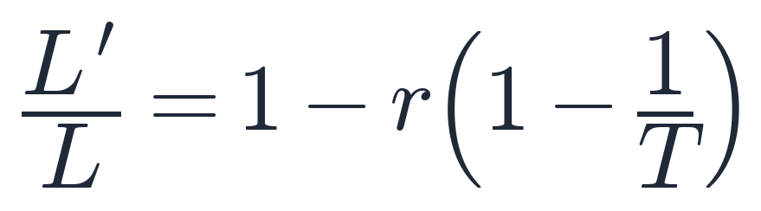
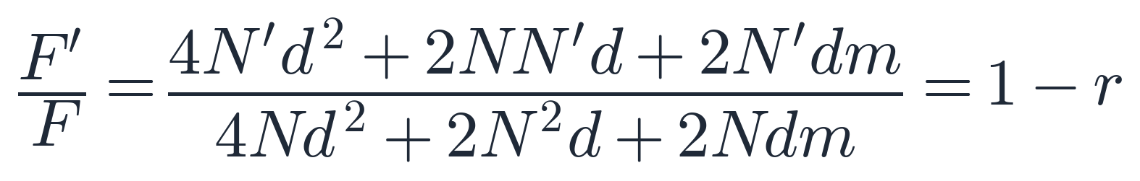
DySta · Context Length and Acceleration
Static-Dynamic Disentanglement for Efficient Multi-Frame Vision-Language-Action Models
Weikang Qiu*, Huashuo Lei*, Tinglin Huang, Aosong Feng, Rex Ying
Static-dynamic disentanglement reduces both the context length (by reusing one copy of static tokens across timesteps) and the per-step LLM FLOPs (by reusing the KV cache of static tokens).
Context Length Reduction
Acceleration Rate (LLM FLOPs)
Only one copy of static tokens is kept across T past observations.
Per-layer cost: QKV projection + self-attention + FFN.
Vanilla VLA (concatenate all past tokens):
Vanilla VLA (recompute every token):
DySta (share one copy of static tokens):
DySta (only N′ dynamic tokens through MHA / FFN):
Ratio (as T grows):
Ratio:
Context drops from NT to NT − rN(T − 1); with r = 0.9 and T = 20, that is an ~85% reduction.
LLM FLOPs scale linearly with the un-cached fraction (1 − r). Gate overhead ≈ 1.27%.
$N$: number of tokens; $T$: steps of past observations; $r$: cached fraction
$d, m$: hidden dim; $N^{′}=rN$
Notes:
The left side shows how much context we need to store a history of observations. Simply concatenating frames repeats every visual token at every step. DySta keeps the static information once and stores the sequence of dynamic tokens. Here we use 20 observations, with 90 percent of the tokens treated as static. The context is about 85 percent shorter.
The right side looks at computation when we reuse the cache. If r is the cached fraction, one minus r is the fraction needing new backbone computation. That reduces work in the projections, attention, and feedforward layers. But actual speed also depends on visual encoding, action decoding, and occasional cache refreshes. We measure the resulting inference speed in the experiments.

Slide 49

DySta · Multi-Frame Memory
Static-Dynamic Disentanglement for Efficient Multi-Frame Vision-Language-Action Models
Weikang Qiu*, Huashuo Lei*, Tinglin Huang, Aosong Feng, Rex Ying
DySta (Ours)
37.4% ⬆️
6.4% ⬆️
29.7% ⬆️
Settings:
20 past observations
Interval = 20 frames (1 frame per second)
Static level: 1
Static ratio: 0.9
Notes:
This memory benchmark asks three questions: what happened, where did it happen, and when did it happen? In the can-heating task, the robot must remember which can was heated. It must also return the can to its original place and remove it after the requested duration. The table tests these abilities through on-stove success, position-reset success, and heating-time error.
DySta uses twenty sampled observations and shares one static context. Most of its history is therefore dynamic information. It performs best on all three measures, including a lower timing error. This shows that the compact history keeps information useful for tasks that the current image alone cannot resolve.

Slide 50


DySta · Inference and Task Success
Static-Dynamic Disentanglement for Efficient Multi-Frame Vision-Language-Action Models
Weikang Qiu*, Huashuo Lei*, Tinglin Huang, Aosong Feng, Rex Ying
DySta reduces inference cost while preserving or improving task success.
Settings:
Static level: 2
Static ratio: 0.52, 0.42
SimplerEnv (base: CogACT)
SimplerEnv
2.26× speedup
Higher task success
+ DySta (Ours)
LIBERO
LIBERO (base: OpenVLA-OFT)
1.70× speedup
96.0% success
Real robot
+ DySta (Ours)
2.21× speedup
Notes:
[40:00] Finally, does reusing computation make inference faster while still letting the robot finish its tasks? The simulation tables test DySta with two base policies: CogACT in SimplerEnv and OpenVLA-OFT in LIBERO. Inference is about 2.3 times faster in SimplerEnv and 1.7 times faster in LIBERO. Task success is preserved or improved.
On the real robot, inference is also more than twice as fast. Together with the memory results, this shows why it helps to separate persistent context from visual changes. Part 3 started with MWM grounding action meaning. It then moved to goals: PHIL searches toward an image-specified state, while DySta follows language instructions through its action policy.

Slide 51




Future: From Reading to Writing… and Closed-Loop
Multi-Modal Brain World Model
(a) World model learning
fUS
fUS
imagined: no observation from here on
fMRI
encode
z_{t}
z_{t+1}
z_{t+2}
z_{t+3}
decode
fMRI
⋯
EEG
EEG
observed
MEG
decode
a
a
a
encode
MEG
stimulus now · stimulation later
⋯
⋯
A foundation model
A brain simulator
One latent behind every modality: encode from any, decode into any, and share it across subjects.
Roll forward with no input, or under a stimulation we choose: the counterfactual a controller needs.
Notes:
So far, most of my work has focused on reading brain signals. We model them, decode what they represent, and use that information to guide AI systems. In the future, I want to move toward writing: influencing brain states through stimulation.
This brings in a new question. How will the brain respond if we intervene? To answer it, we need a model of neural dynamics. It should take the current brain state and a possible intervention, then predict what happens next.
That is the idea of a brain world model. We could use it to compare possible interventions before applying one. Over time, new measurements could help the system update its predictions and move toward a desired brain state.

Slide 52
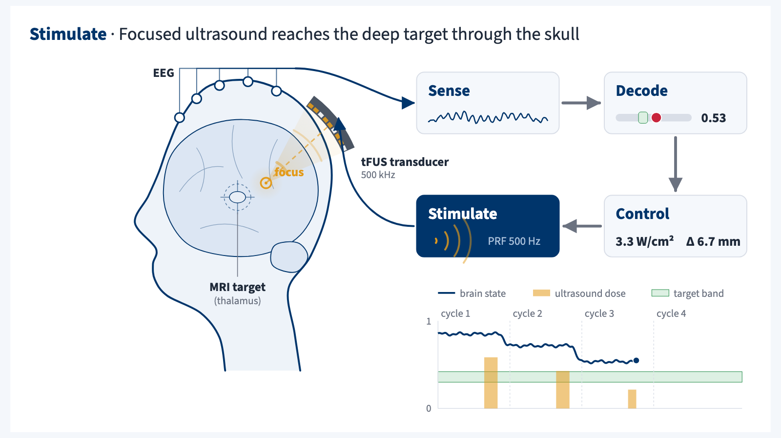
Future: From Reading to Writing… and Closed-Loop
Dreamer over Brain Frames
(b) Actor–critic learning
v value
v value
h
h
⋯
π policy
π policy
v and π decoded from the brain
z: latent state h: recurrent state
Closed-loop focused ultrasound for chronic pain
a = tFUS
r = decoded pain state
Also: depression · anxiety · addiction · stroke rehabilitation · motor control
Notes:
This slide shows how such a system might work. We would map different recording modalities into a shared brain state. The world model would then predict how that state changes under different interventions.
The key difference from MWM is what we predict. Here, we predict neural dynamics. In MWM, we predict the visual consequences of actions.
Following the Dreamer-style approach, we could learn a stimulation policy using these predicted trajectories. We would then refine it with real measurements. The loop is simple: read the brain state, predict a response, apply stimulation, and measure again.
Focused ultrasound for chronic pain is one possible application. A central challenge is making reliable predictions for each individual.

Slide 53




Thanks
Advisor
Committee
Rex Ying
Smita Krishnaswamy
Arman Cohan
Yujun Yan
Yale
Yale
Yale
Dartmouth
Notes:
Before I finish, I'd like to thank my advisor, Rex Ying, for his guidance and support throughout my PhD. I'd also like to thank my committee: Smita Krishnaswamy, Arman Cohan, and Yujun Yan. Thank you for your time and thoughtful feedback.
And thank you to everyone here for joining me today.
[References - not spoken]
Rex Ying
Profile: https://engineering.yale.edu/research-and-faculty/faculty-directory/rex-zhitao-ying
Photo: https://engineering.yale.edu/application/files/thumbnails/custom_720x720_exact/8217/8965/9123/yale-engineering-rex-ying.webp
Smita Krishnaswamy
Profile: https://engineering.yale.edu/research-and-faculty/faculty-directory/smita-krishnaswamy
Photo: https://engineering.yale.edu/application/files/thumbnails/custom_720x720_exact/6417/3090/4793/Smita_Krishnaswamy_computer_science.webp
Arman Cohan
Profile: https://nlp.cs.yale.edu/team/
Photo: https://nlp.cs.yale.edu/images/teampic/arman_cohan.jpeg
Yujun Yan
Profile: https://faculty-directory.dartmouth.edu/yujun-yan
Photo: https://faculty-directory.dartmouth.edu/sites/faculty_directory.prod/files/styles/profile_portrait/public/faculty_directory/images/yujun_wo_background_high_resolution_1.jpg?itok=5YQfHInR

Slide 54
Q&A
Thanks!
Notes:
That's the end of my talk. Thank you for listening. I'm happy to take your questions.

