Slide 1
X-Car review n°0
Team Chidi
November 06 / 2023
Authors :
Ana Carolina Coelho Robl
Arthur Nicola
Baptiste Turpin
Loïc Thomas
Nicolas Siard
Pierre Bonnecaze
Louis Vialan
Well-John Lu

Slide 2
Table of contents
Product Description
Features
State machine
Operational requirements
Reusable features
Stakeholders
Deliverables
Release Vision
First sprint planning
Stories
Product backlog
Validation plan
Risk management

Slide 3






Product Description
Who needs it?
INSA Community : People with reduced mobility, teachers, students, visitors
To carry bulky and heavy items safely and efficiently on the campus

Slide 4

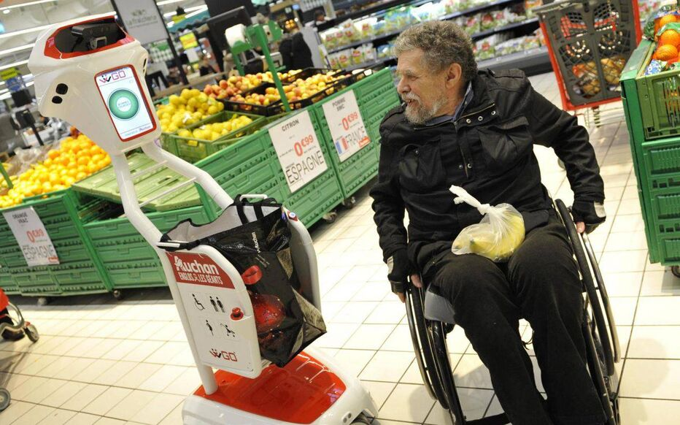



Product Description
How?
Wiigo, a robot that carries your groceries [https://www.leparisien.fr/economie/ce-robot-porte-vos-courses-19-11-2016-6347337.php]
A Human Machine Interface (HMI) to control and get feedback on the vehicle
Bugs, problems and decisions of the vehicle will be explained to the user
3 Different modes : Manual, Tracking, Autonomous

Slide 5



Features
3 Different Modes
Manualc
Tracking
Autonomous

Slide 6
Features
Manual mode
Functionalities
Control the car with a wireless joystick
The vehicle will stop by itself if an obstacle is detected
The system will explain the decision it made through visual/sound feedback
Moving
Detect Obstacles
Emergency STOP
Visual Feedback
Sound Feedback

Slide 7
Features
Tracking mode
The system will be initialized according to some parameters
As long as the vehicle can, it will follow the person wherever it goes
Try to avoid the obstacle to keep tracking the person
At the end of the tracking, the user must leave the car in a safe place
Functionalities
Tracking
Detect Obstacle Type
Avoid Obstacle

Slide 8
Features
Autonomous mode
Send a request from a position through the HMI
The vehicle will reach that position by itself if it is possible
Switch the mode to tracking through the interface
The vehicle will drive back to its departure location if it has a problem (loss of signal, unreachable position) or if the user never used it
Functionalities
Autonomous Driving
Localisation
Navigation

Slide 9

Features
Definitions
Fixed
Moving
Unavoidable
Insurmountable
Obstacle that does not move
Obstacle that is moving (at a minimum speed of 0.25m/s) and can hit the X-car
Obstacle that is too close to the vehicle to bypass it. It can be an obstacle that emerges on the vehicle’s trajectory
Obstacle that cannot be crossed by the vehicle: path that is too narrow or a change in level that is too high like a step

Slide 10
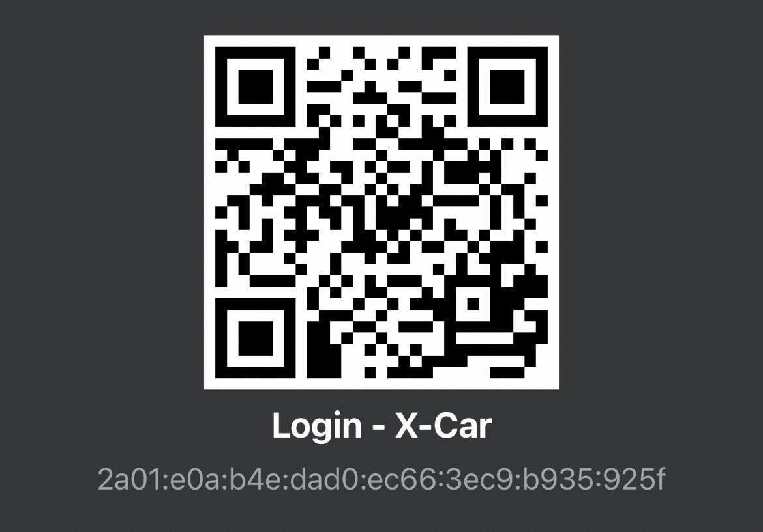

QR CODES
Phone on 4G
Phone on Wifi

Slide 11
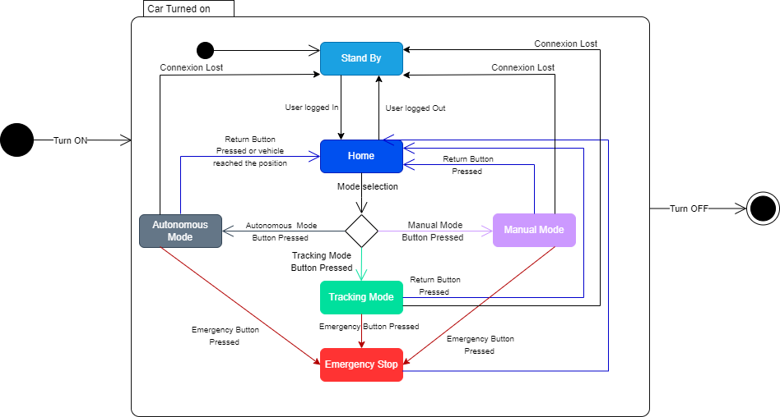
State machine

Slide 12



Operational requirements
Moving the car :
Time response under 0.2s
Maximum speed of 6 km/h
30 degree turn
Obstacle detection :
Detection distance between 40cm and 1m30

Slide 13




Operational requirements
Emergency stop :
On the vehicle, on the remote controller or on the HMI
Unavoidable or insurmountable obstacle
Visual feedback on HMI:
Change mode (Autonomous, Manual, Tracking, Emergency stop)
Battery level
GPS coordinates + Map

Slide 14


Operational requirements
Avoid obstacle :
Avoid obstacle at least at 20cm
Object recognition :
Distinguish between fixed, moving, unavoidable and insurmountable obstacle

Slide 15
Operational requirements
Autonomous moving :
Shortest itinerary
Arriving time
Tracking :
Track the user between 1m and 1m30
Follow the user movement

Slide 16




Operational requirements
Location :
Send and display location
Position accuracy of 1m
(User and X-car)
Sound feedback :
Change mode (Autonomous, Manual, Tracking, Emergency stop)
Low battery warning
Navigation:
Navigation is saved
(loss of connection )

Slide 17
Reusable features
Obstacle detection and avoidance
Autonomous driving
Application and sound communication
Tracking System

Slide 18
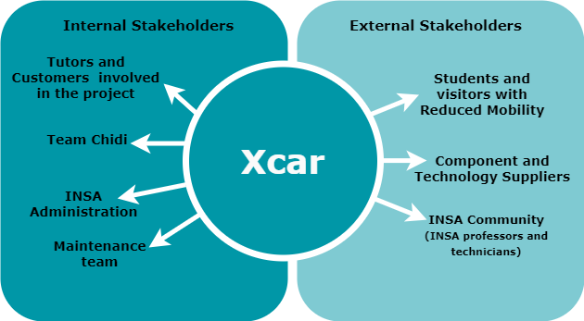
Stakeholders

Slide 19
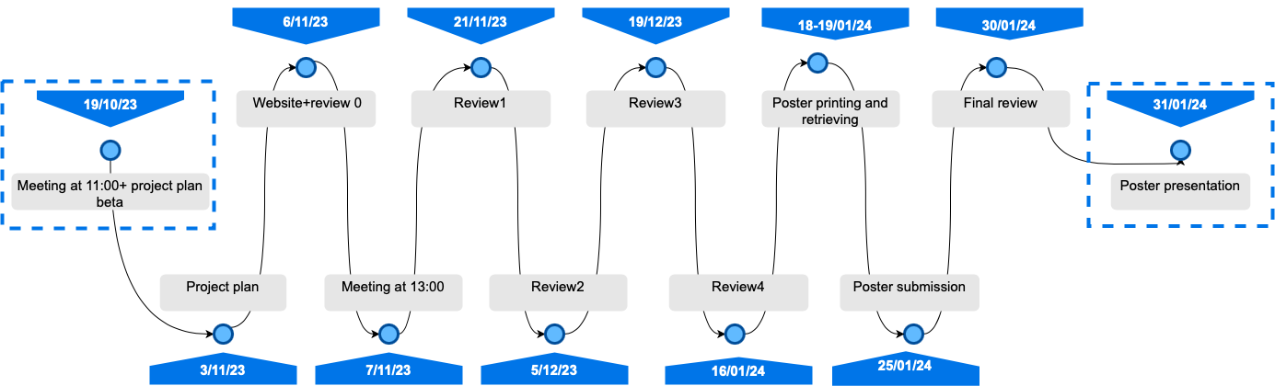
Deliverables

Slide 20
Release Vision
- Tracking a special characteristic.
- Follow the tracked person while detecting obstacles.
- First version of the app.
- First version of the state machine.
- Project plan done.
Sprint 0
Sprint 2
Sprint 1
Sprint 3*
- Autonomous mode.
- Avoid obstacles in tracking mode.
- Final version of the app.
- Final state machine.
- Manual control.
- Obstacle detection.
- Emergency stop button on the remote control.
- HMI : visual feedback on the computer (console).
*It's difficult to know the objectives that we will set for the sprint 3 but here is a first idea.

Slide 21

Story 1
Moving the car : As a user, I want to drive the X-Car with an Xbox controller, so that I can control its speed and direction.
Tests
Tasks
Connect the Xbox controller to the X-Car and check if the connection is established.
Move the left joystick on the controller and check if the X-Car moves forward or backward according to the joystick position.
Move the right joystick on the controller and check if the X-Car turns left or right according to the joystick position.
Task 1- Set up the hardware and software components for connecting the Xbox controller to the X-Car.
Task 2- Write a program that reads the input from the controller and converts it into commands for the X-Car’s motors.
Task 3- Perform unit testing and integration testing for each task.
November

Slide 22

Story 2
Detect obstacle : As a user, I want the X-Car to stop automatically when it faces an obstacle, so that I can avoid collisions and damage.
Tests
Tasks
- Place an obstacle at a distance of 70 cm in front of the X-Car and drive it towards the obstacle. Check if the X-Car stops before 20 cm from the obstacle.
- Place an obstacle at a distance of 70cm behind the X-Car and drive it backwards. Check if the X-Car stops before 20 cm from the obstacle.
- Place an obstacle at a distance of 70 cm with an angle between 20 and 30 ° on the side of the X-Car and drive it sideways. Check if the X-Car stops 20 cm from the obstacle.
Task 1- Set up the hardware and software components for detecting obstacles using ultrasonic sensors and LIDAR.
Task 2- Write a program that reads the distance from each sensor and compares it with a threshold value.
Task 3- Write a program that stops the motors when any sensor detects an obstacle within the threshold distance.
November
Task 4- Perform unit testing and integration testing.

Slide 23


Story 3
Emergency Stop : “As a user, I want to press an emergency stop button on the controller, so that I can stop the X-Car in less than 1s in case of danger.”
Tests
Tasks
Task 1- Set up the hardware and software components for activating an emergency stop button on the controller.
Task 2- Reads the state of the button and sends a signal to the X-Car.
- Press the emergency stop button and check if the X-Car stops in less than 1s.
- Release the emergency stop button and go back to the home menu and check if the vehicle is still immobile.
Task 3- Stop the motors and disable the input when the signal is received.
November
Task 4- Perform unit testing and integration testing.

Slide 24


Story 4
Visual Feedback: “As a user, I want to see the history of the different operating modes of our vehicle, and the actual mode. I also want to see the different transitions activated.”
Tests
Tasks
Task 1- Get the changing mode information in the software
Task 2- Identify the place where the information will be displayed.
- Display the actual mode on the computer console.
- Save the history of the different operating modes in a file “history_operating_mode .txt “. Check that it’s the right history.
Task 3- Display all the information the user needs ( changing mode information, level battery,...)
November

Slide 25
Product backlog
User Stories | Description | Priority
Moving the car | I want to drive the X-Car with an Xbox controller, so that I can control its speed and direction. | 2
Detect Obstacle | I want the X-Car to stop automatically when it faces an obstacle, so that I can avoid collisions and damage | 3
Emergency Stop | I want to press an emergency stop button on the controller, so that I can stop the X-Car in less than 1 second in case of danger | 1
Visual Feedback | I want to see the history of the different operating modes of our vehicle, and the actual mode. I also want to see the different transitions activated. | 4

Slide 26






Validation plan
Test Procedure | Expectations | Process
 | The system must be operational/turned off within a maximum of 10 seconds after pressing the ON/OFF Button | Get the switch On once at the beginning. Observe. Get the switch Off while the car is not moving
 | The vehicle should respond to all remote control commands within 0.2s | 5 seconds forward, right turn at around 25 degrees, 5 seconds backward, left turn ( around 25°)
 | The vehicle stops when it faces an obstacle in the direction maintained (at least 20 cm from the obstacle) | Place an obstacle in the X-Car's path at a distance longer than 70 cm and look at the distance after the car stops
 | The vehicle should stop in less than 1s. The vehicle is still operational. | Test the emergency stop button while the car is moving
 | The user must be able to access the decision history made by the car on the computer from the moment it is turned on until it is turned off. | Check the history on the computer 1 second after the vehicle has detected an obstacle and so has stopped

Slide 27




Risk management
Initial risk assessment strategy :
Identify challenges in development.
Prioritize proactive measures.
Continuous communication in the team.
(progress, updates etc.)

Slide 28

Risk management
Risks and actions – Technical
Risk | Anticipation | Response
The car cannot reach the user (autonomous mode) | The car has to wait in a reachable location | Warn the user and find another meeting point. Or go back to the initial location
Lose the user (tracking) | Use different features for tracking | Stop the car and warn the user (app and audio)
Bad implementation of the state machine (unknown error) | Follow carefully the state machine Increment systematically the state machine | Check firstly if the code does not work or if it is a state machine problem.

Slide 29

Risk management
Risks and actions – Human
Risk | Anticipation | Response
Late for a release | Communication in the team, respect the schedule | Inform the clients Rework on the sprint scheduling Simplify
Members are not available for a meeting | Be clear about availabilities | Postpone the meeting or do it remotely
Stakeholders may request impossible additional features | Clearly define the project scope and obtain stakeholder approval Establish a change control process. | Assess the impact of these changes Negotiate with stakeholders Adjust the project plan

Slide 30
Thanks for listening.
Any questions?

Slide 31
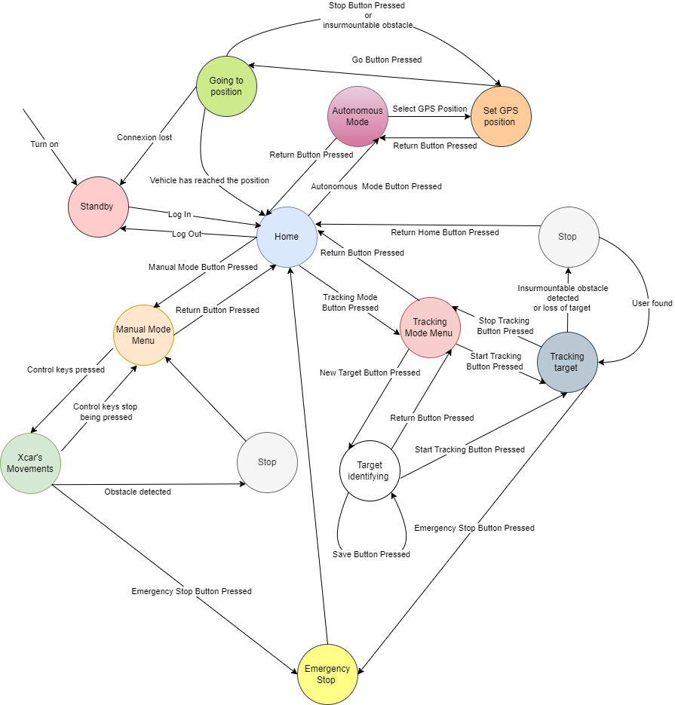
Annex 1

Slide 32
Annex 2.1
Risk | Number | Anticipation | Response
Lose the user (tracking) | 1 | Use different features for the tracking | Stop the car and warn the user (app and audio)
Loose connection | 2 | Always check the connection state, maintain a small distance with the user | Stop the car and warn the use
Blocked by an object | 3 | None | Stop for a few moments. If the object does not move, avoid it. Otherwise stay stopped and warn the user
The car cannot reach the user (autonomous mode) | 4 | The car has to wait in a reachable location | Warn the user and find another meeting point. Or go back to the initial location

Slide 33
Annex 2.2
Some sensors are not working | 5 | Check that the sensors are available with a simple code. For the main components, prepare spare components. | If the sensors are redundant for some features, try to operate without them. Otherwise if the sensors are important stop and warn the user. Buy/Order new sensors
Late for a release | 6 | Communication in the team, respect the schedule | Inform the clients, rework on the sprint scheduling. Simplify or discuss the lowest priority features to give up with the customer
Stakeholders may request additional features or modifications beyond the initially defined scope, leading to project delays | 18 | Clearly define the project scope and obtain stakeholder approval. Establish a change control process. | Assess the impact of requested changes,negotiate with stakeholders, and adjust the project plan as needed.

Slide 34
Annex 2.3
Bad implementation of the state machine (unknown error) | 7 | Follow carefully the state machine (available for us and the client on the drive) while programming. Check the state machine with the tutor. Increment the state machine in an organized manner | Check firstly if the code does not work or if it is a state machine problem.
Phone app does not work properly | 8 | Before releasing the app, check if it works well without the car | Check if it is a communication problem between the car and the phone. Otherwise, check separately the car and the app to find the problem

Slide 35
Annex 2.4
We order an important component but we never have it | 14 | Order as early as possible. Think about other features that not need this component | Find an alternative
Code is lost | 15 | Do not forget to git push when there is a big addition for the project. | When we do something a second time, it is always better so don’t worry
Almost all the team is sick for an important meeting/presentation | 16 | Warn as early as possible | Postpone it
Inadequate communication within the team or with stakeholders can result in misunderstandings and missed requirements | 17 | Maintain clear lines of communication, document project details, and establish regular check-ins | Address communication issues and adjust project plans or documentation to align with revised requirements

Slide 36
Annex 2.5
Risk Matrix | Very high proba | High probability | Small probability | Unlikely
Critical |  |  | 14 | 11;15
Major |  | 17 | 5;12 | 16
Minor |  | 1;2;6;7;13;8;18 | 9
Negligible | 3 | 10 | 4

