Slide 1
X-Car review n°1
Team Chidi
November 21 / 2023
Authors :
Ana Carolina Coelho Robl
Arthur Nicola
Baptiste Turpin
Loïc Thomas
Nicolas Siard
Pierre Bonnecaze
Louis Vialan
Well-John Lu

Slide 2
Table of contents
Introduction
X-Car state machine
Story 1 : Moving the car
Story 2 : Detect obstacle
Story 3 : Emergency stop
Story 4 : Visual feedback
Bilan sprint 1
Release vision
Sprint 2 goals

Slide 3







Introduction
Story 1 : Moving the car
Story 2 : Detect obstacle
Story 3 : Emergency stop
Story 4 : Visual feedback

Slide 4
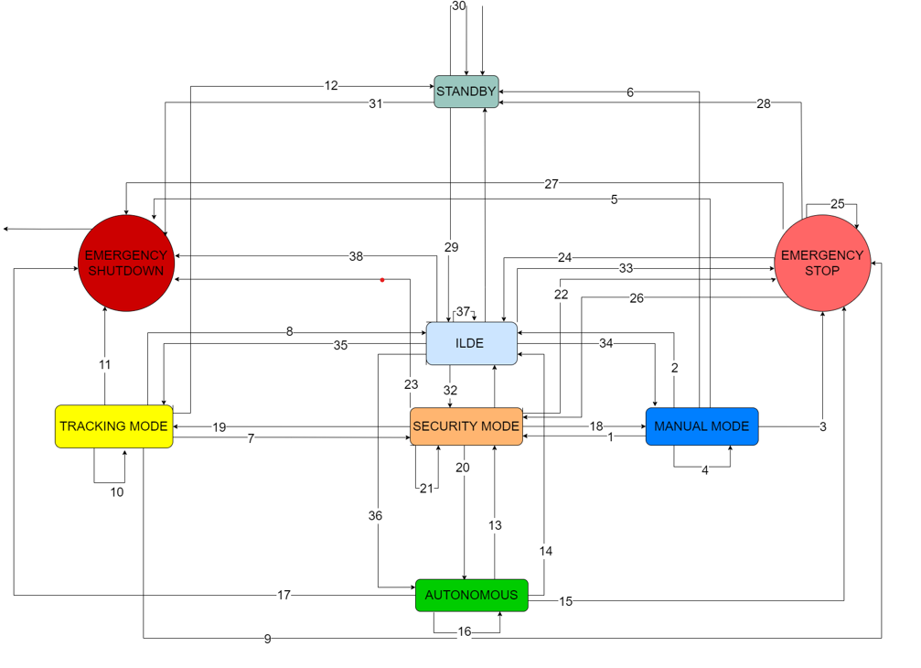
X-Car state machine

Slide 5
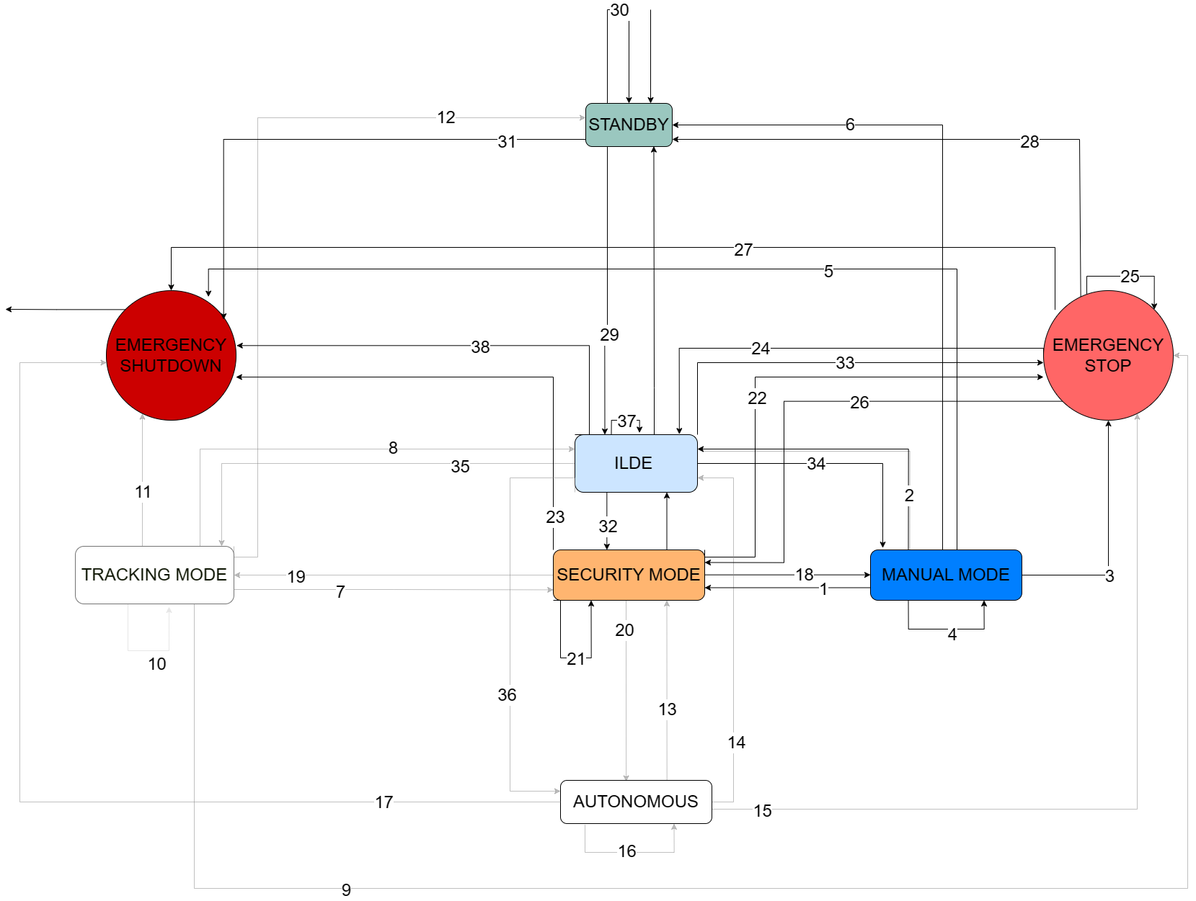
X-Car state machine

Slide 6
Story 1 : Moving the Car
Remote controller is connected to the X-Car
Check connection with Raspberry pi
X-Car can move forward and backward according to the LT and RT buttons
Check the response to these buttons
(LT drive it backward, RT drive it forward)
The X-Car can turns left or right according to the left joystick position
Check X-Car ability to take a minimum of a 30 degree turn

Slide 7
Story 2 : Detect obstacle
X-Car is able to detect an obstacle at a distance of 1m30
Check the value return by the ultrasonic sensor (in cm)
X-Car stop at least at 20cm when facing an obstacle
Check if with an obstacle placed at 70cm, X-Car stop at least at 20cm
Check if it’s work in both directions (drive forward and backward)

Slide 8
Story 3 : Emergency stop
The user can stop the X-Car using the Emergency Stop buttons
Check if the X-Car stop after pressing B button on the remote controller
(X-Car is now in Emergency Stop mode)
Check if the X-Car stop after pressing the power button on the vehicle
(X-Car is now switched off)
The user can exit the Emergency Stop state
Check by pressing start button we go back to IDLE mode
From IDLE mode check by pressing Y button, we go back to Manual mode

Slide 9
Story 4 : Visual feedback
Display the actual mode on the computer console
Check that the actual mode is well display on the console
Check when we changing the mode it can be seen on the console

Slide 10


Bilan Sprint 1
We succeed in our tasks:
Why?
Problems encountered:
Respect the agile method
Good distribution of tasks
Easy to create new Github branches
SD card was not flashed
Potentiometer incorrectly set
Ultrasonic Sensors were not positioned as we wanted

Slide 11
Release Vision
- Tracking a special characteristic.
- Follow the tracked person while detecting obstacles.
- First version of the app.
- First version of the state machine.
- Project plan done.
Sprint 0
Sprint 2
Sprint 1
Sprint 3*
- Autonomous mode.
- Avoid obstacles in tracking mode.
- Final version of the app.
- Final state machine.
- Manual control.
- Obstacle detection.
- Emergency stop button on the remote control.
- HMI : visual feedback on the computer (console).
*It's difficult to know the objectives that we will set for the sprint 3 but here is a first idea.

Slide 12
Release Vision
- Tracking a special characteristic.
- Follow the tracked person while detecting obstacles.
- First version of the app.
- Detect obstacles with LIDAR
- First version of the state machine.
- Project plan done.
Sprint 0
Sprint 2
Sprint 1
Sprint 3*
- Autonomous mode.
- Avoid obstacles in tracking mode.
- Final version of the app.
- Final state machine.
- Manual control.
- Obstacle detection.
- Emergency stop button on the remote control.
- HMI : visual feedback on the computer (console).
*It's difficult to know the objectives that we will set for the sprint 3 but here is a first idea.

Slide 13

Sprint 2 goals story 1
Tracking a person: As a user, I want to be followed at a distance between 1m and 1m and 30 on a straight line by the Xcar
Tasks
Task 1- Set up the hardware components in order to have a first recognition system
Task 2- Write a program that allows the car to follow the user in a straight line
November
Task 3- Add obstacle detection to the tracking mode
Task 4- Perform unit testing and integration testing for each task

Slide 14
Sprint 2 goals story 1
Tracking a person: As a user, I want to be followed at a distance between 1m and 1m and 30 on a straight line by the Xcar
Test
Check that the X-Car recognizes the target
Check the distance between the user and the car
Check that the vehicle stops when it faces an obstacle
Check that the vehicle stops when the user wants to stop the tracking

Slide 15


Sprint 2 goals story 2
Web interface: As a user, I want to navigate on a web application in order to change the modes of the vehicle or to stop it. I also want to have visual feedback on my interface
Tasks
Task 1- Set up the base of our application by using a application development tool
Task 2- Implement our modes and visual feedback on the interface
November
Task 3- Set up the communication between the application and the X-Car
Task 4- Perform unit testing and integration testing for each task

Slide 16
Sprint 2 goals story 2
Web interface: As a user, I want to navigate on a web application in order to change the modes of the vehicle or to stop it. I also want to have visual feedback on my interface
Test
Check all the modes are implemented on the application
Check all transitions of the state machine are respected and functional with the X-Car
Check that the user has access to visual feedback and history on the interface

Slide 17

Sprint 2 goals story 3
Obstacle Detection with LIDAR : As a user, I want to detect an obstacle with the LIDAR to get more accuracy
Tasks
Task 1- Set up the hardware and software components in order to have the data from the LIDAR
Task 2- Write a program that reads the distance and the direction given from LIDAR data
November
Task 3- Visualize 2D map points around the X-Car on ROS
Task 4- Perform unit testing and integration testing for each task

Slide 18
Sprint 2 goals story 3
Obstacle Detection with LIDAR : As a user, I want to detect an obstacle with the LIDAR to get more accuracy
Test
Check the LIDAR detects obstacles at least at 4m all around the car
Check the LIDAR can detect obstacles up to 60 cm high
Check we can have a 2D map of points around the X-Car given by the LIDAR

Slide 19
Annex 1 : Moving the car
Demo video : https://drive.google.com/file/d/1hdfUCTlP9DzCvz_UpzzD98BVzzDjVC91/view?usp=drive_link

Slide 20
Annex 2 : Detect obstacle
Demo video :

Slide 21
Annex 3 : Emergency stop / Visual feedback
Demo video : https://drive.google.com/file/d/1KYftI-AW3MvRsNfEM8WNCY1Xms2nQYzO/view?usp=drive_link

Slide 22
Annex 4 : State machine variables
Variables
obstacle_ar, obstacle_av : if there is an obstacle at 20 cm forward/backward
obstacle_unavoidable: inevitable obistacle
sensor_dead : a/multiple sensors are not working anymore
connection: connection with user established
emergency_btn : emergency button is pressed
dir_av, dir_ar : movement direction of the car (forward or backward)
ps : previous state, at each transition the last state is kept in memory
stop_timer: time of state passage
manual, tracking, autonomous, Idle : button on the HMI
return : return button on the HMI

Slide 23
Annex 5 : State machine transitions
Transitions
1) Manual Mode -> Security Mode [((obstacle_av and dir_av) or (obstacle_ar and dir_ar)) or or sensor_dead ] and connection and !emergency_btn and !emergency_shutdown
2) Manual Mode -> Idle return and !manual and connection and !sensor_dead and !emergency_btn and !emergency_shutdown
3) Manual Mode -> Emergency stop emergency_btn and !emergency_shutdown
4) Manual Mode -> Manual Mode !emergency_btn and ((obsatcle_ar and dir_av) or (obstacle_av and dir_ar) or (!obstacle_ar and !obstacle_av)) and manual and !return and connection and !sensors_dead and !emergency_shutdown
5) Manual Mode -> Emergency_Shutdown emergency_shutdown
6) Manual Mode -> Standby !emergency_btn and !emergency_shutdown and !connection
7) Tracking Mode -> Security Mode [(((obstacle_av and dir_av) or (obstacle_ar and dir_ar)) and obstacle_unavoidable) or sensor_dead ] and connection and !emerrgency_btn and !emergency_shutdown
8) Tracking Mode -> idle Idle and !tracking and connection and !sensor_dead and !emergency_btn and !emergency_shutdown
9) Tracking Mode -> Emergency Stop emergency_btn and !emergency_shutdown

Slide 24
Annex 6 : State machine transitions
10) Tracking Mode -> Tracking Mode ( ( ((obstacle_av and dir_av) or (obstacle_ar and dir_ar)) and !obstacle_unavoidable) or (!obstacle_ar and !obstacle_av) ) and connection and !sensors_dead and !emergency_btn and tracking and !return and !emergency_shutdown
11) Tracking Mode -> Emergency_Shutdown emergency_shutdown
12) Tracking Mode -> Standby !emergency_btn and !emergency_shutdown and !connection
13) Autonomous Mode -> Security Mode [(((obstacle_av and dir_av) or (obstacle_ar and dir_ar)) and obstacle_unavoidable) or sensor_dead ] and connection and !emerrgency_btn
14) Autonomous Mode -> idle Idle and !autonomous and connection and !sensor_dead and !emergency_btn
15) Autonomous Mode -> Emergency Stop emergency_btn
16) Autonomous Mode -> Autonomous Mode ( ( ( (obstacle_av and dir_av) or (obstacle_ar and dir_ar) ) and !obstacle_unavoidable) or (!obstacle_ar and !obstacle_av)) and connection and !sensors_dead and !emergency and autonomous and !return and !emergency_shutdown
17) Autonomous Mode -> Emergency_Shutdown emergency_shutdown
18) Security Mode -> Manual Mode ( (!obstacle_ar and !obstacle_av) or ((obstacle_ar and dir_av) or (obstacle_av and dir_ar))) and !sensor_dead and connection and ps = manual and !emergency_btn and !emergency_shutdown

Slide 25
Annex 7 : State machine transitions
19) Security Mode -> Tracking Mode ((!obstacle_ar and !obstacle_av) or (obstacle_av and dir_ar) or (obstacle_ar and dir_av) or (((obstacle_av and dir_av) or (obstacle_ar and dir_ar))and !obstacle_unavoidable)) and !sensor_dead and connection and ps = tracking and !emergency_btn and !emergency_shutdown
20) Security Mode -> Autonomous Mode ((!obstacle_ar and !obstacle_av) or (obstacle_ar and dir_av) or (obstacle_av and dir_ar) or (((obstacle_av and dir_av) or (obstacle_ar and dir_ar)) and !obstacle_unavoidable)) and !sensor_dead and connection and ps = autonomous and !emergency_btn and !emergency_shutdown
21) Security Mode -> Security Mode (obstacle_unavoidable or sensor_dead or !connection) and !emergency_btn and !emergency_shutdown
22) Security Mode -> Emergency Stop emergency_btn and !emergency_shutdown
23) Security Mode -> Emergency_Shutdown emergency_shutdown
24) Emergency Stop -> Idle btn_to_Idle and !emergency_shutdown and connection and !sensors_dead and !emergency_stop and !emergency_shutdown
25) Emergency Stop -> emergency Stop (!btn_to_idle or !emergency_shutdown or emergency_btn) and !emergency_shutdown
26) Emergency Stop -> Security Mode sensors_dead and !emergency_shutdown and !emergency_btn
27) Emergency Stop -> Emergency_Shutdown emergency_shutdown
28) Emergency Stop -> Standby !connection and !emergency_shutdown

Slide 26
Annex 8 : State machine transitions
29) Standby -> idle connection and !emergency_btn and !emergency_shutdown
30) Standby->standby !connection and !emergency_btn and !emergency_shutdown
31) Standby ->Emergency_Shutdown emergency_shutdown
32) idle -> Security Mode sensor_dead and !emergency_btn and !emergency_shutdown and connection
33) idle->Emergency_Stop emergency_btn and !emergency_shutdown and connection
34) idle -> Manual Mode manual and !tracking and !autonomous and connection or !sensor_dead and !emergency_btn and !emergency_shutdown
35) idle -> Tracking Mode tracking !manual and !autonomous and connection or !sensor_dead and !emergency_btn and !emergency_shutdown
36) idle -> Autonomous Mode autonomous and !tracking and !manual and connection and !sensor_dead and !emergency_btn and !emergency_shutdown
37) idle->idle !sensors_dead and connection and !emergency_btn and !emergency_shutdown
38) Idle -> Emergency_Shutdown emergency_shutdown

Slide 27
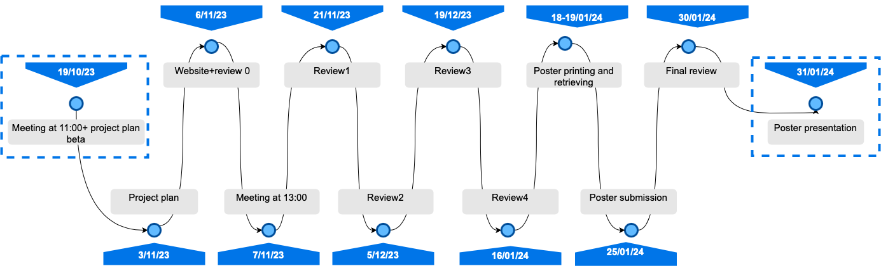
Annex 9 : Deliverables

Slide 28
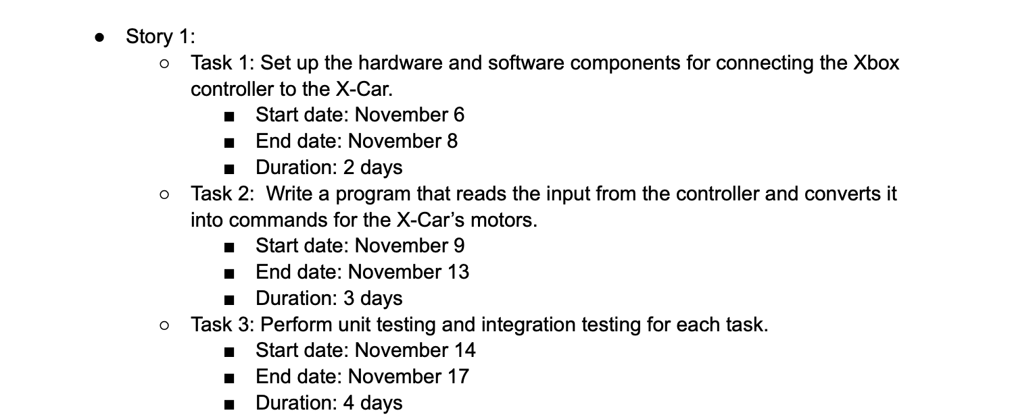
Annex 10 : Calendar story 1

Slide 29
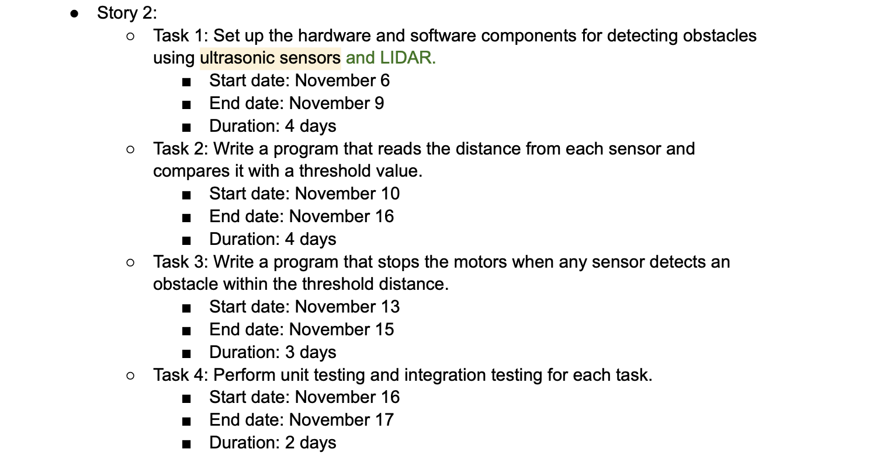
Annex 11 : Calendar story 2

Slide 30
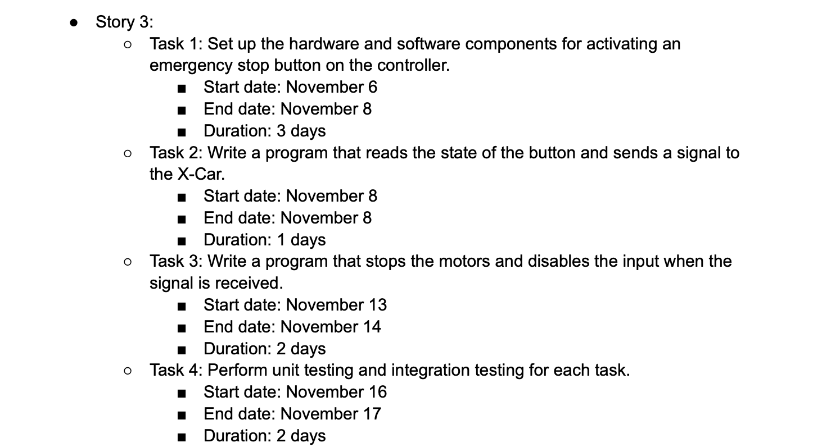
Annex 12 : Calendar story 3

Slide 31
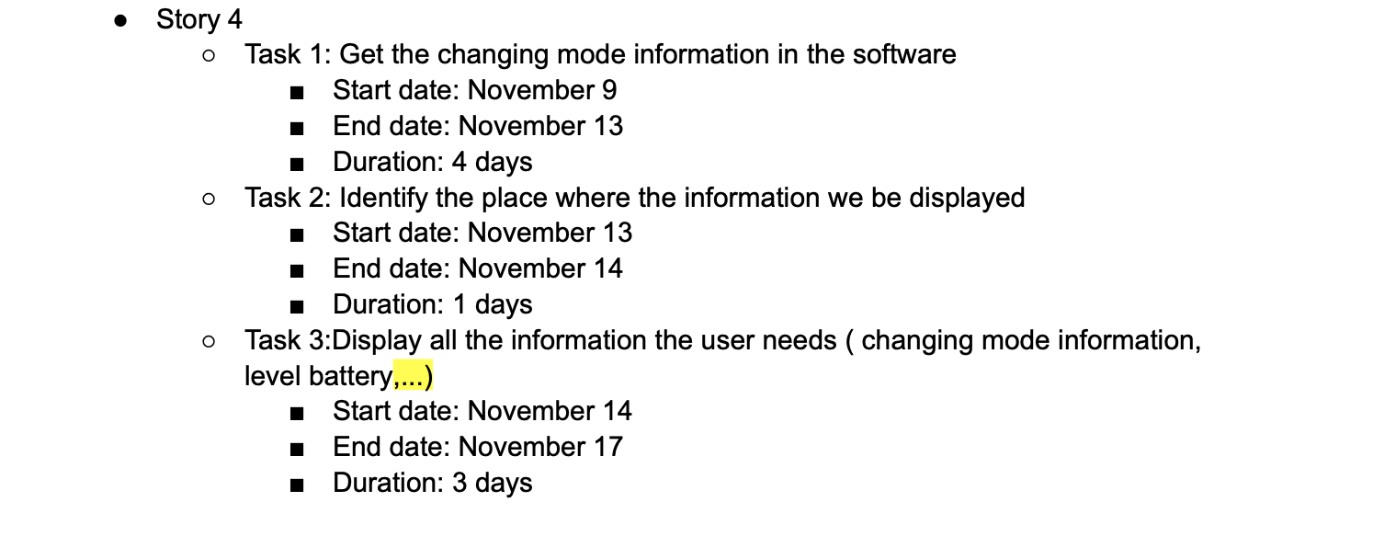
Annex 13 : Calendar story 4

