Slide 1
X-Car review n°4
Team Chidi
January 16 / 2023
Authors :
Ana Carolina Coelho Robl
Arthur Nicola
Baptiste Turpin
Loïc Thomas
Nicolas Siard
Pierre Bonnecaze
Louis Vialan
Well-John Lu

Slide 2
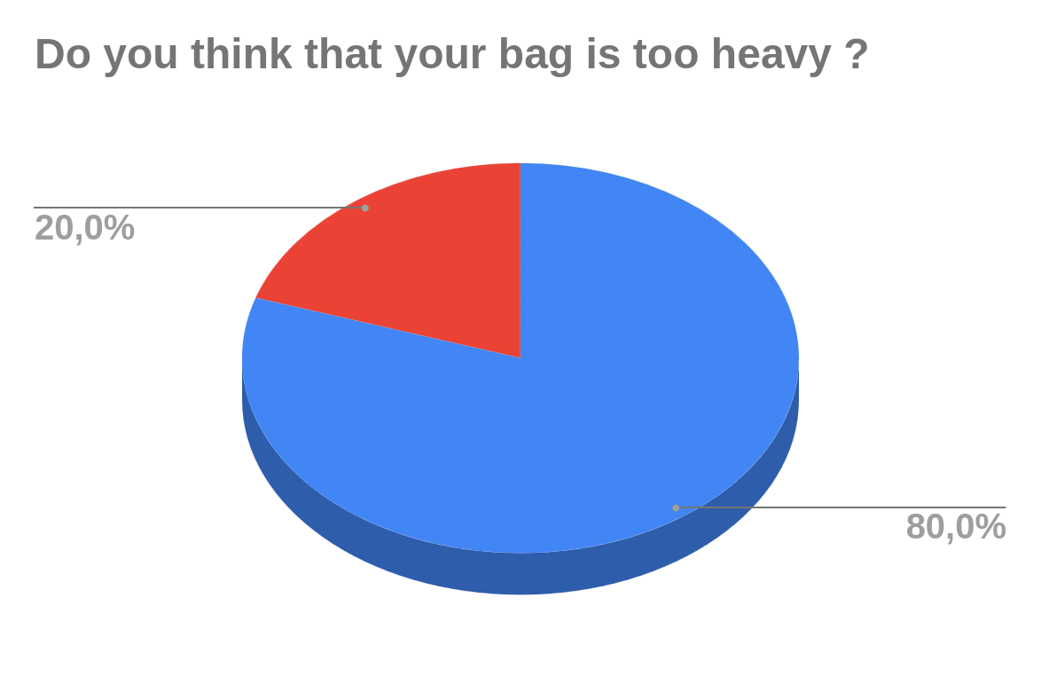
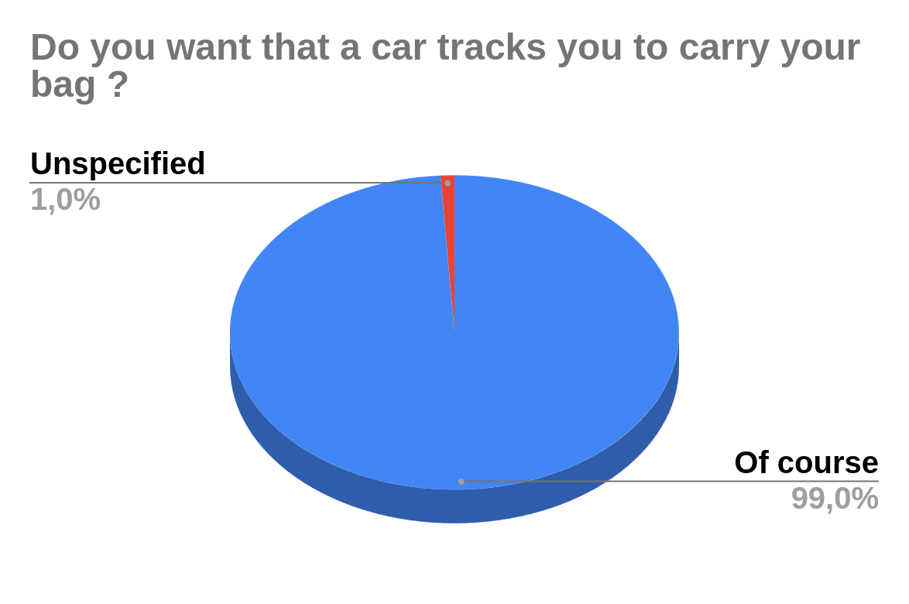
Serious statistics
*
*
Yes in red
Yes !
*Study conducted on Chidi team members

Slide 3




Introduction - why the X-Car ?
Transport heavy loads around the campus
An intelligent car that you can trust
An intuitive interface for the user

Slide 4
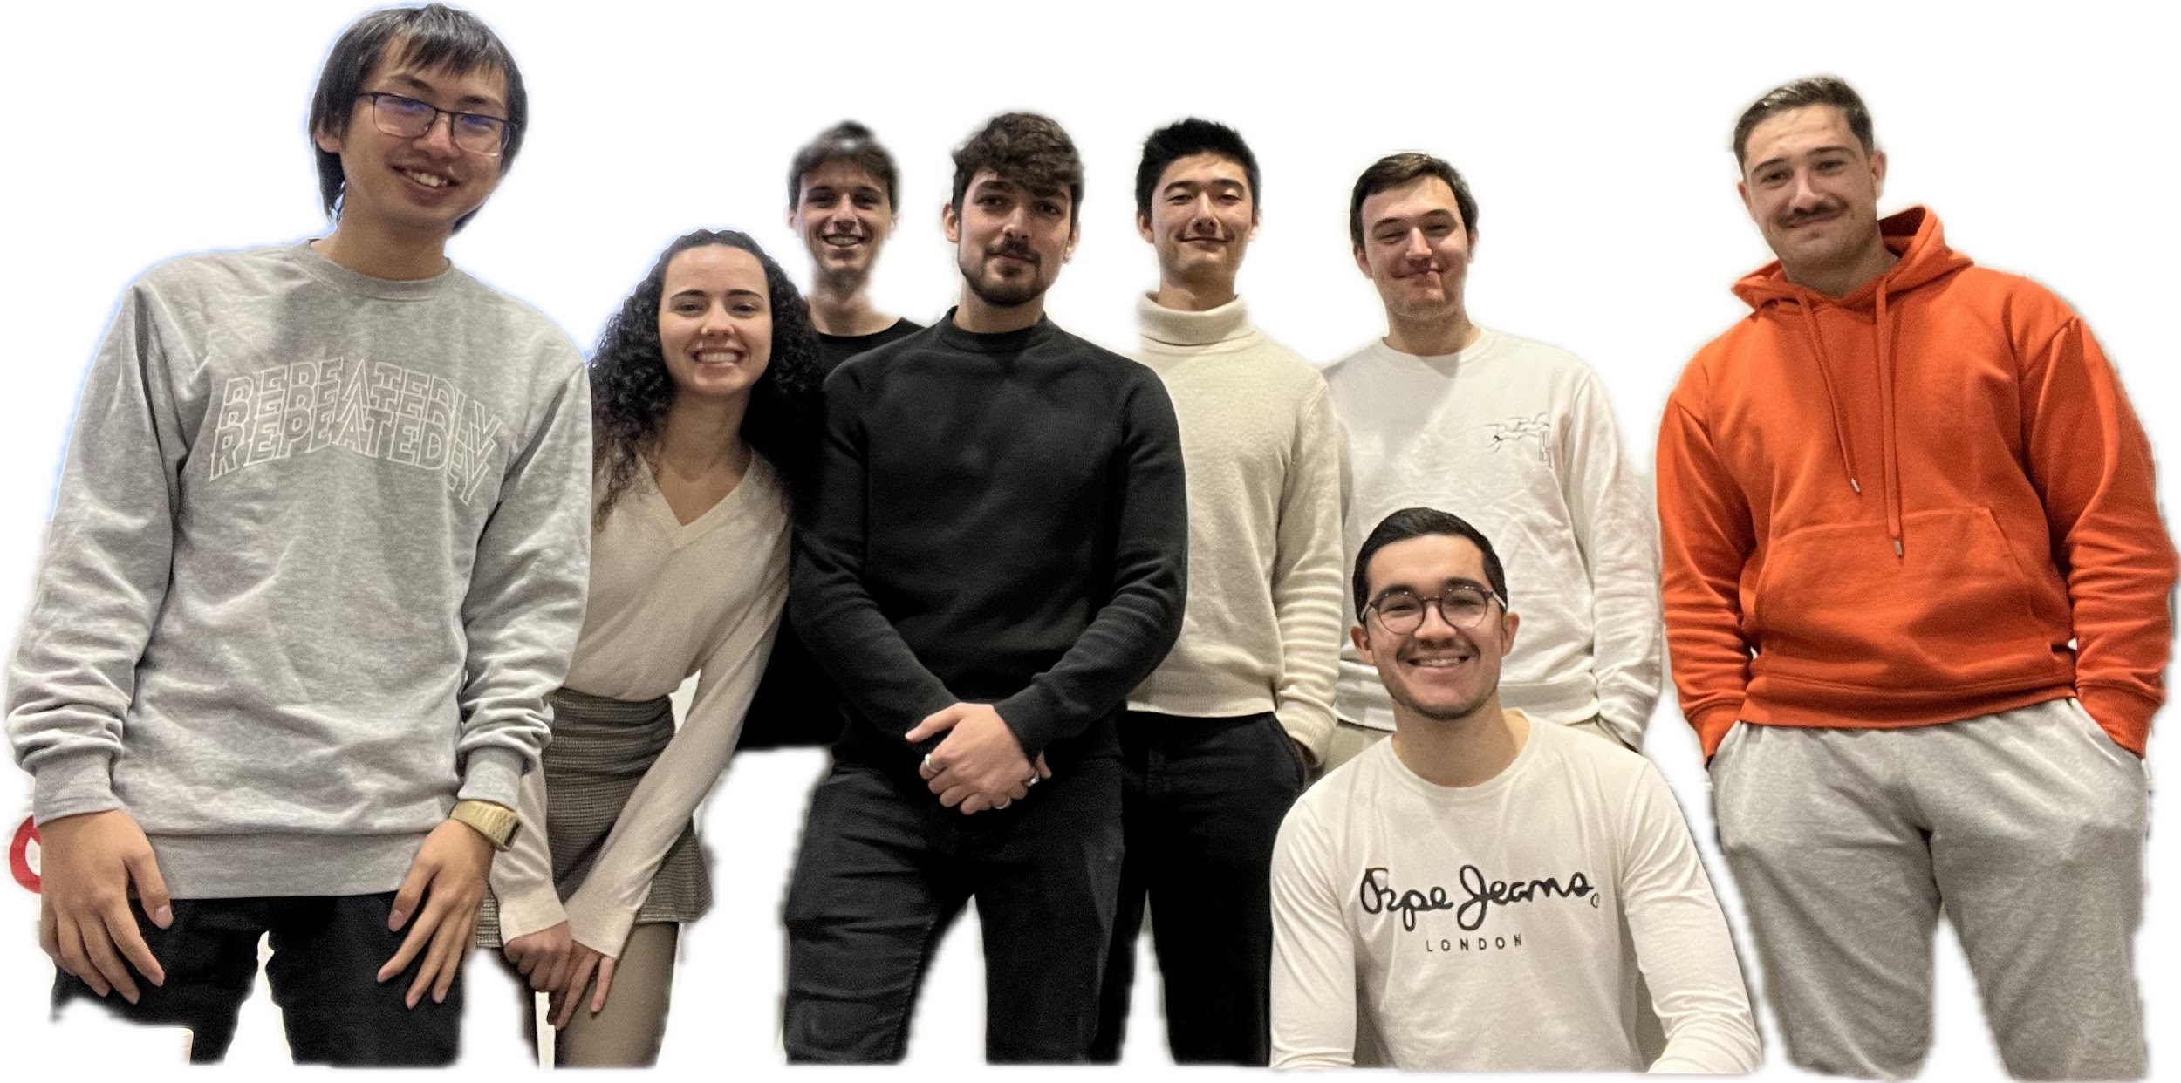

The team

Slide 5




Realised Stories
Story 1: Vocal feedback
Story 2 : System Checking
Story 3 : Improve Tracking mode
Story 4 : Obstacle Avoidance

Slide 6



Story 1 : Vocal Feedback
Tracking mode
Objectives
Improve explainability
Improve user safety
Feedback
Sensor failure
Change mode
Obstacle detected
Sensor failure

Slide 7
Next Sprint : story 1
Improve vocal feedback : As a user, I want the Xcar to be able to warn me of current state changing and system checking : Arthur - Baptiste
Task 1- Play only the current vocal that correspond to the situation
8 Story Points
Tracking mode
IDLE return …
Manual mode
Obstacle detected
…
…
?
?
?

Slide 8

Next Sprint : story 1
Improve vocal feedback : As a user, I want the Xcar to be able to warn me of current state changing and system checking : Arthur - Baptiste
Task 2 - Warn the user when there is a low level of battery
4 Story Points
Low Battery

Slide 9



Story 2 : System Checking
System checking : As a user, I want to check that the system is functioning correctly and that all sensors are operational: Baptiste
Task 1- Detect when a sensor has stopped to work correctly
Task 2- Display the information on the web interface
Task 3- Add obstacle detection in front of the car (tracking mode)

Slide 10


Story 2 : System Checking
Detect obstacles while the car is tracking a person ( forward )
Obstacle must be detected at 70 cm
70 cm
1.20m

Slide 11




Story 2 : System Checking
Implementation in the web interface : Sensors’ failure
=
OR

Slide 12
Story 3: Tracking
Tracking : As a user, I want to be followed in a small curve:
Nicolas - Loïc - Well-John
Task 1- Combine the person tracking feature with the orientation of the wheel according to the position of the user
20 Story Points
Task 2 - Identify the user among several people
15 Story Points

Slide 13
Story 3 : Improve the Tracking mode
Following a person on a small curve
Coupled linear displacement and wheels steering to track the user
Reverse the steering dynamic when going backward
Detect obstacles and drive only if the user is detected

Slide 14
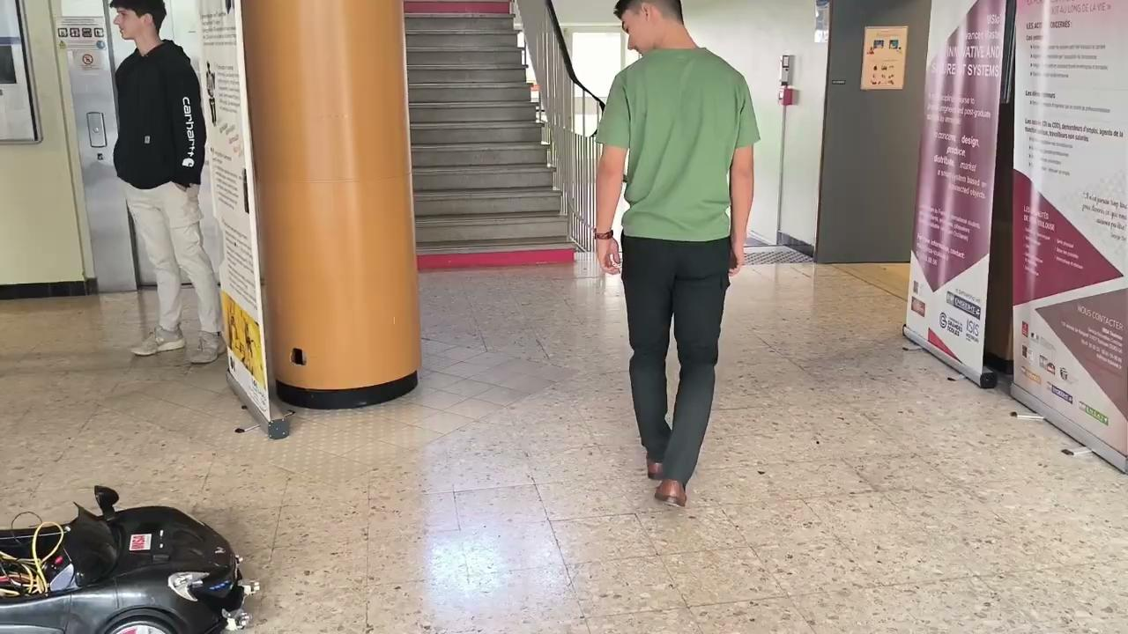
Story 3 : Improve the Tracking mode
Analysis
Able to make small turns
Stop if obstacle detected
Stop if user lost
Hard to turn in confined spaces
Trade-off on distance user-Xcar

Slide 15



Story 3 : Improve the Tracking mode
Identifying the different persons detected by the camera
Check that the camera can detect all the people present in the camera’s view
For each person, assign a unique ID
Each person keep their ID along all the tracking
The ID of the people stays unchanged if they are briefly hided by something or leave the camera’s view
But!
Track the right person
Lock on the target to track
Re identified the target

Slide 16


Story 3 : Improve the Tracking mode
Track the right person: How was it done?
Solution 1:
Solution 2:
Find an already trained model to re-identify a person:
Create our re identification model:
Take the picture of the first person detected with YOLO
Train our model with the Market-1501 dataset
Extract his features with the re identification model with torchreid
Feed the our homemade model with the picture taken by YOLO
Compare these features with all persons detected features and return the one with the highest score
Compare it with other persons detected person and return a boolean result

Slide 17
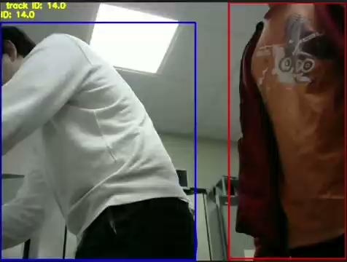
Story 3 : Improve the Tracking mode
Track the right person: demo video

Slide 18

Story 4 : Obstacle Avoidance
Objectives
Add obstacle avoidance in our tracking mode
Steering the car, left or right
After avoidance, follow our user

Slide 19
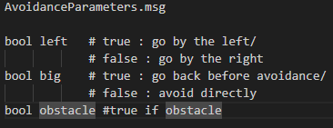
Story 4 : Obstacle Avoidance
Solution
Problem encountered
Define 4 trajectories using this message
Using a timer when an obstacle is detected
[0 ; T/2] : Position the car towards the free zone.
[T/2 ; T] : The car needs to be parallel to the initial trajectory.
After that -> Follow the user
Our car avoids the obstacle at [0; T/2]
We want to keep all functionality during the avoidance process
Our TimerCallback, where the car's position is reset, runs periodically
Falsifies the car's steering values

Slide 20
Next Sprint : story 2
Tracking : As a user, I want to be followed and I want the X-car to be able to avoid obstacles : Nicolas - Ana - Louis - Pierre
Task - Find more solution to avoid obstacle and controlling the trajectory
13 Story Points

Slide 21




Next Sprint : story 3
Documentation : As team chidi, we want a clean documentation of all our project for our clients and customers : Well-John- Loïc - Baptiste
Task 1- Clean our github repository and drive
8 Story Points
Task 2- Update website
4 Story Points

Slide 22
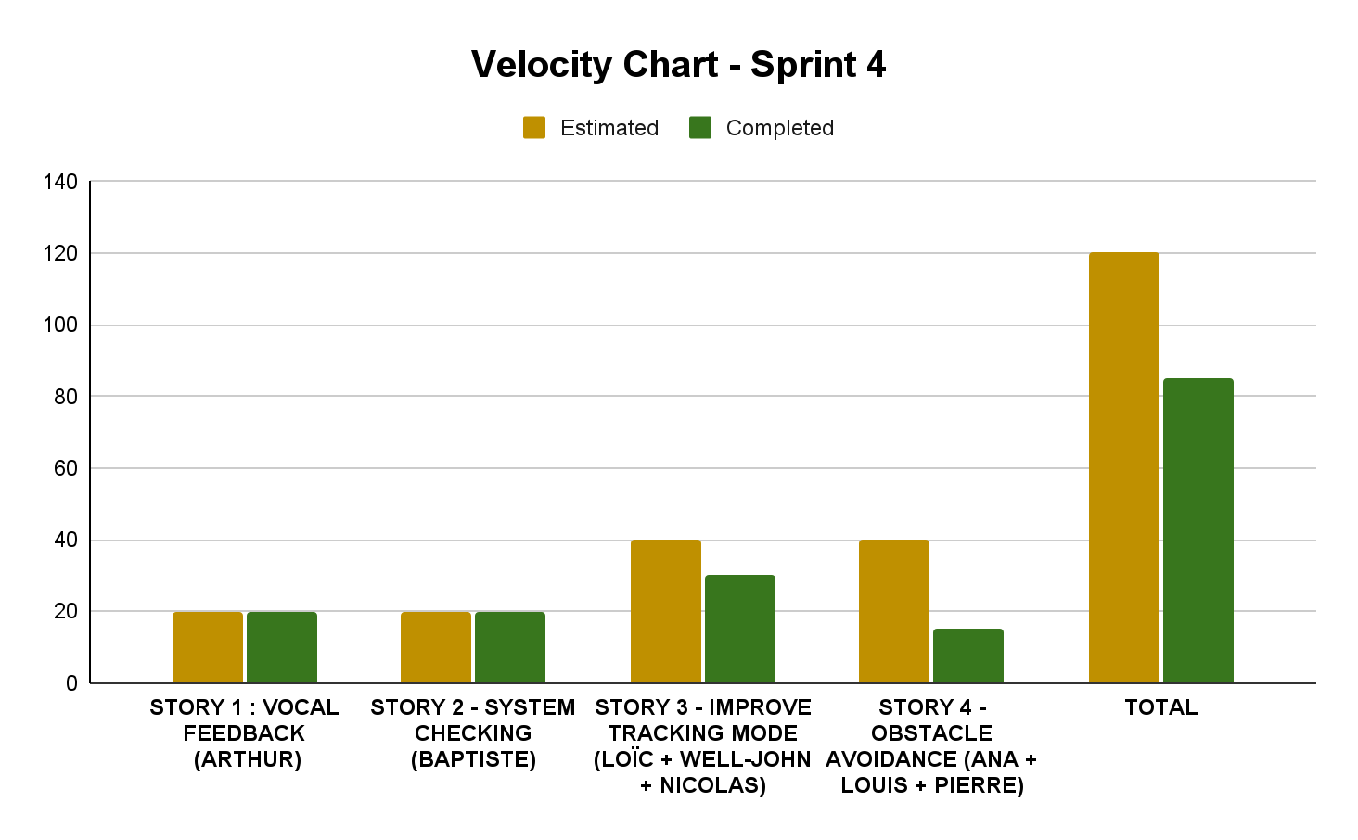

Slide 23
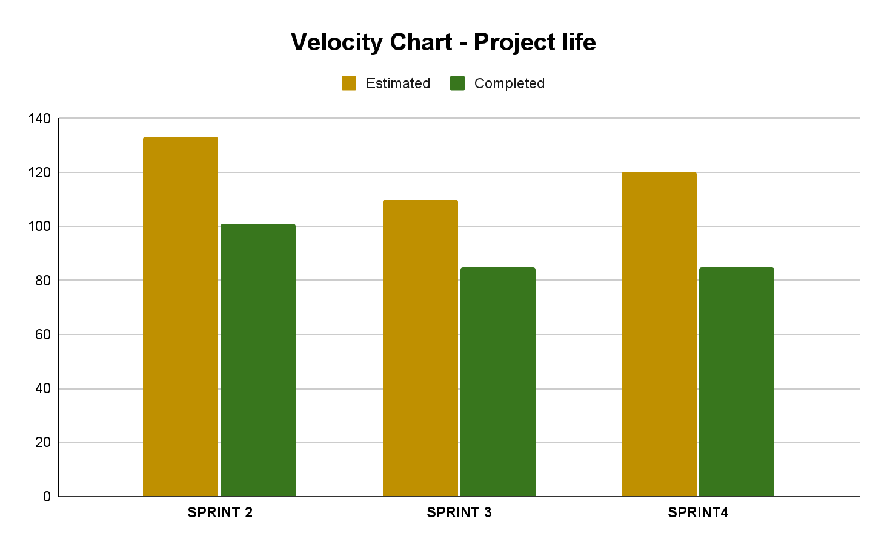

Slide 24
Feared Events : AMDEC
Function | Failure Condition | State Mode | Effects on the car | Classification | support | Verification
Obstacle Detection | Ultrasonics sensors or LIDAR or Camera failure : no message sent | Tracking/Manual | The Xcar goes to Security Mode | Minor | Check Software and Hardware | System Check
Manual | Ultrasonic or LIDAR failure | Manual | The Xcar goes to security Mode | Minor | Check the Hardware | System Check
Manual | Ultrasonic or LIDAR failure: wrong message sent | Manual | The Xcar is not longer able to detect obstacles at a good distance. The user can use the Emergency button to stop the vehicle | Major | Repair and maintenance | The user see that the car doesn’t stop when obstacle
Tracking | Camera or LIDAR failure : no message sent | Tracking | The Xcar goes to Security Mode | Minor | Check Sofware and Hardware | System Check

Slide 25
Feared Events : FMECA
Function | Failure Condition | State Mode | Effects on the car | Classification | support | Verification
Tracking | Camera LIDAR and Ultrasonic: wrong data sent | Tracking | Obstacle hitting : Body’s vehicle and electronic system damages | Major | Repair and maintenance | The user see that the car doesn’t stop when obstacle
System Check | node system check dying | All | No feedback on the different failures | Catastrophic | Check Software | Check Software logs
Web interface | server crashing, lost of connection | All | Car unusable | Important | Reload the server and try a new connection | System Check
Power | Battery empty or disconnected | All | Car unusable | Important | Charge the battery or check the connection | We can’t turn the car on

Slide 26
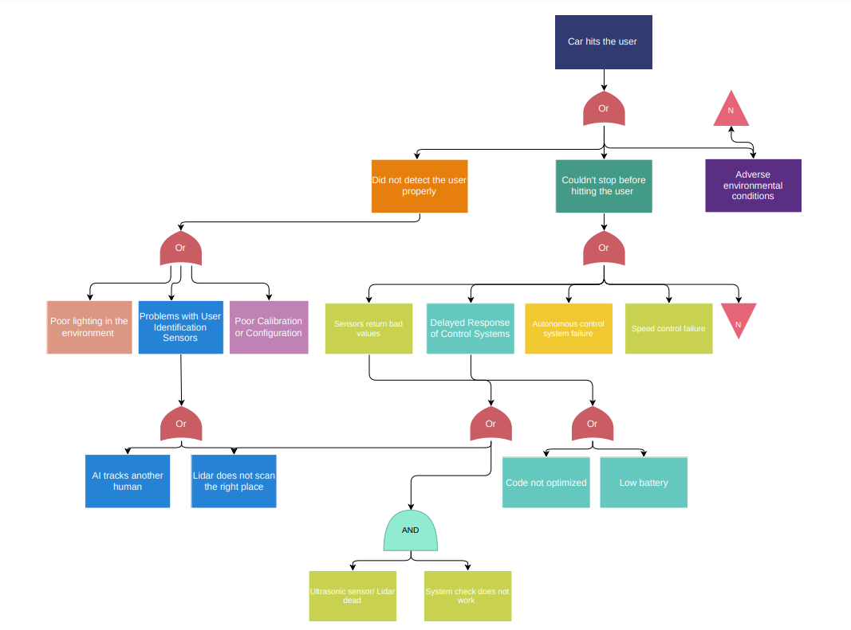


Fault tree

Slide 27
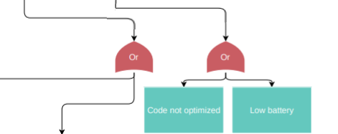
Fault tree

Slide 28
Release Vision
- First version of the app.
- Detect obstacles with LIDAR
- Recognize a human.
- Follow a tracked person.
- First version of the state machine.
- Project plan done.
- Sensor’s failure detection
- Continue obstacle avoidance
- Improve Tracking mode
- Vocal feedback
Sprint 0
Sprint 2
Sprint 4
Sprint 1
Sprint 3
Sprint 5
- Improve Tracking mode
- Improve Web Interface
- A safer and a more accurate Tracking mode
- Improve vocal feedback
- Finishing Obstacle Avoidance
- Documentation
- Final state machine.
- Manual control.
- Obstacle detection.
- Emergency stop button on the remote control.
- HMI : visual feedback on the computer (console).

Slide 29
Release Vision
- First version of the app.
- Detect obstacles with LIDAR
- Recognize a human.
- Follow a tracked person.
- Sensor’s failure detection
- Continue obstacle avoidance
- Improve Tracking mode
- Vocal feedback
- First version of the state machine.
- Project plan done.
Sprint 0
Sprint 2
Sprint 4
Sprint 1
Sprint 3
Sprint 5
- Improve Tracking mode
- Improve Web Interface
- A safer and a more accurate Tracking mode
- Improve vocal feedback
- Finishing Obstacle Avoidance
- Documentation
- Final state machine.
- Manual control.
- Obstacle detection.
- Emergency stop button on the remote control.
- HMI : visual feedback on the computer (console).

Slide 30
Sprint 5 overview
Story 1 : Improve vocal feedback
Story 2 : Tracking and avoidance
Story 3 : Make documentation

Slide 31
Annex 1 : Vocal feedback backup video
Demo video 1 : https://drive.google.com/file/d/1QECoODoERYKgy6BbuLRRDJjGDceDd7AP/view?usp=sharing

Slide 32
Annex 2 :
Demo video 1 :
Demo video 2 :

Slide 33
Annex 3 :
Demo video1 :

Slide 34
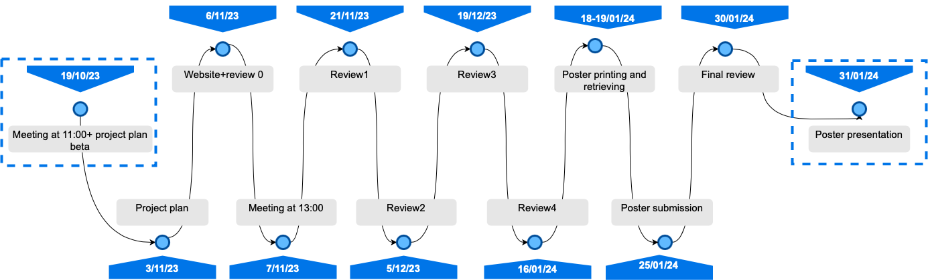
Annex 4 : Deliverables

Slide 35
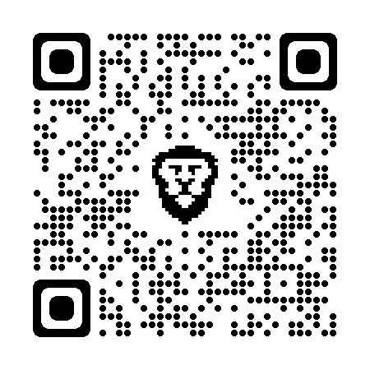
Annex 5 : Website

