Slide 1
Personal Finance Manager Application for Android
Oleksandr Yuriichuk

Slide 2
Introduction
Objective: The primary aim of the Personal Finance Manager Application is to provide users with a comprehensive and user-friendly platform. Here, they can manage their personal finances in an effective and convenient manner.
Technology Stack: The application is primarily built using C# and .NET MAUI, designed for Android devices . This stack was chosen not only for its robust features and extensive libraries but also for its cross-platform capabilities, allowing for easier extension to other operating systems in the future.

Slide 3
The Problem This Application Aims to Solve
Challenges in Modern Finance: Personal finance management in the modern era presents a range of challenges. These include the difficulty in tracking daily expenses, the struggle to adhere to set budgets, and the complexity of planning savings for future financial goals.
Impact: Failure to effectively manage these aspects often results in financial stress, hindering the ability to make informed financial decisions and obstructing the path to financial stability.
The Solution: The Personal Finance Manager Application seeks to alleviate these challenges, offering a streamlined, efficient, and comprehensive solution for managing all aspects of personal finances.

Slide 4
Features Overview
The Personal Finance Manager Application is designed with an array of features to provide an enhanced user experience. These features cover account management, transaction facilitation, financial tracking, and more.

Slide 5

Central Hub for Financial Overview
Financial Metrics: Centralized location for key financial statistics.
Account Listing: Interactive display for all financial accounts.
Action Buttons: Add, Edit, and Delete options available for account management.

Slide 6
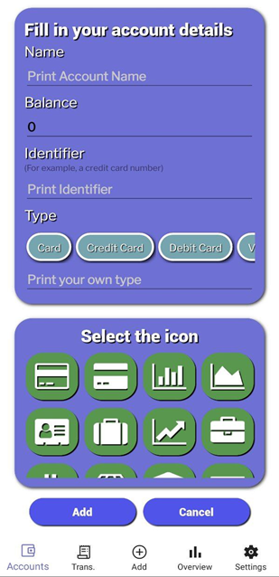
Account Management Page
Users can create and edit accounts with a wide variety of types.
Allows setting a name, setting a balance, assigning a unique identifier, choosing the account type and picking an icon.

Slide 7
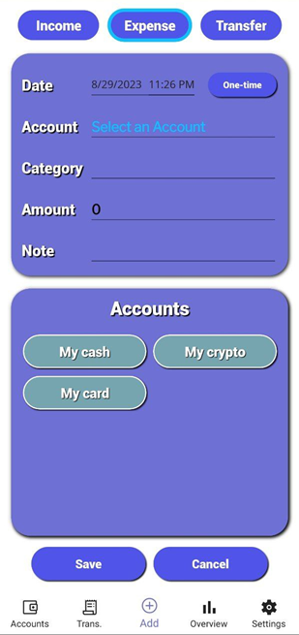
Transaction Management Page
Supports adding transactions of three distinct types: income, expense, and transfers.
Options to select income or expense categories.
Allows users to add notes for context and clarity.

Slide 8
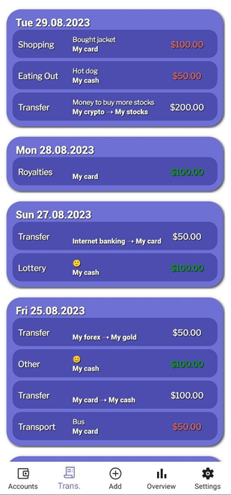
Transactions Page: Financial Activity Log
Transaction Records: Your financial activities, organized and accessible.

Slide 9
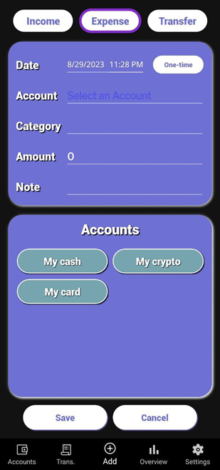
Interface Themes: Light & Dark Mode Support
Theme Adaptability: Automatically adapts to the device's theme settings.

Slide 10
Architecture & Design Patterns

Slide 11
Leveraging .NET MAUI for Optimal App Development
Framework Choice: .NET MAUI (Multi-platform App UI)
Key Benefits:
Unified UI
Single Codebase
Component Reusability
Enhanced Performance
Future-Proof

Slide 12
Adoption of MVVM Design Pattern
Design Pattern: Model-View-ViewModel (MVVM)
Key Components:
Model: Data and Business Logic
View: UI Components and Layout
ViewModel: Application State Management
Advantages:
Clear Separation of Concerns
Supports Simultaneous UI and Logic Development
High Maintainability

Slide 13
Additional Design Patterns and Technologies
Design Patterns Used:
Messaging Pattern
Repository Pattern
Services Pattern
Converter Pattern
Database Management:
Utilizing SQLite for Local Database Management

Slide 14
Key Solutions and Architectural Choices
Fody
Automates INotifyPropertyChanged implementation
Streamlines data binding
Model, ModelView, ModelDisplay
Structured data management
Enhances UI data binding
Commands
Encapsulates user interactions
Enables seamless UI-to-logic communication

Slide 15
Problems Faced and Solutions

Slide 16
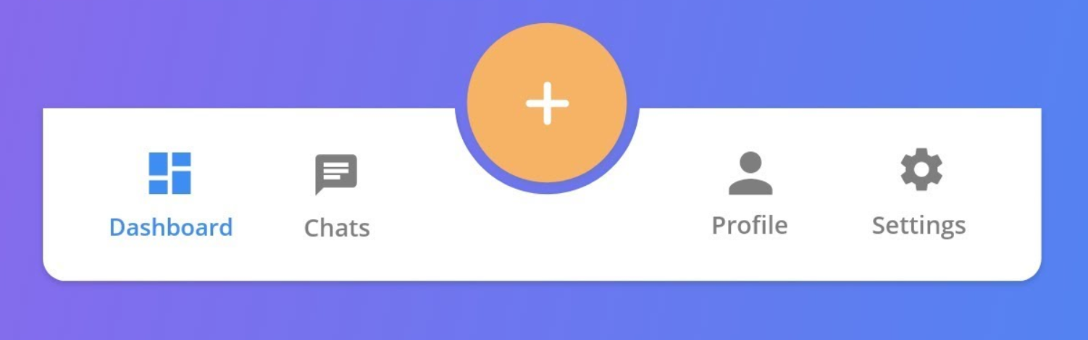
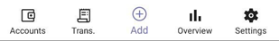
Custom TabBar Challenge & Solution
Problem:
Custom TabBar Design
Wanted a center "Plus" button for adding transactions in TabBar, not supported by default in .NET MAUI.
Solution:
Custom Renderer
Considered using a custom renderer for the TabBar.
Challenges in Custom Solution
Difficult to create.
Not optimized.
Lacked built-in functionality.
Final Decision
Abandoned the custom TabBar idea.

Slide 17
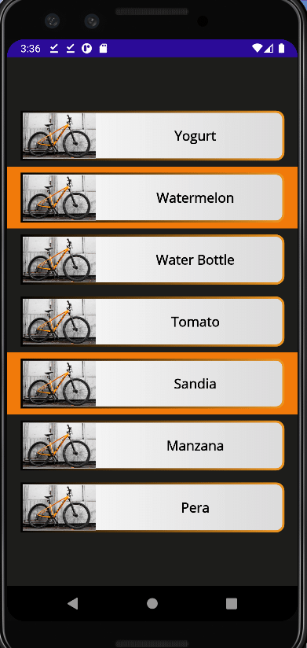
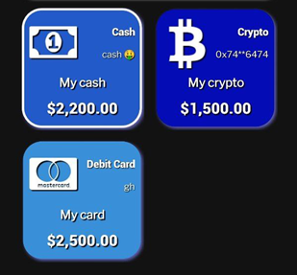
CollectionView Selection Challenge & Solution
Problem:
Unattractive Default Selection
Built-in collection view has a rigid, orange rectangle selection. Custom shapes and colors not easily adjusted.
Solution:
Transparent Built-in Selection
Made the default selection transparent.
Custom Data Template
Used a <Border> element in the <CollectionView.ItemTemplate> with stroke bound to C# variables.
Dynamic Stroke Color
Stroke color dynamically changes based on selection status, providing the desired visual cue.

Slide 18
Image and Icon Disappearance Issue & Solution
Problem:
Random Disappearance of Visual Elements
During development and testing, various types of images (PNG, Skia) and icons (from specialized fonts) would randomly disappear when switching tabs.
Solution:
Stability in Release Version
This issue was primarily observed in the debug version. However, it was not present in the release version, indicating the issue may be environment-specific.

Slide 19
SUMMARY
The Personal Finance Manager Application embodies a comprehensive solution for managing personal finances. This app integrates advanced technology with user-friendly design to empower individuals to take control of their financial landscape.

Slide 20
THANK YOU
Oleksandr Yuriichuk
Github repo

