Slide 1
Amazon Sales Analysis Project

Slide 2
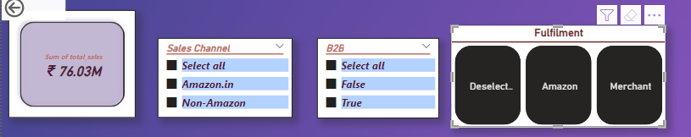
This visual includes the following cards and filters used for data analysis: Total Sales, Sales by Channel dropdown, B2B or Non-B2B filter, Fulfillment Type, and a Date Slicer.

Slide 3
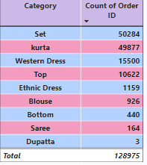
This visual allows us to analyze the total number of categories, the number of orders placed for each, and the top-performing categories. It shows that Set leads the list, followed by Kurta and then Western Dress

Slide 4
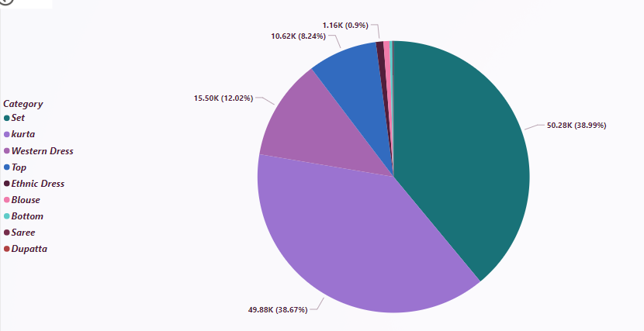
This visual illustrates the percentage contribution of each category to the total sales.

Slide 5
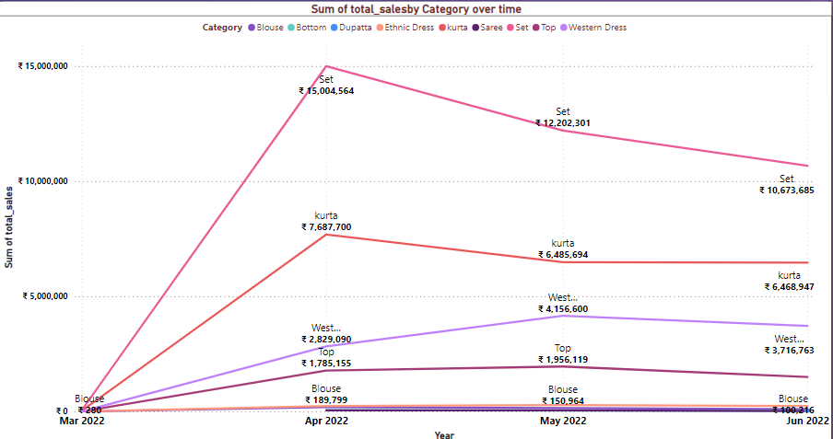
This visual provides detailed insights into the total sales for each category throughout 2022. It features a date hierarchy allowing drill-down to month and day levels, includes tooltips for additional context, and enables analysis of top-performing categories.

Slide 6
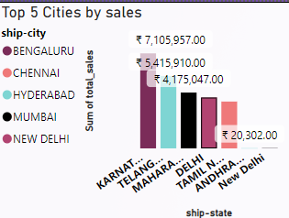
When hovering over the sales over time visual, the tooltip displays information about the top 5 states and cities with the highest number of orders, along with their total sales. This helps in analyzing regional performance in detail.

Slide 7
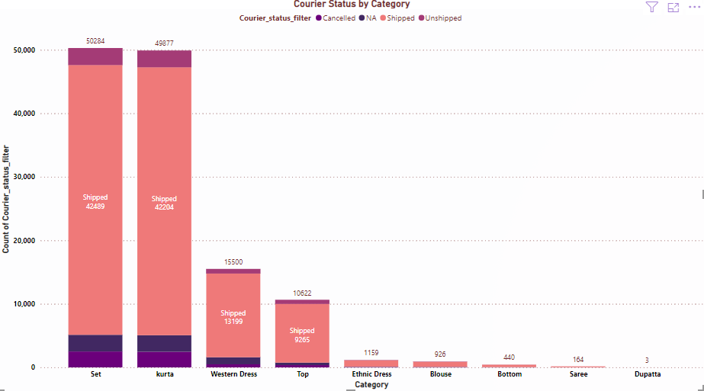
This visual allows for the analysis of courier status by category, showing the numbers for canceled, shipped, and unshipped orders. It reveals that Set and Kurta are the top categories, while Dupatta and Saree are at the bottom of the list.

Slide 8
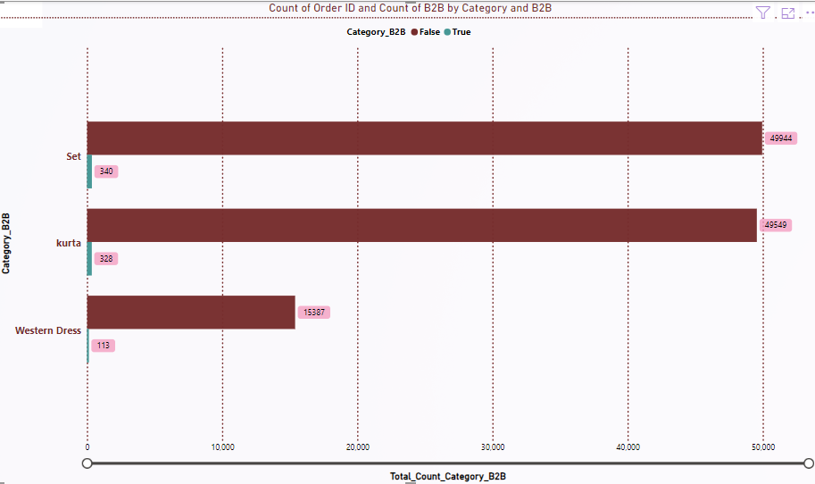
This visual helps analyze which categories are B2B and which are not, displaying the number of orders for each. It allows for analysis using other dashboard filters and highlights that Set and Kurta are the top categories in both B2B and non-B2B segments.

Slide 9
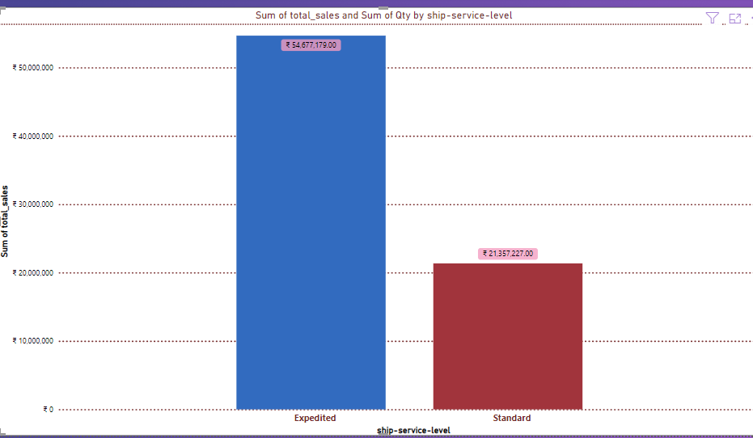
This graph allows for the analysis of shipping types, comparing standard and expedited shipping. It reveals that most orders are expedited. Additionally, hovering over the graph displays a tooltip with the total quantity placed under each shipping type.

Slide 10
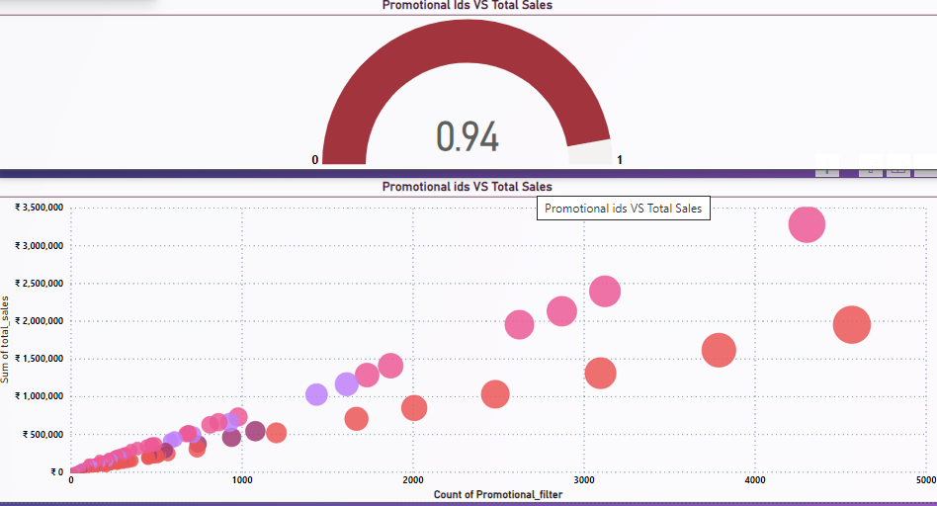
This correlation graph illustrates the relationship between promotional IDs and total sales, with city and category used as legends for a more detailed analysis. With a correlation coefficient of 0.94, it clearly demonstrates the strong connection between promotional activities and sales performance.

Slide 11
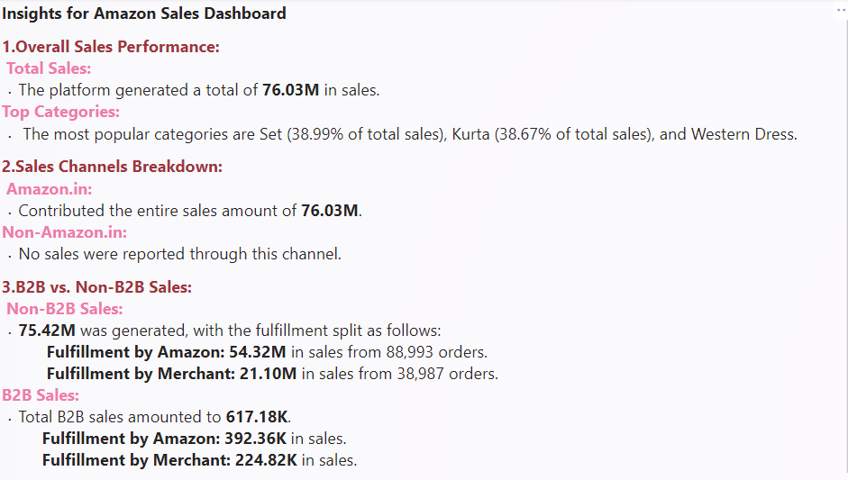

Slide 12
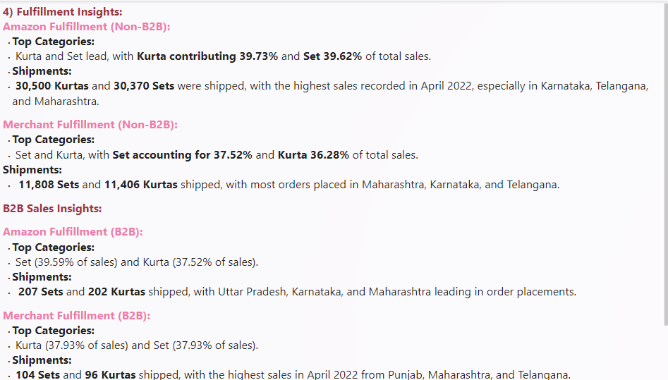

Slide 13
Thank you

