Slide 1
Comprehensive SEO Audit & Optimization for Organic Traffic Growth

Slide 2
Salesforce
We are going to work on Salesforce Company (https://www.salesforce.com/in/) for this SEO Audit Project.
Objective:
This project focuses on identifying and addressing SEO issues, implementing best practices, and improving the site's visibility and ranking on search engines.
About the Company:
Salesforce, founded in 1999 by Marc Benioff and Parker Harris, is a leading cloud-based software company based in San Francisco. It revolutionized the customer relationship management (CRM) software market. Salesforce's core CRM product enables businesses to manage customer interactions, streamline processes, and boost profitability.
Global Presence: Salesforce operates globally, with a strong footprint across North America, Europe, Asia-Pacific, Latin America, and the Middle East. It serves a wide range of industries, including finance, healthcare, retail, and government. Supported by an extensive partner network and global data centers, Salesforce provides localized solutions and robust customer support worldwide.

Slide 3
Salesforce Products :
Salesforce's broad range of services enables businesses to manage every aspect of their customer interactions, from sales and marketing to customer service and analytics. The company's deep integration of AI, extensive partner ecosystem, and focus on innovation have made it a leader in cloud-based enterprise solutions.
Sales Cloud
Service Cloud
Marketing Cloud
Commerce Cloud
Experience Cloud
Analytics Cloud (Tableau CRM)
Integration Cloud
Einstein AI
AppExchange
Platform (Heroku and Salesforce Platform)
MuleSoft
Quip

Slide 4
Initial Audit:
Current Performance:
All CSS files appear to be minified.
The size of the HTML document is 25 Kb. This is under the average of 33 Kb.
The response time is under 0.2 seconds.
The SEO title is set and is 48 characters long.
The meta description is set and is 151 characters long.
One or more keywords were found in the title and description of the page.
The page has a correct number of internal and external links.

Slide 5
Strengths:
The site has a robots.txt file.
All the required Open Graph meta tags have been found.
We found Schema.org data on the page
The response time is under 0.2 seconds.
The site is using a secure transfer protocol (https).
Weaknesses:
The server is not using "expires" headers for the images.
Some Javascript files don't seem to be minified.
The page makes 42 requests. More than 20 requests can result in slow page loading.
Some images on the page have no alt attribute.
Reference Link: https://aioseo.com/seo-analyzer/#section-basic

Slide 6
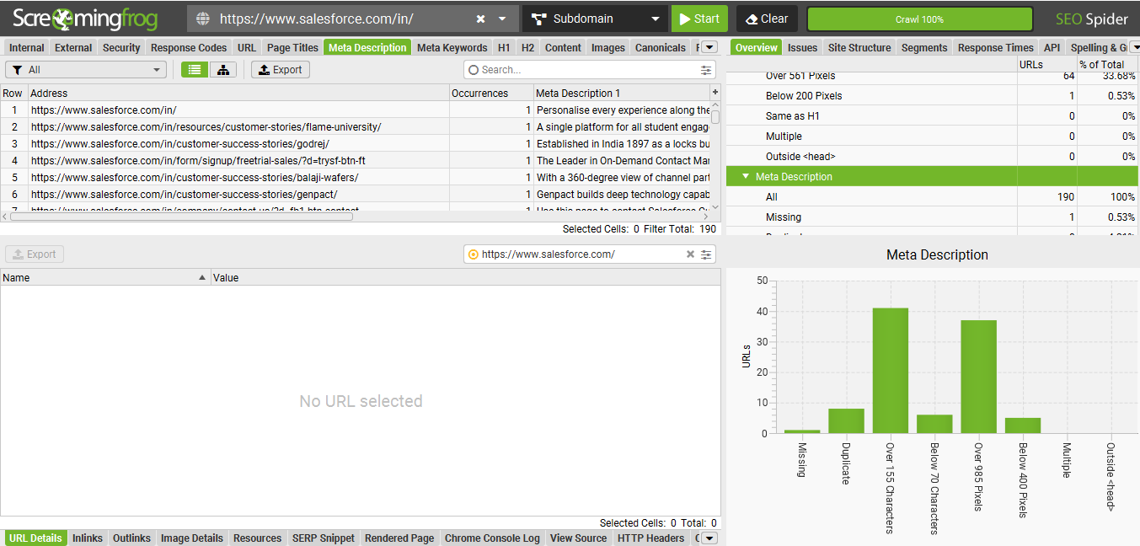

Slide 7
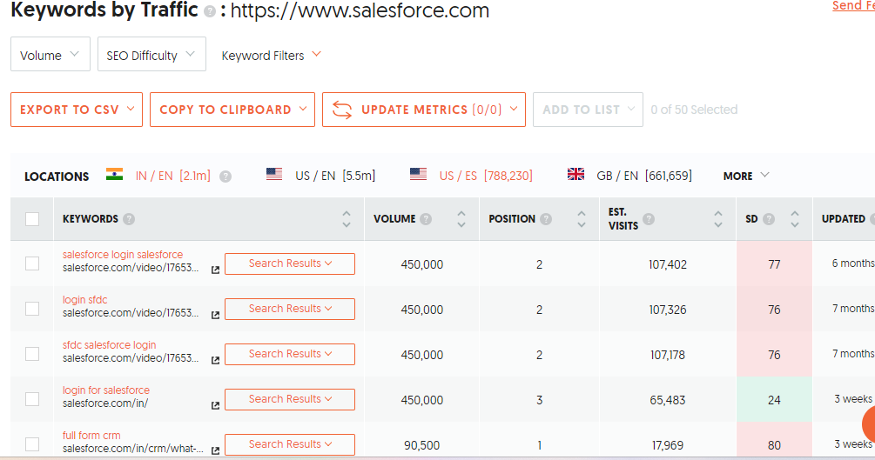
Keyword Research
Targeted Keywords
Primary Keywords:
CRM Software, Cloud CRM, Sales automation tools, Customer Service Software are the Top keywords used .
We can see the keywords by traffic suggested by Ubersuggest from below screenshot

Slide 8
Secondary Keywords:
Salesforce CRM solutions, Customer relationship management software, Salesforce customer success stories, Salesforce automation tools, Salesforce analytics and reporting, Salesforce support and services, These secondary keywords can complement primary keywords and help in improving the website's visibility on search engines for related searches.
Long tail Keywords:
Few Long tail keywords from the website are How to implement Salesforce CRM for small businesses, Best practices for Salesforce data migration, Salesforce integration with third-party apps, Steps to optimize Salesforce for mobile users
Competitor Keyword Analysis and Strategies:
Identify key competitors in the CRM and cloud services market, such as: HubSpot, Microsoft Dynamics 365, Oracle CRM, SAP Customer Experience, Zoho CRM.
Use tools like Ahrefs, Semrush or Moz to analyse competitor’s website to analyse keywords that are driving traffic to their websites , Analyse their Paid and organic Keywords Performance, Keyword Gap Analysis etc..

Slide 9
On – Page SEO Optimization Audit
Page 1: Salesforce CRM Overview: (https://www.salesforce.com/in/products/crm/what-is-crm/)
Title tags, meta descriptions, and HTML tags, Internal Linking and Image Optimization
Title Tag is well optimized, including the primary keyword “CRM” and described the page content concisely.
Meta Descriptions is informative but can be improved by including more action – oriented phrases and secondary keywords
HTML Tags H1 tag is present and well – used
The Page includes relevant internal links to other salesforce product pages and blogs
Images are optimized with relevant alt texts but could use more descriptive file name.
Example: instead of image1 we can use “ salesforce –CRM-Dashboard.
Page 2: Salesforce For Small Business:
(https://www.salesforce.com/in/small-business/)

Slide 10
Title tags, meta descriptions, and HTML tags, Internal Linking and Image Optimization
The title tags are well crafted targeting small businesses
Meta description is concise but lacks a clear call to action. Adding phrases like “ Learn how Salesforce can grow your small business “ could be more engaging and H1 Tags are properly used.
Page includes several internal links to related solutions and case studies, which is beneficial and we can add more external links to small business resources
Images are well optimized with alt texts related to small business solutions. However the file names could be more descriptive to align with SEO best practices
Page 3: Salesforce Customer Success Stories:
(https://www.salesforce.com/in/customer-success-stories/#!page=1)
Title tags, meta descriptions, and HTML tags, Internal Linking and Image Optimization
Title tag is strong and includes relevant keywords
Meta description accurately describes the page content but can be enhanced with more keywords related to industry specific stories
Page effectively uses H1 tags
Internal linking is strong , connecting users to relevant product pages and resources
Similary images are optimized with relevant alt texts but could be more descriptive like other pages.

Slide 11
Technical SEO:
Analysis of Current Technical SEO Status:
URL Structures are clean and user friendly
Titel tags are present and unique for each page but meta descriptions might need optimization.
Site is responsive and mobile friendly
Website uses HTTPS, ensuring secure connections.
Page speed is moderate, improvements can be made
Some images are not fully optimized for faster loading
No major broken links are detected.
Technical SEO Issues:
Page speed is slightly slow which affects user experience and rankings.
Missing or non – optimized meta descriptions for some sections, Some pages lack H2 tags, Title tags are more generic and could be descriptive and include relevant keywords
Large images without proper compression, missing alt text for some images.
Few outdated or incorrect internal links, some outdated URL’s are causing unnecessary redirects.

Slide 12
Best Practices to improve site and web page speed:
Optimize Images
Optimize server response time
Enable Browser Caching to store static files and reduce load times for returning visitors.
Upgarde hosting plans.
Content Strategy:
Increase Organic traffic by optimizing the content to rank for high – value keywords
Create content that attracts potential customers and captures leads.
Create articles and reports on trends in CRM, Cloud technology.
Create regular blog posts addressing key topics and target keywords.
Create case studies on how Salesforce solutions have driven success for various businesses.
Focus on Social Media, Email Marekting, Partnerships.
Release whitepapers, Blog posts, Case study, Infographics and review the content performance and adjust the strategy based on analytics and in this way we can drive meaningful business outcomes.

Slide 13
Off – Page SEO:
Off – Page SEO Plan:
Analyse Backlinks , identify number of backlinks, and the quality of these links
Check authority of linking domains, Check for any toxic or low- quality backlinks that could harm sites SEO.
Check Competitors Backlinks, competitors can be Hubspot,Zoho,Microsoft Dynamics etc..
Identify high – quality backlinks that competitors have and explore to obtain similar links.
Review the performance of Salesforce on Social Media Presence.
Off – Page SEO Strategy:
Focus on acquiring backlinks from reputable sites in tech and CRM
Ensure Salesforce is listed in high quality forums
Work on press releases on major product updates and company milestones
Work with bloggers and journalists to work on Salesforce content and case studies
Partner with local businesses and oragnisations for mutual promotions and backlinks
Regularly check and respond to reviews on various platforms to maintain positive brand image

Slide 14
Project Conclusion:
The SEO audit of Salesforce.in reveals a strong online presence with solid backlink quality but highlights opportunities for improvement.
Current strategies show effective social media engagement, yet there is room to enhance backlink acquisition and local SEO efforts.
Competitor analysis indicates potential for gaining high-quality backlinks through guest blogging and content syndication.
To further boost visibility, focusing on influencer collaborations and reputation management.
Overall, Salesforce.in’s SEO strategy is robust, with targeted optimizations needed to maintain and enhance its competitive edge.

Slide 15
Thank You

