Slide 1
Arduino Home Automation System: Controlling Indoor and Outdoor Illumination through Mobile-To-Bluetooth Module App Connection
Group 2

Slide 2
AGENDA
Introduction
Objective of the Study
Implementation Process
Instrumentation and Design
Design Process
User Manual
Video Presentation
ARDUINO HOME AUTOMATION SYSTEM: CONTROLLING INDOOR AND OUTDOOR ILLUMINATION THROUGH MOBILE-TO-BLUETOOTH MODULE APP CONNECTION

Slide 3
INTRODUCTION
Technology: Home Automation

Slide 4
Objective of the study
The study was conducted by the researchers with the aim of constructing a “Smart Home” house prototype that has Arduino automated LED lights installed. Furthermore, the researchers also aim to create a mobile application that will act as a remote-control device that will control most of the LED lights of the house prototype through Bluetooth connection.
ARDUINO HOME AUTOMATION SYSTEM: CONTROLLING INDOOR AND OUTDOOR ILLUMINATION THROUGH MOBILE-TO-BLUETOOTH MODULE APP CONNECTION

Slide 5
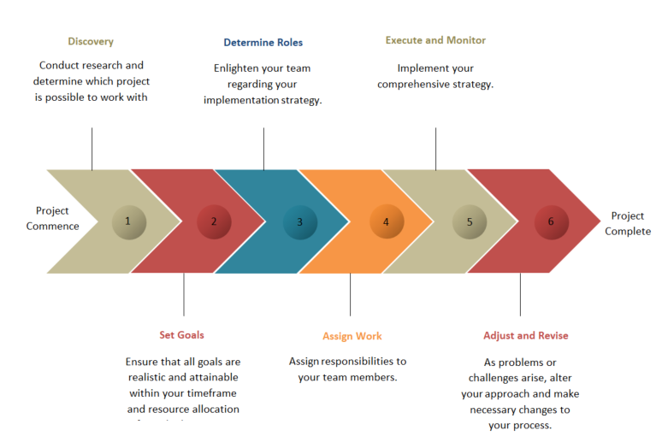
Implementation process of the project

Slide 6
Instrumentation and control
The implementation of instrumentation and control in this study’s prototype is seen through its home automation system where house illumination can be monitored and controlled through the use of a mobile device using this study’s original mobile application. Its implementation can also be observed through the prototype’s automatic outdoor night lights feature and motion sensor-triggered entrance lights.
ARDUINO HOME AUTOMATION SYSTEM: CONTROLLING INDOOR AND OUTDOOR ILLUMINATION THROUGH MOBILE-TO-BLUETOOTH MODULE APP CONNECTION

Slide 7
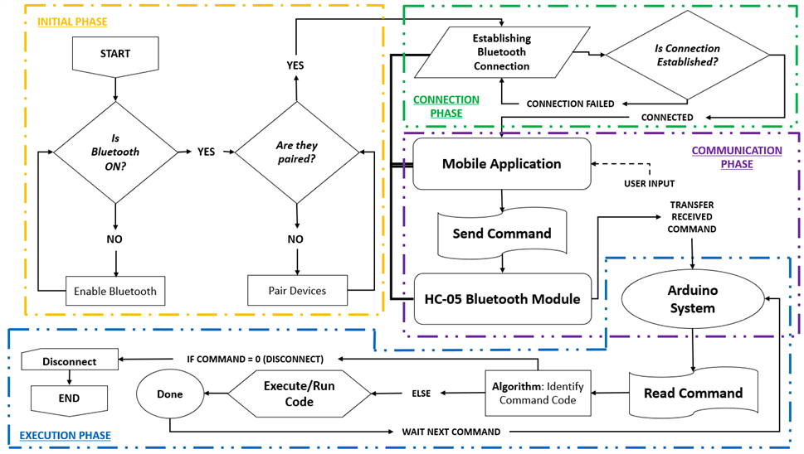
Design process
GENERAL DESIGN
ARDUINO HOME AUTOMATION SYSTEM: CONTROLLING INDOOR AND OUTDOOR ILLUMINATION THROUGH MOBILE-TO-BLUETOOTH MODULE APP CONNECTION

Slide 8
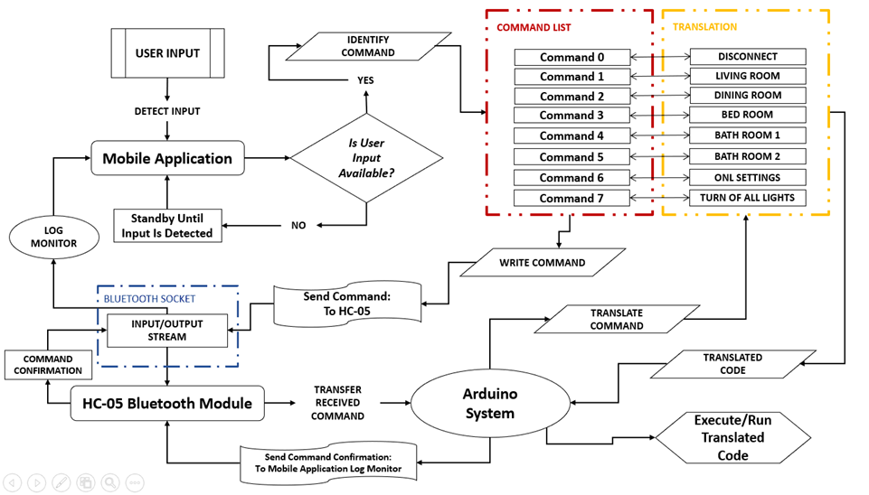
Design process
COMMUNICATION PHASE
ARDUINO HOME AUTOMATION SYSTEM: CONTROLLING INDOOR AND OUTDOOR ILLUMINATION THROUGH MOBILE-TO-BLUETOOTH MODULE APP CONNECTION

Slide 9
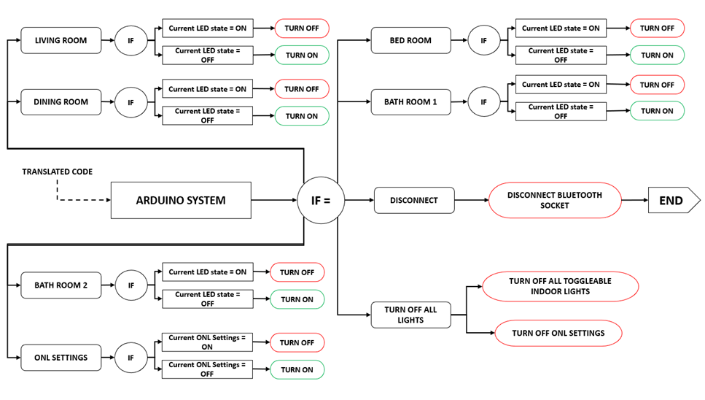
Design process
ARDUINO SYSTEM ALGORITHM: EXECUTION OF TRANSLATED COMMANDS
ARDUINO HOME AUTOMATION SYSTEM: CONTROLLING INDOOR AND OUTDOOR ILLUMINATION THROUGH MOBILE-TO-BLUETOOTH MODULE APP CONNECTION

Slide 10
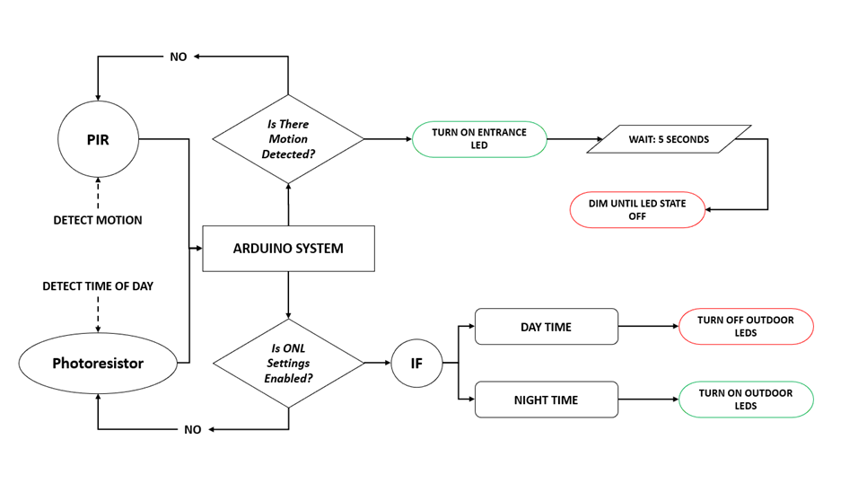
Design process
ARDUINO SYSTEM ALGORITHM: ENTRANCE LIGHT & ONL PHOTORESISTOR
ARDUINO HOME AUTOMATION SYSTEM: CONTROLLING INDOOR AND OUTDOOR ILLUMINATION THROUGH MOBILE-TO-BLUETOOTH MODULE APP CONNECTION

Slide 11
User manual
Application | Bluetooth Connection | Steps and procedures
ARDUINO HOME AUTOMATION SYSTEM: CONTROLLING INDOOR AND OUTDOOR ILLUMINATION THROUGH MOBILE-TO-BLUETOOTH MODULE APP CONNECTION

Slide 12
tutorials
HOW TO CONNECT WITH HC-05 BLUETOOTH MODULE
HOW TO USE UNIVERSAL COMMAND: TURN OFF ALL LIGHTS
HOW TO TOGGLE INDOOR LIGHTS ON/OFF
HOW TO CONNECT WITH HC-05 BLUETOOTH MODULE
HOW TO TOGGLE OUTDOOR NIGHT LIGHTS SETTINGS
ARDUINO HOME AUTOMATION SYSTEM: CONTROLLING INDOOR AND OUTDOOR ILLUMINATION THROUGH MOBILE-TO-BLUETOOTH MODULE APP CONNECTION

Slide 13
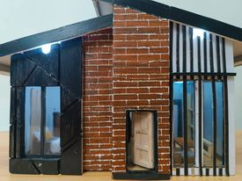
FINAL OUTPUT

Slide 14
VIDEO PRESENTATION
ARDUINO HOME AUTOMATION SYSTEM: CONTROLLING INDOOR AND OUTDOOR ILLUMINATION THROUGH MOBILE-TO-BLUETOOTH MODULE APP CONNECTION

Slide 15

THANK YOU
Jolly Joy A. Cabosor cabosorjollyjoy@gmail.com
Raevon Thaddeus Bernardo bernardoraevon@gmail.com
Reporter | group 2

