Slide 1

Ironhack Project - Units 5&6
Nicole Pinto
Lucie Stenger

Slide 2

A/B Testing : Is the new website design successful?
Measuring Success of the New User Interface:
Higher Completion Rate: Is completion rate in the test group higher than the control group?
Faster Completion Time: Is the average time per step or overall completion time lower in the test group?
Lower Error Rate: Does the test group navigate back fewer times than the control group?
Notes:
Briefly introduce Vanguard and the context of the digital challenge.
State the main question: Did the new UI lead to higher completion rates?
How do we define that the new user interface is a success?
Is completion rate in the test group higher than the control group ?

Slide 3
Data Overview - Cleaning Process
Removing all clients not part of the A/B testing to only keep relevant IDs
Removing rows where demographic information was empty (other than client_ID)
Tables division between test and control groups
Cleaning gender column to group X and U
Merging

Slide 4
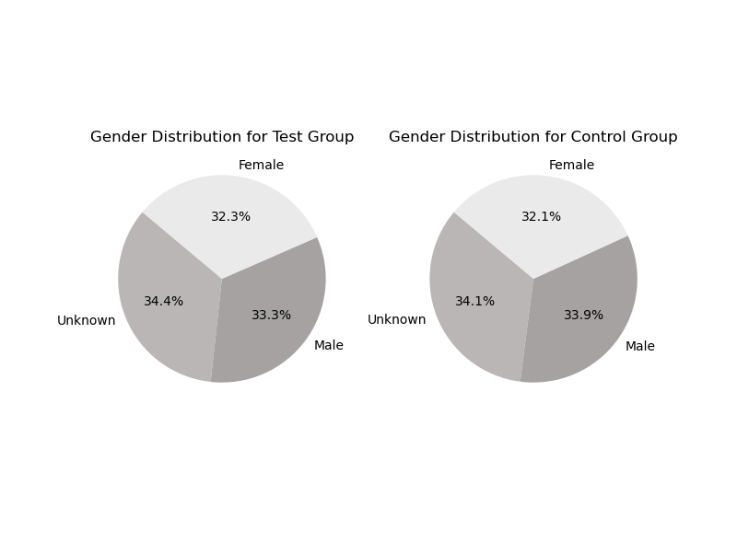
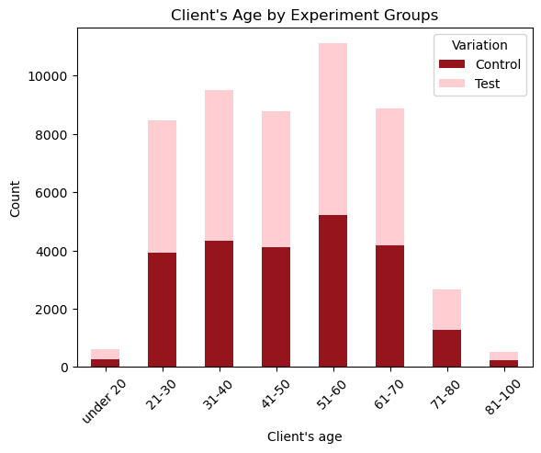
Data Overview - Client Profiles
Notes:
including young professionals, retirees, high-net-worth individuals, and institutional investors, retired

Slide 5
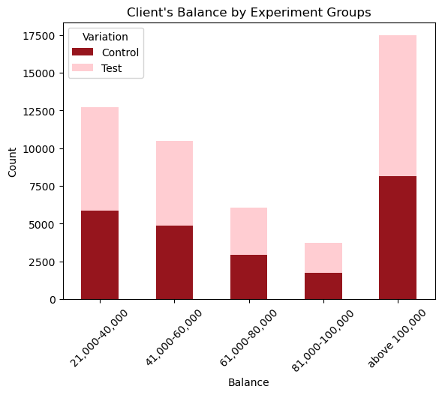
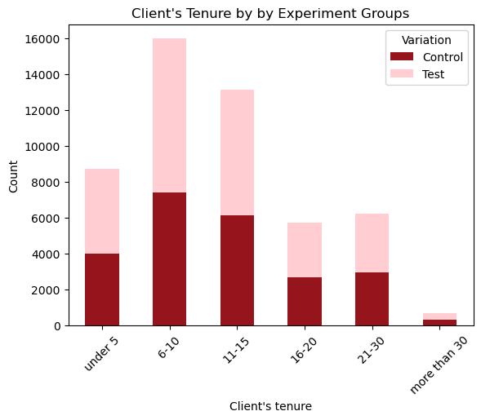
EDA - Client Profiles
Notes:
diverse profiles with substantial high-net investors. they have been clients with vanguard for 6-15 years

Slide 6
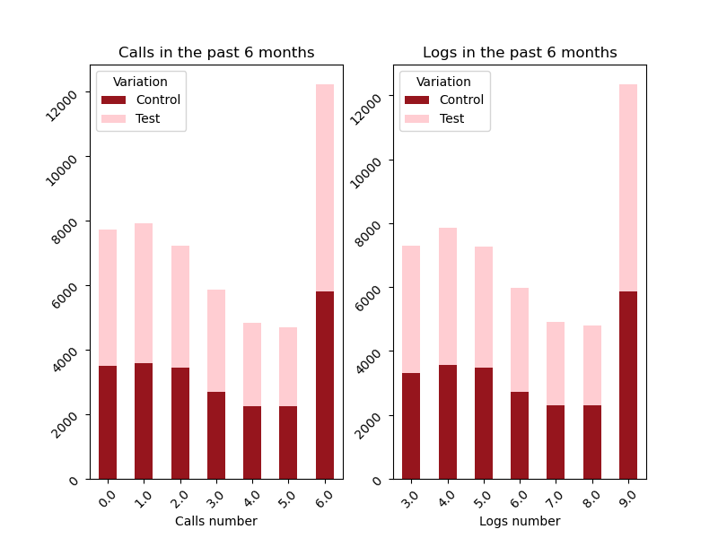
EDA - Client Behaviours
Control and Test groups have similar metric distributions.
Most online clients have been with Vanguard for 6-15 years.
They are also fairly engaged with a majority of clients logging into the online platform 9 times and calling 6 times over the past 6 months.
Notes:
HControl and Test groups have similar data distribution for analysed metrics.
Most online clients have been with Vanguard from 6 to 15 years.
They are also fairly engaged with a majority of clients logging into the online platform 9 times and calling 6 times over the past 6 months.

Slide 7
Performance Metrics
Completion Rate
Average time spent on each step
& Total time spent from start to confirm page
Error Rate
Notes:
Define the KPIs you chose to evaluate the new design’s performance. Compare the KPIs for the Control Group vs. the Test Group. Present visual aids to support the KPI analysis.

Slide 8

Tableau Visualizations
Notes:
Showcase the Tableau dashboard and visualizations created.
Demonstrate how viewers can interact with the data based on demographics.

Slide 9
Hypothesis Testing
Completion rate differences and cost-effectiveness threshold evaluation
Test-conducted: One-tailed z-proportions test
Results: The completion rate in the test group is significantly higher than in the control group.
The observed increase of 8.67% exceeds the 5% threshold. The new design is cost-effective.

Slide 10
Hypothesis Testing - Findings
Time spent on each step
& Total time spent from start to confirm page
Completion Rate
Error Rate
The completion rate in the test group is higher than in the control group.
The error rate in the test group is larger than the control group.
The control group spends less time on average than the test group.
✓
✘
✘

Slide 11
Experiment Evaluation
Design Effectiveness
Clients were evenly divided between old and new designs.
Gender, tenure, account balance, online logs, and calls were proportionally represented in both groups.
Duration Assessment
High error rates and completion times were observed due to the short time period.
These results are not necessarily linked to the new UI being less effective.
Adjusting to a new interface naturally takes time.
Potential Biases - Selection Bias
Notes:
While the characteristics like gender, tenure, account balance, online logs, and calls are proportionally represented, there might be other unaccounted factors (e.g., tech-savviness, age, device type) that could influence how quickly clients adapt to a new design. These unmeasured variables could introduce bias into the comparison of the two groups.

Slide 12
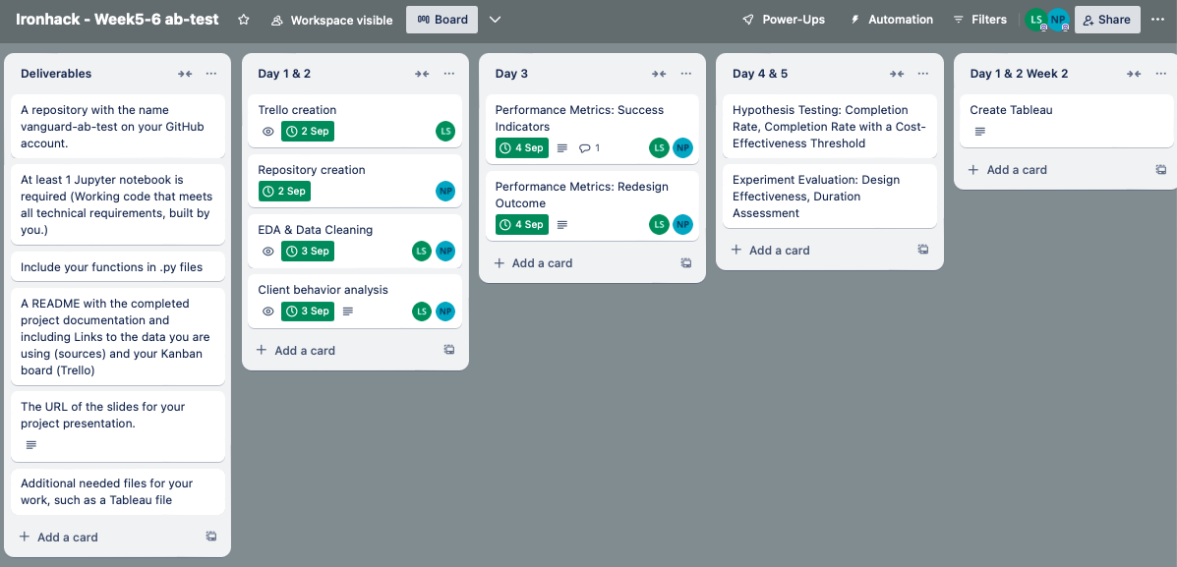
Teamwork & Project Management
Nom d'une personne 2
Insérez votre texte ici Insérez votre texte ici Insérez votre texte ici Insérez votre texte ici
Insérez votre texte ici Insérez votre texte ici Insérez votre texte ici Insérez votre texte ici
Notes:
spent a lot of time on details and discussion: why. what, how we doing it. also on brand colors not only in our presentation but also in Tableau so the learning curve was steep as always.

Slide 13
Challenges & Learnings
Challenge: Trying to replicate complex codes in Tableau
Solution: Keep it simple. Create a data frame and export the file into Tableau
Learning: Tableau is a versatile visualization tool and not a coding tool

Slide 14
Conclusion
From a statistical perspective:
New design improves user completion rates
Positive indicator for increased user engagement
From a business perspective:
Completion rate increase surpasses the 5% threshold
Suggests scaling the solution can provide measurable benefits without overspending
Notes:
and could also offer a competitive advantage. It could transfer to greater user retention, increased revenue or higher productivity

Slide 15
Next Steps
Roll out the new design: to a larger audience
Calculate long-term impact: on financial metrics to see the long-term return on investment from the design change
Evaluate Scalability: check if this new design can be scaled across different customer segments
Notes:
implement the new design more broadly. A phased rollout could help ensure a smooth transition and reduce risks in case there are unforeseen issues at scale.
revenue generated v/s costs incurred
EG: new design may work well for retail investors, but it may need adjustment for high-net-worth clients who expect a more personalized experience. Institutional clients, for instance, might require additional features, such as bulk onboarding for multiple accounts or enhanced compliance tracking.

Slide 16
THANK YOU

