Slide 1
Capstone Project: The Battle of Neighborhoods
Final Project to Coursera
Presenter: BTT
05/19/2020

Slide 2
Introduction
ABC is a company based in Toronto for organizing events, currently it works on a project to organize an event for 5 days for a group of photographers from all over the world. The company has to put a good program, including a hotel of residence, a hall for meetings, places of landscape to visit, stores for shopping, restaurants and cafes. So, the company’s purpose is to make a list of places of landscape in Toronto, including the nearest restaurants, cafes, and shopping stores for each place

Slide 3
Data source
The data used in this project is provided by Foursquare location data. The data are grouped by landscape area, and each area included the information about this area and all information about restaurants, cafes, and stores which in this area.

Slide 4
Methodology
Majorly relied on Foursquare API to retrieve all venues of each neighborhoods, then group by each neighborhood and to count how many venues before filter top 10 most common venue types of each neighborhood.

Slide 5


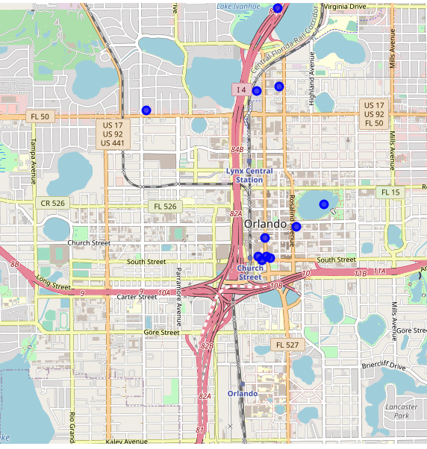

Results
z

