Slide 1
Naive Bayes Classify
Boning Zhao

Slide 2
Problem description
Now we have some news(more than ten thousands) which could be divided into tens of categories(like science. Medicine, computer. Graphics……). With the set of already known news how could we classify unknown news into a correct group?

Slide 3
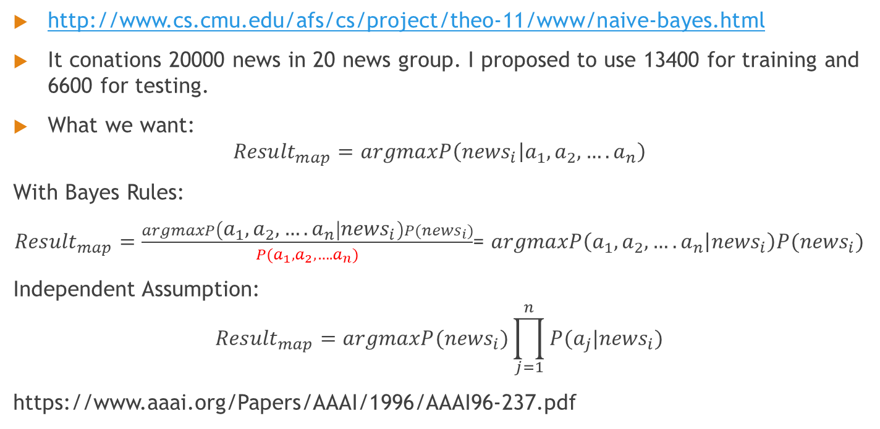
Data and Formula
http://www.cs.cmu.edu/afs/cs/project/theo-11/www/naive-bayes.html
It conations 20000 news in 20 news group. I proposed to use 13400 for training and 6600 for testing.
What we want:
$${Result}_{map}=argmaxP\left({news}_{i} | a_{1},a_{2},….a_{n}\right)$$
With Bayes Rules:
${Result}_{map}=\frac{argmaxP\left(a_{1},a_{2},….a_{n} | {news}_{i}\right)P({news}_{i})}{P(a_{1},a_{2},….a_{n})}$= $argmaxP\left(a_{1},a_{2},….a_{n} | {news}_{i}\right)P({news}_{i})$
Independent Assumption:
$${Result}_{map}=argmaxP({news}_{i})\prod_{j=1}^{n}{P(a_{j}|{news}_{i})}$$
https://www.aaai.org/Papers/AAAI/1996/AAAI96-237.pdf

Slide 4
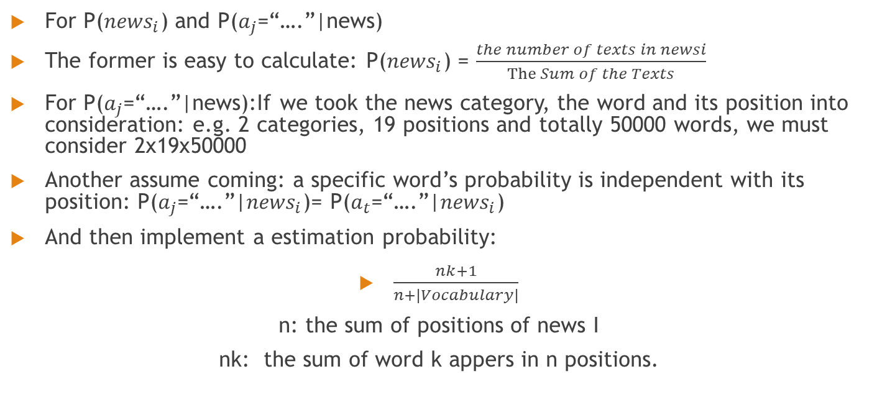
Data and Formula
For P(${news}_{i}$) and P($a_{j}$=“….”|news)
The former is easy to calculate: P(${news}_{i}$) = $\frac{the number of texts in newsi}{The Sum of the Texts}$
For P($a_{j}$=“….”|news):If we took the news category, the word and its position into consideration: e.g. 2 categories, 19 positions and totally 50000 words, we must consider 2x19x50000
Another assume coming: a specific word’s probability is independent with its position: P($a_{j}$=“….”|${news}_{i}$)= P($a_{t}$=“….”|${news}_{i}$)
And then implement a estimation probability:
$\frac{nk+1}{n+|Vocabulary|}$
n: the sum of positions of news I
nk: the sum of word k appers in n positions.

Slide 5
Model
label
Model:
Train data
Vocabulary
With Function
Calculate the max probability
Test data
Output
word

Slide 6
Implementation
Issues:
Words segmentation: JE analysis
Lucene for token stream to build up word information, vocabulary and label set(With Training Data)
Calculate the probability (With Testing Data)
Put out result

Slide 7
Result
Accuracy:
Totally 6600 documents tested, 5610 has been correctly classified
5610/6600=85%

