Slide 1

Notes:
Front Matter

Slide 2
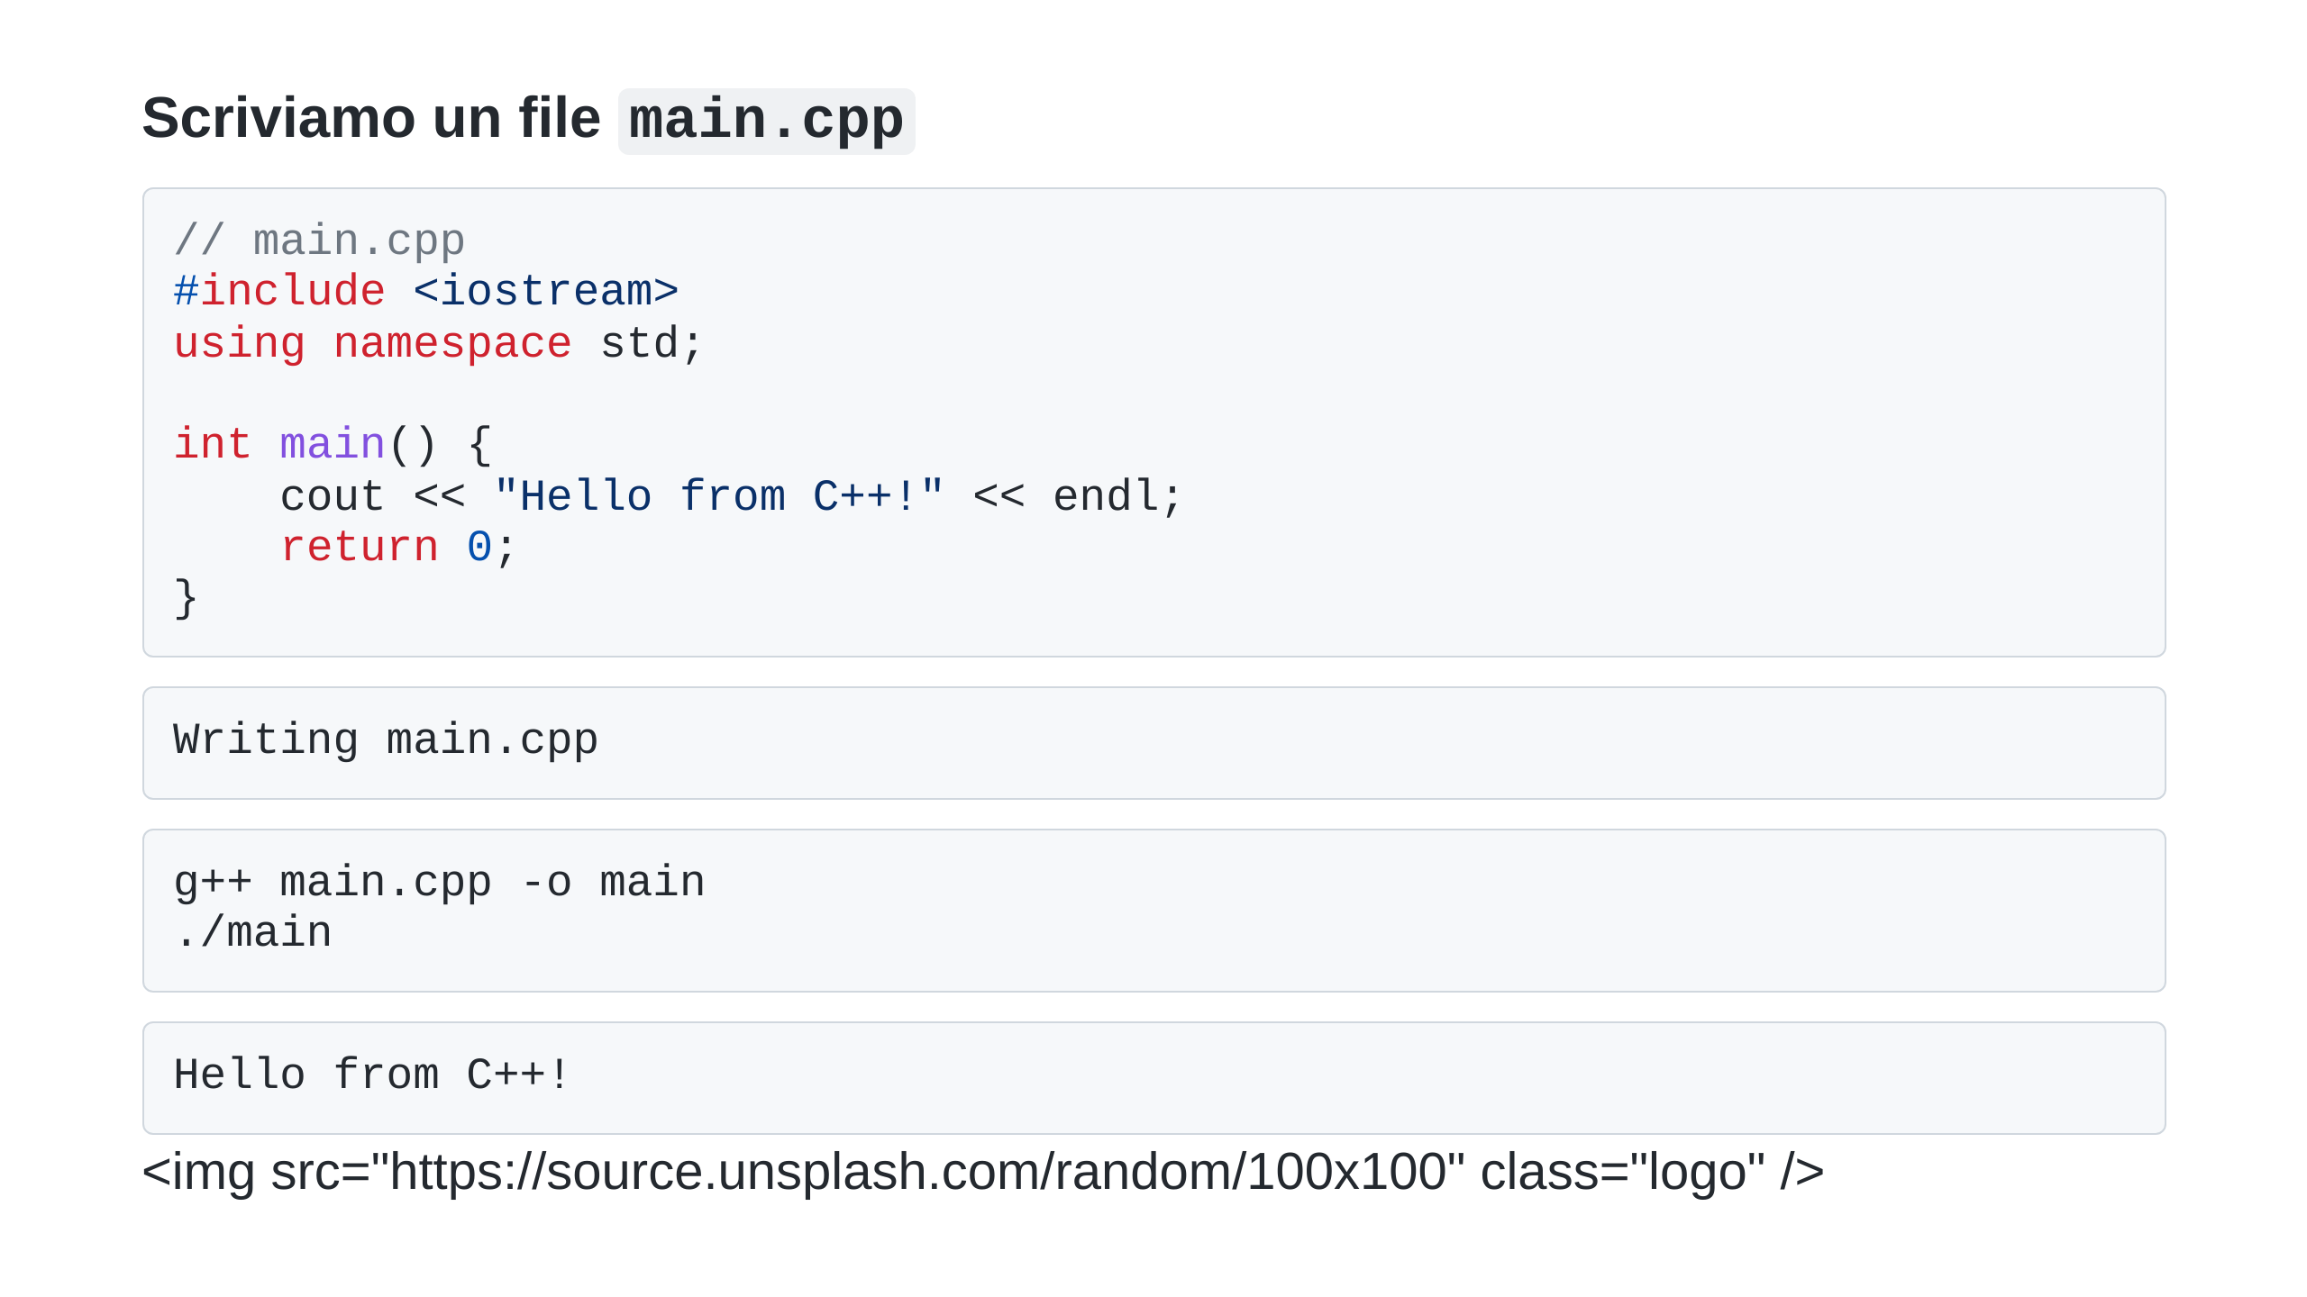
Notes:
Adding the logo at the top of every slide

