Slide 1
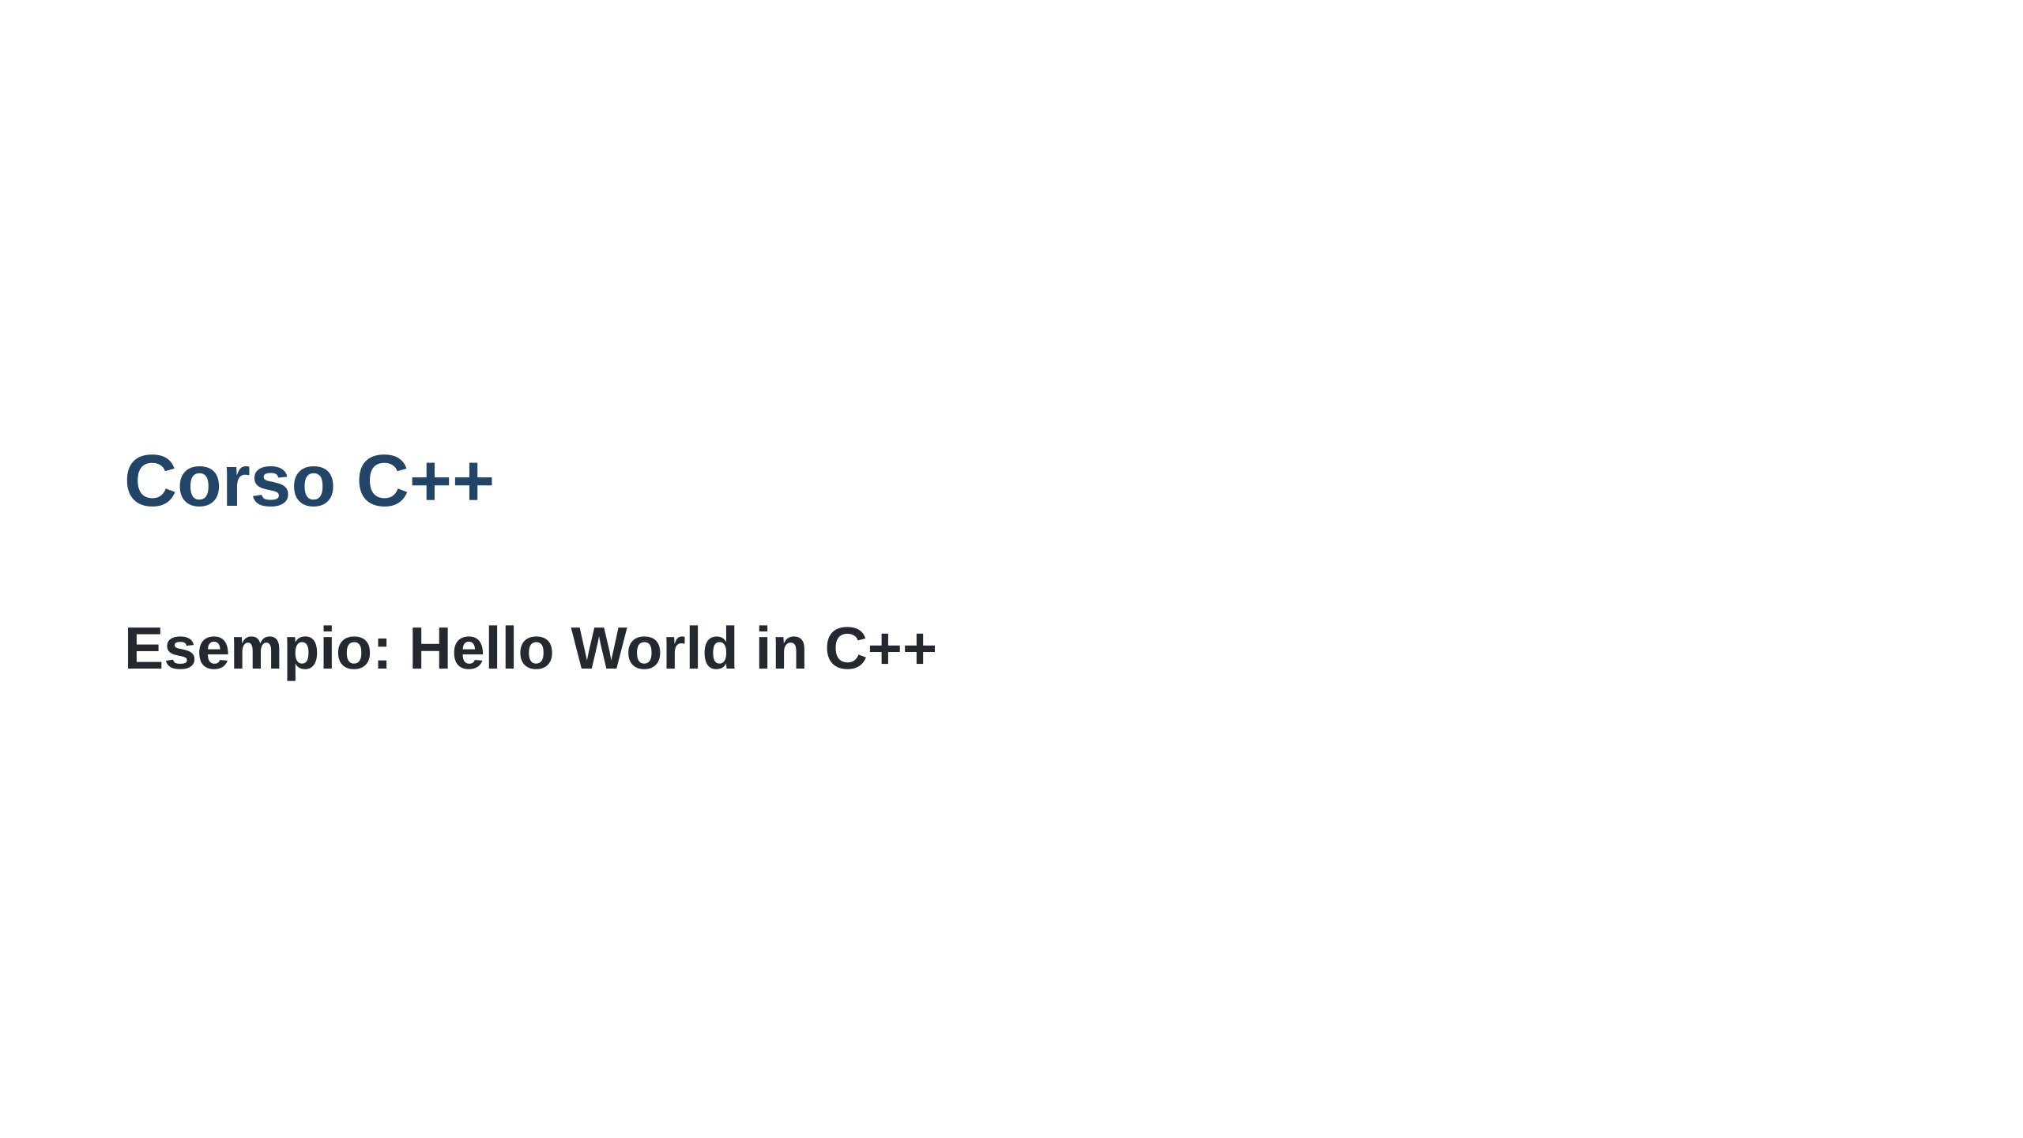
Notes:
--- marp: true style: | section { background-image: url("https://muralsyourway.vtexassets.com/arquivos/ids/236366/Black-Marble-Texture-Wallpaper-Mural.jpg?v=638164405494500000"); background-size: 20%; background-repeat: no-repeat; background-position: 95% 30px; } ---

Slide 2
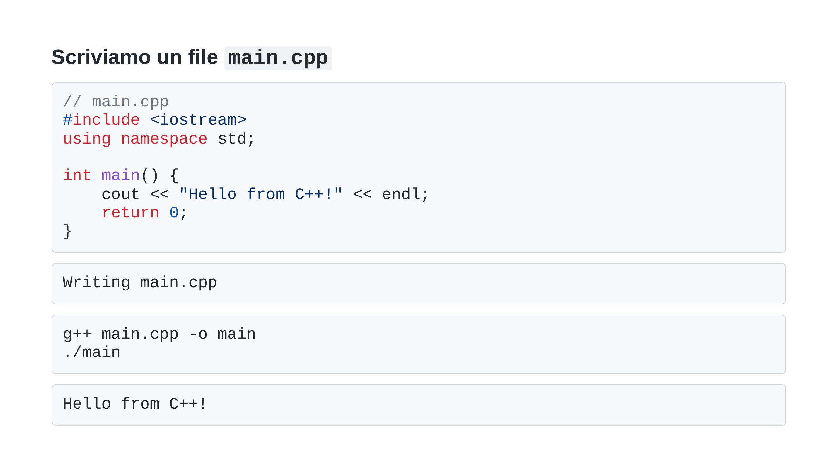

Slide 3


