Slide 1




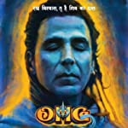

POLL
Most Anticipated Indian Movies of 2022
https://www.imdb.com/poll/pOJyygUg9Pk/

