Slide 1
PROG6212 POE PART 3
Student Number : ST10460357
NAME: SHONA MORAA BONARERI
GROUP 4
Contract Monthly Claim System
Workflow for lecture Claim Management

Slide 2
SYSTEM ARCHITECTURE OVERVIEW
How It's Built: Technology Stack
Content:
  Backend: ASP.NET Core MVC
  Frontend: Razor Pages, HTML, CSS, JavaScript, Bootstrap
  Database: Entity Framework Core (Code-First Approach)
  Authentication: ASP.NET Core Identity (Customized)
  Key Features:
    Session Management
    Model Validation
    File Upload Handling
    LINQ for Data Queries

Slide 3
What THIS PRESNTATION COVERS
PART 2: THE FOUNDATION
• Complete MVC application with database
• User authentication & role-based security
• Basic claim submission & approval workflow
• File upload system & validation
PART 3: INTELLIGENT AUTOMATION
• Automated claim validation & business rules
• Smart approval workflows with auto-processing
• Professional PDF reporting & analytics
• Enterprise security & configuration
LIVE DEMONSTRATION
• End-to-end automated claim processing
• Real-time status tracking
• Professional report generation
• Multi-role system interaction

Slide 4
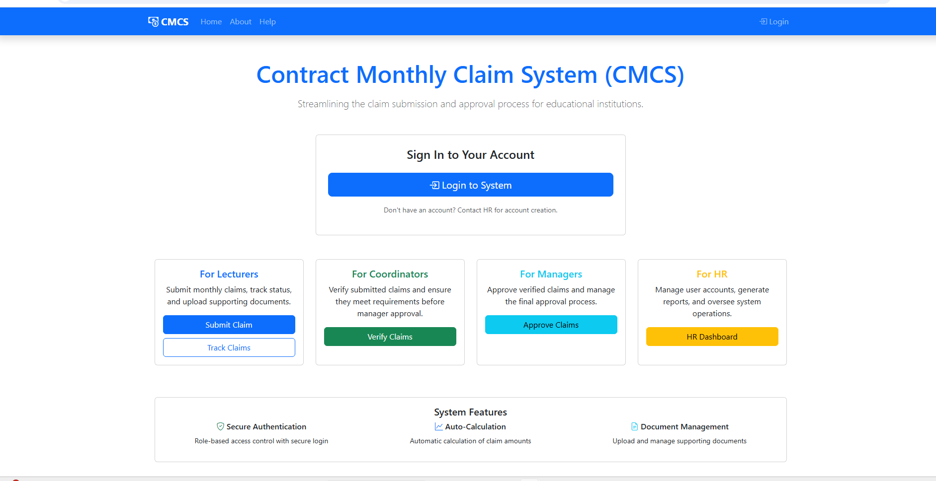
HOME DASHBOARD

Slide 5
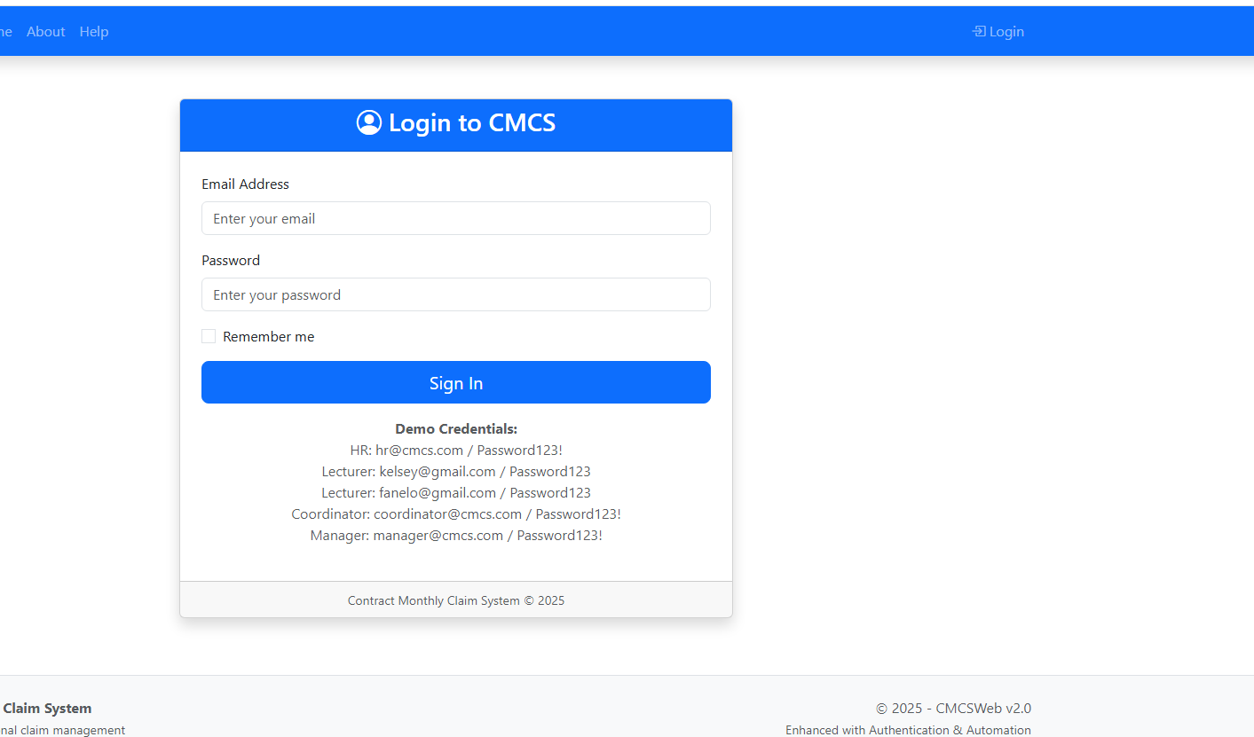
LOGIN SCREEN

Slide 6
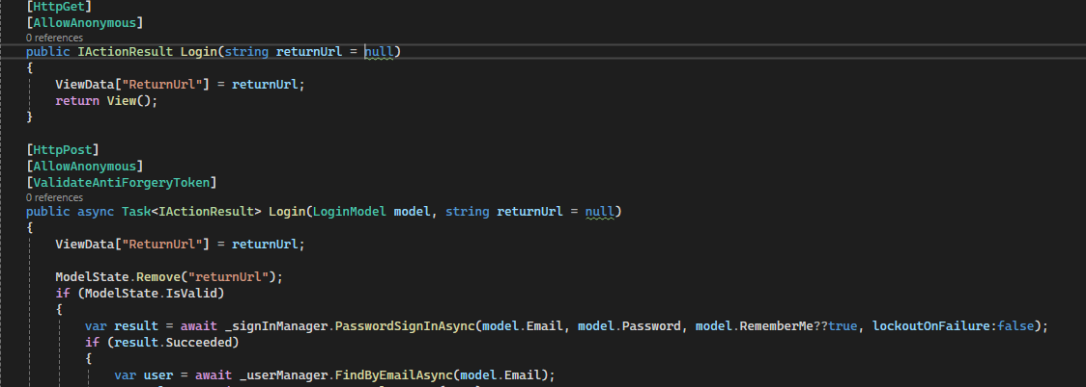
How login function works
How it works:
When users access protected routes, they're automatically redirected to /Account/Login
The login form authenticates users against the ASP.NET Core Identity system
Upon successful login, users are redirected to their role-specific dashboard
The system uses cookie-based authentication to maintain user sessions

Slide 7
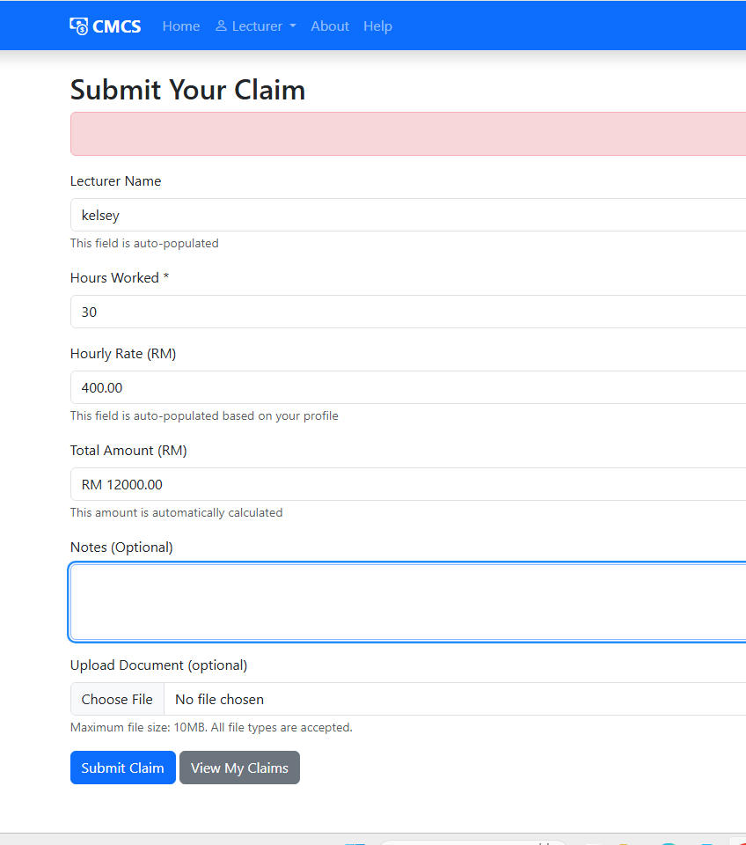
SUBMIT CLAIM FOR LECTURER

Slide 8
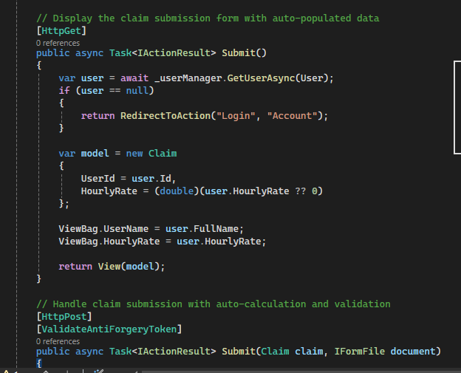
HOW SUBMIT CLAIM WORKS
How it works:
Lecturers access the claim submission form which auto-populates their profile data
The form includes real-time auto-calculation of total amount (Hours × Rate)
Upon submission, claims are validated and stored with "Pending" status
File uploads are processed and stored securely in the uploads folder

Slide 9
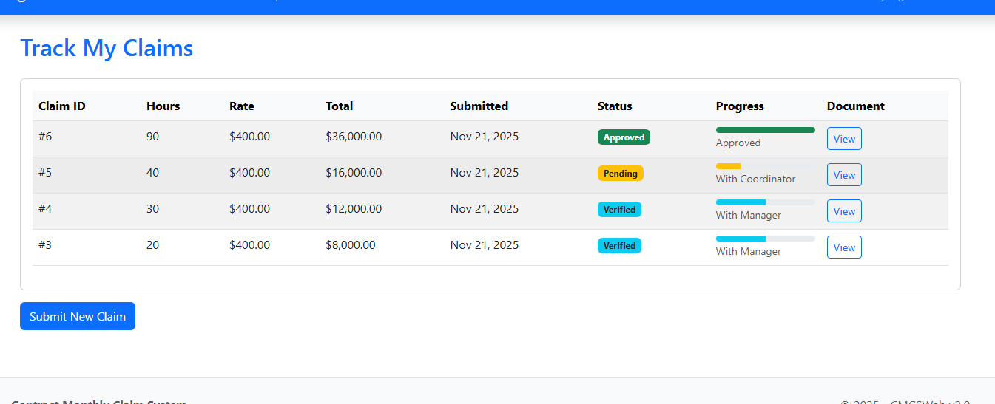
TRACKL CLAIM PAGE FOR LECTURERS

Slide 10
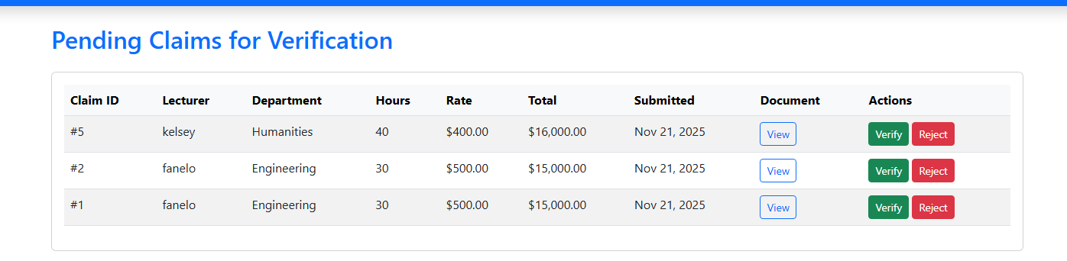
CLAIMS UNDER COORDINATOR

Slide 11
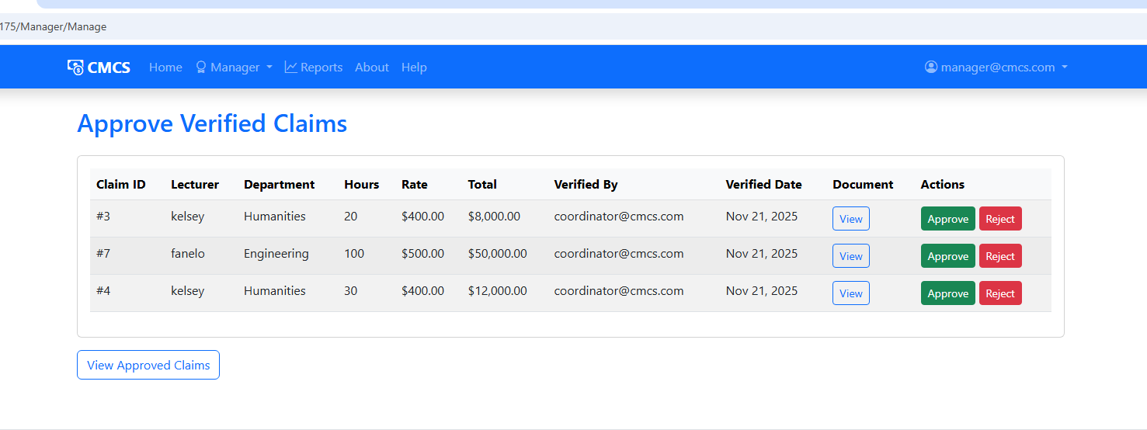
ALL CLAIMS

Slide 12
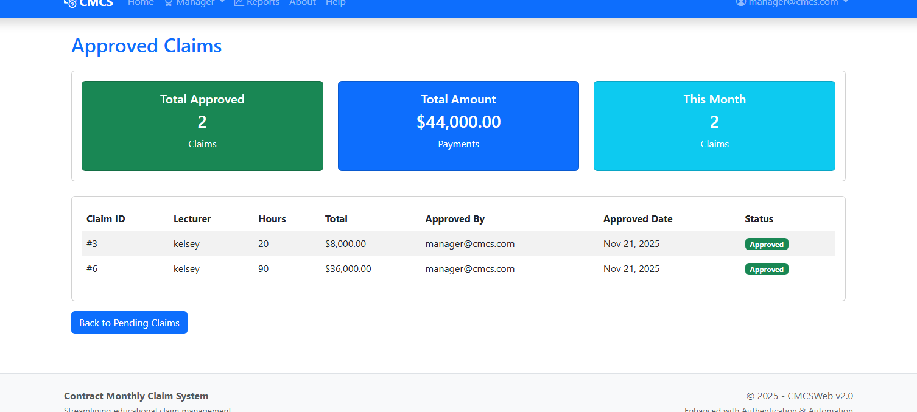
APPROVED CLAIMS BY MANAGER

Slide 13
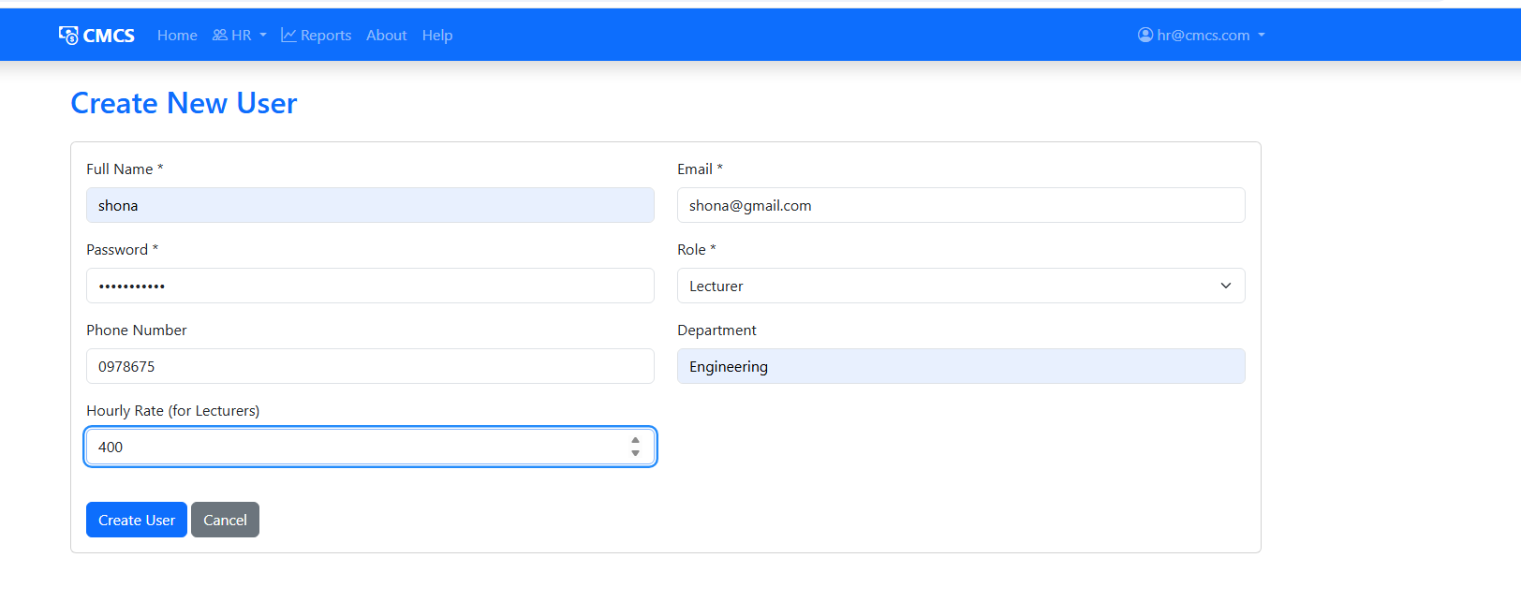
Create new user for HR

Slide 14
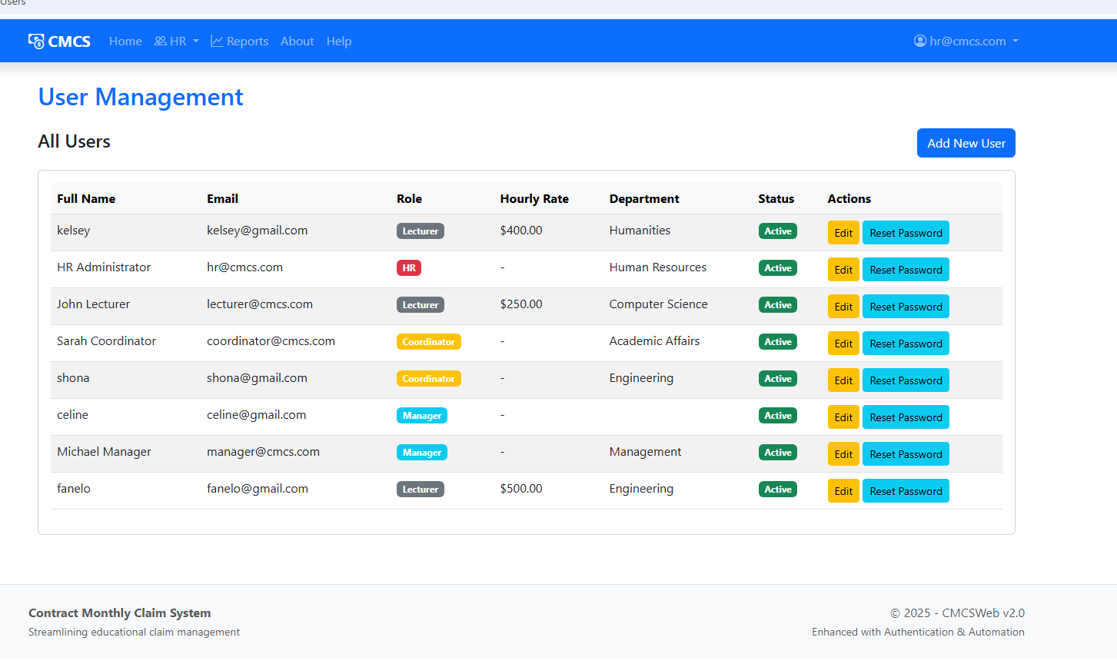
All user created by HR

Slide 15
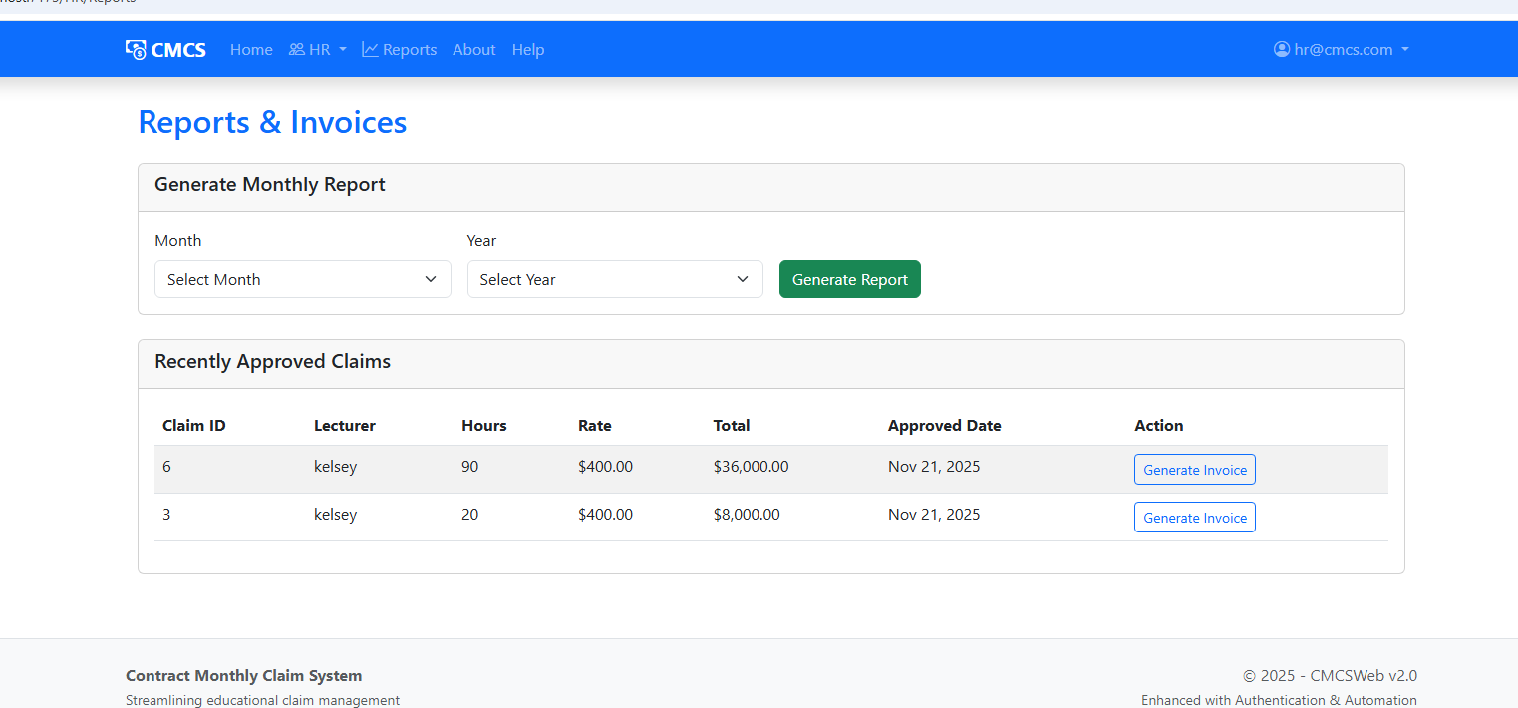
Generate reports by HR

Slide 16
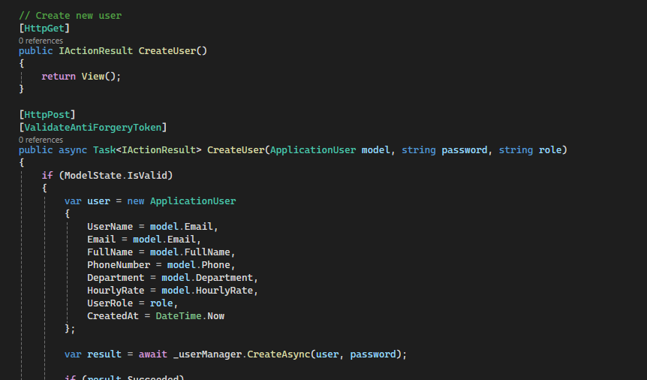
HOW HR CREATES USERS
How it works:
HR administrators access the user management interface to create new accounts
The form collects user details and assigns appropriate system roles
User credentials are securely stored using ASP.NET Core Identity hashing
New users receive auto-populated profiles based on their assigned role

Slide 17
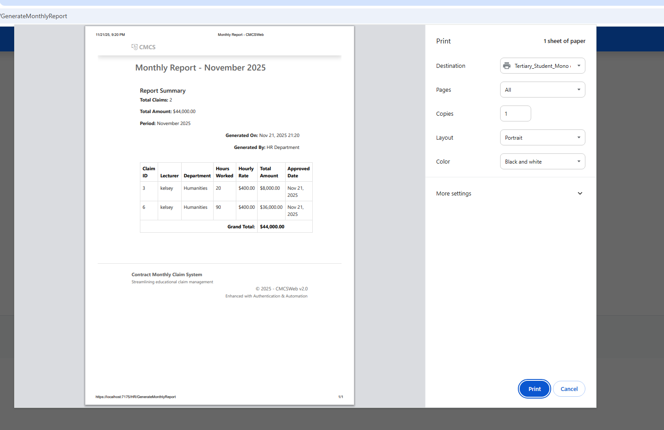
HR GENERATES REPORT THAT CAN BE PRINTED OR DOWNLOADED

Slide 18
COMPLETE AUTOMATION SYSTEM
What My System Does:
• Lecturers submit claims with auto-calculation
• System automatically validates against business rules
• Small claims (<R5000) auto-approve instantly
• Larger claims route to Coordinator → Manager
• HR/Managers generate professional PDF reports
• Complete audit trail for all actions

Slide 19
KEY FEATURES DELIVERED
1. SMART VALIDATION ENGINE
- Automatic hours/rate validation
- Budget limit enforcement
- Policy-based business rules
2. AUTOMATED WORKFLOW SYSTEM
- Role-based claim routing
- Auto-approval for small claims
- Status tracking with history
3. PROFESSIONAL REPORTING
- Invoice creation
- LINQ-powered analytics
4. ENTERPRISE SECURITY
- Custom user roles
- Session management
- Secure file uploads

Slide 20
INTELLIGENT CLAIM VALIDATION
• Checks hours worked (1-180 limit)
• Validates hourly rates against allowed values
• Enforces maximum claim amounts
• Verifies monthly budget limits
• Decides if claim can auto-approve
Result: Claims automatically approved or routed correctly

Slide 21
AUTOMATED APPROVAL WORKFLOW
How It Works:
1. Claim submitted → automatic validation
2. If valid & amount < R5000 → AUTO-APPROVED
3. If valid & amount > R5000 → Sent to Coordinator
4. Coordinator approves → Sent to Manager
5. Manager approves → Claim paid
Result: Claims automatically approved or routed correctly

Slide 22
SECURE ROLE-BASED ACCESS
Implemented Security:
• Custom ApplicationUser with roles
• [Authorize(Roles = "Coordinator")] attributes
• Session-based role verification
• Secure file upload validation
User Roles Working:
• Lecturer - Submit & track claims
• Coordinator - Verify claims
• Manager - Final approval
• HR - Reporting & analytics

Slide 23
INTUITIVE USER EXPERIENCE
Interface Features:
• Responsive Bootstrap 5 design
• Role-based navigation menus
• Real-time status indicators
• Professional color scheme
• Mobile-friendly layout
User Benefit: Easy to use for all technical levels

Slide 24
ADVANCED DEVELOPMENT SKILLS
Technical Skills Demonstrated:
• ASP.NET Core MVC with Entity Framework
• Service Layer Architecture with Dependency Injection
• LINQ Query Optimization
• PDF Generation with iTextSharp
• Async/Await Programming
• Bootstrap 5 Responsive Design
Code Quality: SOLID principles, clean separation, maintainable

Slide 25
BUILDING THE FOUNDATION
Built in Part 2:
• Complete ASP.NET Core MVC Application
• Entity Framework Database with Claims & Users
• Role-Based Authentication System
• Basic Claim Submission & Tracking
• User Management & Security
Foundation Features:
Lecturer claim submission with validation
Coordinator claim verification
Manager approval workflow
Basic status tracking
User registration & login

Slide 26
Database Design
Core Tables Created:
• Claims - Store all claim information
• AspNetUsers - Custom user management
• AspNetRoles - Role-based security

Slide 27
CLAIM PROCESSING WORKFLOW
• Claim submission with data annotations
• Hours worked validation (1-180 hours)
• Automatic total amount calculation
• File upload for supporting documents
• Status tracking through approval stages
Basic Workflow:
Submit → Pending → Verified → Approved

Slide 28
UI FOUNDATION
Interface Components Built:
• Responsive Bootstrap navigation
• Role-based menu system
• Claim submission forms with validation
• Status tracking views
• User dashboard layouts
Design Approach:
• Mobile-first responsive design
• Consistent color scheme
• Intuitive user workflows
• Professional institutional appearance

Slide 29
USER ROLE MANAGEMENT
Role System Working:
• Lecturers - Can submit and view their claims
• Coordinators - Can verify/reject pending claims
• Managers - Can approve verified claims
• HR - Administrative access (added in Part 3)
Access Control:
• [Authorize(Roles = "Coordinator")]
• Session-based role verification
• Action-level permission checks

Slide 30
Complete System Journey
Part A Achievement:
Working claim management system
Secure user authentication
Role-based access control
Basic validation & workflow
Part B Excellence:
Intelligent automation
Advanced analytics
Enterprise architecture
Premium user experience

