Slide 1
ASHRAE – Great Energy Predictor III How much energy will a building consume?
Lovelace Bootcamp – Deep Challenge TEAM

Slide 2
CONTENT - Background - Plan of Approach - Checklist AI/ML - Dataset & Correlations - Approach - Solution and Results - Conclusions & Recommendations

Slide 3
Background Q: How much does it cost to cool a skyscreaper in the summer? A: A lot! And not just in dollars, but in environmental impact.
ASHRAE bigger scope: assessing the impact of energy efficiency improvements on buildings
Great Energy Predictor III: developing a model to predict energy consumtion of non-renovated buildings

Slide 4
Background
Once a building is overhauled the new (lower) energy consumption is compared against modelled values for the original building to calculate the savings from the retrofit.
More accurate models could support better market incentives and enable lower cost financing.

Slide 5
Background THE CHALLENGE: Building counterfactual models across four energy types based on historic usage rates and observed weather. The dataset includes three years of hourly meter readings from over one thousand buildings at several different sites around the world

Slide 6
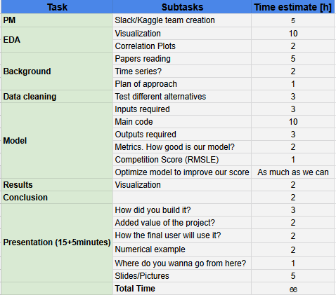
Plan of Approach

Slide 7
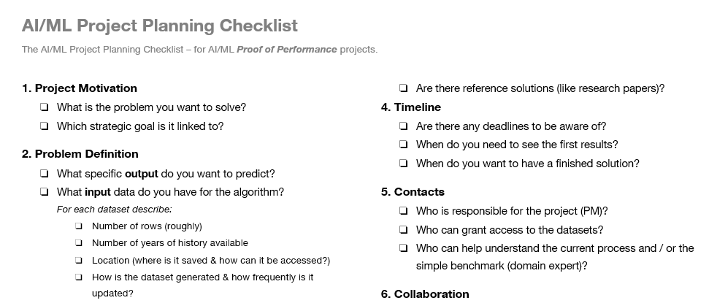
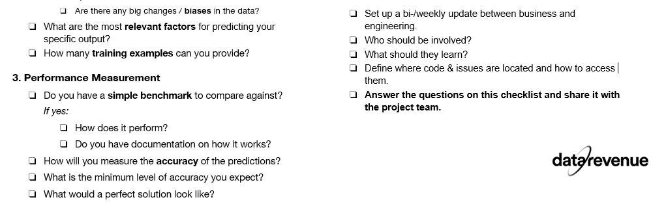

Slide 8
Dataset – ‘building_metadata’
Site_id == 1
building_id == 1
primary_use
square_feet
year_built
floor_count
building_id == ...
...
Site_id == ...
...
...
Site_id == 15
...
...
building_id == 1449
...

Slide 9
Dataset – ‘weather_train’
air_temperature
cloud_coverage
dew_temperature
precip_depth_1hr
sea_level_pressure
wind_direction
wind_speed
Site_id == 1
timestamp == 2016-01-01 00:00:00
timestamp == …
...
timestamp == 2016-12-31 23:00:00
...
Site_id == ...
...
...
Site_id == 15
...
...

Slide 10
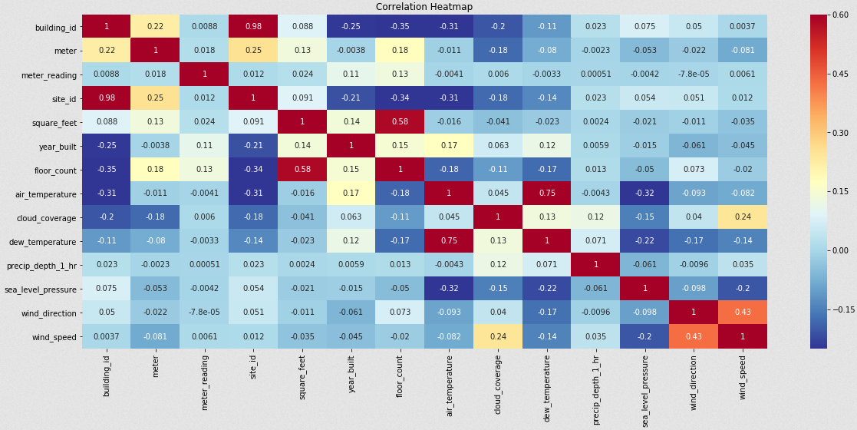
Correlations Weather & Building_metadata

Slide 11
Dataset – ‘train’
building_id == 1
meter == 1
timestamp == 2016-01-01 00:00:00
meter_reading
...
...
meter == 2
...
meter == 3
...
meter == 4
...

Slide 12
Training dataset – combined - ~20,000,000 rows (!) - 15 features (numerical and categorical) - missing values - outliers (?) - continuous target
Supervised ML problem, Regression

Slide 13

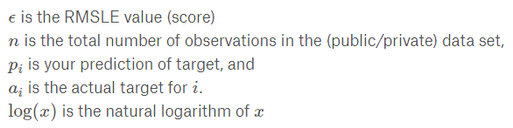
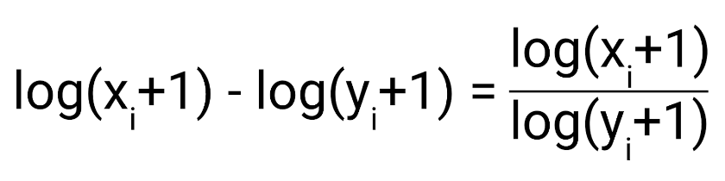
Approach: Evaluation Metric Root Mean Squared Logaritmic Error (RMSLE) - robustness to outliers - quantifies relative error -> - biased penalty -> more penalty is incurred when the predicted value is lower than the actual

Slide 14
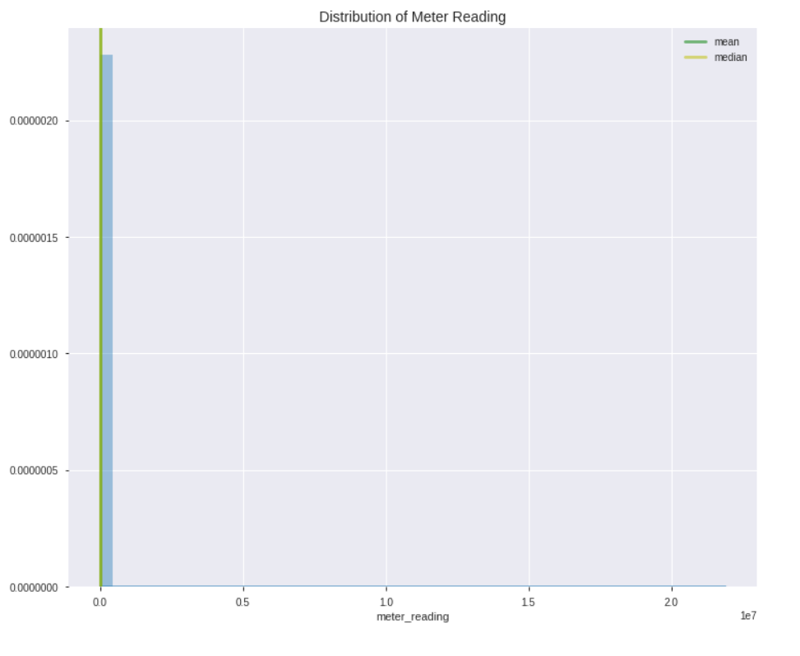
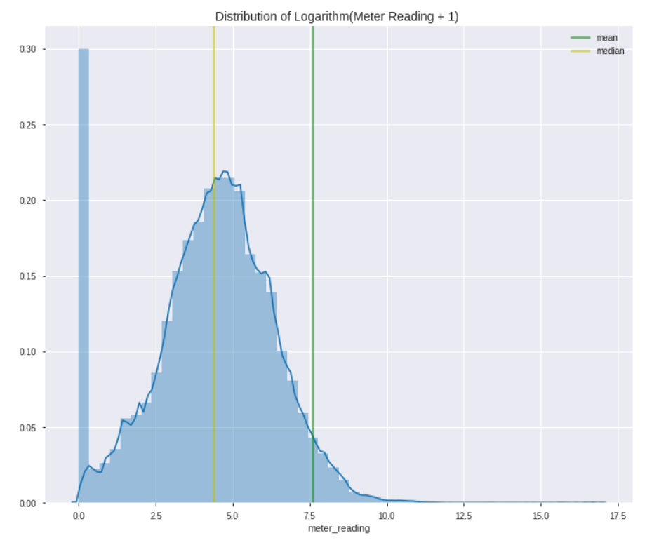
Target ‘meter_reading’ log-transform ‘Note that this is real data with measurement error, which we expect will impose a baseline level of modelling error.’ --> Should zero meter_readings be excluded or not?
Approach: Target Variable

Slide 15
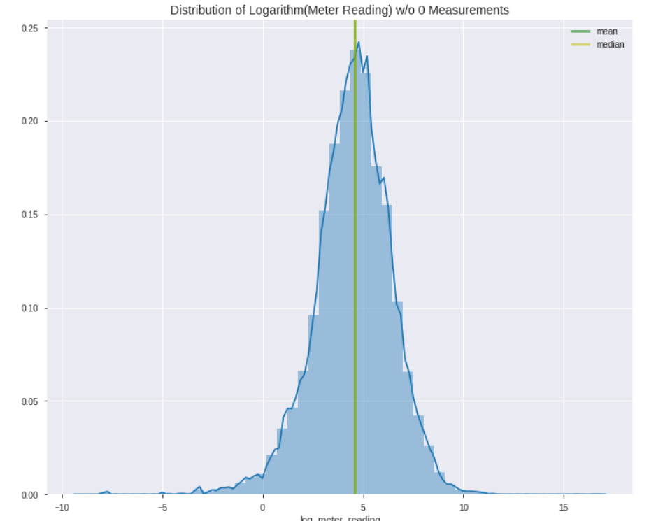
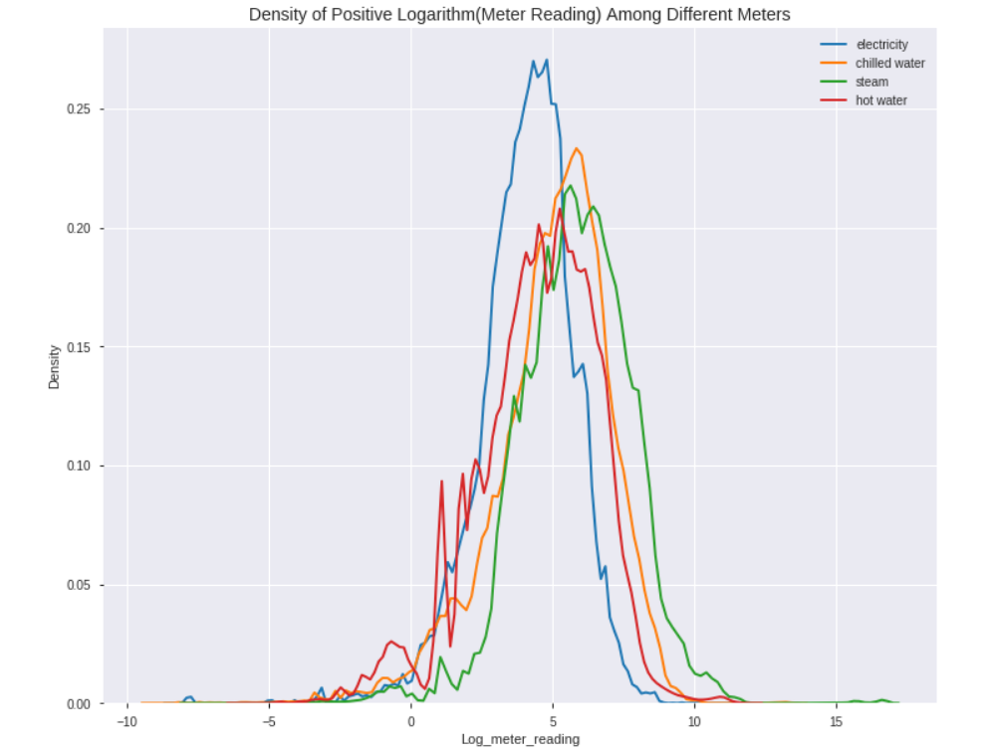
Target ‘meter_reading’ removed zero measurements
Approach: Target Variable

Slide 16
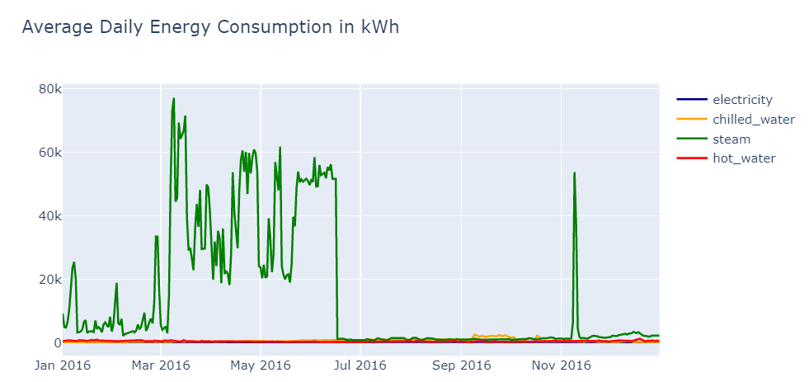
Consumption per meter type steam (‘meter’==2) shows much higher daily consumption. Let’s dig in...
Approach: outliers

Slide 17
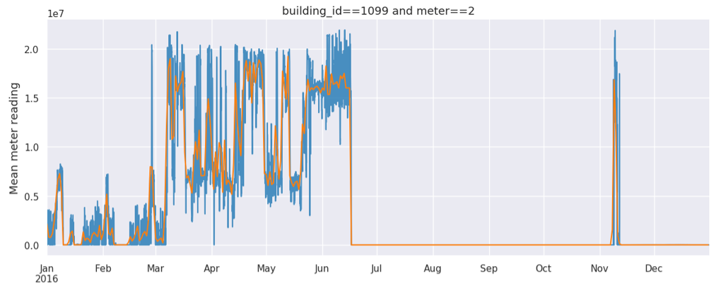
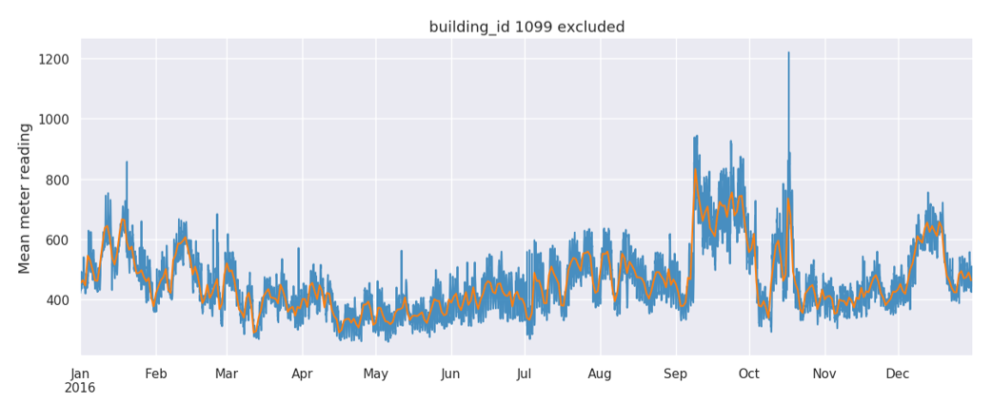
...it turns out 1 building measurement is responsible for the anomaly Let’s get rid of it.
Approach: outliers

Slide 18
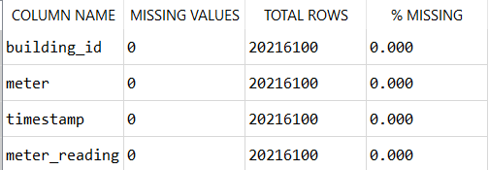
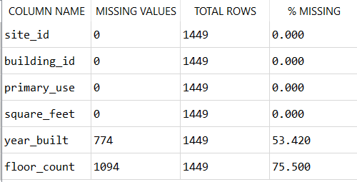
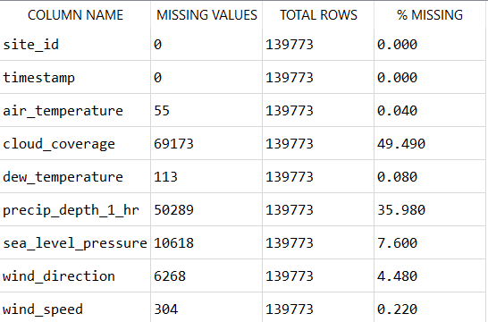
Approach: missing values
Meter reading dataframe
Building dataframe
Weather dataframe

Slide 19
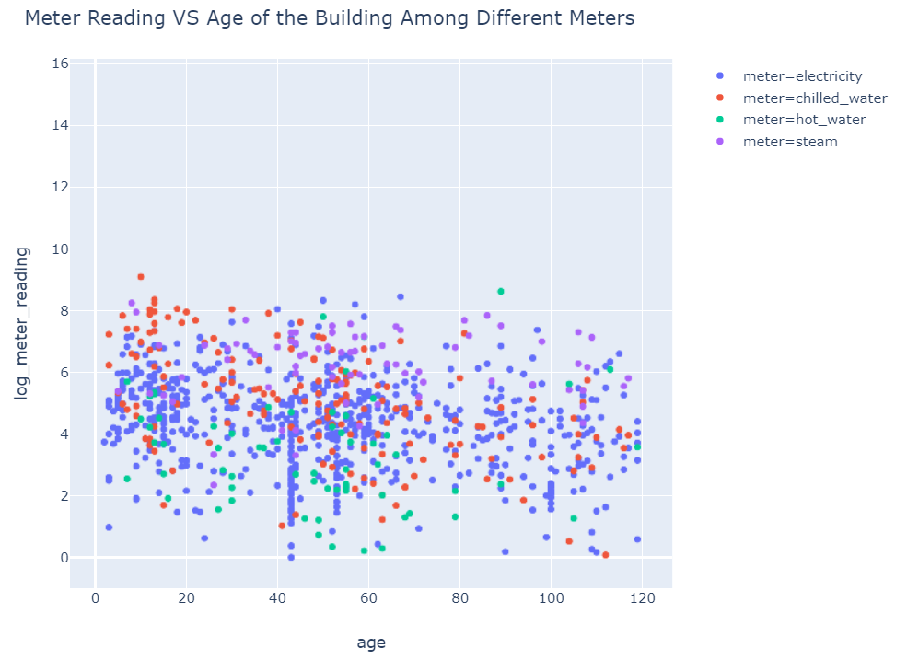
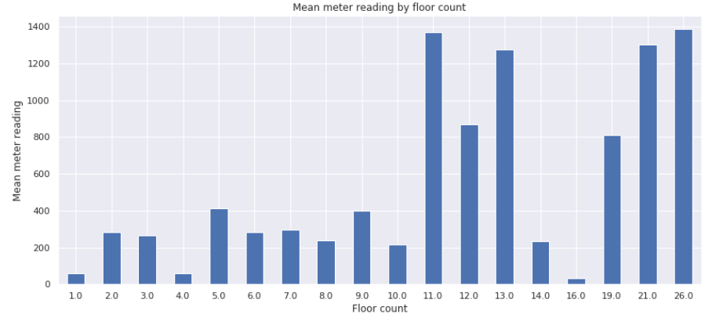
Approach: missing values
Building dataframe
Both columns i.e. ‘year_built’ and ‘floor_count’ are dropped

Slide 20
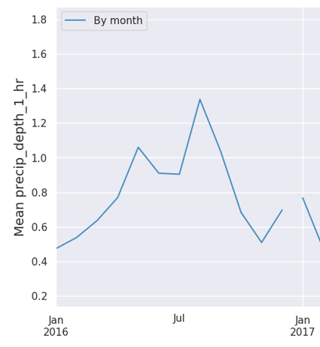
Approach: missing values
Weather dataframe
NaN replaced by the average daily values for that day of the month.
If no daily average available the last valid observation is used
Dropped columns

Slide 21
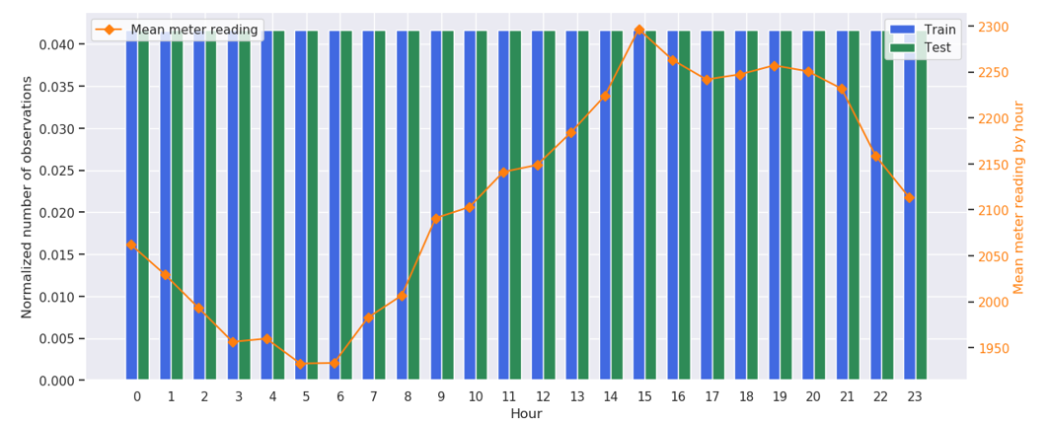
Approach: feature engineering
Hours
Hour is extracted from timestamp and added as a feature

Slide 22
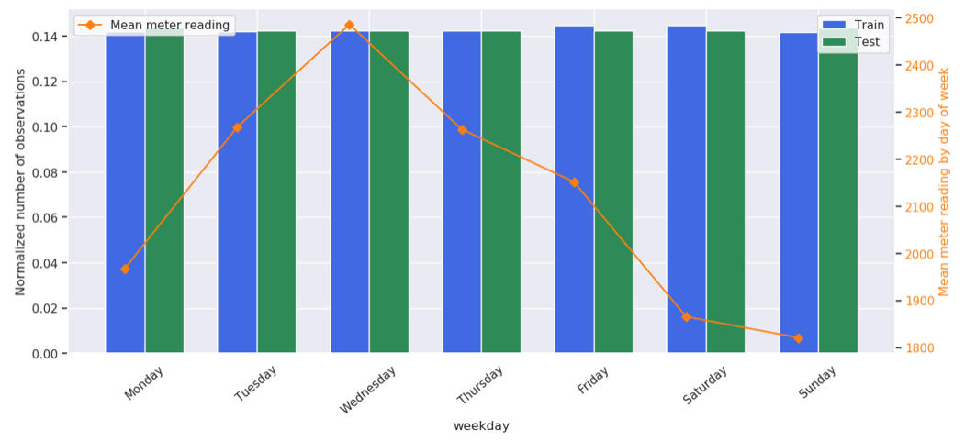
Approach: feature engineering
Day of the week
Day of the week is extracted from timestamp and added as a feature

Slide 23
Approach: engineered dataframe
Starting dataframe
...after EDA, missing values/outliers treatment and feature engineering

Slide 24
Solution and Results Gradient boosting framework that uses tree based learning algorithms - fast training speed and higher efficiency - low memory usage - accuracy - support of parallel and GPU learning https://github.com/microsoft/LightGBM
LGBM - Light Gradient Boosting

Slide 25
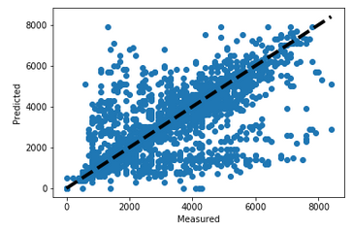
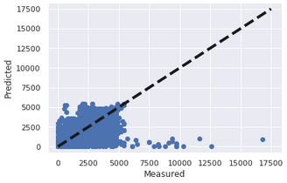
Solution and Results
Additional models tested – Random Forest
building_id = 7 and all meters (electricity, chilled water, steam, hot water)
All building_id’s without outliers and only meter = electricity
RMSE = 1099178, RMSLE= 0.434
RMSE = 10435.855, RMSLE= 1.092
Notes:
Building_id 7 was taken because it has a good amount of data of all meters
We can see that in terms of RMSE it performs really bad
However how we are removing many of the outliers buildings or only testing with one building id, the RMSLE can’t be compared with the LGB output

Slide 26
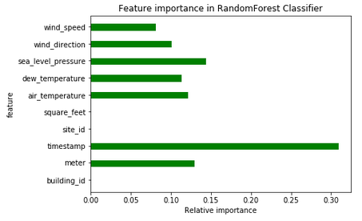
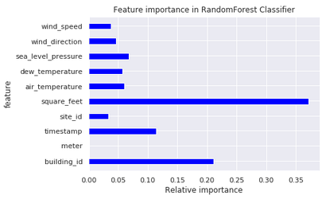
Solution and Results
Additional models tested - Random Forest
building_id = 7 and all meters (electricity, chilled water, steam, hot water)
All building_id’s without outliers and only meter = electricity

Slide 27
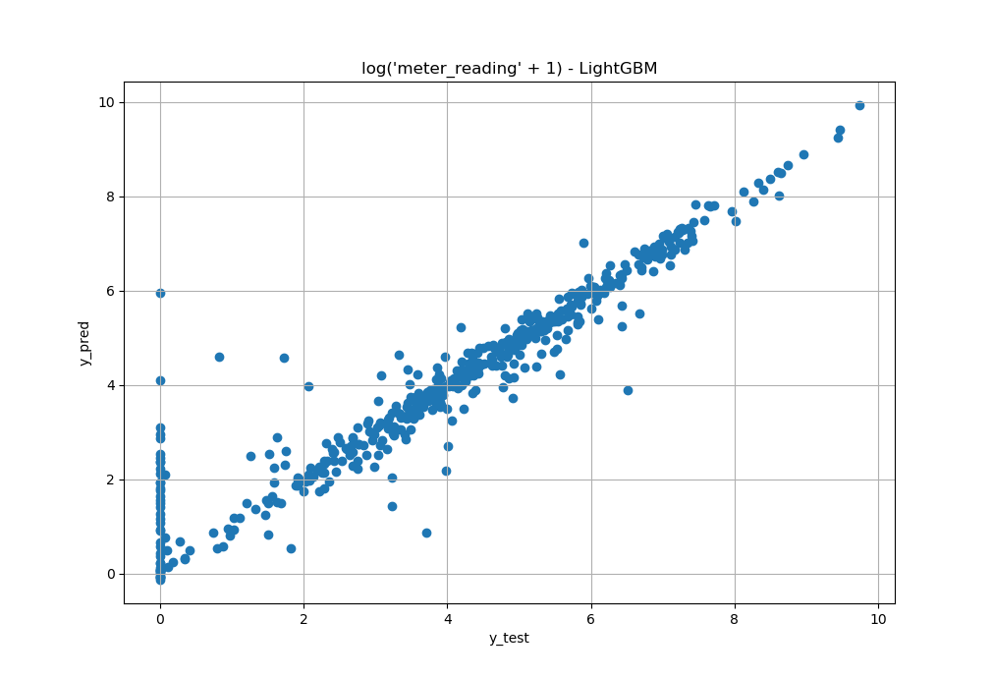
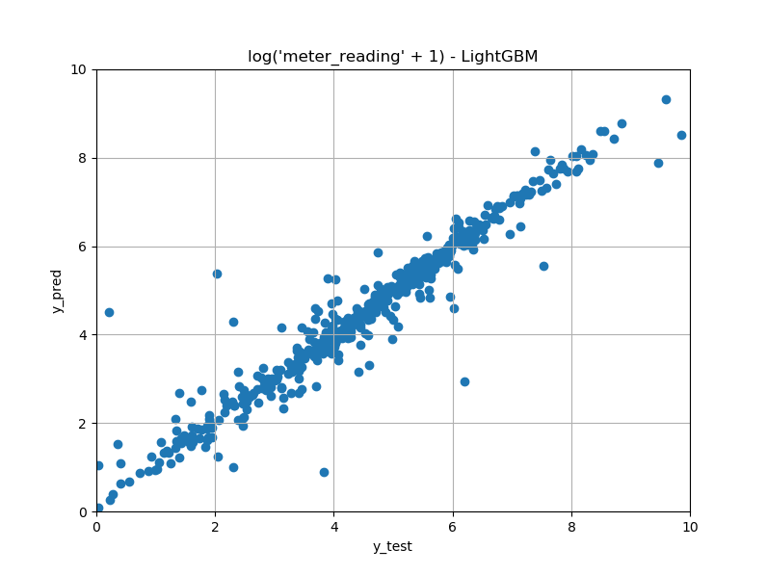
Solution and Results
LGB - Results
Meter_reading == 0 included
Meter_reading == 0 excluded
RMLSE = 0.73
RMSLE = 0.39

Slide 28
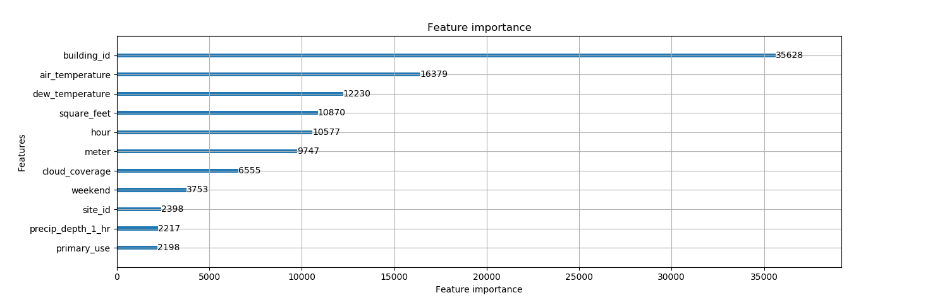
Solution and Results
LGBM - Feature importance

Slide 29
Conclusions and Recommendations Challenges: - dealing with bulky datasets (exploration, training time, etc.) - dealing with state-of-the-art algorithms (many parameters) - planning and workload coordination -> setting realistic goals - understand what some kagglers do (good to try something on your own first)

Slide 30
Conclusions and Recommendations Takeaways: - kaggle competitions are great for learning (hands on experience, resources, q&a, peers, etc.) - Domain expertise does helps - Importance of knowing your data

Slide 31
Conclusions and Recommendations Improvements: - replacing missing values using regression (building dataset) - more thoughts on target i.e. meter readings - feature engineering - hyperparameter tuning (lgb) - other algorithms (neural networks?)

Slide 32
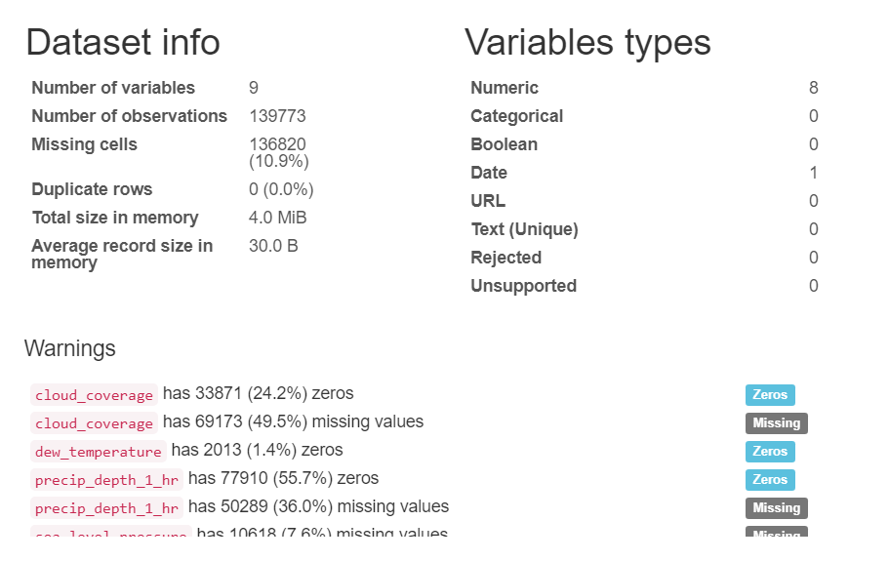
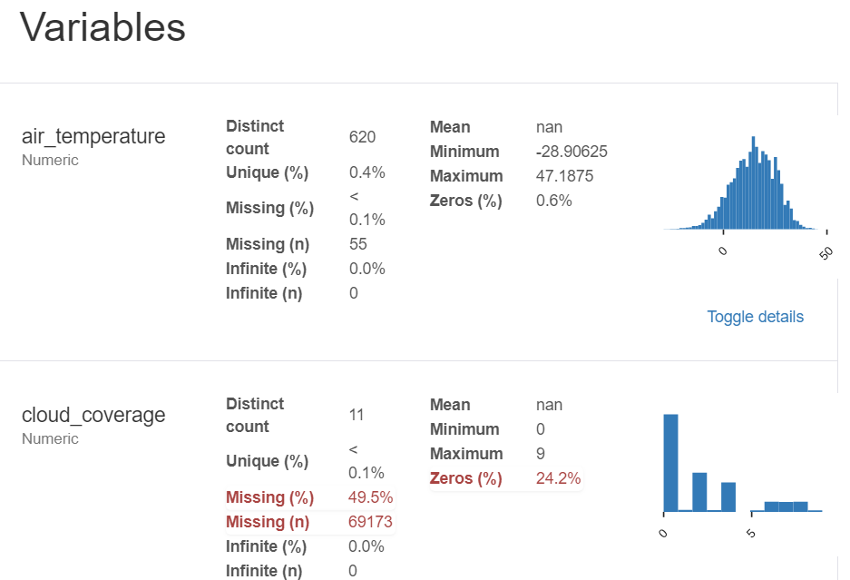
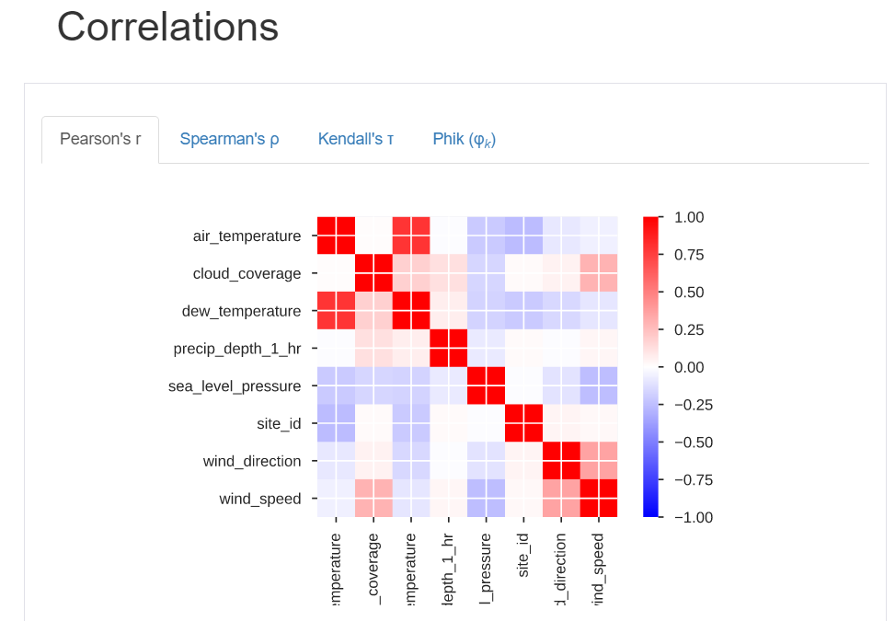
Conclusions and Recommendations Check it out (not sponsored): - pandas profiling https://pandas-profiling.github.io/pandas-profiling/docs/ - featuretools – automated feature engineering https://github.com/FeatureLabs/featuretools

Slide 33

Thank You For Your Kind Attention! From her and from the Deep(ly) Challenge(d) team

