Slide 1
JUNIT TEST NG
Bohdan Bondar

Slide 2
AGENDA
What is software testing
What is Unit testing
JUnit
TestNG

Slide 3
What is Software Testing
Software testing is defined as an activity to check whether the actual results match the expected results and to ensure that the software system is defect free.
Why it is important
Testing is important because software bugs could be expensive or even dangerous. Software bugs can potentially cause monetary and human loss, and history is full of such examples. Here are some examples:
Nissan cars have to recall over 1 million cars from the market due to software failure in the airbag sensory detectors. There has been reported two accident due to this software failure.
China Airlines Airbus A300 crashed due to a software bug on April 26, 1994, killing 264 innocent live.
In April of 1999, a software bug caused the failure of a $1.2 billion military satellite launch, the costliest accident in history.

Slide 4
What is Unit testing
Unit Testing is defined as a type of software testing where individual units/components of a software are tested.
Unit Testing of software applications is done during the development (coding) of an application. The objective of Unit Testing is to isolate a section of code and verify its correctness. Unit testing framework for the Java programming language is JUnit.
Here are few advantages Unit testing provides:
Unit Tests fix bug early in development cycle and save costs.
It helps understand the developers the code base and enable them to make changes quickly
Good unit tests serve as project documentation
Unit tests help with code re-use. Migrate both your code and your tests to your new project.

Slide 5
JUnit
JUnit basic annotations
Depends on JUnit version annotations may differ. Here are some basic nnotations you should understand:
JUNIT 4 | JUNIT 5 | DESCRIPTION
@BeforeClass | @BeforeAll | Run once before any of the test methods in the class
@AfterClass | @AfterAll | Run once after all the tests in the class have been run
@Before | @BeforeEach | Run before each @Test method
@After | @AfterEach | Run after each @Test method
@Test | @Test | Defines a test method

Slide 6
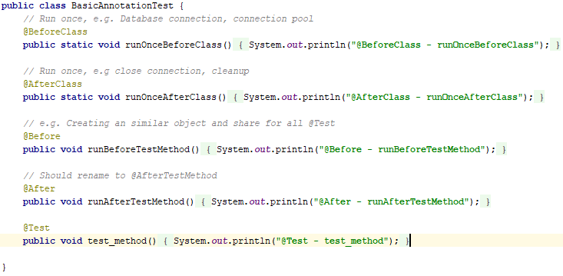

JUnit
Annotations usage example
Output:

Slide 7
JUnit
Assert.class
Assert class provides a bunch of assertion methods useful in writing a test case. If all assert statements are passed, test results are successful. If any assert statement fails, test results are failed. Some of the important methods of Assert class are as follows:
assertEquals(boolean expected, boolean actual) The method compares two objects for equality, using their equals() method.
assertFalse(boolean condition) / assertTrue(boolean condition) The methods tests a single variable to see if its value is either true, or false.
assertNotNull(Object object) / assertNull(Object object) The methods test a single variable to see if it is null or not null.
assertSame(object1, object2) / assertNSame(object1, object2) The methods tests if two object references point to the same object or not.

Slide 8
JUnit
public class TestRunner { public static void main(String[] args) { Result assertsExample = JUnitCore.runClasses(AssertsExample.class); /* Output boolean value whether test was successful */ System.out.println(assertsExample.wasSuccessful()); /* Iterating through failed asserts */ for (Failure failure : assertsExample.getFailures()) { System.out.println(failure.toString()); } } }
public class AssertsExample { @Test public void test() { int num = 1; String str1 = "not equals"; String str2 = null; /* Failure 1 */ assertEquals("equals", str1); /* Success asserts */ assertFalse(num > 10); assertNull(str2); } }
Output: false
test(AssertsExample): expected:<[]equals> but was:<[not ]equals>

Slide 9
JUnit
TestSuite.class
If you want to execute multiple tests in a specified order, it can be done by combining all the tests in one place. This place is called as the test suites. Some of the important methods of TestSuite class are as follows:
void addTest(Test test) - Adds a test to the suite.
int countTestCases() - Counts the number of test cases that will be run by this test.
String getName() - Returns the name of the suite.
void run(TestResult result) - Runs the tests and collects their result in a TestResult.
void setName(String name) - Sets the name of the suite.
Test testAt(int index) - Returns the test at the given index.
int testCount() - Returns the number of tests in this suite.
static Test warning(String message) - Returns a test which will fail and log a warning message.

Slide 10
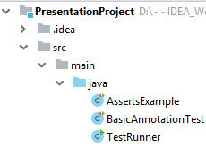
JUnit
public class TestRunner { public static void main(String[] args) { TestSuite testSuite = new TestSuite(BasicAnnotationTest.class, AssertsExample.class); TestResult result = new TestResult(); testSuite.run(result); System.out.println("TestSuite name - " + testSuite.getName()); testSuite.setName("newTestSuite"); System.out.println("Changed TestSuite name - " + testSuite.getName()); System.out.println("Tests count - " + testSuite.testCount()); } }
Output:
TestSuite name - null
Changed TestSuite name - newTestSuite
Tests count - 2

Slide 11
TestNG
TestNG is a testing framework developed in the lines of JUnit and NUnit, however it introduces some new functionalities that make it more powerful and easier to use.
TestNG provides next opportunities:
Annotations
Using XML for flexible tests configuring
Data-driven testing support
Dependent methods for testing server applications
Flexible runtime configuration
Supports parallel testing

Slide 12
TestNG
Basic annotations
ANNOTATION | DESCRIPTION
@BeforeSuite | The annotated method will be run only once before all tests in this suite have run.
@AfterSuite | The annotated method will be run only once after all tests in this suite have run.
@BeforeClass | The annotated method will be run only once before the first test method in the current class is invoked.
@AfterClass | The annotated method will be run only once after all the test methods in the current class have run.
@BeforeGroups | The list of groups that this configuration method will run before. This method is guaranteed to run shortly before the first test method that belongs to any of these groups is invoked.
@AfterGroups | The list of groups that this configuration method will run after. This method is guaranteed to run shortly after the last test method that belongs to any of these groups is invoked.
@BeforeMethod | The annotated method will be run before each test method.
@AfterMethod | The annotated method will be run after each test method.

Slide 13
TestNG
Exceptions
To catch expected exception use annotation @Test and expectedExceptions parameter
@Test(expectedExceptions = NullPointerException.class) public void testNullPointerException() { List list = null; int size = list.size(); }
[TestNG] Running:
C:\Users\BBV\.IdeaIC2018.3\system\temp-testng-customsuite.xml
===============================================
Default Suite
Total tests run: 1, Failures: 0, Skips: 0
===============================================

Slide 14
TestNG
Ignoring test methods
@Test(enabled = false) public void testsetProperty() { System.out.println("This method will be ignored!"); }
Timeout
timeOut parameter allows to limit testing time
@Test(timeOut = 1000) public void waitLongTime() throws Exception { Thread.sleep(1001); }
in this case testing will be failed because executing time is higher than timeOut

Slide 15
TestNG
To divide tests into groups use attribute groups in the @Test annotation
public class TestNGGroupTest { @Test(groups={"unit1","integration"}) public void testingMethod1() { System.out.println("testingMethod1"); } @Test(groups={"unit2","integration"}) public void testingMethod2() { System.out.println("testingMethod2"); } @Test(groups={"unit1"}) public void testingMethod3() { System.out.println("testingMethod3"); } @Test(groups={"unit1", "unit2"}) public void testingMethod4() { System.out.println("testingMethod4"); } }

Slide 16
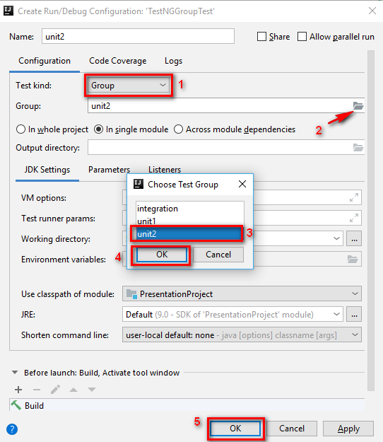
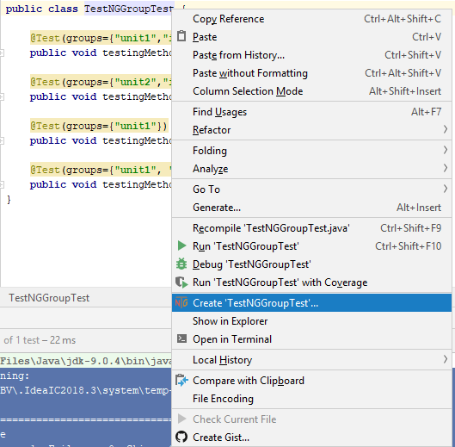
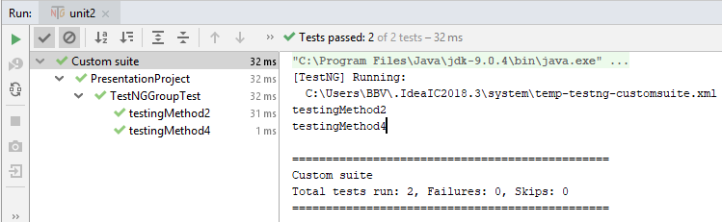
TestNG

Slide 17
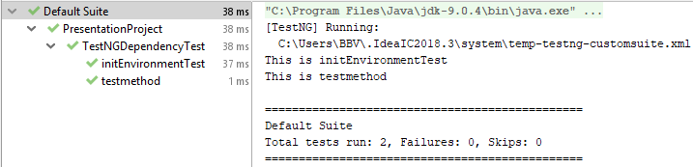
TestNG
Parameter dependsOnMethods in the @Test annotation
@Test public void initEnvironmentTest() { System.out.println("This is initEnvironmentTest"); } @Test(dependsOnMethods={"initEnvironmentTest"}) public void testmethod() { System.out.println("This is testmethod"); }
dependsOnMethods attribute on a test method specifies all the test methods this test method depends on. It means testmethod() will start execution only after all the tests it depends on executed successfully.

