Slide 1
Inheritance
CMPE2300
Winter 2014
JD Silver

Slide 2
Inheritance
Inheritance allows you to create a new derived class from a base class.
The derived class benefits from all of the functionality that the base class has, plus any functionality that you add.
Inheritance allows you to build a set of classes that share common roots, freeing you from having to rewrite the same code in each class.
For example, apples and oranges are quite different; however, they are both fruit, both have a peel, both have seeds, etc...

Slide 3
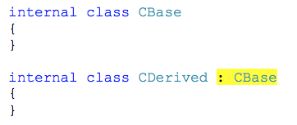
Inheritance
To declare a derived class, you add a colon and the base class specification after the class name.

Slide 4
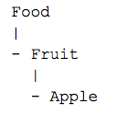
Inheritance
The purpose of building derived classes is to extend functionality.
Derived types should always follow the ‘is a’ rule, meaning, regardless how far down a derived type exists in a hierarchy, it still ‘is a’ base type.
Consider the following hierarchy:

Slide 5
Inheritance
This hierarchy is sound, as an apple is a fruit, a fruit is a food, and an apple is a food.
Not all foods are fruit, nor are all fruits apples.

Slide 6
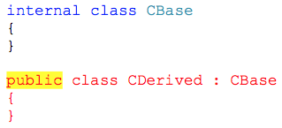
Inheritance
You must be careful not to apply class level access modifiers that are inconsistent with existing access modifiers in the class hierarchy (you can make the class less accessible, not more):

Slide 7
Inheritance
Any non-private methods and fields defined in the base class will be visible in the derived class.
Base class visibility in the derived class is based on the access modifiers applied to those base members.
Base class members that are marked public, protected, internal, or protected internal will be visible in the derived class.
Members marked protected and protected internal are specifically designed to be visible in derived classes only.
As usual, public means anyone can see the member, and private means no one can see the member, not even derived types.

Slide 8
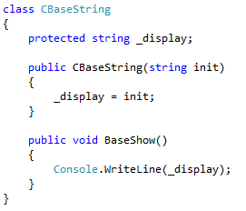
Example
The CBaseString class will act as the base class in the hierarchy and will contain a field member of type string.
The method BaseShow() will display the string.

Slide 9
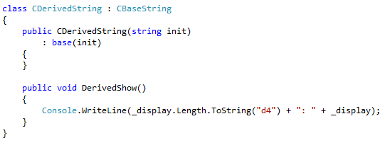
Example
The derived class can access the base class protected field member, the string.
The derived class DerivedShow() method displays the length of the string, and the contents of the string.

Slide 10
Example
The derived class must call at least one base class constructor, which may be the default constructor.
In this case, since a base class constructor was created, the default constructor does not exist.
The derived class calls the base class constructor by using the keyword base in the constructor initializer.
A base class constructor initializer is placed after a colon following the parameter list in a class's constructor declaration.
The constructor initializer will be executed prior to the rest of the constructor, and is used to initialize the base class members.

Slide 11
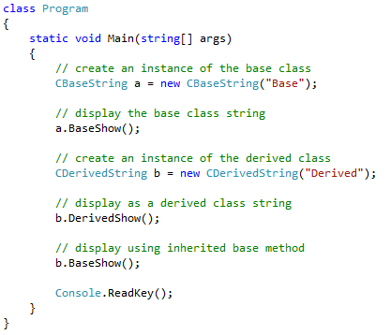
Example
Displays….
Base
0007: Derived
Derived

Slide 12
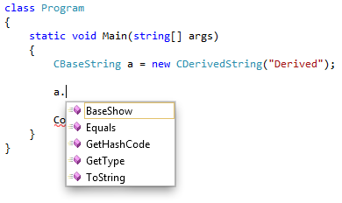
Upcasting
Derived classes can be bound to base class object references, but only base class members will be visible.
This is known as an upcast.

Slide 13
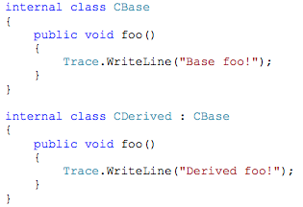
Function Hiding
By default the compiler will issue a warning if you have a function with the same name in both the base and derived classes

Slide 14
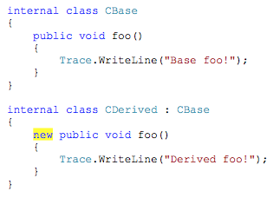
Function Hiding
If you actually intend to hide the base version, use the new keyword in the signature of the derived version:

Slide 15

Function Hiding
You may still use the hidden base class version if you cast the object reference to a more base class type:
Displays….
Derived foo!
Base foo!

Slide 16
The base Keyword
If a class were to foolishly create methods and/or fields that had the same name as in its base class, you would need some way to resolve which version you wanted to use.
The base keyword is used in derived classes to access available members in the immediate parent class (the class this class is derived from).
The base keyword is used to satisfy constructor calls in the base class, and to resolve base/derived class field/method usage.

Slide 17
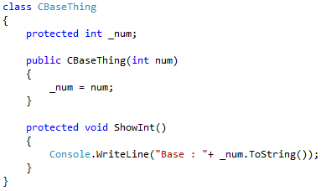
The base Keyword

Slide 18
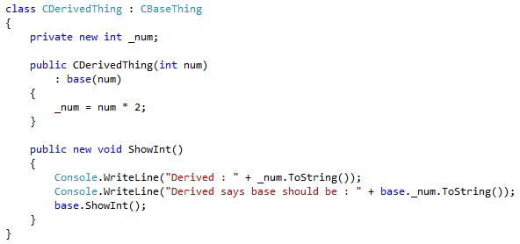
The base Keyword

Slide 19
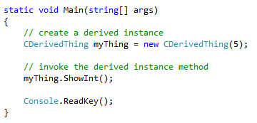
The base Keyword
Displays…
Derived : 10
Derived says base should be : 5
Base : 5

Slide 20
Constructor Responsibility
A constructor should be responsible for initializing its members that it adds to the class hierarchy, leaving the base class constructors to initialize their own members.
In the following example, the base class contains a single private member.
The derived class constructor could not directly initialize it, since it does not have access to the private member.
The derived class construction uses the base keyword to call the base class constructor and pass it the required data.
The base class constructor is invoked in the derived class's initialization list, so the base class constructor is invoked before the derived class member is initialized.

Slide 21
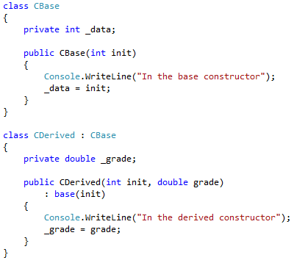
Constructor Responsibility

Slide 22
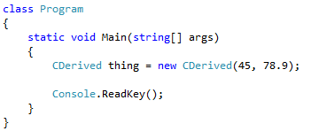
Constructor Responsibility
Displays…
In the base constructor
In the derived constructor

Slide 23
Virtual Methods
A base object reference may be bound to a derived class type.
Through the base class object reference, you can only see base class things.

Slide 24
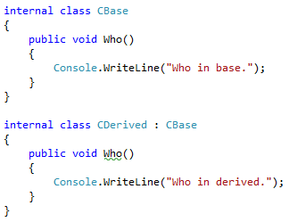
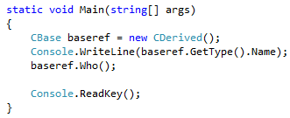
Virtual Methods
Displays….
CDerived
Who in base.

Slide 25
Virtual Methods
When a base class object reference is used to access a derived object, the compiler ensures that the base class version of the Who() method is executed.
From the output provided by the GetType() method call, the compiler is aware that the base class reference variable is referring to a derived class data type.
We can use a virtual method and an override to allow the base class reference to invoke the derived class version of the Who() method.
In the base class, the Who() method is declared as virtual, and in the derived class, the Who() method is declared with an override.

Slide 26
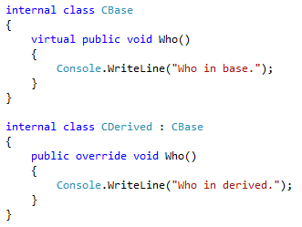
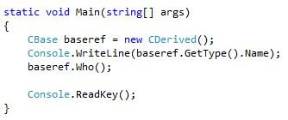
Virtual Methods
Displays….
CDerived
Who in derived.

Slide 27
Polymorphism
Polymorphism allows different objects to respond appropriately to the same message in a class hierarchy.
A generic base class can be defined, from which multiple classes can be inherited.
Virtual methods can be used such that a base class reference can be used to access the object, but the actual behavior of the object can be determined by an overridden method.
In the following example, the base class, CShape, contains a virtual method ShowArea, which is not fully implemented.
The CSquare and CCircle classes inherit from CShape, and both implement overridden versions of ShowArea for their shape.

Slide 28
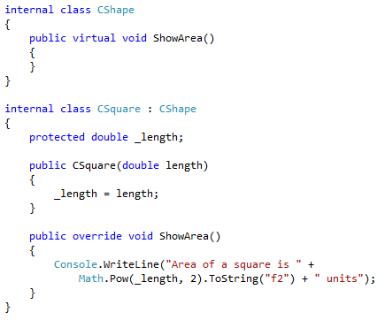
Polymorphism

Slide 29
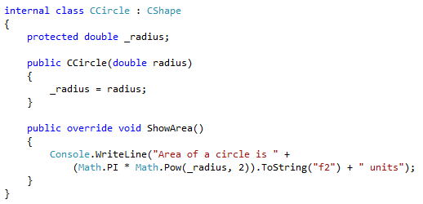
Polymorphism

Slide 30
Polymorphism
In the main program, a list is created to contain references to CShape objects.
Several shapes of each type (CSquare and CCircle) are added to the list of CShapes.
Through the use of virtual methods, the inherited versions of ShowArea are executed, correctly showing the area for each shape in the list.

Slide 31
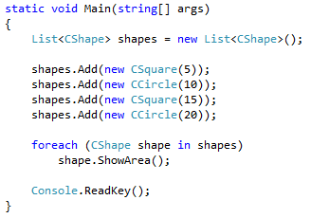
Polymorphism
Displays…
Area of a square is 25.00 units
Area of a circle is 314.16 units
Area of a square is 225.00 units
Area of a circle is 1256.64 units

Slide 32
Abstract Classes
A base class is often just a placeholder in the class hierarchy, and is not designed to be instantiated.
For example, the CShape base class does not contain a dimension, and its ShowArea method is empty.
The CShape class should not be instantiated at all; it is used to create references to other shapes.
When a base class is not designed to be instantiated, it should be declared as abstract.
Abstract classes are created with the sole intent of being derived from.

Slide 33
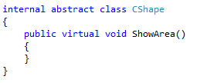
Abstract Classes
A class is marked as abstract with the abstract keyword.
Once a class is marked as abstract, it can't be instantiated.
Attempting to instantiate an abstract class will result in an error.

Slide 34
Abstract Classes
Operable methods and fields may be added to an abstract base class.
Since the abstract base class can't be instantiated, the implication is that these members will operated from derived classes.

Slide 35
Abstract Methods
Methods may be marked as abstract.
An abstract method does not have a definition and must be overridden in every derived class.
In the following example, the Show() method in the base class is abstract, so it must be overridden in the derived class.

Slide 36
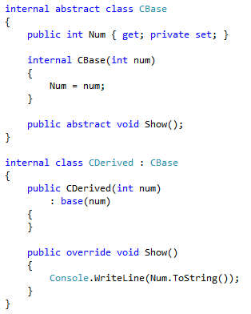
Abstract Methods

Slide 37
IComparable
Interfaces are inherited, so if an interface is used in a base class, then you must implement them properly in derived classes.
In the following example, the CShape base class implements the IComparable interface using an abstract method CompareTo, which must be implemented in any derived classes.
The GetArea() methods calculate the area of each shape, and used to provide a comparison between objects.
Shapes with the same area are considered to be equal.

Slide 38

IComparable
The CShape abstract base class defines two abstract methods, GetArea() and CompareTo().
Both methods must be implemented in derived classes.

Slide 39
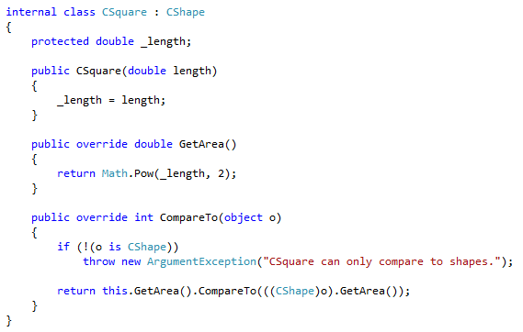
IComparable

Slide 40
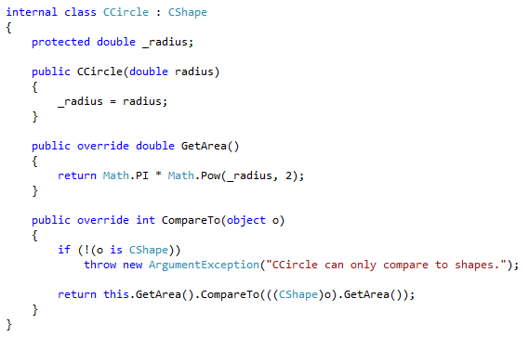
IComparable

Slide 41
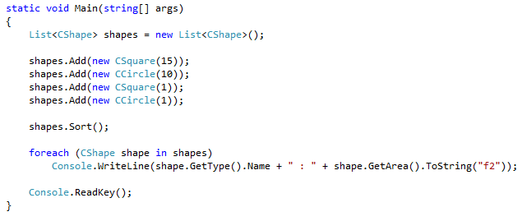
IComparable
Since the derived classes both implement CompareTo(), an List of CShape references can be created and sorted, the order being from smallest area to largest area.
Displays…
CSquare : 1.00
CCircle : 3.14
CSquare : 225.00
CCircle : 314.16

Slide 42
IComparable
A careful observation of the derived classes will note that the CompareTo() methods are identical.
Common behavior belongs in the base class, so the implementation of CompareTo() should be placed in the base class.
This new version uses polymorphism to select the correct version of GetArea() when CompareTo() is invoked for a particular shape.

Slide 43
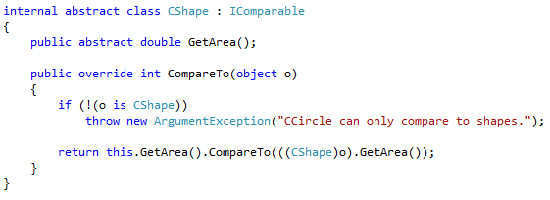
IComparable
The base class now implements CompareTo().

Slide 44
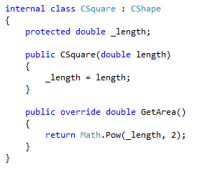
IComparable
The CompareTo() override in each derived class is no longer required.

Slide 45
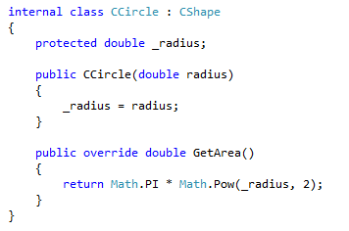
IComparable

